Slide 1
Reading & Writing in the Early Years
Claire Knight

Slide 2
Beginnings & beyond - Writing
Children naturally copy you when you write; lists etc
Writing has distinct stages of development – mark making, lines & zig-zags, letter shapes, letters from children’s name & familiar words
Encourage the children to do their own writing (not copy writing) and ask them what they have written – encourage and be positive
Our aim is by the end of Reception children should be writing sentences, using basic punctuation, spelling simple words correctly, using phonic knowledge to attempt to write more complicated words and forming their letters correctly

Slide 3
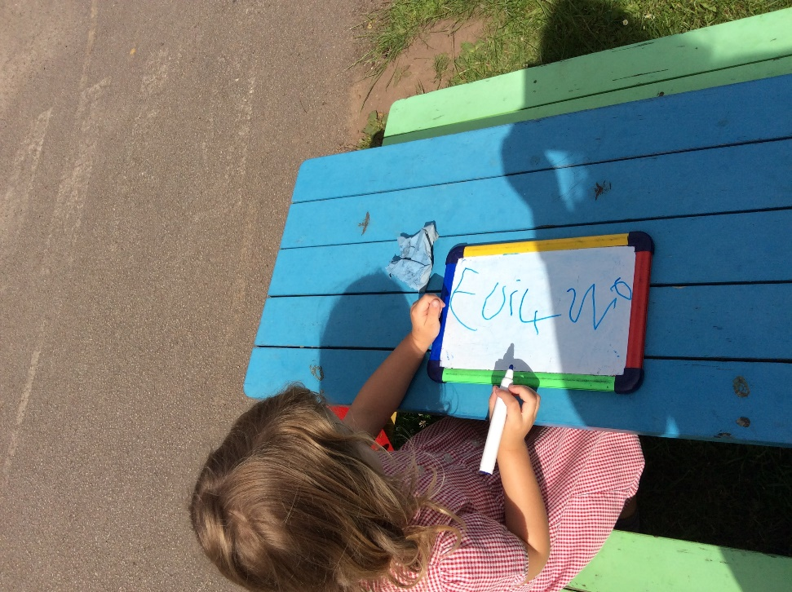
Beginnings - Reading
Children love looking at books – this is something to capture and nurture!
Make reading fun, cosy & lovely
Model reading – as much as possible, read books, magazines, catalogues, computer….

Slide 4
Print
Initially children learn by remembering the shapes of words
Environmental print – children learn to recognise shapes of words, colours for example: McDonalds, Tesco
They remember their names & the letters in their names
Strong link to writing – reading and writing development go hand in hand

Slide 5
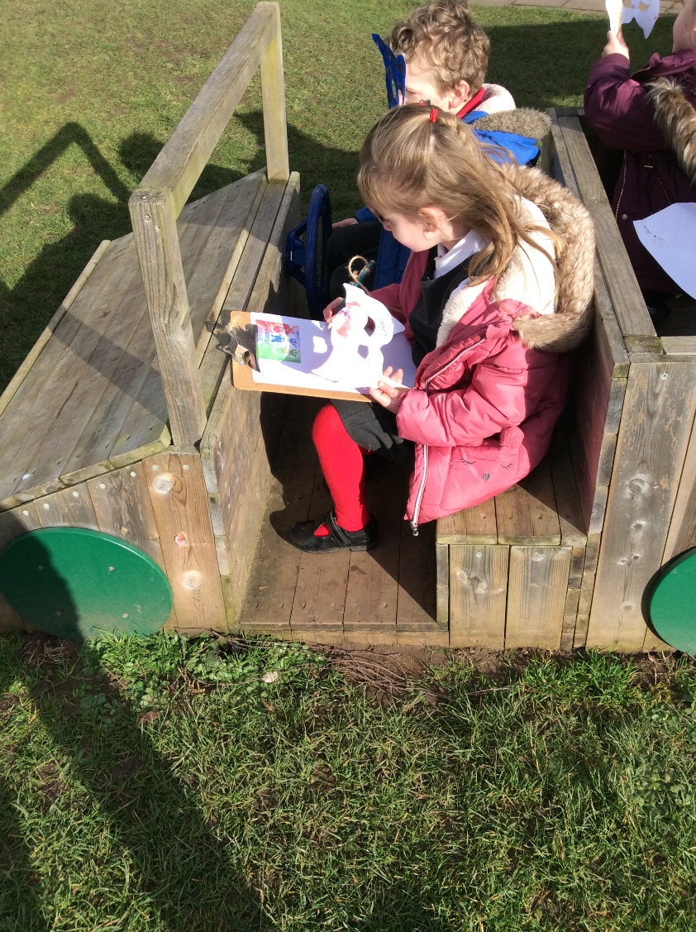
Pictures
Pictures in books – talk about them and ask questions
Children infer meaning from pictures & they are a key to helping children to read words
To help the children – encourage talking about the picture, prediction, and inference

Slide 6
Phonics
Phonics is learning the sounds in words & using them to help us read & decipher language – underpins reading and writing
Nursery – encourage listening to different sounds around us, hidden sounds games and rhymes
Reception – we introduce the sounds in an order that helps with reading and writing
We start with s, a, t, p, i and n – we can make lots of small 3 letter words with them e.g. sat, tin, which the children learn to sound and blend. We build from there and teach tricky words alongside

Slide 7
September
In September we are starting to use a new phonic and reading program and will have another meeting for EY, Y1 and Y2 parents to explain the approach and changes we are making

