Slide 1

Calculation Policy
Subtraction – Years 1-3
Billinge Chapel End Primary School

Slide 2
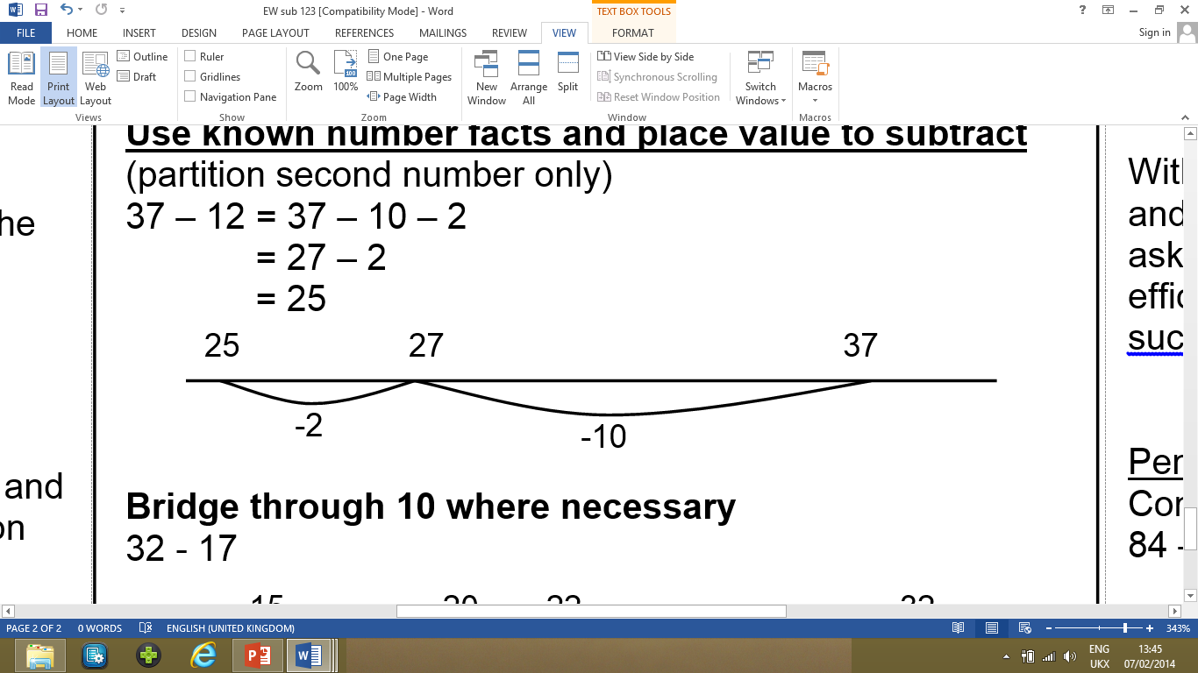
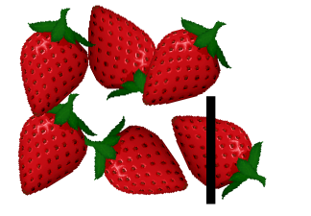
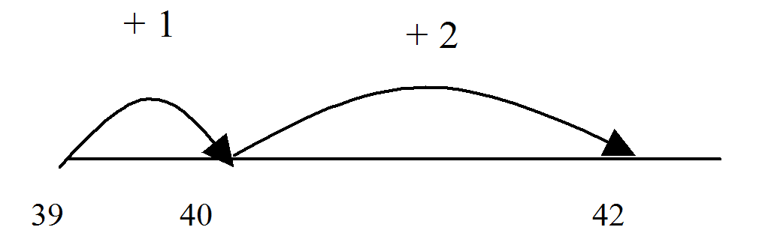

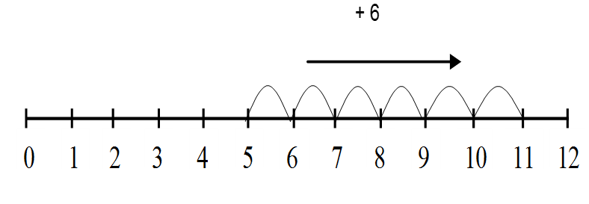
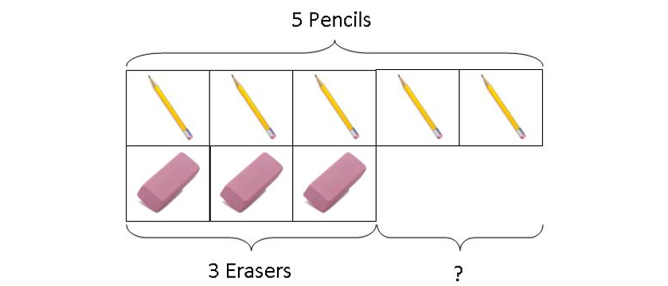
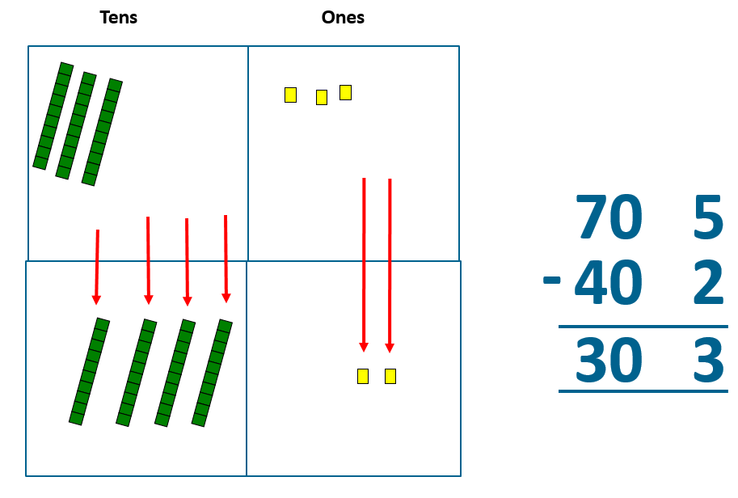
Year 1 | Year 2 | Year 3
Missing number problems e.g. 7 = □ - 9; 20 - □ = 9; 15 – 9 = □; □ - □ = 11; 16 – 0 = □ Use concrete objects and pictorial representations. If appropriate, progress from using number lines with every number shown to number lines with significant numbers shown. Understand subtraction as take-away: Understand subtraction as finding the difference: The above model would be introduced with concrete objects which children can move (including cards with pictures) before progressing to pictorial representation. The use of other images is also valuable for modelling subtraction e.g.bundles of straws, Dienes apparatus, multi-link cubes, bead strings | Missing number problems e.g. 52 – 8 = □; □ – 20 = 25; 22 = □ – 21; 6 + □ + 3 = 11 It is valuable to use a range of representations (also see Y1). Continue to use number lines to model take-away and difference. E.g. The link between the two may be supported by an image like this, with 47 being taken away from 72, leaving the difference, which is 25. Towards written methods Recording addition and subtraction in expanded columns can support understanding of the quantity aspect of place value and prepare for efficient written methods with larger numbers. The numbers may be represented with Dienes apparatus. E.g. 75 – 42 | Missing number problems e.g. □ = 43 – 27; 145 – □ = 138; 274 – 30 = □; 245 – □ = 195; 532 – 200 = □; 364 – 153 = □ Mental methods should continue to develop, supported by a range of models and images, including the number line. Children should make choices about whether to use complementary addition or counting back, depending on the numbers involved. Written methods (progressing to 3-digits) Introduce expanded column subtraction with no decomposition, modelled with Dienes . 90 8 30 5 60 3 For some children this will lead to exchanging, modelled using place value counters (or Dienes). 70 2 40 7 20 5 A number line and expanded column method may be compared next to each other. Some children may begin to use a formal columnar algorithm, initially introduced alongside the expanded method. The formal method should be seen as a more streamlined version of the expanded method, not a new method.
+3 +20 +2
47 50 70 72

Slide 3
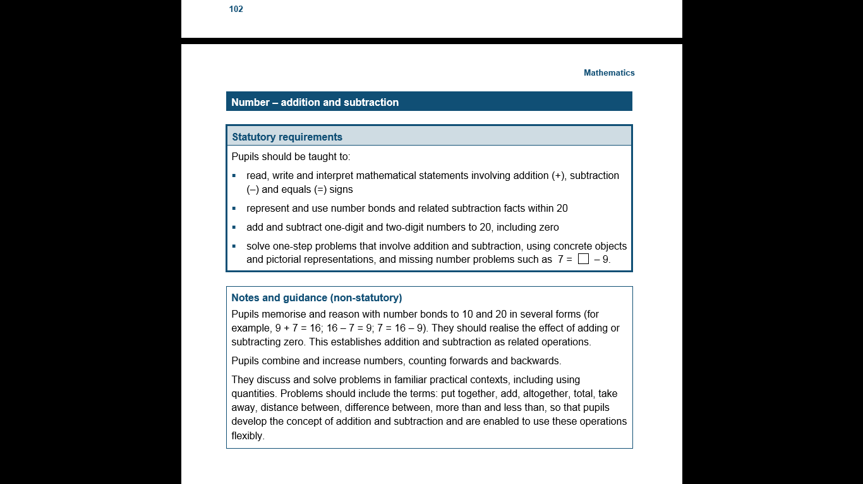
The National Curriculum in England. ©Crown Copyright 2013
Year 1 objectives
Return

Slide 4
The National Curriculum in England. ©Crown Copyright 2013
Year 1 guidance
Return

Slide 5
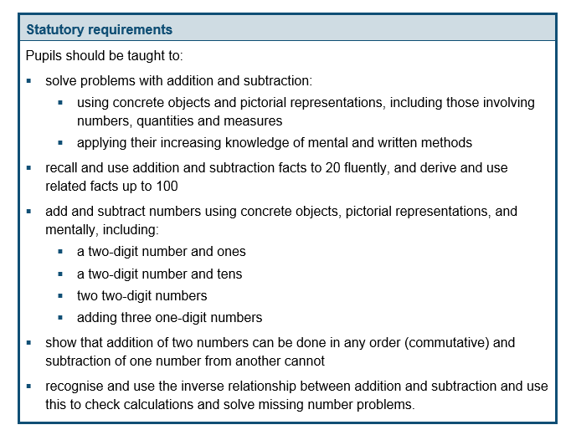
The National Curriculum in England. ©Crown Copyright 2013
Year 2 objectives
Return

Slide 6
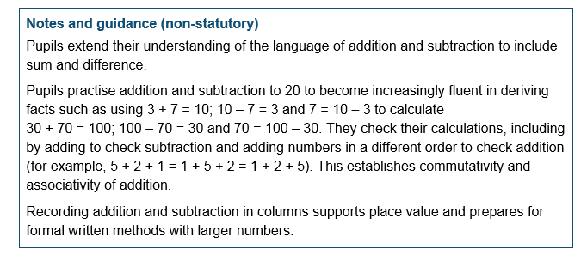
The National Curriculum in England. ©Crown Copyright 2013
Year 2 guidance
Return

Slide 7
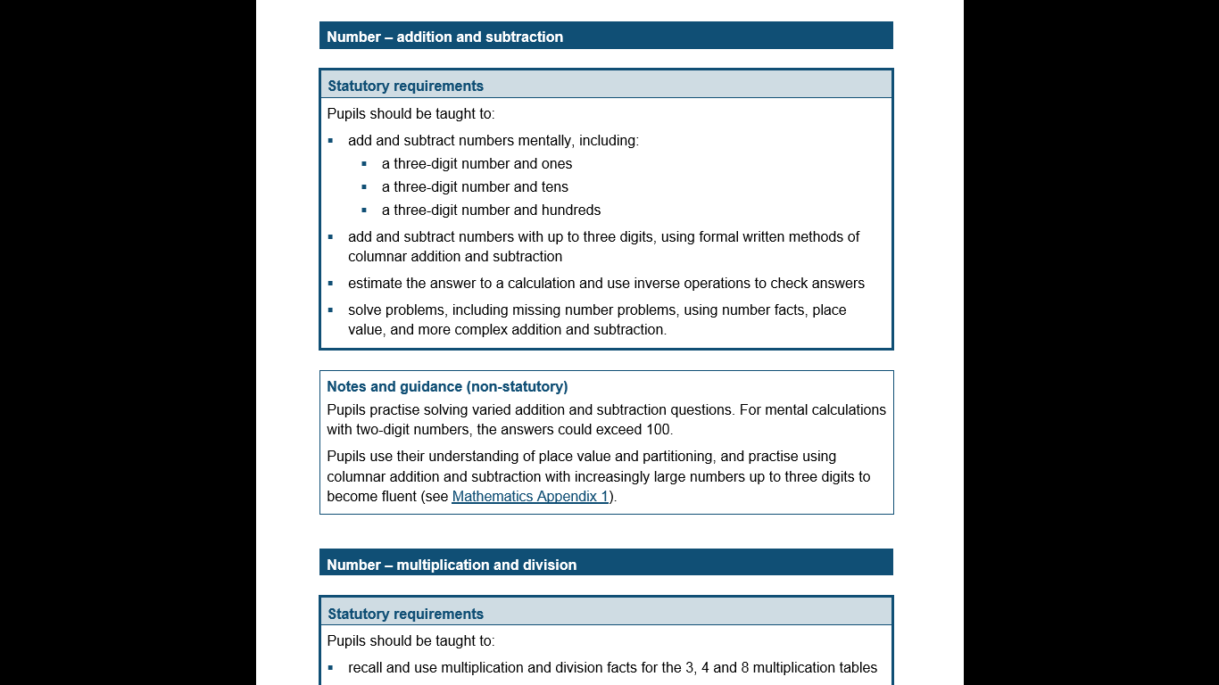
The National Curriculum in England. ©Crown Copyright 2013
Year 3 objectives
Return

Slide 8
The National Curriculum in England. ©Crown Copyright 2013
Year 3 guidance
Return

