Slide 1

Calculation Policy
Multiplication – Years 1-3
Billinge Chapel End Primary School

Slide 2

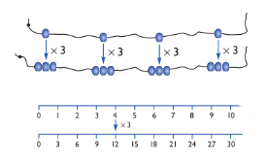
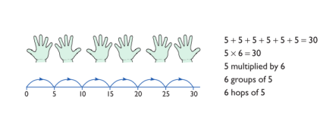
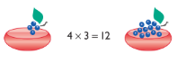
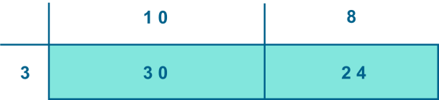
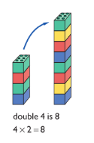
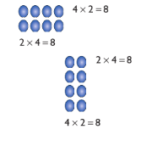
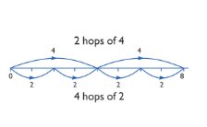
Year 1 | Year 2 | Year 3
Counting in 2s, 5s and 10,s Understand multiplication is related to doubling and combing groups of the same size (repeated addition) Washing line, and other practical resources for counting. Concrete objects. e.g. bundles of straws, bead strings Problem solving with concrete objects (including money and measures Develop the vocabulary relating to ‘times’ e.g. Pick up five, 4 times Use arrays to understand multiplication can be done in any order (commutative) | Times tables to be taught - x2, x5, x10 Expressing multiplication as a number sentence using x Using understanding of the inverse and practical resources to solve missing number problems. 7 x 2 = = 2 x 7 7 x = 14 14 = x 7 x 2 = 14 14 = 2 x x ⃝ = 14 14 = x ⃝ Develop understanding of multiplication using array and number lines (see Year 1). Include multiplications not in the 2, 5 or 10 times tables. Doubling numbers up to 10 + 10 Using known doubles to work out double 2 digit numbers (double 15 = double 10 + double 5) Towards written methods Use jottings to develop an understanding of doubling two digit numbers. 16 10 6 x2 x2 20 12 | Times tables to be taught - x3, x4, x8, x6 Missing number problems Continue with a range of equations as in Year 2 but with appropriate numbers. Mental methods Doubling 2 digit numbers using partitioning Demonstrating multiplication on a number line – jumping in larger groups of amounts 13 x 4 = 10 groups 4 = 3 groups of 4 Written methods (progressing to 2d x 1d) Develop onto the grid method Give children opportunities for children to explore this and deepen understanding using concrete apparatus if needed.

Slide 3
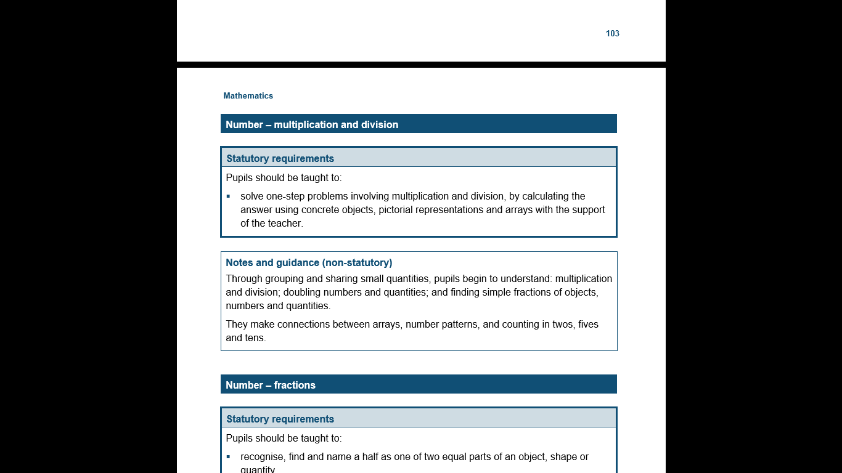
The National Curriculum in England. ©Crown Copyright 2013
Year 1 objectives
Return

Slide 4
The National Curriculum in England. ©Crown Copyright 2013
Year 1 guidance
Return

Slide 5
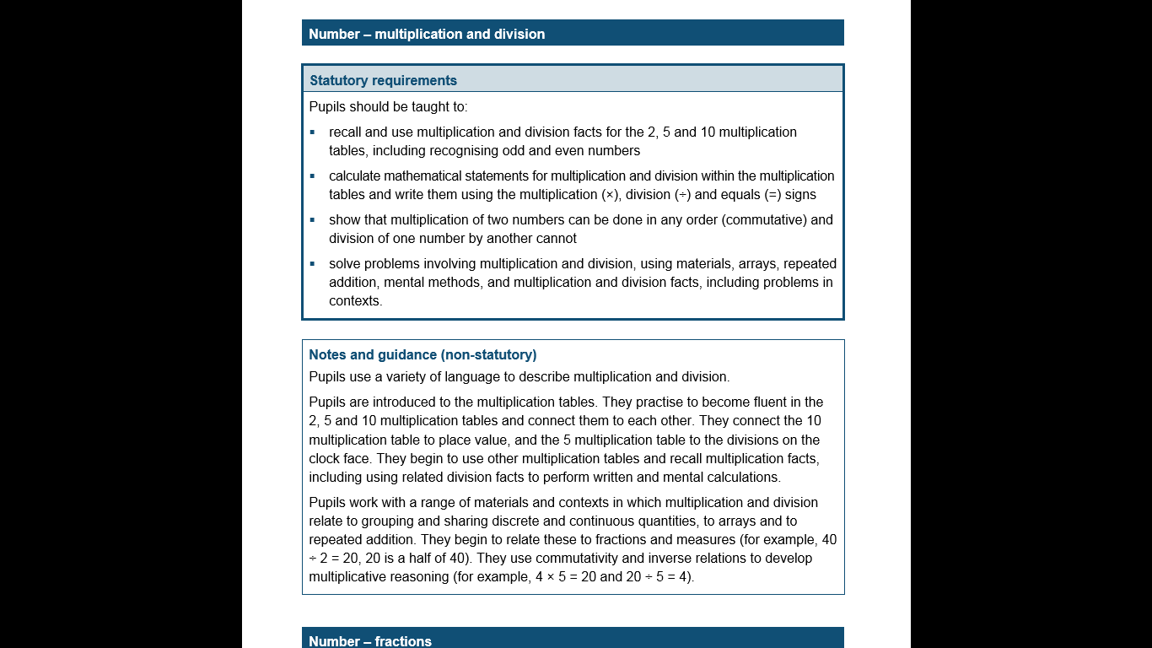
The National Curriculum in England. ©Crown Copyright 2013
Year 2 objectives
Return

Slide 6
The National Curriculum in England. ©Crown Copyright 2013
Year 2 guidance
Return

Slide 7
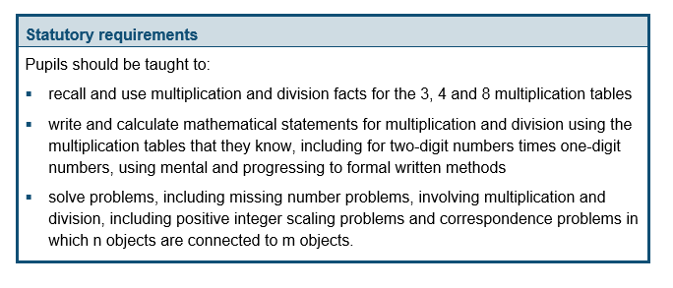
The National Curriculum in England. ©Crown Copyright 2013
Year 3 objectives
Return

Slide 8
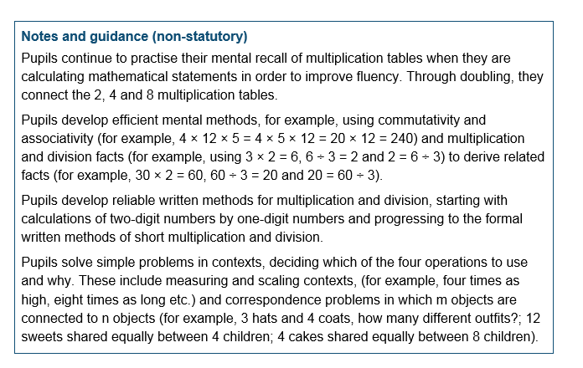
The National Curriculum in England. ©Crown Copyright 2013
Year 3 guidance
Return

