Slide 1

Calculation Policy
Division – Years 4-6
Billinge Chapel End Primary School

Slide 2
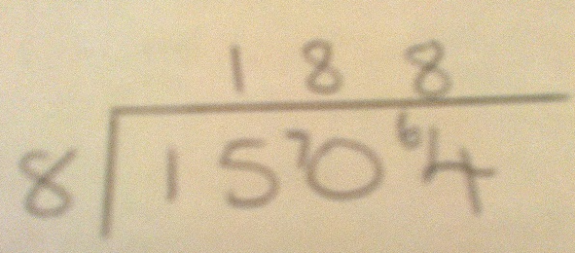
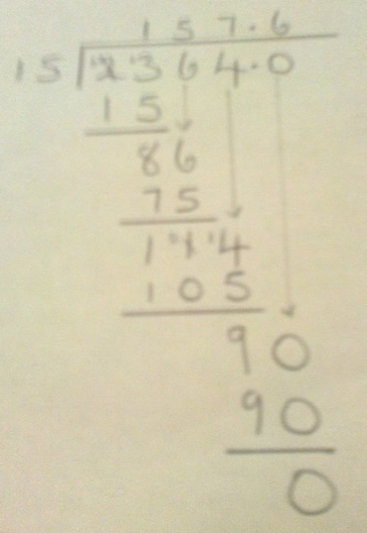
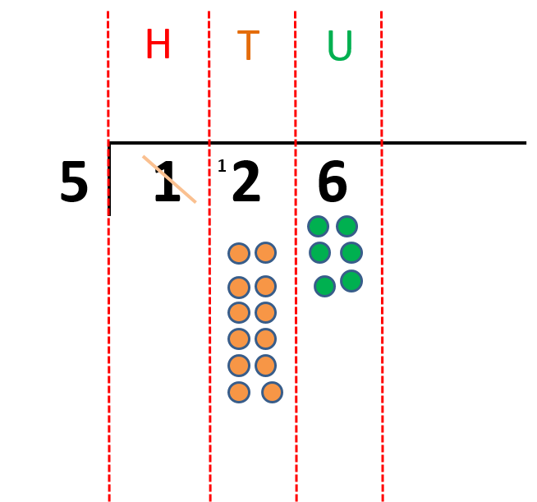
Year 4 | Year 5 | Year 6
÷ = signs and missing numbers Continue using a range of equations as in year 3 but with appropriate numbers. Sharing, Grouping and using a number line Children will continue to explore division as sharing and grouping, and to represent calculations on a number line until they have a secure understanding. Children should progress in their use of written division calculations: Using tables facts with which they are fluent Experiencing a logical progression in the numbers they use, for example: Dividend just over 10x the divisor, e.g. 84 ÷ 7 Dividend just over 10x the divisor when the divisor is a teen number, e.g. 173 ÷ 15 (learning sensible strategies for calculations such as 102 ÷ 17) Dividend over 100x the divisor, e.g. 840 ÷ 7 Dividend over 20x the divisor, e.g. 168 ÷ 7 All of the above stages should include calculations with remainders as well as without. Remainders should be interpreted according to the context. (i.e. rounded up or down to relate to the answer to the problem) Recording by In Year 4: Keep numbers no higher than 3 digits, starting In Year 5: Formal recording by (Consolidation of Y4) with 2 digits where a ‘chunk’ of 10 can be taken off easily Chunking for 2 digit numbers 256 ÷ 13 (demonstrate). 72 ÷ 5 50 ÷ 5 = 10 22 ÷ 5 = 4 r 2 72 ÷ 5 = 14 r 2 |  | ÷ = signs and missing numbers Continue using a range of equations but with appropriate numbers Sharing and Grouping and using a number line Children will continue to explore division as sharing and grouping, and to represent calculations on a number line as appropriate. Quotients should be expressed as decimals and fractions Formal Written Methods – long and short division E.g. 1504 ÷ 8 E.g. 2364 ÷ 15
Formal Written Methods Formal short division should only be introduced once children have a good understanding of division, its links with multiplication and the idea of ‘chunking up’ to find a target number (see use of number lines above) Short division to be modelled for understanding using place value counters as shown below. Calculations with 2 and 3-digit dividends. E.g. fig 1
Jottings
7 x 100 = 700
7 x 10 = 70
7 x 20 = 140
e.g. 840 ÷ 7 = 120
100 groups
20 groups
0
700
840
1 4 r2
5 7 ²2
1 9 r9
13 2 5 6
1 3 0 10 x 13
1 2 6
6 5 5 x 13
6 1
5 2 4 x 13
9
Formal method to be more focused
1 1 4
3 3 4 ¹2
Moving to the compact method

Slide 3
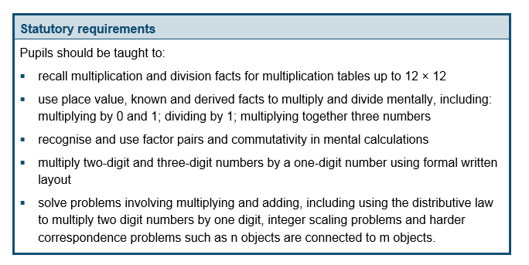
The National Curriculum in England. ©Crown Copyright 2013
Year 4 objectives
Return

Slide 4
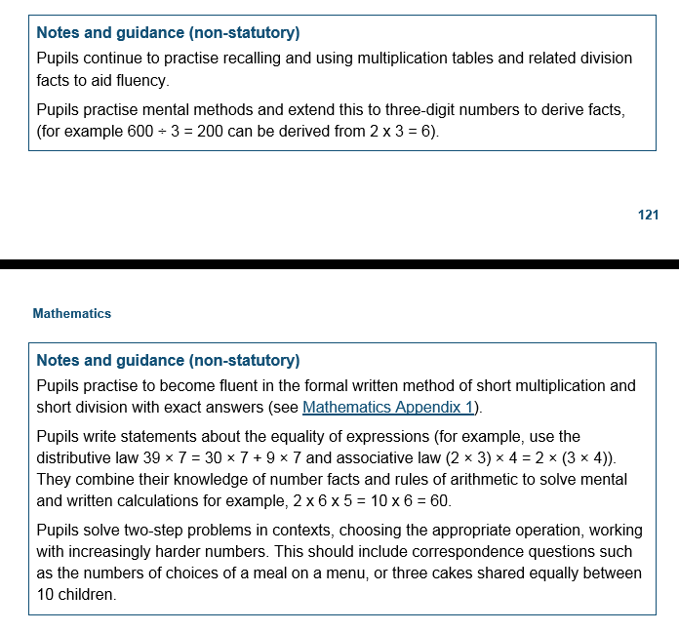
The National Curriculum in England. ©Crown Copyright 2013
Year 4 guidance
Return

Slide 5
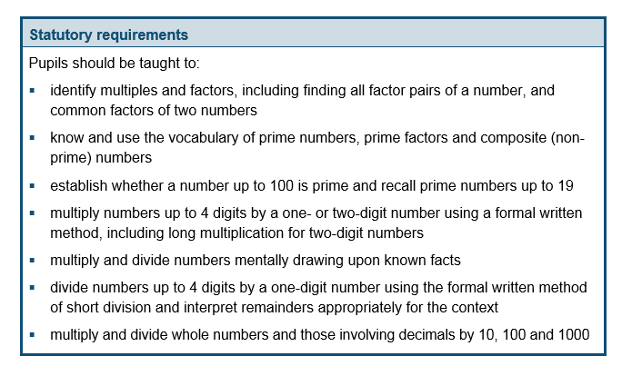
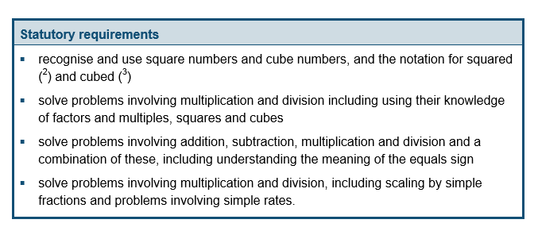
The National Curriculum in England. ©Crown Copyright 2013
Year 5 objectives
Return

Slide 6
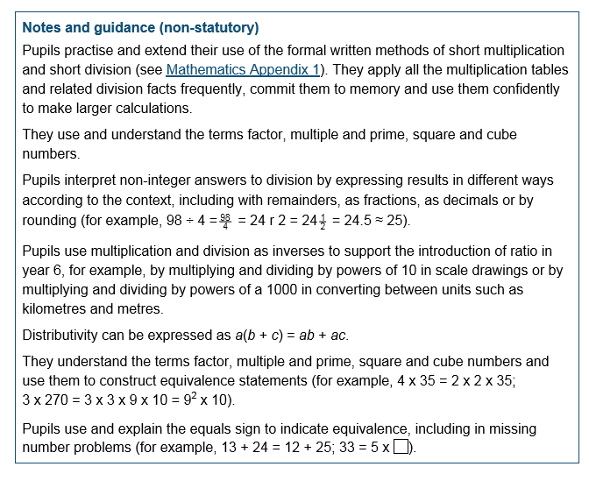
The National Curriculum in England. ©Crown Copyright 2013
Year 5 guidance
Return

Slide 7
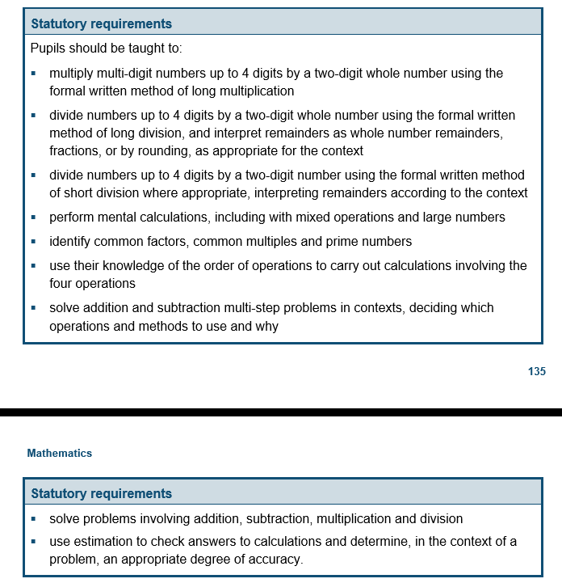
The National Curriculum in England. ©Crown Copyright 2013
Year 6 objectives
Return

Slide 8
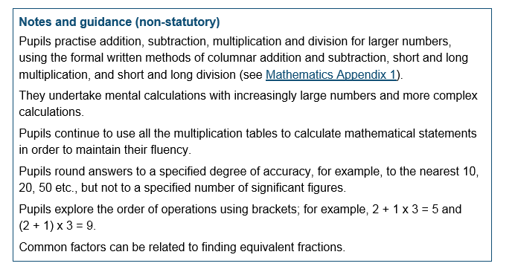
The National Curriculum in England. ©Crown Copyright 2013
Year 6 guidance
Return

