Slide 1

Calculation Policy
EYFS
Billinge Chapel End Primary School

Slide 2

Early Maths
Research on children’s learning in the first six years of life demonstrates the importance of early experiences in mathematics. An engaging and encouraging climate for children’s early encounters with mathematics develops their confidence in their ability to understand and use mathematics. These positive experiences help children to develop dispositions such as curiosity, imagination, flexibility, inventiveness, and persistence, which contribute to their future success in and out of school (Clements & Conference Working Group, 2004).
The NCTM (National Council of Teachers of Mathematics) states
“Young learners’ future understanding of mathematics requires an early foundation based on a high-quality, challenging, and accessible mathematics education. Young children in every setting should experience mathematics through effective, research-based curricula and teaching practices. Such practices in turn require that teachers have the support of policies and resources that enable them to succeed in this challenging and important work.”
They go on to highlight how early maths can support the aims of the new Curriculum 2014:
“Early childhood educators should actively introduce mathematical concepts, methods, and language through a variety of appropriate experiences. Teachers should guide children in seeing connections of ideas within mathematics as well as with other subjects, developing their mathematical knowledge throughout the day and across the curriculum. They must encourage children to communicate, explaining their thinking as they interact with important mathematics in deep and sustained ways.”
THE EARLY YEARS FOUNDATION STAGE
Mathematics involves providing children with opportunities to develop and improve their skills in counting, understanding and using numbers, calculating simple addition and subtraction problems; and to describe shapes, spaces, and measures.
(Statutory Framework for the Early Years Foundation Stage, DfE: 2012)

Slide 3



Addition
Maths for young children should be meaningful. Where possible, concepts should be taught in the context of real life.
GUIDANCE/ MODELS AND IMAGES | KEY VOCABULARY
Children are encouraged to use a variety or resources to: Identify 1 more 1 less Combine pieces to add Find number bonds Add without counting Children can record this by printing or drawing around shapes or objects Children can begin to combine groups of objects using concrete apparatus Construct number sentences verbally or using cards to go with practical activities. Children are encouraged to read number sentences aloud in different ways “Three add two equals 5” “5 is equal to three and two” Children make a record in pictures, words or symbols of addition activities already carried out. Solve simple problems using fingers Number tracks can be introduced to count up on and to find one more: What is one more than 4? 1 more that 13? Numberlines can be used alongside number tracks and practical apparatus to solve addition calculations and word problems. Children will need opportunities to look at and talk about different models and images as they move between representations. | Games and songs can be a useful way to begin using vocabulary involved in addition e.g. Alice the Camel Number Fun add more and make sum total altogether score double one more, two more, ten more … how many more to make…? how many more is…than…?

Slide 4




Subtraction
Maths for young children should be meaningful. Where possible, concepts should be taught in the context of real life.
GUIDANCE/ MODELS AND IMAGES | KEY VOCABULARY
Children begin with mostly pictorial representations Concrete apparatus is used to relate subtraction to taking away and counting how many objects are left. Concrete apparatus models the subtraction of 2 objects from a set of 5. Construct number sentences verbally or using cards to go with practical activities Children are encouraged to read number sentences aloud in different ways “five subtract one leaves four” “four is equal to five subtract one” Children have a record in pictures, words or symbols of subtraction activities already carried out. Solve simple problems using fingers Number tracks can be introduced to count back and to find one less: What is 1 less than 9? And 1 less than 20? Number lines can then be used alongside number tracks and practical Apparatus to solve subtraction calculations and word problems. Children Count back under the number line. Children will need opportunities to look at and talk about different models and images as they move between representations. | Games and songs can be a useful way to begin using vocabulary involved in subtraction e.g. Five little men in a flying saucer. take (away) leave how many are left/left over? how many have gone? one less, two less…ten less… how many fewer is…than ..? difference between is the same as

Slide 5



Multiplication
Maths for young children should be meaningful. Where possible, concepts should be taught in the context of real life.
GUIDANCE/ MODELS AND IMAGES | KEY VOCABULARY
The link between addition and multiplication can be introduced through doubling. Children will be encouraged to use resources to visualise the repeated adding of the same number. These can then be drawn around or printed as a way of recording. Children begin with mostly pictorial representations. How many groups of 2 are there? Real life contexts and use of practical equipment to count in repeated groups of the same size: How many wheels are there altogether? How much money do I have? Count in twos; fives; tens both aloud and with objects. Children are given multiplication problems set in a real life context. Children are encouraged to visualise the problem. How many fingers on two hands? How many sides on three triangles? How many legs on four ducks? Children are encouraged to read number sentences aloud in different ways “five times two makes ten” “ten is equal to five multiplied by two” | lots of groups of times multiply multiplied by multiple of once, twice, three times…ten times …..times as (big, long, wide…and so on) repeated addition double

Slide 6



Division and fractions
Maths for young children should be meaningful. Where possible, concepts should be taught in the context of real life.
GUIDANCE/ MODELS AND IMAGES | KEY VOCABULARY
The ELG states that children solve problems, including doubling halving and sharing. Children need to see and hear representation of division as both grouping and sharing. Division can be introduced through halving. Children begin with mostly pictorial representations linked to real life contexts: Grouping model Mum has six socks. She grouped them into pairs – how many pairs did she make? Sharing model I have 10 sweets. I want to share them with my friend. How many will we have each? Children have a go at recording the calculation that has been carried out. | halve share, share equally one each. two each, three each… group in pairs, threes, tens equal groups of divide divided by divided into left, left over
Fractions
GUIDANCE/ MODELS AND IMAGES | KEY VOCABULARY
Although not explicit in the Development Matters document, the sharing model is a useful way of introducing young children to fractions and calculating with fractions. Setting the problems in real life context and solving them with concrete apparatus will support children’s understanding. “I have got 5 bones to share between my two dogs. How many bones will they get each?” Children have a go at recording th e calculation that has been carried out. 2 ½ + 2 ½ = 5 | as division vocabulary plus: fraction half halves third thirds

Slide 7
Development Matters in the
Early Years Foundation Stage (EYFS)
This non-statutory guidance material supports practitioners in implementing the statutory requirements of the EYFS.
©Crown Copyright 2012
Links to calculation:
22 – 36 months Creates and experiments with symbols and marks representing ideas of number. Begins to make comparisons between quantities. Uses some language of quantities, such as ‘more’ and ‘a lot’. Knows that a group of things changes in quantity when something is added or taken away. | 30 – 50 months Beginning to represent numbers using fingers, marks on paper or pictures. Compares two groups of objects, saying when they have the same number. Separates a group of three or four objects in different ways, beginning to recognise that the total is still the same. | 40 – 60 months Says the number that is one more than a given number. Finds one more or one less from a group of up to five objects, then ten objects. In practical activities and discussion, beginning to use the vocabulary involved in adding and subtracting. Records, using marks that they can interpret and explain. | Early Learning Goal for Numbers Children count reliably with numbers from one to 20, place them in order and say which number is one more or one less than a given number. Using quantities and objects, they add and subtract two single-digit numbers and count on or back to find the answer. They solve problems, including doubling, halving and sharing.
Obj
Gui
Obj
Gui
Obj
Obj
Obj
Gui
Ex
Gui
Gui
Gui

Slide 8
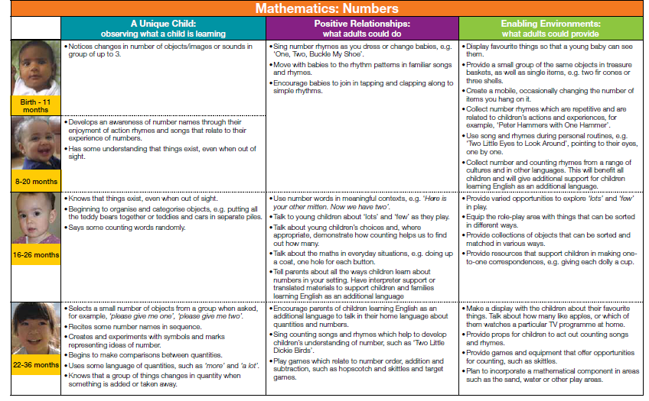
Development Matters in the
Early Years Foundation Stage (EYFS)
This non-statutory guidance material supports practitioners
in implementing the statutory requirements of the EYFS.
©Crown Copyright 2012
Return

Slide 9
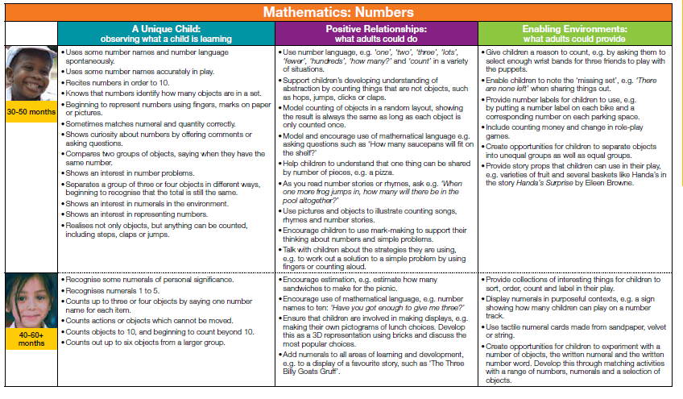
Development Matters in the
Early Years Foundation Stage (EYFS)
This non-statutory guidance material supports practitioners
in implementing the statutory requirements of the EYFS.
©Crown Copyright 2012
Return

Slide 10
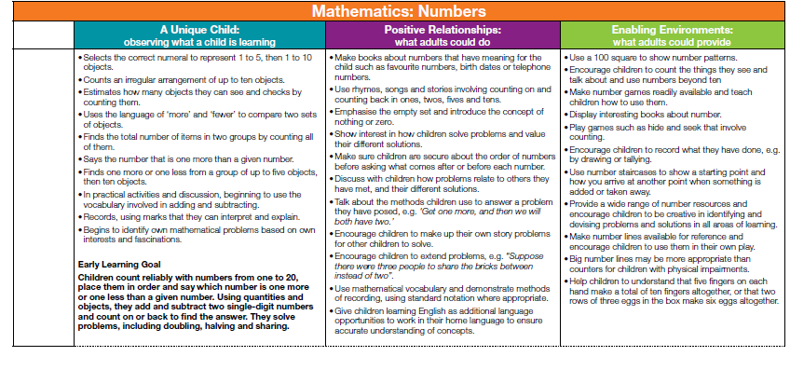
Development Matters in the
Early Years Foundation Stage (EYFS)
This non-statutory guidance material supports practitioners
in implementing the statutory requirements of the EYFS.
©Crown Copyright 2012
Return

Slide 11
Additional information for the ‘exceeding’ judgement taken from the 2014 Early Years Foundation Stage Handbook
Numbers: Children estimate a number of objects and check quantities by counting up to
20. They solve practical problems that involve combining groups of 2, 5, or 10, or sharing
into equal groups.
(This descriptor has been amended to reflect the increased level of challenge applied to the expected descriptor
following the Tickell review.)
© Crown copyright 2013
2014 Early Years Foundation Stage Handbook

