Slide 1

Introducing your Smart School Council

Slide 2
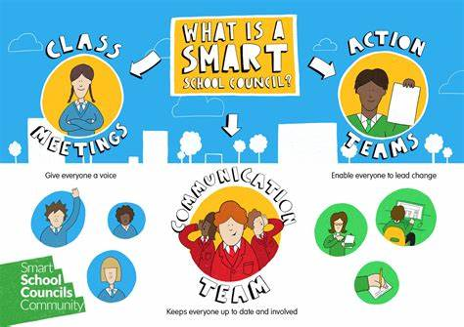

Slide 3
Who Represents You?
We are your school council with representatives from every class.
Y1
Milla and Isaac
Y4
Natasha and Leah
Y2
Eleanor & Evie
Y5
Poppy, Theo & Benjamin
Y3
Layla & Charlotte
Y6
Ruby & Miley

Slide 4
How we work?
We meet with the Smart School Council Leaders every week to look at the answer to last week’s question, set a question for this week and talk about anything else important
We come to your classes on a Friday afternoon to talk to you about this week’s question and to get everybody's views
You usually talk about the question and then give an answer that all of you or the majority of you agree on. Sometimes we might ask you to vote individually.

Slide 5
What Do We Do?
Meetings
Listen
Help
We meet every week with Mr Montrose and Mrs Montrose to discuss school events and changes.
We’ll also let you know any news from all our meetings.
Any of you can talk to any of us at any time to let us know if you have a worry or concern about something at school, or even if you have a great idea you would like to make happen.
The Smart School Council are here to help around school and we are involved in regular events at school.

Slide 6
Our Current Projects
This is what we have been working on this term:
Children in need fundraiser
Improving behaviour on the playground
End of term treat/ Santa Dash/ food bank fundraiser

Slide 7
How to Get in Touch
We are always ready to listen but you can get in touch with us in different ways.
Talk to us when you see us around school.
Put a suggestion in the Suggestions Box.
Write a letter and give it to one of us.
Ask questions when we give feedback to your class.

Slide 8
Any Questions?
This is your chance to ask us about Smart School council or our work.

