Slide 1
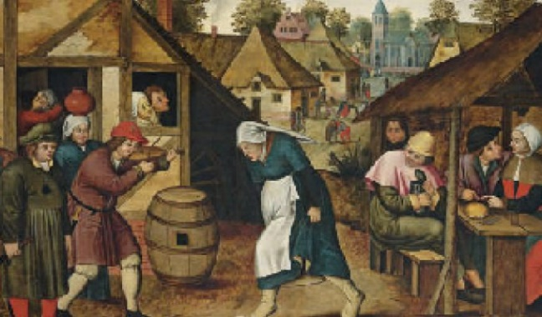
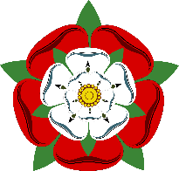
Tudors: Year 6 Knowledge Mat
Subject Specific Vocabulary
almhouses | Houses provided for poor people, usually by a rich person or a charity.
chamberlain | The person in charge of a large household.
congregation | All the people attending a Christian or Jewish religious service.
courtiers | Men who serve the monarch.
reformation | A Cristian movement to reform the Roman Catholic Church that led to the founding of the Protestant religion.
gibbet | A frame in which the bodies of executed criminals were displayed.
plague | In Tudor times, a deadly disease spread by the fleas on rats.
protestant | A branch of the Christian religion, founded during the Reformation. Today there are many different Protestant religions including the Church of England
sheath | A protective case for a sword or dagger, usually made of leather.
stone mason | A person who prepares and lays the stone needed to construct a building.
treason | The act of betraying your monarch or country.
workhouse | A house where the poor have to work in return for food and shelter.
Tudor Monarchs
Henry V11 (1485 – 1509)
Henry V111 (1509 – 1547)
Edward V11 (1547 – 1553)
Lady Jane Gray (1553)
Mary 1 (1553 – 1558)
Elizabeth 1 (1558 – 1603)
Henry V111’s six wives
Catherine of Aragon (1509 – 1533)
Anne Boleyn (1533 – 1536)
Jayne Seymour (1537 – 1537)
Anne of Cleaves (1540)
Catherine Howard (1540-1541)
Catherine Parr (1543 – 1547)
Key Knowledge and Skills
Know about a theme in British history which extends beyond 1066 and explain why this was important in relation to British history.
Know how to place historical events and people from the Tudor period in a chronological framework.
Know how Britain, during the Tudor, had a major influence on the world.
Research in order to find similarities and differences between two or more periods of history
Know how to place features of historical events and people from the Tudor period in a chronological framework.
Know about the main events from the Tudor period, explaining the order of events and what happened.

