Slide 1
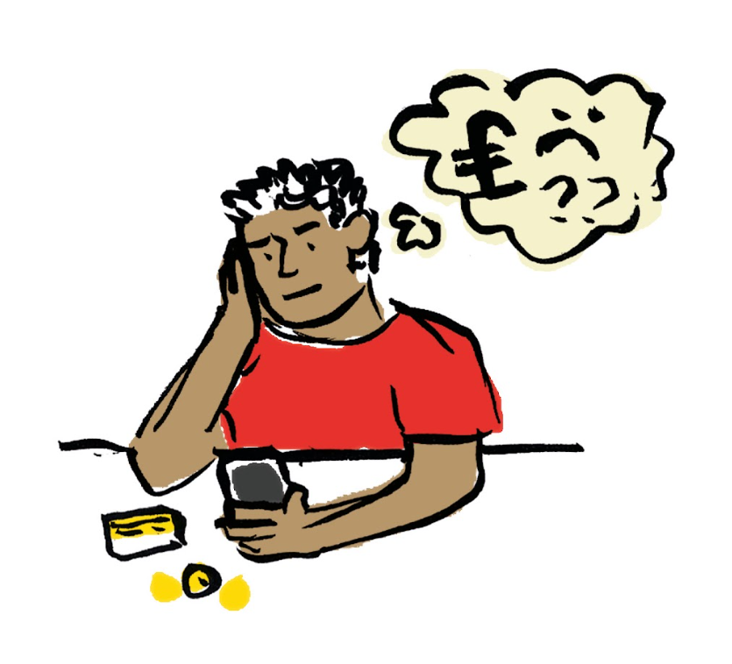

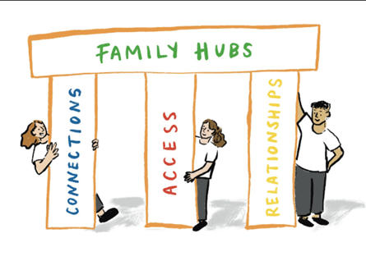




Halton Borough Council

Slide 2

Free Mobile Data for People Who Need it
Runcorn | Widnes
Halton Lea Library | Healthwatch Halton
Castlefields Community Centre | Halton Housing
Runcorn Library | O2 Widnes
 | Trinity Safe Space
 | Ditton Library
18+ years old AND from a low income household
AND/OR have no access or insufficient access to the internet at home
AND/OR have no or insufficient access to the internet when away from the home
AND/OR cannot afford an existing monthly contract or top up
Please note that individuals must access the National Databank for themselves and are unable to collect on behalf of anyone else.

Slide 3

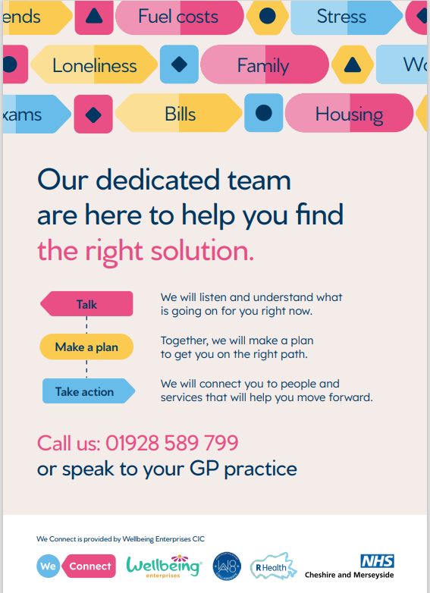
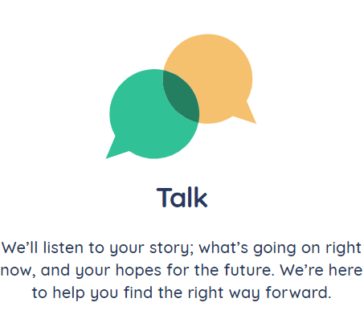
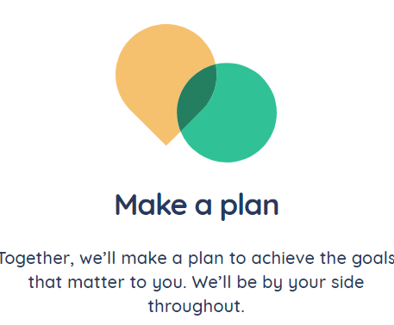
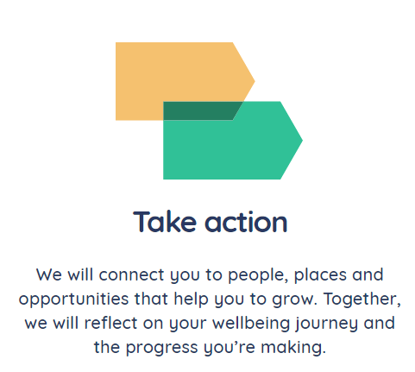
Wellbeing Enterprises

Slide 4
Widnes Foodbank
Halton Family Nurse Partnership
Halton Housing Trust
Halton People into Jobs
Halton Short Break Service for Children with Disabilities
St Michael with St Thomas Church
Talking Therapies Halton
The Whitechapel Centre
Transform Widnes
Transition Team HBC
Trinity Safe Space
Urgent Care Team (Walk-in)
Wellbeing Enterprises
Widnes Health Visitors Team
Widnes Locality Help Team
(Early Help Family Support)
Assessment and Home Treatment Team
Attendance and Behaviour Service (HBC)
Bevan Group Practice
Brennan Lodge (Changing Lives)
British Red Cross (Care in the Home Service)
Change, Grow, Live
Cheshire Police
Child in Need – Widnes
Children in Care – Care Leavers Team
Christian Life Centre Church
Citizens Advice Halton
Clarion Housing
HBC 14-19 Team
HBC Social Services (IAT) Initial Assessment Team
and Complex Care
Households into Work
Housing First Service Liverpool City Region CA
Kingsway Health Visiting Team
Maya Court SHAP Limited
Medaille Trust
MySpace Housing Solutions
Nightstop Communities
Outreach Team (Mental Health)
Plus Dane Shap Ltd
Recovery Team (Mental Health)
Community Bridge Building Team
District Nursing Team, Bridgewater Community
Healthcare NHS Foundation Trust
Early Intervention in Psychosis Team (IAPT)
Elemel 2018 CIC
Emergency Duty Team Halton and St Helen’s Council
Fit Park Medical Centre
Foundry Community Church
Halton Borough Council Housing Solutions Admin Support
All of the above agencies can issue foodbank vouchers. Once someone has been issued with a voucher, they can exchange this for a minimum of three days of emergency food at your nearest foodbank centre.

Slide 5
Runcorn Foodbank
We have a number of voucher agencies who have switched to using electronic vouchers (evouchers). Below is a list of our current ones offering evouchers. You can ring one of those and be given the code number for a voucher over the phone, or an agency can give a printed one if you are attending in person, Either can be used to exchange for food.
GENERAL SUPPORT:
Halton Citizens Advice – 0151 257 2443
Wellbeing Enterprises CIC – 01928 589799
Refugee support: A Better Tomorrow – Facebook
HOUSING:
Weaver Vale Housing – 01606 815528
Plus Dane Housing – 0800 169 2988
Halton Housing – 0151 510 5024
Riverside Housing
SHAP – 01744 454056
Halton Housing Solutions HBC – 0151 511 7268
HEALTH AND MEDICAL PRACTICES:
Brookvale Practice – 01928 718182
Castlefields Health Centre – 01928 566671
Early Intervention in Psychosis (Widnes) – 0151 422 6826
Grove House – 01928 566561
Tower House – 01928 567404
Mental Health Outreach – 0151 422 1714
Change Grow Live: Halton Integrated Recovery Service – 0151 422 1400
Recovery Team: HBC Mental Health – 01928 753968
Stroke Association (Halton) – 01928 249487
Red Cross Association (Halton) – 0151 424 7873
All Family Hubs & most schools in Runcorn
CHURCHES:
Hallwood Parish
St Andrew’s – The Grange
Electronic Vouchers | Runcorn & District Foodbank

Slide 6
Household Support Fund
Discretionary Support Scheme
The council’s Discretionary Support Scheme has been allocated additional funding from the Household Support Fund to help individuals or families who need urgent help to pay for things such as essential food, toiletries or household items or essential fuel bills.
If you are in need of immediate support you can contact the council’s local welfare provision team called the Discretionary Support team. They can assist with immediate short-term needs due to a circumstance that presents a serious risk to the health or safety of the claimant or their family.
Awards will normally be made for immediate essential day to day living expenses only, and will usually be made by way of a parcel delivered direct to the customer from the supplier, for items such as:
Essential food items
Essential toiletries
Essential household items
Essential Fuel Awards
There will be no cash payments
Free school meal vouchers during school holidays
Free school meal vouchers of £12 per week will be provided to approximately 7,500 eligible pupils. These will be provided for the Autumn half term (1 week), the Christmas holidays (2 weeks), and the Spring half term (1 week). This process is already underway through the schools.
Emergency Support | Community Support
Halton Resident 16+ No alternative forms of help Not has 2 previous awards in the last 12 months Only way of preventing risk to health or safety | Halton resident Aged 16 + In receipt or imminent receipt of an income-related benefit, and No funds to meet the need themselves and, There are no other alternative sources of help and, Not have had 2 previous awards in the last 12 months and the claimant is Moving out of institutional or residential care or, Moving to more suitable accommodation or, Under exceptional pressure or, Setting up home as a part of a resettlement programme

Slide 7


Early Education

Slide 8
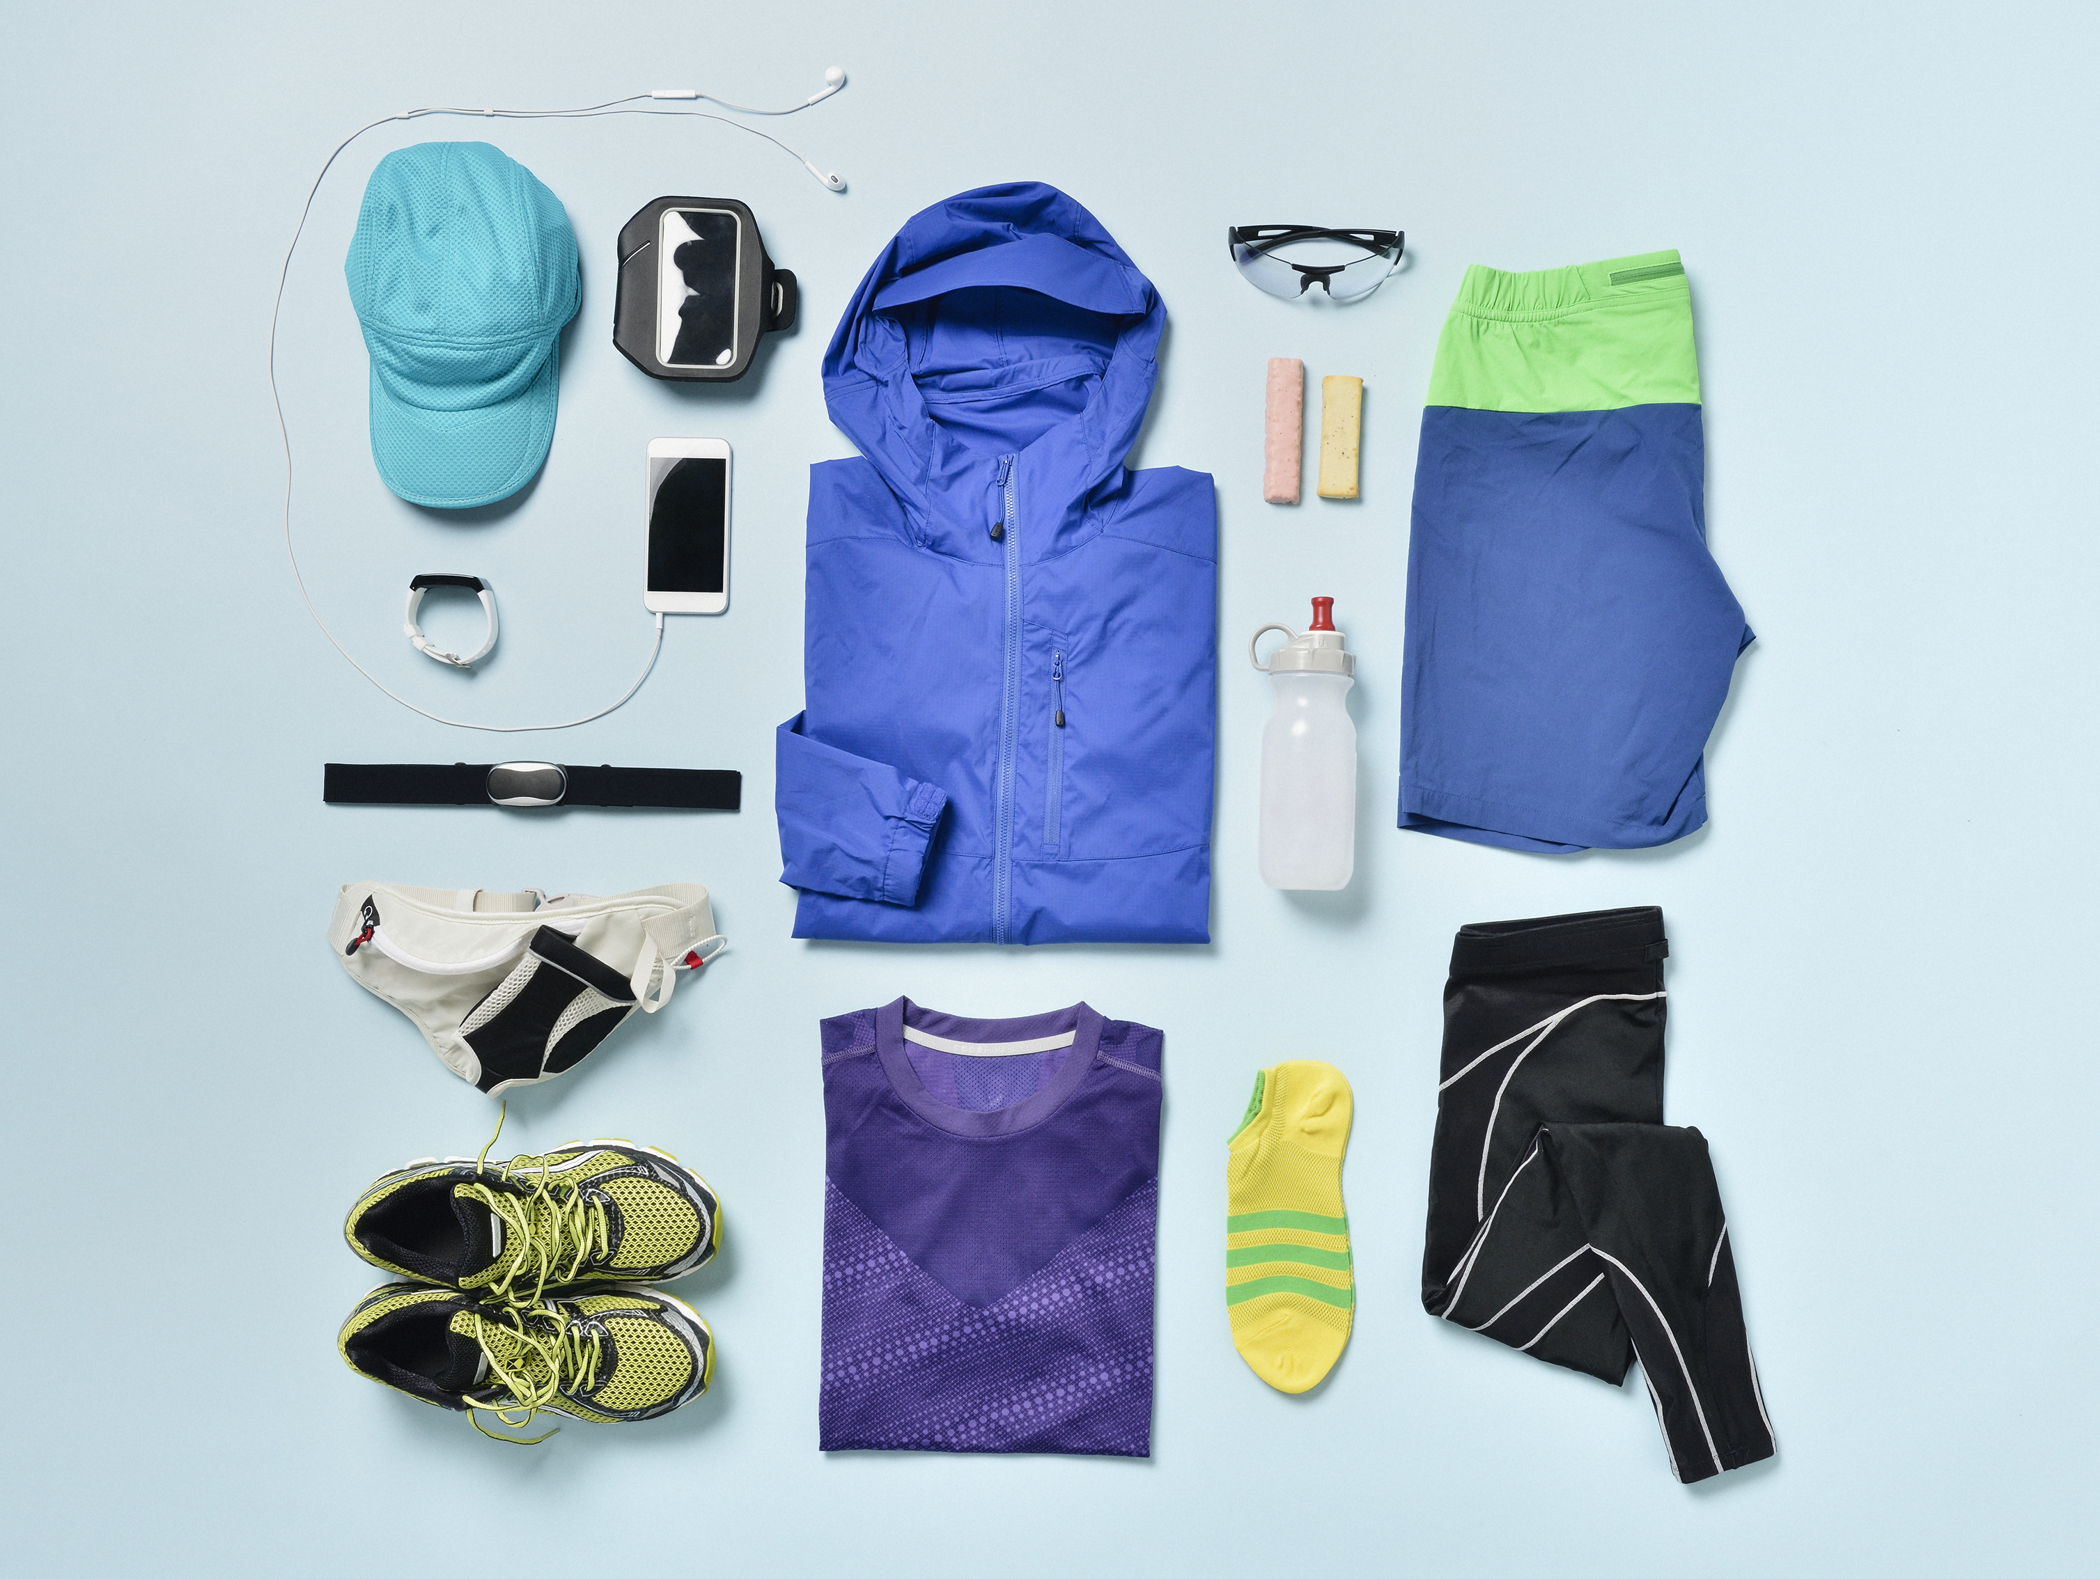
Sport Swap
Name of Provider | What they offer
Halton Hornets (biggest rugby club in Halton) | Boot swap scheme
Halton Table Tennis | Hand back competitions tops and shorts when they are too small. Lend out; Tops, shorts, bats, balls Discounted club kit Free places for children who can’t afford
Beechwood Netball | Facebook Group to swap kit
Runcorn Cricket Club | Loan equipment
Widnes Cricket Clubs

Slide 9
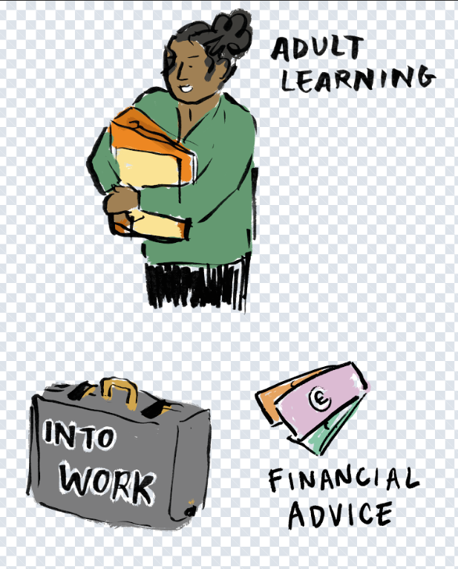
Adult Learning
Halton People into Jobs
Halton People into Jobs (Halton Borough Council) offers a range of services to help local residents address barriers to employment i.e. debt/money advice, health improvement, training, skills for life. Advisors/Key Workers also help participants access support through a network of expert specialist organisations.
To register for support please contact:
0151 511 7555 or email hpij@halton.gov.uk
Halton People into Jobs has a dedicated Employment Liaison service. As a level 3 Disability Confident Leader, the team are able to share experiences with employers as to how best to adapt practices to attract, recruit and support employees who may need help in work.
By providing a bespoke job matching service for individuals looking for work and employers seeking new employees we are able to match participants to a range of opportunities to help them move closer to work.
To access support with your recruitment please contact:
0151 511 8222 or email jobmatching@halton.gov.uk

Slide 10

Households into Work
Households into Work provides up to 12 months of support to unemployed Liverpool City Region Residents aged 16 and over, who because of their current circumstances are unable to consider taking up or sustaining employment.
https://youtu.be/uaeur72waiknk

Slide 11
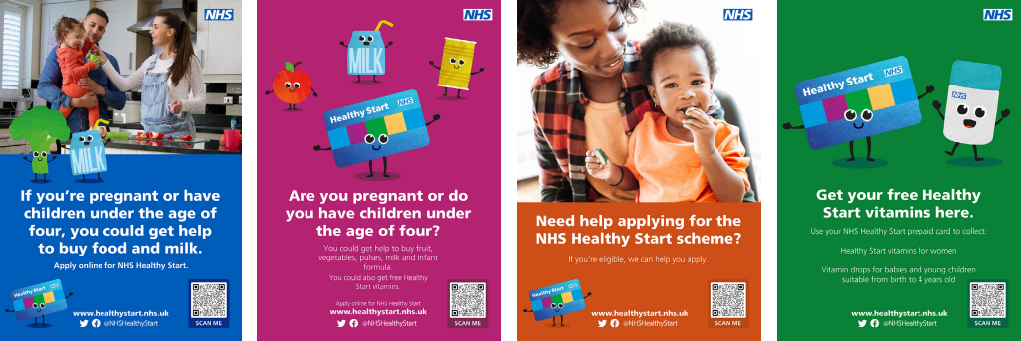
Healthy Start Vitamins
Baby essentials
Each family hub has a limited supply of baby essential vouchers – from Asda (£20 each) . These have proven invaluable with the increasing cost of essentials such as formula milk and nappies etc.
A stock of vitamins are held at each Family Hub.
These can be purchased for £2 or free with Healthy Start card.
Data is recorded on EIS

Slide 12
Halton Libraries
Halton Libraries provide free access to a wide range of books from our 4 libraries across the borough. It is free to join the library, no ID or fixed address is required and there are no fines or reservation charges.
A wide range of e-books and e-audio books are also available to library customers, free of charge via the Borrowbox app.
Free access to online newspapers and magazines is available via the Pressreader app.
Halton Libraries offer a variety of free activities for children at each of our libraries, including Rhymetimes, Lego Clubs, Brilliant Builds, access to games, toys and colouring as well as school holiday craft activities and monthly Science clubs at Halton Lea and Widnes libraries.
Each of our libraries offer computers for library customers to use, free of charge, as well as low-cost printing.
We offer support to those requiring help to get online with e.g. setting up email accounts, accessing Universal Credit and job searches.
Free Wi-Fi is available, with space in each library for customers to use their own devices.
The libraries provide warm spaces in addition to free tea and coffee mornings. Activities for adults are also available at no cost, including craft groups, board games and opportunities to meet with others e.g. Midweek Meet-up at Halton Lea every Wednesday morning.
Each library acts as a Data Bank issuing free sim cards for those in data poverty provided by The Good Things Foundation
Halton library service has worked for the past year to secure funding from Public Health to provide approx. 1000 free packed lunches to children during school holidays and will continue to do so.

Slide 13
Halton Social Supermarkets
Queens Pantry: Queens Avenue, Ditton, WA8 8GR (Mon-Fri, 10am-4pm)
The Route Café: Grenfell House, 116 Widnes Road, Widnes, WA8 6AX (Mon-Fri, 10am-4pm)
Community Pantry: Palacefields Community Centre, WA7 2UA (Weds, 10am-12 noon)
The Hillcrest Centre, Leaside, Halton Brook, Runcorn WA7 2DY (Thur 10am-11.30am)
Halton Royal British Legion: British Legion, Castle Road, Runcorn, WA7 2BE (Tues, Weds & Fri, 1-2pm)
Halton’s social supermarkets are open to all. They offer great quality surplus food and household items from supermarkets at reduced prices available in a local community setting

Slide 14
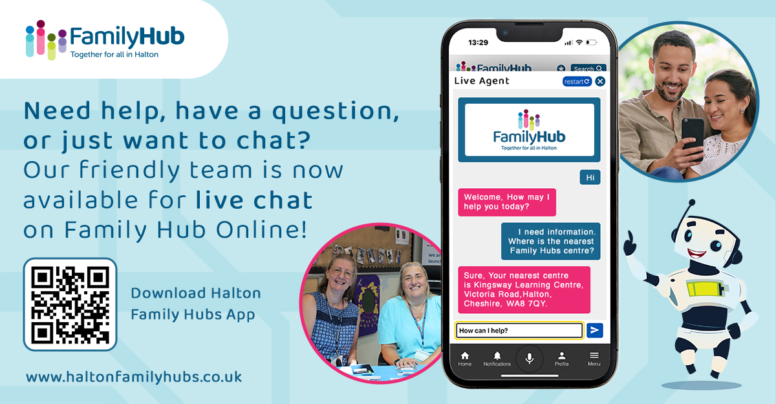
Add in live chat asset Jan did

Slide 15
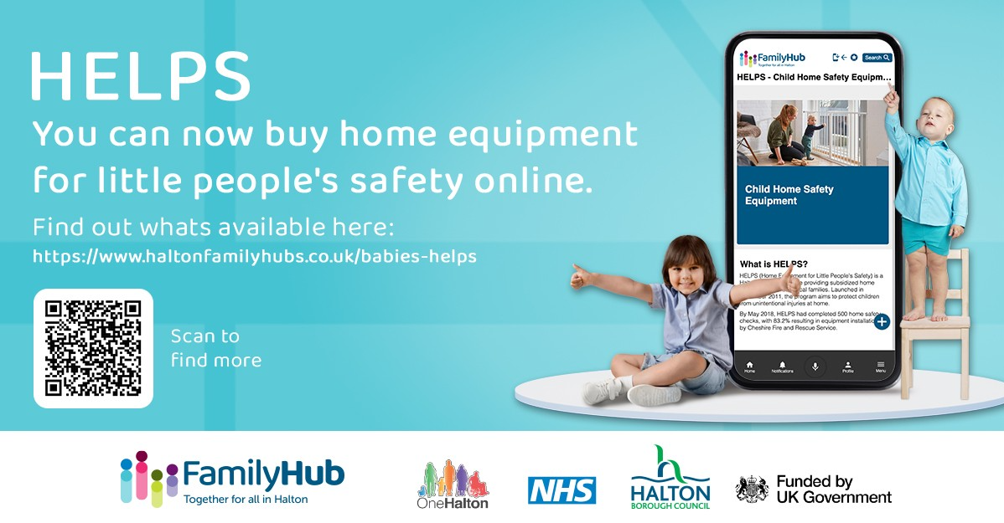
Notes:
All the HELPS equipment is supplied either free or at a subsidised cost which financially assists our families in Halton to receive British safety stranded approved equipment to help reduce the number of accidents in and around the home, which potentially could be life limiting, life changing or result in death
There are five main ways children get injured in the home –
Falls.
Poisonings.
Threats to breathing – choking suffocation and strangulation.
Drowning.
Burns and Scalds
Over the last 12 months Halton HELPS Home Equipment for Little Peoples Safey has supplied
• 523 items of free of charge (referred into the scheme by professionals working with the family)
• 201 Families have been reached and equipment provided free of charge
Equipment purchased from the HELPS outlets at a subsidised cost
• 421 items have been purchased
• 193 Families have been reached and equipment purchased

