Slide 1
Multiplication
When multiplying by 1-digit, we use either mental strategies or the short column method.
For e.g.
150 x 4 = 600 (can be done mentally by realising that 15 x 5 = 60, then make it 10 times bigger)
478 x 9 =
We can use a short column method
4 7 8
x 9
4
3
0
2
7
7

Slide 2
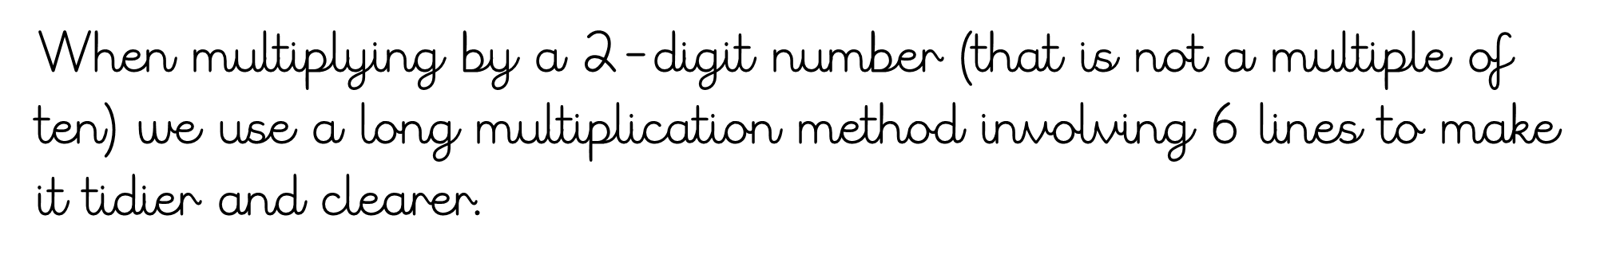
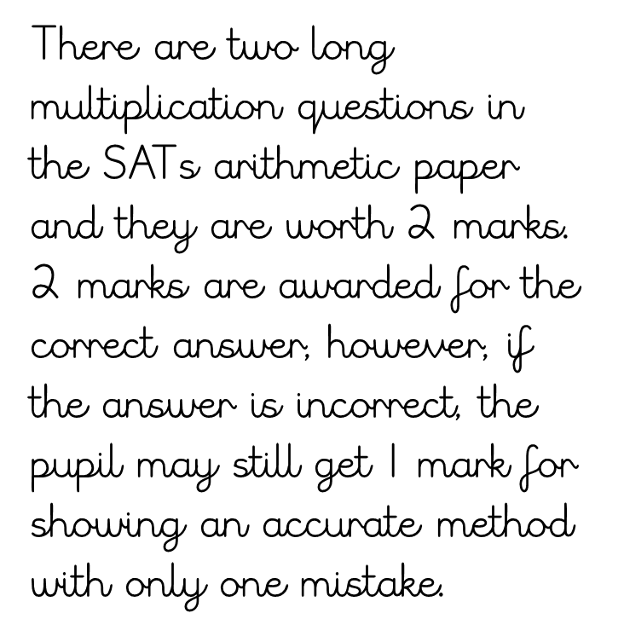
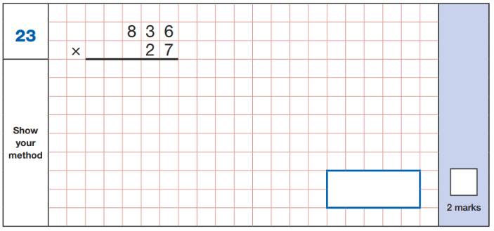

Slide 3
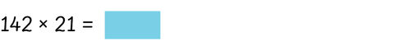
1 4 2
x 2 1
1
4
2
(x1)
We put the place holder in as we are now multiplying 142 by 20 (a multiple of ten).
2
8
4
0
(x20)
Now, we add our two products together.
2
9
8
2

Slide 4
2 2 1
x 4 3
6
6
3
(x3)
8
8
4
0
(x40)
9
5
0
3
1
1

Slide 5
7 6 9
x 5 8
6
1
5
2
(x8)
5
7
3
8
4
5
0
(x50)
3
4
4
4
6
0
2
1
1

Slide 6
Division
Like multiplication, if we are dividing by a 1-digit number we would either use mental strategies or short division (bus stop)
For e.g.
2100 ÷ 7 = 300
This can be done mentally as pupils should recognise that 21 can be divided by 7 three times.

Slide 7
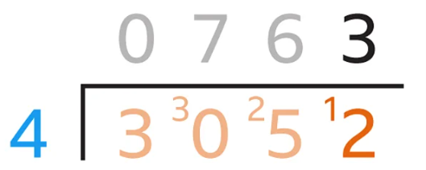
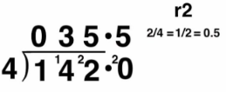
Division
Some division questions, where the children are dividing by just 1 digit, may require the short division method (bus stop).
For e.g.
3052 ÷ 4 = 763
Some answers may give remainders

Slide 8
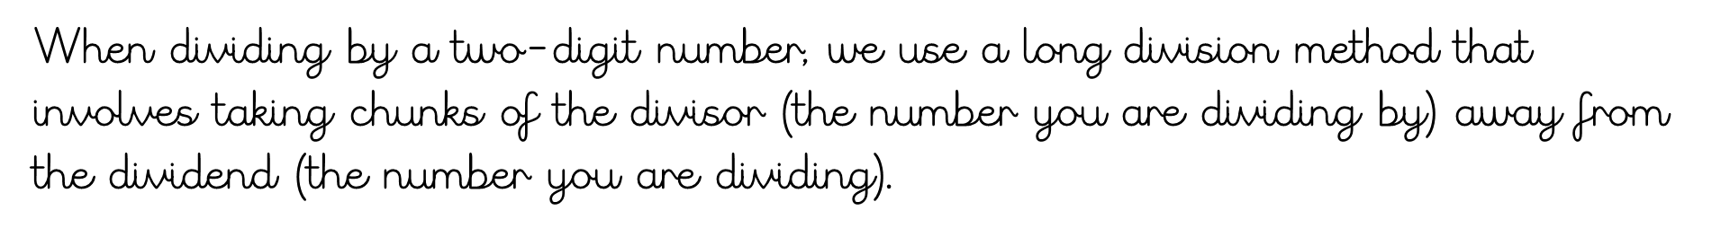
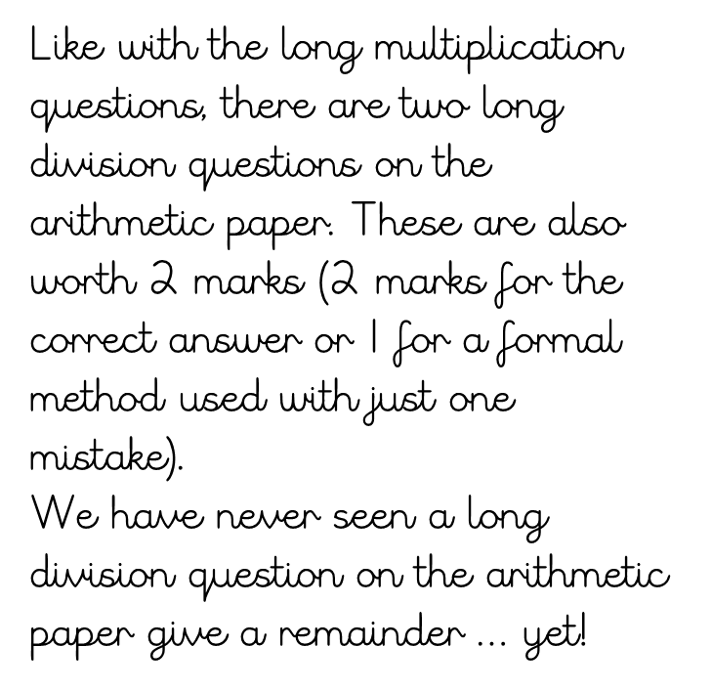
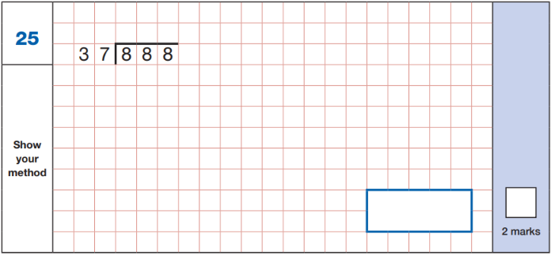

Slide 9
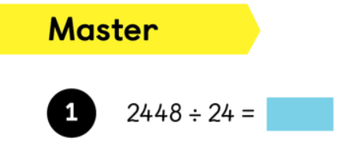
What facts do we know?
1 x 24 = 24
2 x 24 = 48
102
10 x 24 = 240
20 x 24 = 480
102
24
2448
102 groups of 24 go into 2448. How can we check this?
-2400
(x 100)
100 x 24 = 2400
200 x 24 = 4800
48
- 48
(x 2)
00

Slide 10
What facts do we know?
167
1 x 28 = 28
2 x 28 = 56
5 x 28 = 140
10 x 28 = 280
20 x 28 = 560
50 x 28 = 1400
100 x 28 = 2800
4676 ÷ 28 =
28
4676
-2800
(x 100)
167 groups of 28 go into 4676. How can we check this?
1876
-1400
(x 50)
476
- 280
(x 10)
196
- 140
(x 5)
56
- 56
(x 2)
00

Slide 11
1376 ÷ 32 =
43
What facts do we know?
32
1376
- 640
(x 20)
1 x 32 = 32
2 x 32 = 64
5 x 32 = 160
10 x 32 = 320
20 x 32 = 640
736
-640
(x 20)
96
- 64
(x 2)
32
- 32
(x 1)
00

Slide 12
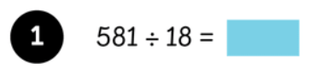
What key facts can we use?
1 x 18 = 18
2 x 18 = 36
5 x 18 = 90
32r5
18
581
10 x 18 = 180
20 x 18 = 360
-360
(x 20)
221
- 180
(x 10)
41
- 36
(x 2)
5

Slide 13
What key facts can we use?
1 x 16 = 16
2 x 16 = 32
5 x 16 =80
125r4
16
2004
-1600
(x 100)
10 x 16 = 160
20 x 16 = 320
50 x 16 =800
100 x 16 = 1600
404
- 320
(x 20)
84
- 80
(x 5)
4

