Slide 1


Whilst You Are At Home
We are going to stay in touch
Edition 12
7th July 2020

Slide 2
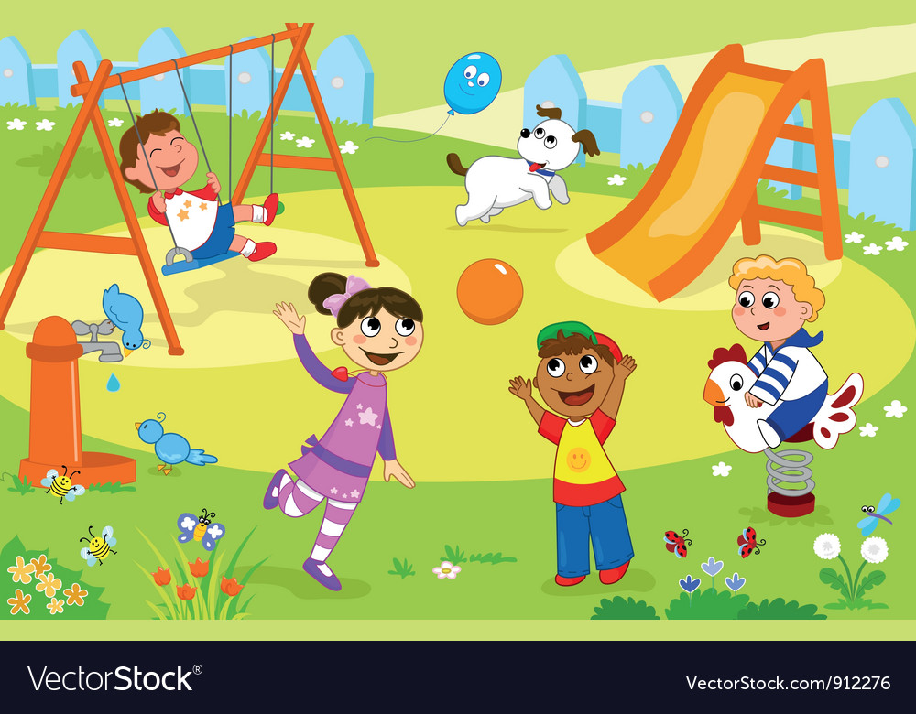
Positive messages of the week
Hello Everybody
How fantastic is it to have the parks back open again for the summer holidays.
It is not long now until the 6 weeks holidays and hopefully we will see you at the start of the next school year.
Remember to keep yourselves safe, PC Panda has lots more information this week to help you to do this!

Slide 3

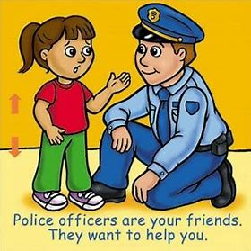


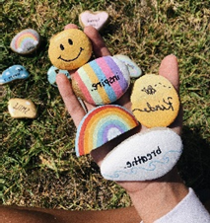

Personal Messages From Your Local PCSO
PCSO Rebecca said. "Please don’t talk to strangers Online!”
PCSO Rebecca: Said…
“When outside for your exercise Always use the Green Cross Code.”
PCSO Rebecca Said…
“Always wear a helmet when on your bike”

Slide 4
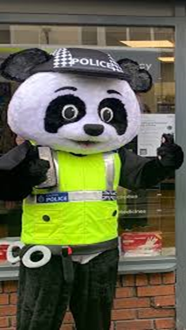




INTERNET SAFETY
Last week we looked at setting up a strong password. This week PC Panda would like you to check your privacy settings with your parents to make sure you are staying safe!
Keep location services off

Slide 5
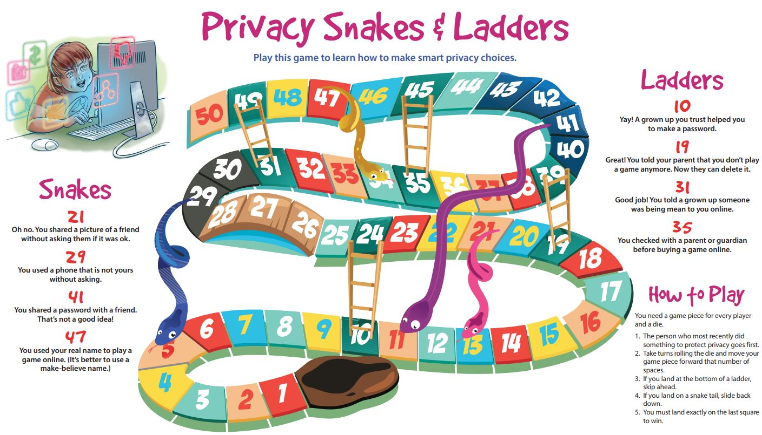
Internet Safety Activity

Slide 6

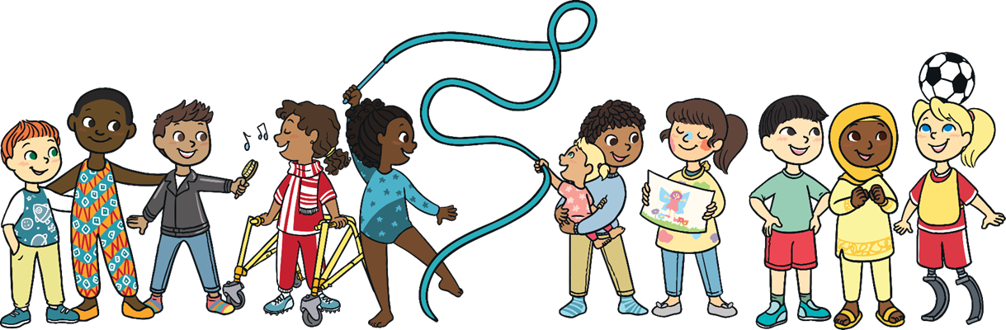
Great Britain is a Wonderfully Diverse Country
DIVERSITY
We are all Amazingly Different…
We are all Amazingly Wonderful

Slide 7
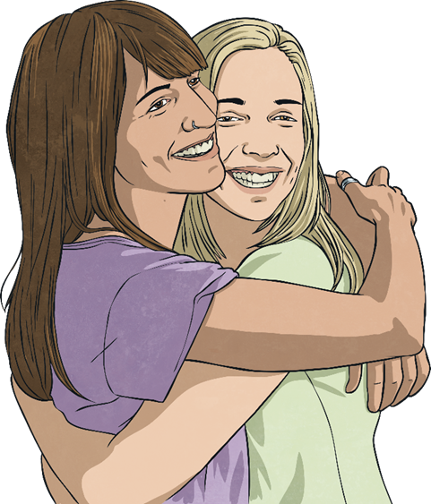
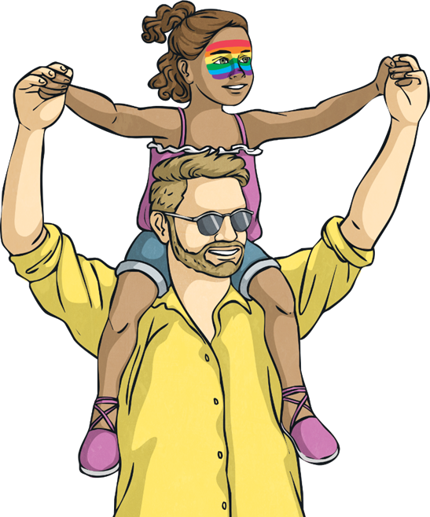


ACROSTIC POEM
Can you make your own acrostic poem with the word ‘DIVERSITY’
DIVERSITY
_________________________
_________________________
_________________________
_________________________
_________________________
_________________________
_________________________
_________________________
_________________________
THERE ARE SOME WORDS ON THE NEXT PAGE TO GIVE YOU INSPIRATION

Slide 8
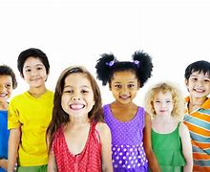


DIVERSITY WORDS AND PHRASES
RESPECT
EQUALITY
HELPING OTHERS
UNITED
OVERCOMING HURDLES
DIVERSITY IS
STRONGER TOGETHER
SUPPORTING EACH OTHER
LOVE
PRIDE
CELEBRATE DIFFERENCES
UPLIFTING
HAPPINESS
UNIQUE

Slide 9

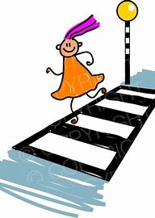
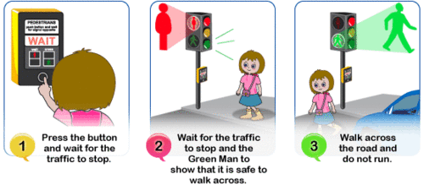
Road Safety
Think where is the safest place is to cross……
STOP! At the side of the road or crossing
LOOK! Use your eyes and ears to see any approaching vehicles
LISTEN! Wait until any vehicles have passed.
Look & listen again and then cross but keeping looking!

Slide 10

BE SAFE
BE SEEN

Slide 11







If it is your Birthday this week
Happy Birthday
Happy Birthday to you, Happy Birthday to you, Happy Birthday Special person Happy Birthday toooo yoooou

Slide 12

Until next Time 14th July 2020
Keep washing your hands and carry on with your exercise.
Stay healthy, by doing a bit of exercise every day.
Keep positive, by reminding yourself, You are an Amazing Child.
Do Your Bit for Great Britain and the NHS
Childline | Childline
https://www.childline.org.uk
Get help and advice about a wide range of issues, call us on 0800 1111, talk to a counsellor online, send Childline an email or post on the message boards
NSPCC Helpline
0808 800 5000

