Slide 1
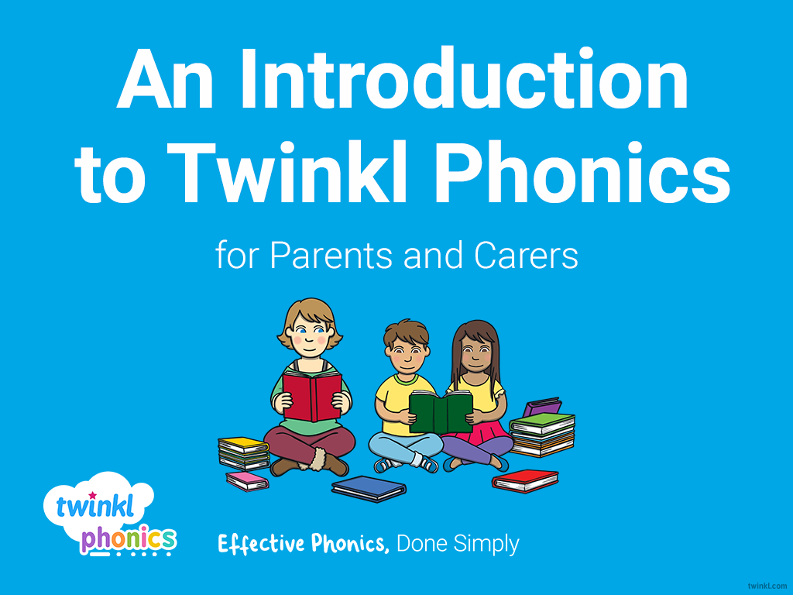

Slide 2
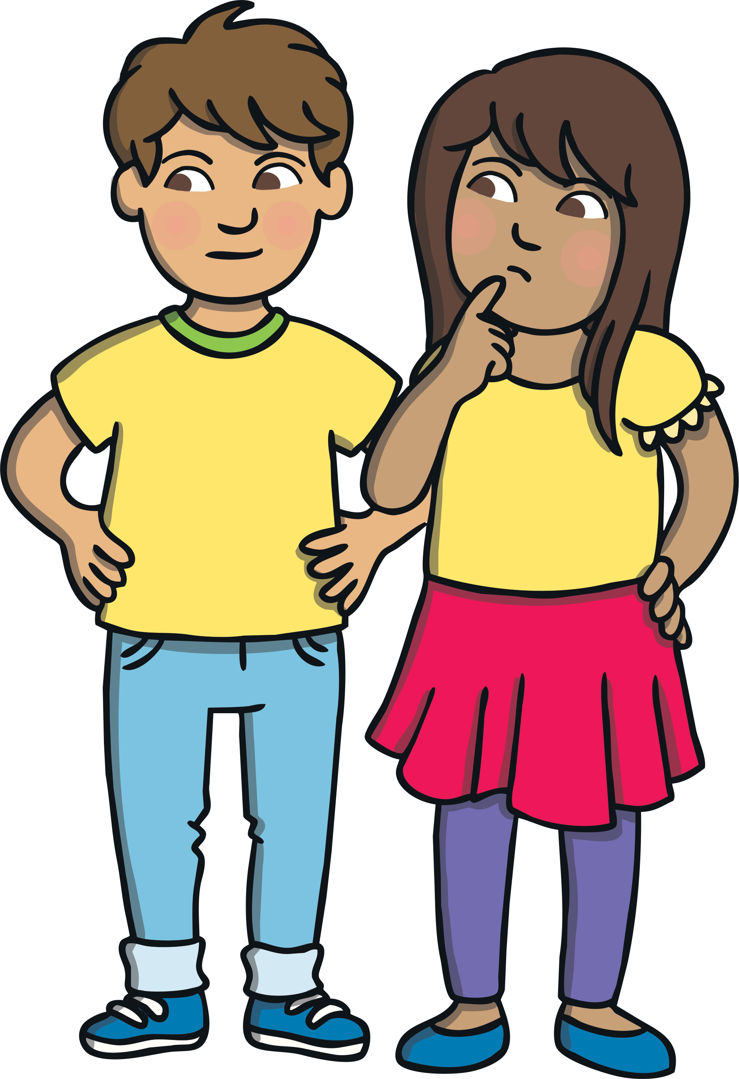
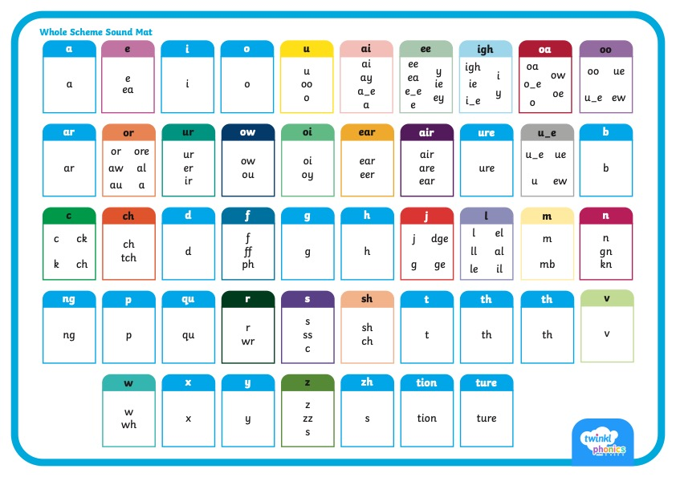
      Did You Know…?
There are 26 letters in the alphabet but there are 44 sounds and over 100 different ways of spelling them.
This is why English is one of the most complex languages to learn!

Slide 3
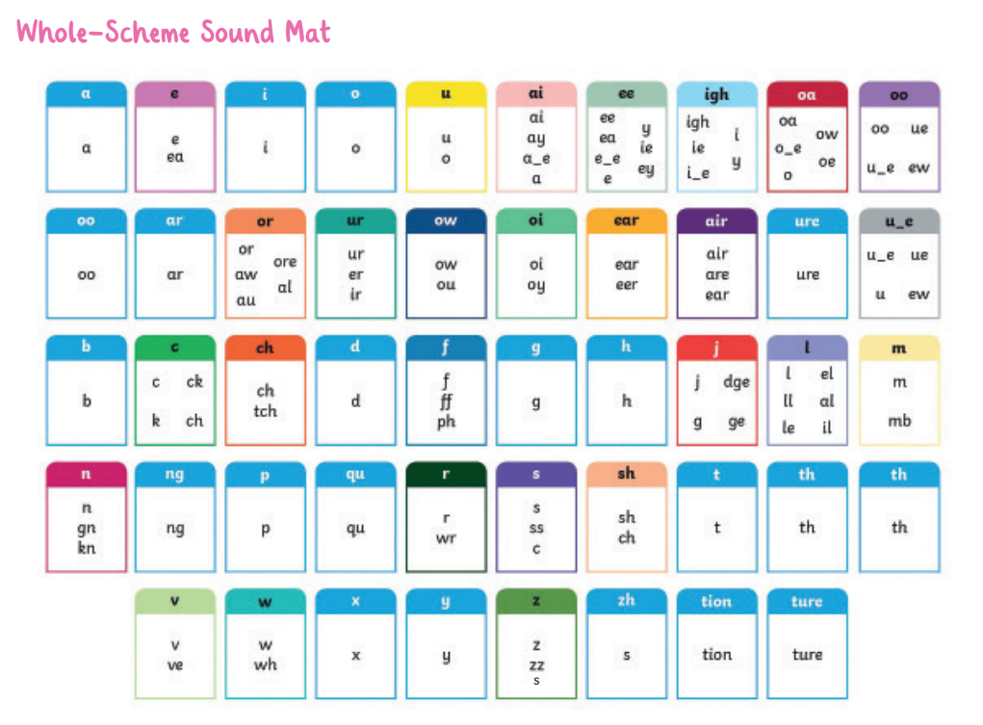

Slide 4
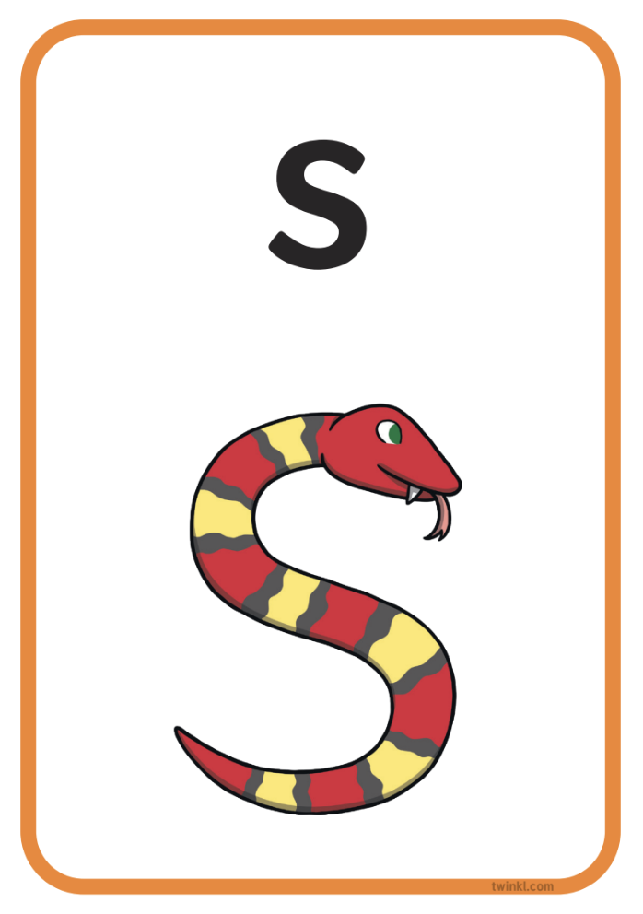
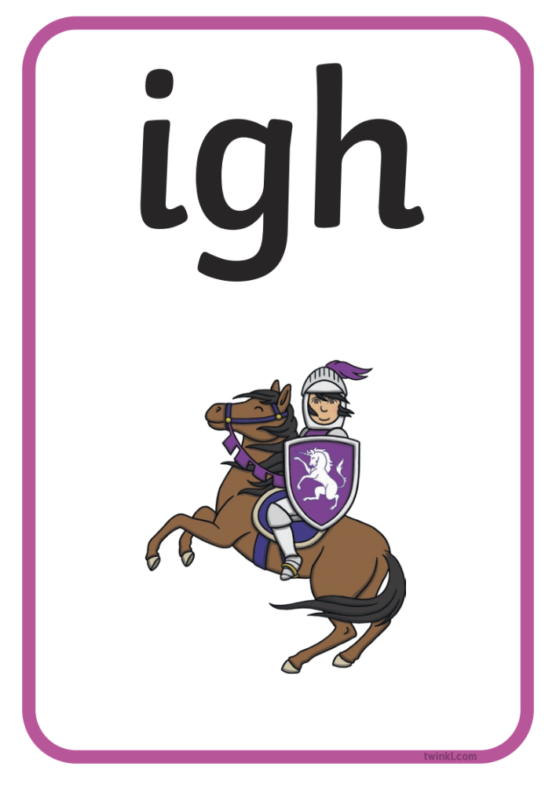
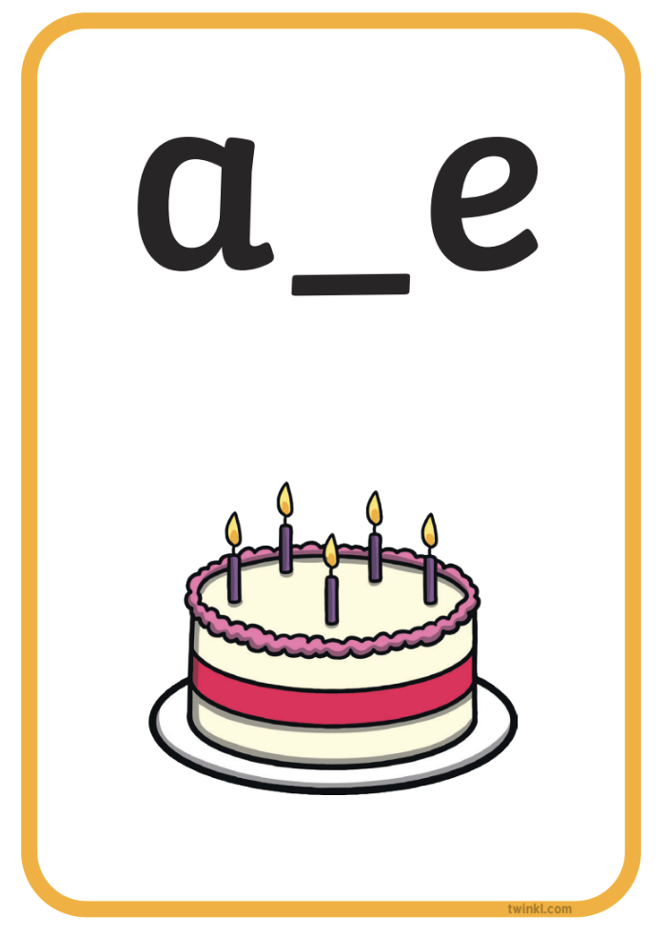


Phonics Terminology
Here is some of the terminology you might hear as your children begin to learn phonics.
Phoneme | the smallest unit of sound in words
Grapheme | the written representation of a sound
GPC (Grapheme-Phoneme Correspondence) | being able to match a phoneme with the correct grapheme and vice versa
Blending | joining individual speech sounds together to read a word
Segmenting | breaking down words into individual speech sounds to spell a word
Digraph | two letters making one sound e.g. ‘sh’
Trigraph | three letters making one sound e.g. ‘igh’
Split Digraph | two letters making one sound which are divided by a consonant e.g. the i_e sound in the word ‘side’
Tricky/Common Exception Words | words that are not fully decodable such as ‘the’ and ‘was’
Sound buttons | circles or spots that can be written underneath a sound to support reading
Sound bars | lines that can be written underneath digraphs or trigraphs to show that the letters make one sound
Mnemonic | a visual prompt to help children remember a sound

Slide 5

      What Is Taught and When?
Twinkl Phonics Level | Number of Teaching Weeks | Recommended Year Group (UK schools) | Age of Children
Level 1 | 36 | Nursery/Preschool | 3-4 years
Level 2 | 7 | Reception | 4-5 years
Level 3 | 12 | Reception | 4-5 years
Level 4 | 5 | Reception | 4-5 years
Level 5 | 30 | Year 1 | 5-6 years
Level 6 | 30 | Year 2 | 6-7 years
Level 1 continues to be taught alongside the other levels.
This is just an overview. We understand that every child progresses at their own pace.

Slide 6
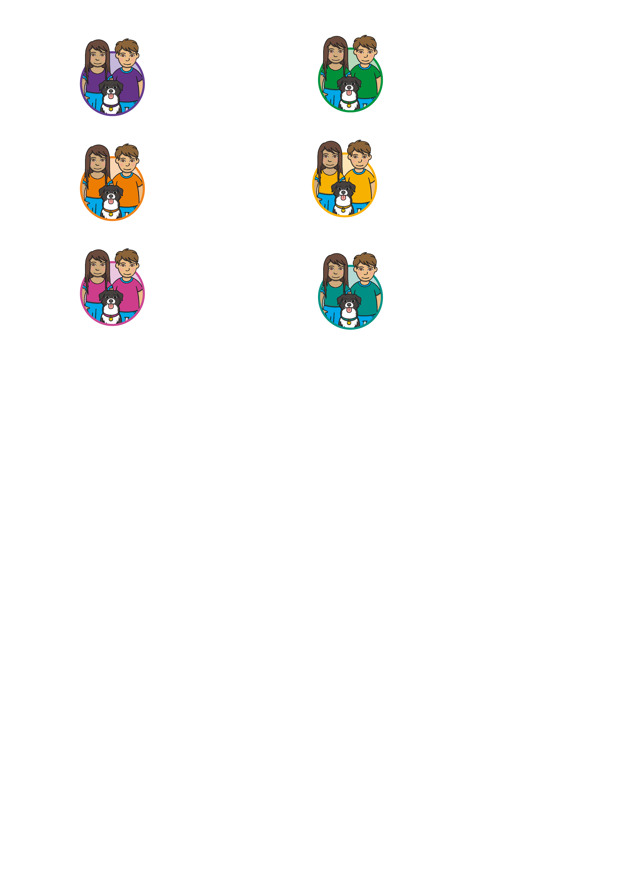

      Level 1
Level 1 is taught in Nursery/Preschool.
By the end of Level 1, children will have had the opportunities to:
listen attentively;
enlarge their vocabulary;
speak confidently to adults and other children;
discriminate different sounds including phonemes;
reproduce audibly the phonemes they hear in words;
orally segment words into phonemes.
These learning opportunities are presented through 7 Aspects.

Slide 7
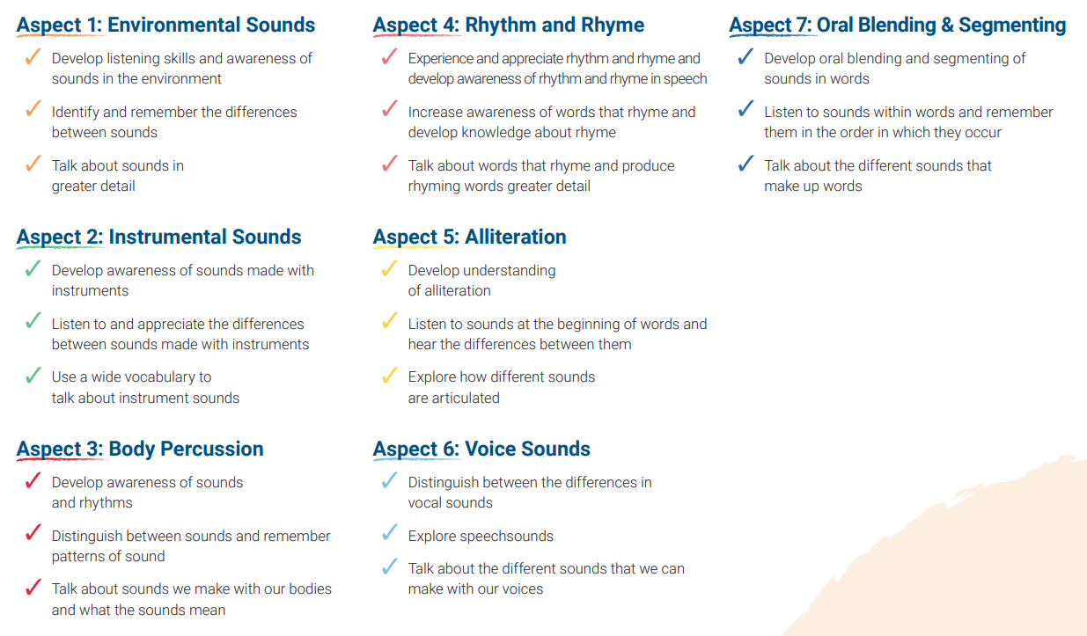
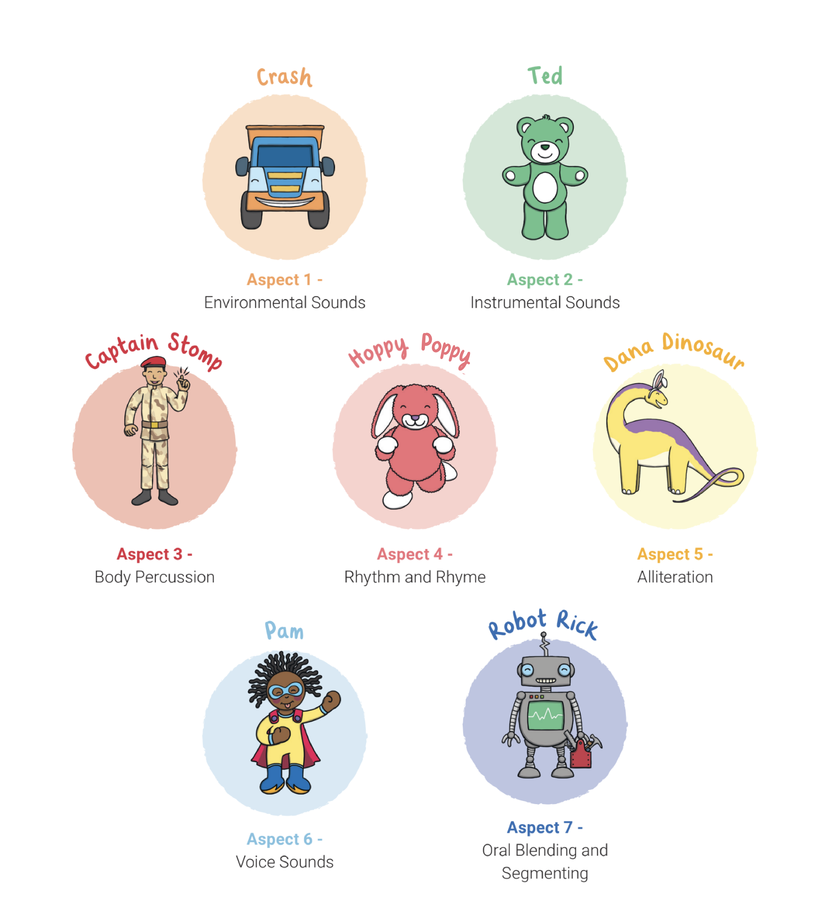
      What Are the 7 Aspects of Level 1?

Slide 8
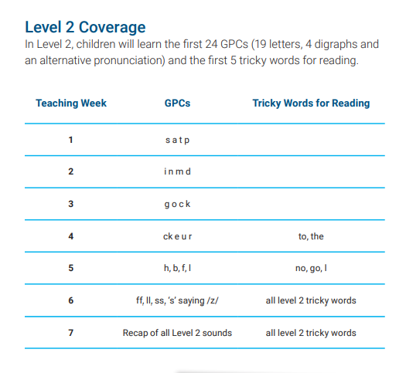
      Level 2
Level 2 is taught in Reception.
By the end of Level 2, children will have had the opportunities to:
identify the phoneme when shown any Level 2 grapheme;
identify any Level 2 grapheme when they hear the phoneme;
orally blend and segment CVC words such as, ‘sat’ and ‘pat’;
blend sounds to read VC words such as, ‘if’, ‘am’, ‘on’ and ‘up’;
segment VC words into their sounds to spell them (using magnetic letters);
read the tricky words (words that cannot be sounded out): the, to, I, no, go.

Slide 9
      Level 2 Actions and Mnemonics
Every sound has a corresponding action and mnemonic which helps children to remember them. You can support your child by modelling the same sounds and actions at home.

Slide 10
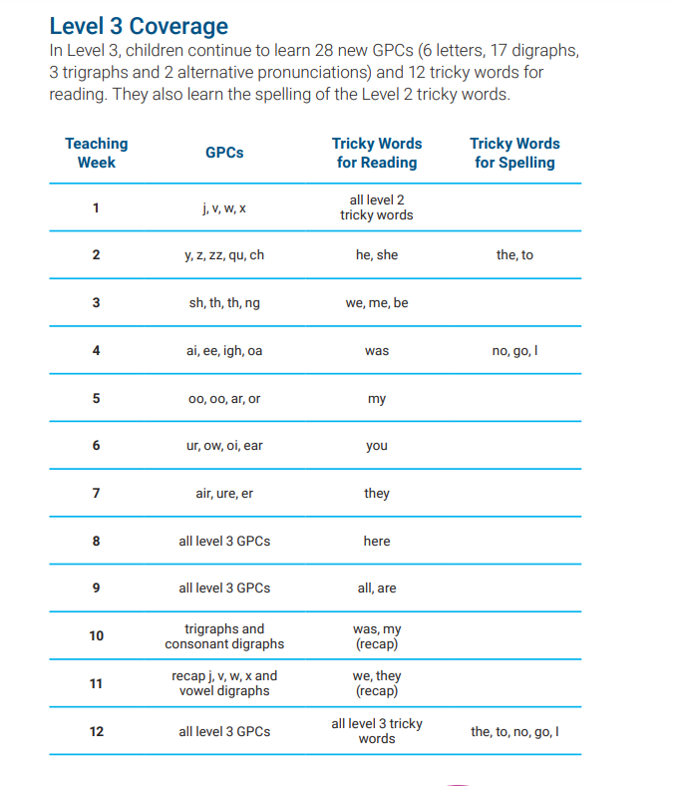
      Level 3
Level 3 is taught in Reception.
By the end of Level 3, children will have had the opportunities to:
say the phoneme when shown all or most Level 2 and Level 3 graphemes;
find all or most Level 2 and Level 3 graphemes, from a display, when given the phoneme;
blend and read CVC words (single-syllable words consisting of Level 2 and Level 3 graphemes) such as ‘chop’ and ‘night’;
segment and make phonetically plausible attempts at spelling CVC words (single-syllable words consisting of Level 2 and Level 3 graphemes) such as ‘paid’ and ‘seed’;
read the tricky words - he, she, we, me, be, was, my, you, her, they, all, are & spell the tricky words - the, to, I, no, go;
write each letter correctly when following a model.

Slide 11
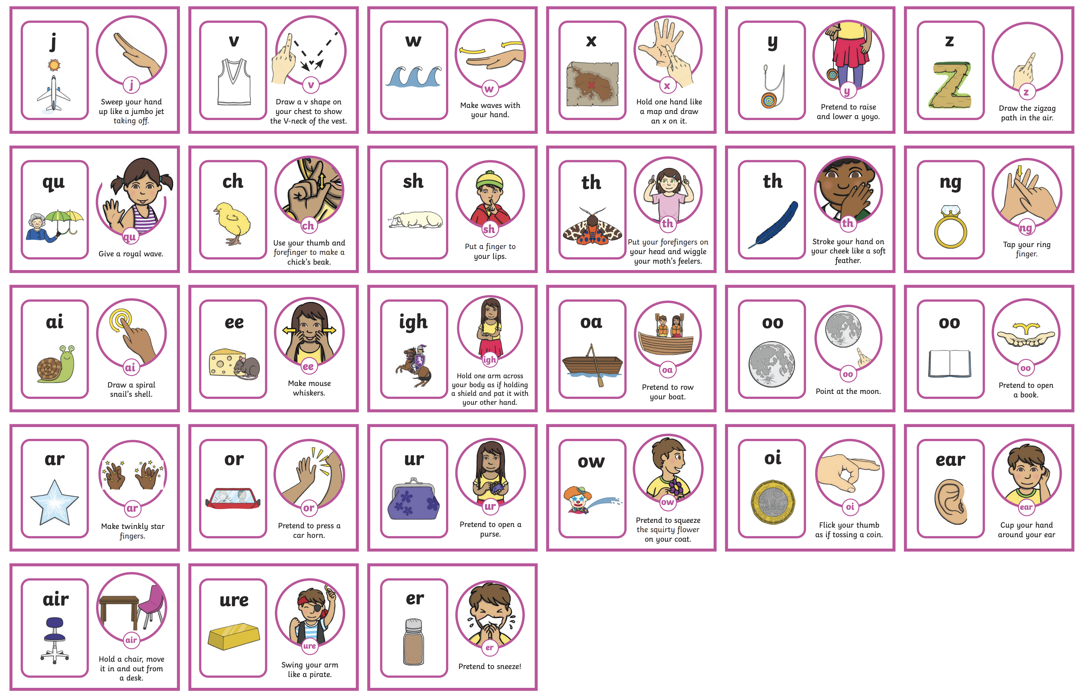
      Level 3 Actions and Mnemonics
It is really important that children learn to form the letters using the correct letter formation when writing. As they are introduced to a new sound, children are taught how to write it correctly. It would be great if you could also model this at home.

Slide 12
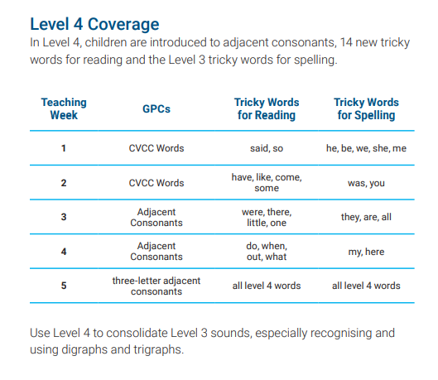

      Level 4
Level 4 is taught in Reception.
By the end of Level 4, children will have had the opportunities to:
give the phoneme when shown any Level 2 or Level 3 grapheme;
find any Level 2 or Level 3 grapheme when given the phoneme;
blend and read words containing adjacent consonants as well as segment and spell words containing adjacent consonants, such as ‘sand’, ‘bench’ and ‘flight’;
read the tricky words - some, one, said, come, do, so, were, when, have, there, out, like, little, what & spell the tricky words - he, she, we, me, be, was, my, you, here, they, all, are;
write each letter, usually using the correct formation;
orally segment words into phonemes.
No new sounds are taught in Level 4.

Slide 13
      What Is Taught and When?
Twinkl Phonics Level | Number of Teaching Weeks | Recommended Year Group (UK schools) | Age of Children
Level 1 | 36 | Nursery/Preschool | 3-4 years
Level 2 | 7 | Reception | 4-5 years
Level 3 | 12 | Reception | 4-5 years
Level 4 | 5 | Reception | 4-5 years
Level 5 | 30 | Year 1 | 5-6 years
Level 6 | 30 | Year 2 | 6-7 years
Level 1 continues to be taught alongside the other levels.
This is just an overview. We understand that every child progresses at their own pace.

Slide 14

      Level 5
Level 5 is taught in Year 1.
By the end of Level 5, children will have had the opportunities to:
give the phoneme, when shown any grapheme that has been taught;
for any given phoneme, write the common graphemes;
apply phonics knowledge and skills as the primary approach to reading and spelling unfamiliar words that are not completely decodable;
read and spell phonically decodable two-syllable and three-syllable words such as ‘dolphin’ and ‘parachute’;
read automatically all taught tricky and common exception words;
accurately spell all the Level 2, 3 and 4 tricky words and most of the common exception words for reading;
form each letter correctly;
use alternative ways of pronouncing and representing the long vowel phonemes.

Slide 15
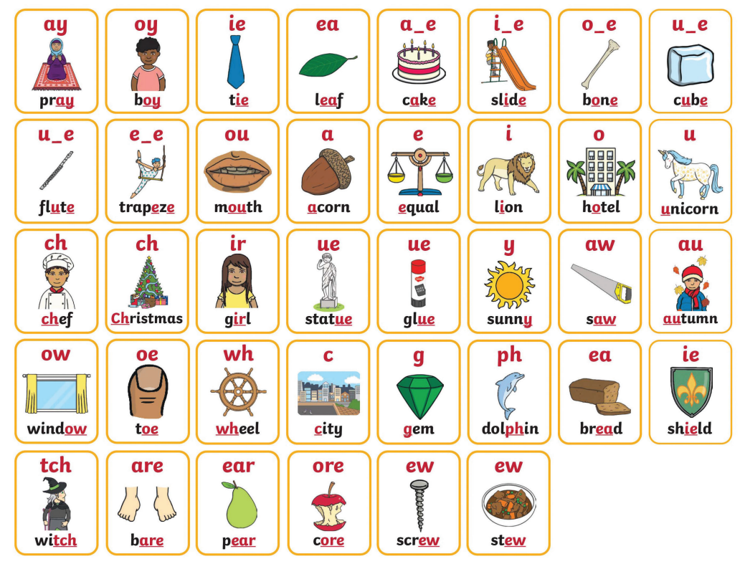
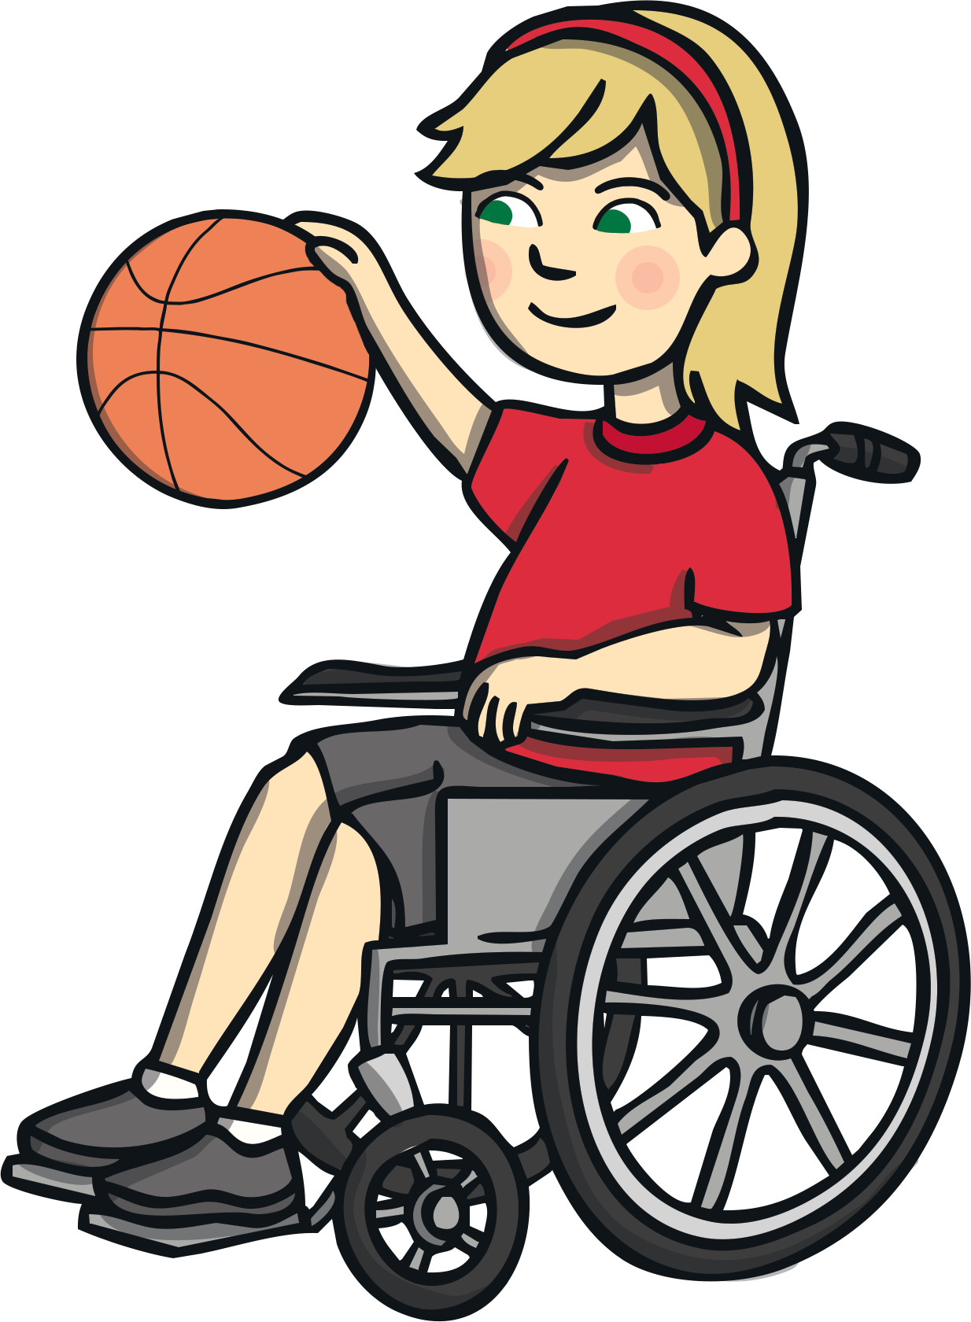
      Level 5 Mnemonics
The new sound is displayed within a word linked to the mnemonic for Level 5.

Slide 16
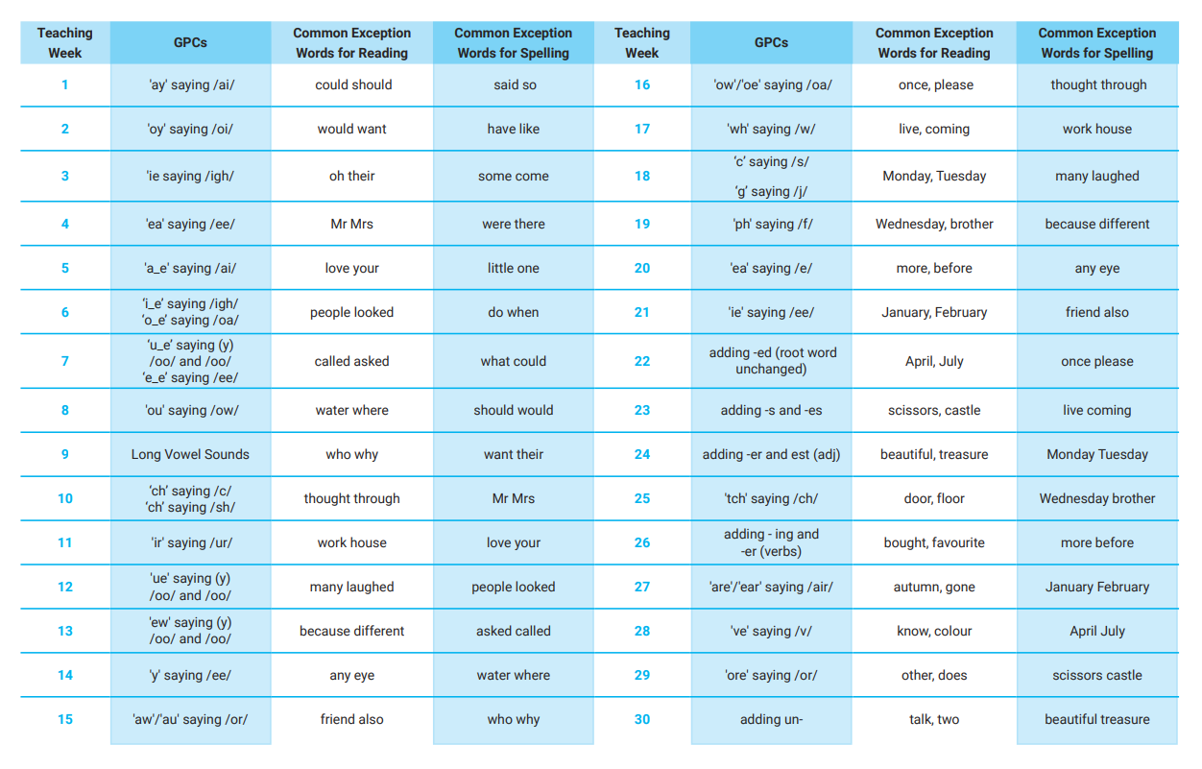

      Level 5 Overview

Slide 17
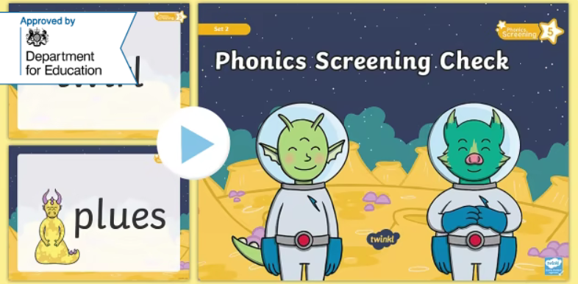
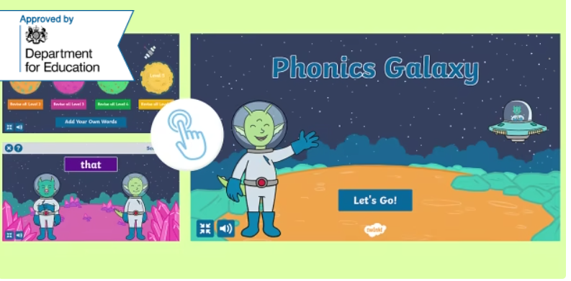
      Year 1 Phonics Screening Check
In June, all year 1 children are expected to complete the Year 1 Phonics Screening Check.
The aim is to check that a child is making progress in phonics. They are expected to read a mixture of real words and ‘nonsense’ words. (Nonsense words can also be referred to as ‘pseudo’ or ‘alien’ words)
For more information why not take a look at the
Twinkl Phonics Year 1 Screening Check Guide for Parents
If a child has not reached the expected standard, schools must give additional support to help the child to make progress in year 2.
Children who have not passed the check in year 1 will have the opportunity to retake it in year 2.

Slide 18

      Level 6
read accurately most words of two or more syllables;
Level 6 is taught in Year 2.
By the end of Level 6, children will have had the opportunities to:
read most words containing common suffixes;
read most common exception words;
read most words accurately, in age-appropriate books, without overt sounding and blending, fluent enough to allow them to focus on their understanding rather than on decoding individual words;
At this stage, children can read hundreds of words automatically. They are now reading for pleasure and reading to learn rather than learning to read.
sound out most unfamiliar words accurately, without undue hesitation;
segment spoken words into phonemes and represent these by graphemes, spelling many of these words correctly and making phonetically plausible attempts at others;
spell most common exception words correctly.

Slide 19
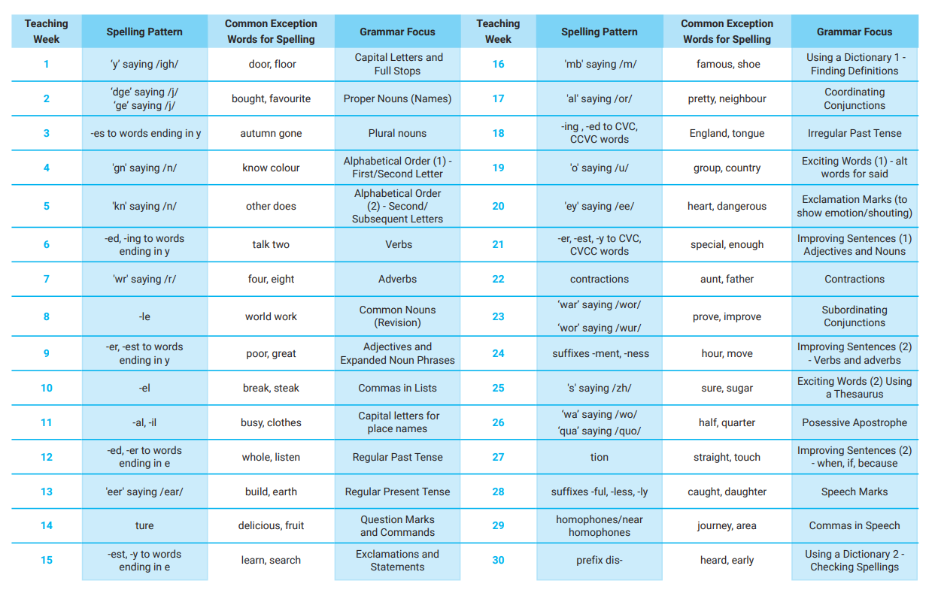

      Level 6 Overview

Slide 20
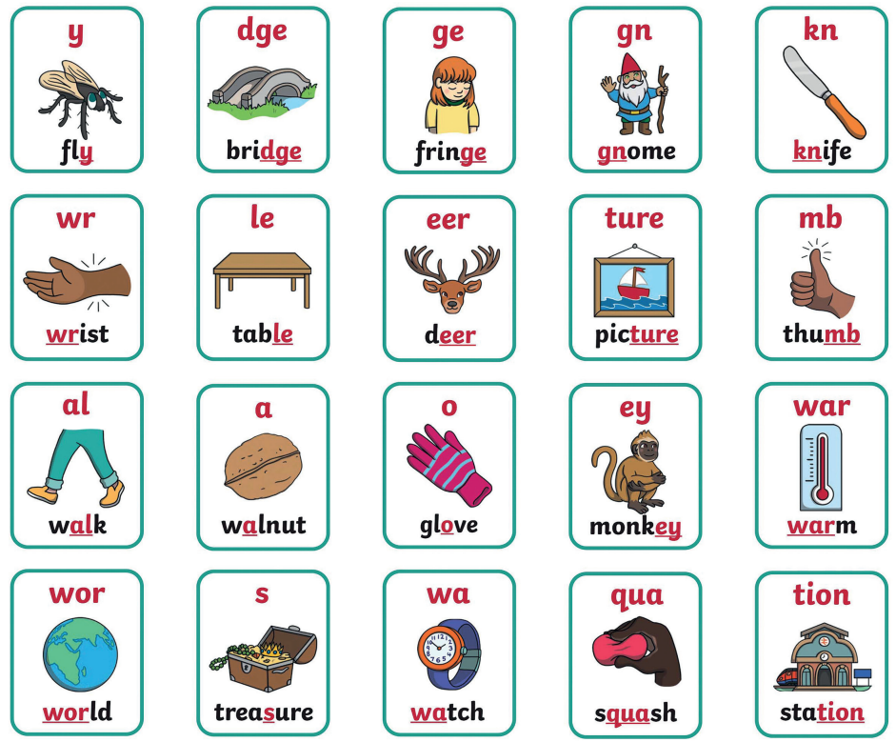

      Level 6 Mnemonics

Slide 21
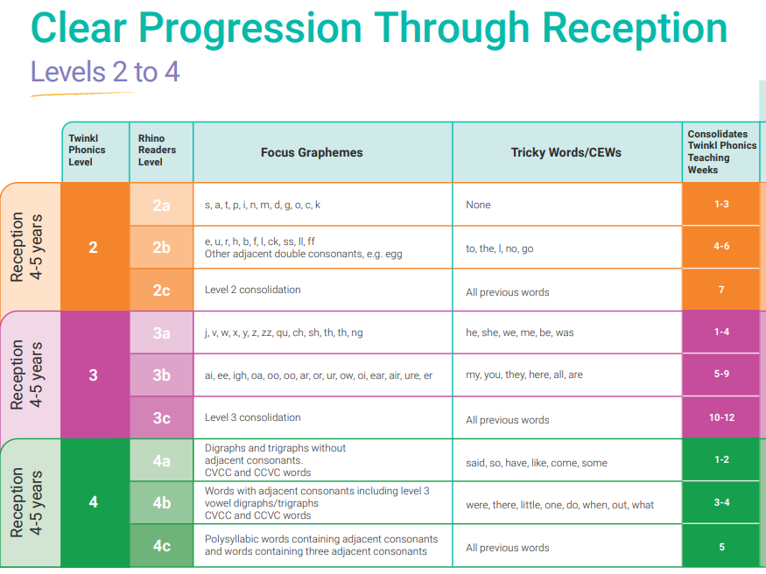

Slide 22
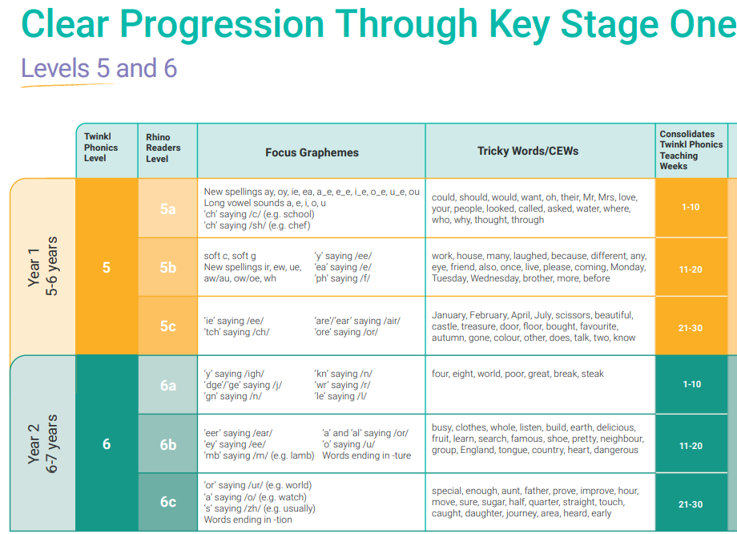

Slide 23
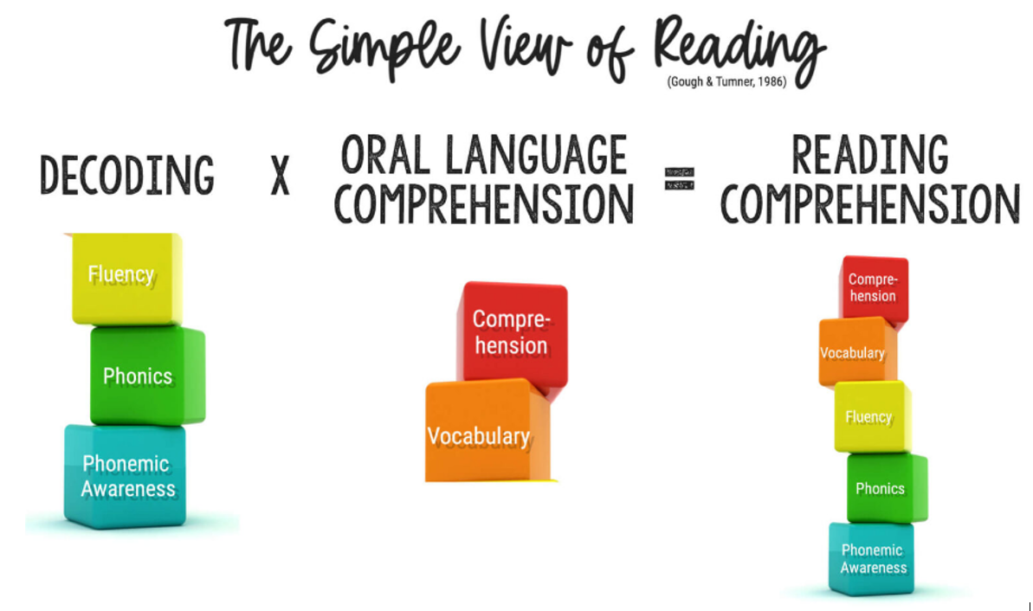

Slide 24
      How You Can Help
Practise the new sounds and graphemes using the Parent Information Sheets and information on the class webpage.
Revisit past books and spellings – interrupt their forgetting.
Please state exactly which pages your child has read in the reading record each time they read.
Use pure sounds – don’t add ‘uh’.
Support your child to complete any homework they bring home.
Finally, remember to ask your child’s class teacher if you are unsure about any aspect of your child’s phonics learning.
A consistent approach is important.
Read to and with your child every day. Reading for pleasure is just as important as ‘reading scheme’ books.

Slide 25
