Slide 1
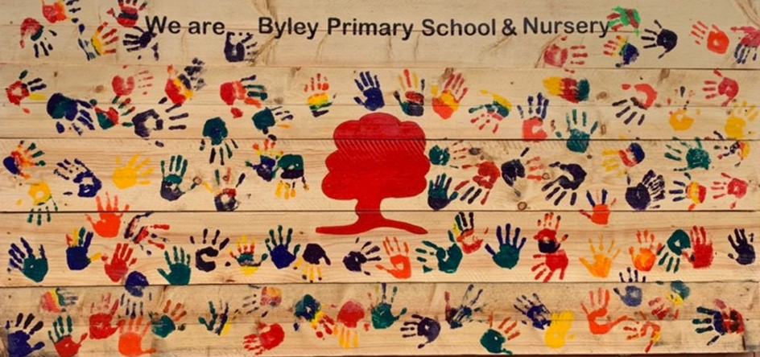

Welcome To
Byley Primary School & Nursery
Nursery & Reception STARTERS Information 2026

Slide 2
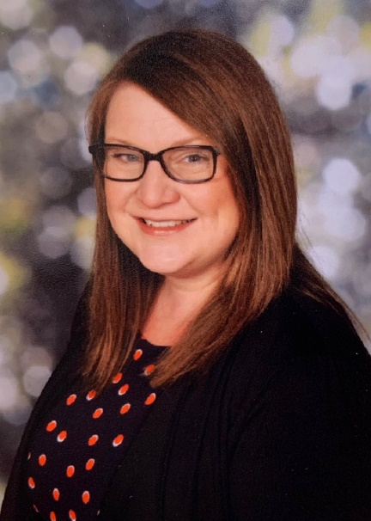
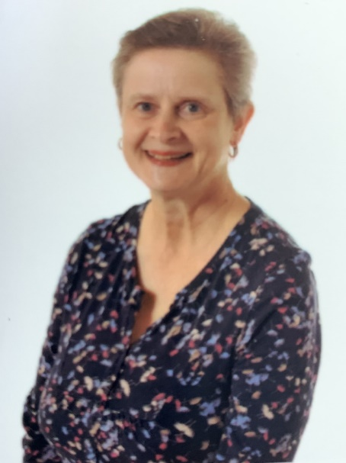
Meet the EYFS Team….
Class Teacher Teaching Assistant Teaching Assistant
Mrs Joanne Madden Mrs Myeda Smalley Mrs Heather Bradbury

Slide 3
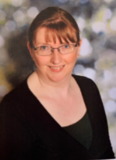
Meet the EYFS Team….
Mrs Linda Boyd

Slide 4
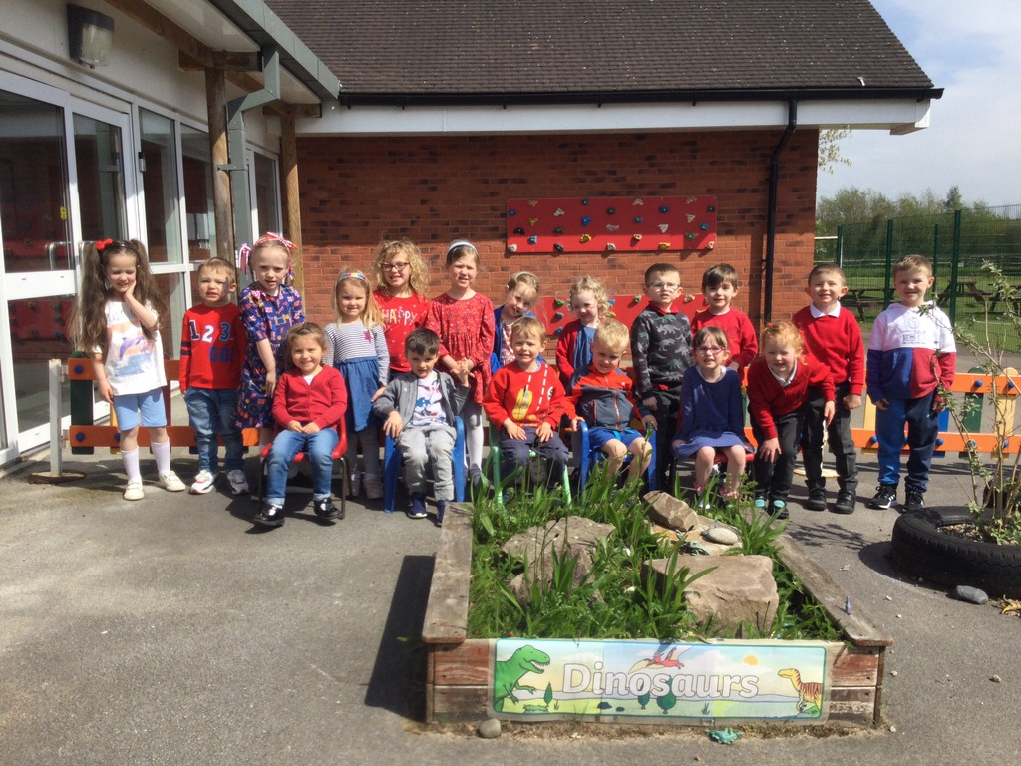
School Expectations
We look after ourselves
We look after other people
We look after our environment

Slide 5



Rewards
House Points - Four School Houses (Siblings are in the same house)
  ELM BEECH ASH FIR
Stickers
Celebration Assembly - Special Book (Friday)
Star in the jar – Class reward
Ten Stars – lunch with Miss Whittingham
Visits to Miss Whittingham, KS1 Team

Slide 6
School Houses
Fir |  | Beech
N | Billie | N | Leo
N | Archie | R | Maeve
R | Roman | R | Daisy
R | Paisley | R | Felicity
Ash |  | Elm
N | Jake | N | Emmerson
R | Ettie | R | Abigail
R | Alfie | N | Harrison
R | Poppy | N | Andre
 |  | N | Amaia

Slide 7
Book Bags are available in school, priced £5.
Water Bottles – please don’t put these in book bags.
PE: Reception PE kit on the children’s pegs (Tuesday)
All clothing, water bottles, bags should be
clearly marked with the child’s name.

Slide 8

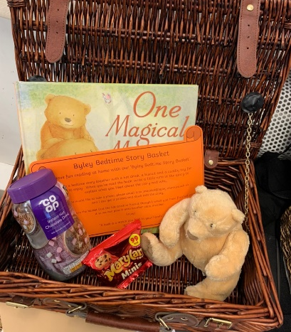
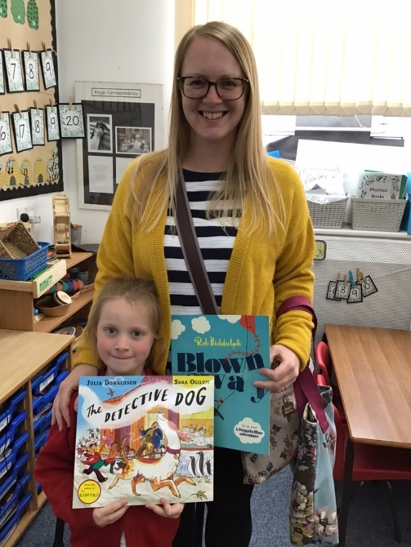
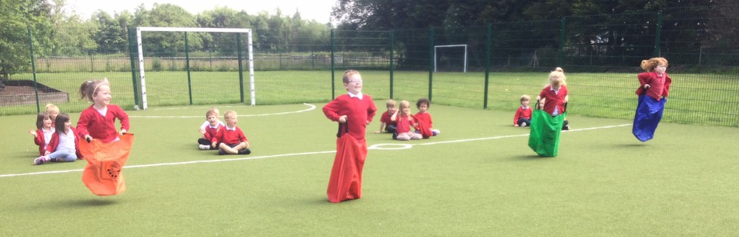
Valued partnerships with parents
Tapestry Online app – Photos of learning shared
Reading Records
Secret Storyteller
Bedtime Story Basket
Parent Workshops
Coffee Mornings
PTA Events – Cake Sales, Christmas & Summer fairs
Sports Day
Website - www.byley.cheshire.sch.uk
Facebook – Byley Primary School and Nursery
Open Door Policy

Slide 9
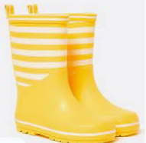
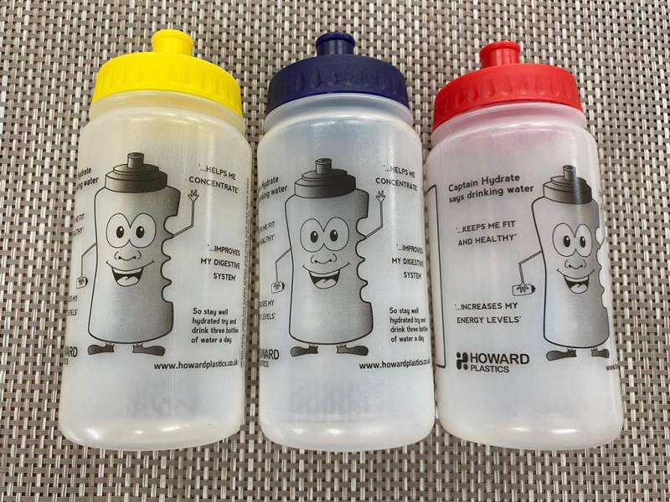
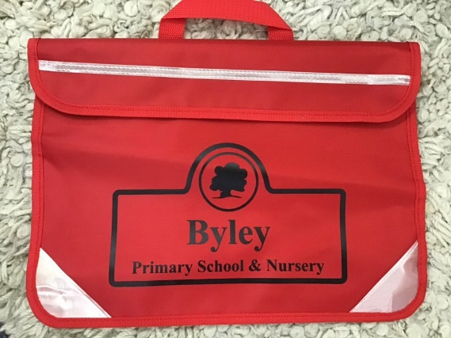
What to bring to school:
Suitable coat for the weather.
During hot weather, please apply long lasting sun screen before school.
Unfortunately staff are unable to apply this.
A pair of named wellies is helpful on wet days.
Book bag
Named water bottle with fresh water
  First bottle is free. Replacements are £1 for a bottle or 50p for a lid

Slide 10
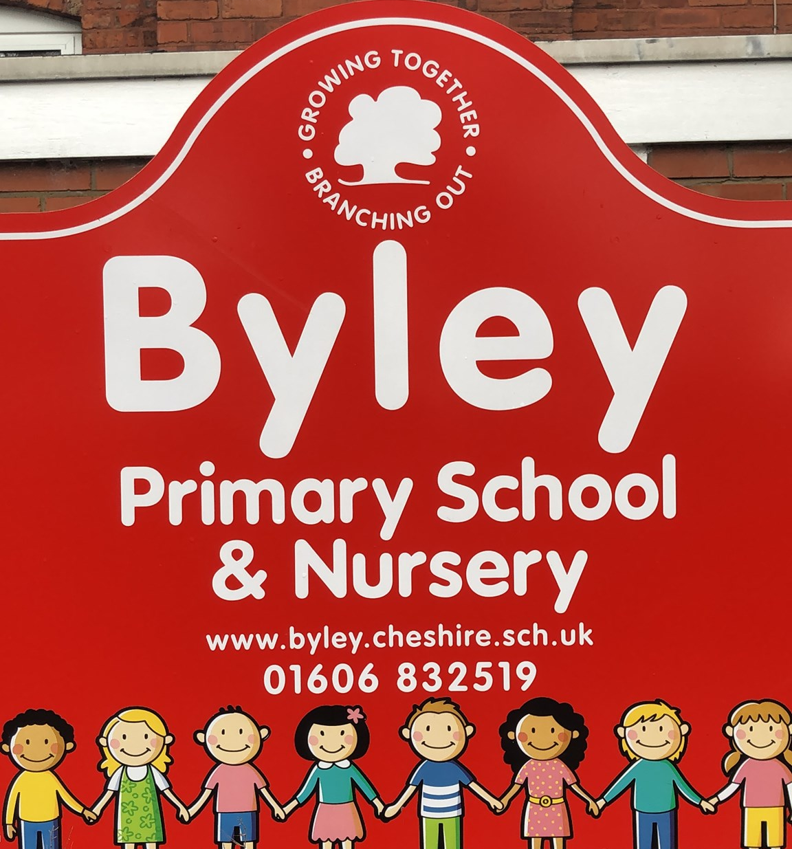
A typical day at Byley:
Doors open at 8.40am please wait with your child outside the main school entrance until Miss Whittingham opens the front door and we will greet the children taking them into class. A quick transition is always best.
Teachers register the children from 8.50am (doors are closed at 8.50am – children who are late must be signed in.
Learning time begins immediately, using the indoor and outdoor areas.
Learning includes a balance of whole class teaching, focus group teaching and independent learning in continuous provision
Snack time- children receive a free piece of fruit every day. If your child has any allergies to fruits, please feel free to send them with a healthy snack.
Milk – children under 5 years old receive free milk.
Nursery Home Time – 12:00pm – wait by the main school entrance
Nursery/Reception Lunch Time – 12.00pm – 1pm
Continued learning time in class & story-time
Home time – Nursery 3:00pm Main Entrance
Reception from EYFS gate 3.20pm
Please inform us if someone different is to collect your child.

Slide 11
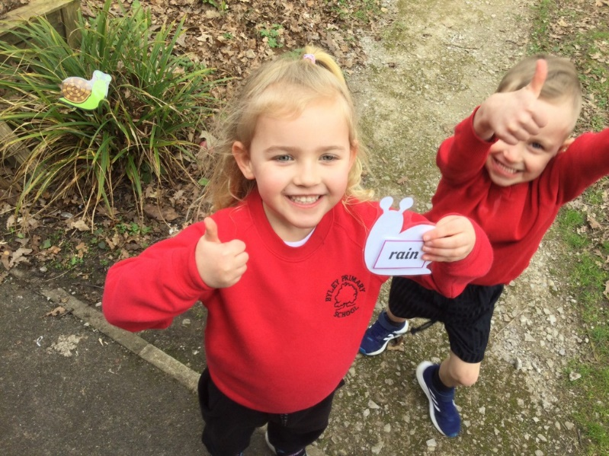
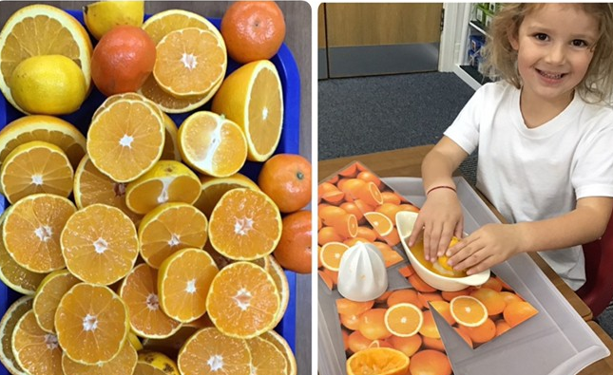
The Early Years Foundation Stage
Our Foundation Stage prepares children for their school life as well as preparing them for future learning and success in Key Stage 1and beyond.
We believe children in Nursery and Reception learn best through purposeful play, by exploring, being active, and through creative and critical thinking which takes place both indoors and outside.

Slide 12
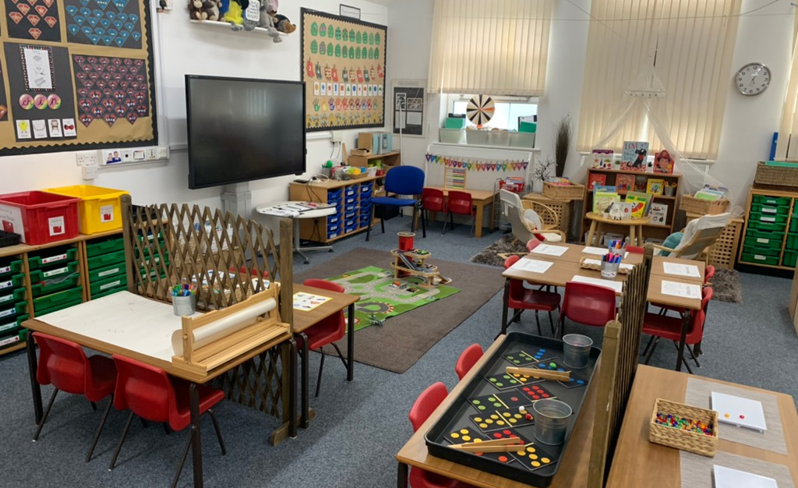
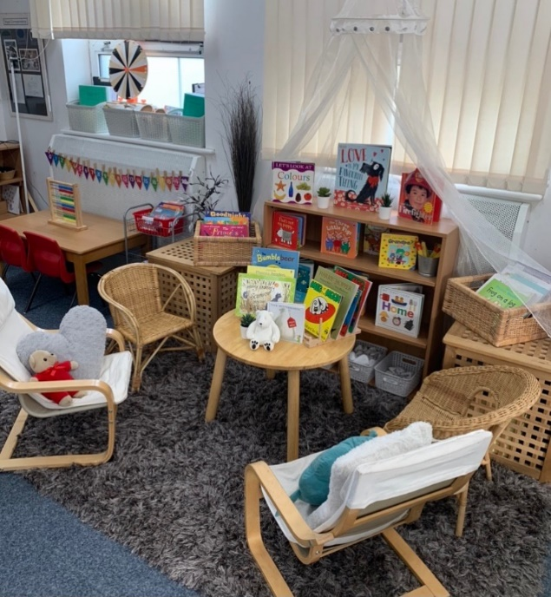
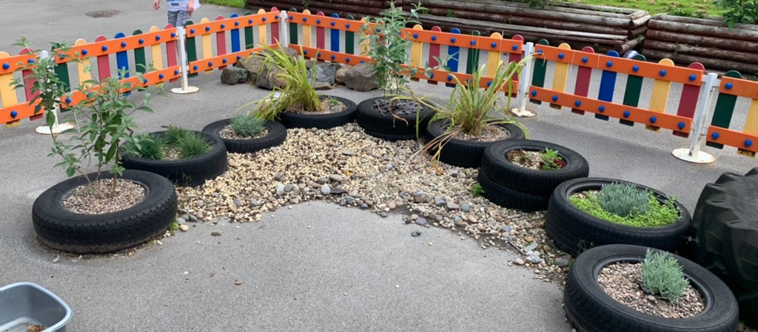
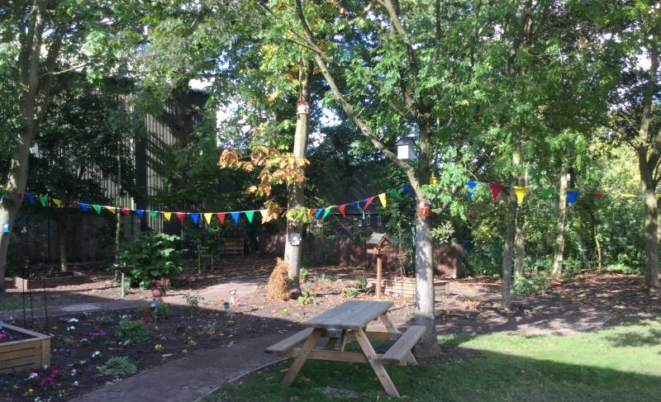
The Early Years Foundation Stage
Our children learn skills, acquire new knowledge and demonstrate their understanding through 7 areas of learning and development.

Slide 13
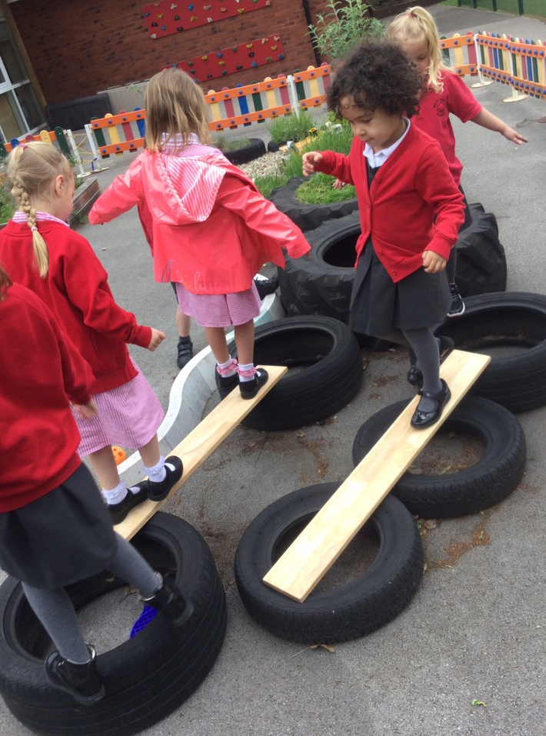
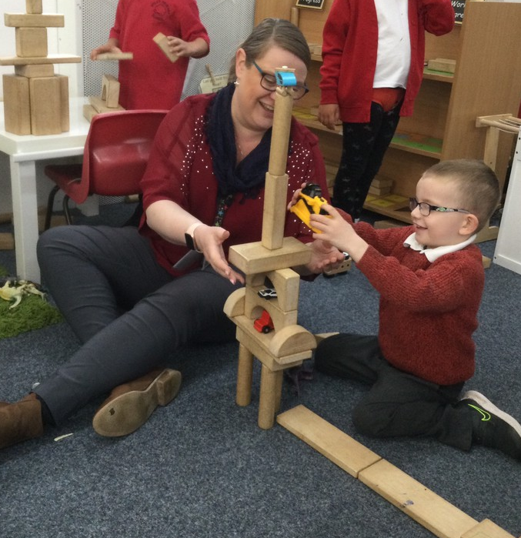
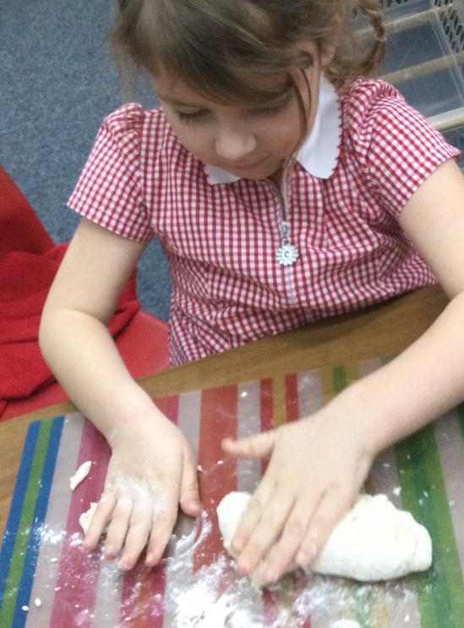
The Early Years Foundation Stage
Most children develop the 3 prime areas first.
These are:
Communication and Language
Physical Development
Personal, Social and Emotional Development
These prime areas are essential for your child’s healthy development and future learning.

Slide 14
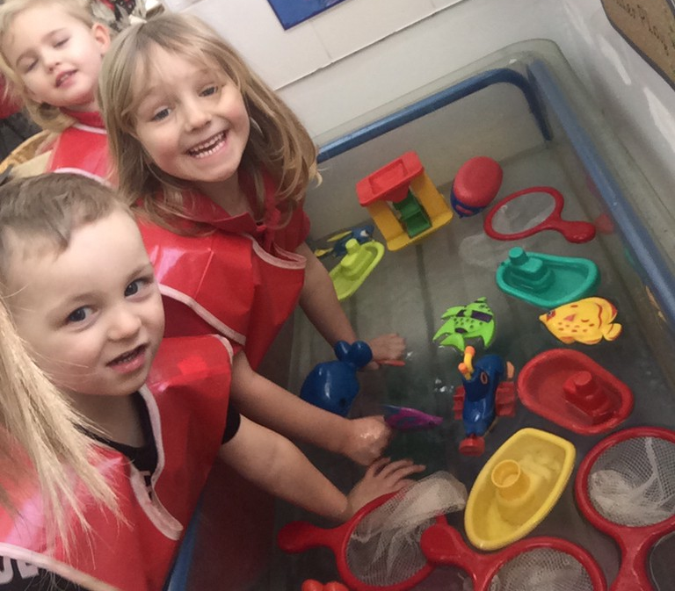
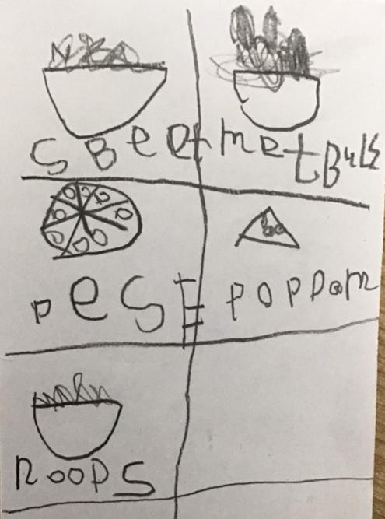
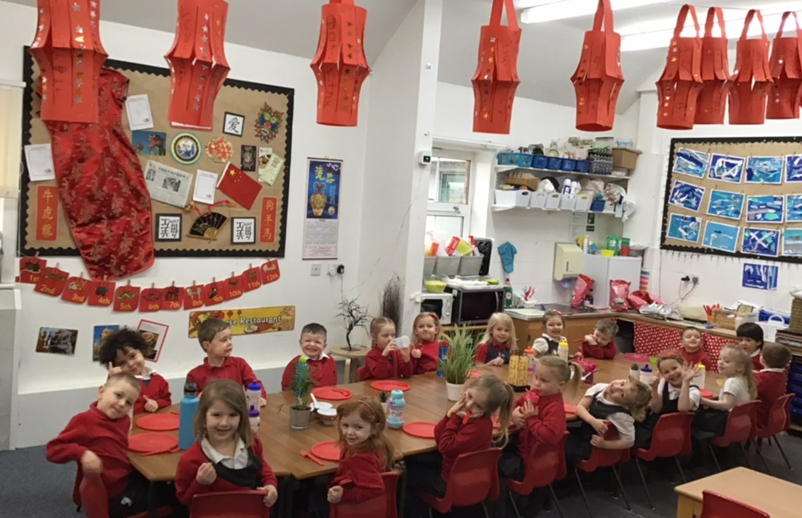
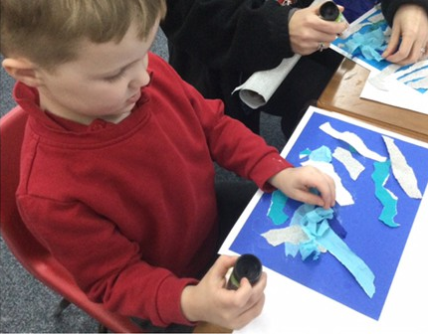
The Early Years Foundation Stage
As children grow, the prime areas will help them to develop skills in 4 specific areas.
These are:
Literacy
Mathematics
Understanding the World
Expressive Arts and Design

Slide 15
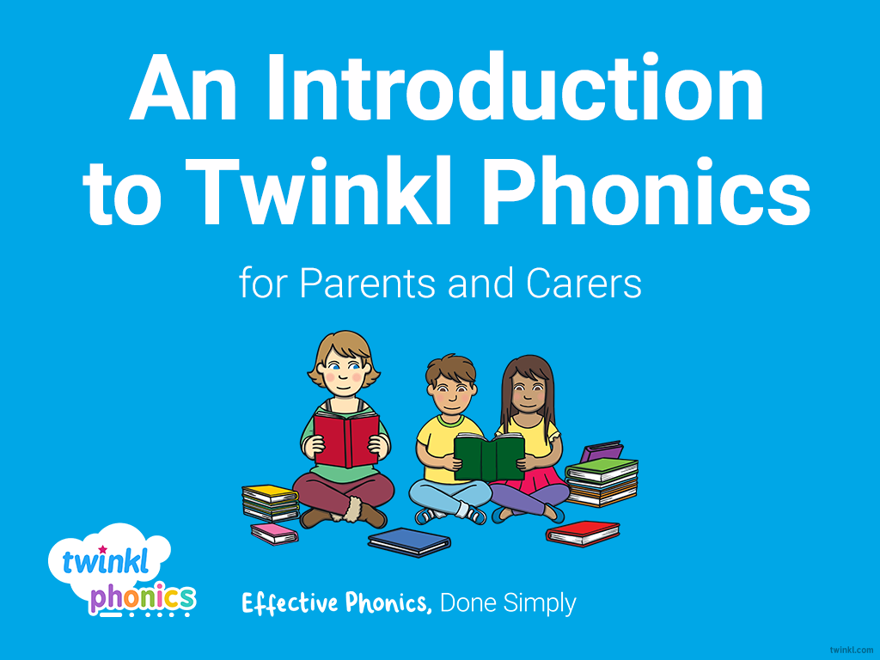
Reading

Slide 16

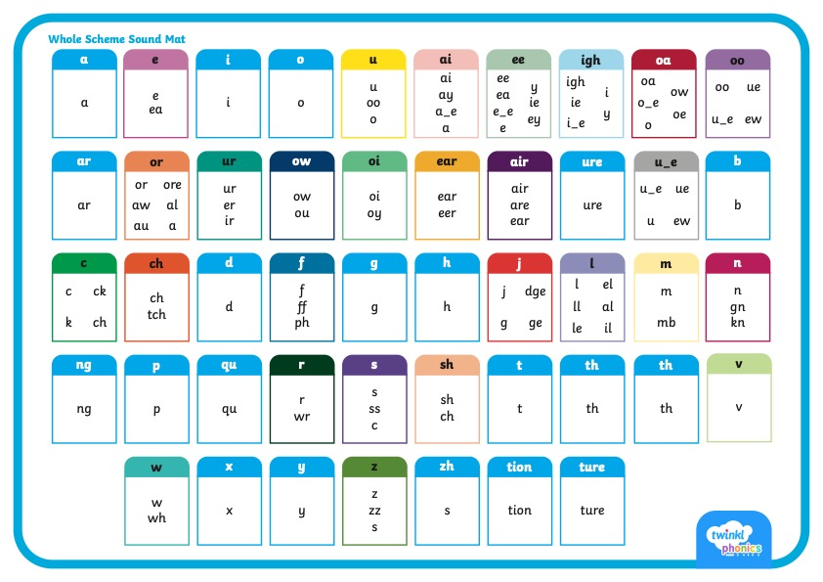
      Did You Know…?
There are 26 letters in the alphabet but there are 44 sounds and over 100 different ways of spelling them.
This is why English is one of the most complex languages to learn!

Slide 17
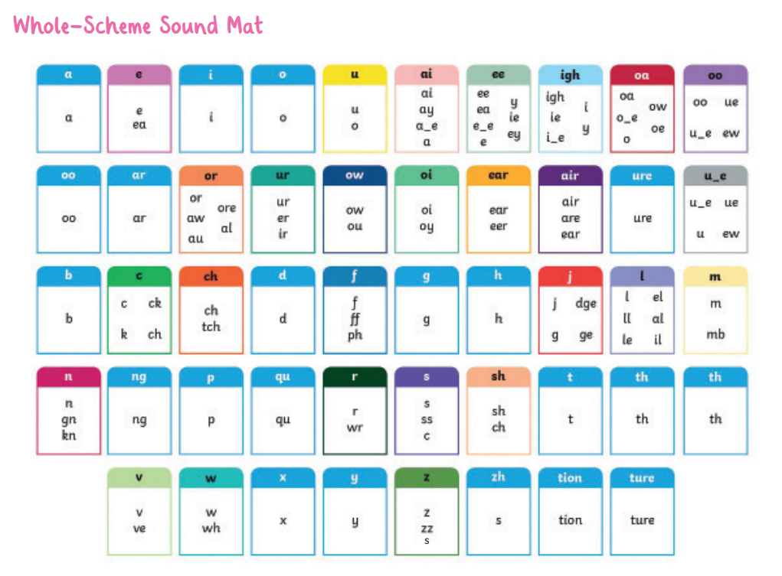

Slide 18


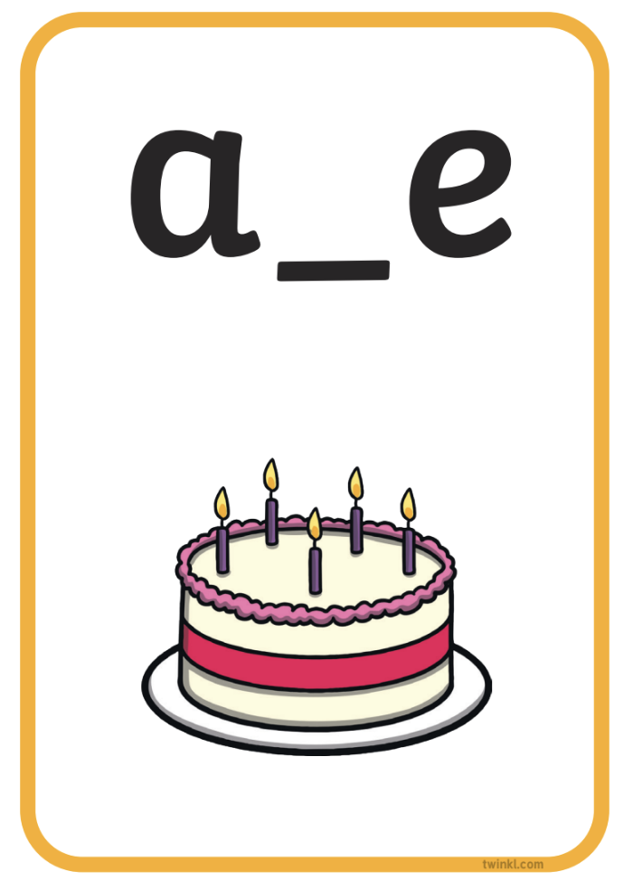


Phonics Terminology
Here is some of the terminology you might hear as your children begin to learn phonics.
Phoneme | the smallest unit of sound in words
Grapheme | the written representation of a sound
GPC (Grapheme-Phoneme Correspondence) | being able to match a phoneme with the correct grapheme and vice versa
Blending | joining individual speech sounds together to read a word
Segmenting | breaking down words into individual speech sounds to spell a word
Digraph | two letters making one sound e.g. ‘sh’
Trigraph | three letters making one sound e.g. ‘igh’
Split Digraph | two letters making one sound which are divided by a consonant e.g. the i_e sound in the word ‘side’
Tricky/Common Exception Words | words that are not fully decodable such as ‘the’ and ‘was’
Sound buttons | circles or spots that can be written underneath a sound to support reading
Sound bars | lines that can be written underneath digraphs or trigraphs to show that the letters make one sound
Mnemonic | a visual prompt to help children remember a sound

Slide 19

      What Is Taught and When?
Twinkl Phonics Level | Number of Teaching Weeks | Recommended Year Group (UK schools) | Age of Children
Level 1 | 36 | Nursery/Preschool | 3-4 years
Level 2 | 7 | Reception | 4-5 years
Level 3 | 12 | Reception | 4-5 years
Level 4 | 5 | Reception | 4-5 years
Level 5 | 30 | Year 1 | 5-6 years
Level 6 | 30 | Year 2 | 6-7 years
Level 1 continues to be taught alongside the other levels.
This is just an overview. We understand that every child progresses at their own pace.

Slide 20
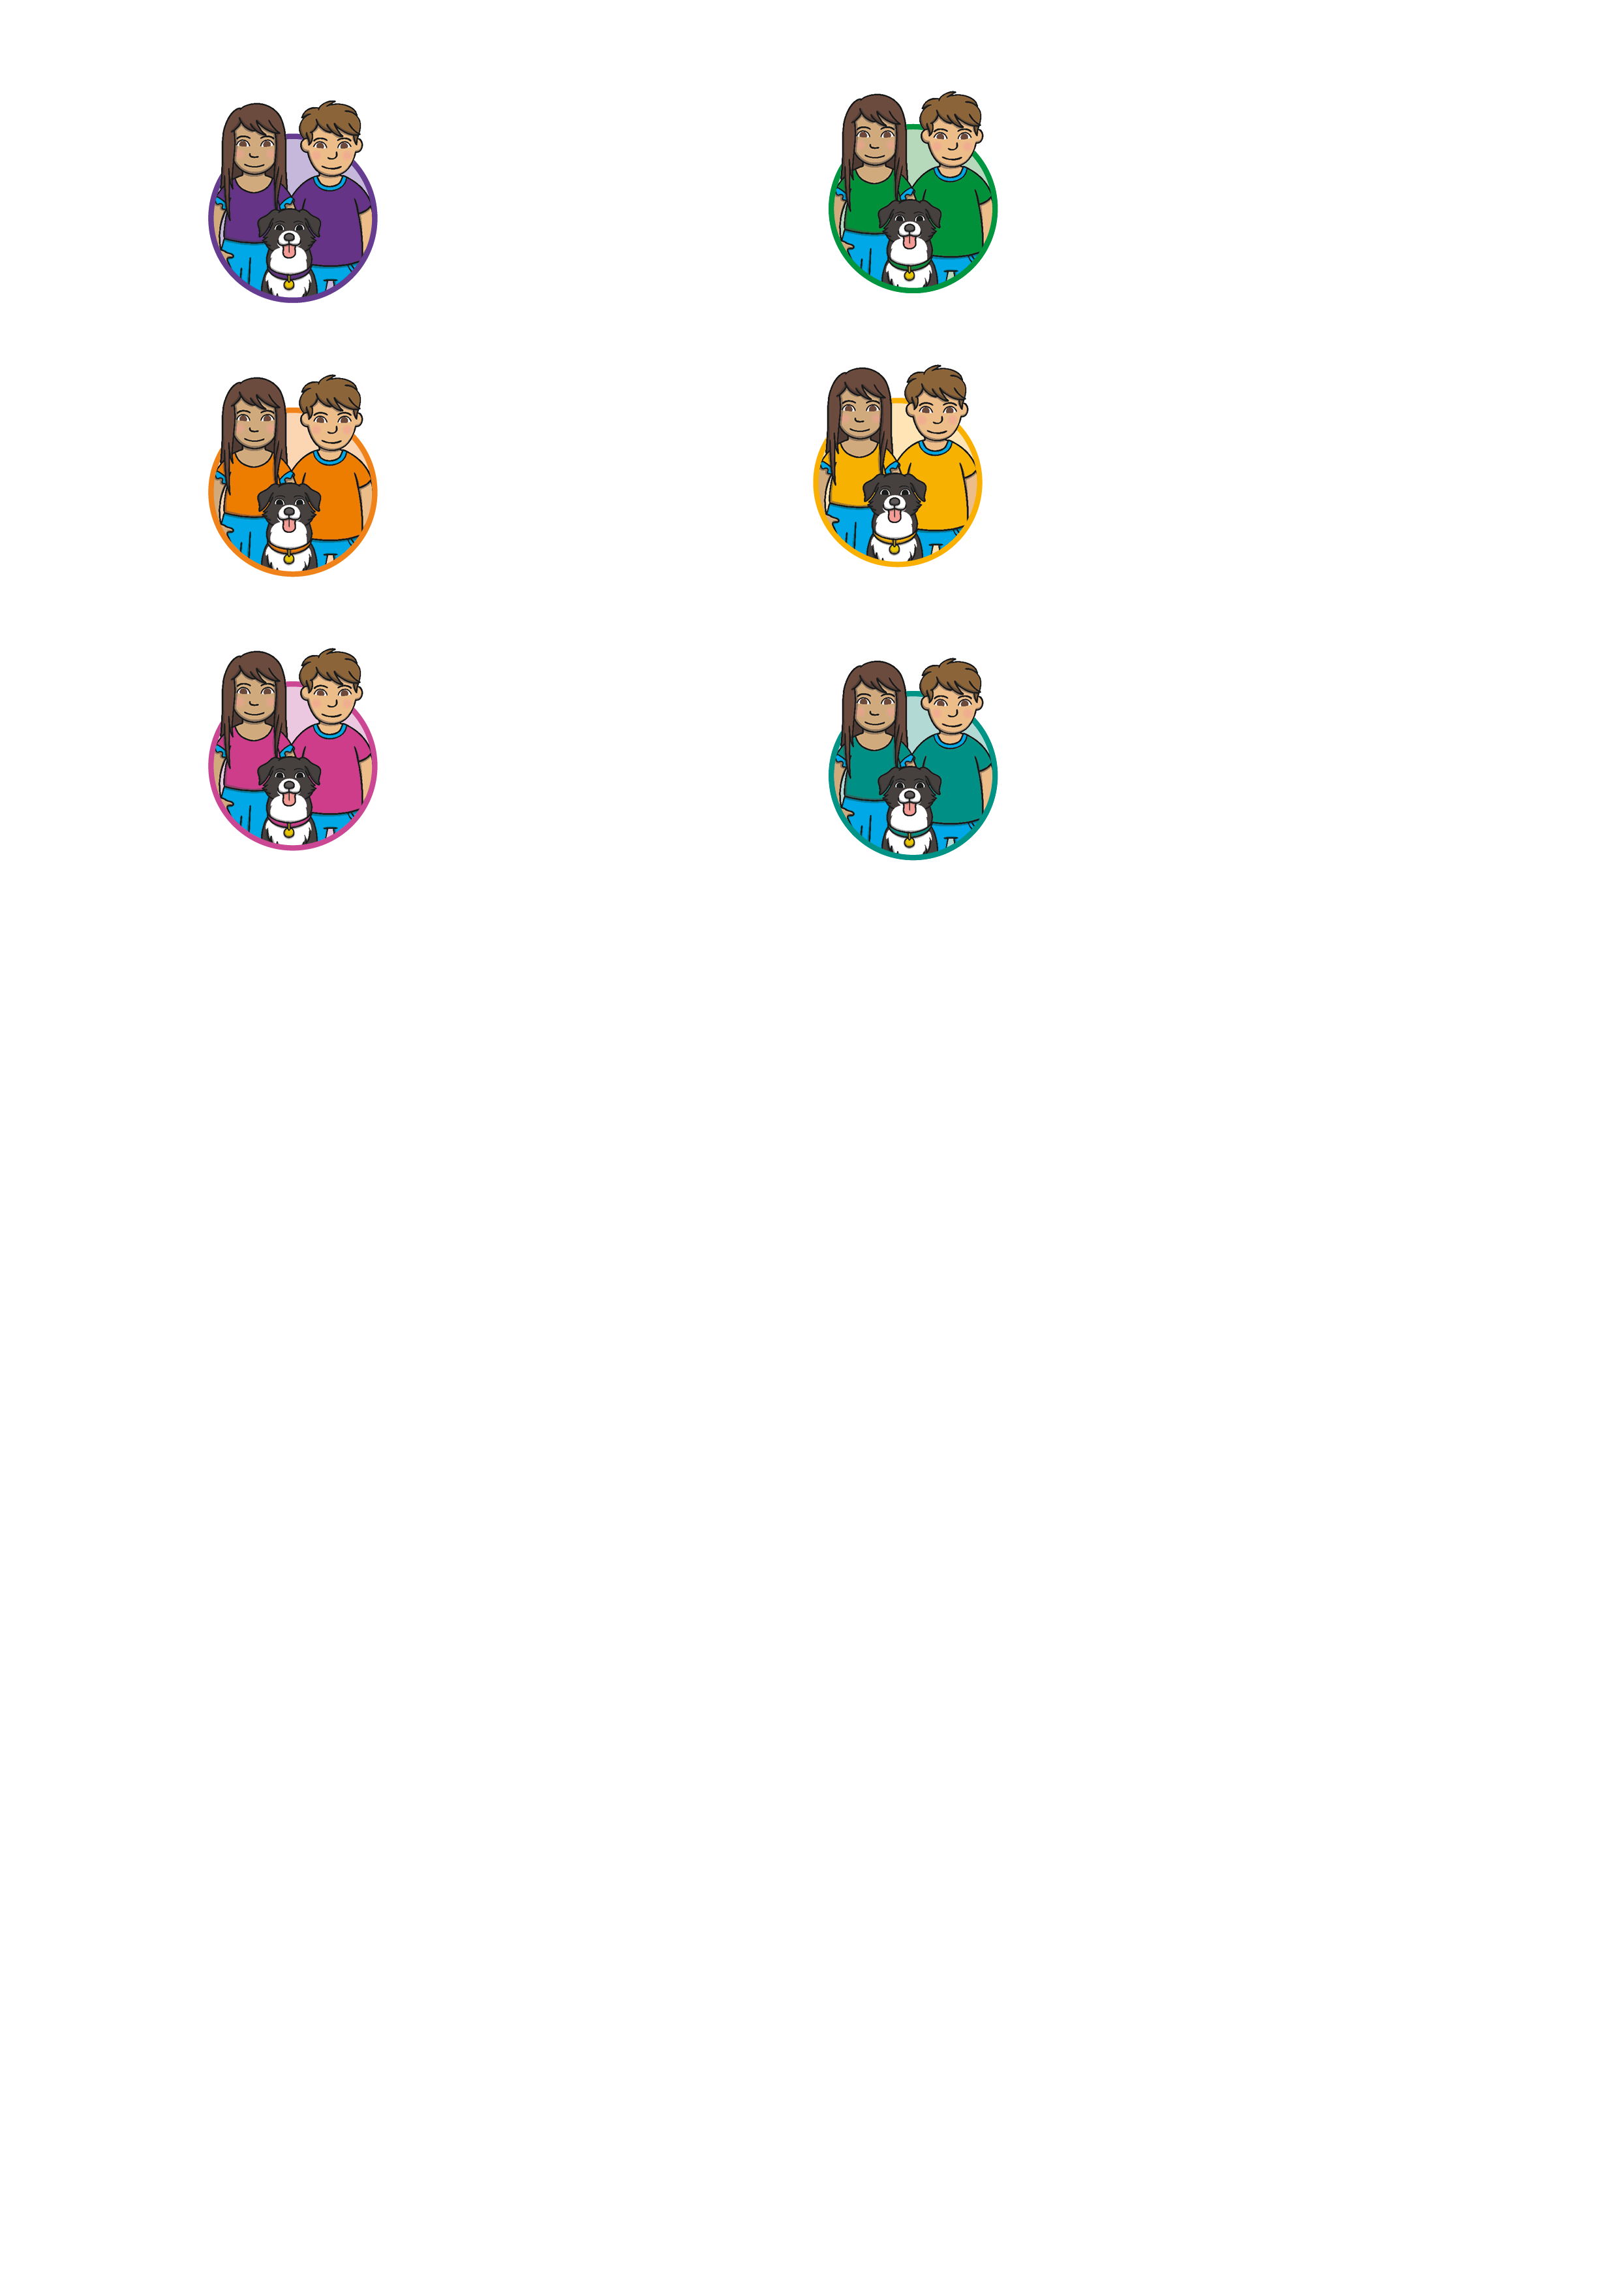

      Level 1
Level 1 is taught in Nursery/Preschool.
By the end of Level 1, children will have had the opportunities to:
listen attentively;
enlarge their vocabulary;
speak confidently to adults and other children;
discriminate different sounds including phonemes;
reproduce audibly the phonemes they hear in words;
orally segment words into phonemes.
These learning opportunities are presented through 7 Aspects.

Slide 21
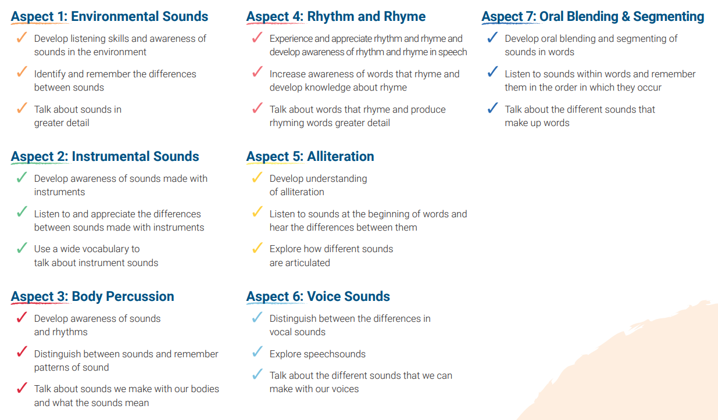
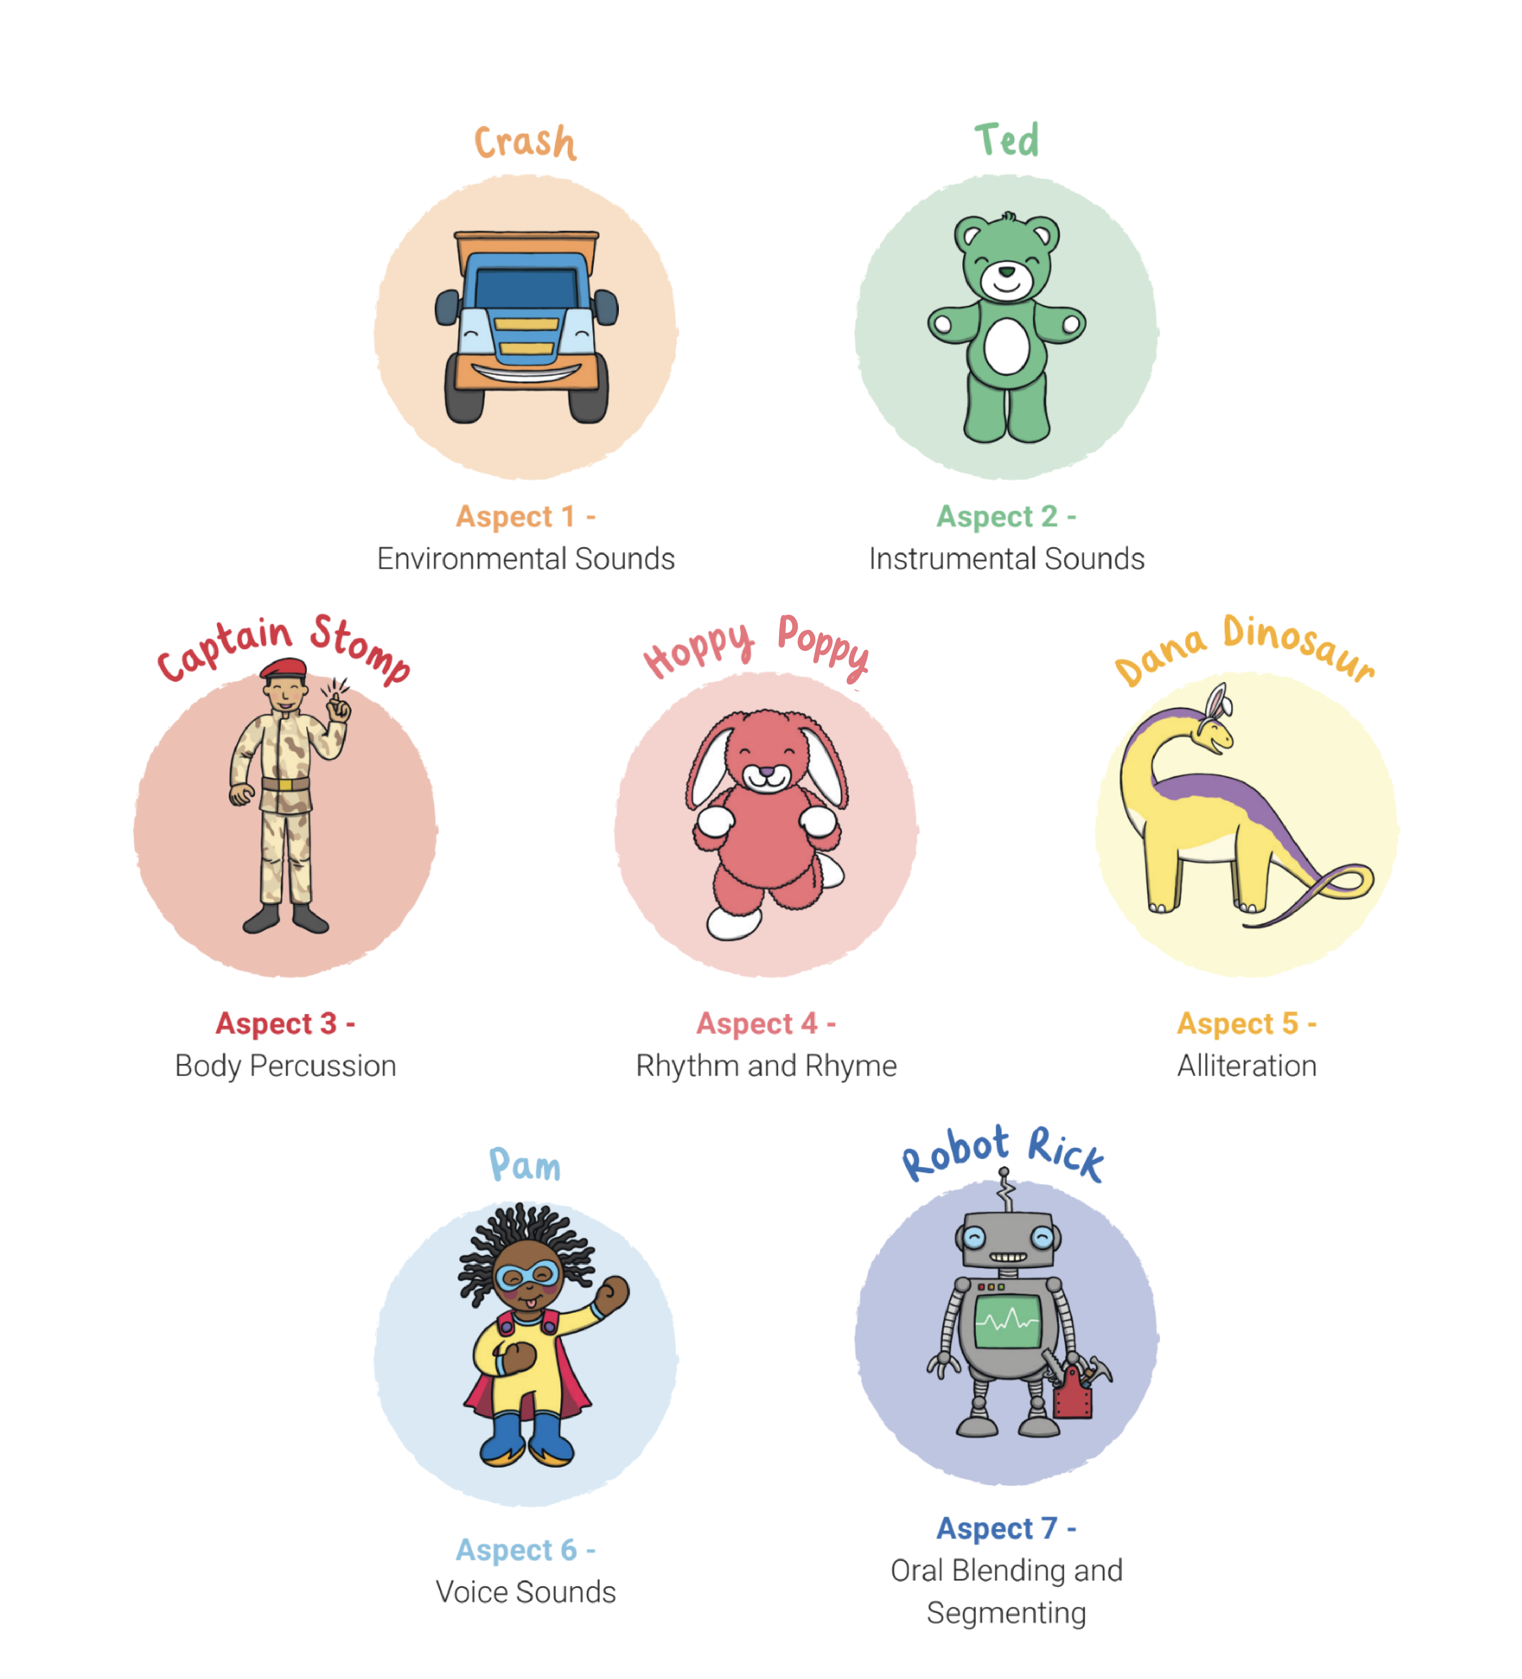
      What Are the 7 Aspects of Level 1?

Slide 22
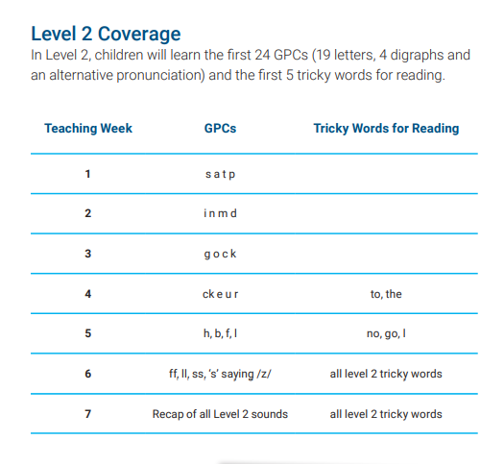
      Level 2
Level 2 is taught in Reception.
By the end of Level 2, children will have had the opportunities to:
identify the phoneme when shown any Level 2 grapheme;
identify any Level 2 grapheme when they hear the phoneme;
orally blend and segment CVC words such as, ‘sat’ and ‘pat’;
blend sounds to read VC words such as, ‘if’, ‘am’, ‘on’ and ‘up’;
segment VC words into their sounds to spell them (using magnetic letters);
read the tricky words (words that cannot be sounded out): the, to, I, no, go.

Slide 23
      Level 2 Actions and Mnemonics
Every sound has a corresponding action and mnemonic which helps children to remember them. You can support your child by modelling the same sounds and actions at home.

Slide 24
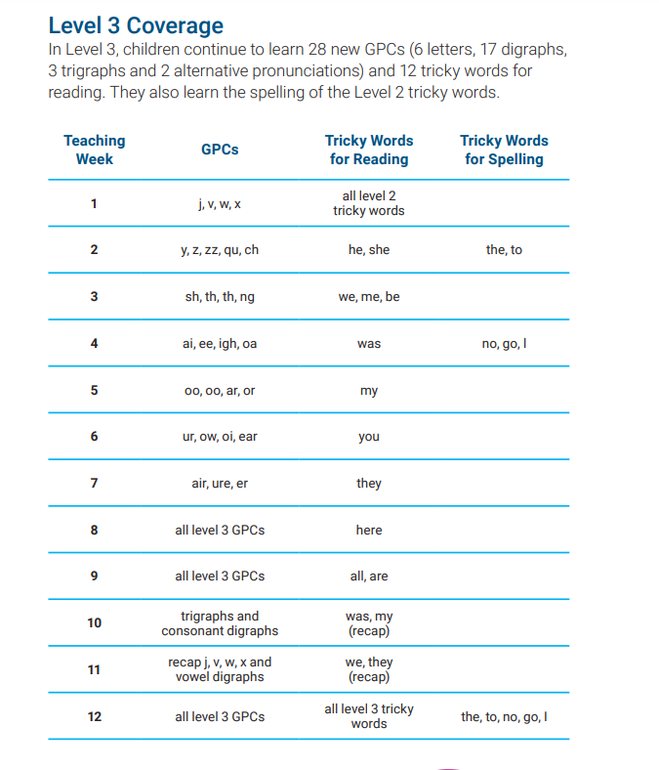
      Level 3
Level 3 is taught in Reception.
By the end of Level 3, children will have had the opportunities to:
say the phoneme when shown all or most Level 2 and Level 3 graphemes;
find all or most Level 2 and Level 3 graphemes, from a display, when given the phoneme;
blend and read CVC words (single-syllable words consisting of Level 2 and Level 3 graphemes) such as ‘chop’ and ‘night’;
segment and make phonetically plausible attempts at spelling CVC words (single-syllable words consisting of Level 2 and Level 3 graphemes) such as ‘paid’ and ‘seed’;
read the tricky words - he, she, we, me, be, was, my, you, her, they, all, are & spell the tricky words - the, to, I, no, go;
write each letter correctly when following a model.

Slide 25
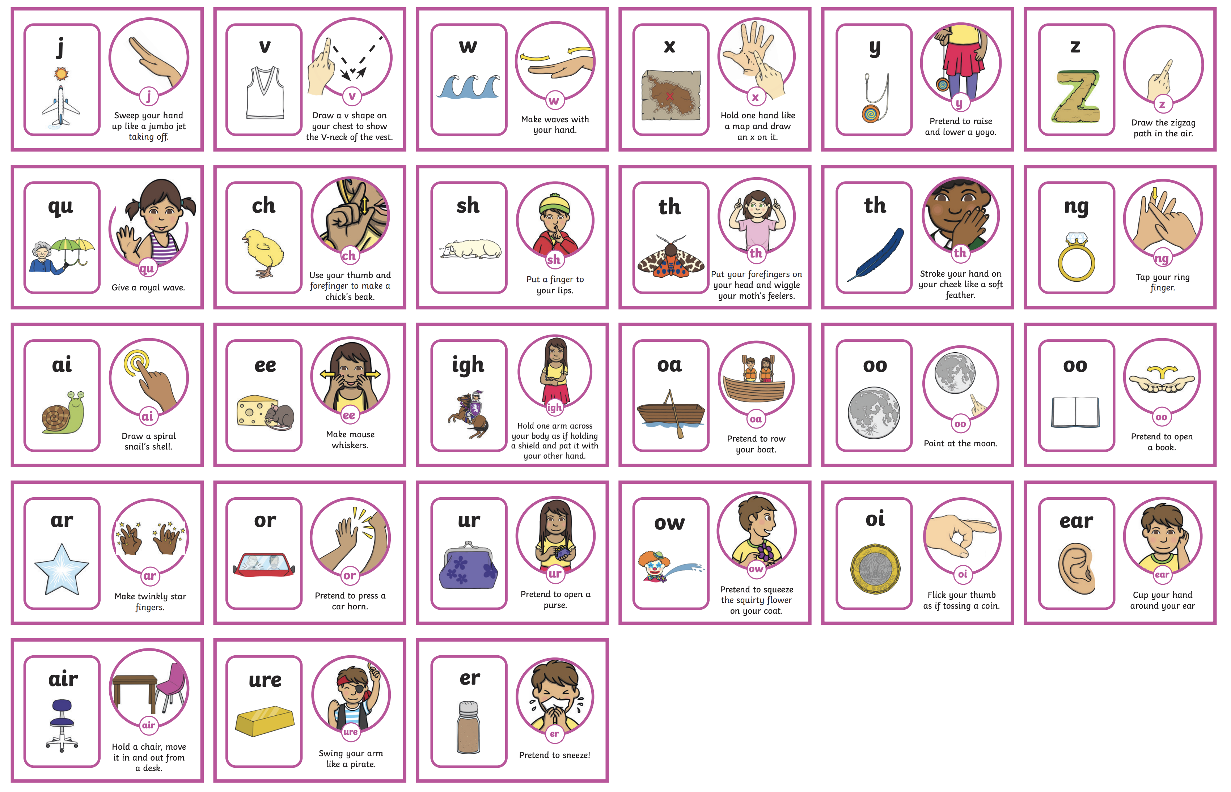
      Level 3 Actions and Mnemonics
It is really important that children learn to form the letters using the correct letter formation when writing. As they are introduced to a new sound, children are taught how to write it correctly. It would be great if you could also model this at home.

Slide 26
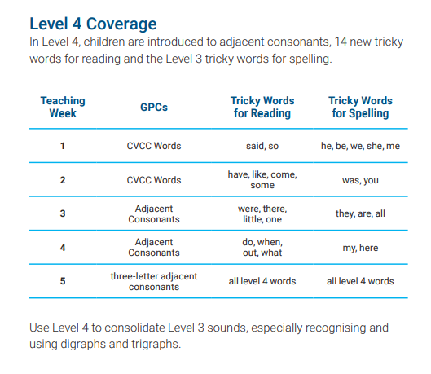

      Level 4
Level 4 is taught in Reception.
By the end of Level 4, children will have had the opportunities to:
give the phoneme when shown any Level 2 or Level 3 grapheme;
find any Level 2 or Level 3 grapheme when given the phoneme;
blend and read words containing adjacent consonants as well as segment and spell words containing adjacent consonants, such as ‘sand’, ‘bench’ and ‘flight’;
read the tricky words - some, one, said, come, do, so, were, when, have, there, out, like, little, what & spell the tricky words - he, she, we, me, be, was, my, you, here, they, all, are;
write each letter, usually using the correct formation;
orally segment words into phonemes.
No new sounds are taught in Level 4.

Slide 27
      What Is Taught and When?
Twinkl Phonics Level | Number of Teaching Weeks | Recommended Year Group (UK schools) | Age of Children
Level 1 | 36 | Nursery/Preschool | 3-4 years
Level 2 | 7 | Reception | 4-5 years
Level 3 | 12 | Reception | 4-5 years
Level 4 | 5 | Reception | 4-5 years
Level 5 | 30 | Year 1 | 5-6 years
Level 6 | 30 | Year 2 | 6-7 years
Level 1 continues to be taught alongside the other levels.
This is just an overview. We understand that every child progresses at their own pace.

Slide 28

      Level 5
Level 5 is taught in Year 1.
By the end of Level 5, children will have had the opportunities to:
give the phoneme, when shown any grapheme that has been taught;
for any given phoneme, write the common graphemes;
apply phonics knowledge and skills as the primary approach to reading and spelling unfamiliar words that are not completely decodable;
read and spell phonically decodable two-syllable and three-syllable words such as ‘dolphin’ and ‘parachute’;
read automatically all taught tricky and common exception words;
accurately spell all the Level 2, 3 and 4 tricky words and most of the common exception words for reading;
form each letter correctly;
use alternative ways of pronouncing and representing the long vowel phonemes.

Slide 29
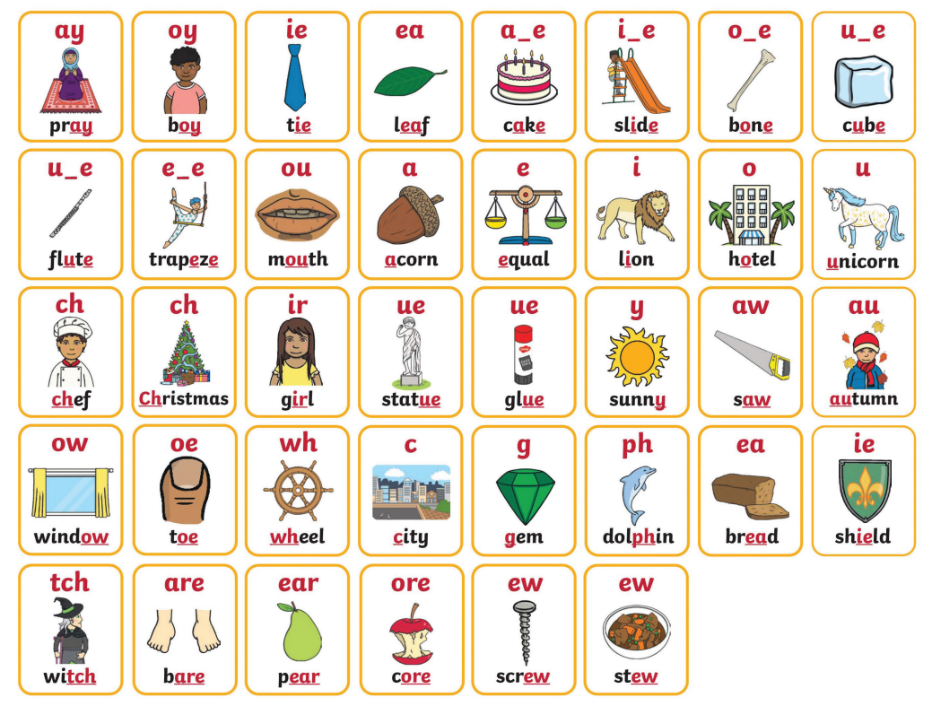

      Level 5 Mnemonics
The new sound is displayed within a word linked to the mnemonic for Level 5.

Slide 30
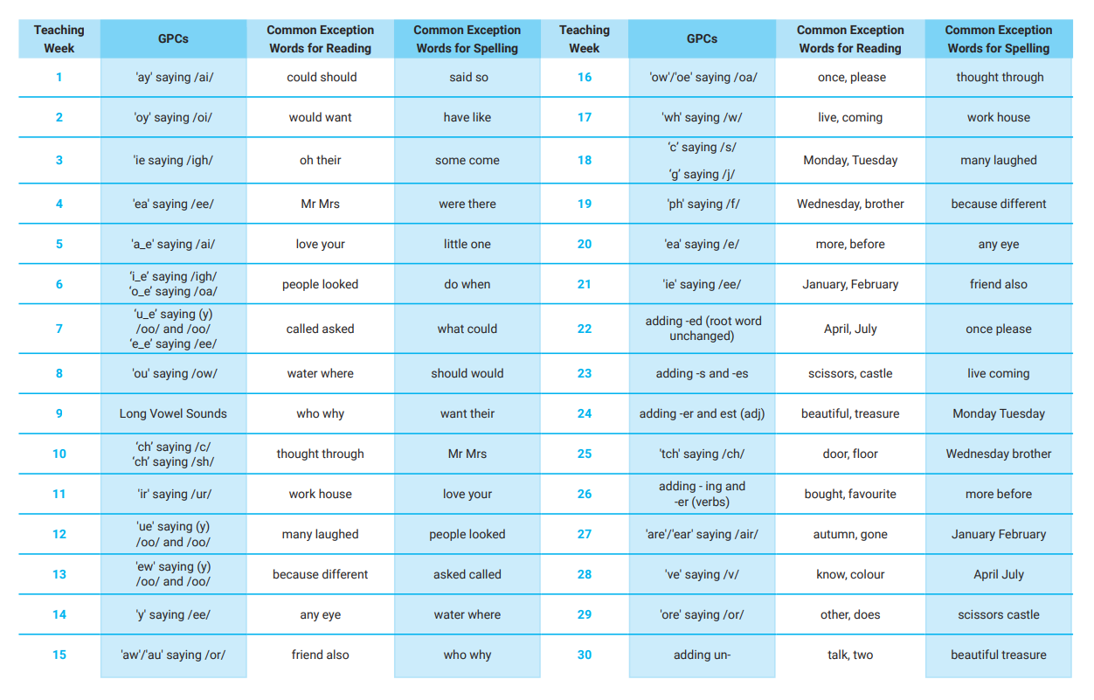

      Level 5 Overview

Slide 31
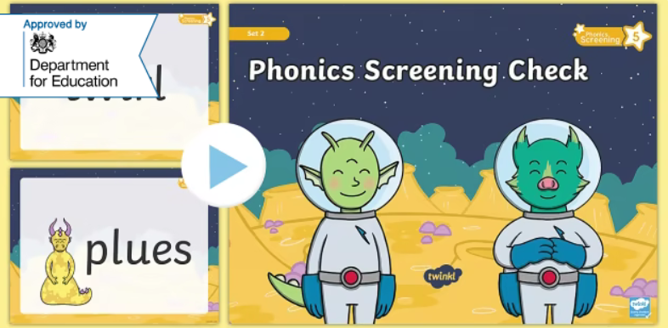
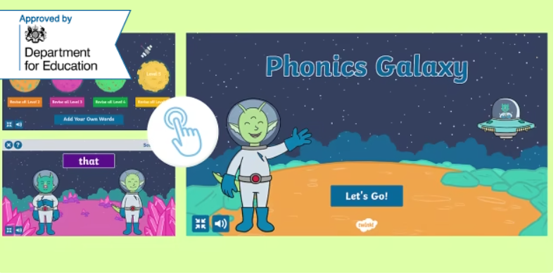
      Year 1 Phonics Screening Check
In June, all year 1 children are expected to complete the Year 1 Phonics Screening Check.
The aim is to check that a child is making progress in phonics. They are expected to read a mixture of real words and ‘nonsense’ words. (Nonsense words can also be referred to as ‘pseudo’ or ‘alien’ words)
For more information why not take a look at the
Twinkl Phonics Year 1 Screening Check Guide for Parents
If a child has not reached the expected standard, schools must give additional support to help the child to make progress in year 2.
Children who have not passed the check in year 1 will have the opportunity to retake it in year 2.

Slide 32

      Level 6
read accurately most words of two or more syllables;
Level 6 is taught in Year 2.
By the end of Level 6, children will have had the opportunities to:
read most words containing common suffixes;
read most common exception words;
read most words accurately, in age-appropriate books, without overt sounding and blending, fluent enough to allow them to focus on their understanding rather than on decoding individual words;
At this stage, children can read hundreds of words automatically. They are now reading for pleasure and reading to learn rather than learning to read.
sound out most unfamiliar words accurately, without undue hesitation;
segment spoken words into phonemes and represent these by graphemes, spelling many of these words correctly and making phonetically plausible attempts at others;
spell most common exception words correctly.

Slide 33
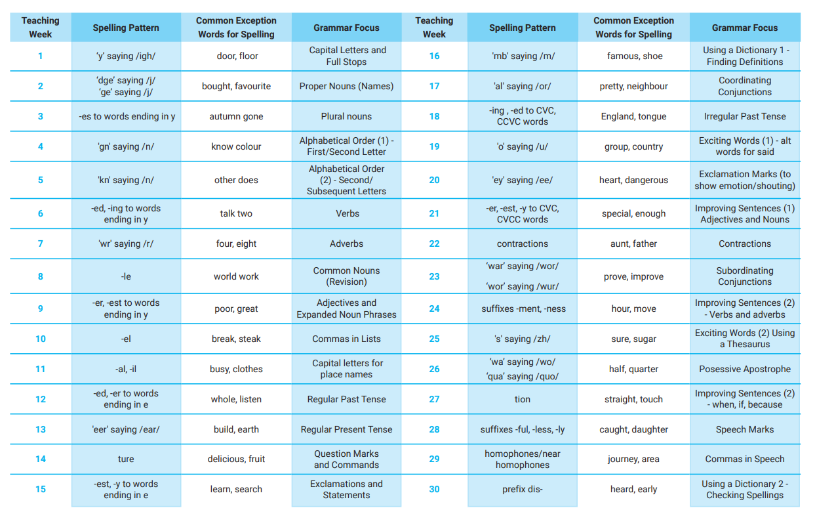

      Level 6 Overview

Slide 34
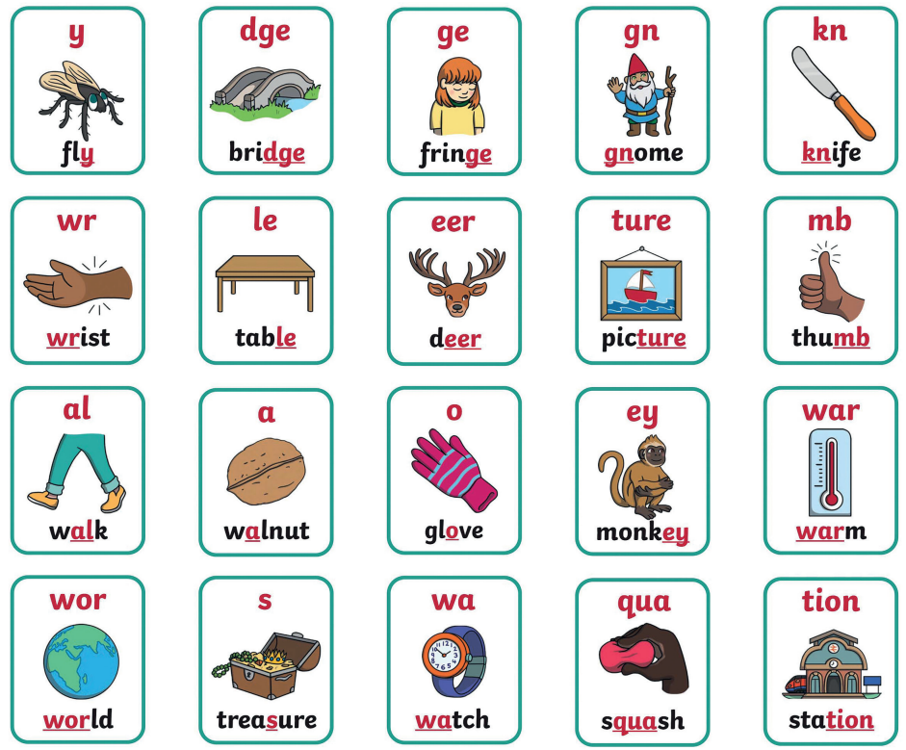

      Level 6 Mnemonics

Slide 35
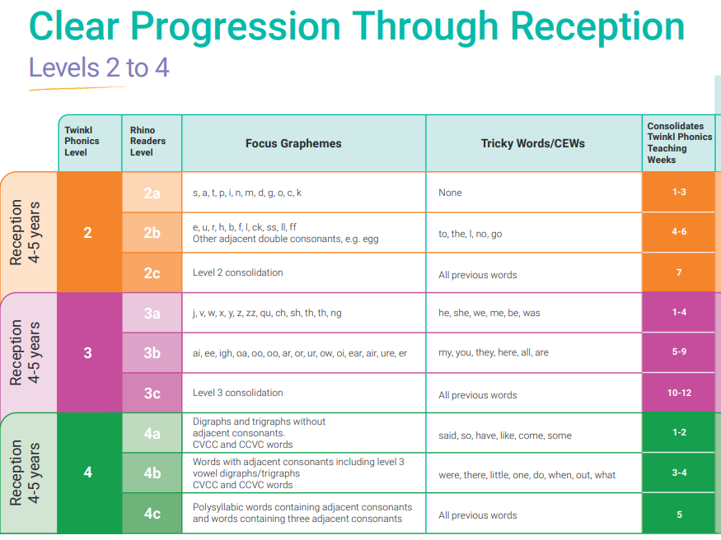

Slide 36
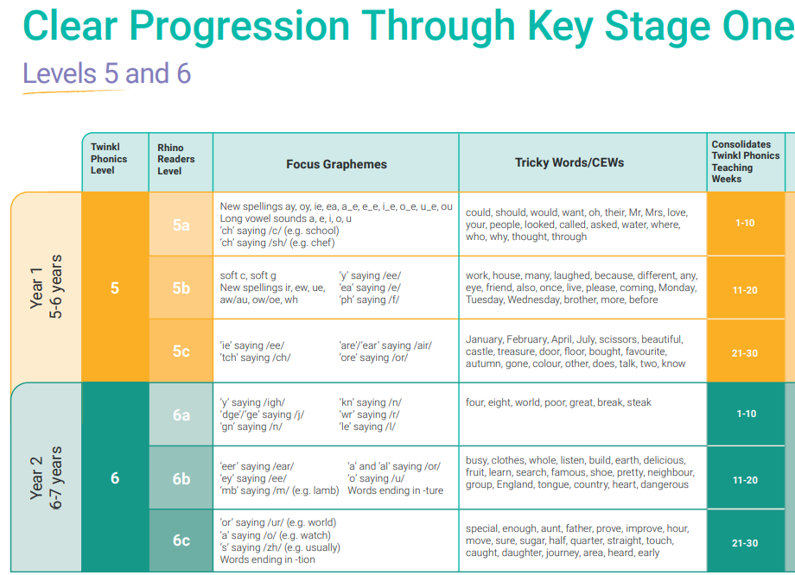

Slide 37
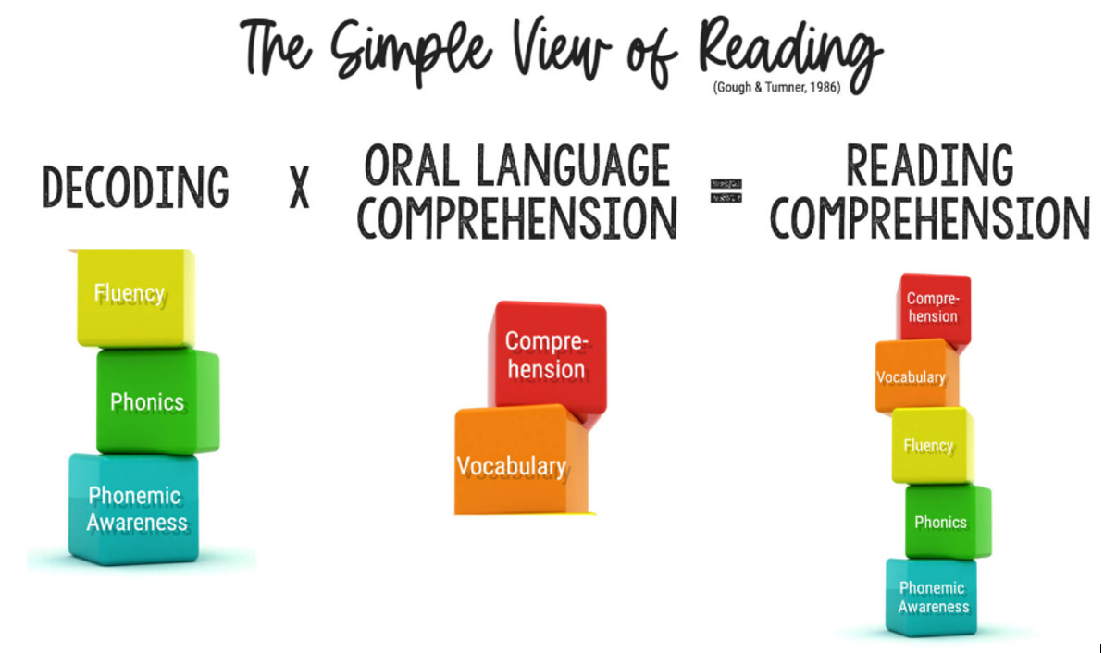

Slide 38
      How You Can Help
Practise the new sounds and graphemes using the Parent Information Sheets and information on the class webpage.
Revisit past books and spellings – interrupt their forgetting.
Please state exactly which pages your child has read in the reading record each time they read.
Use pure sounds – don’t add ‘uh’.
Support your child to complete any homework they bring home.
Finally, remember to ask your child’s class teacher if you are unsure about any aspect of your child’s phonics learning.
A consistent approach is important.
Read to and with your child every day. Reading for pleasure is just as important as ‘reading scheme’ books.

Slide 39

Segment and blend!

Slide 40

cat

Slide 41
cat

Slide 42
cat

Slide 43

cat

Slide 44
peg

Slide 45
peg

Slide 46
peg

Slide 47
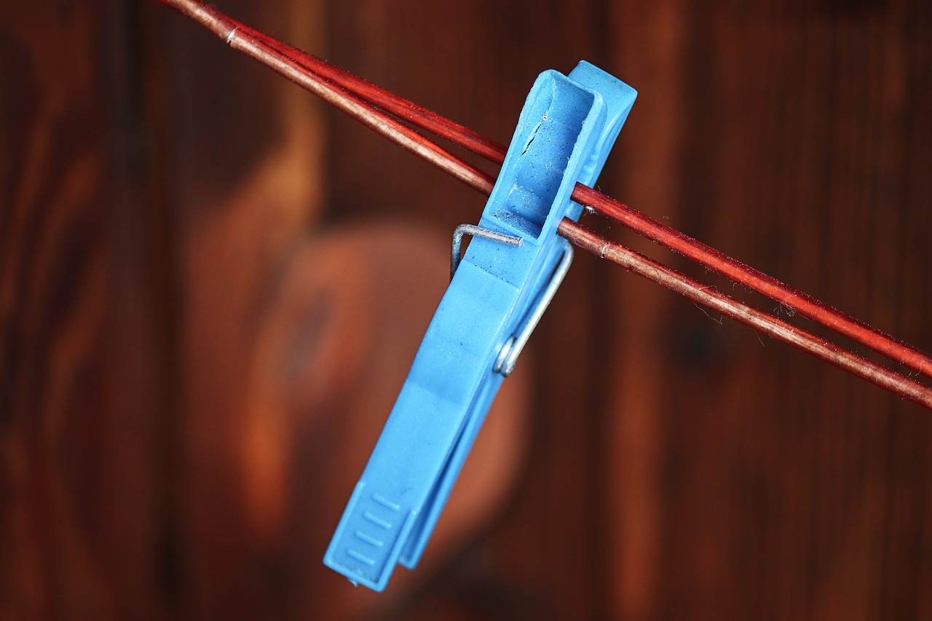
peg

Slide 48
Please contact us by ….
Telephone: 01606 832519
Email:
    head@byley.cheshire.sch.uk
    admin@byley.cheshire.sch.uk
    busybuddies@byley.cheshire.sch.uk
    Any Questions?
Thank you coming this morning!

