Slide 1
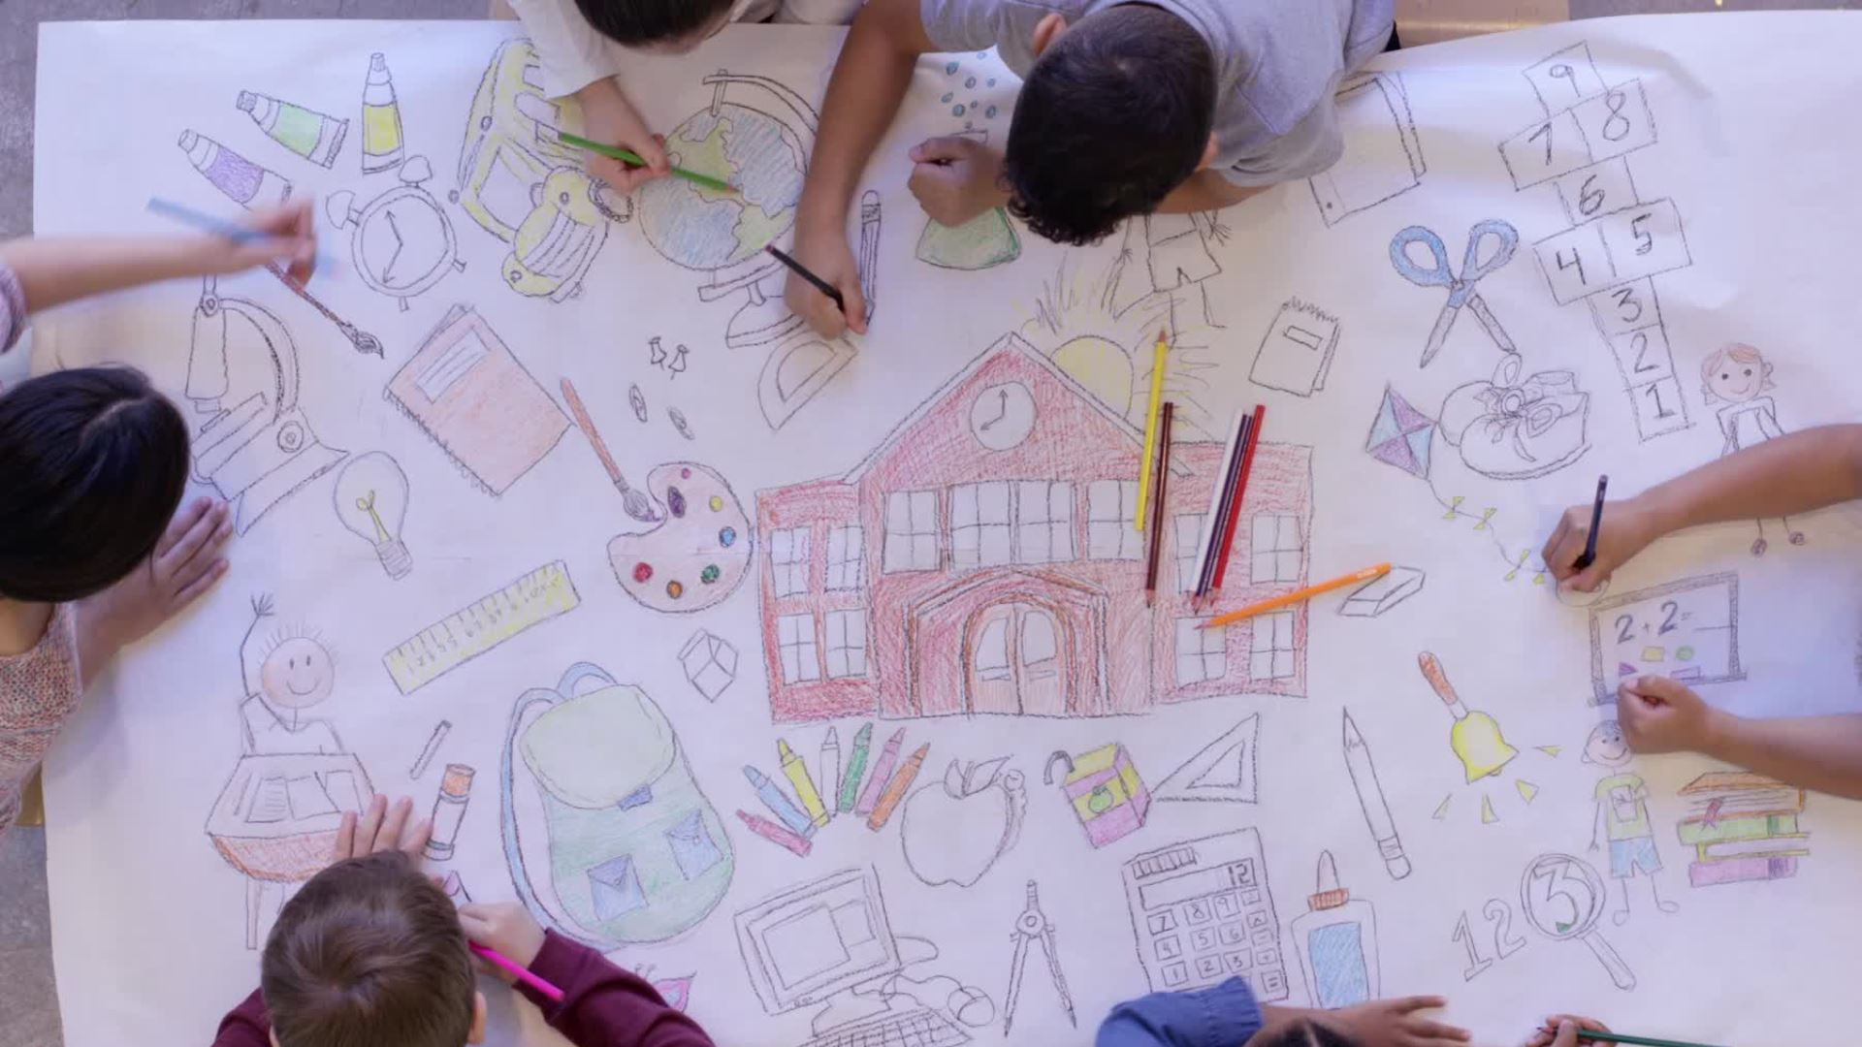
Welcome to KS1 at Byley Primary School and Nursery
Years One and Two

Slide 2
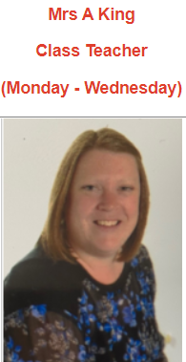
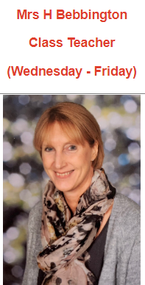
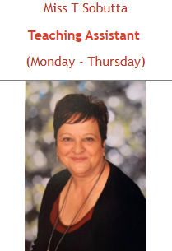
Meet the KS1 team

Slide 3
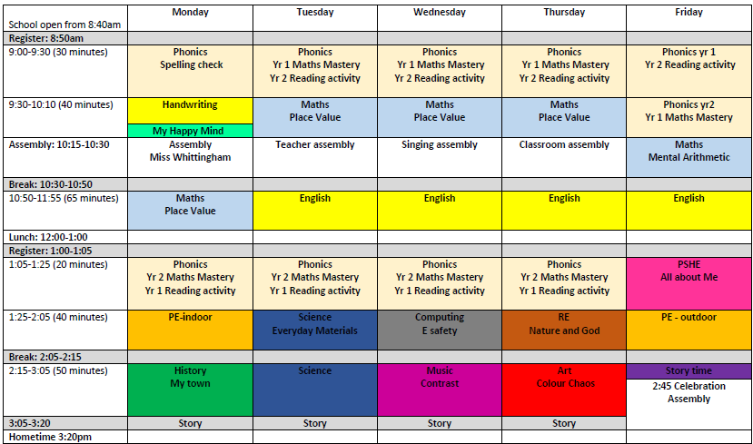
A typical day in year one and two

Slide 4
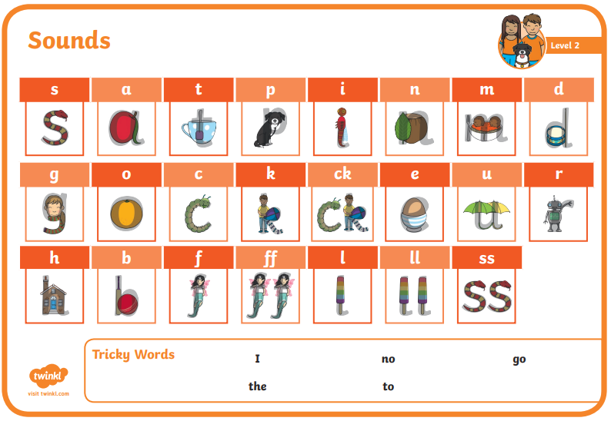
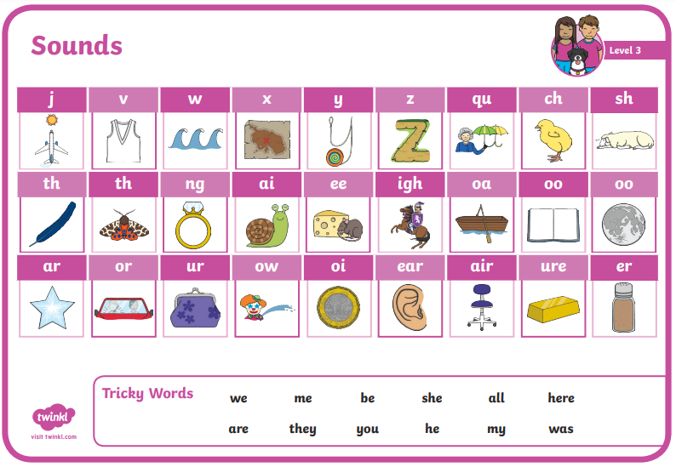
Phonics During their nursery years children will complete level 1 phonics. This phase focuses on developing children’s speaking, listening and awareness of sound. Developing these skills creates foundations for when children begin to learn their letters and sounds in later phases During their reception year they complete level 2, level 3 and level 4 phonics. By the end of the reception year the children will have knowledge of these phonemes.

Slide 5
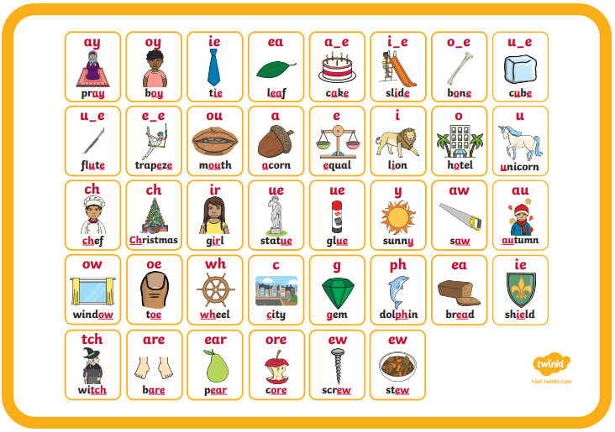
Throughout Y1 the children will complete level 5. Here they will learn a set of new digraphs as well as looking at alternative spellings for different sounds. Not all sounds are spelt the same way all of the time. For example, made, pay and grain all contain the ‘ay’ sound but are all spelt differently. They are introduced to split-digraph words too. Your child will continue to learn more tricky words in phase 5. They have already explored a variety of tricky words in the other phases, but these will become increasingly complex. Tricky words are words that don’t follow the phonics rules, containing sounds that are not spelt with the usual phonetic letters. For example, words like ‘could’ or ‘called’.

Slide 6
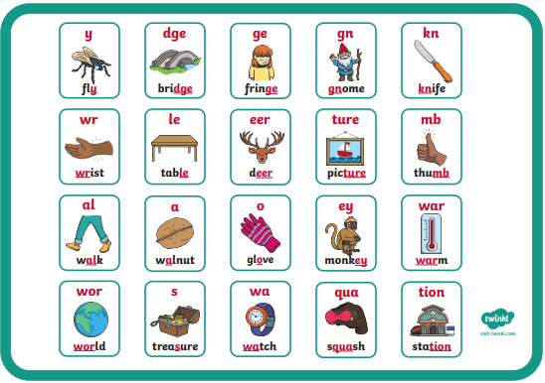
Level 6 is completed during Year 2. The main aim for children is to develop their fluency as a reader and increase their accuracy when spelling. They will have already learnt the most often used grapheme-phoneme correspondences (GPCs).

Slide 7


Children are encouraged to read for 15-20 minutes every day if possible. Please discuss what your child has read, getting them to retell the story, give opinions on what they have read and answer questions around the book.

Slide 8
Changing reading books. All children will have their reading books changed on Mondays and Thursdays. Reading books and diaries are expected to be brought in every day. Your child needs to have read the whole book/s before they will be changed. Can you please clearly identify in their reading records what page number they are up to or that the whole book/s have been read and add a parent signature. We do not expect the whole book/s to be read in one sitting.

Slide 9
Reading Awards We encourage children to read regularly and will award them a reading stamp for their card if they read 3 times in a week at home. If they read 5 times a week at home, they will earn 2 stamps. Every 20 stamps counts towards a bronze, silver or gold award presented in assembly.

Slide 10
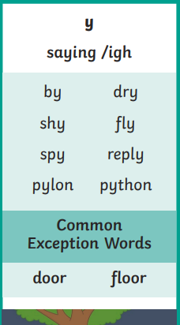
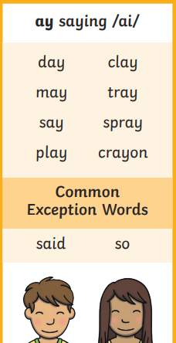

Each Monday the children will bring home spellings based on their phonic learning that week. Please encourage your child to practise these. There are lots of fun ways to help the children learn them- using chalk on boards or the floor, using magnetic letters, creating pyramids out of their spellings.

Slide 11
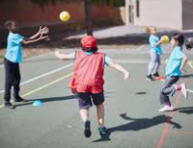
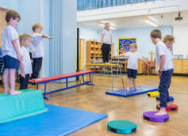
P.E is every Monday and Friday. Children are to leave their P.E kits on their pegs for the half term. Kits will be sent home at the end of every half term to be washed and checked. Sessions will be indoor and outdoor activities.

Slide 12

"Show me how you shine!" aka Y2 SATS is no longer statutory. However, assessments do take place over a week in December, March and June very informally.

Slide 13
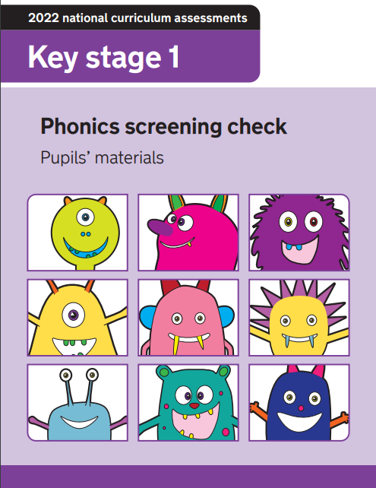
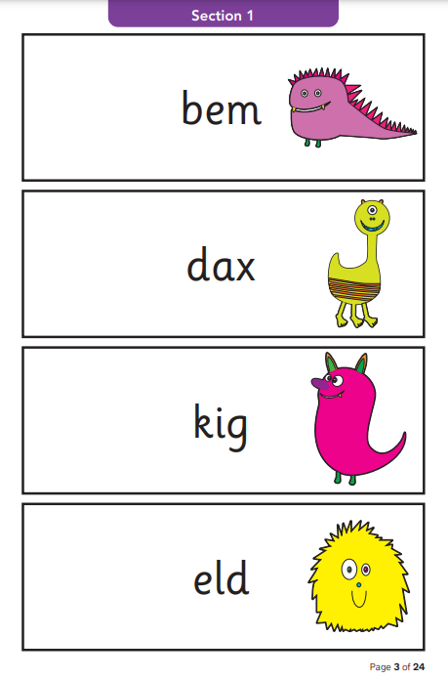
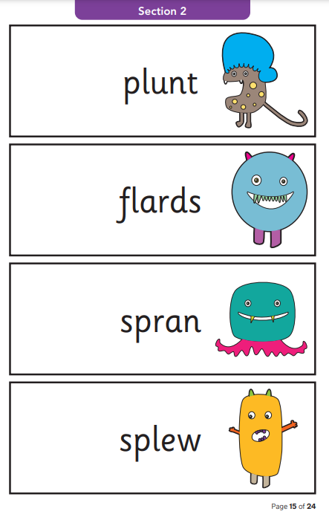
In June the Y1s will complete the “Phonics Screening” check.

Slide 14

Please refer to the website for any clarification on what is happening in class.

