Slide 1

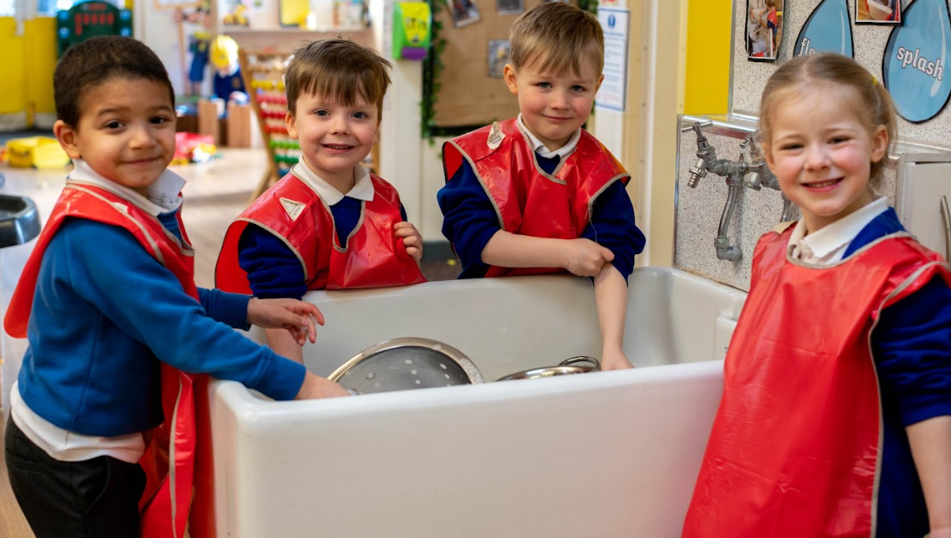
WELCOME TO ST MARY’S CATHOLIC INFANT ACADEMY
Nursery Class Teacher- Mrs Tither
Teaching Assistant- Mrs Warburton

Slide 2

Our School Vision
The Federation of St Mary’s Catholic Schools are a secure, friendly and faith-centred community where we seek to realise the full potential of all our family through the living love of Christ. All our work with children and their families, staff, governors, parishioners and the wider community is influenced by our core values which are Compassion, Respect and Resilience.

Slide 3
Data Collection Forms
It is essential that we have all the relevant data on our
system for your child.
The data collection form was sent out with the letter inviting you to this meeting. If you have not returned this, there are some spare.
If the people who can collect your
child/ren have changed or you wish to add more name
persons to this list, please inform the school office.
If your child's medical information changes throughout the
academic year, please inform the office as it is vital for us to
be able to provide the best care for your child.

Slide 4
School Money
We use the SchoolMoney App for payments of book bags, water bottles, trips and nursery fees. On the day that your child starts nursery, you’ll be sent a login for your SchoolMoney account where you can pay for any items we have requested from you.
If for any reason you are struggling to log in, it may be because you have not provided us with the correct contact details. Please
let us know immediately if either your mobile number or email address changes. Please email school to advise us of any changes or for further information.

Slide 5

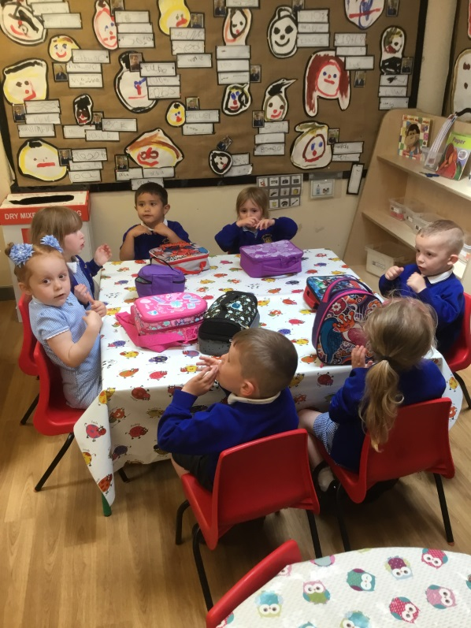
30 Hours
Qualified for 30hours funding
Must update your account every 3 months
A fee of £4.00 per day is required to cover lunchtime supervision
Packed lunch - due to allergies no nuts at school.

Slide 6
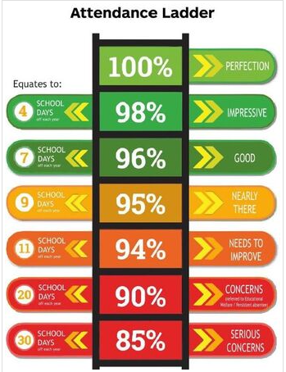
Attendance Matters
We believe that children can only
learn effectively if they attend school regularly and they are punctual. Our
aim is for all pupils to achieve at least 97% attendance.
• All school doors are closed at 8.55am
• Pupils arriving after 8.55am need to access school via the school office
and will be marked late.
• Children arriving after 9.30am will be marked in the register as
unauthorised absence.

Slide 7
Reporting a school absence
• If your child is unable to attend school due to illness please can you email, telephone or leave a message at the school office on the morning of illness before 9.00am to report the reason for absence. If we receive no reason for an absence a member of staff will contact parents/carers to gain a reason
for absence. This may be via a text message, phone call or email. If we are not able to reach you, we will leave a message for you to call us back with information about the absence. If parents/carers do not return our call this may lead to other safeguarding protocols being implemented

Slide 8
Morning Nursery Sessions:
8:40am-11:40am
Afternoon Nursery Sessions:
12.20pm-3:20pm
All day Sessions (30 hours):
8:30am-3:20pm
Session Times

Slide 9
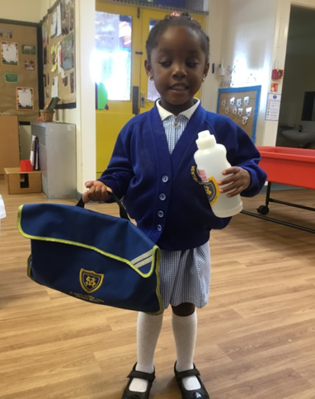
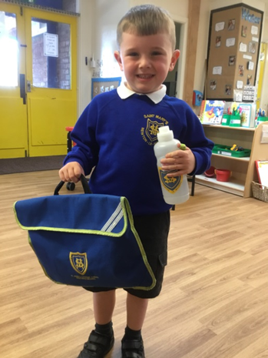
School Uniform
A warm coat
with a hood,
which can be
fastened by
themselves.
Grey
Trousers or skirt
White collar t-shirt
(with optional logo)
Royal blue cardigan or jumper with or without school logo
Black shoes
which can be
fastened by
themselves

Slide 10
Nursery Daily Routine
Nursery is organised so children have time to be involved in adult directed activities and in their own initiated activities. Children are encouraged to make decisions and solve problems, to initiate plan, carry out and review their activities. The children become more independent, acquire a desire to explore and learn, and develop
skills which will enable them to become successful students as they grow older. All children will undertake a wide range of activities and explore learning opportunities in both the indoor and outdoor environments, with the school’s Early Years department having it’s own, dedicated outdoor provision.

Slide 11
Early Years Curriculum
Activities in Foundation Stage are carefully planned and organised in order to provide a range of learning
experiences.
• Planning for each week is carried out using an objective based approach which fluidly follows the children’s
interests and responds to specific events.
• There are 7 Areas of Learning in the Early Years Foundation Stage (EYFS), which activities are planned around:
• Personal, Social and Emotional Development
• Physical Development
• Communication and Language
• Literacy
• Mathematics
• Understanding the World
• Expressive Arts and Design
• Throughout the EYFS, children will be working towards the Early Learning Goals. These describe the level of attainment expected at the end of your child’s Reception year in school.

Slide 12
Read, Write, Inc
Read Write Inc is a phonics scheme that we follow here at St Mary’s. It begins in Nursery and children take part in daily 30-minute sessions. The aim is for children to complete the scheme by the end of Year 1, but if necessary, they will continue to access sessions until they no longer need them.
• Children are placed into small groups according to their phonic knowledge and assessments are completed every half term.
• We teach pre reading skills initially and then the sounds first – in a specific order.
• We then teach your children to blend those sounds together in order to read words
• The children read words in the matched Storybooks. Each Storybook is carefully matched to the sounds they can already read - setting them up for success.

Slide 13


Slide 14
We hope we can work together with you to make Nursery a successful
and enjoyable experience for your child. If you have any questions, please
speak to your child’s class teacher or email school
info@smi.allsaintsmat.org
Any correspondence sent to our Year Group Inbox will be responded to
during working hours.

