Slide 1

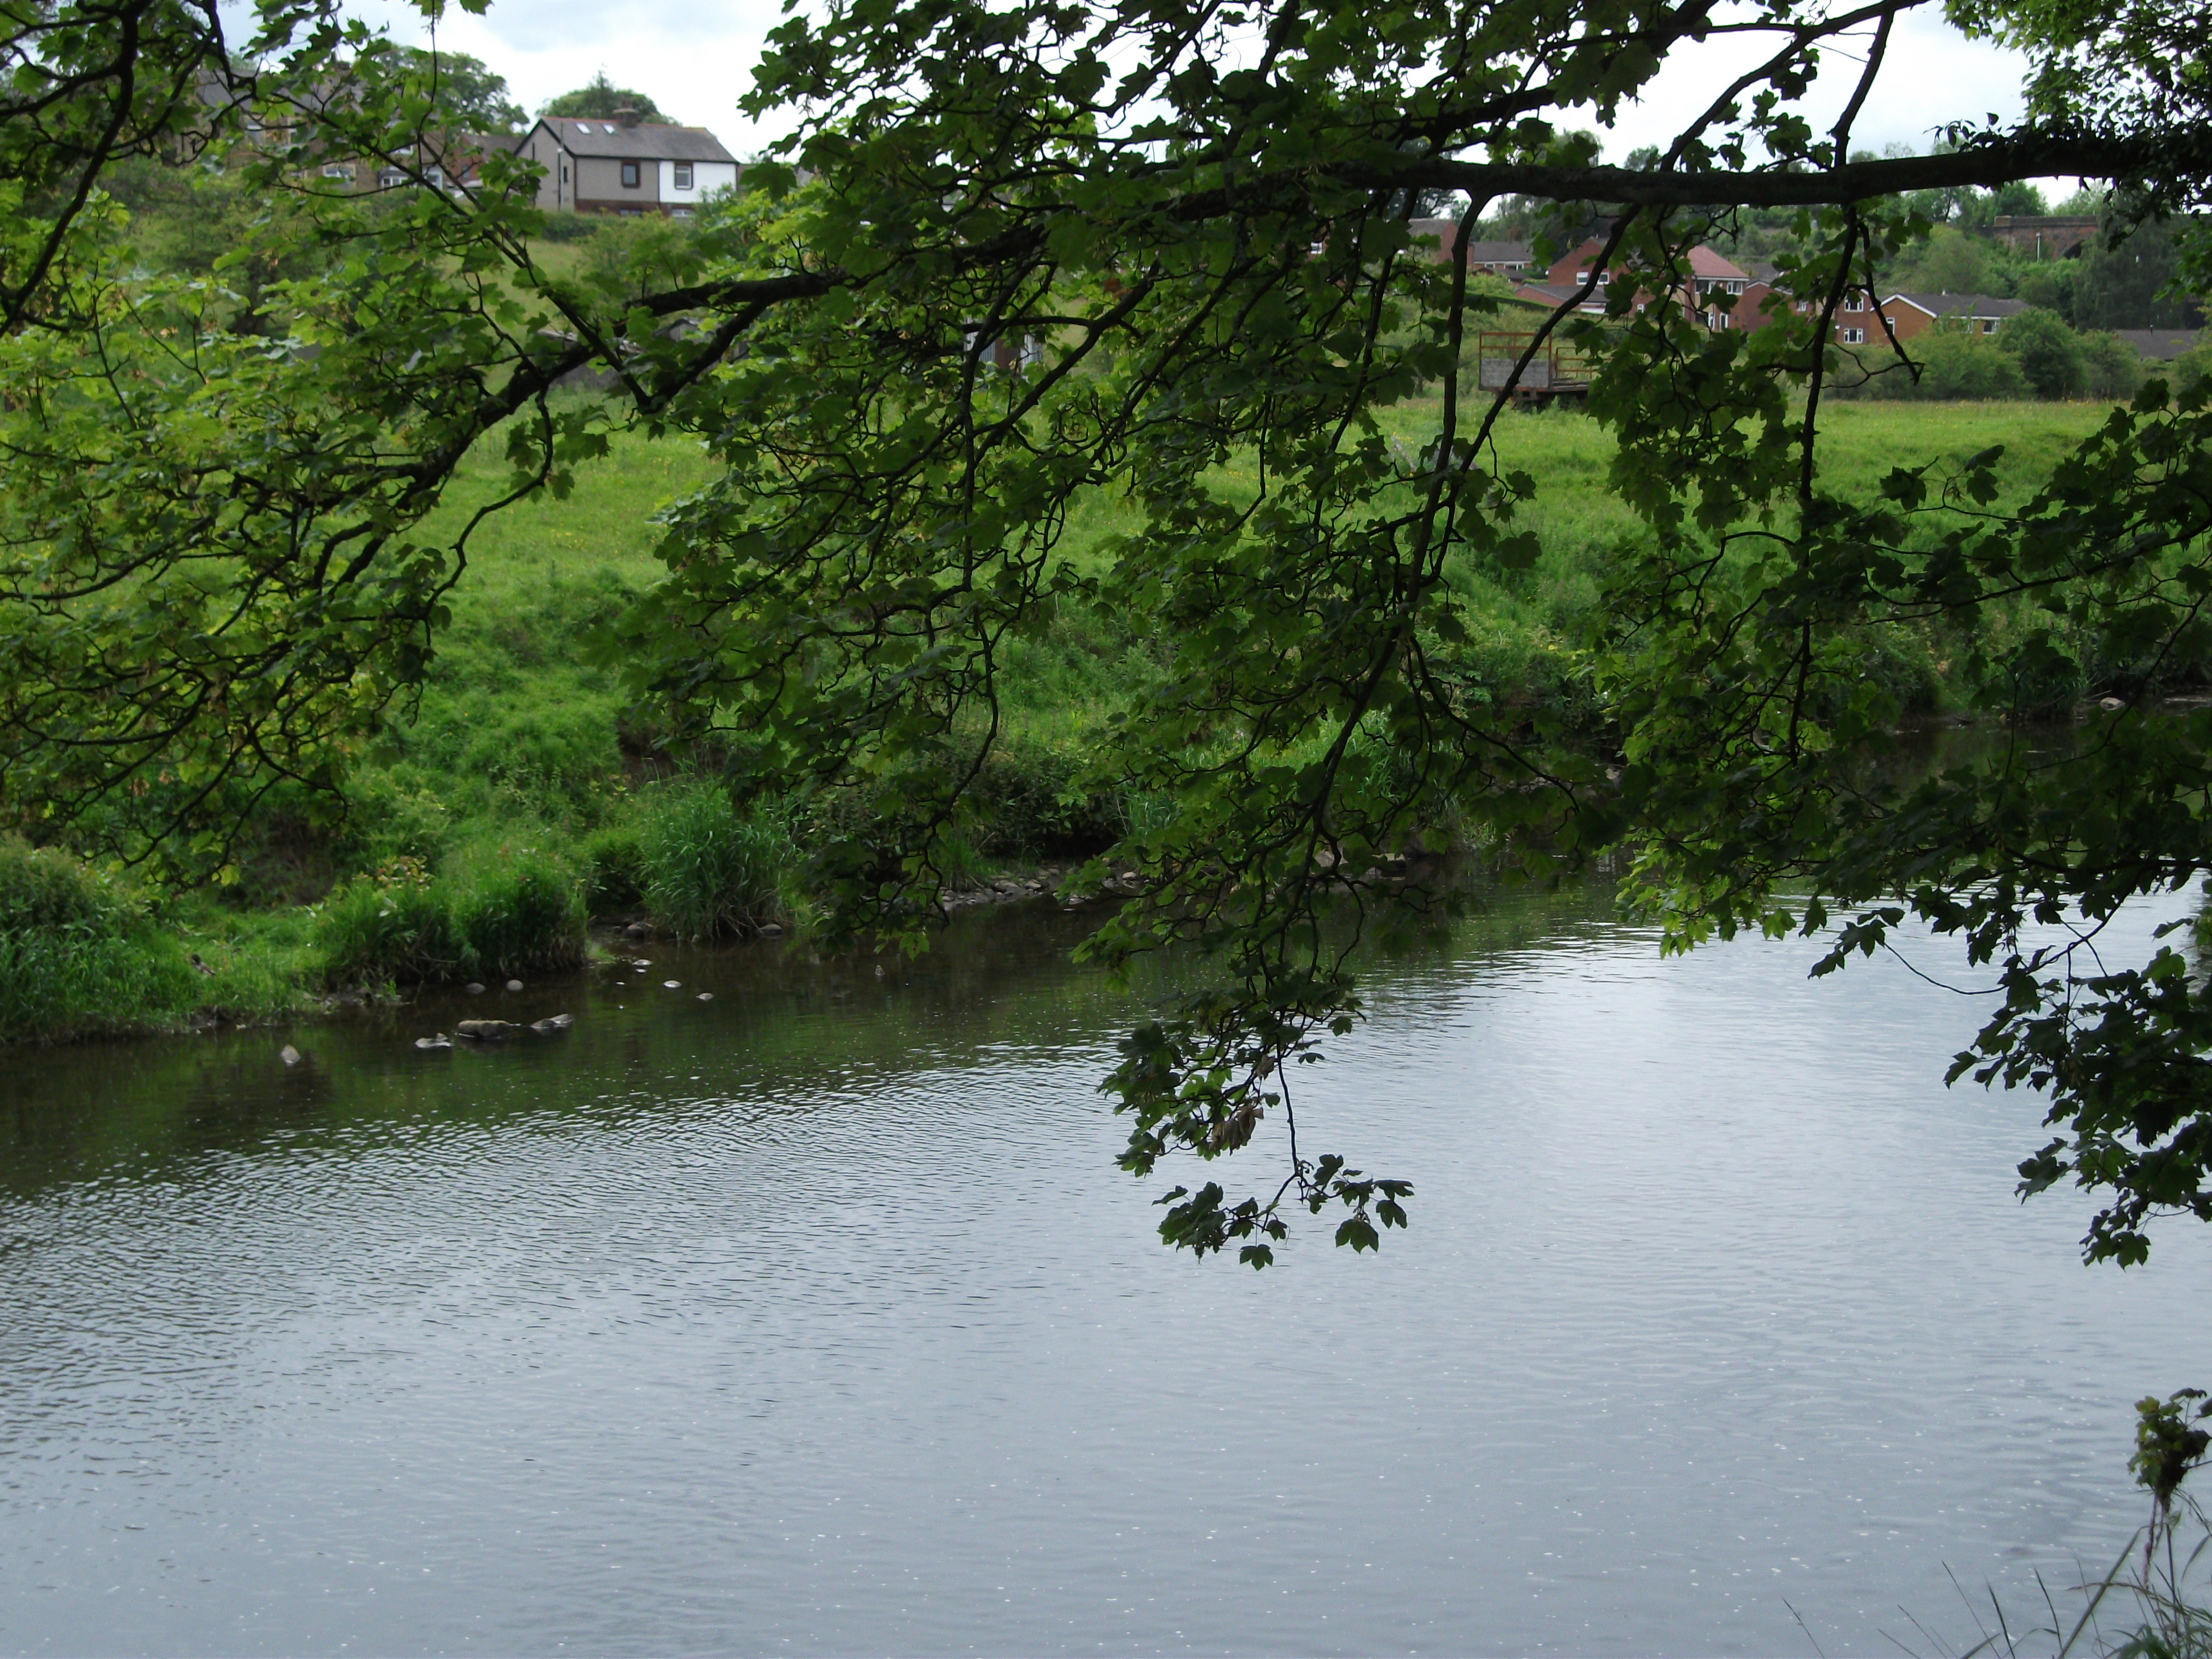
Be still and know that I am God

Slide 2
trust

Slide 3
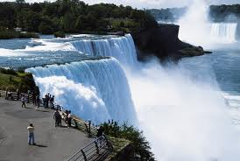
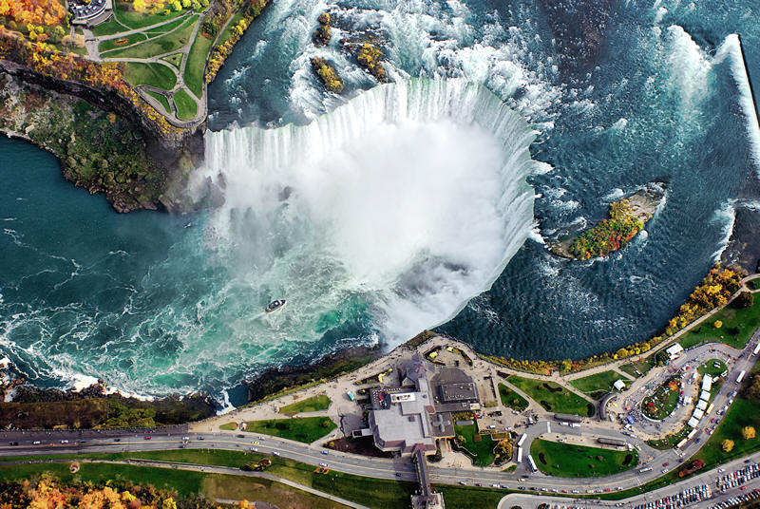
Niagara Falls

Slide 4
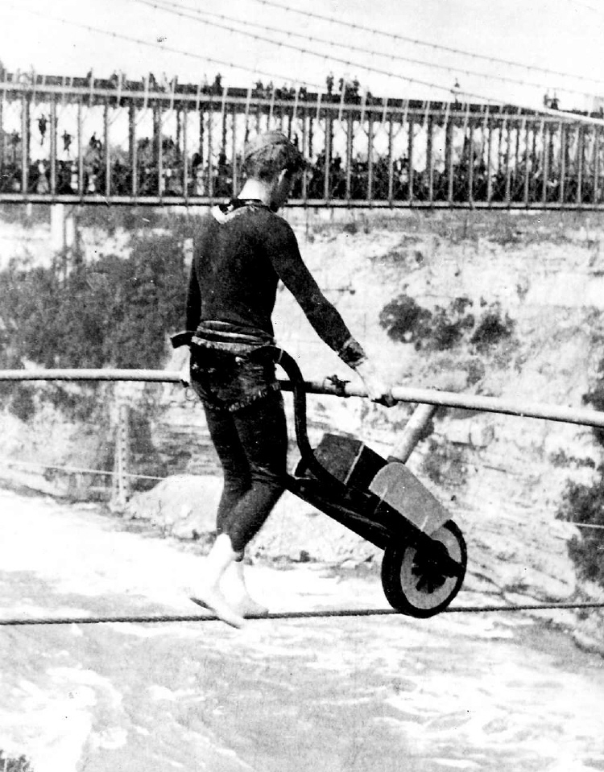
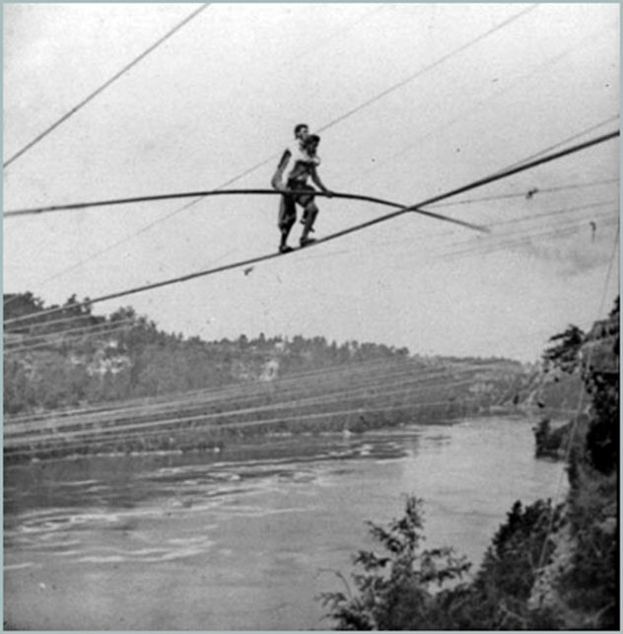
Charles Blondin
1824-1897

Slide 5
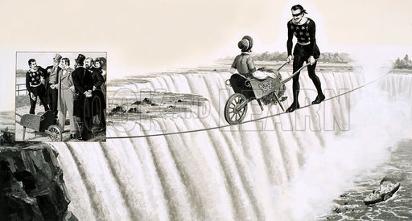
How much trust do you have?

Slide 6
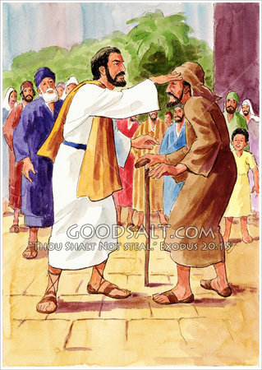
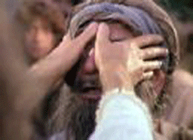
"Your faith (trust)
has healed you."
Mark 10v52

Slide 7
Thought for the Week
trust is like a broken mirror ...
once it's broken it's never the same

Slide 8

"Trust in the Lord with all you hear,
do not rely on yourself."
Proverbs 3v5

Slide 9
Dear God,
Please help us to know who to trust,
and help us to be truthful and trustworthy ourselves.
Amen.

