Slide 1







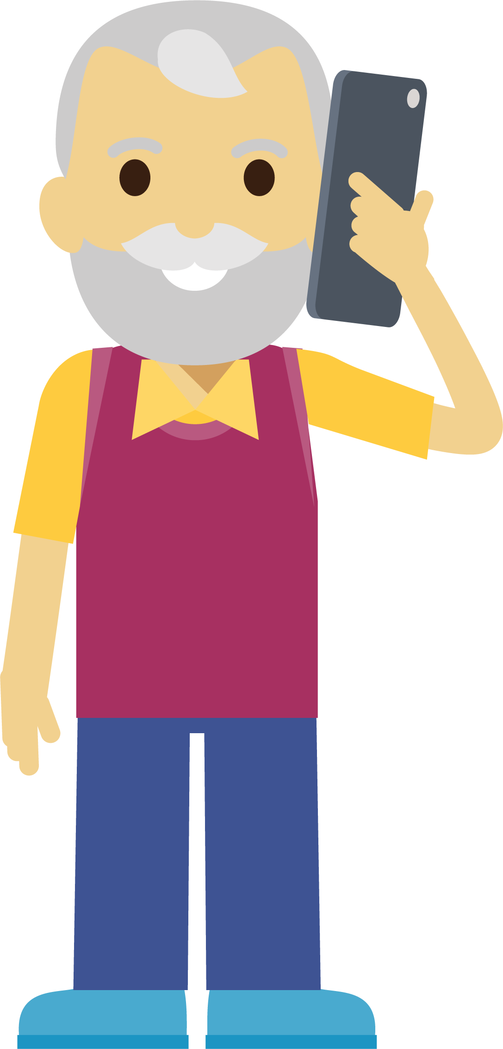






Parents and Carers (Primary)
Protect your children from sexual abuse online
www.thinkuknow.co.uk/parents
Notes:
Note to presenter: Please read through the presentation thoroughly before delivery and familiarise yourself with the Thinkuknow websites (www.thinkuknow.co.uk) and NCA-CEOP Safety Centre (www.ceop.police.uk) if needed.
If you haven’t already, register for an account, as you will have access to more information and guidance which will help you, as the presenter, to feel confident in delivering this presentation.
There are delivery notes and instructions in italics on some slides to aid your delivery.
Do register for a Thinkuknow account to gain access to our downloadable learning resources.

Slide 2

This presentation will cover:
Children online
What can you do?
Thinkuknow resources for primary
Thinkuknow resources for parents and carers
Reporting to NCA-CEOP
Notes:
In this presentation we are going to introduce you to the Thinkuknow education programme, highlight some of the resources available for you and your children and remind you of some of the things you can do to keep your child safe online.
We will cover:
Children online – The impact of growing up online and some of the popular activities children like to do.
What can you do? Advice for parents and carers
Thinkuknow resources for primary aged children
Thinkuknow resources for parents and carers
Reporting to NCA-CEOP – Children and young people, as well as their parents and carers, can report directly to CEOP if they are concerned about Child Sexual Abuse or Exploitation

Slide 3

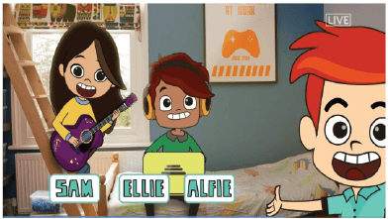
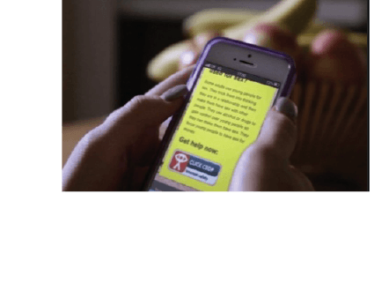
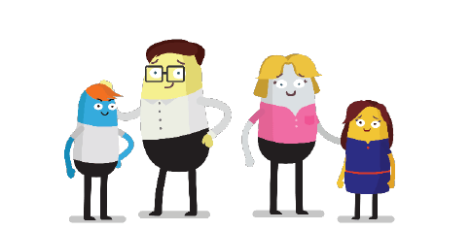
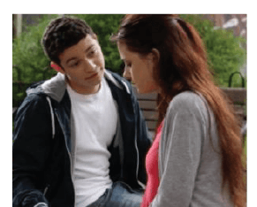
What is Thinkuknow?
Thinkuknow is the education programme provided by CEOP.
Thinkuknow offers resources for different audiences:
4-7
8-10
11-13
14+
Parents and Carers
Resources for those with special educational needs and disabilities (SEND)
Visit www.thinkuknow.co.uk for information and advice
Notes:
What is Thinkuknow?
Thinkuknow is the national education programme created by the CEOP Education Team at the National Crime Agency . The National Crime Agency is committed to protecting the public from serious and organised crime, and CEOP's role is to tackle the sexual abuse and exploitation of children both online and offline.
The Thinkuknow education programme aims to empower and protect children and young people from sexual abuse and exploitation.
Thinkuknow provides professionals with the resources to teach children and young people, aged 4 -18, about important online safety and relationships education topics that help keep children safe from sexual abuse online. The Thinkuknow programme includes films, animations, websites, presentations, and lesson plans which help professionals explore difficult and sensitive issues safely with children and young people.
We have also created information and advice for parents and carers to help build their confidence and knowledge in protecting their children online.
In addition to providing professionals with resources there is information and advice for parents and carers to help build their confidence and knowledge in protecting their children online. Thinkuknow also offers expert advice to parents and carers supporting children who are victims of sexual abuse and exploitation.
This presentation is part of the Thinkuknow package for parents and carers.

Slide 4
Children Online
www.thinkuknow.co.uk/parents

Slide 5




Understanding apps, sites and games
Sharing
Chatting
Viewing
Friending
Notes:
Parents and carers have told us that they can feel overwhelmed by the internet. The emergence of new apps and games every day can make the internet feel vast and ever-changing.
But the reality is, that there are actually only a limited number of functions that apps and games can have.
We recommend using a simple technique of breaking down an app into its key functions of ‘Viewing, Sharing, Chatting, Friending’, and asking some simple questions in order to gain a better understanding of how the app or game works.
This will help you to focus on the safety messages you give your child, based on what they are using.
Let’s take a look at these in more detail.

Slide 6
Understanding apps, sites and games
Anyone can post and share content
There may be inappropriate, sexual or violent content online
Most apps and games include privacy and security settings
Parental controls and filters can also help manage online activities
Viewing
Notes:
The internet provides lots of opportunities for young people to learn and gain information and support, but it is a public and open place, one where anybody can post and share content.
Unfortunately, it can be easy for children to come across inappropriate, sexual or violent content online. Most apps and games (but not all) include privacy and security settings that allow you to control what content can be seen and shared.
In addition, tools such as parental controls and filters can help to manage a child’s online activities and what they are exposed to. Remember, however, these are never totally guaranteed. What is vital is open and ongoing conversations with young people about what they see online and making sure they are that they can talk to an adult if they see anything online that upsets them.
So ask yourself : What content can they see? Is it age appropriate? What filtering/privacy settings can be utilised?

Slide 7
Understanding apps, sites and games
It’s easy to share online
Younger children – seek permission before they share
Children should never feel pressurised, uncomfortable or blackmailed
Look out for others by not sharing inappropriate content
Sharing
Notes:
A key part of our education with children is talking to them about what they share online. It’s easy to share things online that we wouldn’t face-to-face and it’s important to talk to children about safe sharing.
Children of primary school age are always encouraged to seek permission whenever they share something online, especially if they are sharing a photo with other children in it.
With older children it’s important we explore the motivations to share online. An image or video should never be shared if they feel pressured, uncomfortable or blackmailed.
We also want to encourage young people to look out for others by not sharing inappropriate content.
So ask: What are they sharing and who are they sharing it with?

Slide 8
Understanding apps, sites and games
Chatting and meeting new people can be fun and appealing
Most people just want to chat or be friends, but some seek to harm
Advise them not to share too much personal information
Talk to a trusted adult if anything worries them
Chatting
Friending
Notes:
Chatting and meeting new people on the internet can be fun and appealing for children. There are lots of online apps and communities that can be educational and supportive for them, however this also opens up the opportunities for adults to contact children online.
No matter how young your child is, if they are using a device that has the internet - it is important to talk to them about the people who contact them online. Some people online genuinely just want to chat or be friends, but others may put pressure on children or manipulate them into doing something they don’t want to do and it’s important to speak to your child openly and honestly about this.
Children should always be advised not share too much personal information online, and never feel pressured to do something online that they don’t want to do.
Sometimes children may find it difficult to tell you if something is worrying them online. They may be embarrassed or think that you won’t understand because you don’t ‘get’ their online lives. Other times they may have initiated the contact so they feel they are responsible, or have been told they are responsible for what has happened.
Therefore it is vital that they know that they can talk to a you, or another trusted adult if anything bothers or worries them.
So ask: Who are they friends with and what are they sharing with them?

Slide 9
Understanding apps, sites and games
Sharing
What can you share?
Chatting
Who can you talk to? How? Where?
Viewing
What kinds of content do you see?
Friending
Who can you be friends with?
Notes:
Let’s recap.
If your child is using an app, site or game and you want to know more about it you can explore together and ask:
What content can they see?
What can they share and who can they share it with?
Who can they chat with? How and where?
Who can they be friends with?
Which apps should I be concerned about?
There are no apps, sites or games that are more or less dangerous or risky. People who want to harm children will use any sites or services which children use. Children should know to be wary of people they friend and talk to online, especially if they are asking to talk privately with them, and children should always be advised not share personal information online or any photos or videos that make them feel uncomfortable. Most importantly, it is vital that they know that they can talk to a trusted adult if anything bothers or worries them.
Age restrictions exist to make viewers aware of the type of content in a game or app, and it is important that parents and carers take age restrictions seriously. Younger children are more likely to come across inappropriate content if they are using apps, websites or services before reaching the minimum age requirements.
Lets take a look at some of the popular activities children like to do.

Slide 10
Viewing videos online
www.thinkuknow.co.uk/parents
Notes:
Children and young people love watching videos online. Videos can be entertaining, funny, creative or educational. There are many different types of videos available online – which means your child may see something inappropriate.

Slide 11

In appropriate video content
The risks
They may, accidently, see something not intended for them
They can be exposed to unsuitable videos through a link they’ve found or been sent, or an app they’ve downloaded
They are curious and they may go looking for content
Notes:
The risks mainly focus on viewing inappropriate content.
What is inappropriate video content? An inappropriate video is anything that worries, scares or upsets your child. It could be aimed at adults and include sexual images or show violent behaviour. Or it might encourage crime, terrorism, eating disorders or suicide and self harm.
How could your child see inappropriate content?
If your child is watching videos online, whether it’s on a streaming service, YouTube or through another platform, they may, accidently, see something not intended for them.
Sometimes, children can be exposed to unsuitable videos through a link they’ve found or been sent, or an app they’ve downloaded.
Sometimes children are curious and they may go looking for content.

Slide 12
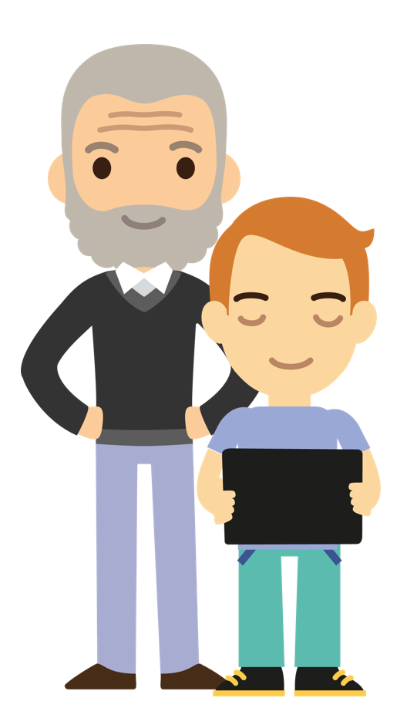
Viewing videos online
What can you do?
Talk to your child - about the videos they like to watch, what makes a video inappropriate and what to do if they see anything they shouldn’t.
Look up the age ratings - before your child uses them for a guide as to whether it’s appropriate.
Set up parental controls and filters - to help you manage the content your child may see.
www.thinkuknow.co.uk/parents/articles/parents-guide-to-watching-videos-online
Notes:
1.Talk to your child
Talk about the videos they like to watch and watch some together, as this will help you to identify if they are suitable for them. Talk about what might make a video inappropriate and make sure they know what to do if they see anything they shouldn’t. Encourage your child to talk to you or another adult they trust if they see anything whilst watching videos that makes them feel worried, scared or sad.
2. Look up the age ratings
Younger children are more likely to come across inappropriate content if they are using apps, websites or services before reaching the minimum age requirements. Check the age ratings or requirements before your child uses them for a guide as to whether it’s appropriate.
3. Set up parental controls and filters
Most apps, sites, games and services have parental controls and filters to help you manage the content your child may see. Some services also let you set up child accounts, so content can be automatically filtered, or you can choose what content your child can view and block any obvious adult content.

Slide 13
Gaming online
www.thinkuknow.co.uk/parents
Notes:
Gaming is a popular with children, young people and adults across the world. Many games have an interactive online element- whether it's playing against others, chatting or making purchases.
For most children and young people, gaming is a fun way to spend time with friends. Gaming creates opportunities to develop teamwork, concentration skills and problem-solving.
While playing games online is often great fun, it's important you understand what risks there are and what measures you can take to protect them while they’re playing their favourite games.

Slide 14
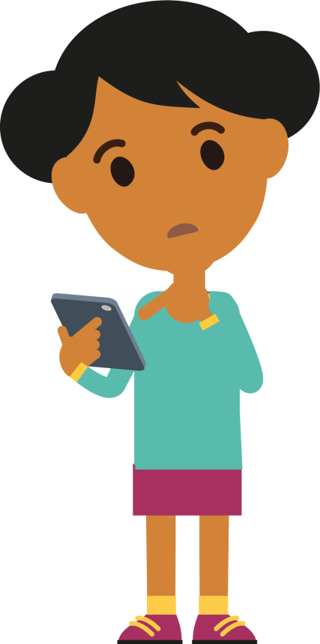
Gaming online
The risks
Chatting with people they don’t know
Inappropriate or unmoderated chat
Requests to chat in private
Offering gifts or trades
Notes:
What are the risks?
•Chatting with people they don’t know. Gaming is different to social networks, as players often play against people they don’t know. This may include adults.
•Inappropriate or unmoderated chat. In some games swearing and insults are common, especially when a player hasn’t performed very well. Mean comments or insults can hurt, and competitive criticism might feel like bullying for some children.
•Requests to chat in private. Once a child moves to private chat, it may not be monitored by the game. They might share personal information or feel pressured to do something that they don’t want to do.
•Offering gifts or trades. Some people may offer to trade – or give – your child in-game items or currencies to earn their trust and persuade them to have a separate conversation outside of the game.

Slide 15


Gaming online
What can you do?
Play with them - to understand how they talk online, who they talk to online and what you’re comfortable with.
Talk to them - about the games they play, who they talk to and how.
Use family controls - to manage, limit or turn off in-game chat.
Encourage reporting – of inappropriate chat in game and anything in the game makes them feel worried or uncomfortable.
www.thinkuknow.co.uk/parents/articles/in-game-chat
Notes:
Play with them . Play, or watch your children play, online games to understand how they talk online, who they talk to online and what you’re comfortable with. Look at the privacy settings together.
Talk to them. With older children, who may not want you to play with them, have regular chats about the games they play, who they talk to and how.
Use family controls. Use family controls and in-game settings to manage, limit or turn off in-game chat to make sure that you’re confident interactions are right for your children.
Encourage reporting. To catch potential problems early, encourage your children to report inappropriate chat in game and to tell you if anything in the game makes them feel worried or uncomfortable.

Slide 16
Live streaming
www.thinkuknow.co.uk/parents
Notes:
Live streaming is technology that lets you watch, create and share videos in real time, a bit like live TV.
All you need to be able to live stream is an internet enabled device, like a smart phone or tablet. And a platform (such as a website or app) to live stream from.
Unlike pre-recorded videos that can be cut and edited, live streaming is just that – live and uncensored.
Some live streams can be private. For example, video conferencing, like Skype or Zoom, uses live streaming technology to allow you to talk to people you know, who have been invited. To make sure they stay private, they should be password protected and passwords shouldn’t be shared with people you don’t know.
Some live streams are public, like a live TV broadcast, and the audience could be hundreds of people.

Slide 17

Live streaming
The risks
Exposure to age inappropriate content, including sexual or violent content
Negative or inappropriate comments
Acting on impulse, and saying or doing something they’d be less likely to do offline
Inappropriate contact
Notes:
What are the risks?
•Content. Children could be exposed to age inappropriate content, including sexual or violent content.
•Offensive comments. If the live stream is public, viewers may be able to leave negative or inappropriate comments.
•Live streaming is ‘in the moment’. This increases the risk of children and young people acting on impulse, and saying or doing something they’d be less likely to do offline.
•Inappropriate contact. People seeking to harm children may attempt to trick them into engaging in sexual activity, flatter them with positive comments or gifts, or make threats to try to force them to do things they don’t want to do.

Slide 18
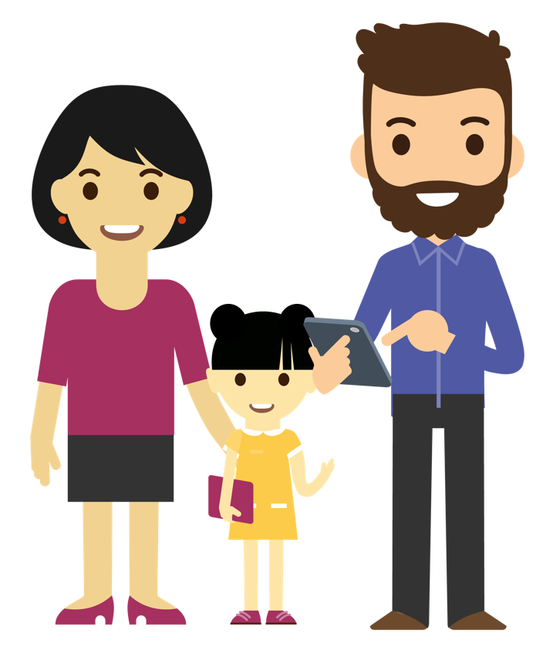
Live streaming
What can you do?
Talk to them – have an ongoing conversation as part of your family life.
Use devices in public spaces.
Go through privacy and safety settings.
Be wary of requests to chat in private.
Know where to get support and how to report.
www.thinkuknow.co.uk/parents/articles/what-is-live-streaming
Notes:
Talk to them. The best way you can protect your child is to talk with them about online life. And not just once: make this an ongoing conversation as part of your family life.
Use devices in public spaces. Younger children should be closely supervised by an adult and live streaming should not take place in a private space, like the bedroom or bathroom.
Privacy and safety settings. Go through the privacy and safety settings together with your child. Make sure only trusted friends and family they know offline can view their online profiles and videos.
Be wary of requests to chat in private. Remind your child to be wary of people they meet online who want to chat to them in private, away from other people.
Support and Reporting. It’s really important that your child knows how to get support. Remind them that they can always speak to you or another adult they trust if they have any worries. Talk to them about how to report to social media platforms or CEOP if they're concerned about contact from an adult.
(Note – a specific Live Streaming presentation for parents/carers can be downloaded from www.thinkuknow.co.uk/professionals/resources/live-streaming)

Slide 19
Social media
www.thinkuknow.co.uk/parents
Notes:
Children love to socialise and as they get older, they will want to stay in touch with family and friends online. There are lots of social media websites and mobile apps that people use to chat, comment, share pictures and game with their friends.

Slide 20

Social media
The risks
Inappropriate content
Inappropriate behaviour
Over-sharing
Making friends with people they don’t know
Notes:
What are the risks?
•Inappropriate content. Anybody can post and share videos, pictures, or ideas on social media. This means children may see things they don’t want to, including sexual or violent content.
•Inappropriate behaviour. Children can feel more confident when they are online as they feel protected by the screen. This can result in them, or their friends, saying or doing something they’d be less likely to do offline, including oversharing.
•Over-sharing. Social media lets people share information about who they are and what they like doing – with lots of different people. It’s easy to share things online that we wouldn’t face-to-face. Once something has been shared, you can never be sure who has seen it, saved it, or shared it.
•Making friends with people they don’t know. It’s also easy to set up fake profiles, and some adults may even pretend to be children when they’re much older. This makes it hard to tell the difference between someone who’s genuine and a fake. Some people online, can also put pressure on children or manipulate them into doing something they don’t want to do.

Slide 21
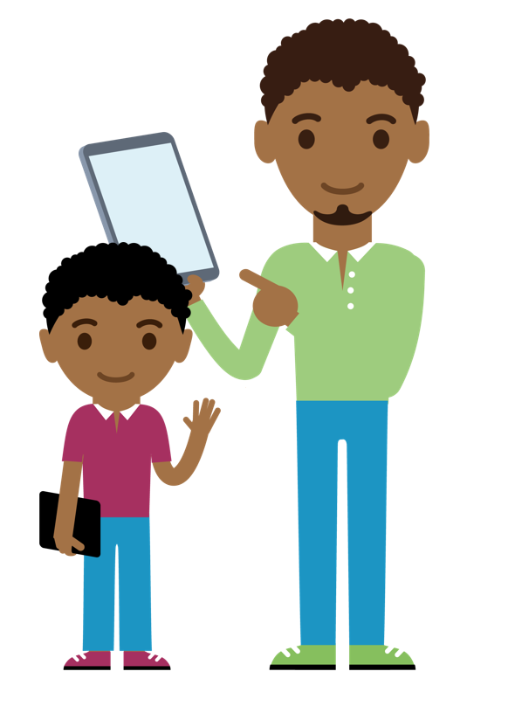
Social media
What can you do?
Make sure they are ready.
Be a great role model.
Get involved and support them.
Talking about safe social media use.
www.thinkuknow.co.uk/parents/articles/is-my-child-ready-for-social-media
Notes:
•Make sure they are ready. Remember, most of the popular social media services require users to be at least 13 years of age before they can register. It’s also a good idea to check out the social media site or app they want to use with them, look at the privacy settings, age requirements and talk with them about how they can use it safely.
•Be a great role model. What you do on social media will influence their online behaviour. Make sure your social media accounts are a good example to your child, by taking some time to check your friendships, privacy settings and the things you that you have posted.
•Get involved and support them. The best way you can protect your child is to establish a positive relationship with them around their life online. Let them know you want to support them as they begin to explore, and that they can come to you if they have any worries or problems. Talk about any worries you might have, and why you have them.
•Talking about safe social media use. Talk about what it means to be a good friend online, how would they deal with disagreements and how the treat their friends online. Talk about how to share with care by using the privacy settings and reporting systems.

Slide 22

#WhoisSAM?
Notes:
Optional video – please watch before delivery. It is at your discretion whether you would like to include.
If you do include be mindful of your audience. It should be used as a way to lead into the importance of talking and how the Thinkuknow resources can help.
It can be viewed as scaremongering if used to frighten parents and should not be used if you have had any incidents in your organisation which might trigger parents or carers.
Insert video file to slide – WhoIsSam?
Before watching the video
We have looked at some of the things children like doing online, and now I am going to show you a short animation which is narrated by a fictional character called Sam. Sam is an online offender who targets children online and quickly builds trust with them.
After watching the video.
This video is not here to scare you, but remind you that you play an important role in helping your child stay safe.
Online offenders can be anyone. There is not just one ‘type’ of person, as shown in this video. All children can be vulnerable and it is very important we do not approach this from a perspective of ‘it won’t happen to someone I know’.
What is important, is that you, as parents and carers talk openly to your children about being safe online, about healthy relationships and encouraging them to speak out if anything happens online that worries them or doesn’t feel right.
Let’s take a look at how you can do this.

Slide 23
What can you do?
www.thinkuknow.co.uk/parents

Slide 24




Chat little and often
Talk to your child about their life online
Take the opportunity to talk to them about how to stay safe
Explain any worries you may have
Notes:
What can you do to keep your child safe online?
Chat little and often
The best way you can protect your child is to establish a positive relationship with them around their life online. Talk to them – not just once but have ongoing conversations as part of your family life.
Ask them what they are doing online, and what they like and dislike about the apps and services they use. Take the opportunity to talk to them about how to stay safe on these services and in general. For example, you could ask about the types of issues that have arisen for their friends online, and what advice they would offer to help them feel safe. Talking about others, can help you avoid directly questioning what they do online, and possible embarrassment.
Explain to them any worries you have. Your child might think that you are getting worried for no good reason, but if you explain why something is troubling you they will understand why you want to talk to them. Tell them if it is something you have read about or seen their friends doing.

Slide 25



Report anything that worries them
Make sure they know they can come to you
Help them identify trusted adults
Let them know you won’t blame them
Notes:
Remind them to report anything worrying, and how they can do this
It’s important that children and young people always know where to go if they come across something that worries them or makes them feel uncomfortable online. Make sure they know that you would never blame them for anything that might happen online.
To help, you could, encourage them to speak to you or another adult immediately if they have any worries or concerns. Help them to identify a trusted adult that they can approach, if they feel they can’t talk to you, even if this means on the phone.
Make sure they know that they can always report to CEOP if they are worried about sexual abuse online. Or if they are worried about something else, they can call a helpline, like Childline. We tell you more about this at the end.

Slide 26

Take some practical steps
Create a family agreement and regularly review
Use parental controls
Direct your child to age appropriate information
Notes:
Practical steps
There are also some simple practical steps you can take.
•Create a family agreement about how much time they spend online doing different things and what games and apps are appropriate to use.
•Parental controls can be a quick and effective tool to help protect your child online, but they are not a single solution to staying safe; talking to your children and encouraging responsible behaviour is critical.
•Direct your child to age appropriate information, especially information about relationships and friendships online. For example from Thinkuknow, Childline or BBC’s Own It.

Slide 27
Thinkuknow resources
www.thinkuknow.co.uk/parents
Notes:
Explore the Thinkuknow resources together
The ThinkuKnow films and activities are a great way to start and continue chats about online safety.
We also have our Thinkuknow websites for children and parents and carers.

Slide 28
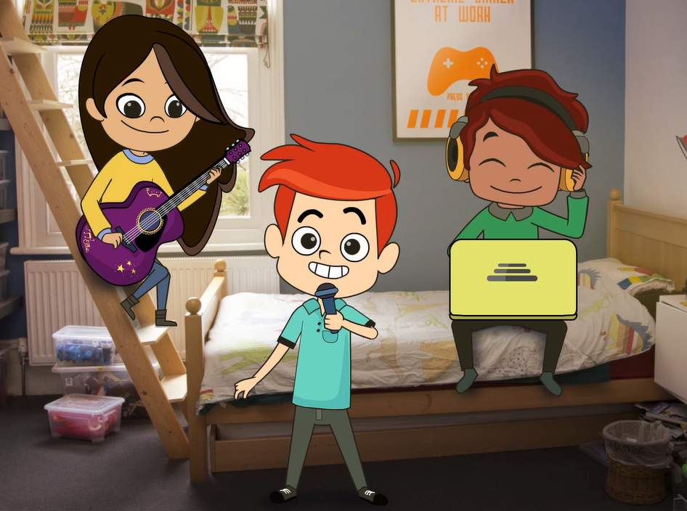
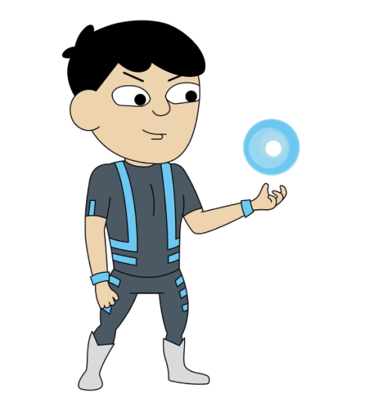
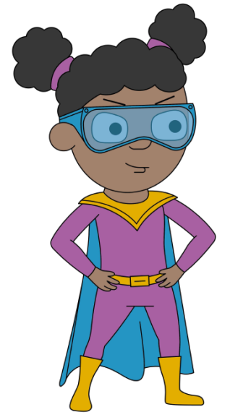
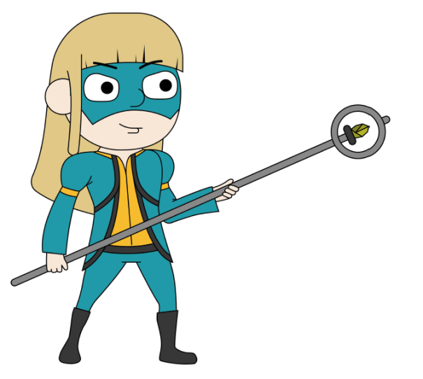
Resources for primary aged children
4-7s: Jessie & Friends
8-11s: Play Like Share
& Band Runner Game
Notes:
For primary aged children we have Jessie and Friends, Play Like Share and Band Runner.

Slide 29
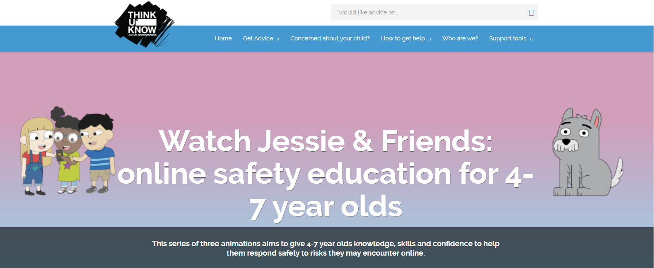
4-7s: Jessie & Friends
Notes:
Insert Jessie and Friends parents video
Jessie & Friends is a series of three animations for 4 – 7-year olds. The series follows the adventures of Jessie, Tia and Mo as they begin to navigate the online world, watching videos, sharing pictures and playing games. There’s also a storybook for each episode, to help you and your child keep the conversation going, and a catchy song at the end, aimed to reinforce the films safety messages.

Slide 30
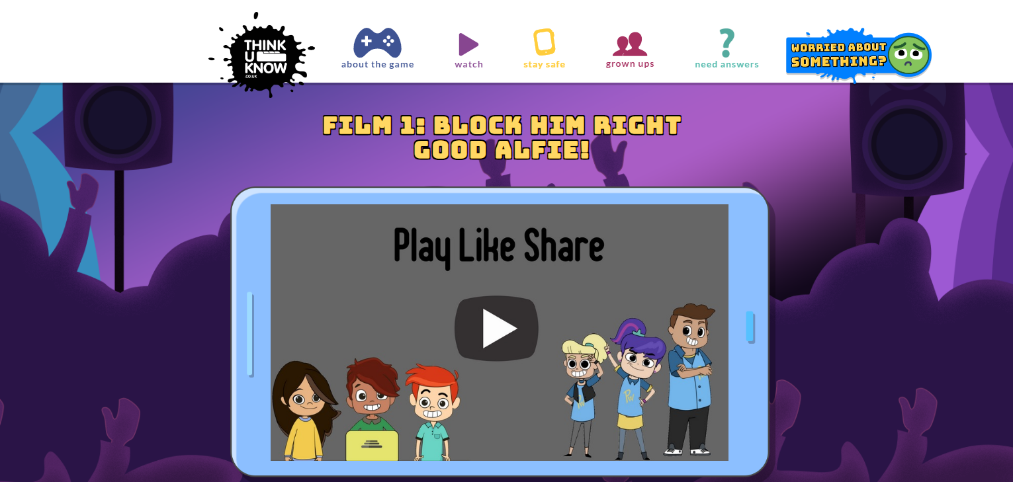

8-10s: Play Like Share
Notes:
Insert Play Like Share parents teaser video
Play Like Share is for 8 – 10-year olds. It follows the adventures of Alfie, Ellie and Sam as they form a band and enter their school’s Battle of the Bands contest, taking on the mean but ‘cool’ Popcorn Wizards as they go. The three friends learn that while the internet can help, they need to use it wisely and safely. The films teach children how to spot the early signs of manipulative, pressurising and threatening behaviour by people they might meet online and develops their confidence to respond safely and get help.

Slide 31
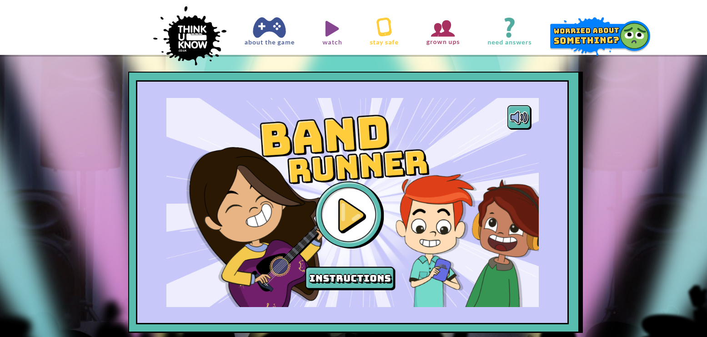
Band Runner
Notes:
Band Runner is a fun interactive game on the 8- 11s website . It features the characters and safety messages from the Play, Like Share films, and puts children’s knowledge about online safety to the test by asking them to help characters make safe choices.

Slide 32
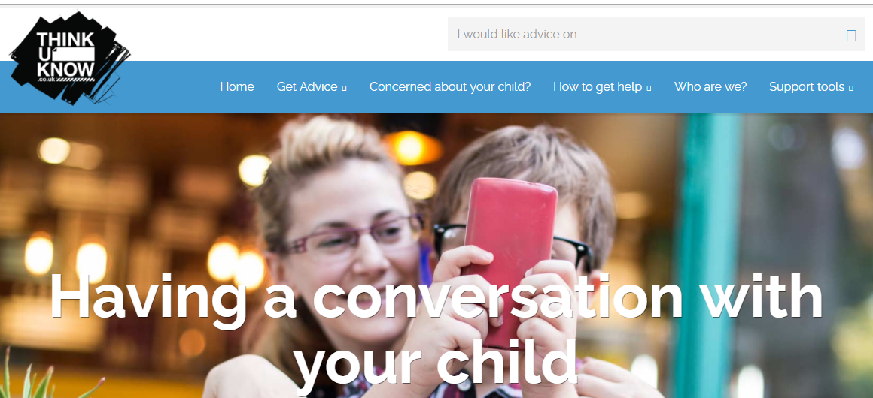
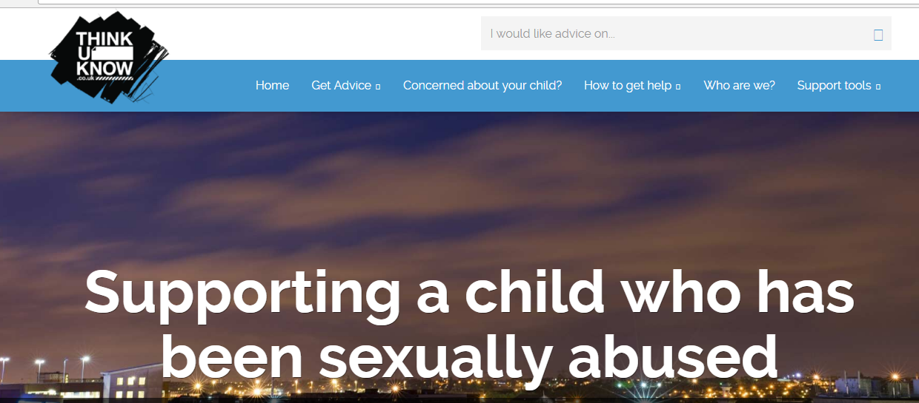
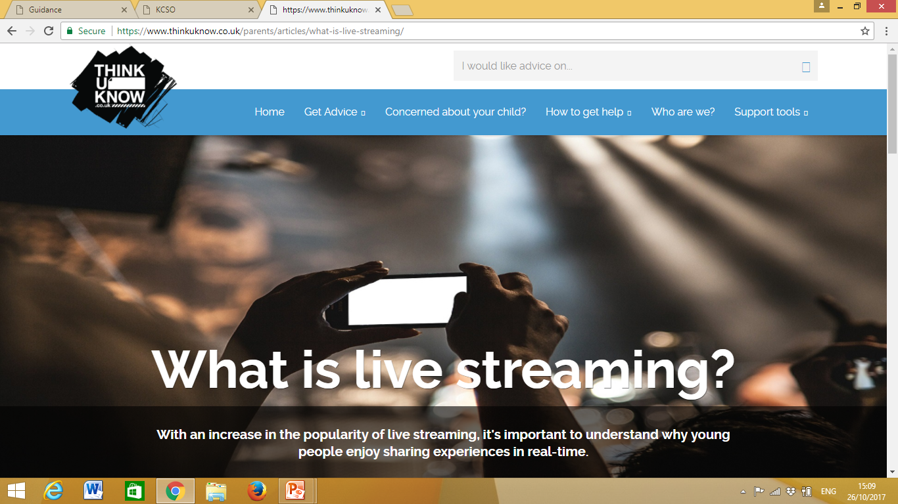
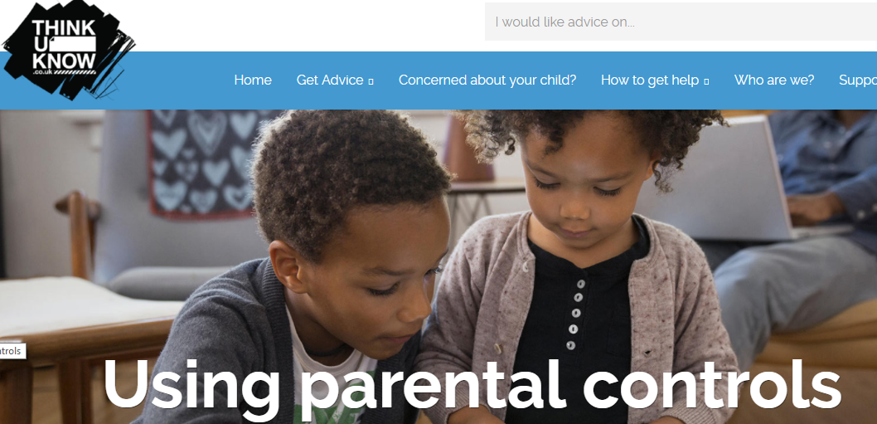
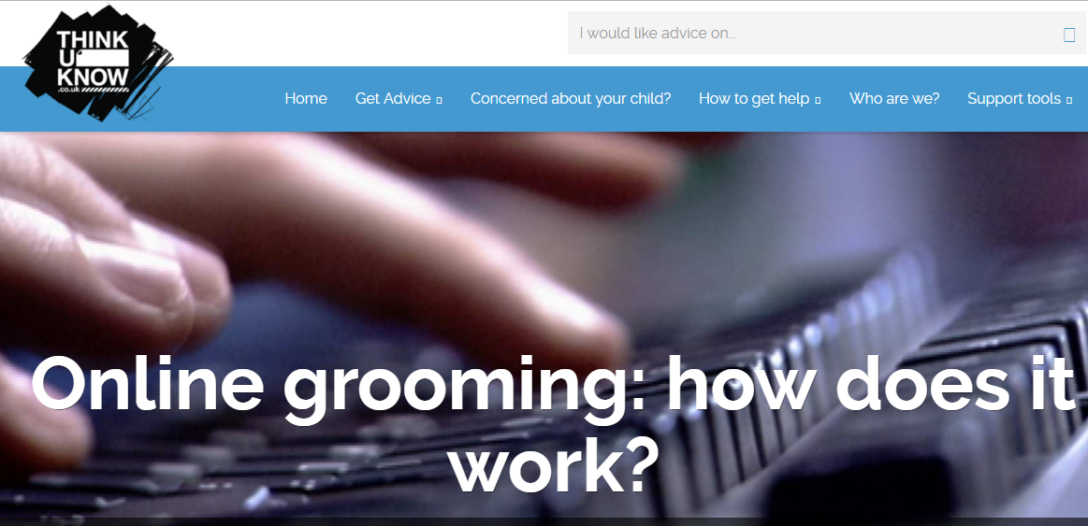
Resources for Parents and Carers
Notes:
The Thinkuknow Parents and Carers website contains a wealth of information and advice for parents and carers on keeping their children safe online.
Parents and carers can visit www.thinkuknow.co.uk/parents
The website is divided into three sections:
I need to report an incident – for information and support when something has already happened to a child or young person
I’m concerned about my child – for information and support when there are concerns about a child or young person
I’d like to understand more about keeping my child safe – for preventative information and advice on keeping children safe online

Slide 33
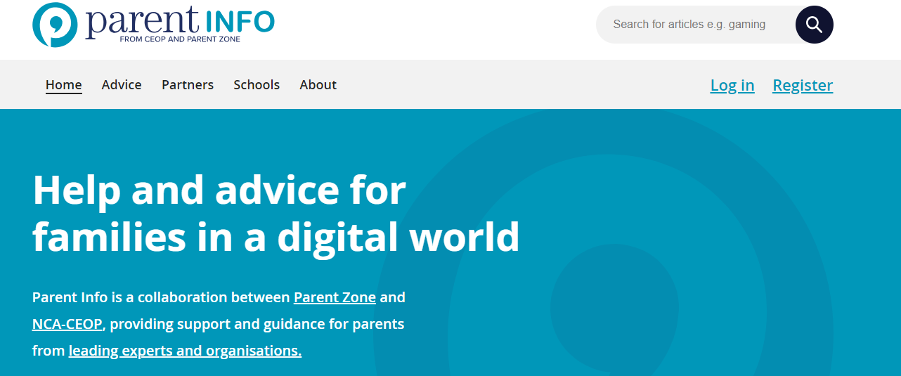

www.parentinfo.org
Notes:
Parent info
Parent Info is a partnership project between NCA-CEOP and the parent organisation Parent Zone.
It’s a website and advice service for parents and carers, which aims to build the resilience of their children through articles, tips and advice. Articles are written by expert organisations on a range of different topics, all linked by the internet. The website is divided into the following categories:
Games, apps and tech
Parenting
Safety and settings
Relationships and sex
Education and the future
Health and wellbeing

Slide 34

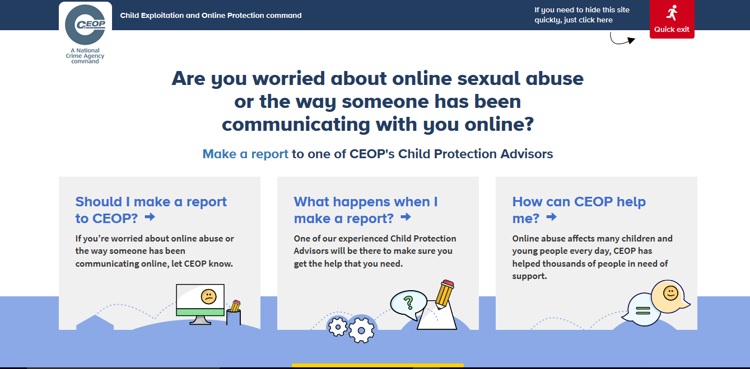
Reporting to NCA-CEOP – www.ceop.police.uk
Notes:
Note to presenter: Before delivering this section, familiarise yourself with NCA-CEOP’s website and advice pages by visiting www.ceop.police.uk.The website has information on:
When to report to NCA-CEOP
What happens when a report is made to NCA-CEOP
How NCA-CEOP can help
You can have the ClickCEOP button embedded in your organisation’s website to provide children and young people with easier access to the reporting form. Contact us at ceopeducation@nca.gov.uk to find out more.
CEOP is part of the National Crime Agency, a law enforcement agency. The NCA-CEOP website hosts an online reporting tool, made specifically for children and young people in order for them to report concerns related to online sexual abuse and exploitation. Before accessing the reporting form, information is available on the types of reports CEOP receive and what happens following a report.
CEOP reporting is designed specifically for children, so that they always have somewhere to go if they are worried. The reporting form is designed to be as accessible as possible by children, but it is highly recommended that young children of primary school age seek the support of an adult they trust to help them make a report.
It is not possible to report to NCA-CEOP anonymously. NCA-CEOP advise any urgent reports where a child is in immediate danger should be reported to the local police force where the child is located.

Slide 35

Other advice and support services
Notes:
CEOP can only respond to concerns related to sexual abuse and exploitation.
If you, or your child need support with other online issues, for example, online bullying, there are other organisations who can help, and we highlight these through the website.
Remind them that they can always call Childline. Childline is a confidential 24/7 counselling service run by the NSPCC for all children up to the age of 19. Children can speak to a trained counsellor on the phone or online about any issue they are going through, no matter how big or small.
The Mix is another confidential helpline and support service for young people under the age of 25. The Mix specialises in topics such as sex and relationships, homelessness, drugs, mental health and finding a job.

Slide 36

Chat little and often
Talk to your child about their life online
Take the opportunity to talk to them about how to stay safe
Explain any worries you may have
Make sure they know they can come to you
Help them identify trusted adults
Let them know you wont blame them
Create a family agreement and regularly review
Use parental controls
Direct your child to age appropriate information
Remind them to report anything worrying
Take some practical steps
Notes:
Before you go, here’s a quick recap on what you can do, to help your child stay safe online.

Slide 37




Staying up to date:
@CEOPUK
ClickCEOP
www.thinkuknow.co.uk
www.thinkuknow.co.uk/parents
www.ceop.police.uk/safety-centre
Notes:
Thank you for taking the time to join us today.
For more information on any of the resources we have talked about, reporting or further advice and guidance please visit our website – www.thinkuknow.co.uk/parents
The NCA-CEOP ‘safety centre’ and reporting tool can be found at www.ceop.police.uk
You can also keep up to date by following NCA-CEOP on Twitter or Facebook.

