Slide 1

Partnership with Families: Fred Talk

Slide 2
Teach a child to read and keep that child reading and we will change everything.
And I mean everything.
Jeanette Winterson

Slide 3

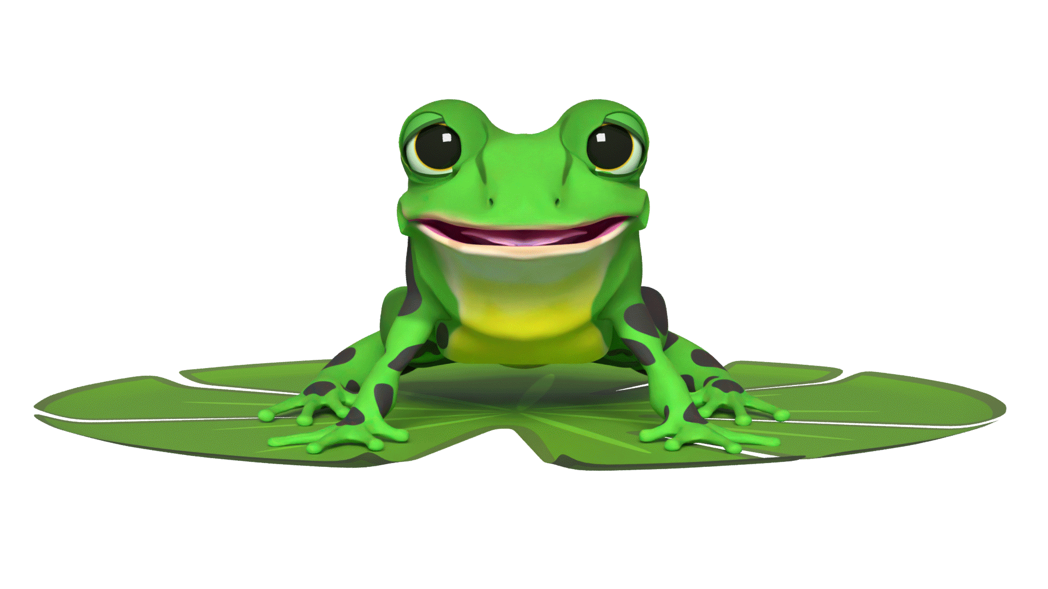

Speedy sounds + Fred = decoding
I want to help you understand how your child is learning to read words in Read Write Inc. Phonics by blending sounds together.
Alongside teaching children the Set 1 sounds, we teach them to blend sounds to read words e.g. s-a-t, sat.

Slide 4
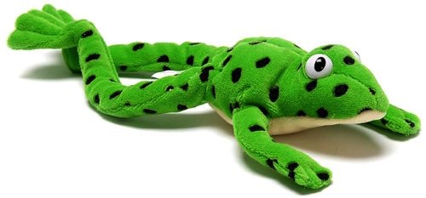
Make friends with Fred!
Let me introduce you to Fred.
Fred helps children learn to blend sounds into a word.
Fred can only speak in sounds. He says d-o-g, h-a-t etc.
He says the sounds c-a-t, and then children help him to say the word.
This is how we quickly teach all of our children to blend orally.
We practise blending orally so children will find word-reading easier.

Slide 5
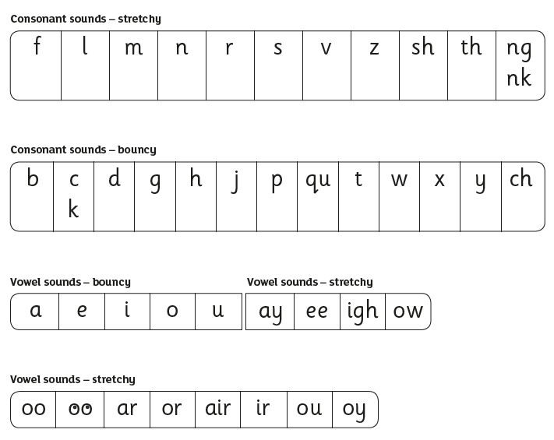
Speed Sounds Set 1
Remember that:
Children need to know sounds – not letter names – to read words
we say the sounds in a way to make them easy to blend into a word (‘m’ not’ muh’, ’s’ not ‘suh’, etc)
We aim to eliminate the ‘uh’ at the end of the sound. This is called a ‘schwa’ sound. This makes it easier to blend sounds into word.

Slide 6
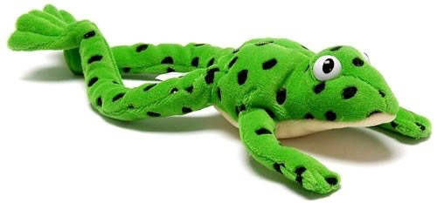

Fred Talk Routine
Say the word in sounds e.g. c-a-t.
Ask the child to repeat.
Can they ‘jump-in’ with the whole word?
Say the word in sounds followed by the whole word e.g. c-a-t, cat.
Ask the child to repeat.

Slide 7
Fred Talk throughout the day
Shall we have some
What would you like to
Let’s put on your
-ch
l
-n
-u
?
-ay
-l
p
?
-oa
-t
c
.

Slide 8




Reading with Fred Talk
Once children know their Set 1 sounds and can orally blend, we teach children to read words using Fred Talk e.g. m-a-t, mat.
We say ‘Fred Talk, read the word’.

Slide 9
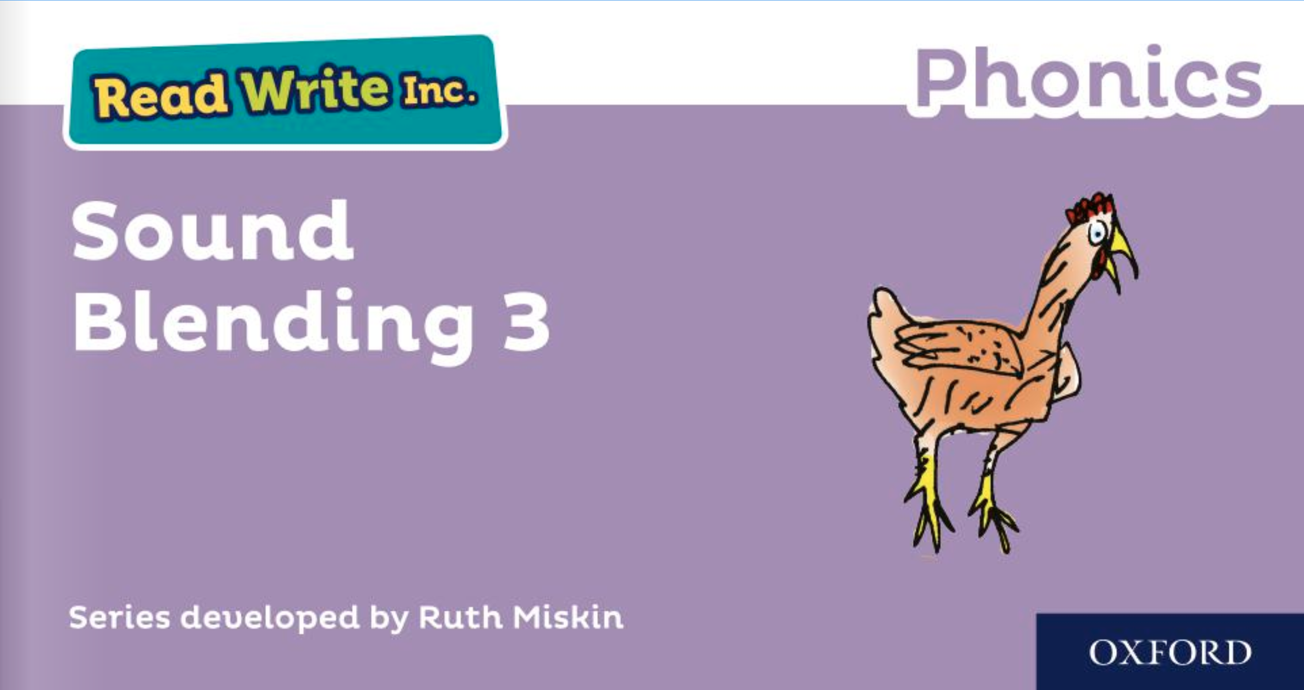
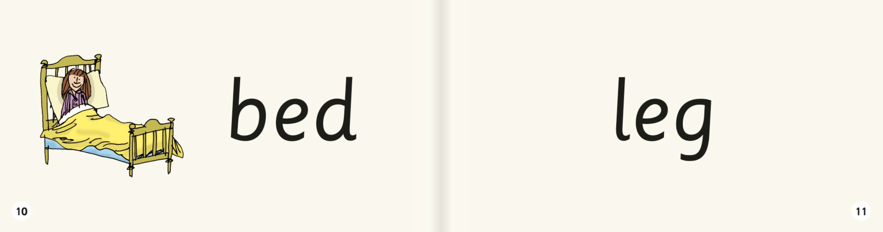
Sound blending books
Once your child can blend the sounds they know to read words, they will bring home a sound blending book to practise reading words
Children love reading the word and then using the picture to check if they are right.

Slide 10

Online resources available
Ruth Miskin Families Page:
https://www.ruthmiskin.com/parentsandcarers/
Ruth Miskin Facebook:
https://www.facebook.com/miskin.education
Free e-books for home reading:
http://www.oxfordowl.co.uk/Reading/

Slide 11
Teach a child to read and keep that child reading and we will change everything.
And I mean everything.
Jeanette Winterson
Notes:
Read quote.

