Slide 1
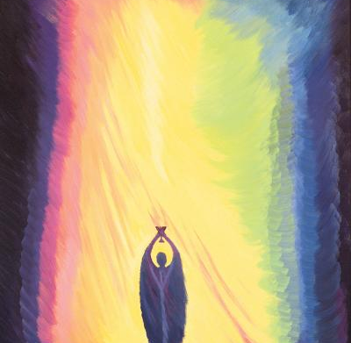
Welcome to the Year 3 Parents’ Meeting for Sacramental Preparation

Slide 2
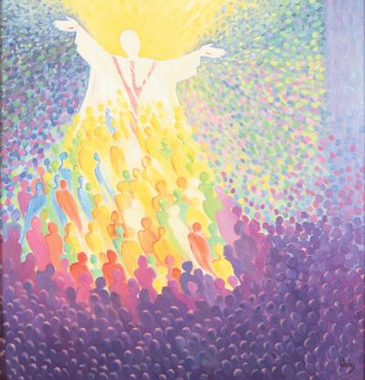
Aims of our meeting…
To consider the programme of preparation for the Sacraments of First Forgiveness and First Eucharist
To explore the triangulation approach between Home, School and Parish
To answer any questions
To set out the logistical arrangements for the programme and key dates

Slide 3
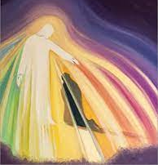
God our Loving Father,
You love us so much that you have given yourself to us in the gifts of the sacraments.
Guide us as we prepare our young people to receive you in this special way
Bless them and strengthen them. Help them to grow in understanding as you fill them with your grace.
Bless their parents and families as they endeavour to walk alongside their children, towards you on this journey of love.

Slide 4

Our Programme

Slide 5
I Belong is a programme that contains lively, colourful material in which illustrations and examples are used to reflect the world where today’s children live and experience faith.
It is hoped that the children using this book will create a personal memento of this special time in their relationship with God.
At the end of each chapter is a “Family Time” page with suggestions for prayer and something to do together as a family.
Small information boxes have been added throughout the book. These cover areas such as: search the church for particular items, explanation of Catholic practices, what to look out for while at Mass and new words associated with reconciliation, First Holy Communion and the Mass. There is also a symbol of a Bible to check out bible references at the end of scripture passages. A small candle features on the corner of each page which, when coloured, indicates progress through the book.

Slide 6
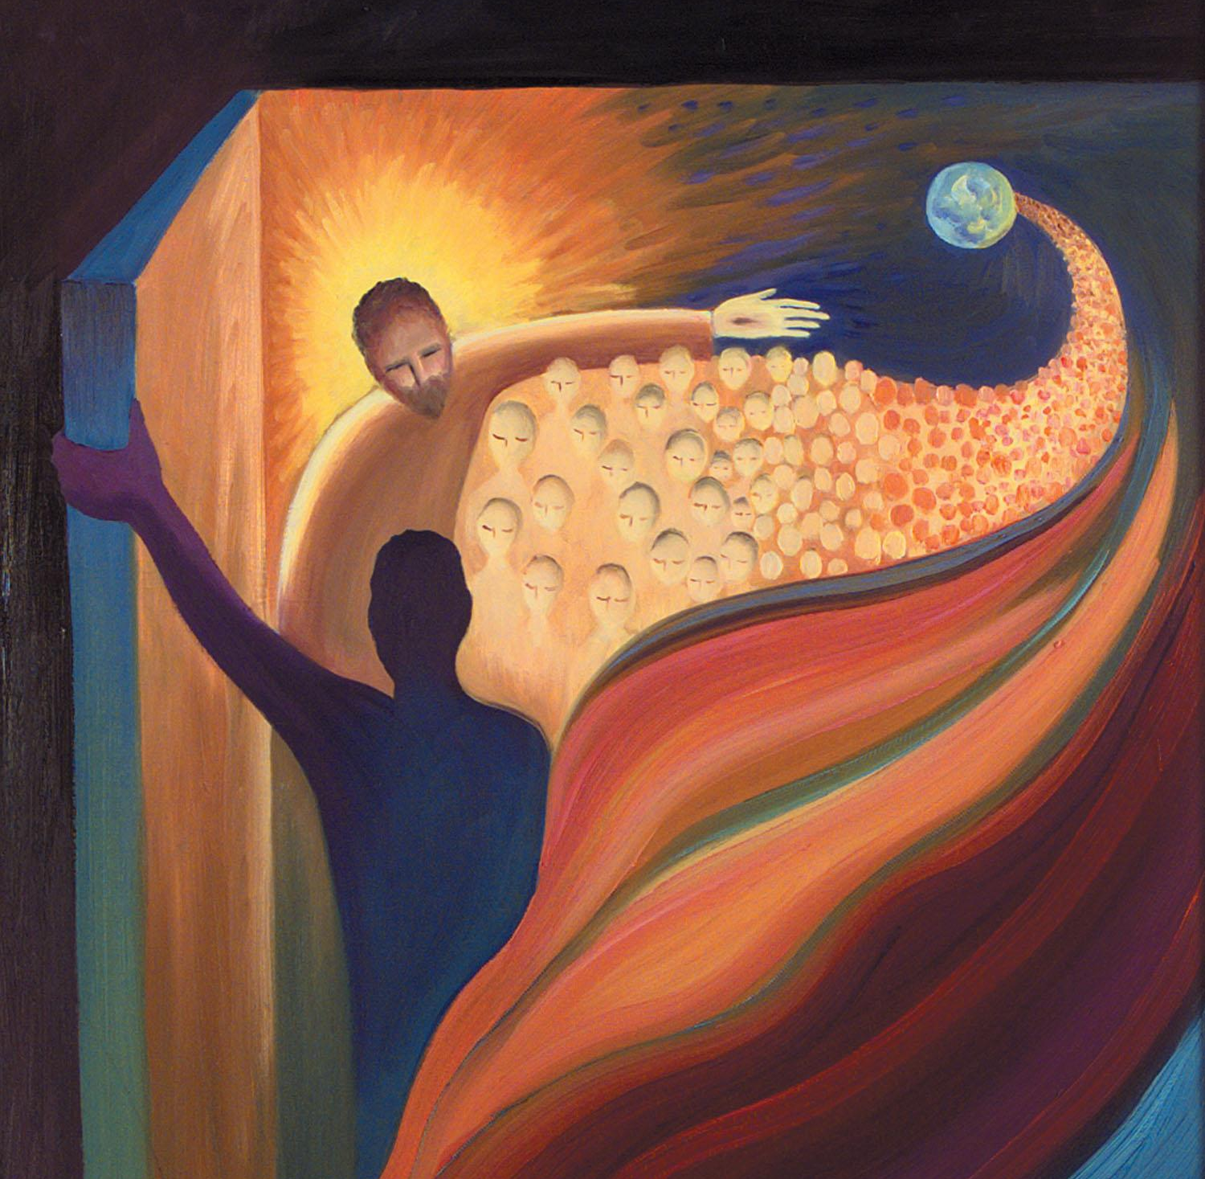
Preparation at school…
Begin our programme on Friday 31st January
Meet weekly – Mrs Kane
Explore our journey of faith
Learn about the sacraments
Reflect on Bible stories
Learn the prayers and the rites of the Mass
Grow in awe and wonder at the path ahead

Slide 7
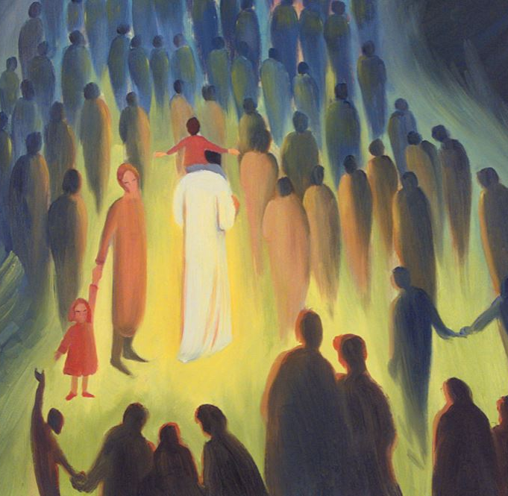
Preparation at home
Support your child with their journey of faith
Engage in the programme and weekly activities – ensure the book is in school for each Friday class.
Talk to your child about your memories of receiving the sacraments of Reconciliation and Eucharist for the first time
Attend Mass

Slide 8
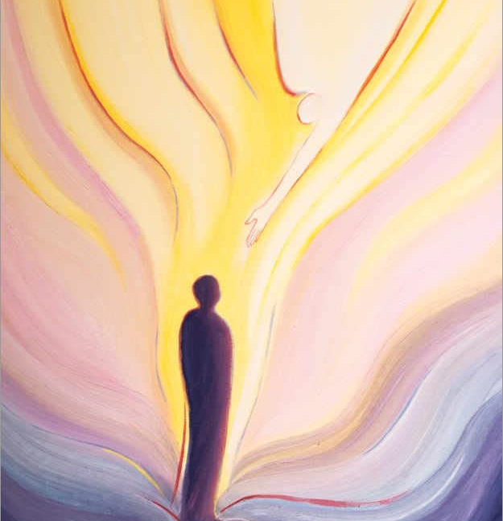
Preparation in the Parish
Children’s Liturgy Group is offered every week at the 11am Mass at Our Lady’s Church
Engagement in all areas of parish life is always welcome – there any so many ways to get involved
Attendance at Mass is warmly welcomed and part of our faith formation. The Eucharist is our “source and summit” We cannot offer this through engagement with school alone.

Slide 9
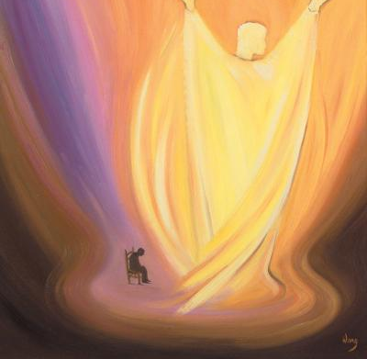
Key Dates
Thursday 3rd April - Celebration of First Forgiveness at Our Lady’s Church, 6pm
Saturday 10th May – Celebration of First Eucharist at Our Lady’s Church, 10am
Monday 12th May – Thanksgiving tea party for all children in Year 3 during the school day

Slide 10
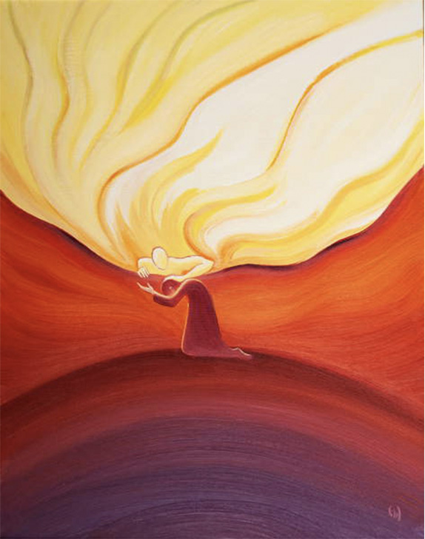
First Forgiveness
6pm – Our Lady’s Church
Order of Service
Fr Edmund
own clothes (warm)
No photography during service
Engagement
Penance

Slide 11
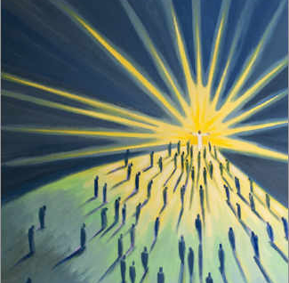
First Eucharist
10am Mass
Our Lady Star of the Sea Church
Limited numbers on family row
Blended families
Smart dress
No photography during Mass
Expectations

Slide 12
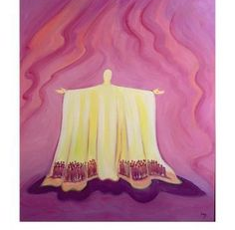
Tea Party
Monday 12th May – 2pm
Tea party, games,
School hall
Thanksgiving and celebration
Communion wear welcome
Please send in a donation of party food for sharing

Slide 13
Next steps…
Q&A
Enrolment forms
I Belong Books

