Slide 1


Friday 20th September
Celebration Assembly

Slide 2
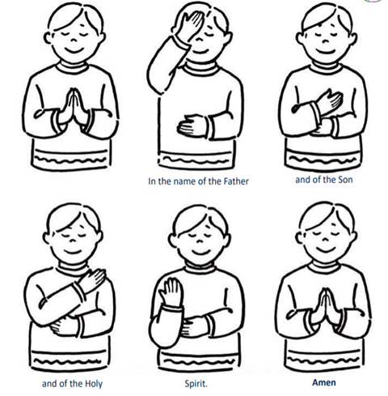

Gather…
We gather together as one family, as we pray…

Slide 3
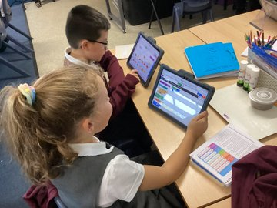
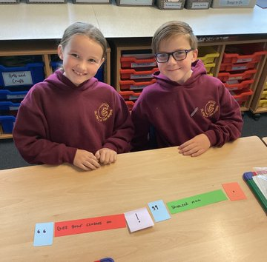
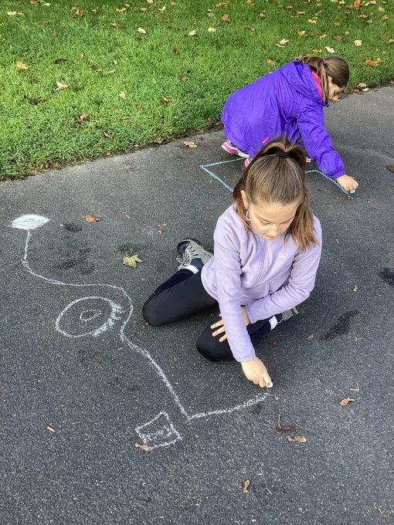
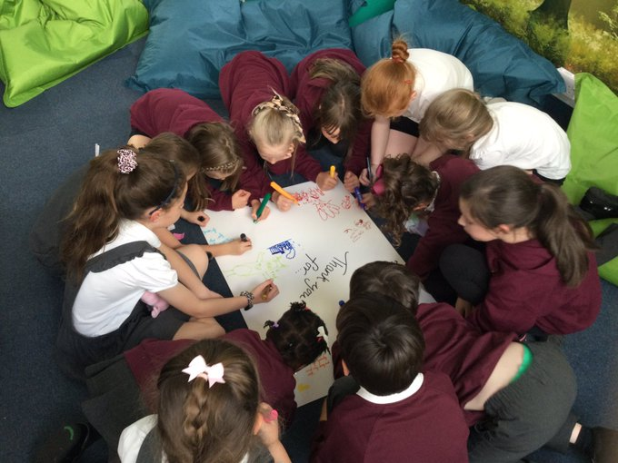
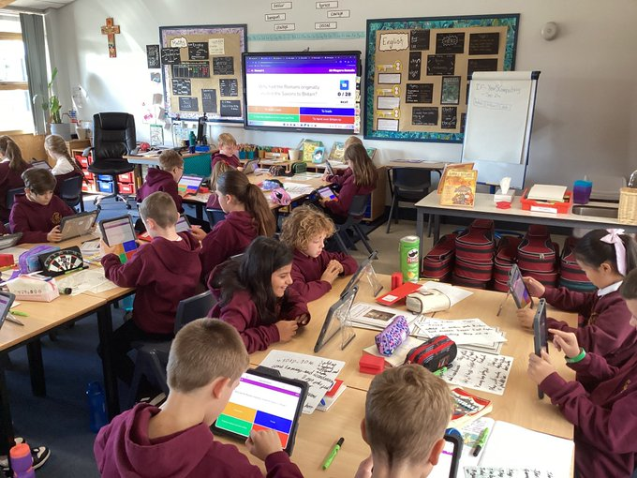
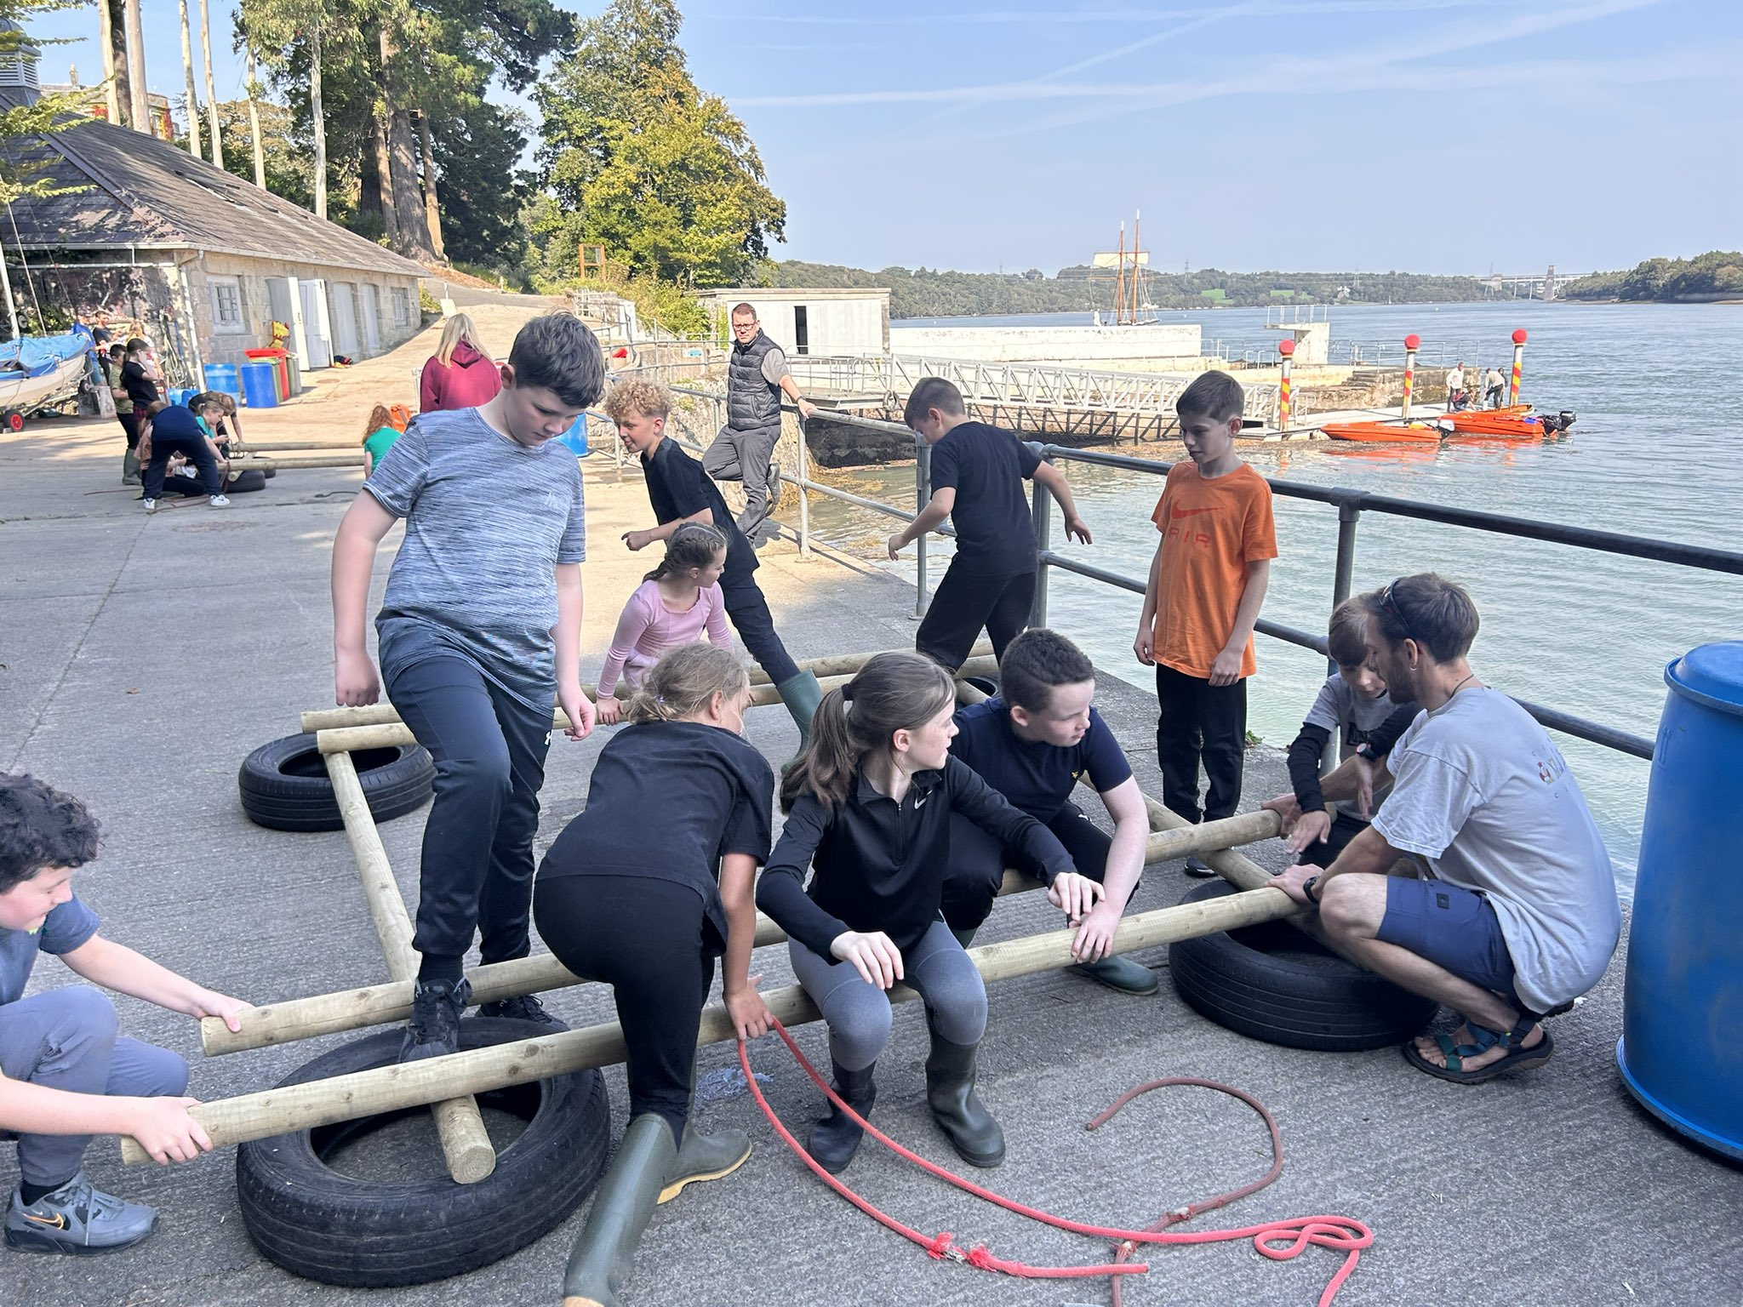
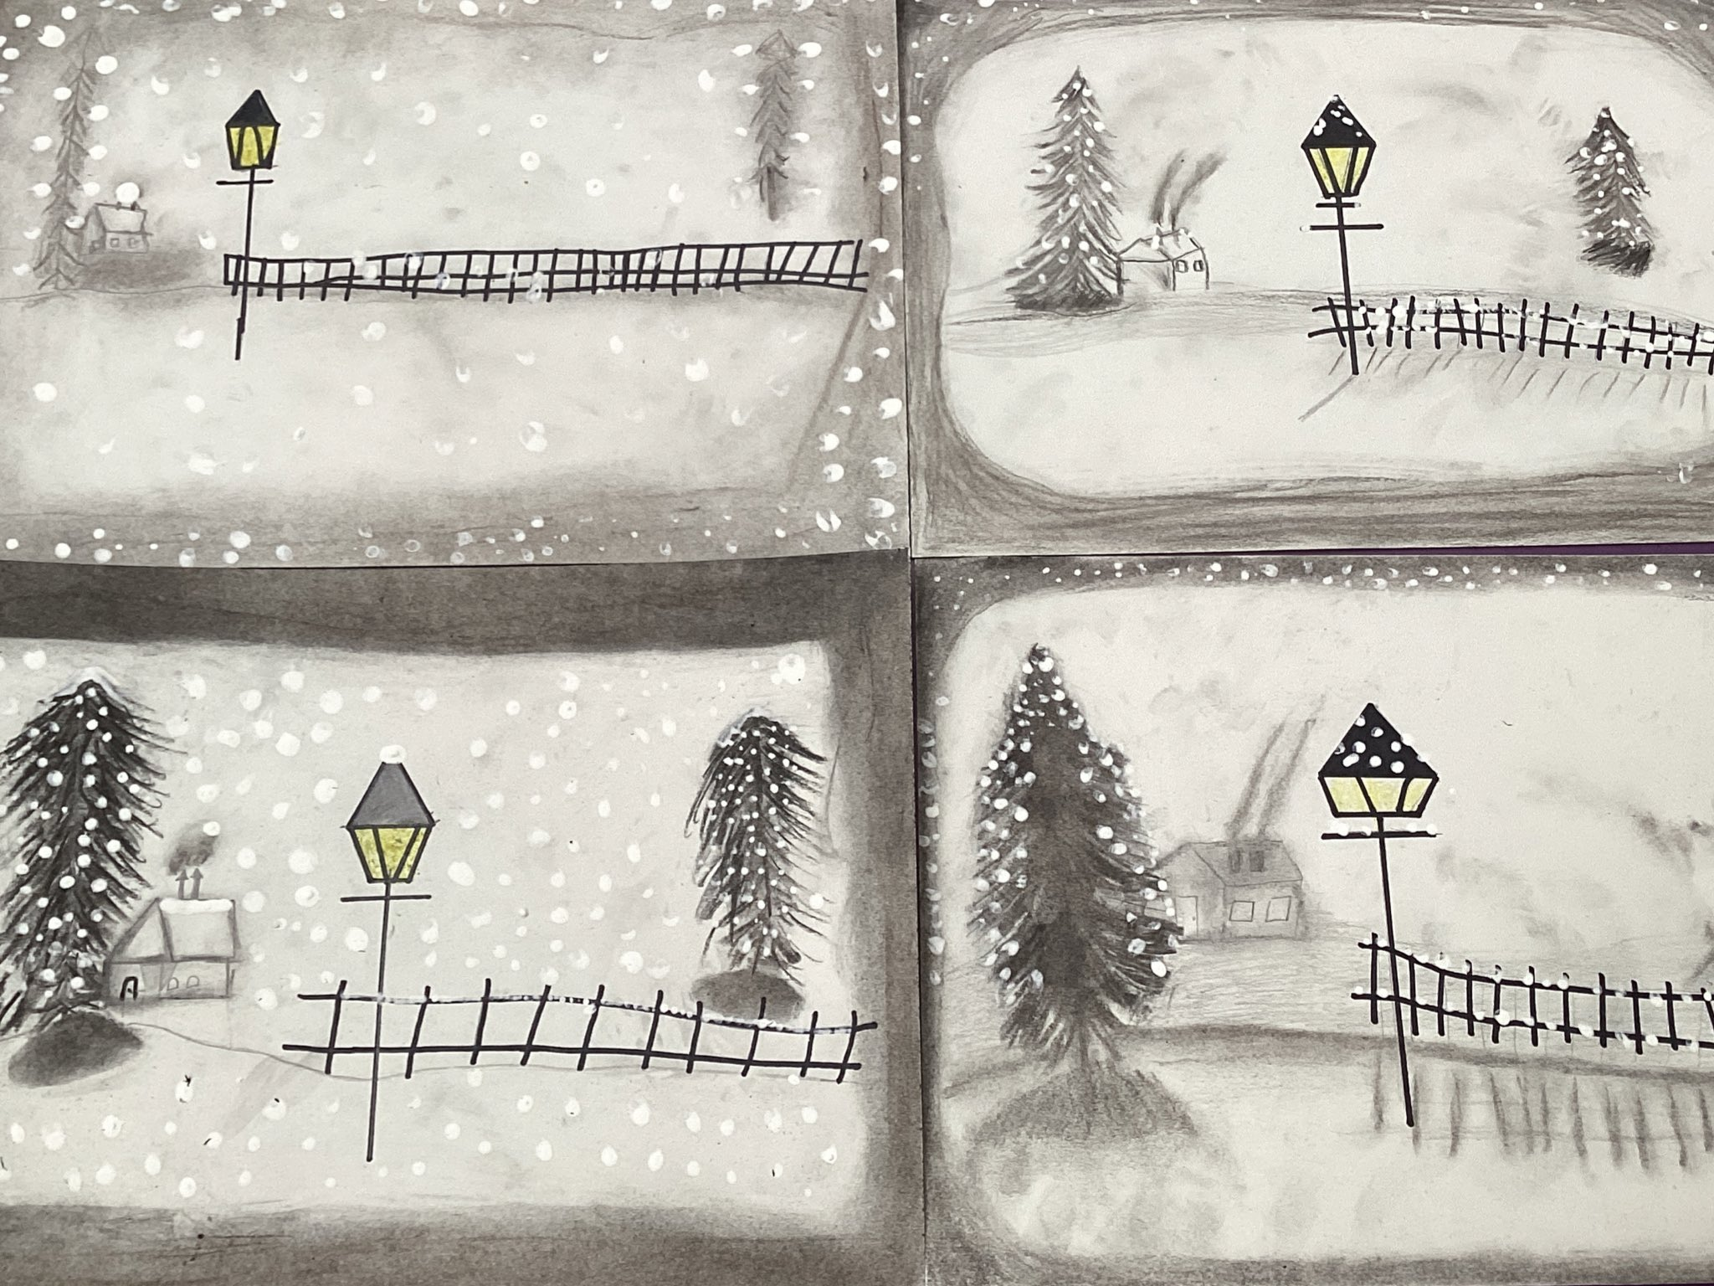
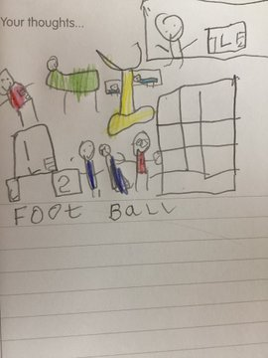
This week…..

Slide 4
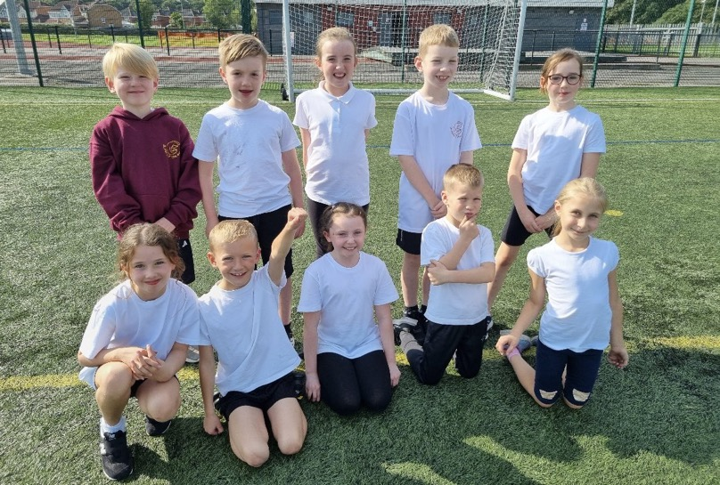
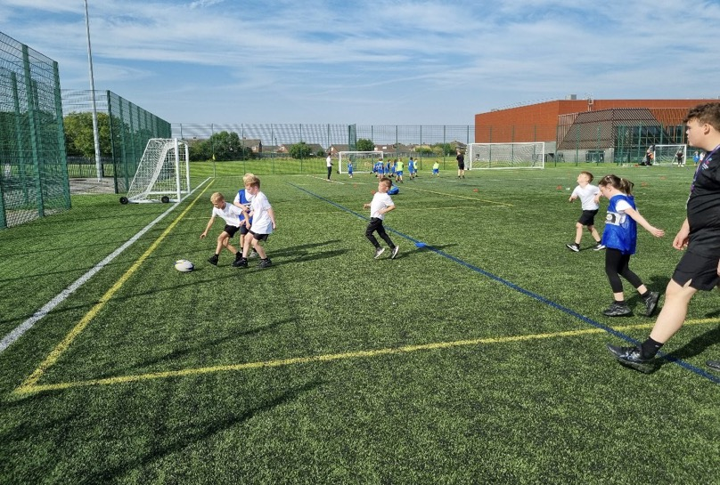
Rugby Stars

Slide 5


Slide 6

This week’s attendance is 96.84%
The class with the highest attendance is Y3 with 99.63%

Slide 7

Year 1 – Kaja
Year 2 – Sebastian
Year 4 – George
Year 6 – Sophia

Slide 8

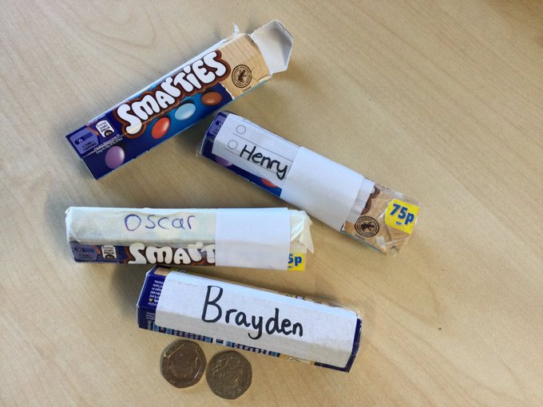


Slide 9

Celebrating our achievements outside of school!

Slide 10
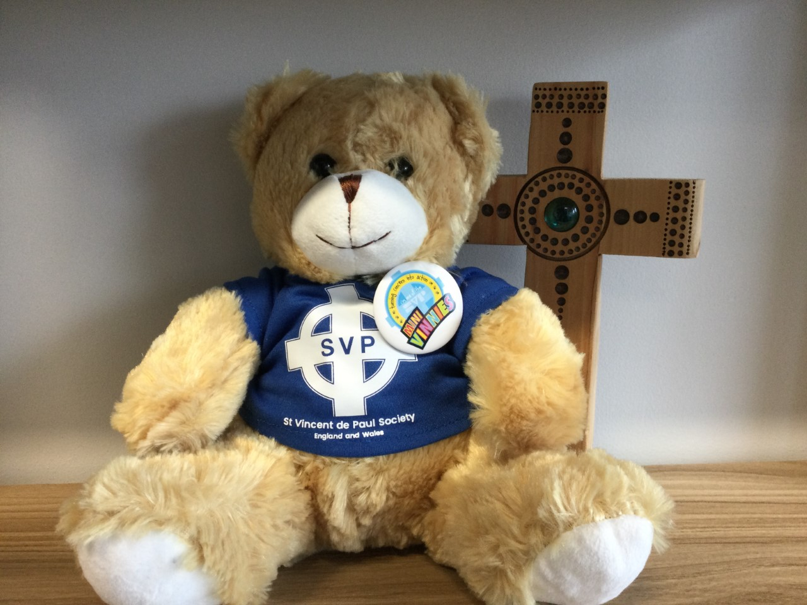

Slide 11
