Slide 1


Friday 11th October
Celebration Assembly

Slide 2
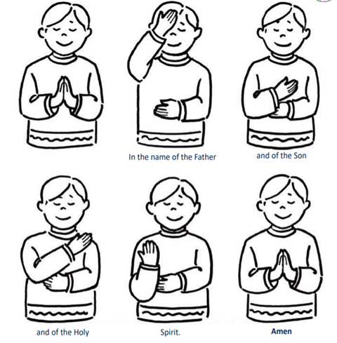

Gather…
We gather together as one family, as we pray…

Slide 3


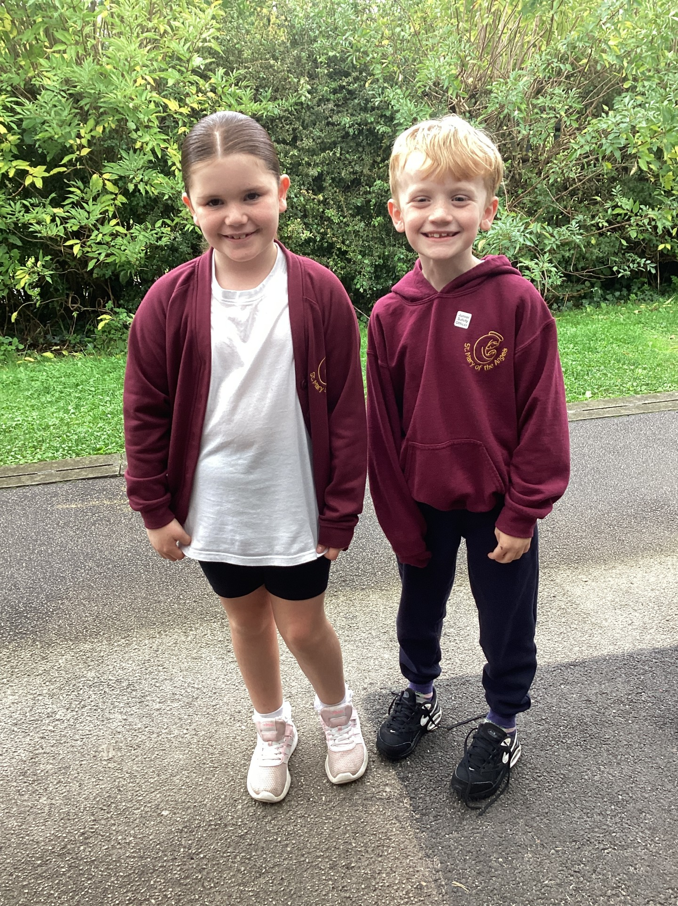

Slide 4
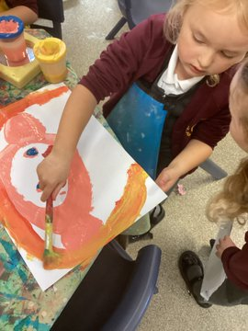
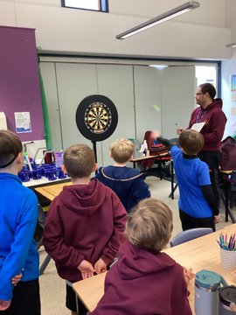
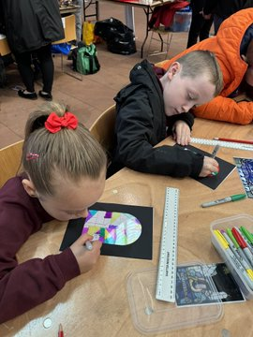
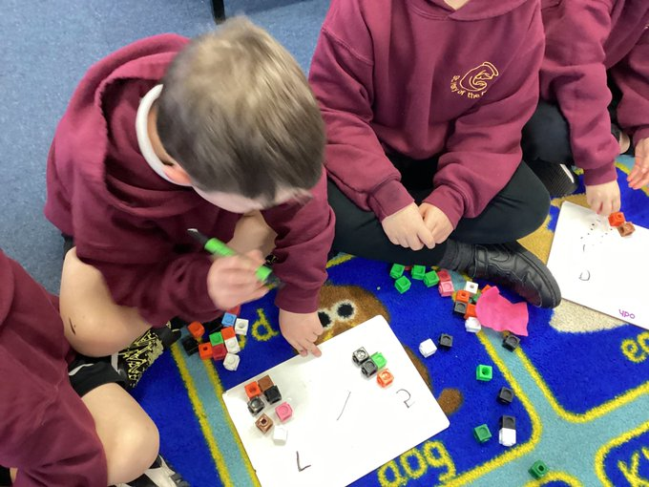
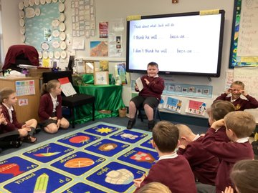
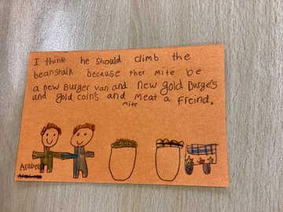
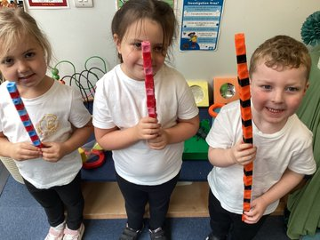
This week…..

Slide 5

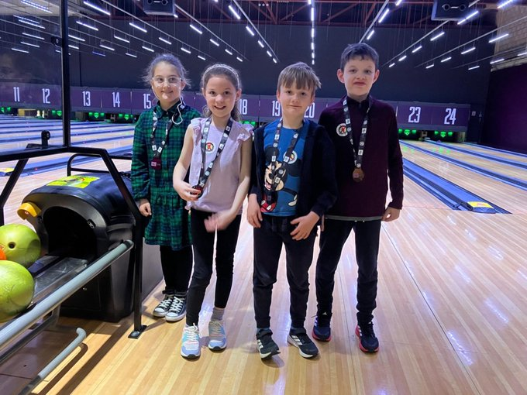
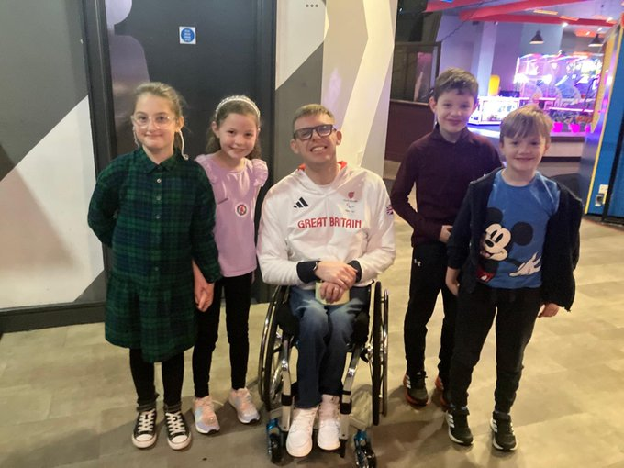
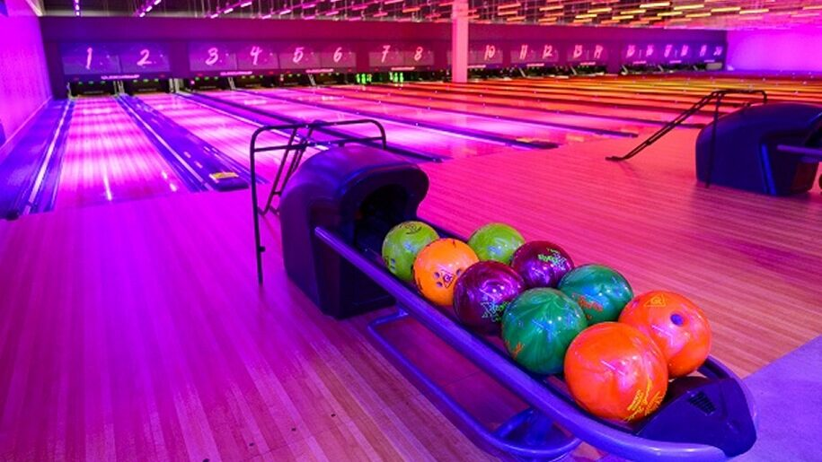
This week…..

Slide 6


Slide 7


Slide 8

This week’s attendance is 98%
The class with the highest attendance is Y3 and Y4 with 100%

Slide 9

Y1 – Darci, Louie, Tommy
Y2 – Elliot
Y3 – Maja, Reggie

Slide 10
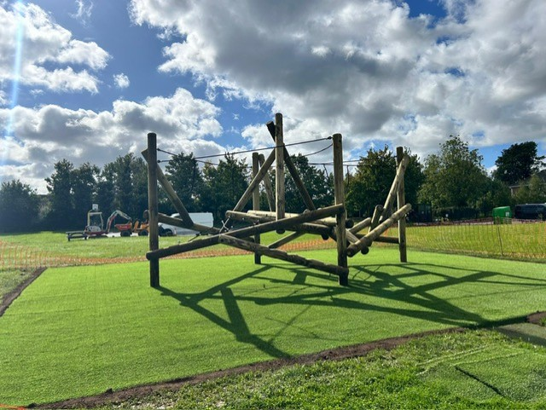

Slide 11

Celebrating our achievements outside of school!

Slide 12
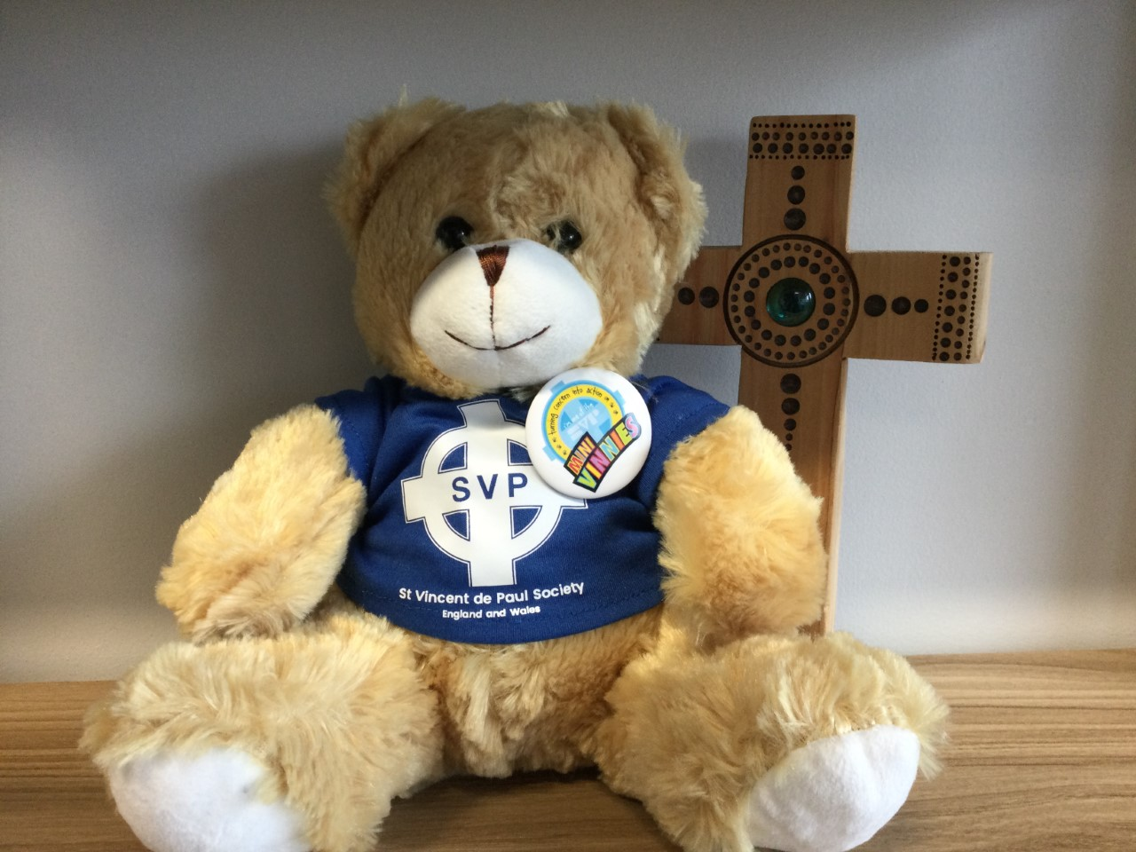

Slide 13
