Slide 1
Strangers

Slide 2
What is a STRANGER?
A “stranger” is someone you and your family do not know.
A stranger does not always look mean or scary!

Slide 3
What DO they look like then?
Most strangers look innocent and act very friendly! Some strangers may look nice and dress well.

Slide 4
You can NEVER tell how a stranger will be by their looks!

Slide 5
There are two kinds of “Strangers”...
The first kind of stranger is “A Good Stranger”
What are some examples of good strangers?

Slide 6
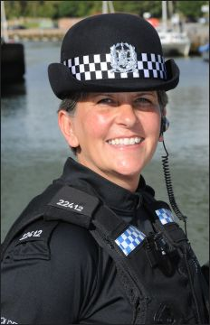
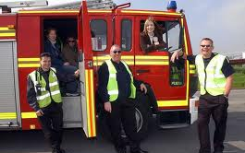
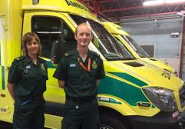
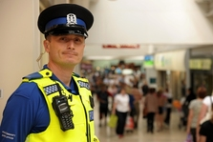
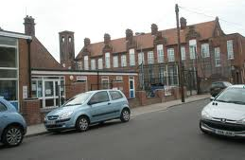
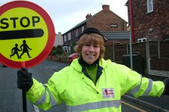
“Good Strangers”...
Police Officer/PCSO
Firefighters/Paramedics
Adults in a school
School crossing patrol

Slide 7
Good Strangers are...
Safe Adults. Adults, or grown-ups, that we know will help us if we need it. Safe adults can be lots of different people…
Managers at McDonalds - If you are being followed and you duck into the nearest fast food restaurant or open business.
Neighbours that display the “Neighbourhood Watch” sign in the front window of their homes. They will call the police and your parents if you need help or feel like someone is watching you or trying to talk to you!

Slide 8
Talk To Your Parents About Who A Safe Adult Is
Your parents love you and can give you important advice on who in your life are “safe adults”.

Slide 9
The BIG 3...
There are 3 things to remember...
Now, these are easy, and there will be a quiz at the end
If a stranger offers you sweets, or a toy to come with them, you should…

Slide 10
Say No Loudly!
It is OK to say NO to someone you don’t know!
Say it loud and clear, let them know you mean it!

Slide 11
RUN AWAY
Make Lots of Noise
Run Away Fast
Find A Safe Adult

Slide 12
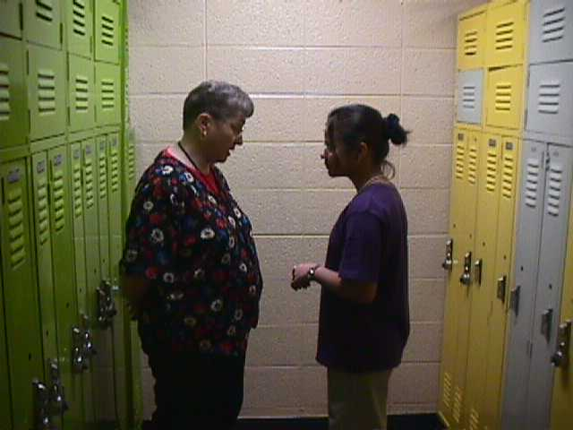
TELL A SAFE ADULT
Your parents and the police cannot help you, AND OTHERS, if we don’t know something happened!
Tell your teachers or parents right away.
They will tell the police what happened so we can do our job.

Slide 13
***QUIZ***
1. What was rule #1?
2. What was rule #2?
3. What was rule #3?

Slide 14
ALWAYS tell a safe adult if...
A stranger tries to get you to go someplace with them
A stranger offers you sweets or money or a toy. DON’T TAKE ANYTHING FROM A STRANGER
A stranger asks you to go any place with him or her. IF YOU DON’T KNOW…DON’T GO
A stranger tries to join in when you are playing
A stranger asks you to do anything that makes you feel funny, or uncomfortable
It is OK to say NO to a stranger. Be safe and don’t take any chances!!

Slide 15
What you SHOULD know...
1. Your name, address, and phone number
2. Your parent’s names and work phone numbers
3. What number you call in an emergency
The EMERGENCY number is...
999

Slide 16
Rules To Live By...
Only play in SAFE places
NEVER play in an unfamiliar place
Have a friend go with you when you play
DON’T stay out after dark
NEVER go ANYWHERE without your parents’ permission
ALWAYS check in with parents before changing locations, or if late.

Slide 17
Strangers
Based on a presentation from The Huber Heights Police Division Crime Prevention Unit

