Slide 1
Welcome to year six!

Slide 2
Class Structure
We have a class of 29 children in Year 6
We have a range of needs in the class which we cater for through adaptive teaching and specialised interventions
We are supported by Mrs Rickett all week. Mrs Rickett is a HLTA and has extensive experience working amongst Key Stage 2 classes and we are very lucky to have her
Mrs Thorpe and Finch support in the class during a Tuesday afternoon. Mrs Finch is a qualified teacher and also the school SENCO.
We have a big focus on the basics in Year 6 and preparing the children for their next step. In addition, we strive to build up independence more and more this year
With this in mind, we strive for excellent learning behaviour. We want the children to be ready to learn and responsive to feedback
We have a big push on presentation. We want to set the bar high as we want the children to be proud of the work they have produced. You can help at home by supporting your child with letter and number formation.

Slide 3
What must children bring to school?
Uniform all named please, including coats and hats
Water bottle – water only, no juice please, named
Bookbag – named, please bring everyday
No jewellery, make-up, nail varnish
Long hair must be tied back with a plain bobble or hair band
Packed lunches – named, healthy choices, no items with nuts
Plain socks (no branding e.g. Nike tick)
Reading Planners – please bring in every day
Pencil cases and stationery

Slide 4
Rules and Values
We have three school rules that we all follow:
We listen to each other
We look after ourselves and each other
We always do our best
Our school values are taken from the Gospel, and they are: Truth & Justice, Forgiveness & Mercy, Faithfulness & Integrity, Tolerance & Peace, Service & Sacrifice, Humility and Gentleness, Dignity & Compassion

Slide 5
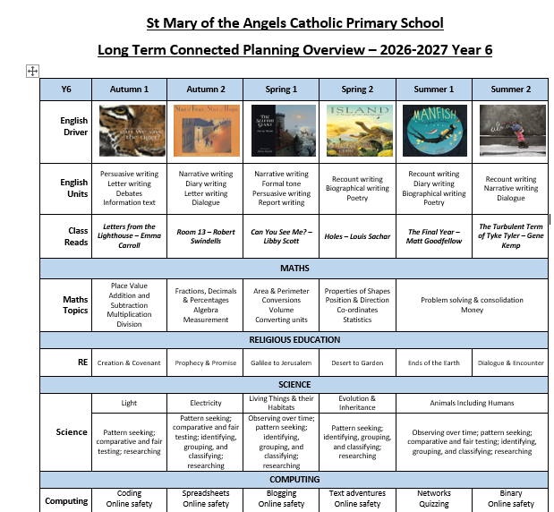

Slide 6
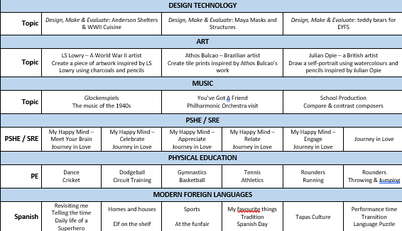

Slide 7
Homework
Set every Friday to be completed by the following Friday
Found on Google Classroom (absence on a Friday no longer an excuse)
Spelling groups are up and running and are based on assessments compiled in the first week
Please use planners to communicate any homework concerns
Atom Learning is used to consolidate Maths objectives taught throughout the week or to recap on prior learning for future teaching - homework is an add on to what we are doing in class
Children should be reading aloud nightly with planners being regularly signed. Questioning is the key in juniors (page 5-6).
As SATs approach, homework will change slightly to reflect the skills needed

Slide 8
SATS
SATs (Statutory Assessment Tests) take place in May 2027 and are an opportunity to assess the children’s progress at the end of Key Stage 2. The children will complete assessments in Reading, Grammar, Punctuation & Spelling, and Mathematics. Writing and Science are assessed through teacher assessment rather than formal SATs tests.
At this stage, there is no need to worry about SATs. Throughout the year, we will continue to build the children’s confidence, address any gaps in their learning and gradually familiarise them with the types of questions and formats they may encounter. We will have a dedicated SATs Information Evening later in the year, where we will go into much more detail about the assessments, how we prepare in school and how you can support your child at home. For now, our focus is on helping the children to have a happy, successful and enjoyable Year 6.

Slide 9
How can you help at home?
Make time to chat about your child’s day, share ideas and opinions, and encourage them to explain their thinking. These everyday conversations are a great way to develop vocabulary, confidence and oracy skills.
Read regularly. Encourage your child to read every day and talk to them about what they have read. Ask questions, discuss unfamiliar words and encourage them to explain their thoughts using evidence from the text.
Support homework, but encourage independence. Help when needed, but allow your child to have a go, make mistakes and work things out for themselves. Developing independence is an important part of Year 6.
Keep a consistent bedtime routine. A good night's sleep makes a huge difference to children's concentration, mood and readiness to learn. Find a routine that works for your family.
Make use of the resources we provide. Our school website and online platforms contain useful resources and links to support learning at home.
Most importantly: encourage, praise and celebrate their effort. We want children to feel confident about their learning rather than worried about getting everything right.

Slide 10
Home school communication
Brief chats at the beginning and end of the day
Email – admin@smota.co.uk
Phone calls
Newsletter
• Parents’ Evening – Autumn and Spring term
Reports in December and at the end of summer term
Coffee Afternoon
Praise post-cards/emails

