Slide 1


Welcome to Year 3
Mrs Turley | Wednesday 16th September

Slide 2

YEAR 3 TEAM
Mrs Turley
Class Teacher
Miss Bridgeman
Teaching Assistant
Mrs Robinson
Teaching on Wednesdays
2

Slide 3
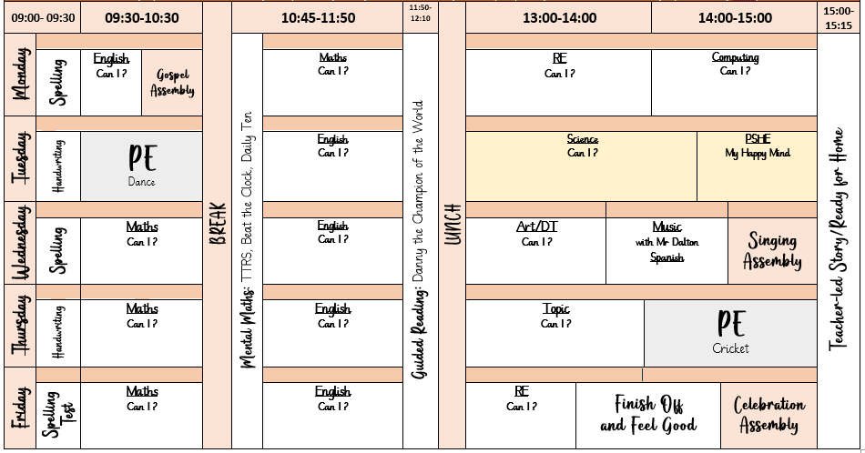
WEEKLY SCHEDULE
3
PE:
Tuesdays (Dance) and Thursdays (Cricket). Please ensure your child comes to school in their PE kit on these days. Earrings must be removed.

Slide 4
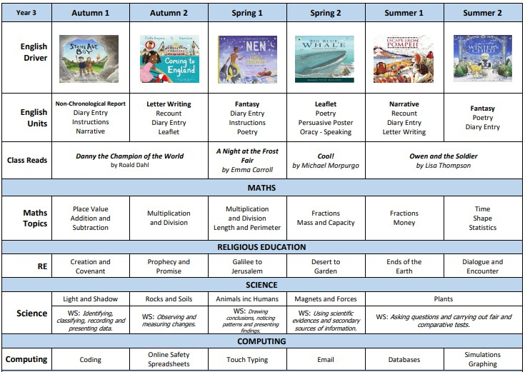
LONG TERM PLAN
4

Slide 5
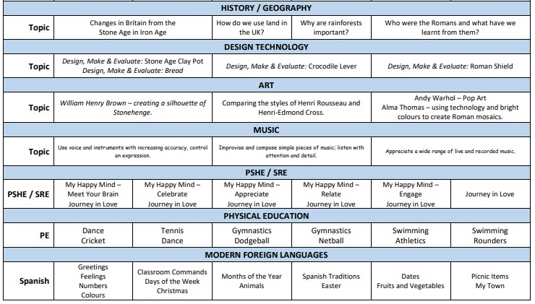
LONG TERM PLAN
4

Slide 6
ASSESSMENT
Year 2 SATS
This assessment has informed our planning and transition notes.
Year 4 Times Tables Testing
In Year 4, all children will be tested on their ability to recall the times tables
up to 12. They have 25 randomised questions, and must answer each question correctly within 6 seconds.
By the end of Year 2, children should have a solid understanding of their 2s, 5s and 10s.
By the end of Year 3, children should have a solid understanding of their 3s, 4s and 8s.
Internal Assessments
Weekly – spelling tests
Half-termly – end of unit maths tests, independent writing Termly reading, spelling and maths tests

Slide 7
HOMEWORK
Google Classroom is our homework platform. Every Friday, new tasks will be uploaded for the children to complete at home.
Weekly spelling tests will be held each Friday. Children should also read daily at home and record this in their reading diary. TTRS (Times Tables Rock Stars) and EdShed are fantastic tools — please encourage regular practice!
Weekly note in reading records.
6

Slide 8

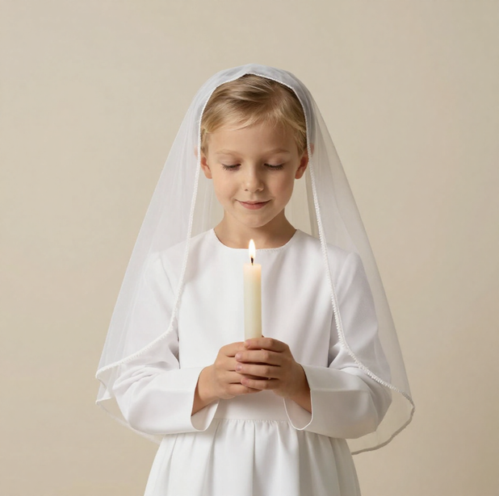
FIRST HOLY COMMUNION
Sacramental Programme Meeting: Early January in school
Enrolment which will be in church
First Forgiveness: April - church
First Holy Communion: Saturday in May.
7

Slide 9

SWIMMMING
During the school day.
Part of the National Curriculum.
Children will be assessed during the final week:
-Can I swim 25m unaided?
-Can I perform safe self-rescue?
Information will follow in Spring Term
8

Slide 10
KEY DATES
Forest School Dates:
Thursday 1st October
Thursday 3rd December
Thursday 11th February
Thursday 22nd April
Thursday 24th June.
Please ensure your child wears old, weather-appropriate clothing on these days.
Curriculum Enrichment
Beeston Castle - 22nd October
Amazing Light Workshop - 3rd November
Little Sutton Library Visit - 10th November
Local Area Land Use Walk - 21st January
Yr3/4 Coffee Afternoon - 12th February
Rainforest Animals Workshop - 9th March
Chester Romans DEWA Trip - 22nd June
9

Slide 11
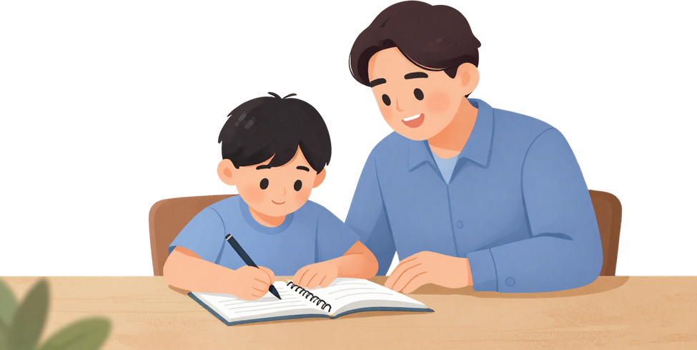
SUPPORTING YOUR CHILD
Ask about their learning each day - find out what topics they are exploring and show interest in their work.
Encourage independence by letting them try tasks on their own before stepping in.
Ensure early nights so they arrive at school rested and ready to learn.
Work together as a team - we are partners in your child's education, so please don't hesitate to get in touch with me.

Slide 12

THANK YOU
Parents Evening: Wednesday 21st October

