Slide 1

Year 4 Parents’ Meeting
Mr Dalton Wednesday 16th September

Slide 2
Agenda
The team and class
Important dates
Assessment
What we’ll be covering this year
Homework
What can you do?
Questions

Slide 3
The Team and Class
Mr Dalton
Mrs Thompson-Jones
Mrs Halpin

Slide 4
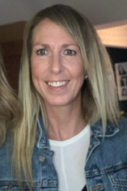
Learning Mentor – Mrs Filson
At St. Mary of the Angels Catholic Primary School, we firmly believe that through nurturing the health and wellbeing of our pupils, we assist them in improving their academic outcomes and enjoying a positive-lifelong journey in education.
Mrs Filson can support children and families struggling with:
Anxiety and worries
Difficulties at home
Poor behaviour for learning
Issues concerning bullying/friendships/social anxieties
Dealing with bereavement/loss
General disaffection and disengagement from learning
Worries about transferring from primary to high school
Difficulties with organisation
Anger Management
SEMH- Social skills, Self-esteem, Honesty, Positive thinking
Emotional Literacy Support Assistant (ELSA)
Mental Health

Slide 5
Class Expectations
Rewards and sanctions – we give out Green Dojos for good behaviour. The top three each week get a small reward.
If a child is spoken to about something they will be given a warning as a chance to change their behaviour. If I need to speak to them again I will put their name on the board. This can be removed if they change their behaviour. If it is still there at the end of the session they will receive a Red Dojo and miss 5 minutes of their playtime.
Red Dojos work alongside Green Dojos and do not take away from them.
In Year 4, we have a culture of high expectations although at an age appropriate level. Especially earlier in the year, we are trying to foster independence and encouraging the children to make some decisions for themselves, rather than repeatedly asking the adults in the room. This of course is not about support but for instance recognising what to do when they have finished their work.

Slide 6



Some things you might have heard of...
Toileting – In a classroom situation, we want to get the balance right between allowing children to go the toilet but in a way that is not too distracting. We encourage the children to go at breaktimes but also have a toilet book in use. As long as children are not going multiple times during lessons, it is not an issue.
Any child with a particular issue is free to go as they please.
Darts – Contrary to popular belief we don’t actually plays darts that often in class-times. It is used for some fun maths games and to teach the children about mental maths. Mostly it is used as a reward tool, and children are sometimes allowed to stay in and play it at breaktimes and lunchtimes. An adult is always with them at these times.
Pen Licence – Handwriting is an important skill, and the Pen Licence can be a great motivator for children to improve. Children need to demonstrate neat handwriting for a prolonged period across all of their work, rather than just individual pieces.

Slide 7
Important Dates
PE Days:
Monday and Thursday afternoon. Please make sure your child comes dressed in their PE kit on these days
INSET days:
Friday 23rd October
Parental information:
Parents evening: Wednesday 21st October
Termly reports: Friday 18th December

Slide 8
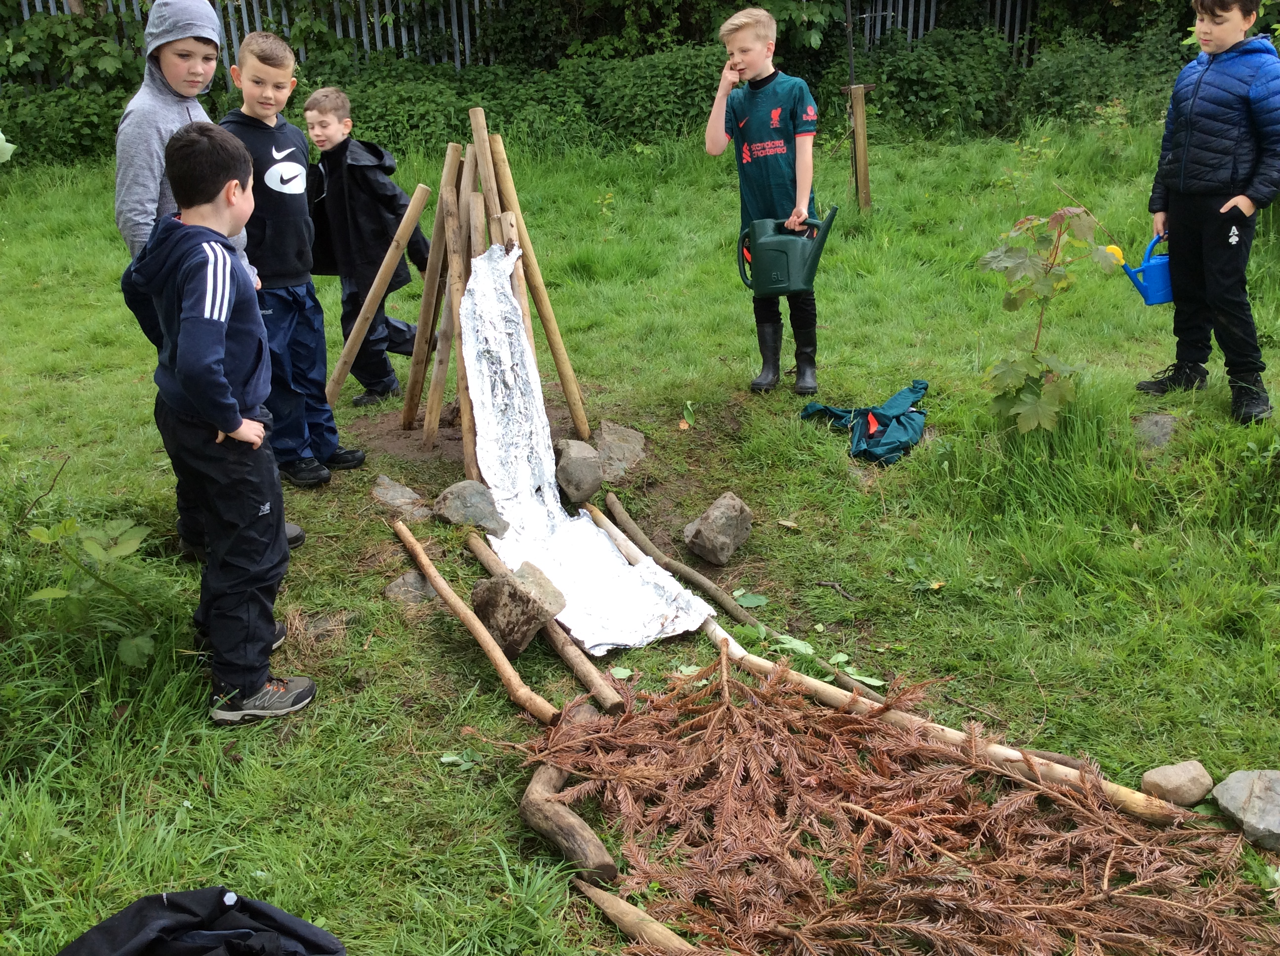
Important Dates
Forest School:
24th September
26th November
28th January
15th April
17th June
Trips and visits:
16th October– Electricity Workshop
Nov/Dec– Ancient Egyptians Day – Past Productions
4th February – Barnstondale
Future trips
9th October – Trip to library
16th December – Whole School Trip to Panto

Slide 9
Assessment information
Termly Assessments
We will assess the children formally every half-term in reading and maths, and they will receive a level for this reading. These will be reported to parents termly and are a useful tool for teachers regarding interventions.
Year 4 Times Tables Testing
In June, all children are tested on their ability to recall the times tables up to 12. They have 25 questions and must answer each question correctly within 6 seconds.
TT Rockstars is a useful tool for this. Also practising specific times tables on Hit the Button can be good practice.

Slide 10
What we’ll be covering this year
A number of interesting topics and areas of interest!
Topic:
Was Ancient Greece that same as modern Greece?
Who were the Ancient Egyptians?
Mountains and Rivers
Science:
Electricity, Sound, Human Nutrition, Changes of State, Living Things, Habitats
Religious Education:
Creation & Covenant, Prophecy & Promise, Galilee to Jerusalem, Desert to Garden, Ends of the Earth

Slide 11
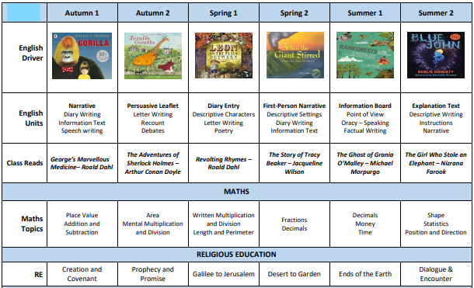

Slide 12


Slide 13
Homework
Google Classroom
Each Friday, all homework will be uploaded onto Google Classroom
This will include 10 spellings based on their group, which will be assessed the following Friday
This might also include an activity which will be relevant to that week’s learning, which should help you child to consolidate any prior understanding – please use the school planners to communicate with school regarding any support that may be needed.
If needed children will be provided with a paper copy – they can often annotate and upload that way
Most homework will not be set on Atom Learning

Slide 14
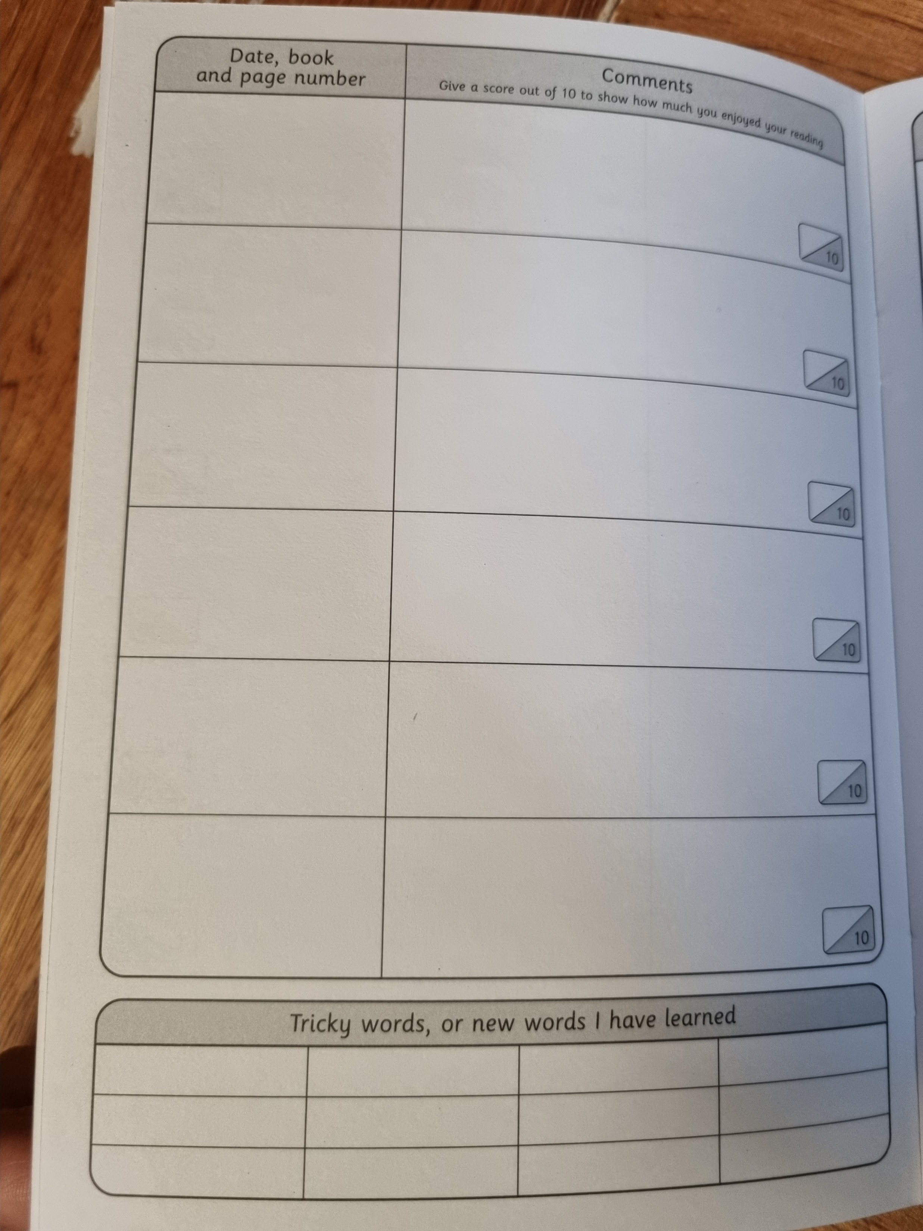
Homework
There is also an expectation that you child reads every night, and accesses TTRS and EdShed
  Daily reading with an adult continues to be the main and most valued homework activity that you can do with your child, please update this in the school planner
  TTRS is essential especially this year. Children are expected to complete one soundcheck per week at a minimum – this will be checked on a Friday
  Homework timings fully comply with national guidance and are referred to in the school planner

Slide 15

Reading at home
As the children are getting older, the focus for reading is different from when they were younger and it was mostly about sounding out words.
A key skill is working on fluency. This is the ability to read at a comfortable pace without hesitation. Often this is linked to confidence and ‘trusting the text’. Try not to overly correct them if the understanding is still fine.
A big part of this is choosing the right text. Some children will become free-readers this year, but that doesn’t mean they jump straight to War and Peace! It should still be a book that they can access, and one that isn’t too daunting. Here is a website with some age appropriate ideas: Best Books for Year 4: Recommended Booklist for Ages 8-9 (booksfortopics.com)
When reading, try to focus more on what they are understanding and asking them questions about it to see that they are taking it in. Questions to ask your child during reading - Growing Young Minds (gyminds.co.uk) is a good list of ideas you could ask them.

Slide 16
What Can You Do?
Work as a team – I am only an email or a call away so please feel free to contact me. Ask if you have any questions or concerns
Ask you children about their day and their learning, they might be reluctant to share but they might verbalise if they were finding something difficult
Little things: using a watch, money, asking questions.
Encourage them to actively practise spellings too, rather than just writing them out
Encourage independence as this will help them in the long run. This can be getting their things ready for the school day, reminding parents about reading or completing their homework
Early nights – sleep is so important to development, especially during early years

Slide 17

The WhatsApp Group…
A fact of modern-life and they can be very useful for remembering things and clearing things up
However, they can also create confusion and rumour can spread before the facts have been made clear. I know this first hand as a parent who has been in these groups
All I would ask is that you contact me first when possible. I’m more than happy to accept if I’m in the wrong and often things aren’t as bad as they seem. Also, I’m not dogmatic: if something isn’t working or there is a better idea I am open to change
If you’re still not happy, then vent away!

Slide 18
Any Questions?

