Slide 1
Welcome to
Year 1
Meet the Teacher 2026/27

Slide 2
Aims
Meet the team
Class structure and layout
Curriculum
Expectations - Classroom, Homework, PE, Dojos
Any questions?

Slide 3
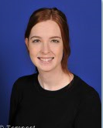
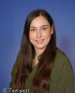
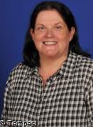
2026-27
The Team
Miss Hart
Mrs Robinson
Mrs Williamson

Slide 4
Class Structure
We have a class of 30 children in Year 1.
Miss Hart teaches Monday - Wednesday and Mrs Robinson teaches Thursday and Friday.
We are supported by Mrs Williamson all week.
We begin the school year using continuous provision to ease the transition into formal learning.
We have a big focus on phonics and learning to read in Year 1. We also aim to embed the foundations of maths to support learning throughout their school life.
We have a big push on presentation. We want to set the bar high as we want the children to be proud of the work they have produced. You can help at home by supporting your child with letter and number formation.

Slide 5
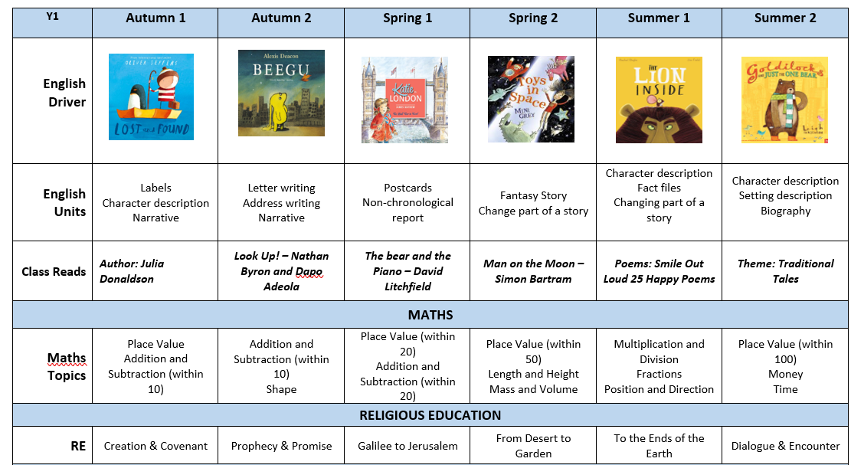
Long Term Plan
26-27
Su
Mo
Tu
We
Th
Fr
Sa
01
02
04
05
06
07
08
09
11
12
13
14
15
16
18
19
20
21
22
23
24
25
26
27
28
29

Slide 6
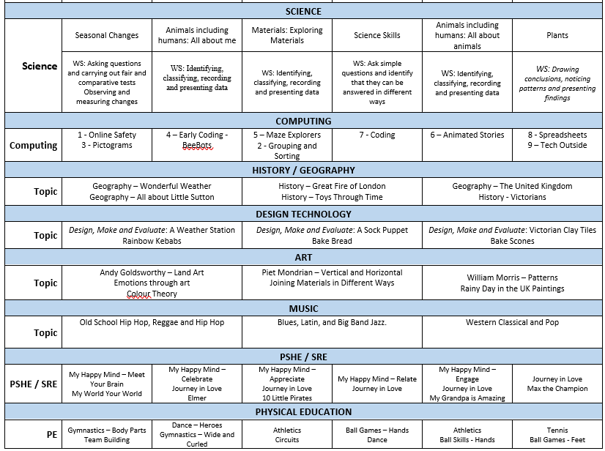
Long Term Plan
25-26
Su
Mo
Tu
We
Th
Fr
Sa
01
02
04
05
06
07
08
09
11
12
13
14
15
16
18
19
20
21
22
23
24
25
26
27
28
29

Slide 7



Slide 8

Reading at Home
Reading at home is expected daily and to be recorded in reading diaries
Your child will have 1 x RWI book and 1 x book banded book
These will be changed weekly
We will be offering a phonics workshop to all parents in Y1 and Reception to support with your reading journey. This will be on Tuesday 17th November

Slide 9
Homework
Set on the first Friday of each half term. This will begin from Friday 18th September.
Found on Google Classroom - log ins will be the same as last year and found in your reading diaries.
This will be a selection of activities to support your child’s education at home. There is no expectation to provide evidence for school.
The suggestions listed are linked to current learning.
Please use planners to communicate any homework concerns.

Slide 10


Slide 11
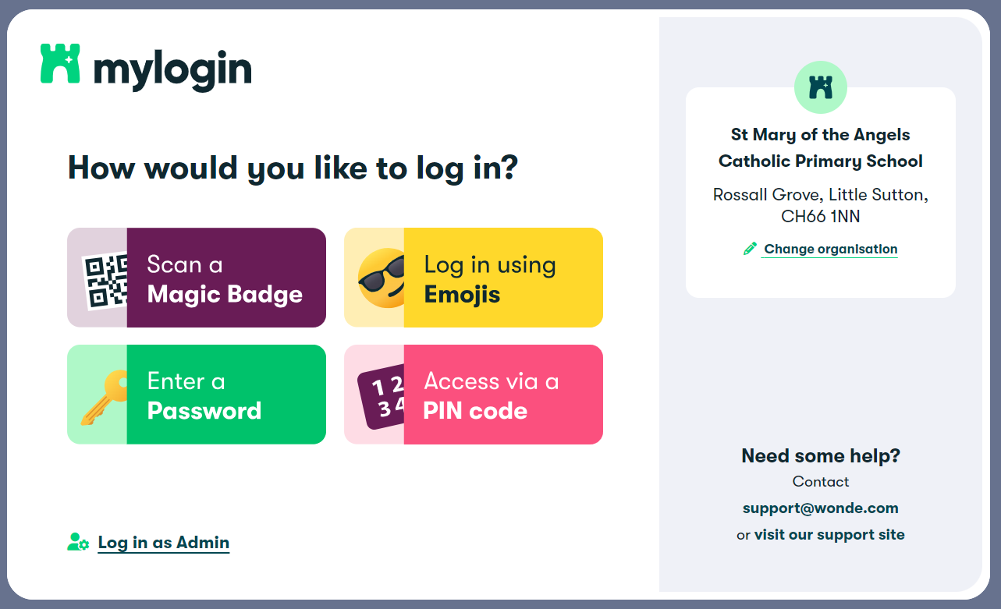
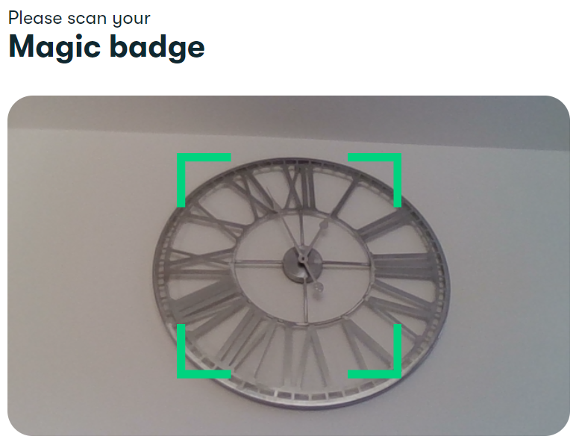
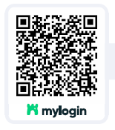
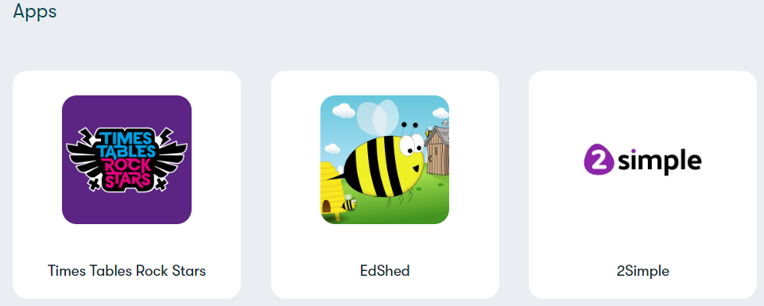
MyLogin
Homework might occasionally be found on MyLogin, this is how you access it.

Slide 12
PE Days
PE will be delivered on a Tuesday and Friday.
ALL jewellery and watches must be removed and staff cannot help.
Suitable footwear - not fashion trainers

Slide 13
Any questions?

