Slide 1

Welcome to Year 5
2026-27

Slide 2
Staffing
Mr Campbell
Mon – Tue – Weds – Fri
Mrs Finch
Thurs
Teaching Assistants
Mrs Teese
Mon – Fri
Mrs Rickett
Mon PM
Forest School (Thurs)
Mr Thorpe

Slide 3
Rules & Values
We have three school rules that we all follow:
We listen to each other
We look after ourselves and each other
We always do our best
Our school values are taken from the Gospel, and they are: Truth & Justice, Forgiveness & Mercy, Faithfulness & Integrity, Tolerance & Peace, Service & Sacrifice, Humility and Gentleness, Dignity & Compassion

Slide 4
Rewards & Consequences
Rewards may take different forms, including:
Headteacher’s Award
Stickers
Green Dojos
Certificates
Praise Postcard - Emails
If we repeatedly make poor choices, there may be consequences. These can include:
Verbal and non-verbal reminders
Red Dojo
Reflection time
Speaking to parents

Slide 5
Our Curriculum
Our school values are interwoven into everything we do at St Mary’s.
They can be taught as stand alone lessons, through Religious Education, assemblies, or trips and visits and our day to day behaviour choices.
  Our Year 5 Topics are:
  Autumn
  Invasions and Settlements: The battle for the kingdom of England
  Spring
  What’s so special about North America?
  Summer
  The History of Home

Slide 6
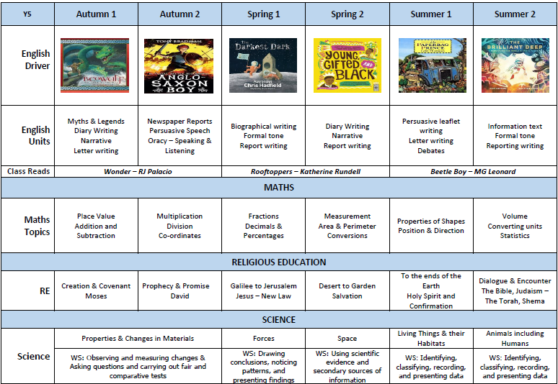
Our core Curriculum

Slide 7
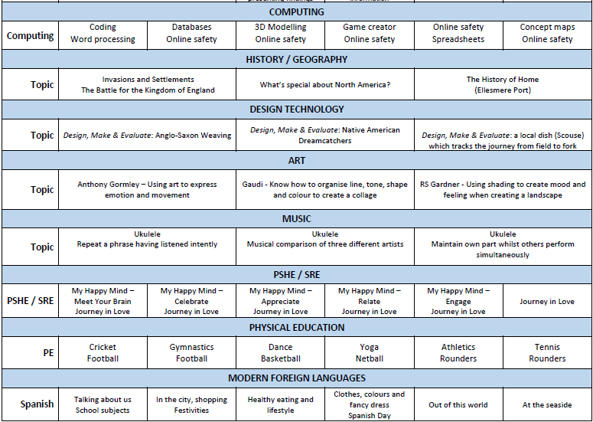
Our Foundation Curriculum

Slide 8
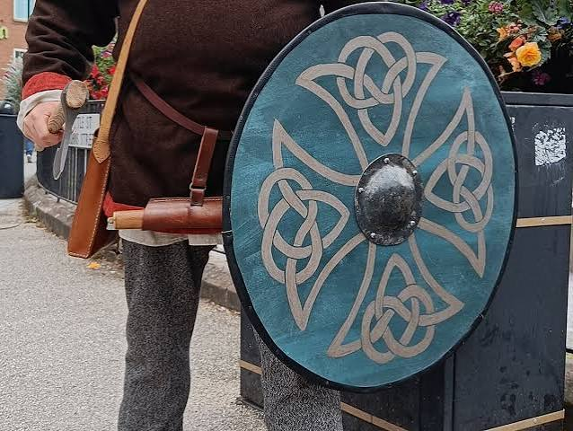

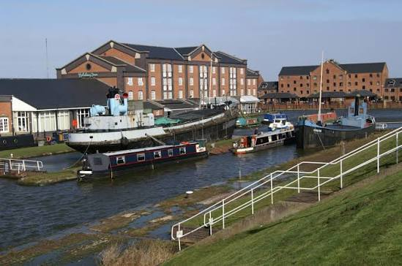
Trips & visits
Chester Viking Experience Day
Monday 2nd November 2026
Liverpool World Museum
Thursday 11th February 2027
Ellesmere Port Boat Museum
Tuesday 25th May 2027

Slide 9
Trips & visits
Year 5/6 Coffee Afternoon
Thursday 22nd October 2.00pm-3.00pm
Cathedral Pilgrim Day
Tuesday 13th October 9.30am – 3.00pm
Little Sutton Library: Purpose & Processes
Tuesday 20th October 1.30pm – 3.00pm
Little Sutton Library: Author Visit
Thursday 4th March 9.30am – 11.30am
Little Sutton Library: Local History
Tuesday 15th June 1.30pm – 3.00pm
Amasing Arts Festival
Tuesday 29th June – 2.00pm – 8.30pm

Slide 10

reading
In class, we will be reading the following amazing novels during the course of the year: Wonder, Rooftoppers and Beetle Boy.
We will use the books for a combination of reading for pleasure and class reading.
During class reading sessions, we will be focusing on developing our VIPERS skills, and they are:
Vocabulary
Inference
Prediction
Explanation
Retrieval
Summarising

Slide 11
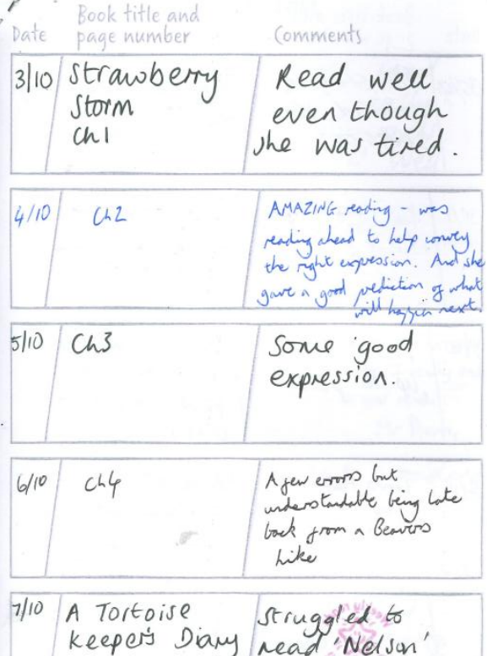
Reading planners
Please strive for 5 reads per week and record these in your child’s planner.
We find comments like this really useful.
By Year 5, we appreciate that the children may sign their own planners from time to time however it is imperative that parents are also signing them several times per week. This goes for both ‘free readers’ and those still on coloured book bands.
Reading is much, much more than fluency and expression and as such answering questions about what the children have read is really important.

Slide 12
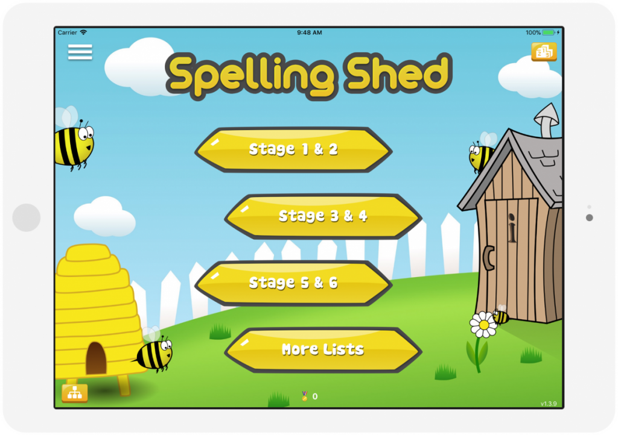
Spelling
Children will have spellings lessons on alternate days, learning different spelling rules across the year.
They will have a spelling test every Friday based on the words they’ve been learning the previous week.
Although Spelling Shed is the scheme we use for teaching spelling, the online platform is not the only way in which the children can practise their spellings for homework.

Slide 13
Atom Learning & Rockstars
Atom Learning is set every Friday to be completed by the following Friday.
The link, along with spellings, can be found on Google Classroom which is updated weekly.
Please use school journals or drop offs to communicate any homework concerns.
Atom Learning is used to consolidate maths objectives taught throughout the week or to recap on prior learning for future teaching.
Please strive for 15 minutes of Rockstars Timestables per week. This can be split across different nights or completed in one ‘chunk’. In Year 5, times tables are a big part of the maths curriculum and needed for accessing fractions, area, perimeter, written methods of multiplication and division… the list goes on.

Slide 14
What do the children need to bring to school?
Uniform all named please, including coats and hats
Water bottle – water only, no juice please, named
Bookbag – named, please bring everyday
No jewellery, make-up, nail varnish
Long hair must be tied back with a plain bobble or hair band
Packed lunches – named, healthy choices, no items with nuts
Plain socks (no branding e.g. Nike tick)
Reading Planners – please bring in every day
Pencil cases and stationery

Slide 15
What do the children need to bring for PE?
PE kits on agreed PE days (Wednesday and Thursday for Autumn 1)
A plain white round-necked Tshirt
Black shorts (not short running shorts)
Black tracksuit bottoms/leggings
Trainers are needed for outdoor PE (spare socks are needed if your child wears tights to school)
The children have the option of wearing their St Mary’s branded sports hoodies on PE days
Please make sure these are all named

Slide 16
Snack
Children should bring to school with them a healthy snack to have during the morning.
School is no longer able to offer bagels. The children will have access to fruit should they have no snack.
Please remember that we are a nut free school and to avoid snacks which contain nuts.

Slide 17
Home-school communication
Brief chats at the beginning and end of the day
Email – admin@smota.co.uk
Phone calls
Newsletter
Instagram
• Parents’ Evening – Autumn and Spring term
Reports in December and at the end of summer term
School website – Year 5 Class Page
Coffee Afternoon
Praise post-cards/emails

Slide 18
Thank you
Any questions?

