Slide 1
Welcome to
Year 1
Meet the Teacher 2025/26

Slide 2
Aims
Class structure and layout
Meet the team
Curriculum
Expectations - Classroom, Homework, PE, Dojos
Any questions?

Slide 3
Class Structure
We have a class of 30 children in Year 1.
Miss Hart teaches Monday - Wednesday and Mrs Robinson teaches Thursday and Friday.
We are supported by Mrs Williamson all week.
We have a big focus on phonics and learning to read in Year 1. We also aim to embed the foundations of maths to support learning throughout their school life.
We begin the school year using continuous provision to ease the transition into formal learning.
We have a big push on presentation. We want to set the bar high as we want the children to be proud of the work they have produced. You can help at home by supporting your child with letter and number formation.

Slide 4
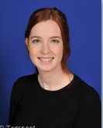
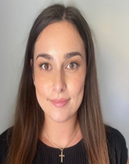
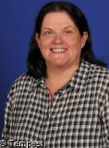
2024-25
The Team
Miss Hart
Mrs Robinson
Mrs Williamson

Slide 5
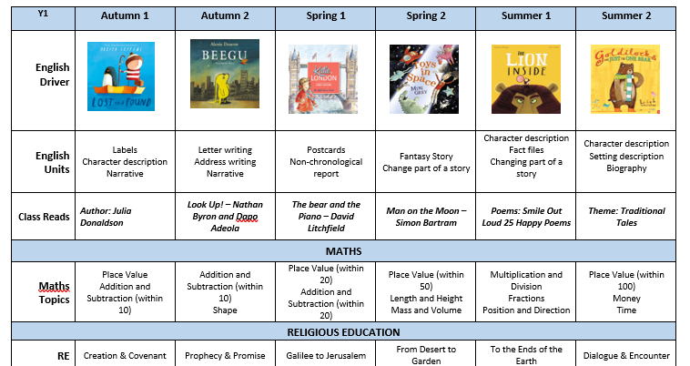
Long Term Plan
25-26
Su
Mo
Tu
We
Th
Fr
Sa
01
02
04
05
06
07
08
09
11
12
13
14
15
16
18
19
20
21
22
23
24
25
26
27
28
29

Slide 6
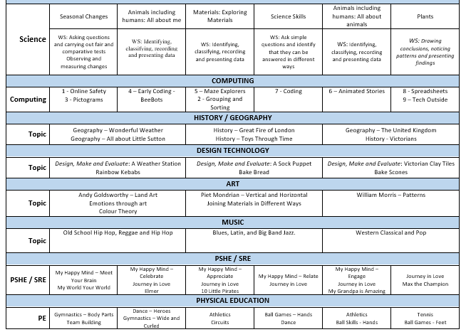
Long Term Plan
25-26
Su
Mo
Tu
We
Th
Fr
Sa
01
02
04
05
06
07
08
09
11
12
13
14
15
16
18
19
20
21
22
23
24
25
26
27
28
29

Slide 7

Dojos are used in class as to support positive behaviour choices. Each week, the child with the most green dojo points will be entered into the ‘dojo raffle’ to win a reward of their choice.
Red dojos are given should a child choose not to follow instructions after an initial warning. Red dojos work alongside our green dojos and children do not lose a positive dojo as a consequence of a poor choice.
We foster a culture of high expectations and for this reason I like to embrace mistakes as learning opportunities. Occasionally, children may be asked to start a piece of work again if standards are not as high as they should be. We want to see the children taking pride in every piece of work they complete.

Slide 8
Reading at Home
Reading at home is expected daily and to be recorded in reading diaries
We change both reading books on a Monday and book banded books again on a Friday. Children will begin to have ownership over changing their own book banded books.
We will be offering a phonics workshop to all parents in Y1 and Reception to support with your reading journey. This will be on Monday 6th October.

Slide 9
Homework
Set every Friday to be completed by the following Friday. This will begin from Friday 19th September.
Found on Google Classroom - log ins will be the same as last year and found in your reading diaries.
Spellings will be linked to the phonics group
Please use planners to communicate any homework concerns

Slide 10
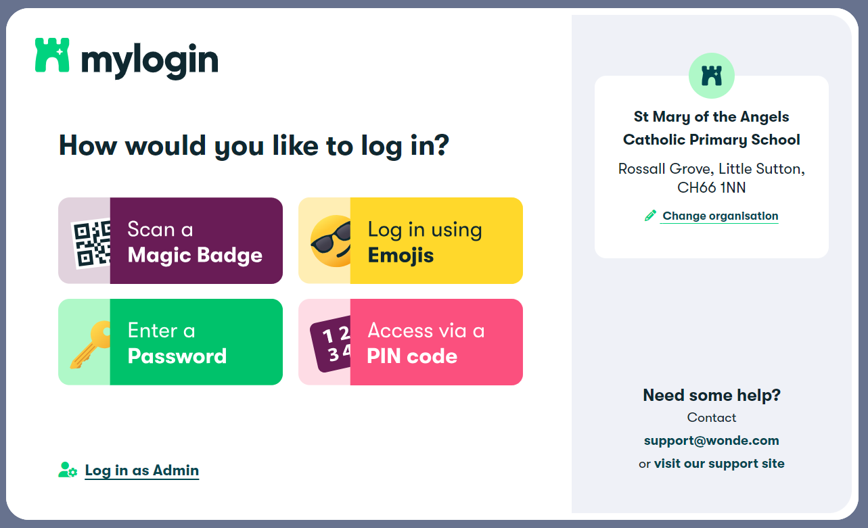
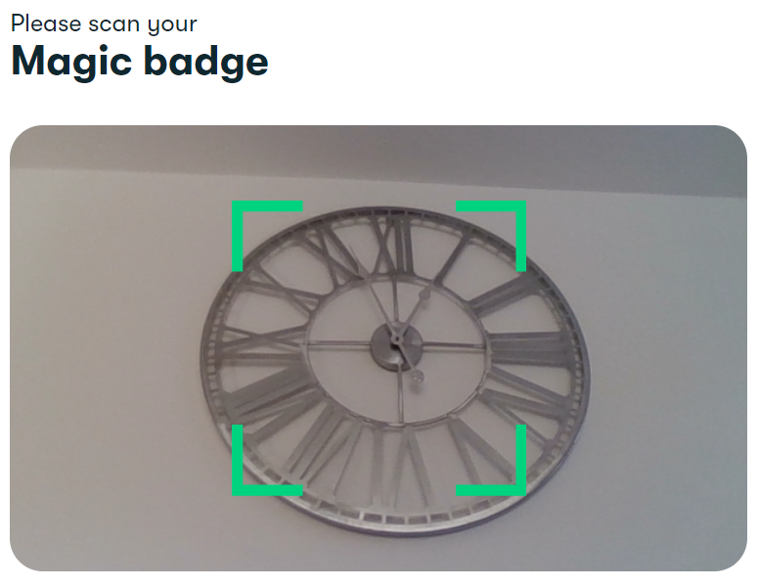
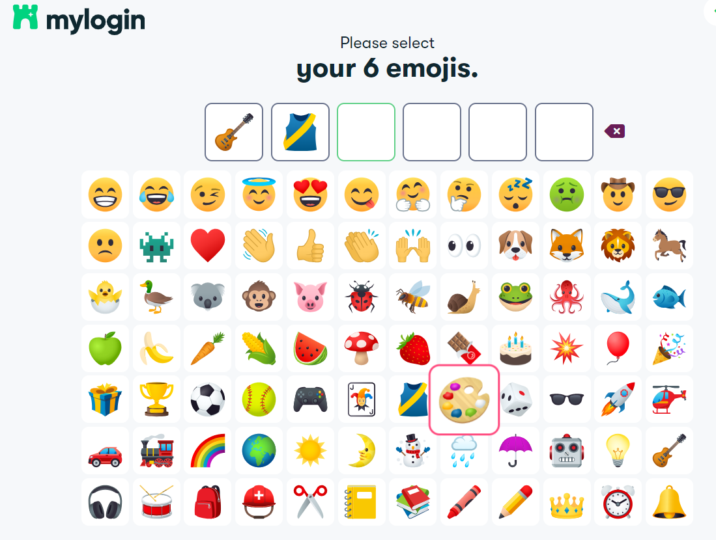
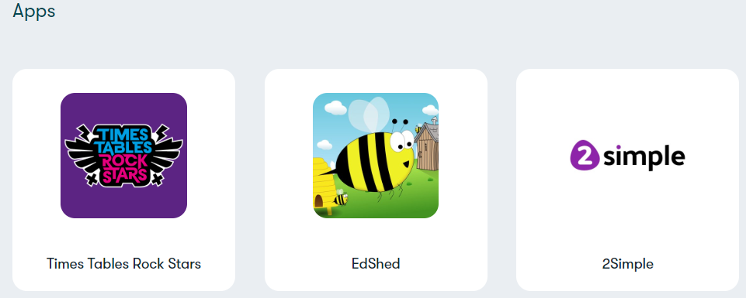
Wonde
Was hopefully to make logging into different apps easier!

Slide 11
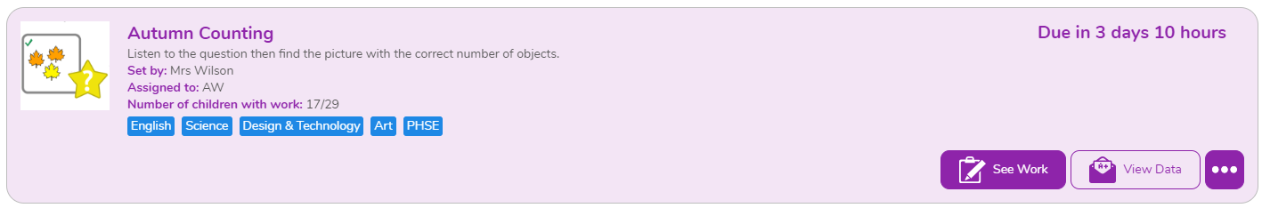
Purple Mash

Slide 12
Useful sites and key dates
Remote Learning Website
https://sites.google.com/smota.school/stmaryoftheangelscatholicprima/home
The link above should speed up your child accessing lots of useful sites that we use in school and recommend for home. Let me know if any of the links don’t work and I can look at amending the site.
PE Days
PE will be delivered on a Tuesday and Friday.
ALL jewellery and watches must be removed and staff cannot help.
Suitable footwear - not fashion trainers

Slide 13
Any questions?

