Slide 1
Welcome to
Year 5
Meet the Teacher 2025/26

Slide 2
Aims
Class structure and layout
Meet the team
Learning Mentor
Curriculum
Expectations - Classroom, Homework, PE, Dojos
Useful websites, dates and Forest School
What you can do
Any questions?

Slide 3
Class Structure
We have a class of 29 children in Year 5
We have a range of needs in the class which we cater for through adaptive teaching and specialised interventions
We are supported by Mrs Rickett all week. Mrs Rickett is a HLTA and has extensive experience working amongst Key Stage 2 classes and we are very lucky to have her
Mrs Finch supports in the class during a Thursday (management time). Mrs Finch is a qualified teacher and also the school SENCO. We are also supported by Miss Bridgeman this year on a Thursday and Friday afternoon.
We have a big focus on the basics in Year 5 and preparing the children for their final year with us
With this in mind, we strive for excellent learning behaviour. We want the children to be ready to learn and responsive to feedback
We have a big push on presentation. We want to set the bar high as we want the children to be proud of the work they have produced. You can help at home by supporting your child with letter and number formation.

Slide 4
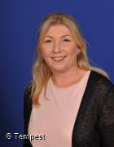
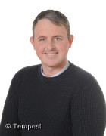
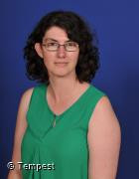
2025-26
The Team
Mrs Finch
Mrs Rickett
Mr Campbell

Slide 5
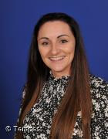
Learning Mentor
Miss Hennessy
At St. Mary of the Angels Catholic Primary School, we firmly believe that through nurturing the health and wellbeing of our pupils, we assist them in improving their academic outcomes and enjoying a positive-lifelong journey in education.
Miss Hennessy can support children and families struggling with:
Anxiety and worries
Difficulties at home
Poor behaviour for learning
Issues concerning bullying/friendships/social anxieties
Dealing with bereavement/loss
General disaffection and disengagement from learning
Worries about transferring from primary to high school
Difficulties with organisation
Anger Management
SEMH- Social skills, Self-esteem, Honesty, Positive thinking
Emotional Literacy Support Assistant (ELSA)
Mental Health

Slide 6
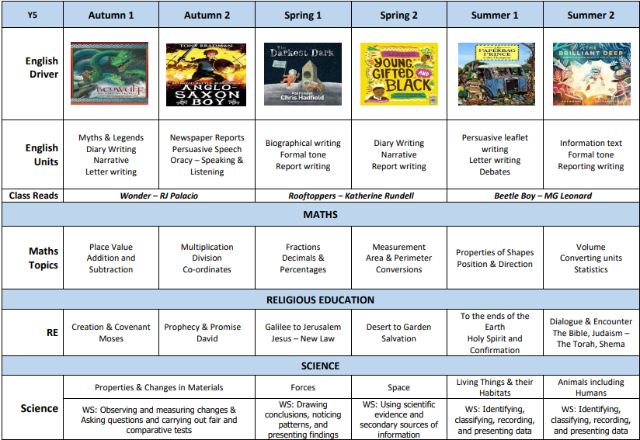
Long Term Plan 2025-26
Su
Mo
Tu
We
Th
Fr
Sa
01
02
04
05
06
07
08
09
11
12
13
14
15
16
18
19
20
21
22
23
24
25
26
27
28
29

Slide 7
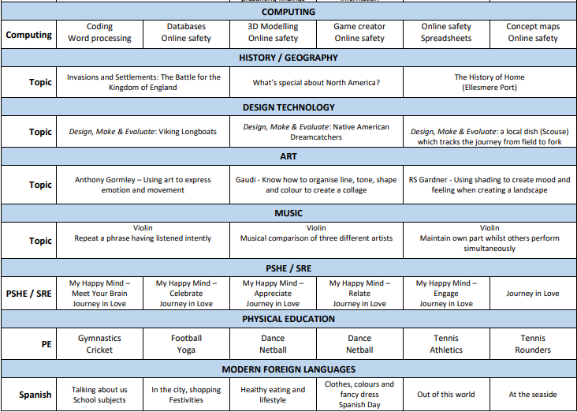
Long Term Plan 2025-26
Su
Mo
Tu
We
Th
Fr
Sa
01
02
04
05
06
07
08
09
11
12
13
14
15
16
18
19
20
21
22
23
24
25
26
27
28
29

Slide 8

Expectations
http://www.stmaryoftheangels.co.uk/class/year-5
The school website has lots of information about homework expectations and key dates.
I will be adding pictures to our Instagram account which can be accessed via the website homepage.
Google Classroom will be your first port of call for all homework and classroom communication.

Slide 9
Dojos are used in class as to support positive behaviour choices. Each week, the child with the most green dojo points will be given a certificate to bring home and also a reward of their choice.
Red dojos are given should a child fail to follow instructions after an initial warning. Red dojos work alongside our green dojos and children do not lose a positive dojo as a consequence of a poor choice.
We foster a culture of high expectations and for this reason I like to embrace mistakes as learning opportunities. Occasionally, children may be asked to start a piece of work again if standards are not as high as they should be. We want to see the children taking pride in every piece of work they complete.
Pen licenses in Year 5 are not a ‘thing’- whilst the aim is for all children to be writing in pen, there may be times when they are asked to write in pencil if their presentation standards begin to drop. This is a fluid process and never something that should be seen as a punishment.

Slide 10
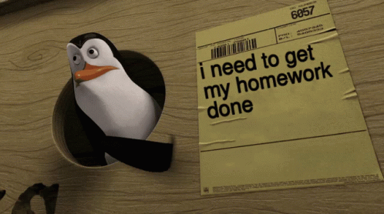
Homework
Set every Friday to be completed by the following Friday
Found on Google Classroom (absence on a Friday no longer an excuse)
Spelling groups will soon be up and running based on assessments to be compiled over the coming weeks
Please use school journals or drop offs to communicate any homework concerns
Atom Learning is used to consolidate Maths objectives taught throughout the week or to recap on prior learning for future teaching - homework is an add-on to what we are doing in class
Children should be reading aloud nightly with journals being regularly signed. Questioning is the key in juniors.

Slide 11
How can you help at home?
Sit down for dinner around the table and discuss your child’s day. We are REALLY trying to focus on oracy and developing speaking and listening skills this year (please do support this at home)
Keep updated on X to learn more about what is happening in class (a good conversation starter for those more reluctant to share!)
Find time to read with your child each night and ask them questions about the text
Support your child with their homework as and when they need it, but try to foster independence
Establish a strong bedtime routine which works for you and your family - every family is different
Use the useful links and sites tab on the website to support with extended home learning tasks

Slide 12

Reading at home - Before they start
Why did you select this book?
What makes you think this book is going to be interesting?
What do you think the book is going to be about?
Does this book remind you of anything else you’ve already read or seen?
What kind of characters do you think will be in the book?
What do you think is going to happen?

Slide 13
Reading at home - During the text
Will you catch me up on the story? What’s happened so far?
What do you think will happen next?
If you were that character, what would you have done differently in that situation?
If the book was a TV show, which actors would you cast in it?
Where is the book set?
If the main character in that story lived next door, would you be friends? Why?
What does the place look like in your head as you read? Would you want to visit there?
Did you learn any new words or facts?

Slide 14
Reading at home - At the end of a text
What was your favourite part of the book? Why?
Who was your favourite character? Why?
What was the most interesting thing you learned from the book?
Why do you think the author wrote this book?
Would you have ended the book differently? Did it end the way you thought it would?
Did the problem of the book’s plot get solved?
If you could change one thing in the book, what would it be?

Slide 15

Maths - How we teach it!
Click on the image to be taken to our calculation policy.
The policy gives a clear progression in how we teach different areas of the Maths curriculum
You will be able to use the policy alongside the long term plan (slide 6) to support your child with their Maths learning at home
Maths vocabulary has been a key area of development that you can also support at home e.g. altogether, the product of, total

Slide 16
Useful sites and key dates
https://www.booksfortopics.com/booklists/recommended-reads/year-5/
The link above is also provided on the class website. It’s an excellent link for quality books to read for children aged 8-11. The library is a fantastic resource for loaning books and if we don’t use it then we will likely lose it sadly. We also have many of these texts in our class library.
Remote Learning Website
https://sites.google.com/smota.school/stmaryoftheangelscatholicprima/home
The link above should speed up your child accessing lots of useful sites that we use in school and recommend for home. Let me know if any of the links don’t work and I can look at amending the site.
PE and Music Days
This half term, PE will be delivered on a Tuesday morning (gymnastics) and Thursday morning (cricket) and Music will be every Thursday afternoon. Forest school dates can be found on our class website page.

Slide 17
Key Dates 2025-26
10th September 2025 – Meet the Teacher
17th Septemeber 2025 – Urenco Workshop
18th September 2025 - Forest School session
22nd Septemeber 2025 – Lilttle Sutton library visit
2nd October 2025 – Mysterious Materials Workshop
3rd October 2025 – Harvest Festival
17th October 2025 - Year 5/6 Coffee Afternoon 2-3pm
22nd October 2025 – Parents’Evening
24th October 2025 – Whole School Photos
Half term
10th November 2025 - Chester Viking Experience Day
20th November 2025 - Forest School session (History and DT focus)
20th November 2025 – UK Parliament Workshop
28th November 2025 - INSET Day
4th December 2025 – Christmas Fair
16th December 2025 – Key Stage 2 Carol Service (9.15am)
17th December 2025 – Key Stage 2 Carol Service (2.00pm)
18th December 2025 – Autumn Term Reports Sent Out
Also…
We will be visiting Liverpool Museum in Spring term (22nd January) for a planetarium visit and also Ellesmere Port Boat Museum in the Summer term (10th June) to learn about the history of Ellesmere Port.

Slide 18
Any questions?

