Slide 1

We love to read!

Slide 2
Which book have you really enjoyed reading lately?

Slide 3


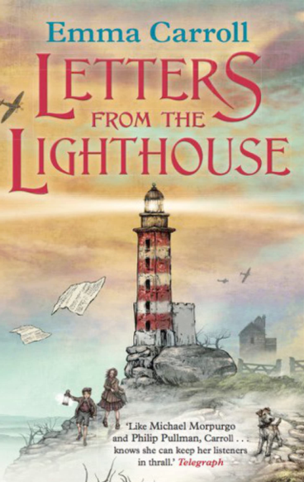
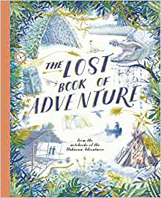


Which authors have you read in class?

Slide 4



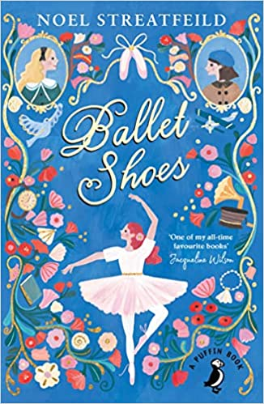
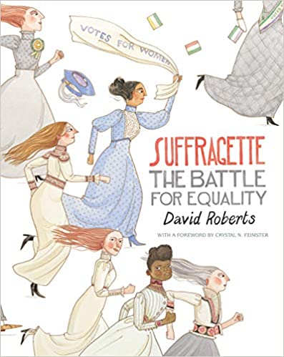

Mrs P’s Faves

Slide 5


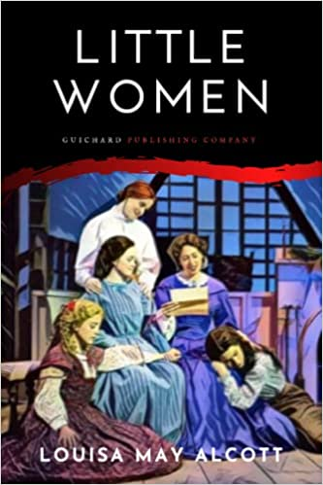
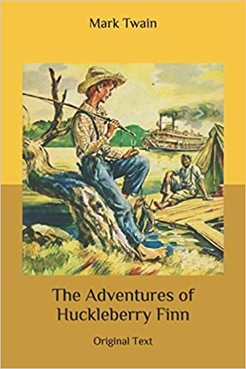
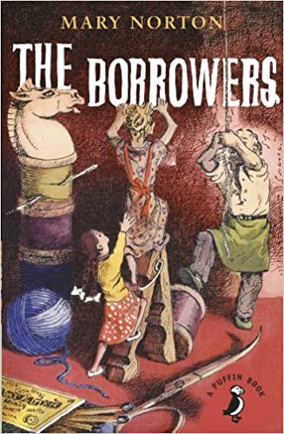
Classic Books

Slide 6





Books about other places

Slide 7
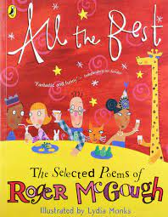


Why not try a poetry book?

Slide 8



Who is your favourite author?

Slide 9

Reading is dreaming with your eyes open!

