Slide 1
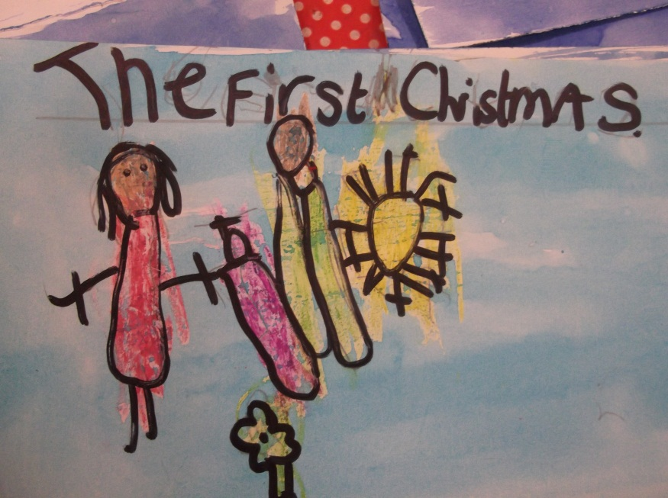
Creative R.E. Teaching at Eccleston C.E. Primary School
Katie Prescott
Eccleston CE Primary

Slide 2

About Us
Small village school on the edge of the Duke of Westminster's Estate
105 on roll
Period of ‘unsettlement’
Ofsted ‘Good’ in June 2017
SIAS ‘Outstanding’ in September 2017
Voluntary Aided

Slide 3
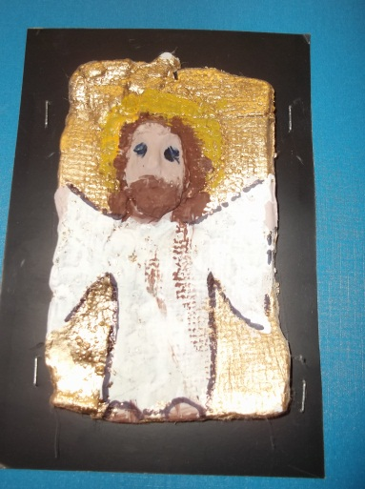
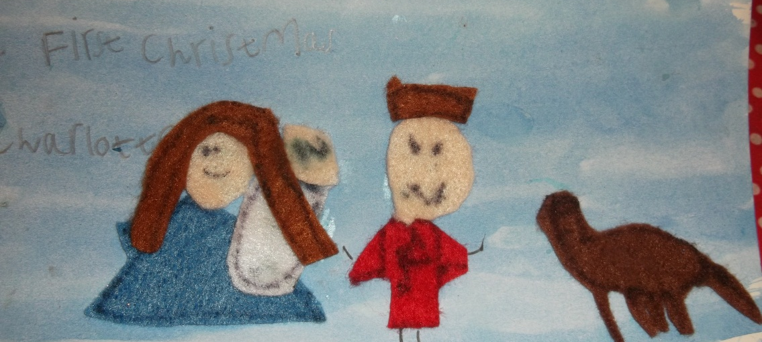
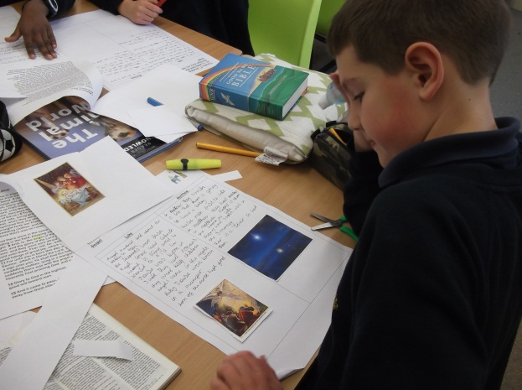
R.E. at Eccleston C.E. Primary
Creative – taught whenever possible through Literacy, Drama, Music, Art and Dance
Thought provoking
Discrete and cross curricular
Promotes tolerance and respect for all
Emphasis on Christianity in KS1
4 other major religions studied by the end of KS2

Slide 4
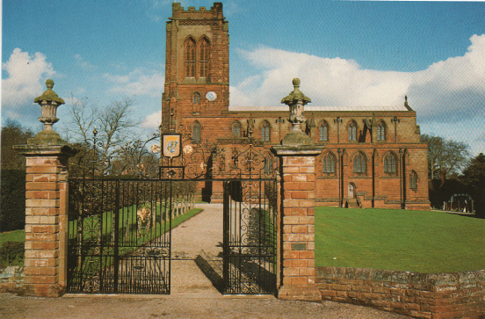

Slide 5
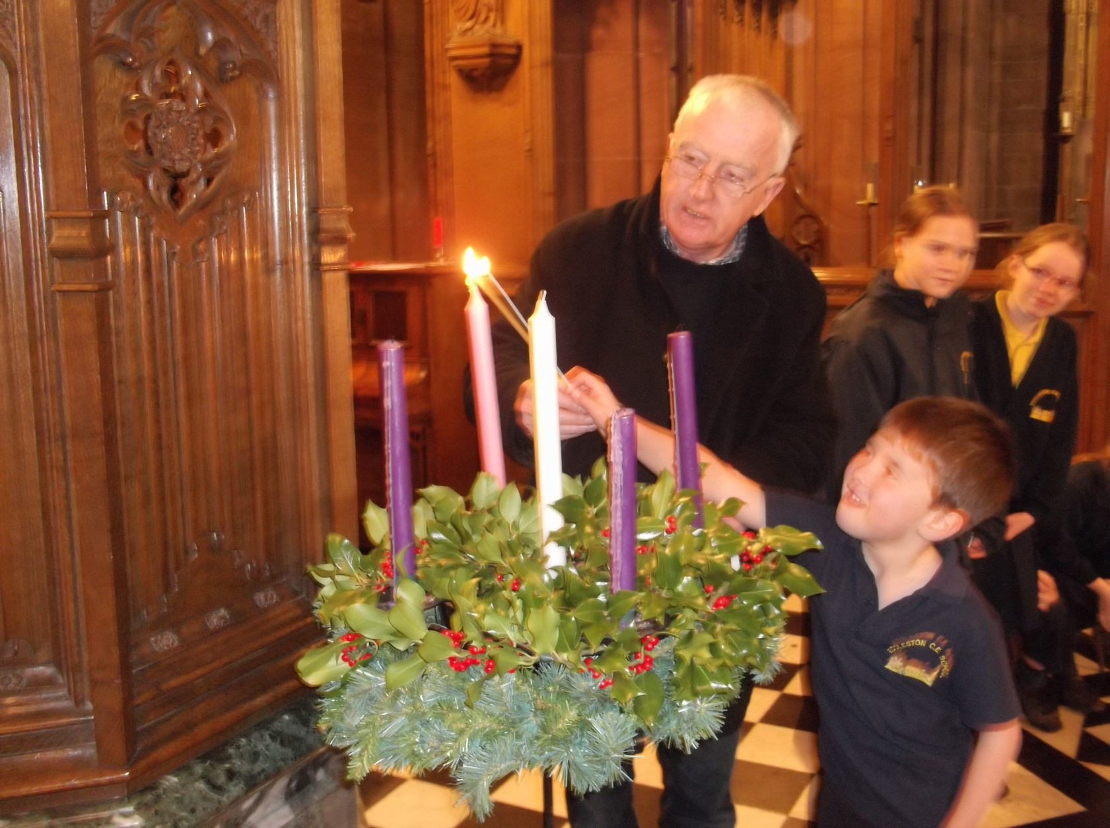

Slide 6
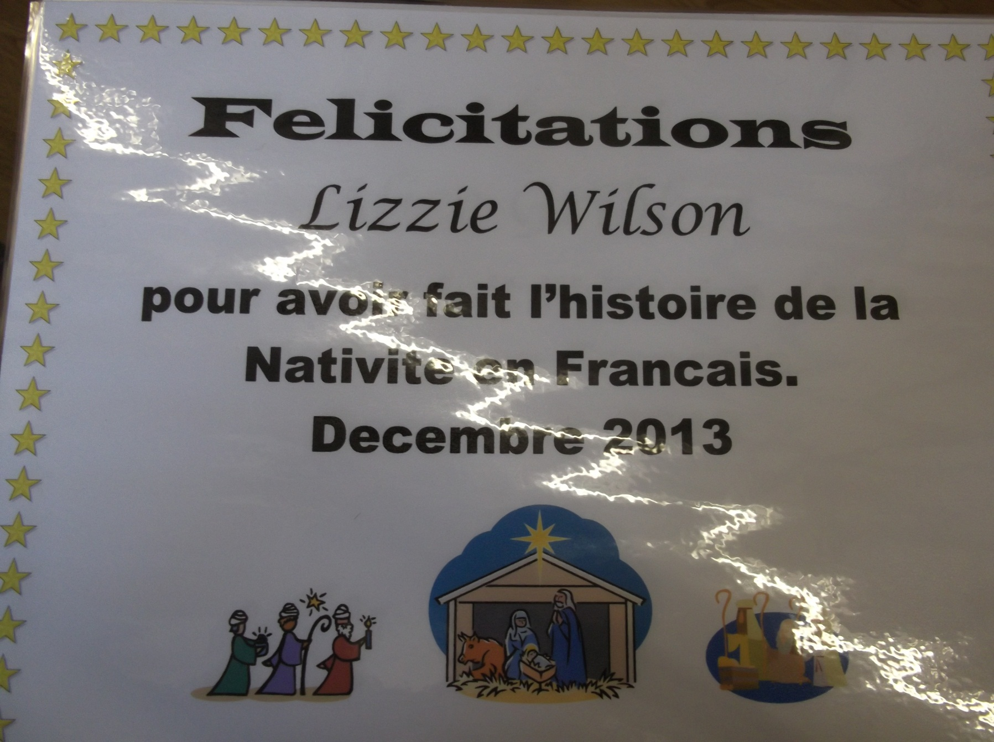

Slide 7
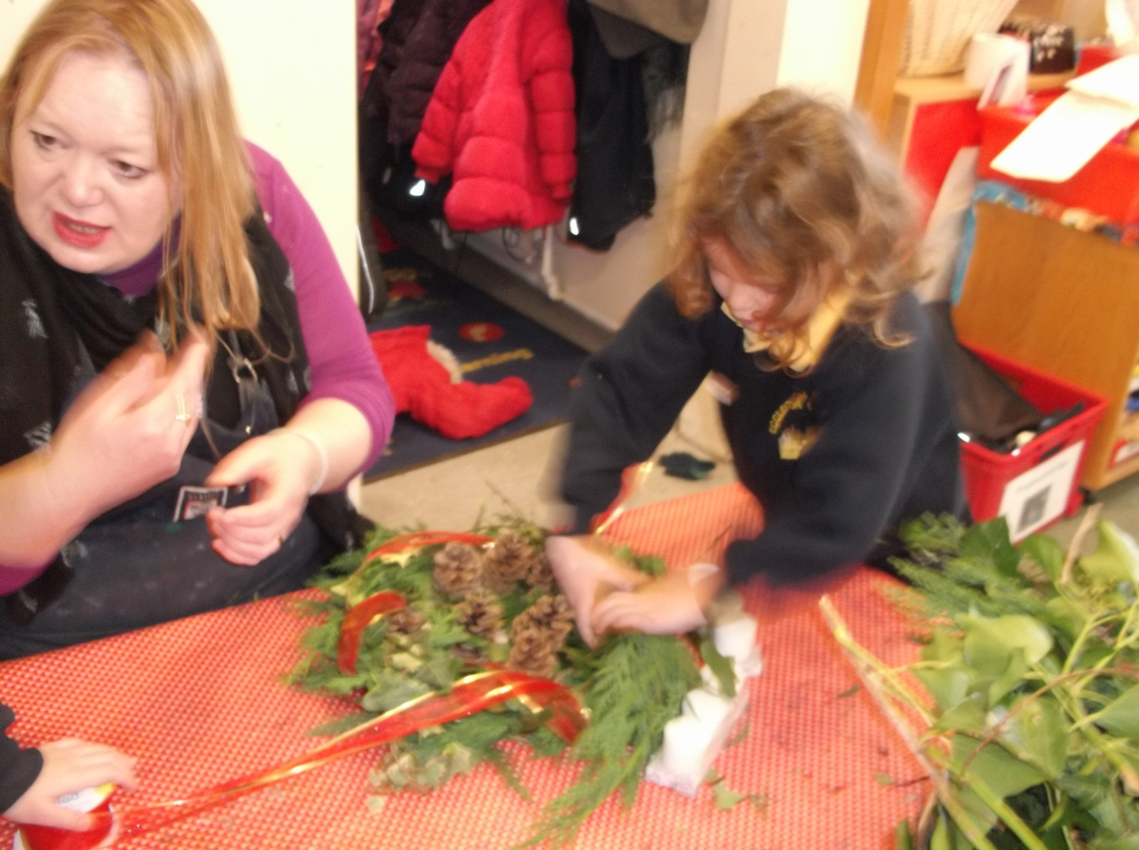

Slide 8
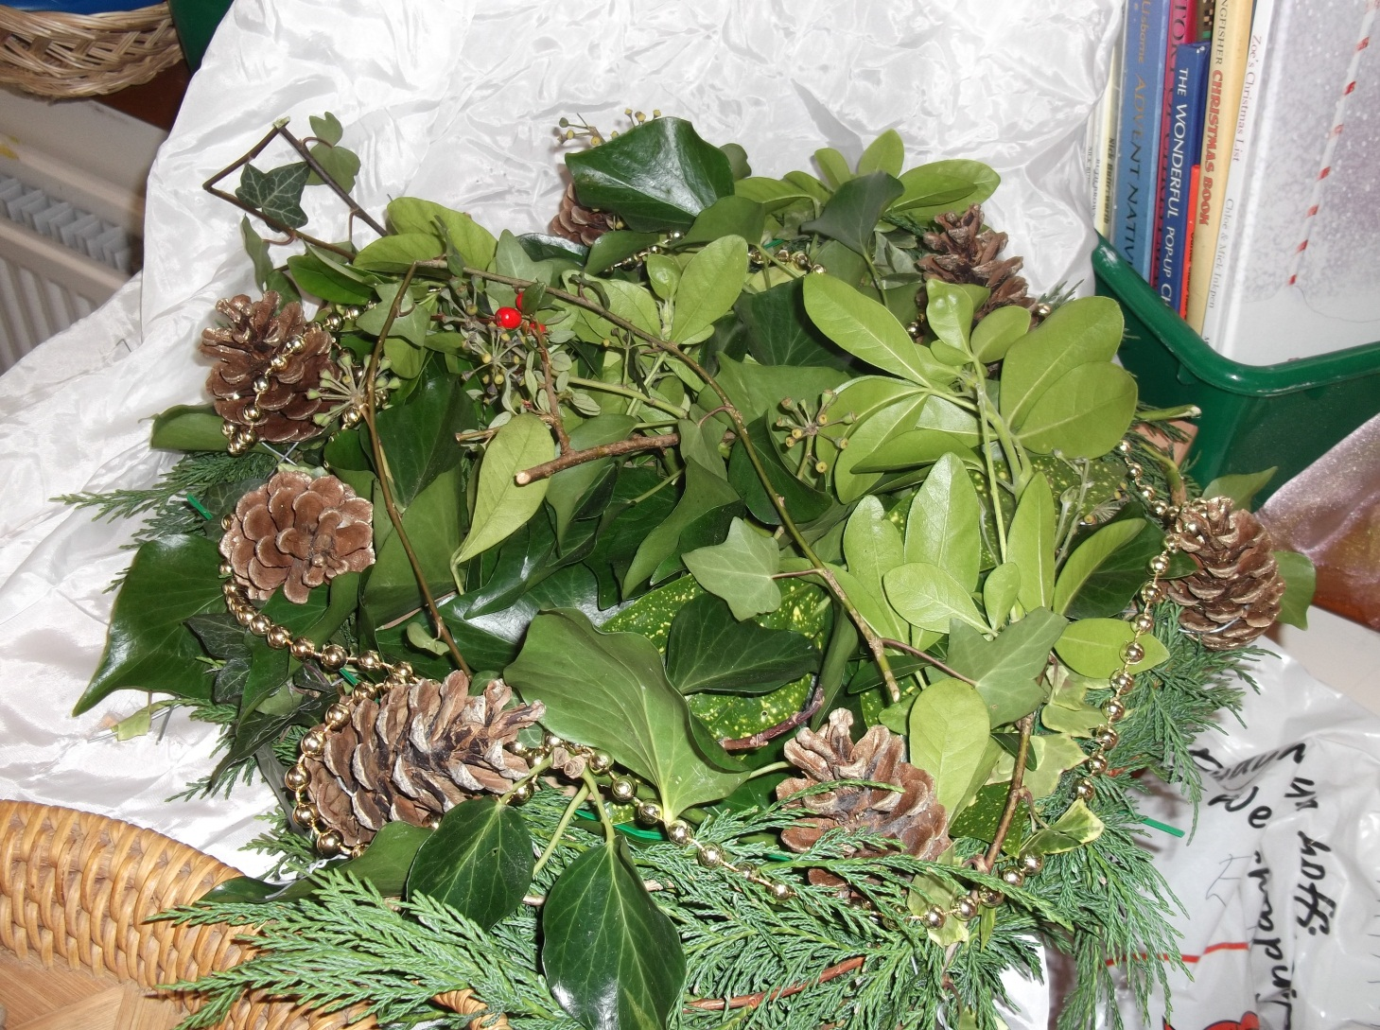

Slide 9
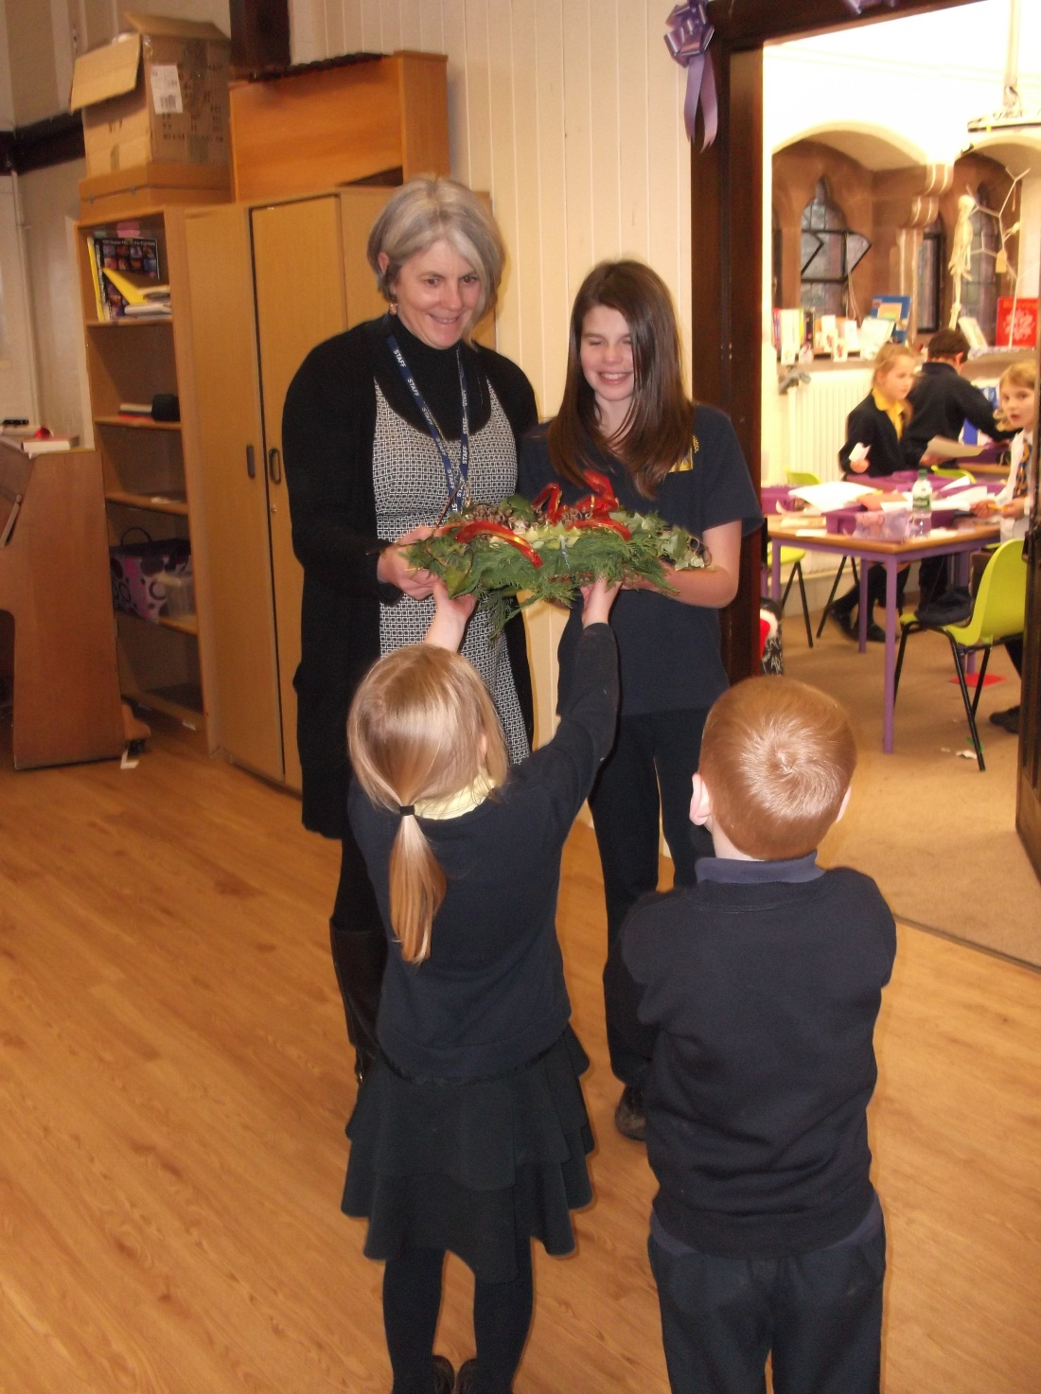

Slide 10
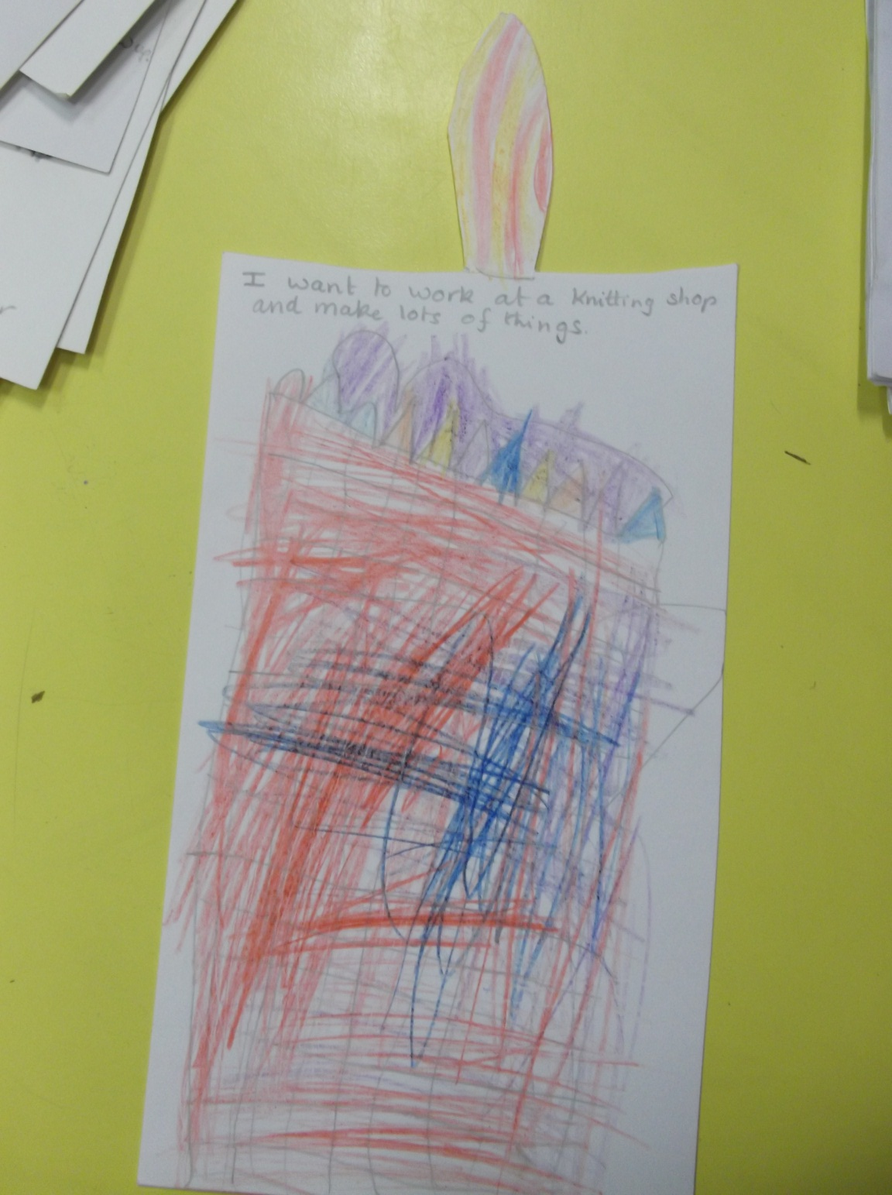

Slide 11
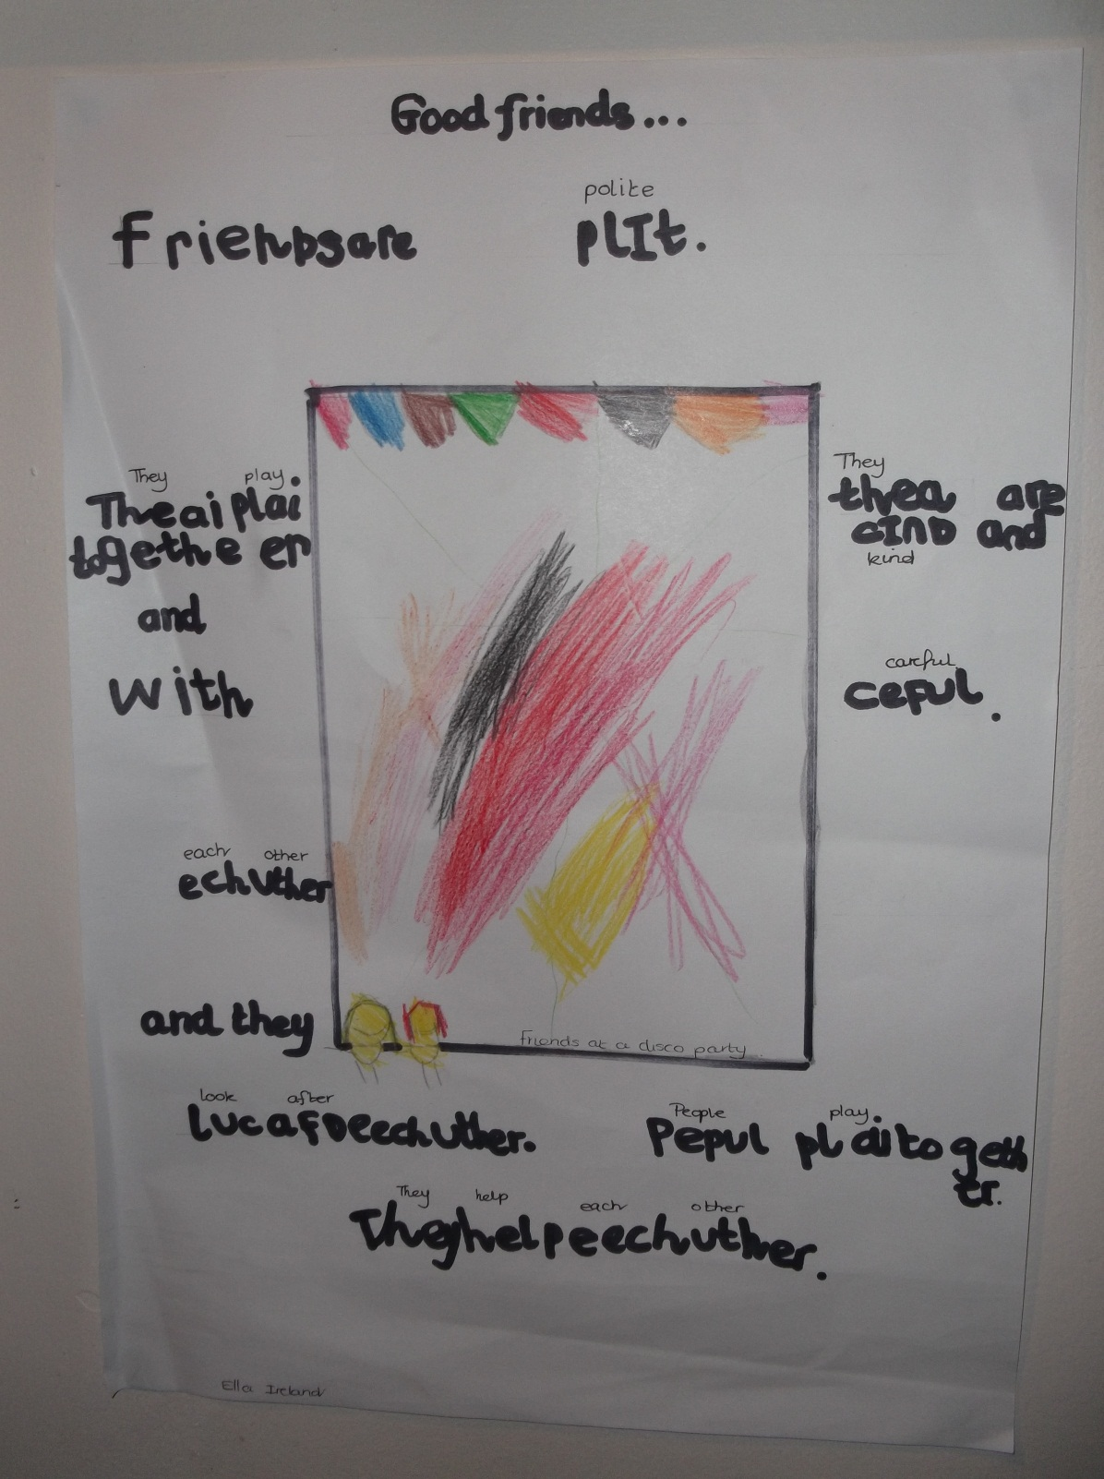

Slide 12
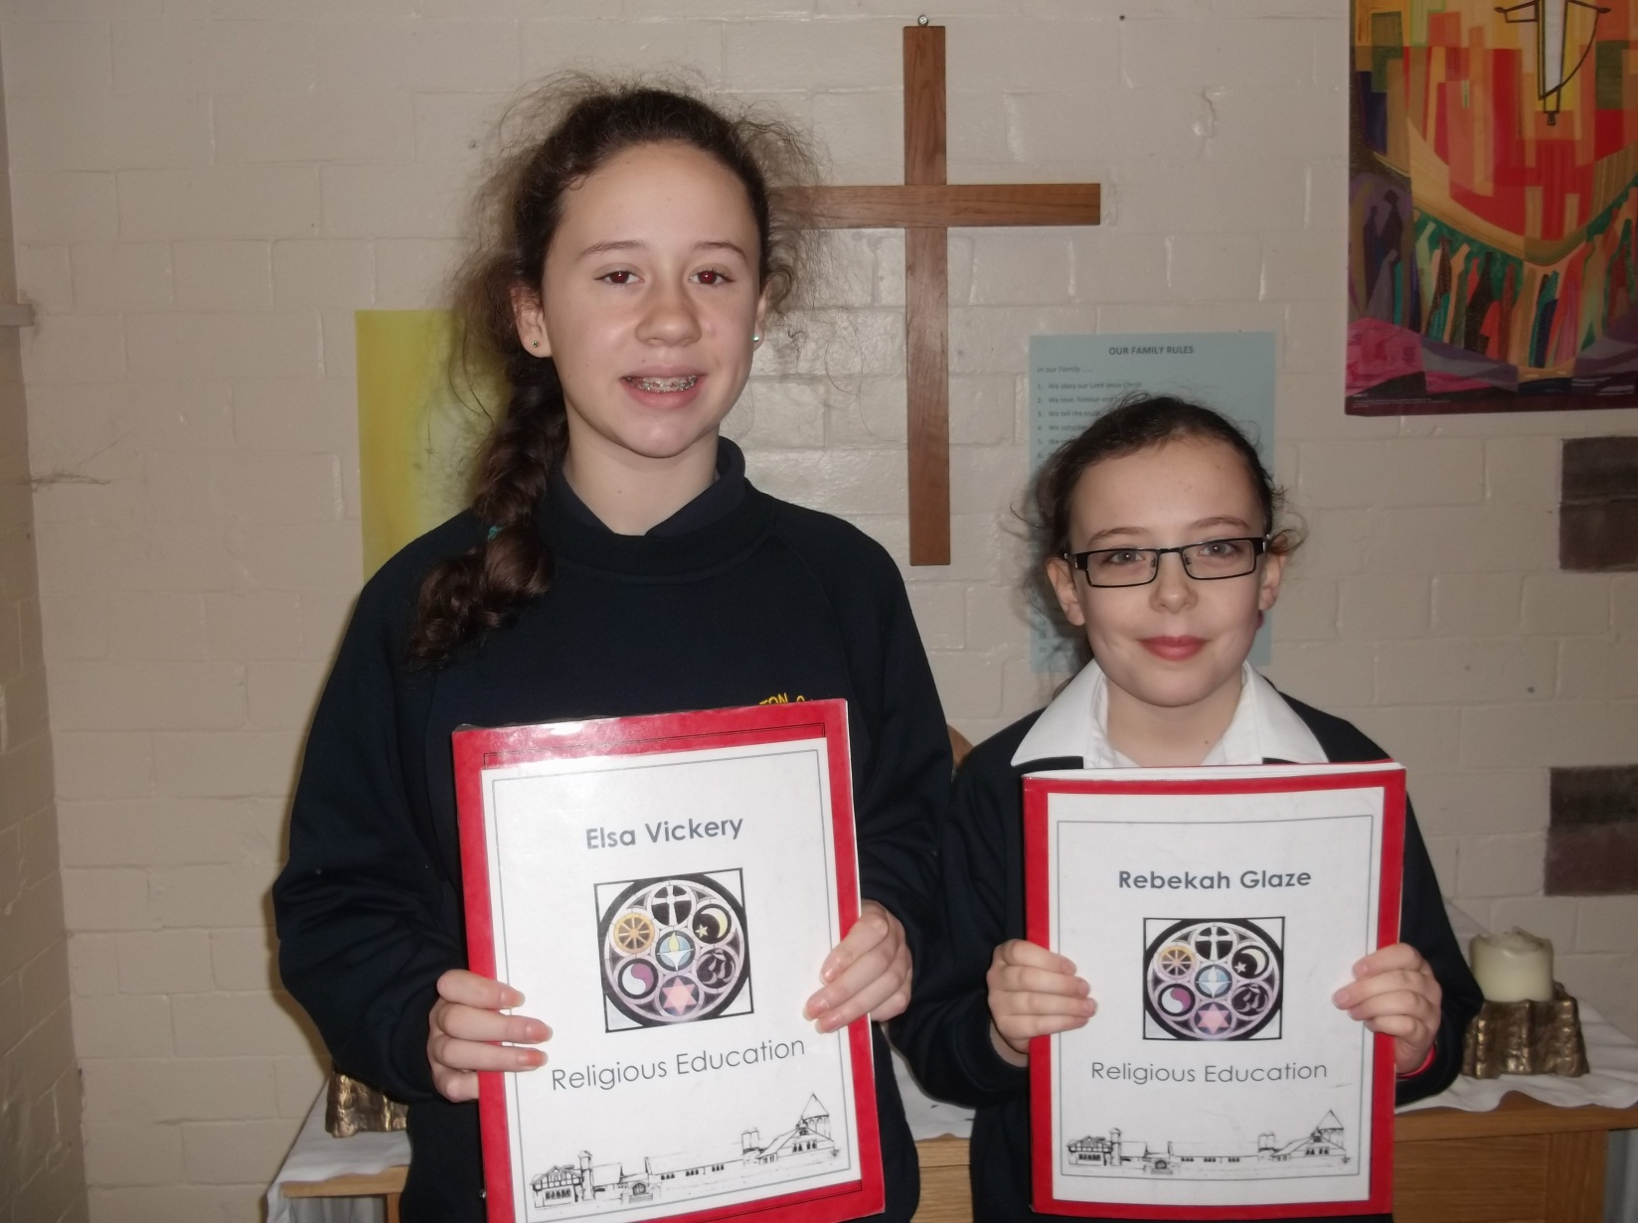

Slide 13
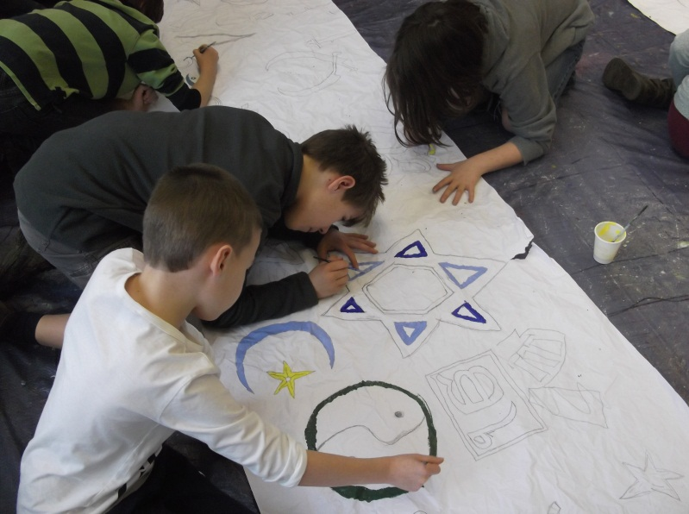
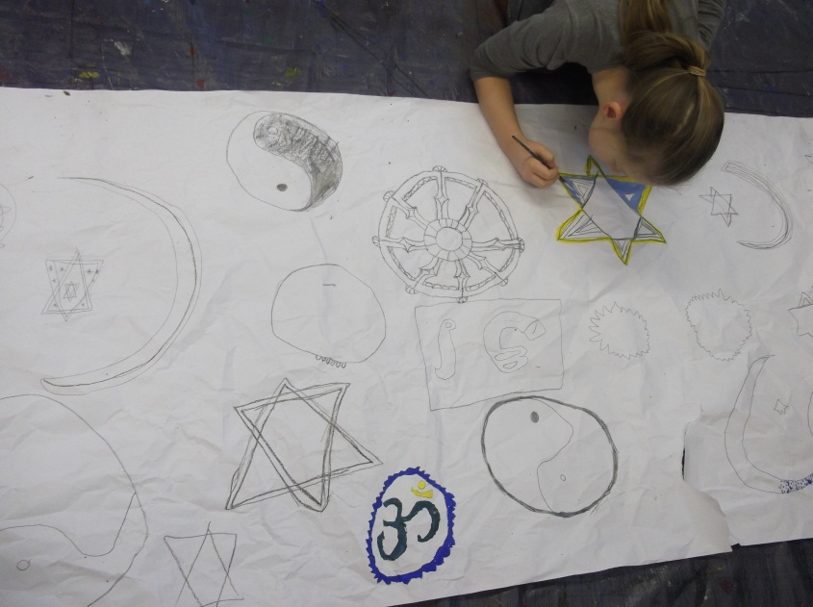
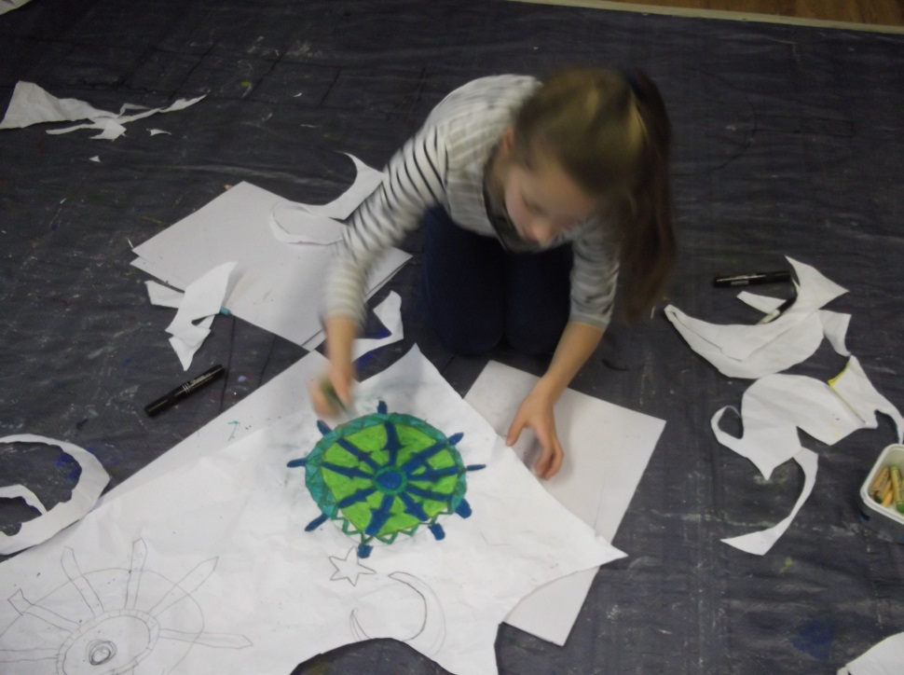
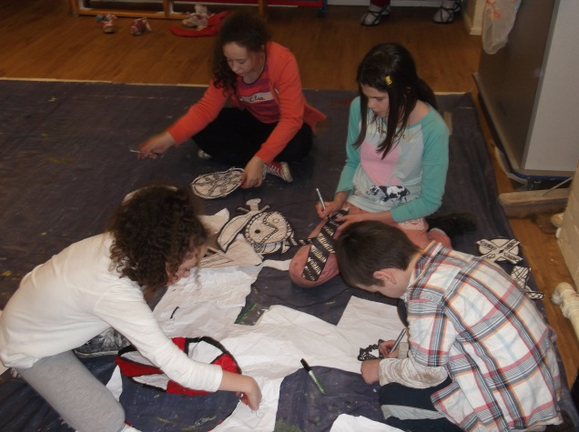
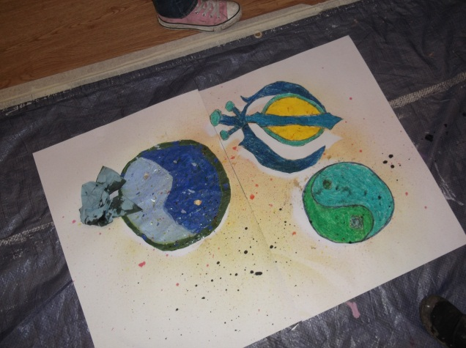

Slide 14
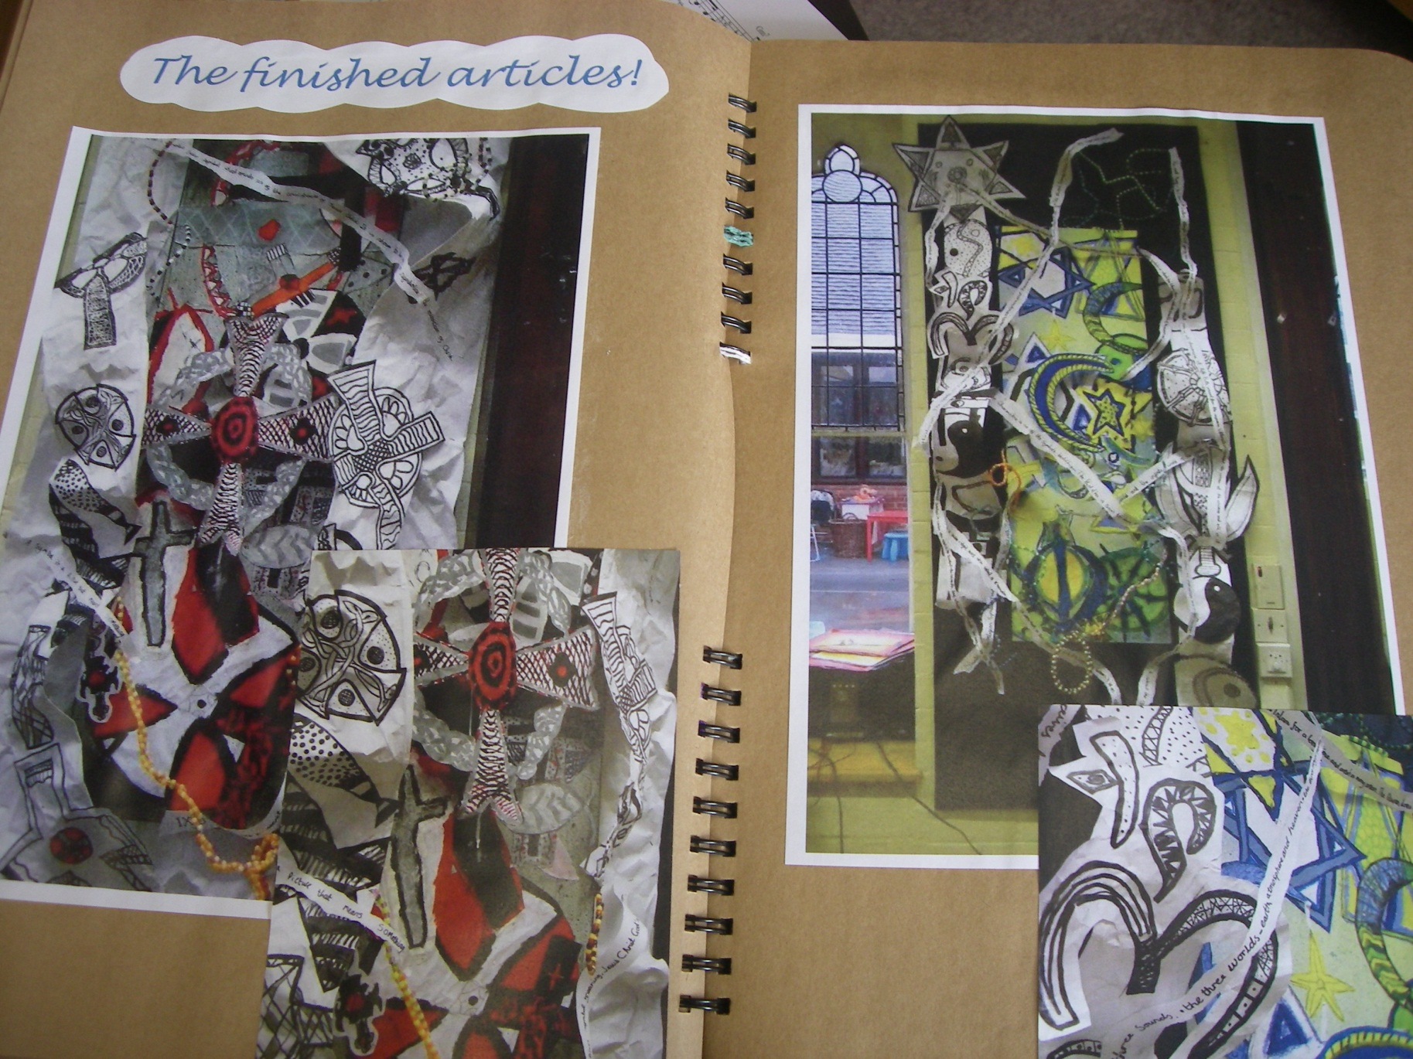

Slide 15
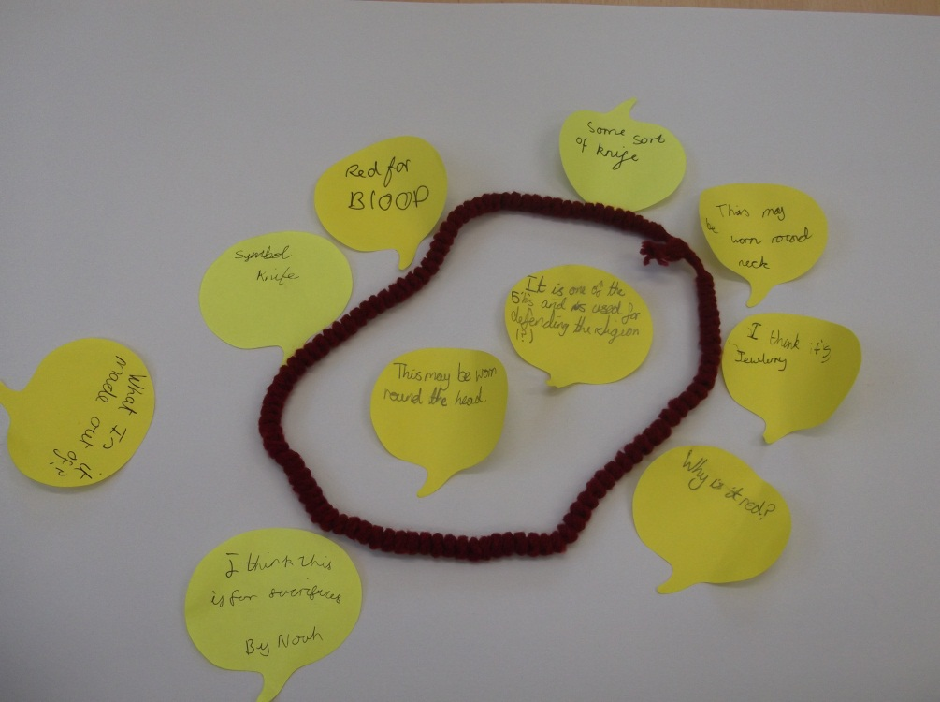
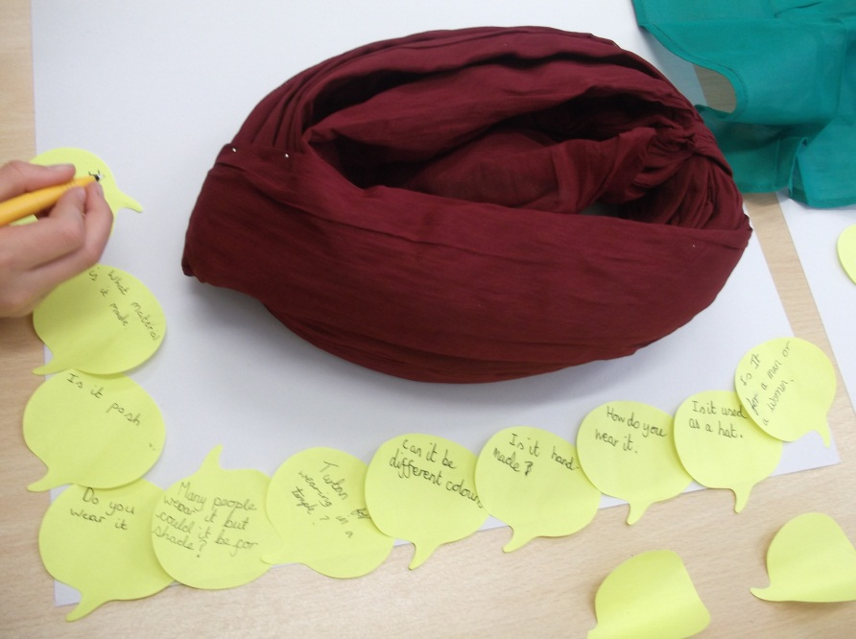
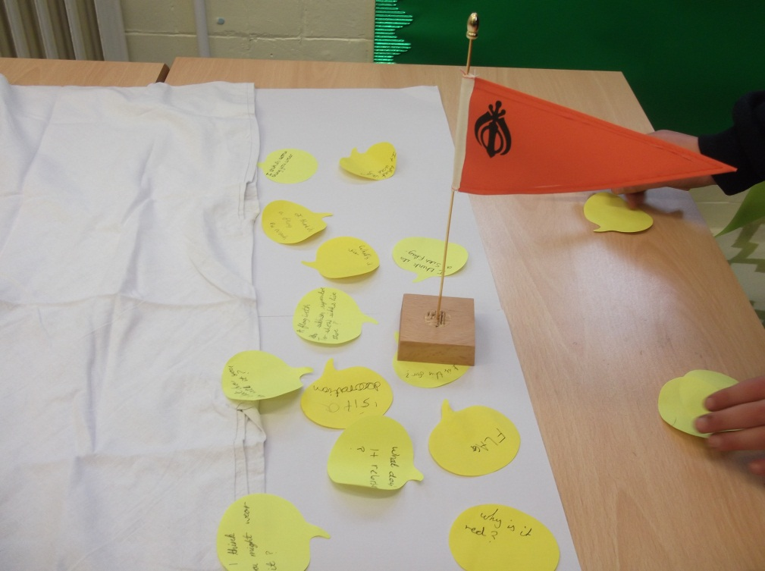
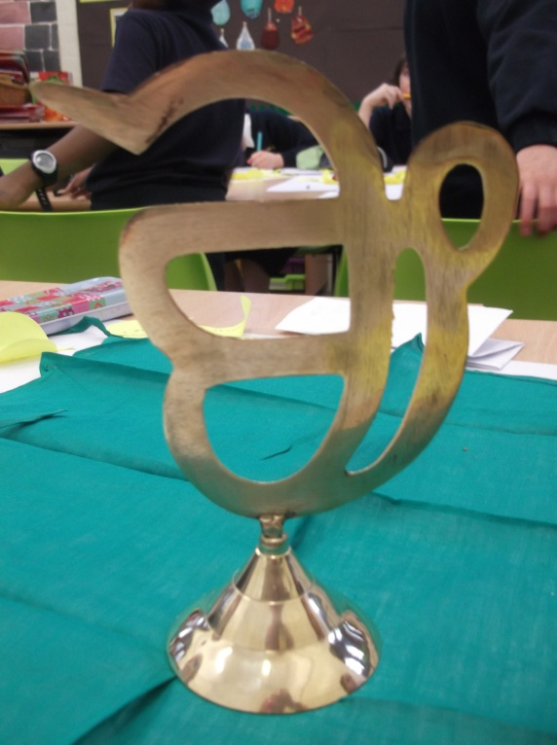

Slide 16

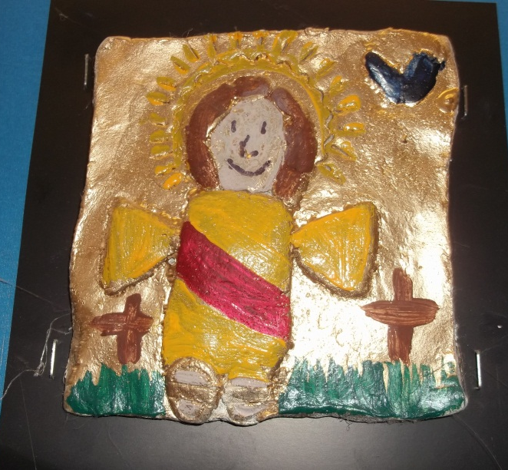
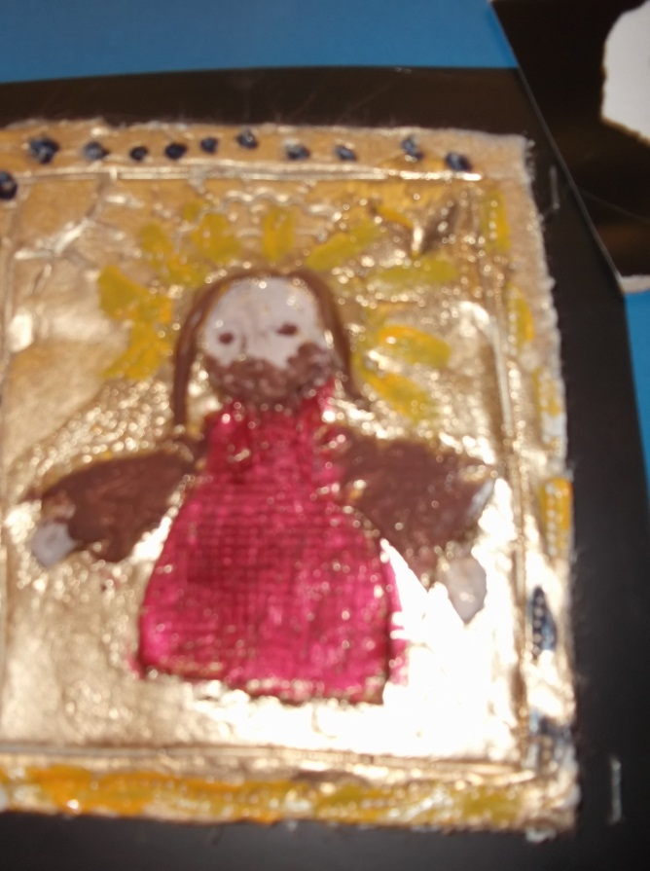
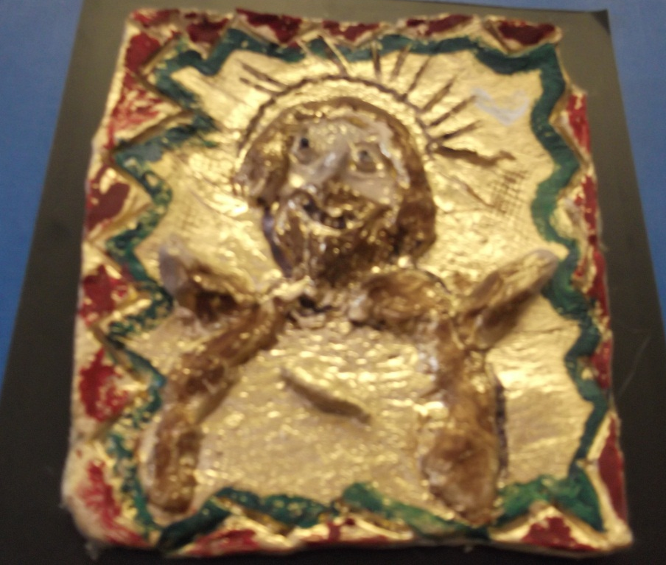

Slide 17
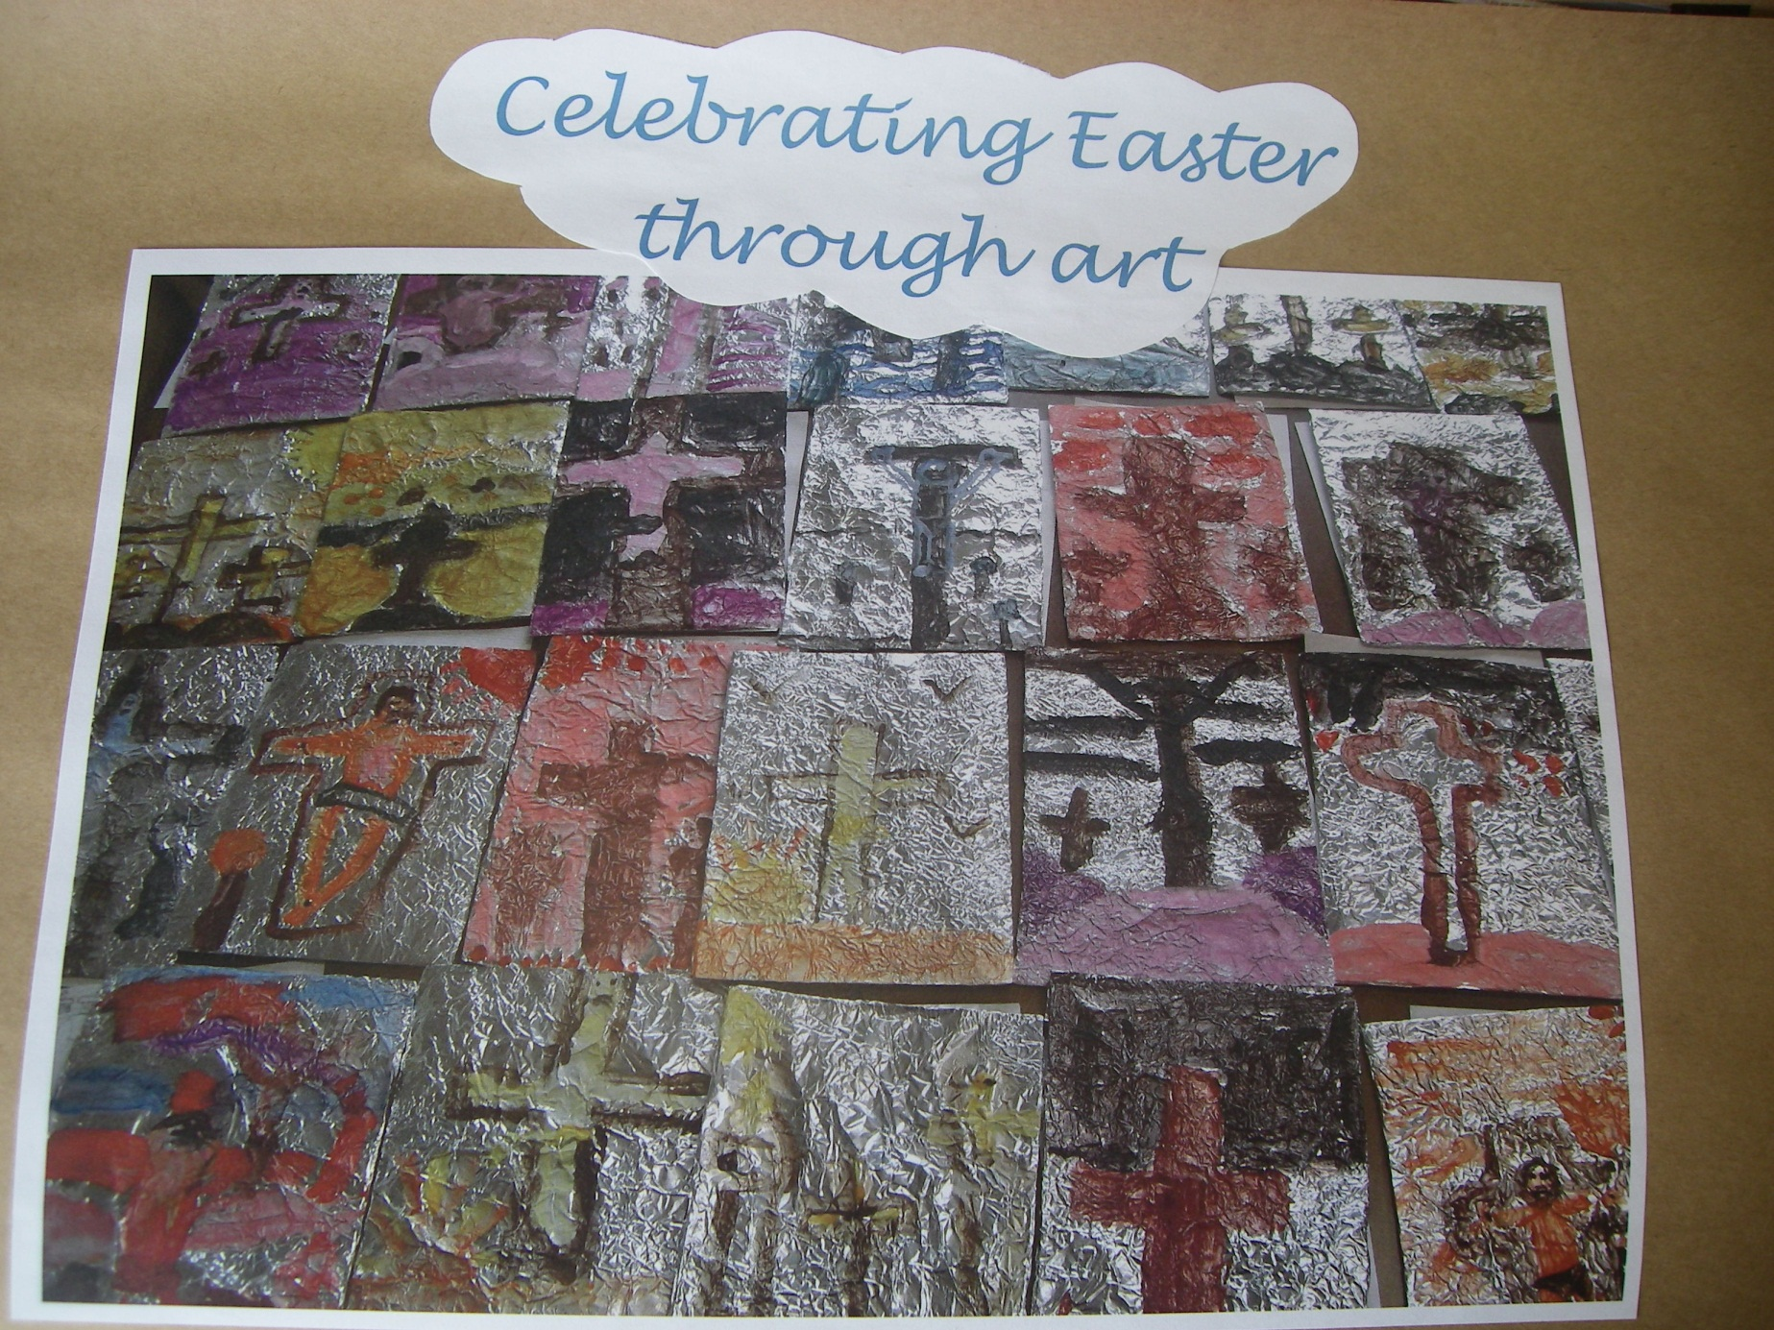

Slide 18
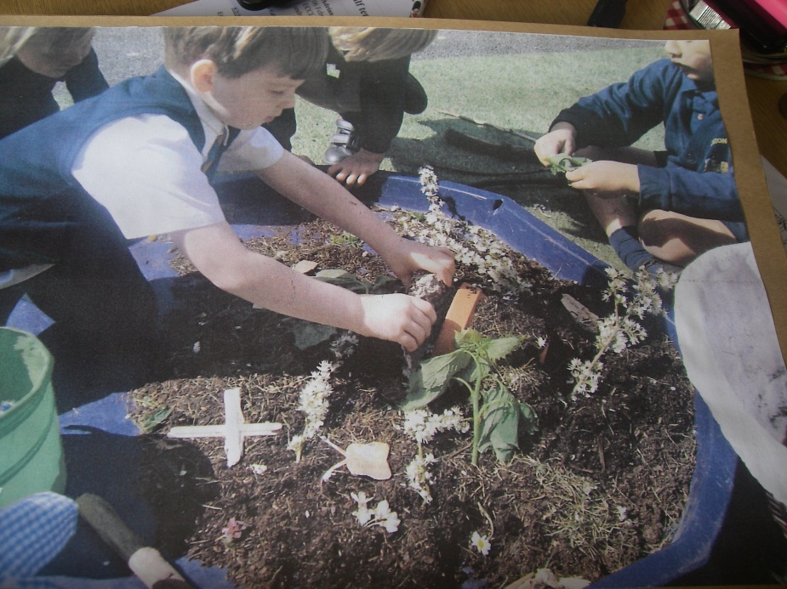
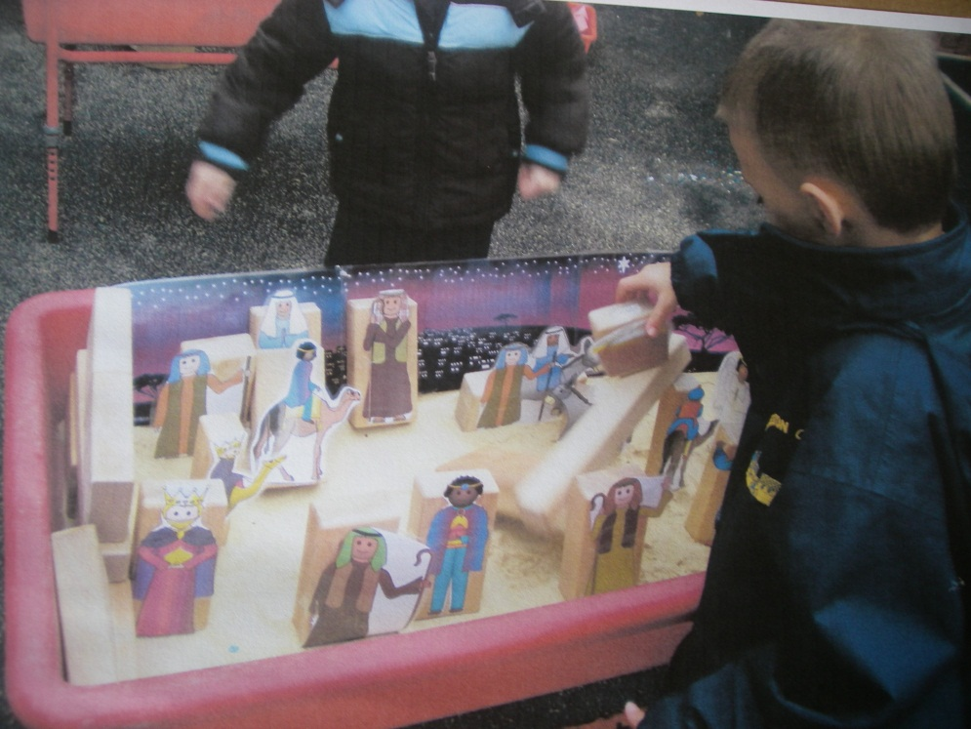
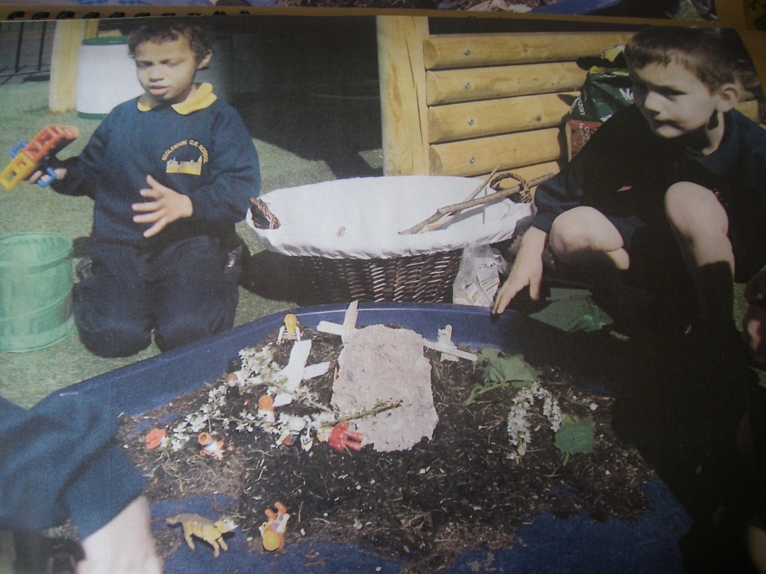

Slide 19
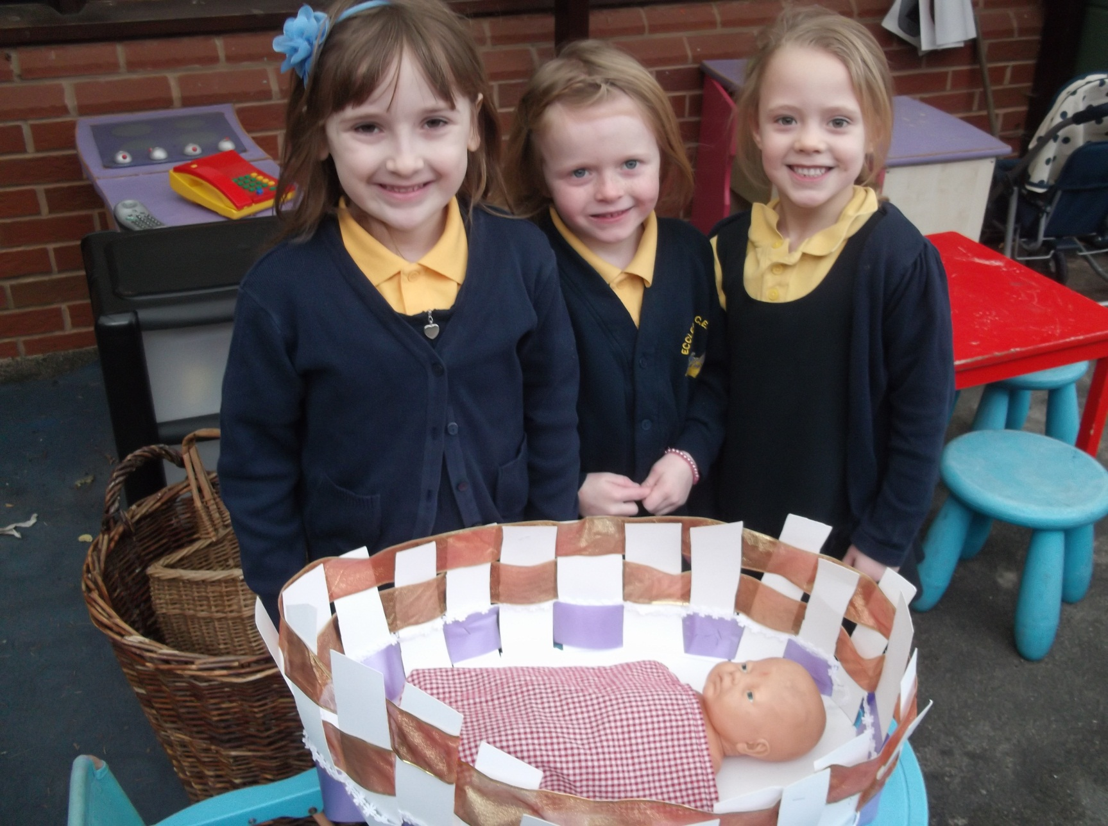

Slide 20
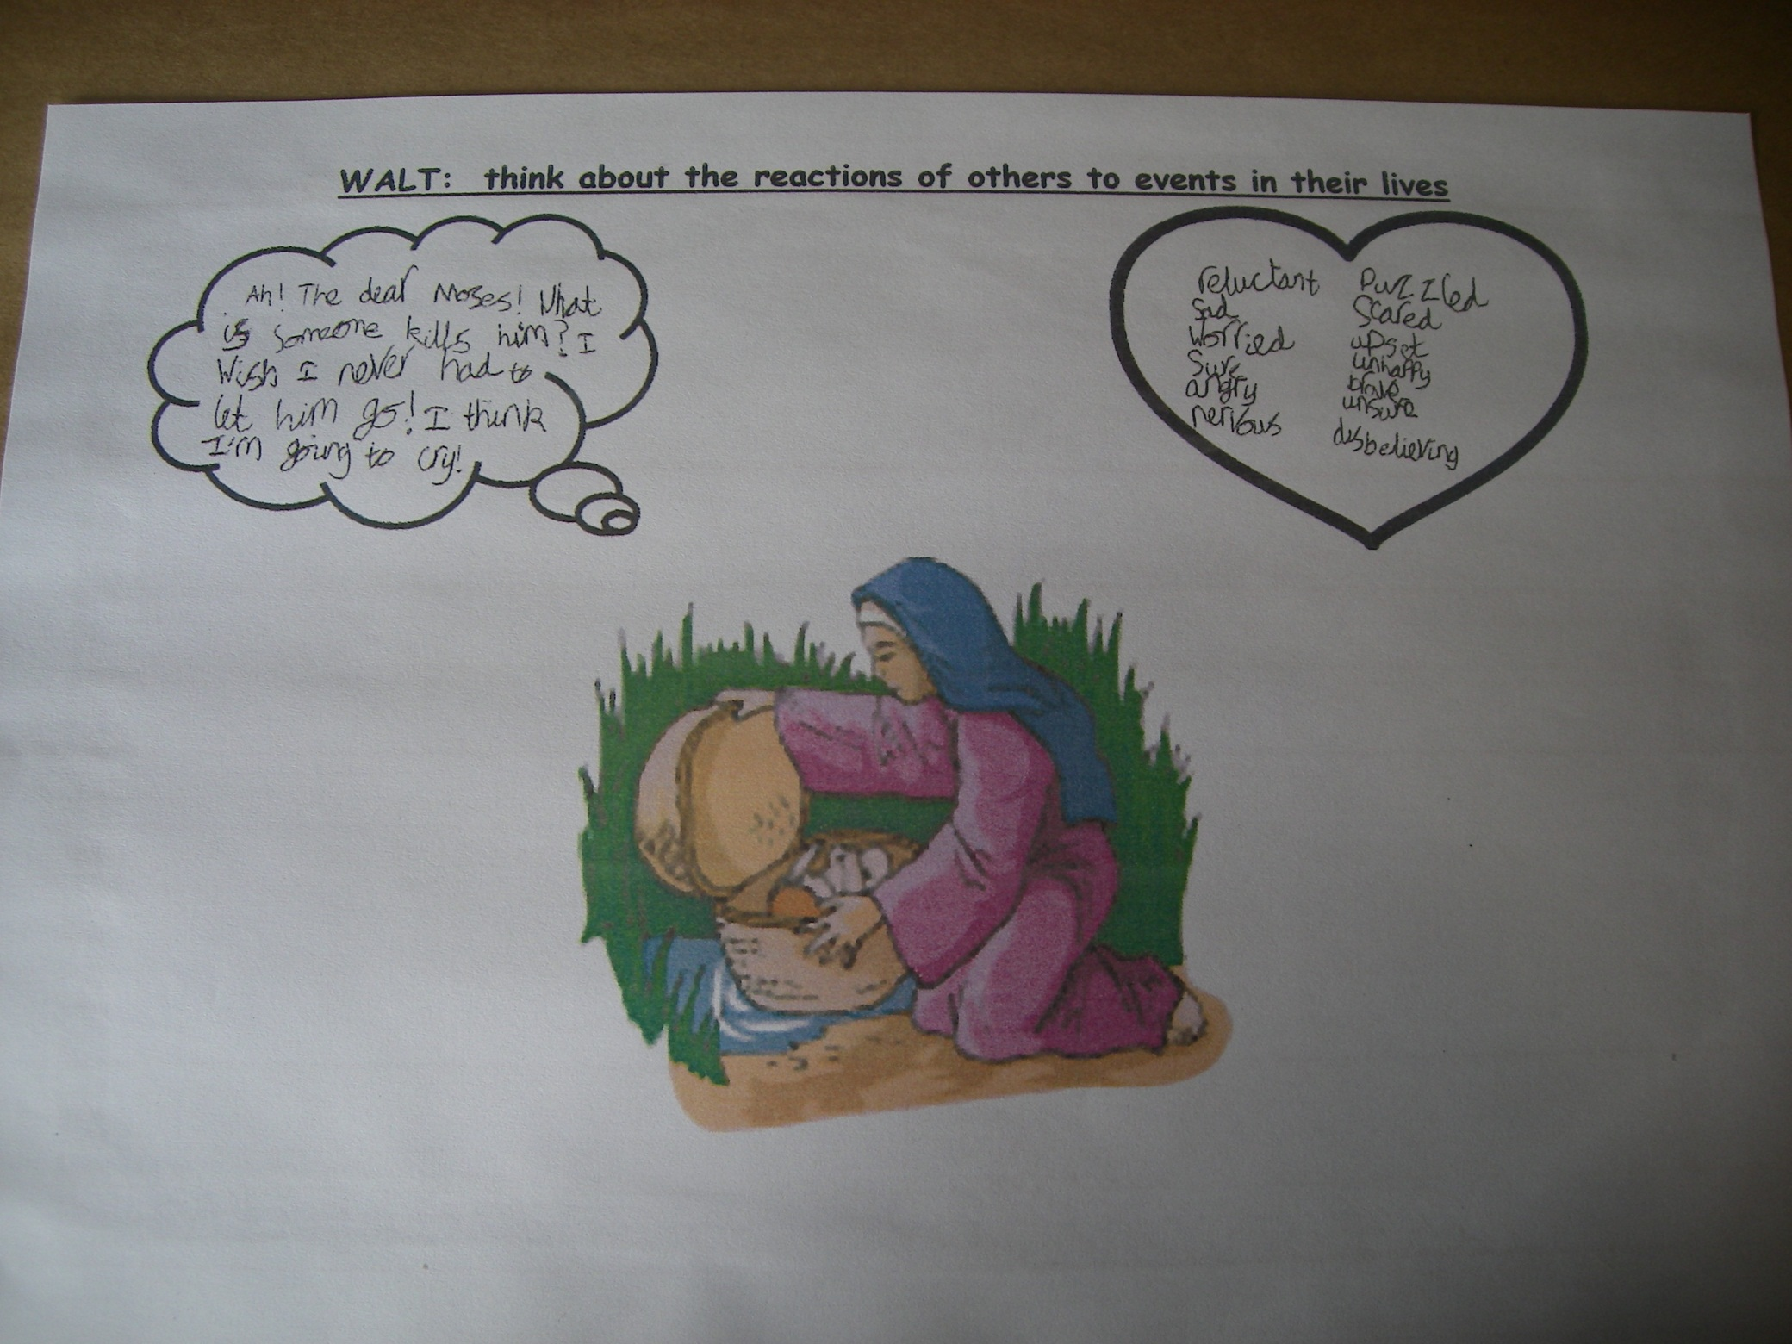

Slide 21
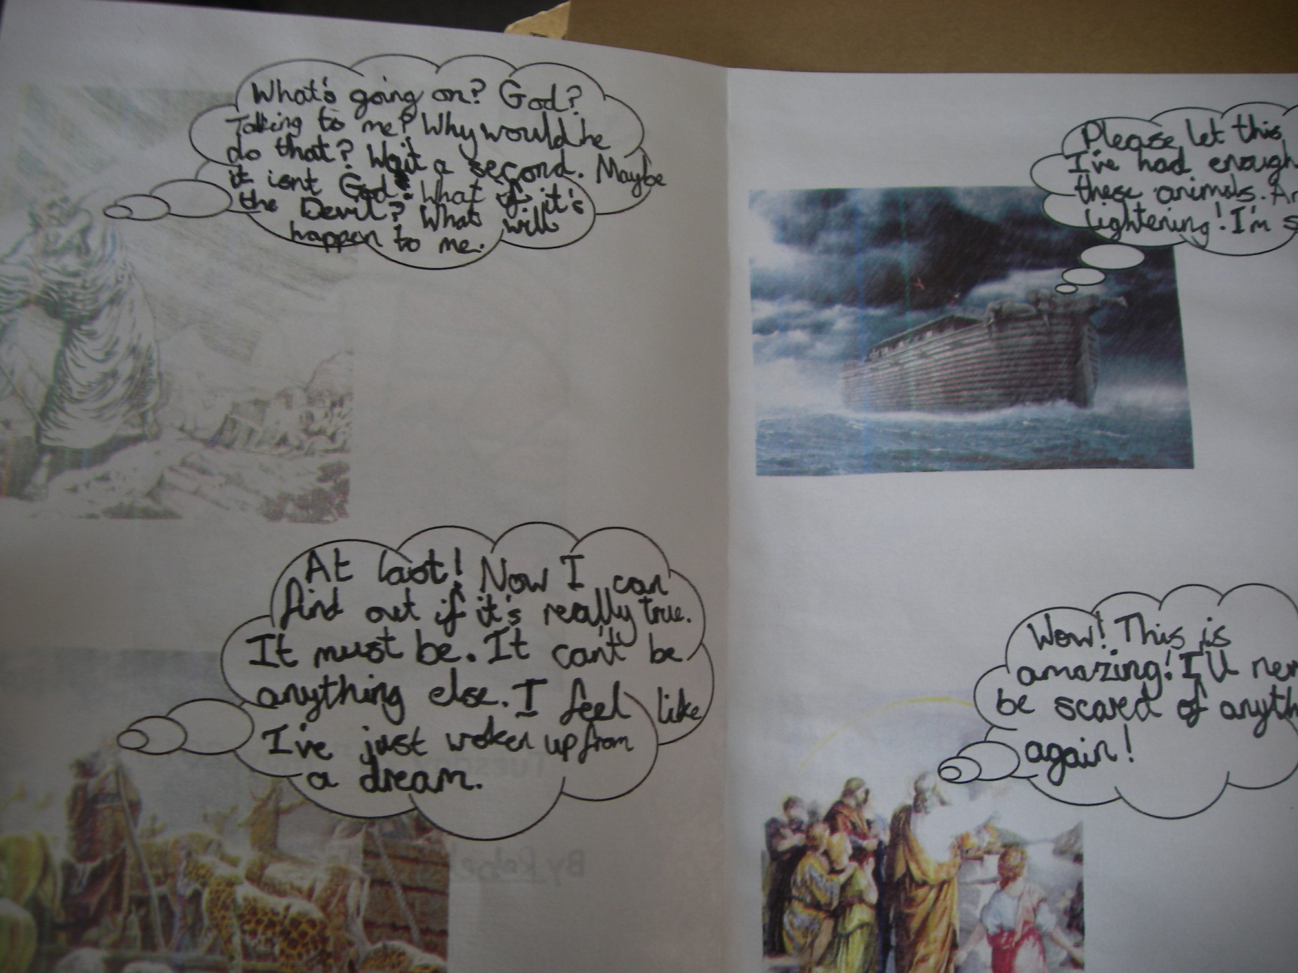

Slide 22
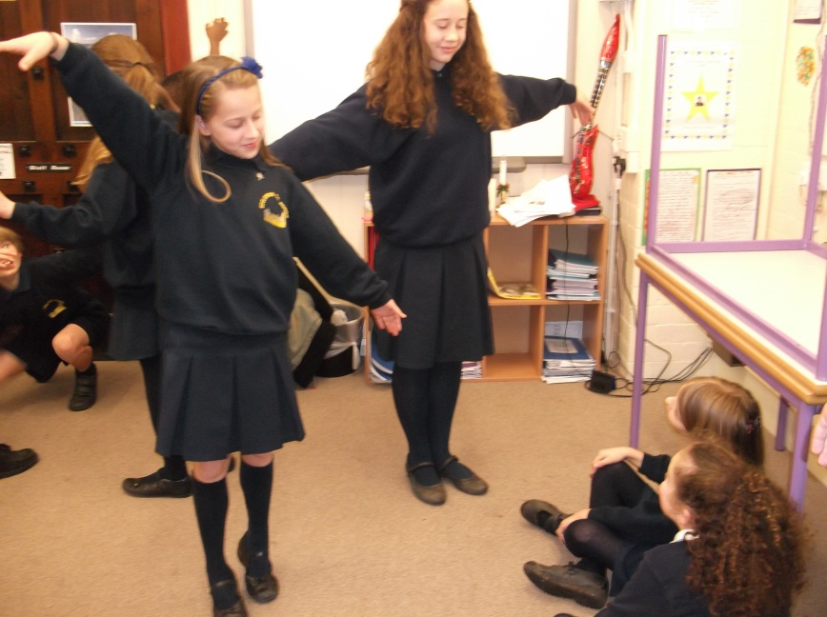
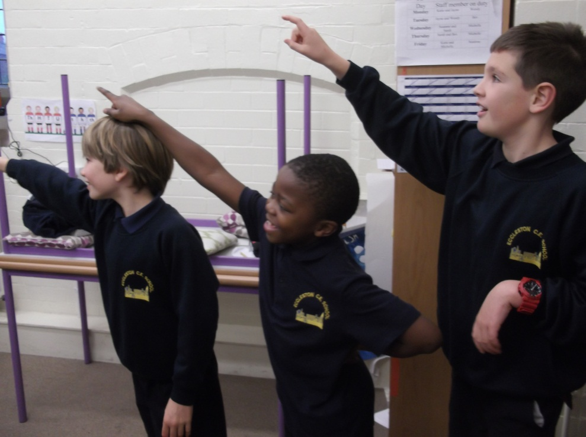
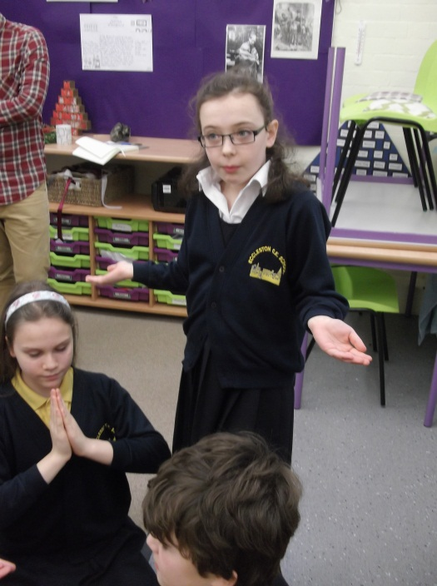
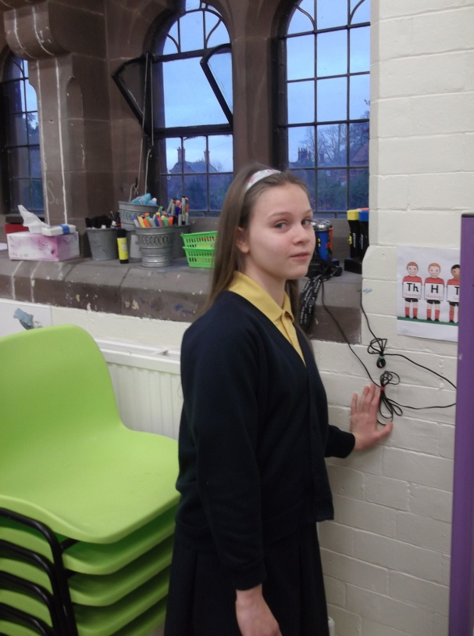
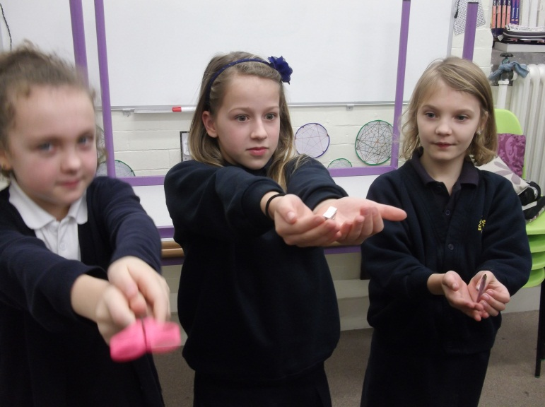

Slide 23
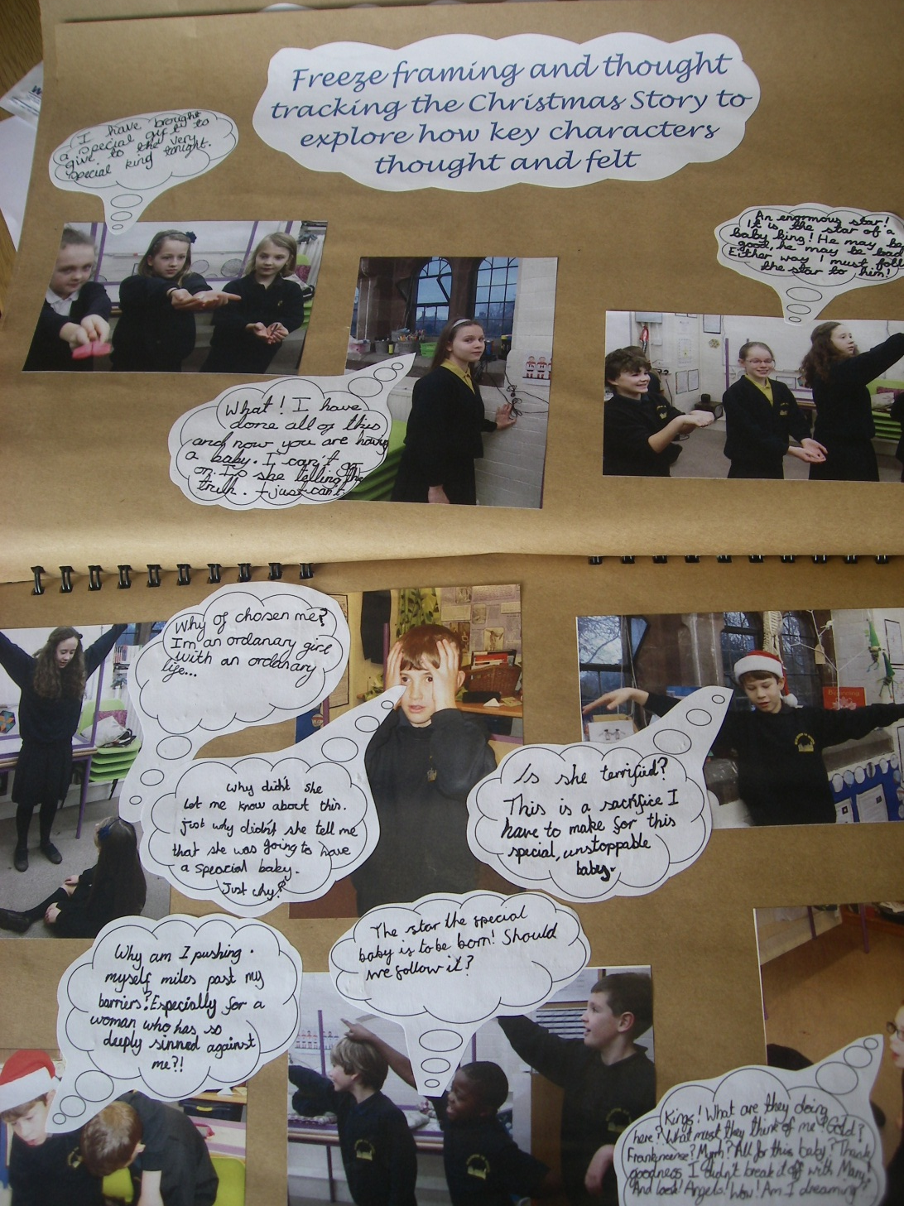

Slide 24
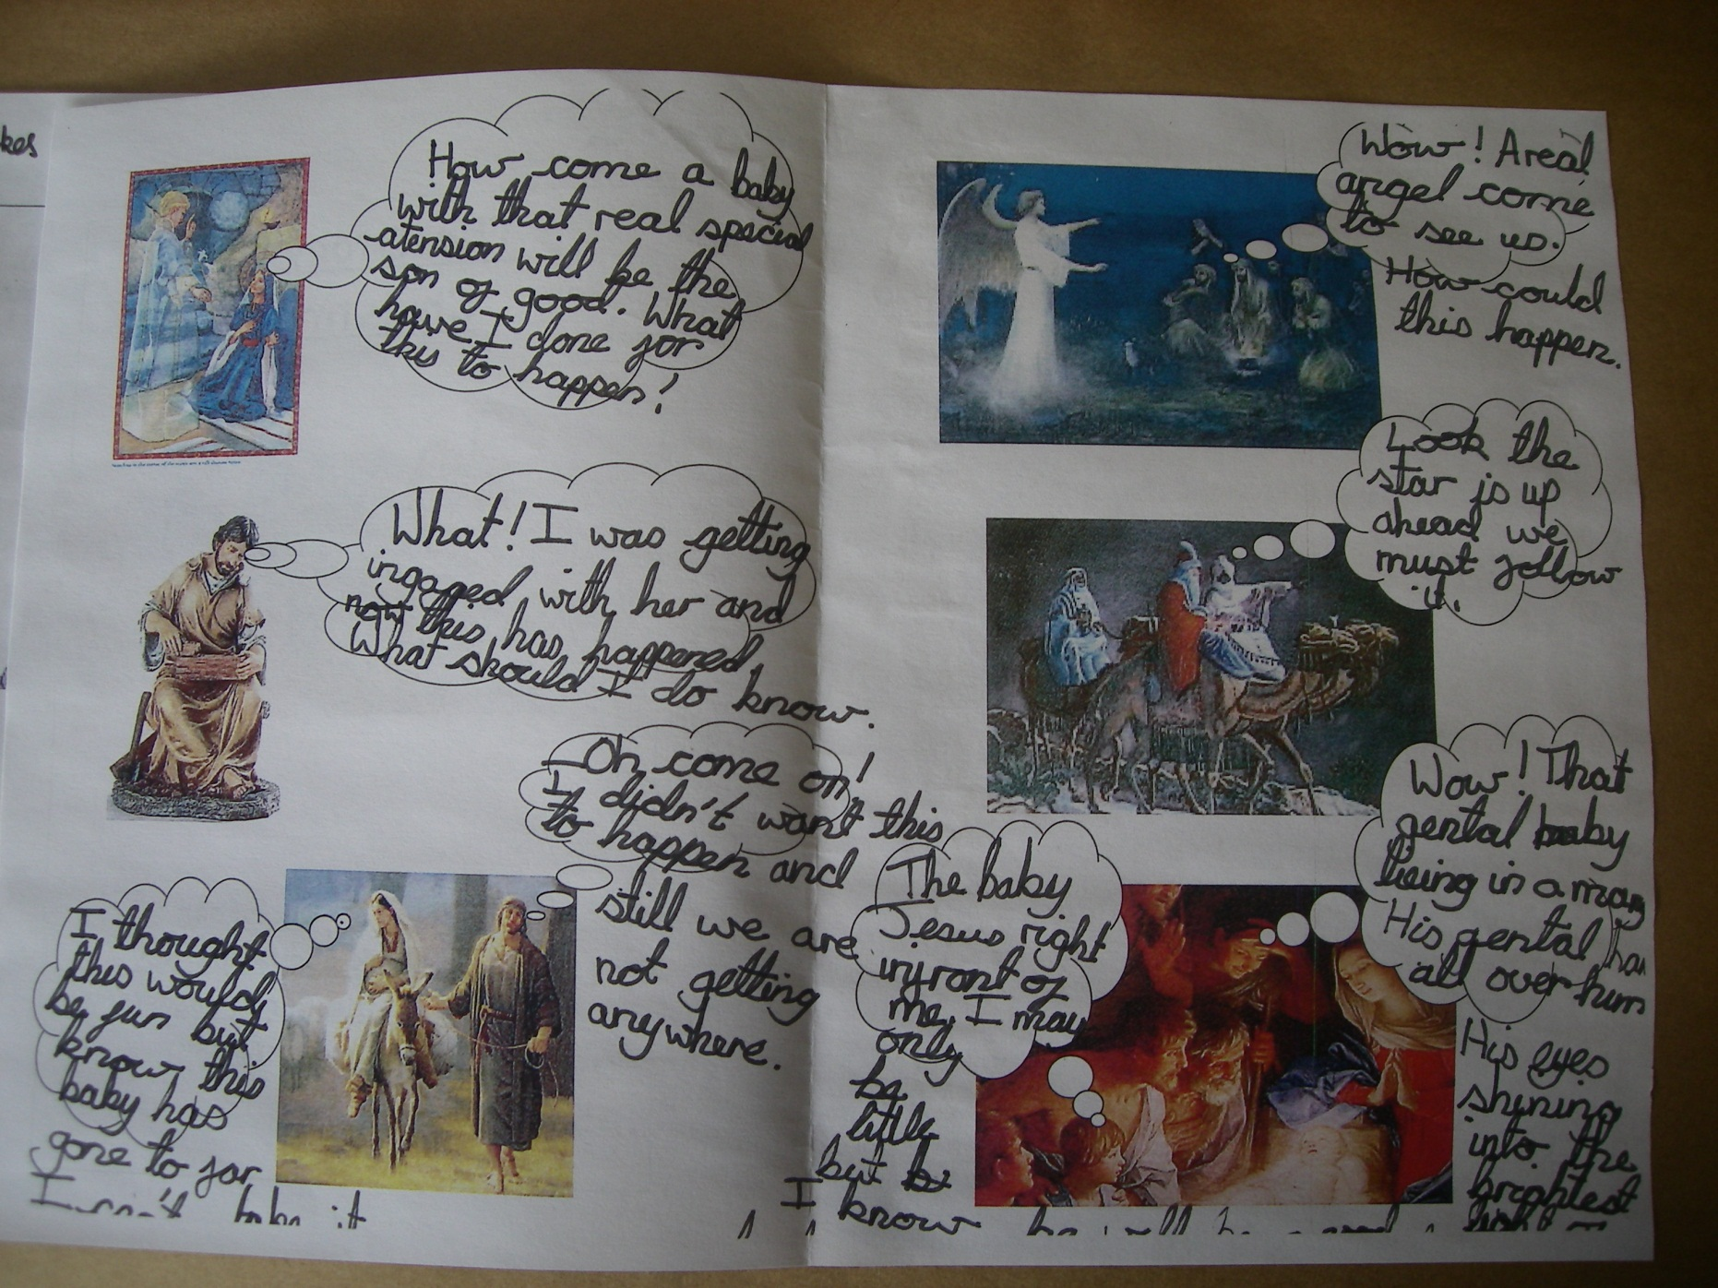

Slide 25
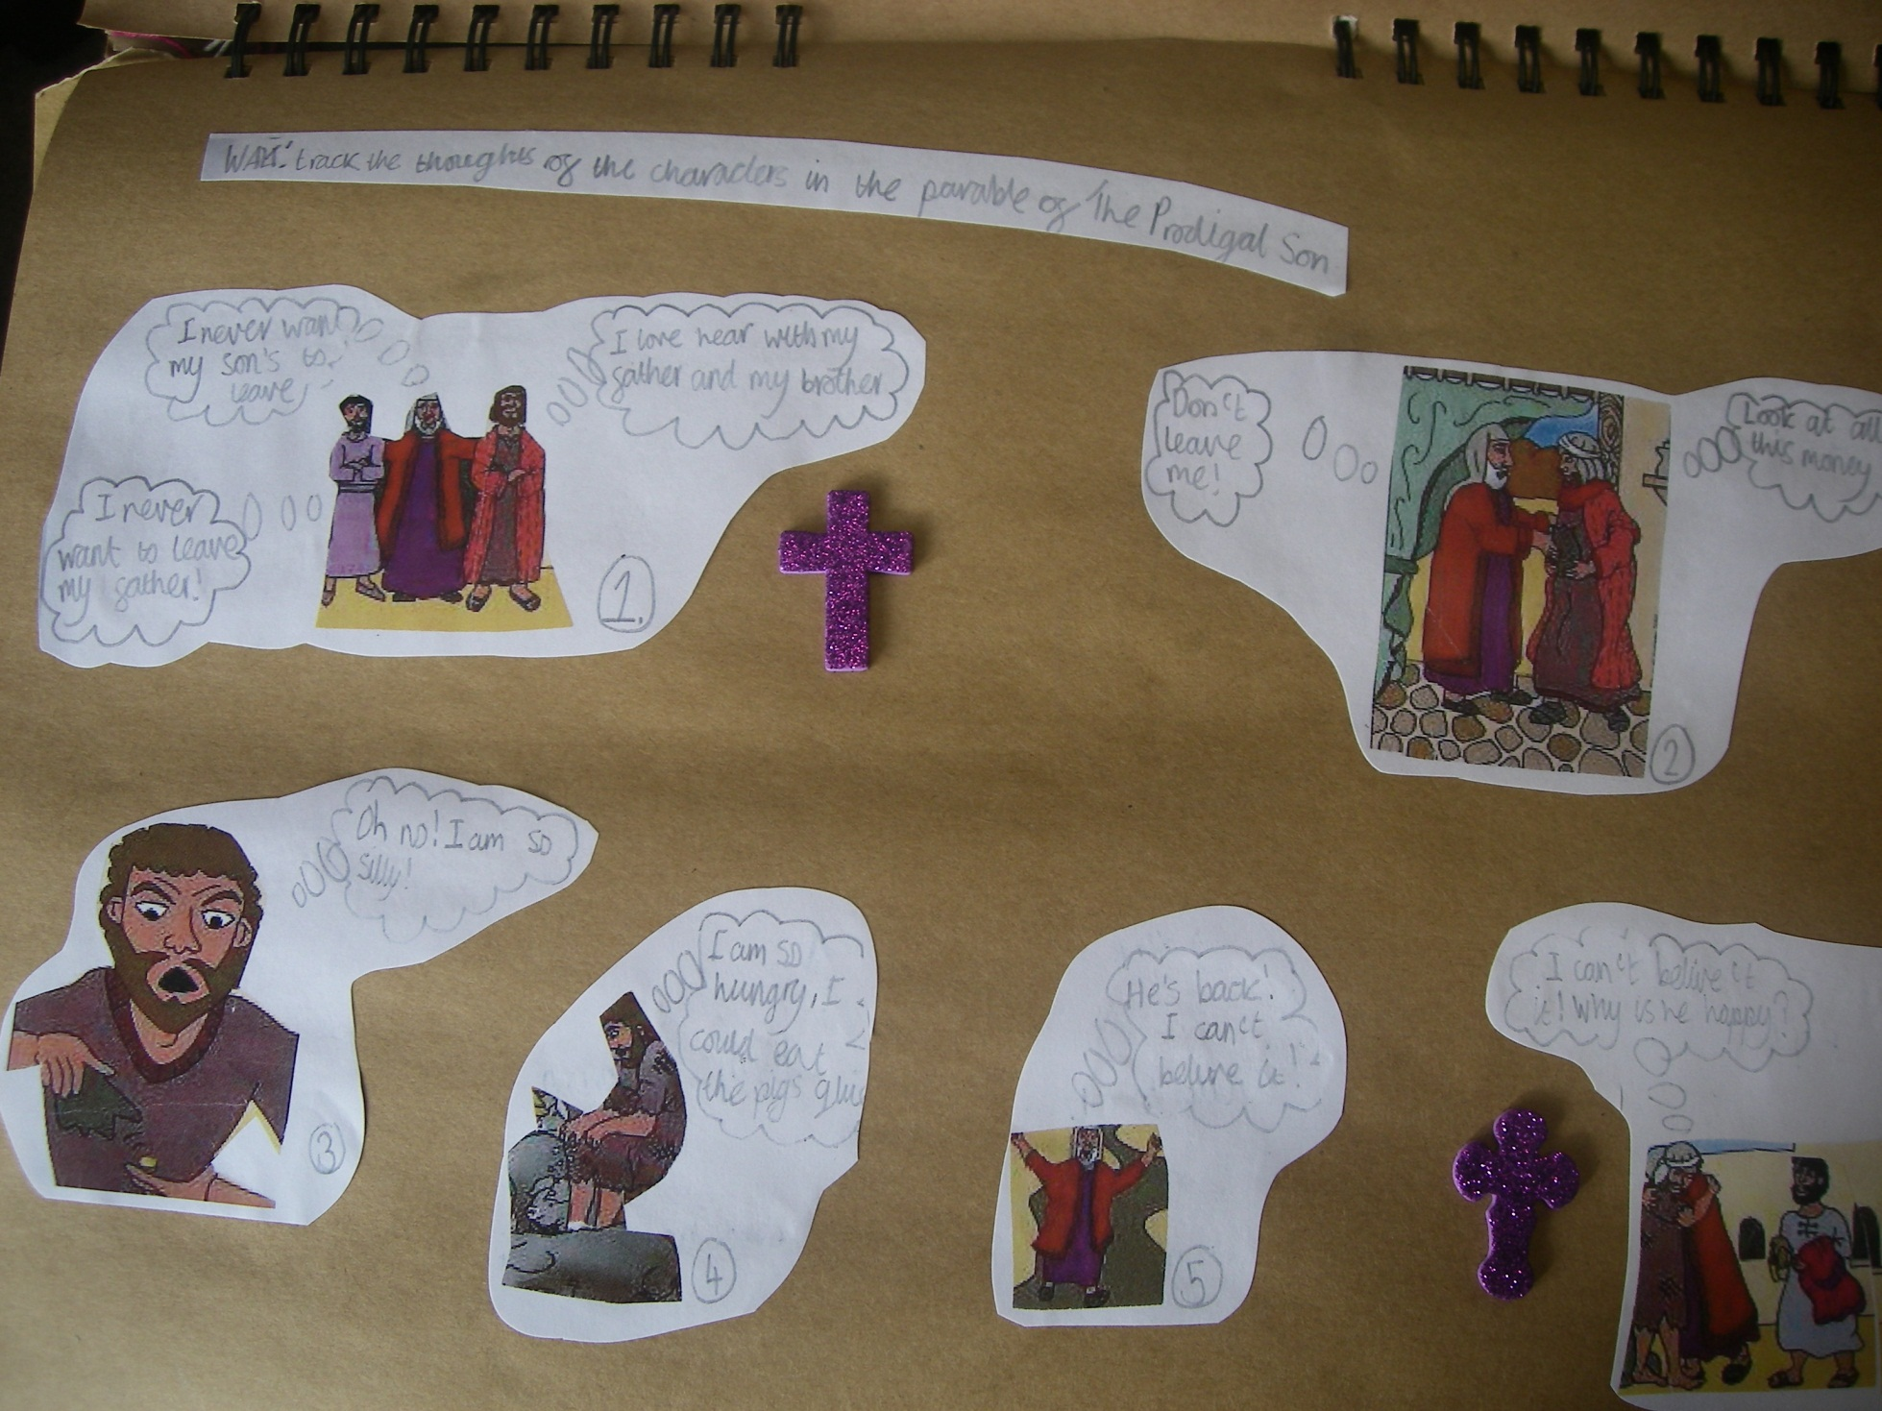

Slide 26
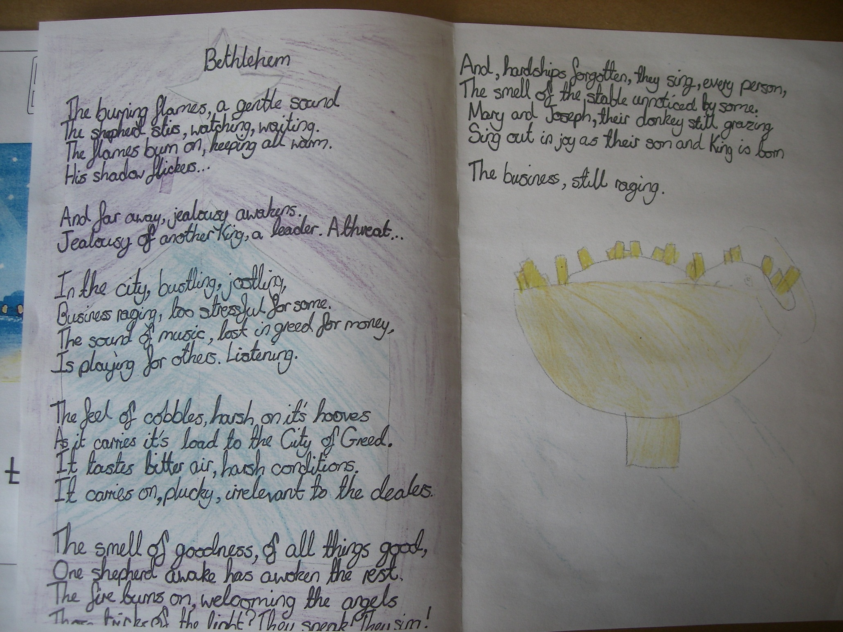

Slide 27



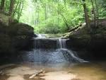
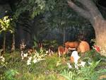

Slide 28
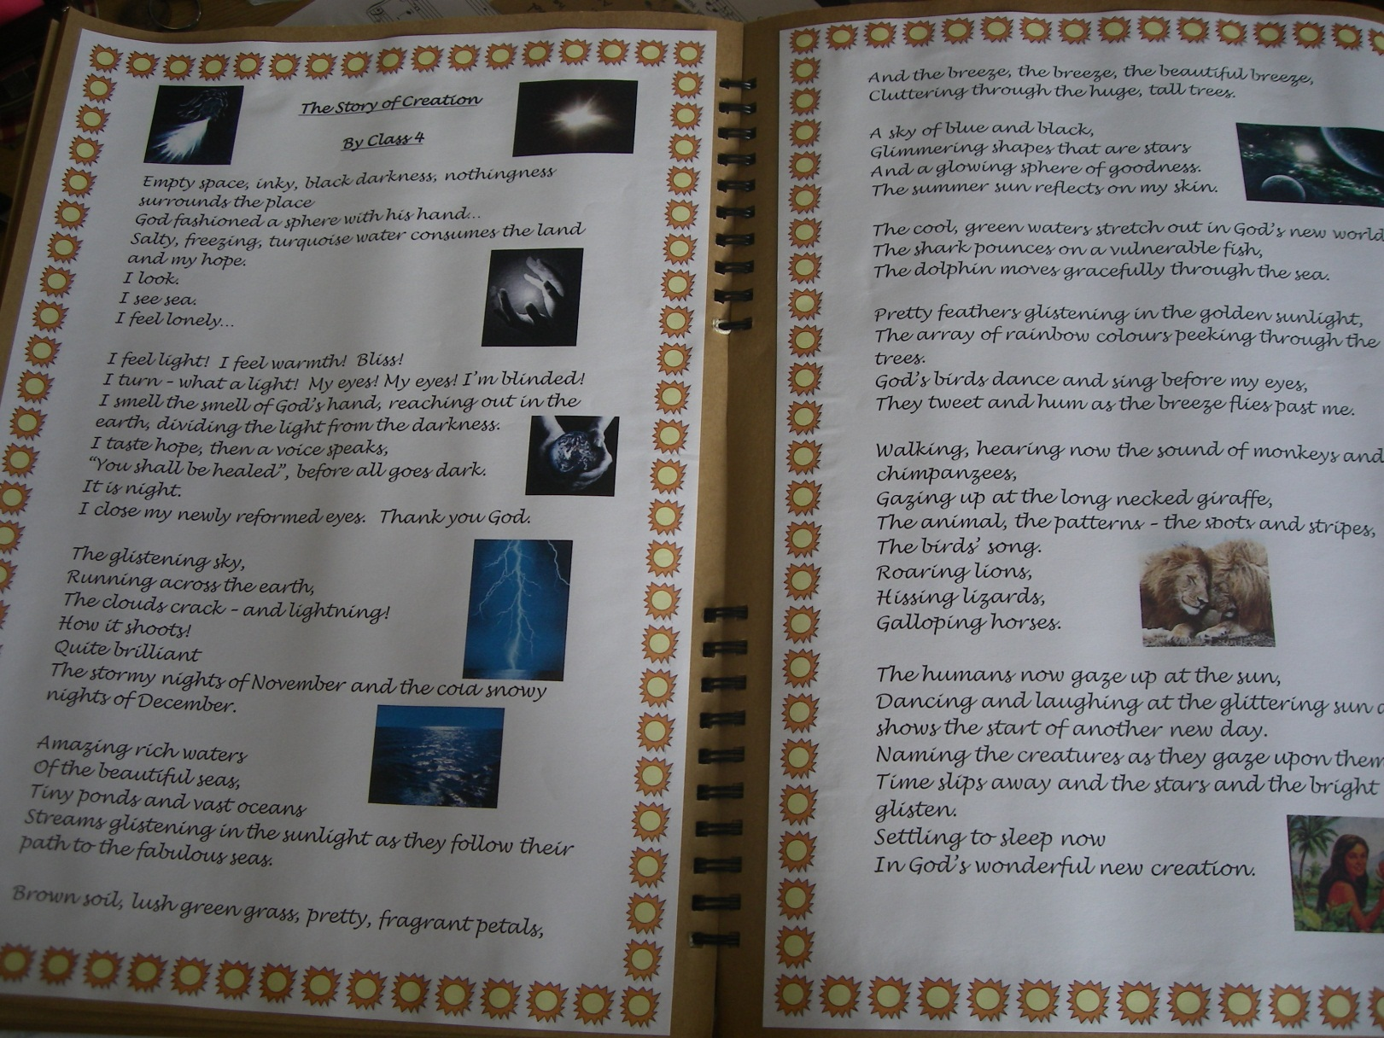

Slide 29
The Story of Creation
By Years 5 and 6
Empty space, inky, black darkness, nothingness
surrounds the place
God fashioned a sphere with his hand…
Salty, freezing, turquoise water consumes the land and my hope.
I look.
I see sea.
I feel lonely
I feel light! I feel warmth! Bliss!
I turn – what a light! My eyes! My eyes! I’m blinded!
I smell the smell of God’s hand, reaching out in the earth, dividing the light from the darkness.
I taste hope, then a voice speaks,
“You shall be healed”, before all goes dark.
It is night.
I close my newly reformed eyes.
Thank you God.

Slide 30
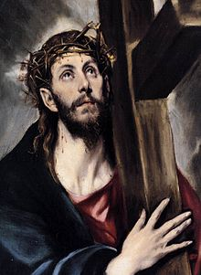
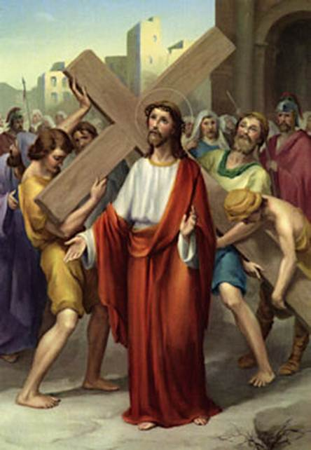
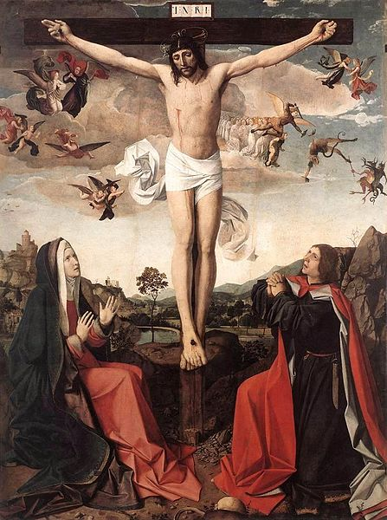


Slide 31
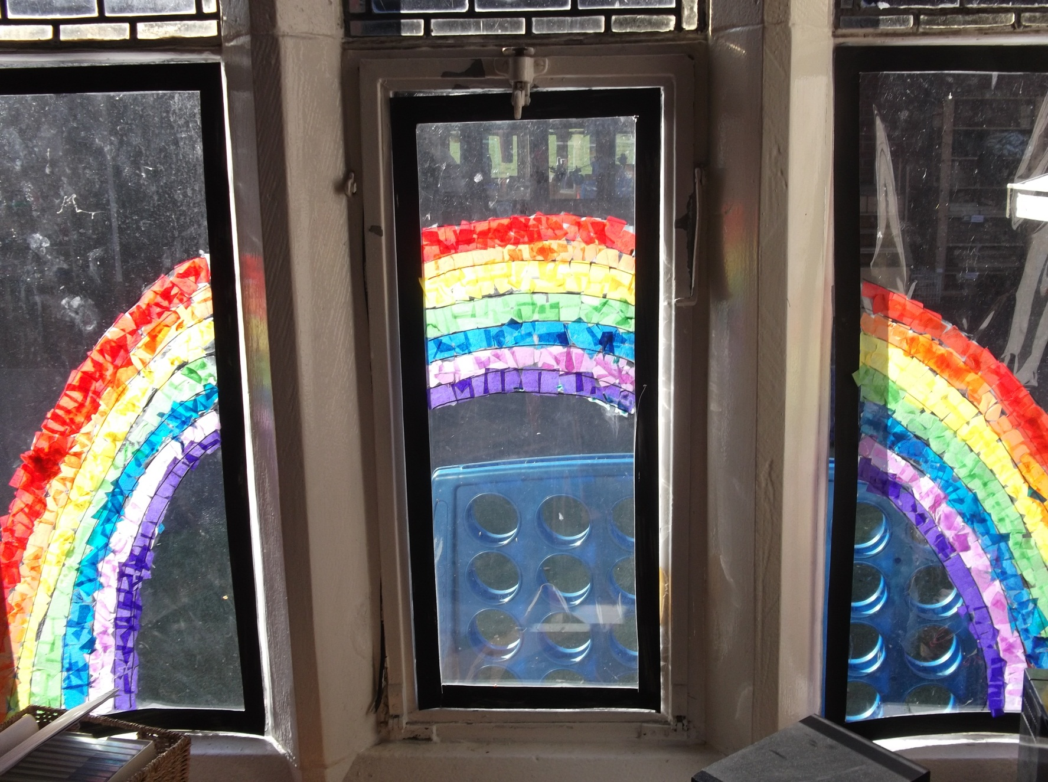

Slide 32
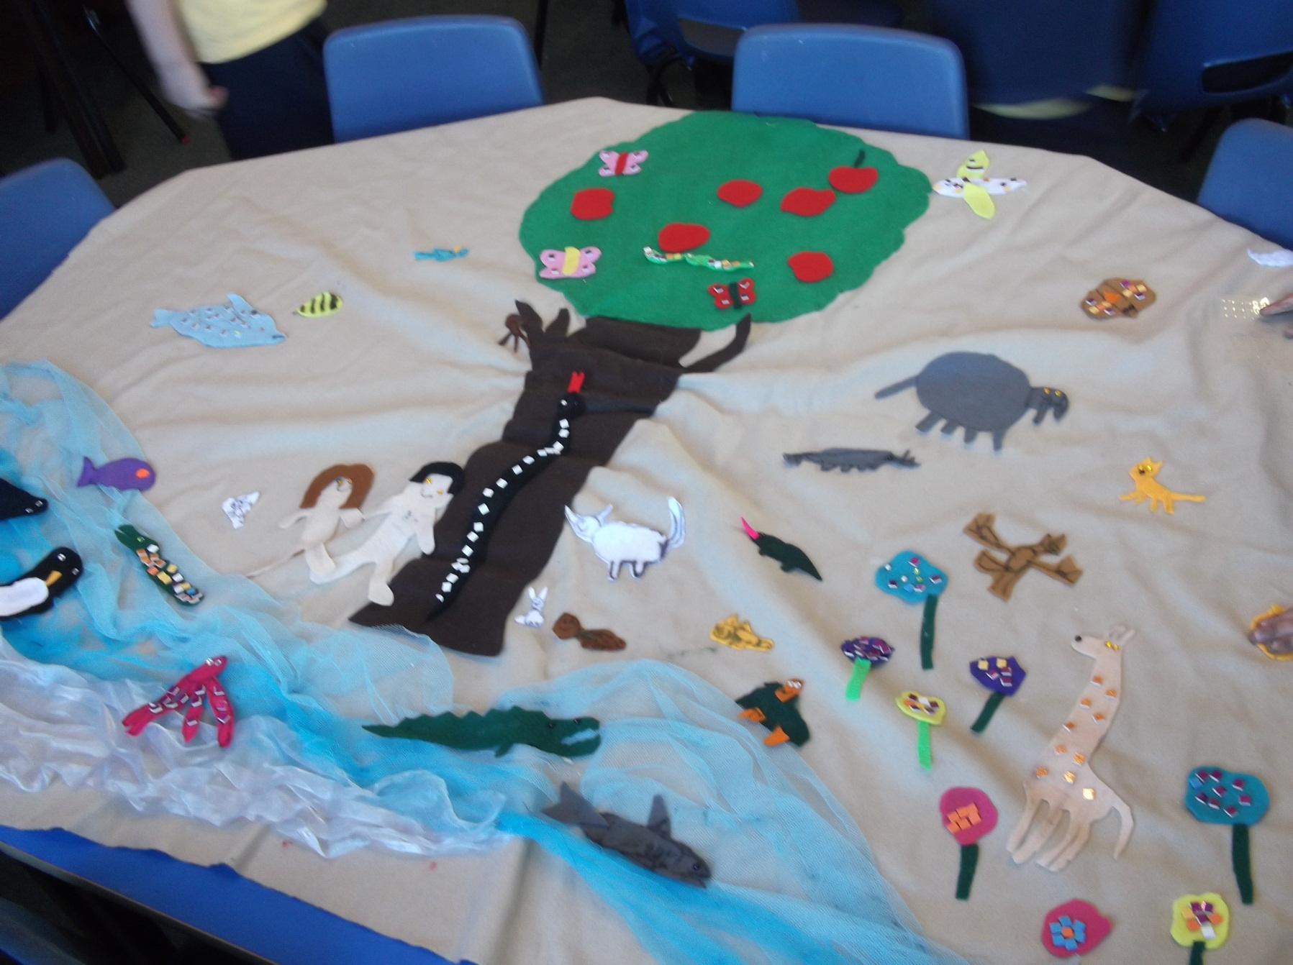

Slide 33





Slide 34


Slide 35
What The Children Say..
I like it when we do drama and art in RE because it makes it fun.
I think RE is fun because instead of just looking at a piece of paper we have fun and we do drama and stuff.
RE at Eccleston is very diverse; my favourite part is when we do art in our books and I can it can be easier to express what you feel in pictures rather than words.
RE at Eccleston is lively and interesting. We never do religious subjects without knowing that a great deal of thought is being put into our learning and there is always a great deal of thought that we put back in.

Slide 36

Any questions or comments?

