Slide 1
KS1 Mathematics
Parent Workshop
Miss Opdam
Maths Leader

Slide 2
Contents
The 4 operations – including calculation methods used and progression through the key stage
Arithmetic: Number bonds, times tables and mental strategies
Problem Solving
Your turn to have a go/Using and Applying
Year 2 SATS & the future of tests
How you can help at home: Online Applications, websites, mathletics

Slide 3
Aims
Provide you with a greater understanding of how mathematics is taught in school.
Show you the progression of the 4 operation methods through Key Stage 1.
Enable you to see the types of different questions children are asked in the Year 2 SATs and the new testing procedures.
Help you understand how you can help your child at home.

Slide 4
The New Curriculum
- More cross curricular
Problem Solving no longer discrete but embedded within each area/domain of mathematics

Slide 5
The New Curriculum
By the end of Year 1 ALL pupils should know:
Number bonds to 20
Use and understand place value

Slide 6
Key Stage 1
The Basics
Recognise, read and write numbers:
Three 3

Slide 7
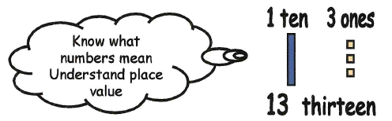
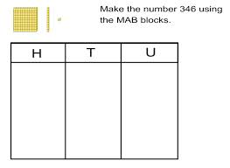
Key Stage 1
The Basics
Understand place value:

Slide 8
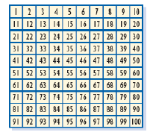
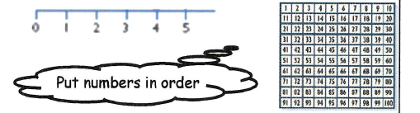
Key Stage 1
The Basics
Put numbers in order:

Slide 9
Key Stage 1
The Basics
Count forwards and backwards in same size steps

Slide 10
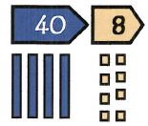
Key Stage 1
The Basics
Partition a number and recombine it

Slide 11
4 Operations Calculation Methods and Progression

Slide 12
The Four Operations
Addition and Subtraction
Correctly understanding and using the symbols +, - and =
Understanding the relationship between adding and subtracting and the importance of order when subtracting and putting the biggest number in their head to count on when adding
9 + 7 = 16
7 + 9 = 16
16 – 7 = 9
16 – 9 = 7

Slide 13

The Four Operations
Addition – Practical Resources
Diennes Apparatus
Counters/multi link cubes
Toys
Pebbles
4 + 3 =

Slide 14
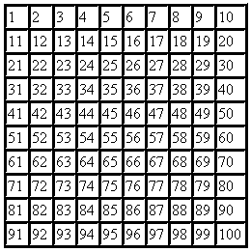

The Four Operations
Addition – Practical Resources
100 square
25 + 9 =

Slide 15
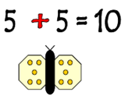
The Four Operations
Addition
One more
Doubling

Slide 16
The Four Operations
Addition – Practical Resources
Number Line/Ruler. Starting with single ‘jumps’ and then moving onto jumps of 2, 5, 10
+ 2
+ 2
+ 2
14
16
18
20
14 + 6 = 20

Slide 17
The Four Operations
Addition – Partitioning for 2 digit + 2 digit
Number Line/Ruler
2nd digit is partitioned
16 + 12 =
12 is partitioned into T + U
12 = 10 + 2
+ 10
+ 1
+ 1
16
26
27
28
Notes:
For this method to be successful children need to be confident with:
Place value – partitioning and recombining numbers
Counting forwards in 10s and 1s from any number
Highlights importance of mental skills

Slide 18
The Four Operations
Addition – Written Method
- Bridging through multiples of ten
56 + 38 = 94
+ 30
+ 4
+ 4
56
60
90
94
Notes:
Children will practise adding with and without crossing tens.
For children to bridge through ten or a multiple of ten. It is essential that they have accurate and secure knowledge of their number bonds.

Slide 19
The Four Operations
Addition – Written Methods
Partitioning
Partitioning means splitting the number into the tens and units. It is essential that their place value is secure.
56 + 32 = 50 + 30 = 80 (partition tens first)
6 + 2 = 8 (partition units)
80 + 8 = 88 (add tens and units answer together)

Slide 20
The Four Operations
Subtraction – Practical Resources
Diennes Apparatus
Counters
Toys
Pebbles
5 – 2 =

Slide 21
The Four Operations
Subtraction – Practical Resources
Number Line/Ruler
13 – 6 =
1 | 2 | 3 | 4 | 5 | 6 | 7 | 8 | 9 | 10 | 11 | 12 | 13

Slide 22
The Four Operations
Subtraction – Practical Resources
100 square
34 – 8 =

Slide 23
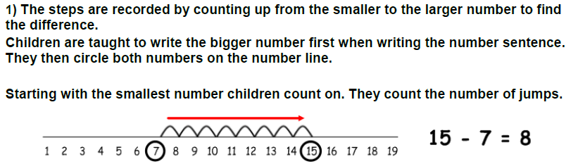
The Four Operations
Subtraction – Finding the difference
Notes:
Counting ON from the smallest to the largest to find the difference between the 2 numbers.
This is a valuable but difficult concept for children to learn.

Slide 24
The Four Operations
Subtraction – Counting Backwards
Count back from the largest to the smallest.
74 – 48 = 20 + 4 + 2
= 26
- 20
- 2
- 4
48
50
70
74
Notes:
Use of number bonds to bridge through multiples of tens.

Slide 25
The Four Operations
Subtraction – Counting On
Finding the difference
Count on from the smallest to the largest once again bridging through ten or a multiple of ten.
52 60 70 74
74 – 52 = 10 + 8 + 4
= 22
+ 10
+ 8
+ 4
Notes:
In Year 2, using number bonds again to bridge to multiples of 10.

Slide 26
The Four Operations
Multiplication – Doubling
Notes:
Doubling again. As multiplication is repeated addition and this is what the chn are taught.
Also counting choirs – could get parents to have a go

Slide 27
The Four Operations
Multiplication – Doubling
Moving onto partitioning to double numbers
Double 23 = Double 20 + 3
40 + 6 = 46
Notes:
In Year 2 children are extended to use partitioning to double numbers.

Slide 28
The Four Operations
Multiplication – Practical Resources/Repeated Addition
3 x 5 = (3 groups of 5) = 5 + 5 + 5 =

Slide 29
The Four Operations
Multiplication – Practical Resources/Repeated Addition
5 x 3 = (5 groups of 3) = 3 + 3 + 3 + 3 + 3 =
Children learn that 5 X 3 is the SAME as 3 X 5.
This assists with their times tables as well.
Notes:
Use of arrays to help with multiplication

Slide 30
The Four Operations
Multiplication – Number lines/100 square
Children use the number line and the idea of repeated addition to count in groups.
4 X 3 =
3
3
3
3
0
3
6
9
12

Slide 31
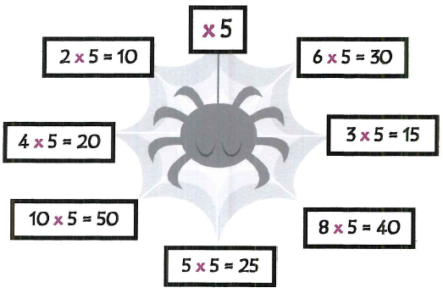
The Four Operations
Multiplication – Times Tables

Slide 32

The Four Operations
Division – Halving

Slide 33
The Four Operations
Division - Halving
Moving onto partitioning to halve numbers
Halve 28 = Halve 20 + 8
10 + 4 = 14
Notes:
Use of Dienes apparatus to support children. Relying on the sharing out technique taught in Year 1

Slide 34
The Four Operations
Division – Practical Resources – Sharing
15 ÷ 3 = 15 ‘shared between’ 3 =
Notes:
Children learn to share practical objects and then move onto recording this as ‘dots in pots’

Slide 35
The Four Operations
Division – Grouping
The number in the group is known but how many groups is unknown.
How many 3s in 12?
We need to count the number of groups.

Slide 36
The Four Operations
Division – Corresponding times table facts
From here we get the children to use their times tables knowledge to work out the inverse operation
27 ÷ 3 =
Children need to use their knowledge of 3 times table to use the corresponding fact
3 x 9 = 27 so 27 ÷3 = 9

Slide 37
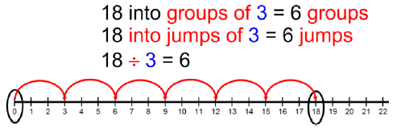
The Four Operations
Division – Marked number line
Notes:
Children begin to use a marked number line to solve division problems.
This method requires children to find out how many jumps of 3 can they make between 0 and 18. They circle 0 and 18 on a number line before they commence their equal jumps of 3. The constant reinforcement of vocabulary ‘into groups of’ is very important.
Once children are confident can move onto a blank number line.

Slide 38
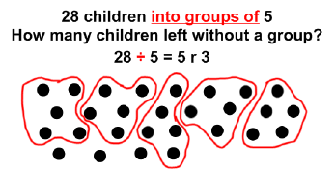
The Four Operations
Division – with remainders
Notes:
Reinforce division as grouping through arrays and jottings and introduce remainders.
28 children into groups of 5. How many children left without a group?

Slide 39
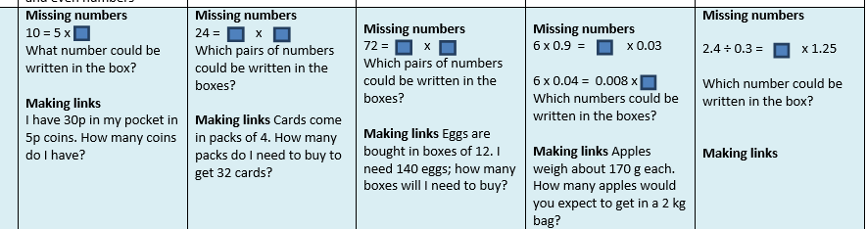
Reasoning

Slide 40
Year 2 SATS
Occur in May.
All children sit the same paper
Children will have already attempted past papers so use to the format.
Very relaxed.
Some children who attain a high pass mark may be classed as ‘Greater Depth’
Notes:
Change in 2016. Still awaiting guidance from government.

Slide 41
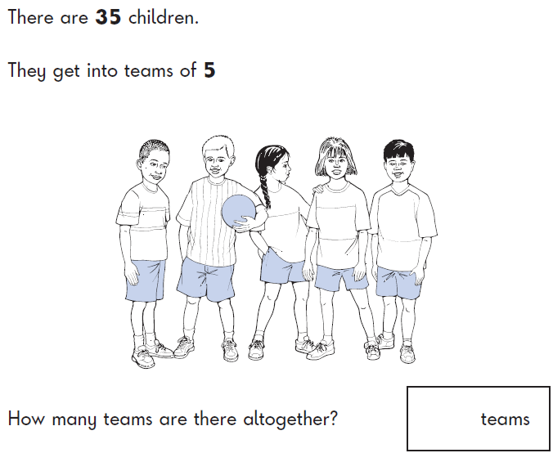
Your turn

Slide 42
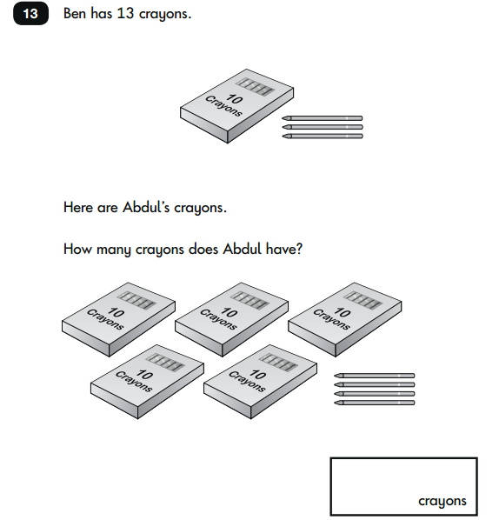

Slide 43
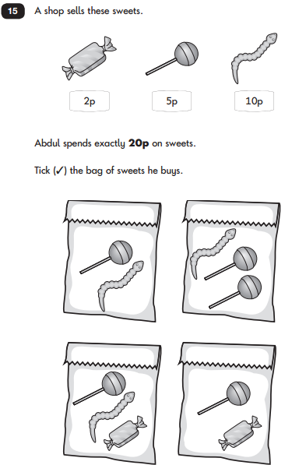

Slide 44
Problem Solving
Understanding mathematical vocabulary
Applying strategies taught
Explaining process
Reasoning for why doing that
Justifying answer

Slide 45
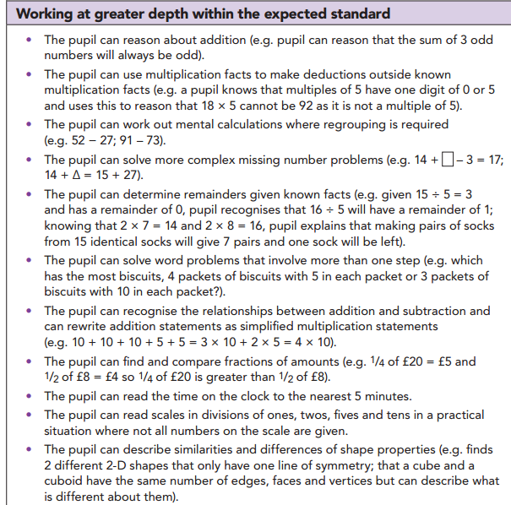
Greater Depth

Slide 46
How you can help at home
Lots of practice – in the car, online games, counting stairs, cars, trees etc
Playing games – cards, snakes and ladders, dominoes
Cooking
Telling the time
Mathletics.co.uk
Online Applications

Slide 47




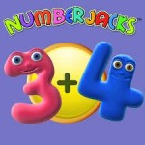

Online Applications
Multi player mental maths game
Four operation practice
Math Bingo: Four operation bingo
Squeebles Times Tables 2
Numberjacks: Addition facts up to 10
Amazing coin: Learn about different British currency

Slide 48
Handouts
Presentation
Mathematics objectives for KS1

Slide 49
Any other questions?
Thank you.

