Slide 1
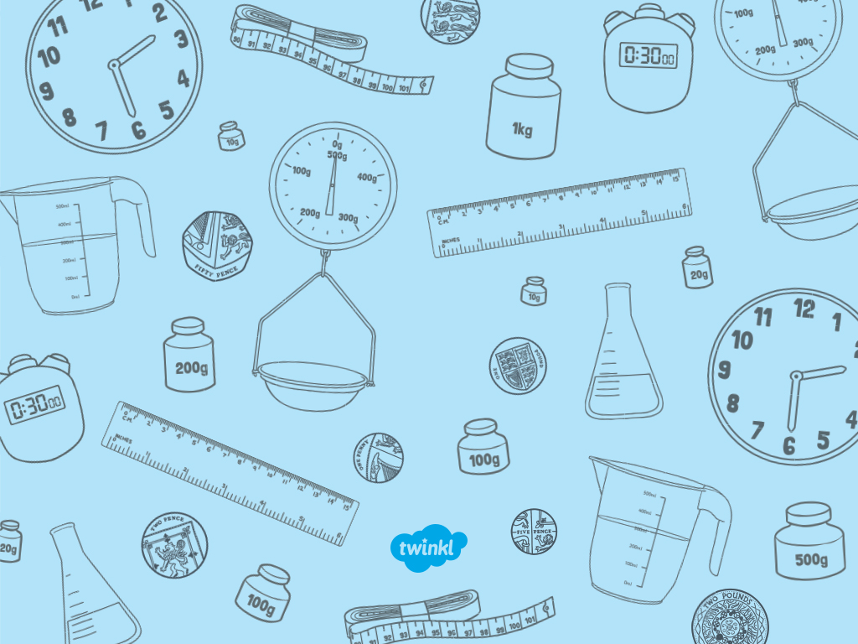

Monday 18th May
O’clock Times

Slide 2
Aim
I can use a clock to tell the time to the hour.
Success Criteria
I can describe a clock face.
I can tell the time to the hour.

Slide 3

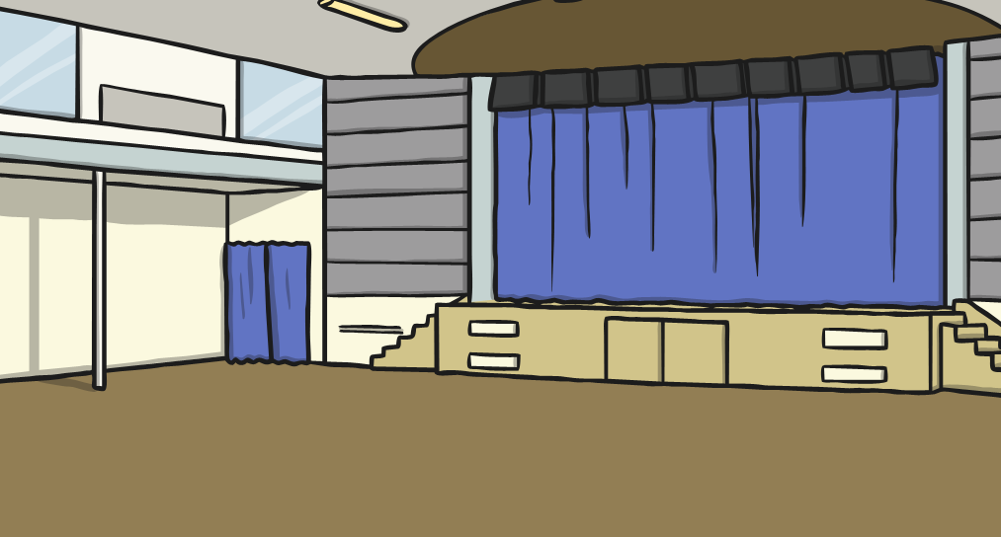
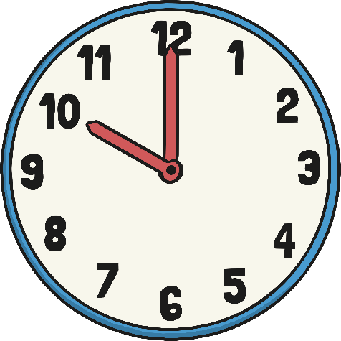
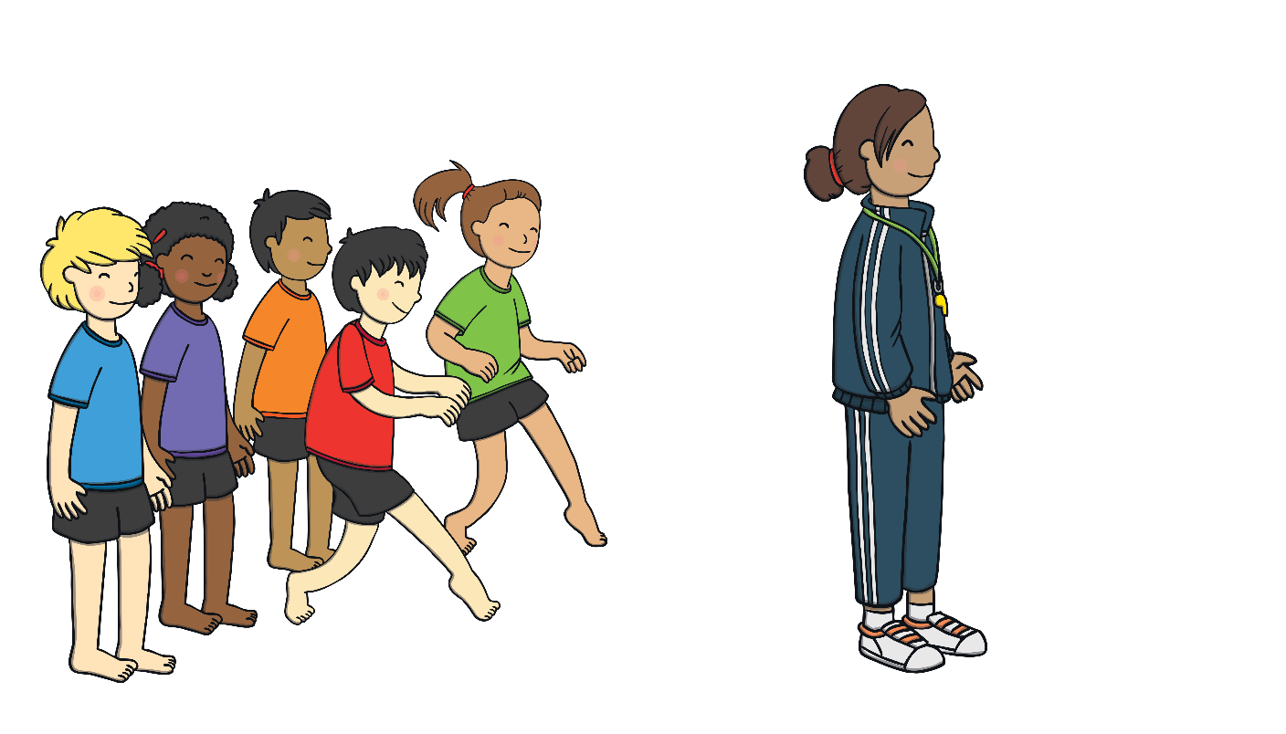
What’s the Time, Mr Wolf?
Line up in a line.
Move the same number of steps as the time.
Choose a wolf.
The wolf will shout out times.
Try to get the wolf before they shout,
‘Dinner time!’

Slide 4

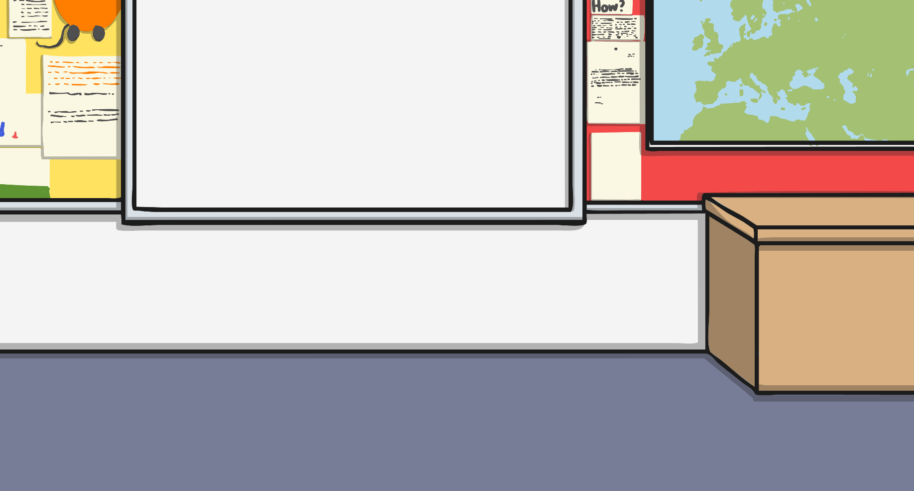
Clocks
Time is measured in years, months, weeks, days, hours, minutes
and seconds. We use clocks to measure time.
There are 24 hours in a day, which is made up of 2 lots of 12 hours.
12 hours in the first half of the day and 12 hours in the second half of the day.
1 hour is made up of 60 minutes.

Slide 5

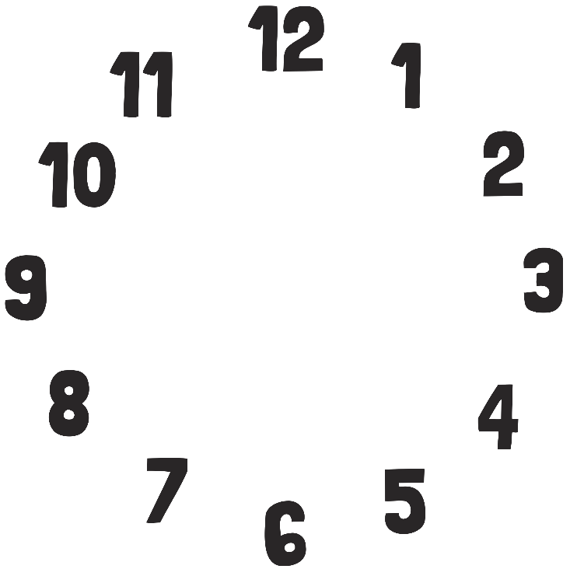


Clocks
We use clocks to tell us the time. What are these parts of the clock called?
clock face
minute hand
hour hand
numbers

Slide 6

Clocks
We use clocks to tell us the time.
The small hand tells us what hour it is. We call this the hour hand.
The big hand tells us how many minutes past or to each hour it is. We call this the minute hand.
When the minute hand points straight up to the number 12, this tells us that it is an 'o'clock' time.
This is when a new hour starts.

Slide 7

Clocks
We use clocks to tell us the time.
The minute hand is pointing straight up towards the number 12. This means that it is an o’clock time.
The hour hand is pointing to the number 3. This means that the time is 3 o’clock.

Slide 8




Clocks
Let’s say the time on the clock together.

Slide 9

What Time Is It?
Click the correct time.
2 o’clock
4 o’clock
12 o’clock

Slide 10
What Time Is It?
Oops!
Try again

Slide 11
What Time Is It?
Correct!

Slide 12
What Time Is It?
Click the correct time.
1 o’clock
6 o’clock
7 o’clock

Slide 13
What Time Is It?
Oops!
Try again

Slide 14
What Time Is It?
Correct!

Slide 15
What Time Is It?
Click the correct time.
9 o’clock
4 o’clock
6 o’clock

Slide 16
What Time Is It?
Oops!
Try again

Slide 17
What Time Is It?
Correct!

Slide 18
What Time Is It?
Click the correct time.
1 o’clock
7 o’clock
11 o’clock

Slide 19
What Time Is It?
Oops!
Try again

Slide 20
What Time Is It?
Correct!

Slide 21
What Time Is It?
Click the correct time.
5 o’clock
2 o’clock
6 o’clock

Slide 22
What Time Is It?
Oops!
Try again

Slide 23
What Time Is It?
Correct!

Slide 24
What Time Is It?
Click the correct time.
2 o’clock
8 o’clock
12 o’clock

Slide 25
What Time Is It?
Oops!
Try again

Slide 26
What Time Is It?
Correct!

Slide 27
What Time Is It?
Click the correct time.
12 o’clock
1 o’clock
11 o’clock

Slide 28
What Time Is It?
Oops!
Try again

Slide 29
What Time Is It?
Correct!

Slide 30
What Time Is It?
Click the correct time.
10 o’clock
12 o’clock
6 o’clock

Slide 31
What Time Is It?
Oops!
Try again

Slide 32
What Time Is It?
Correct!

Slide 33

What Time Is It?
Click the correct time.
12 o’clock
6 o’clock
2 o’clock

Slide 34
What Time Is It?
Oops!
Try again

Slide 35
What Time Is It?
Correct!

Slide 36
What Time Is It?
Click the correct time.
2 o’clock
12 o’clock
10 o’clock

Slide 37
What Time Is It?
Oops!
Try again

Slide 38
What Time Is It?
Correct!

Slide 39
What Time Is It?
Click the correct time.
6 o’clock
9 o’clock
3 o’clock

Slide 40
What Time Is It?
Oops!
Try again

Slide 41
What Time Is It?
Correct!

Slide 42
What Time Is It?
Click the correct time.
9 o’clock
8 o’clock
10 o’clock

Slide 43
What Time Is It?
Oops!
Try again

Slide 44
What Time Is It?
Correct!

Slide 45

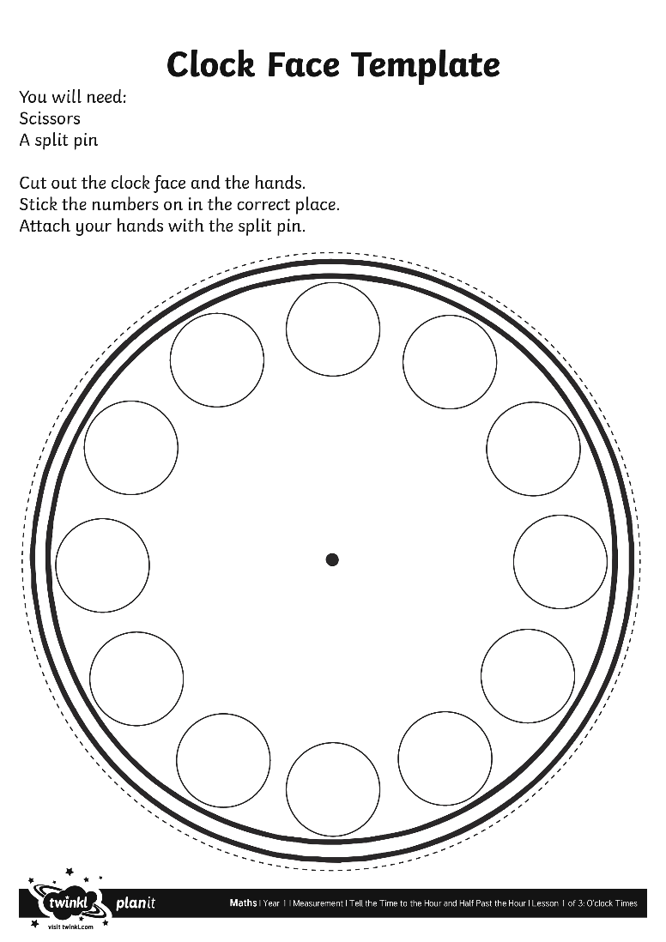
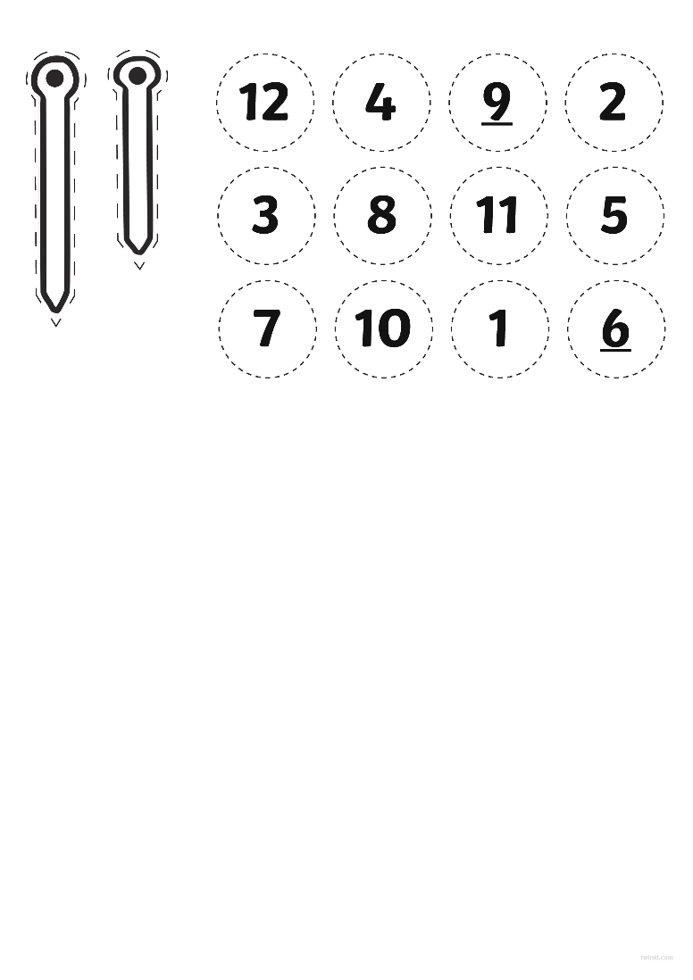
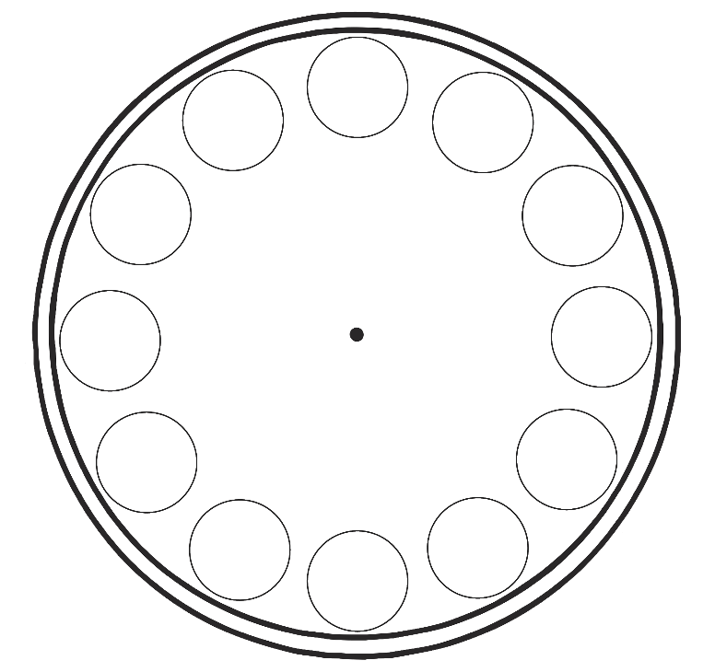
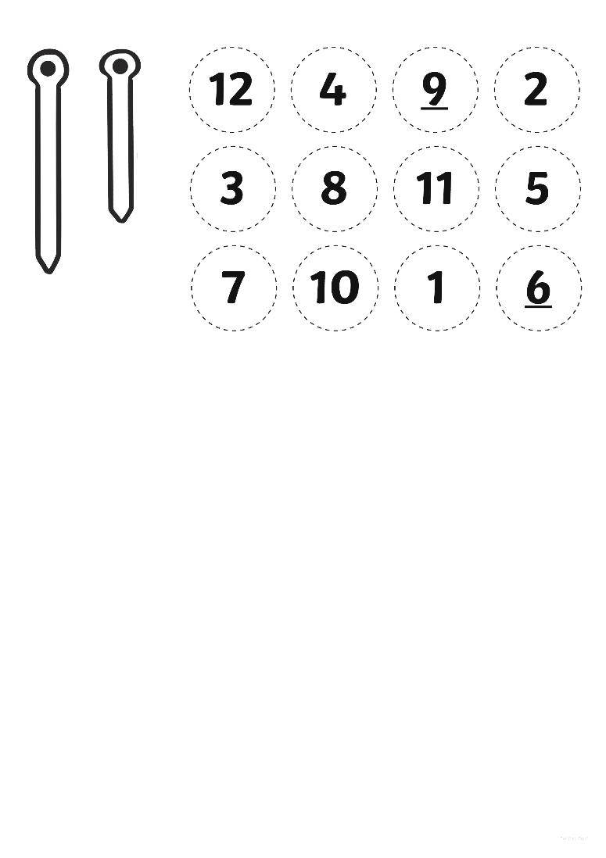

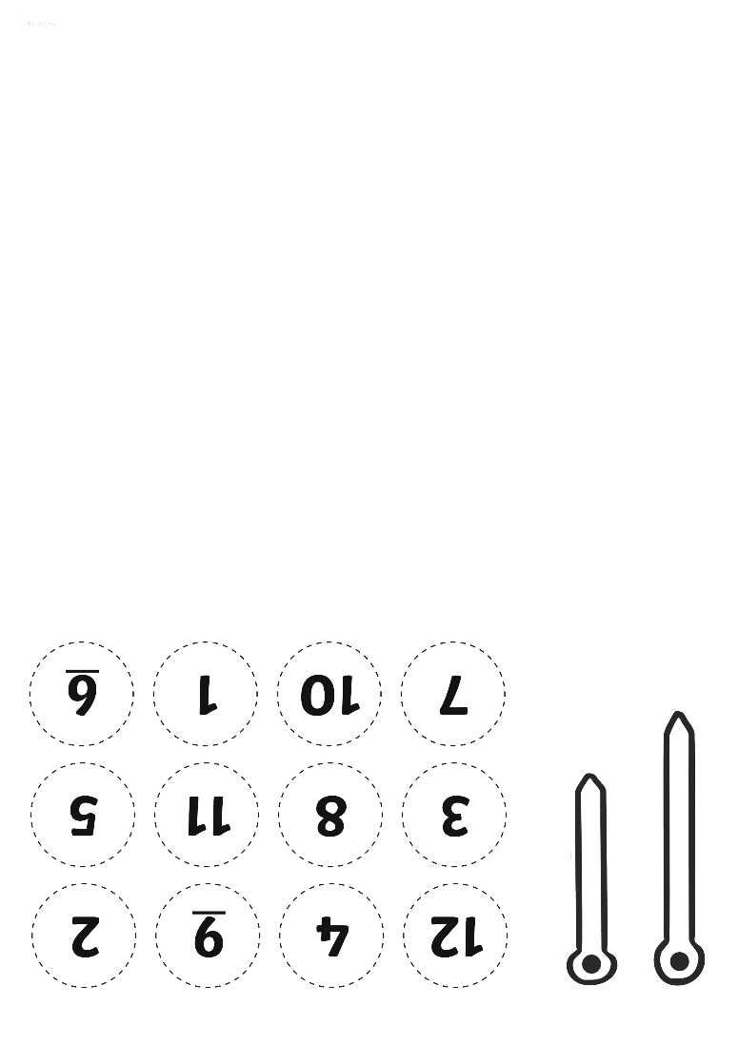


Clock Faces

Slide 46
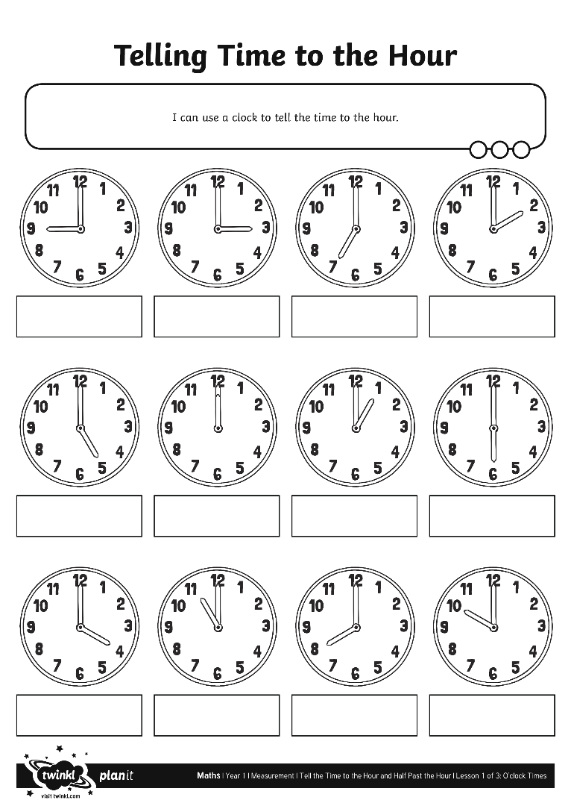
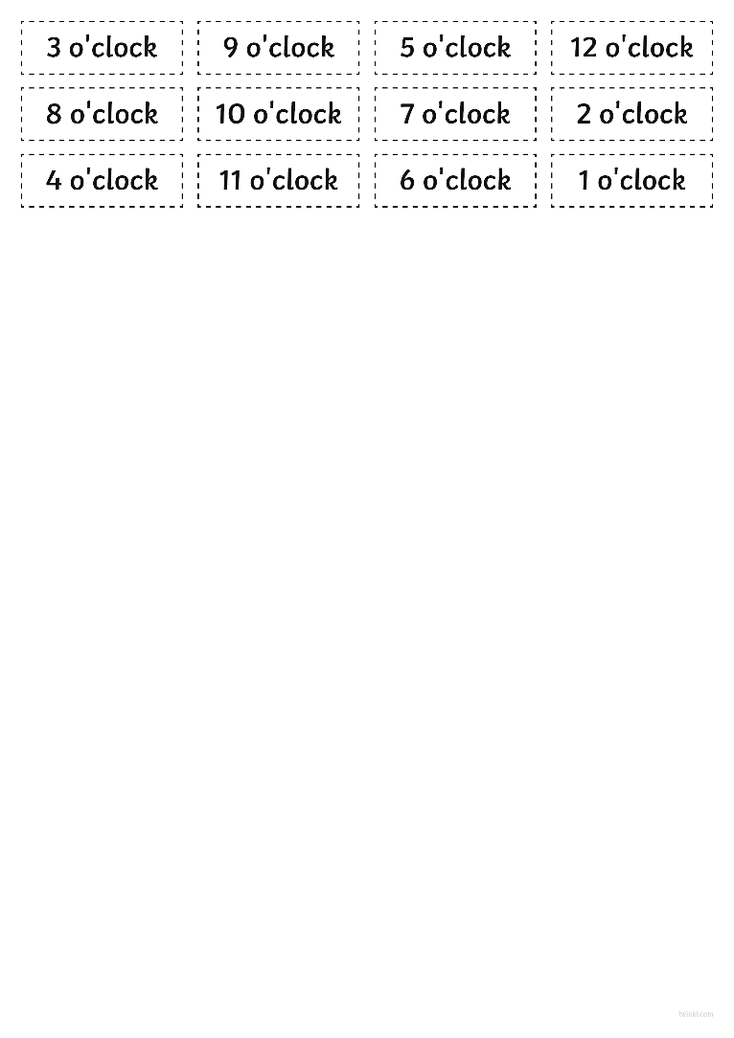
Telling Time to the Hour

Slide 47
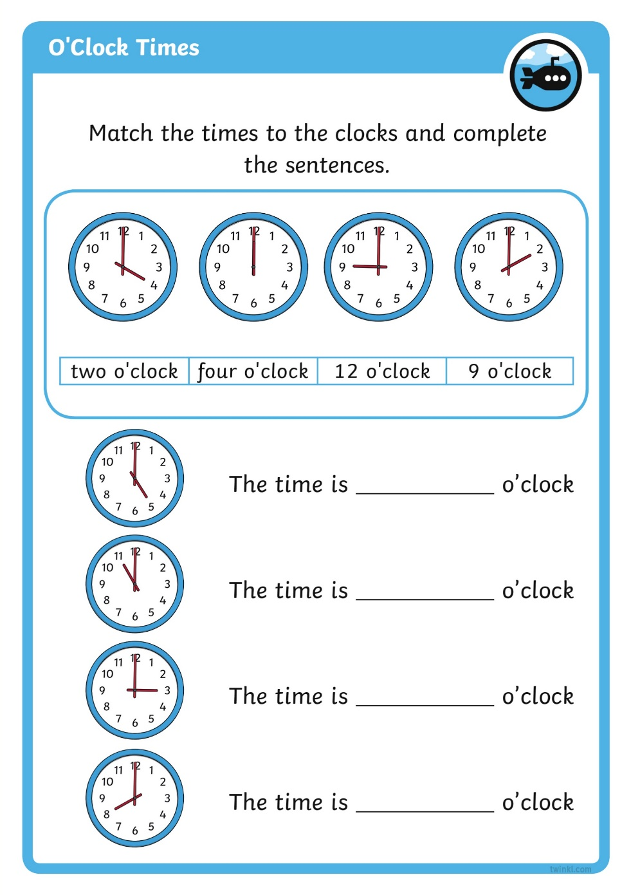
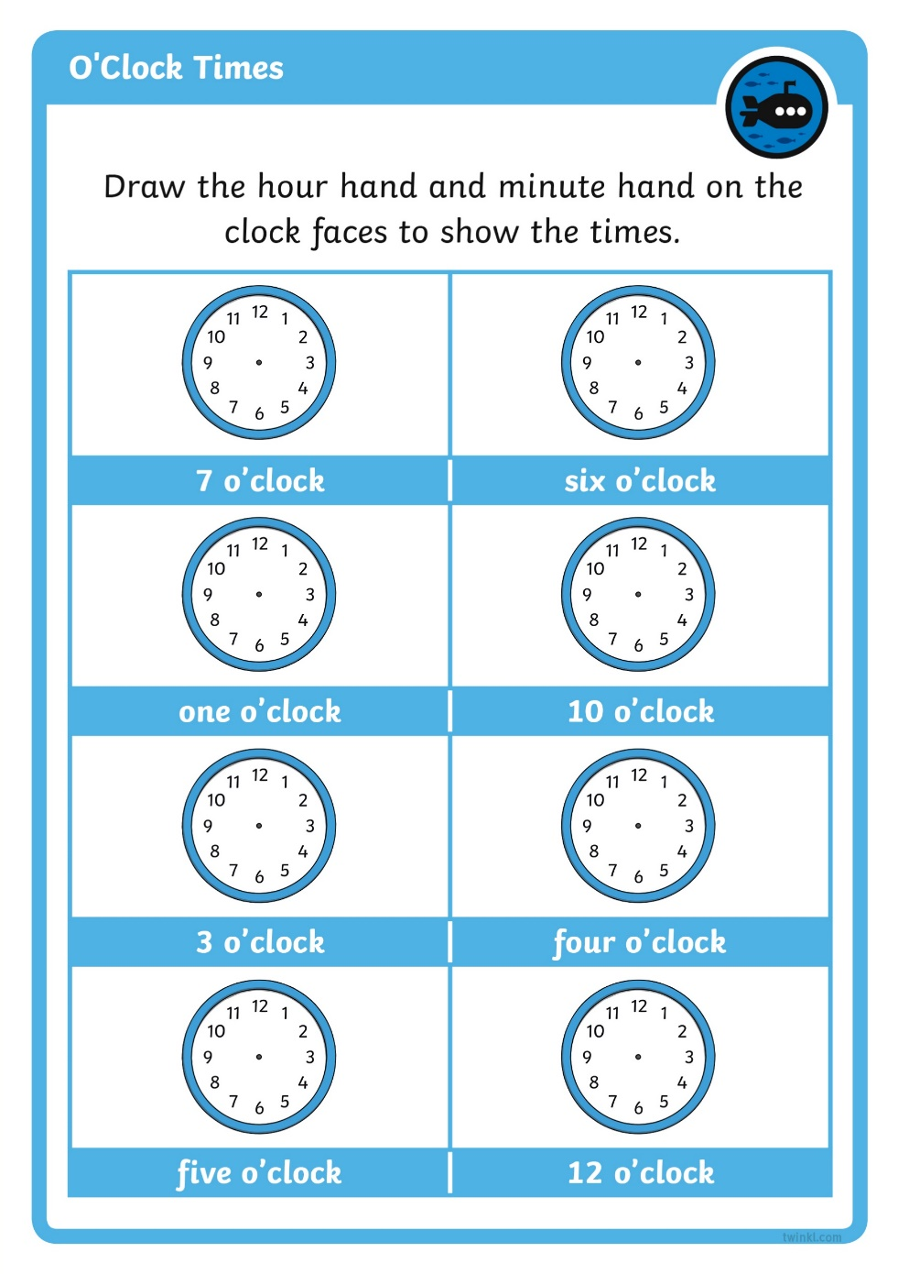
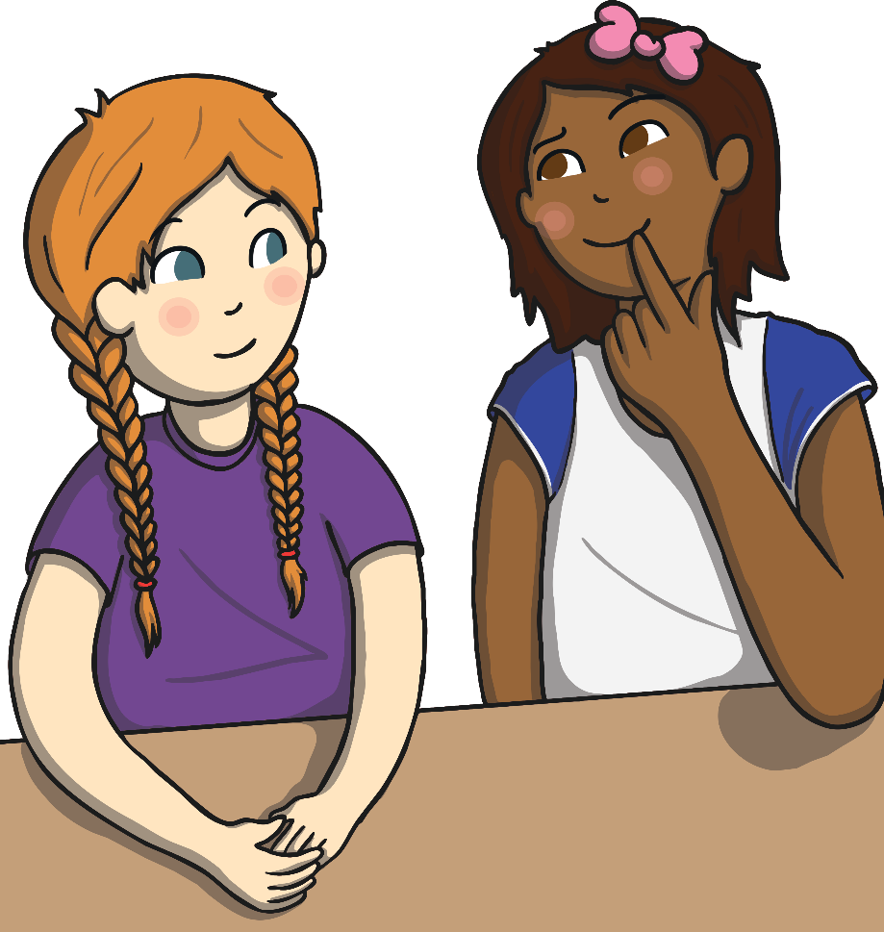
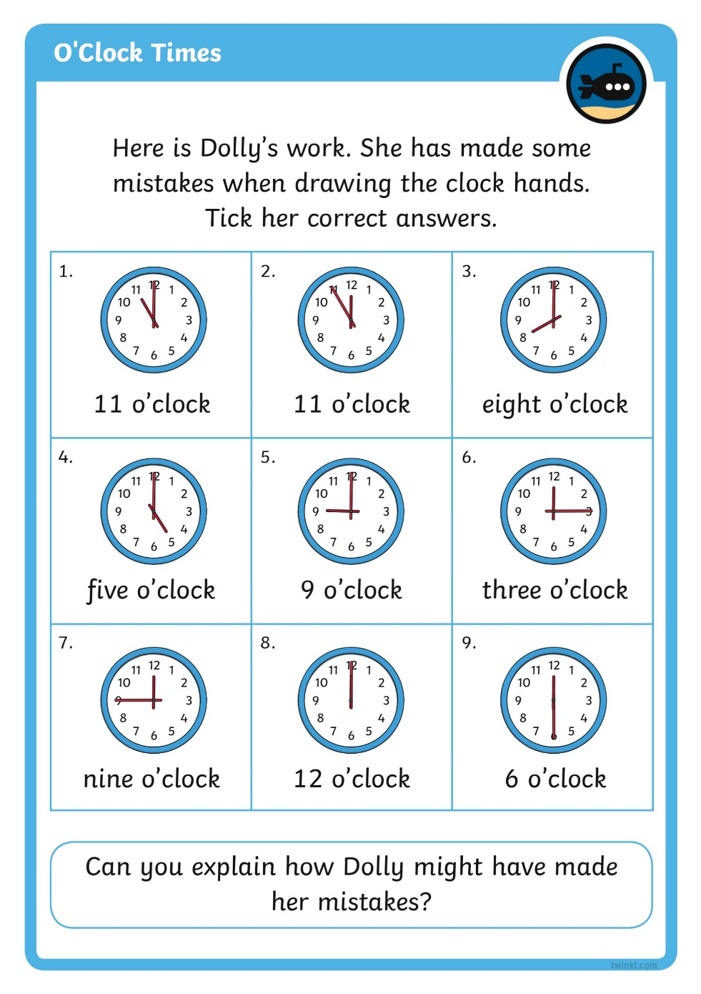
Diving into Mastery
Dive in by completing your own activity!

Slide 48
Show Me The Time
Show these times on your clock faces.
2 o’clock

Slide 49
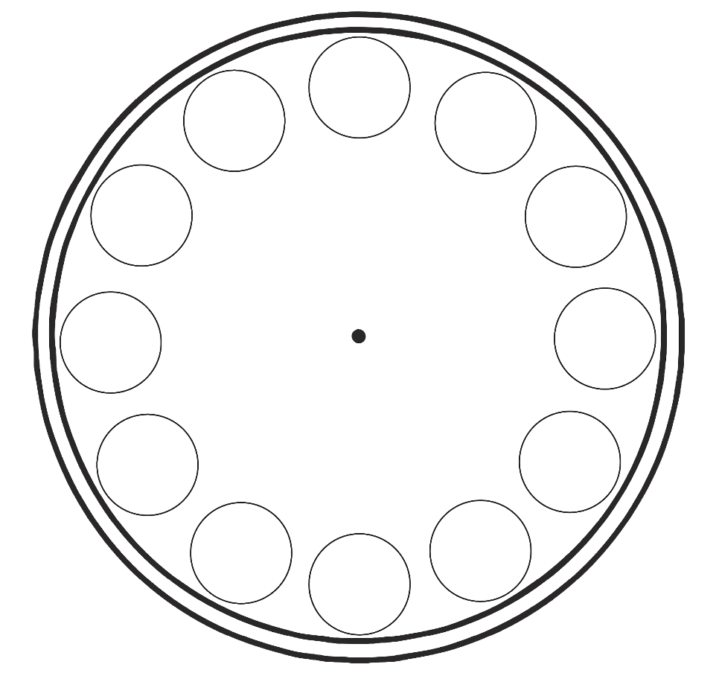





Show Me The Time
Show these times on your clock faces.

Slide 50
Show Me The Time
Show these times on your clock faces.
6 o’clock

Slide 51
Show Me The Time
Show these times on your clock faces.

Slide 52
Show Me The Time
Show these times on your clock faces.
12 o’clock

Slide 53
Show Me The Time
Show these times on your clock faces.

Slide 54
Show Me The Time
Show these times on your clock faces.
7 o’clock

Slide 55
Show Me The Time
Show these times on your clock faces.

Slide 56
Aim
I can use a clock to tell the time to the hour.
Success Criteria
I can describe a clock face.
I can tell the time to the hour.

Slide 57
