Slide 1


Maths
Measurement
Year One
Maths | Year 1 | Measurement | Tell the Time to the Hour and Half Past the Hour | Lesson 3 of 3: Clock Hands

Slide 2

Clock Hands

Slide 3
Aim
I can draw hands on a clock to show o’clock times and half past times.
Success Criteria
I can tell o’clock times and half past times.
I can draw hands on a clock to show times.

Slide 4

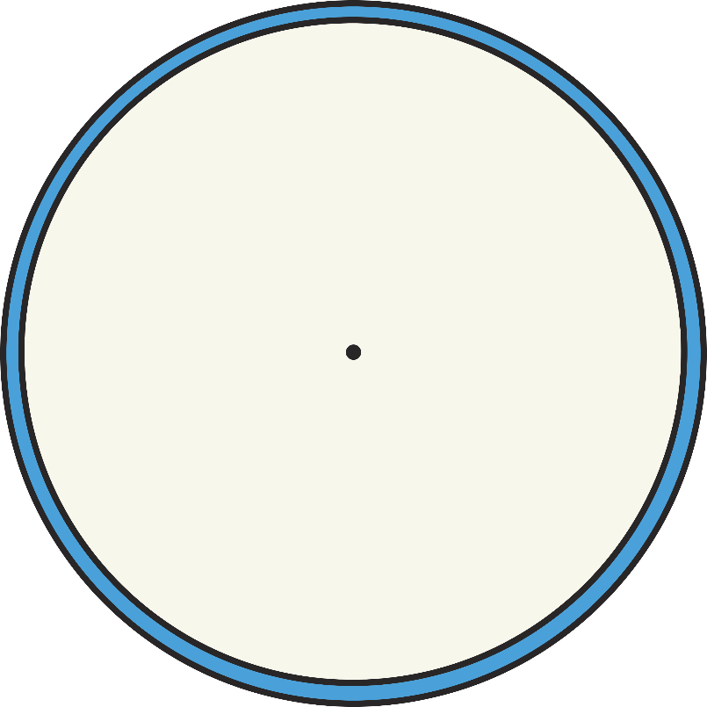
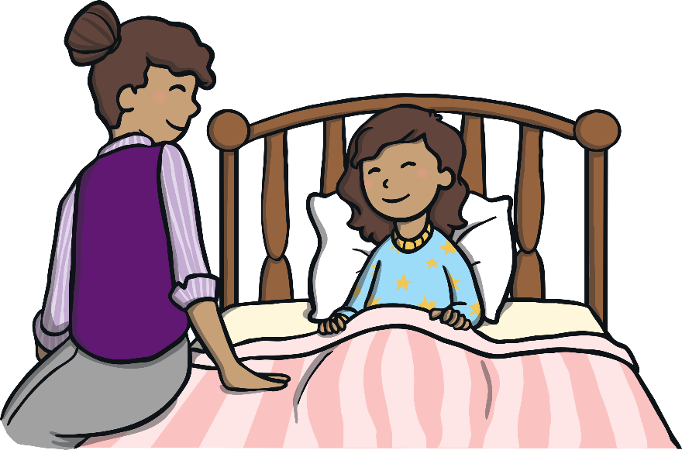
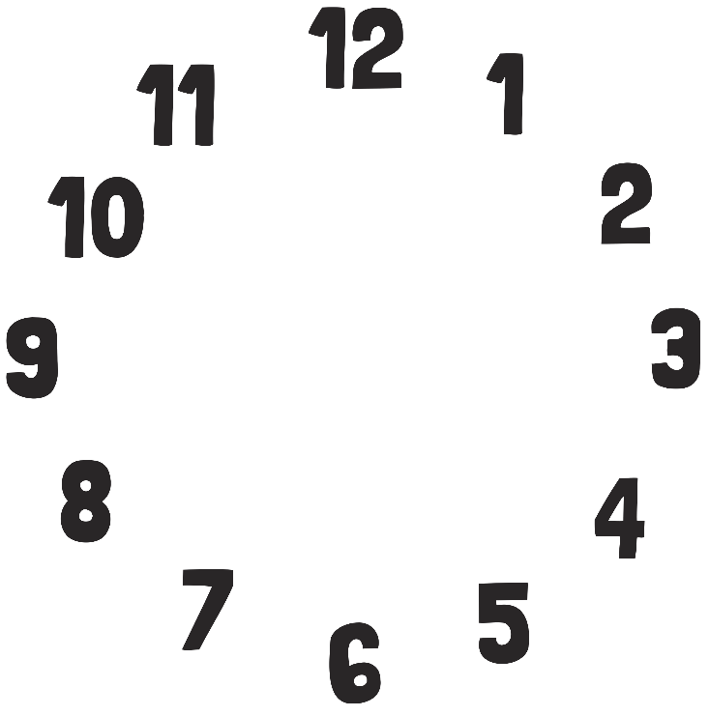


One Hour Later
I wake up at 7 o’clock.
What time will it be in one hour?
8 o’clock

Slide 5
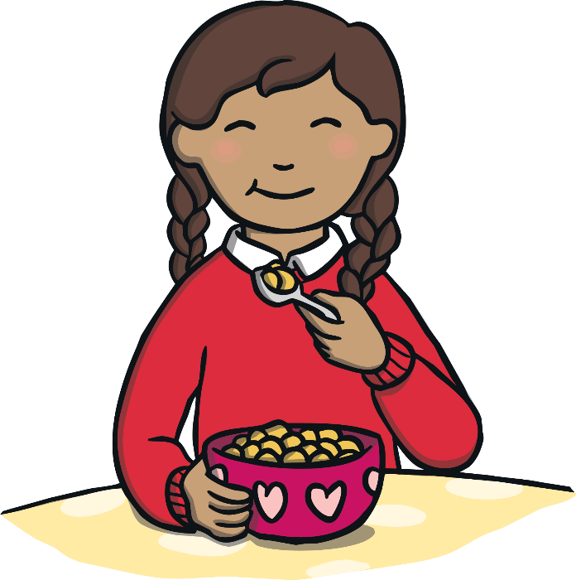
One Hour Later
I eat my breakfast at 8 o’clock.
What time will it be in one hour?
9 o’clock

Slide 6

One Hour Later
I read my book at 11 o’clock.
What time will it be in one hour?
12 o’clock

Slide 7

One Hour Later
I eat my lunch at 12 o’clock.
What time will it be in one hour?
1 o’clock

Slide 8
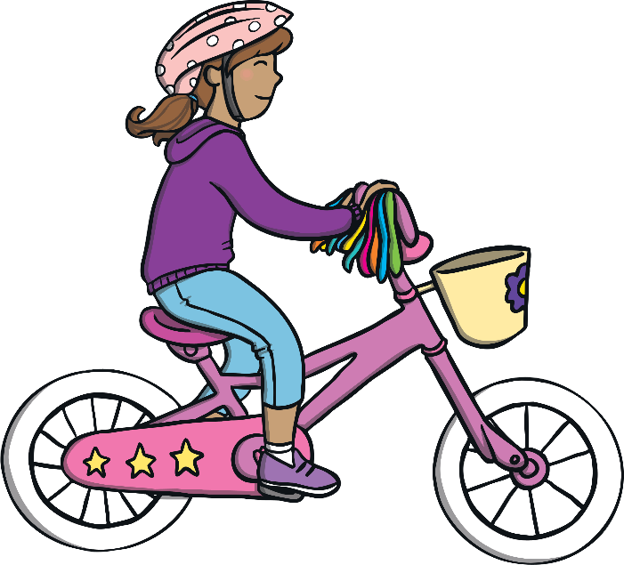
One Hour Later
I ride my bike at 2 o’clock.
What time will it be in one hour?
3 o’clock

Slide 9
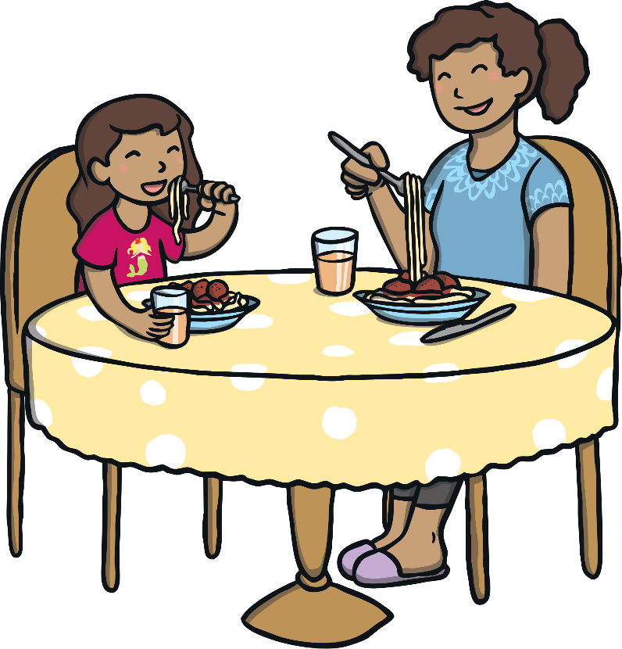
One Hour Later
I eat my dinner at 5 o’clock.
What time will it be in one hour?
6 o’clock

Slide 10
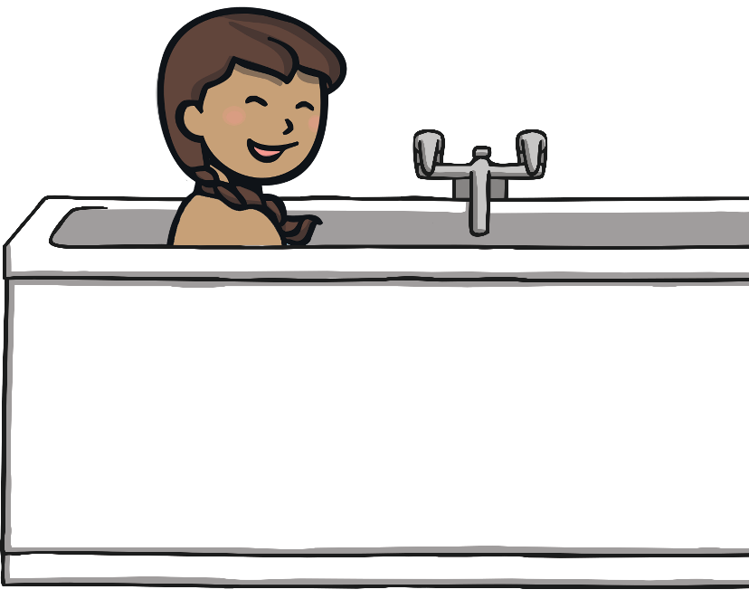
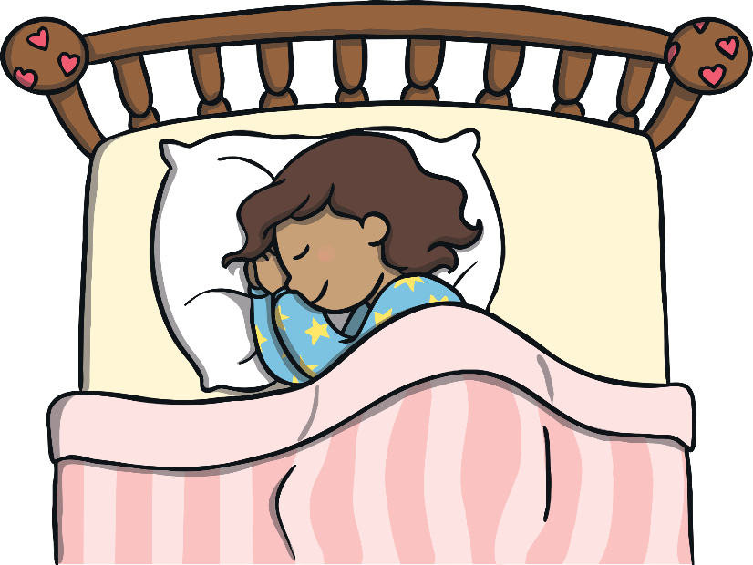
One Hour Later
I have my bath at half past 6.
What time will it be in one hour?
Bedtime! Goodnight!
half past 7

Slide 11

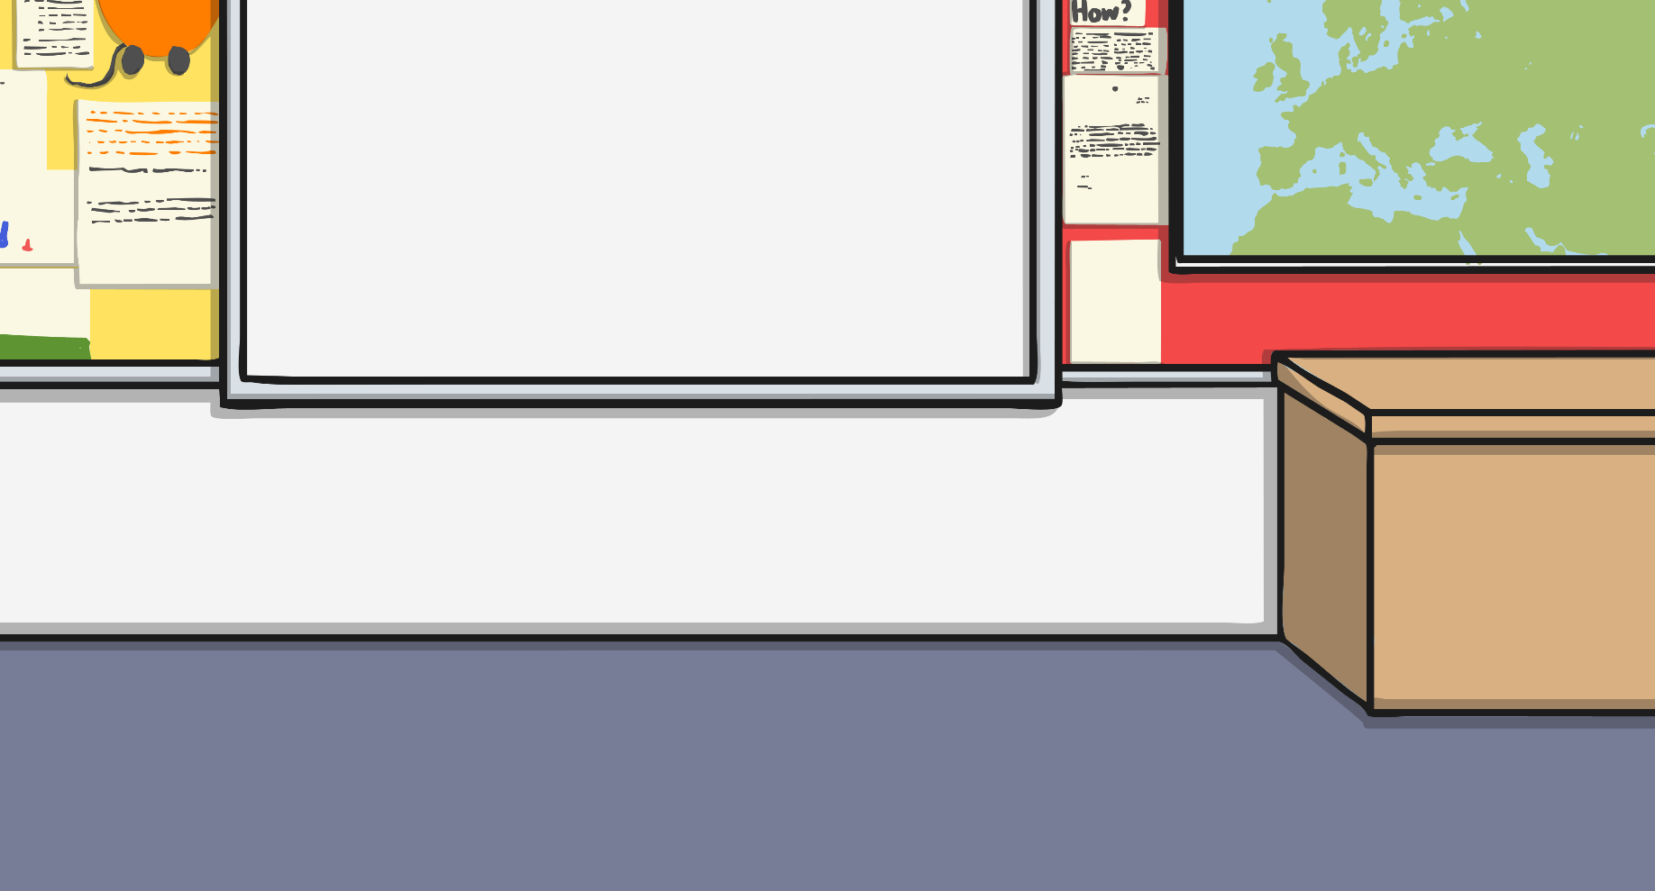
Clocks
Time is measured in years, months, weeks, days, hours,
minutes and seconds.
There are 24 hours in a day, which is made up of 2 lots of 12 hours; 12 hours in the morning and 12 hours in the afternoon.
1 hour is made up of 60 minutes.
We use clocks to help us tell the time.

Slide 12
Clocks
The big hand points to the minutes, this is called the minute hand.
The small hand points to the hour, this is called the hour hand.

Slide 13
Clocks
The minute hand points to 12.
When it is an ‘o’clock’ time, the minute hand will point straight towards the number 12.
The hour hand points to 3.
The hour hand will point straight at a number.
What time is it?
3 o’clock

Slide 14
Clocks
The minute hand points to 6.
When the time is ‘half past’ the hour, the minute hand will point to the 6.
The hour hand is halfway between the 7 and the 8.
The hour hand will point halfway between one number and the next.
What time is it?
half past 7

Slide 15

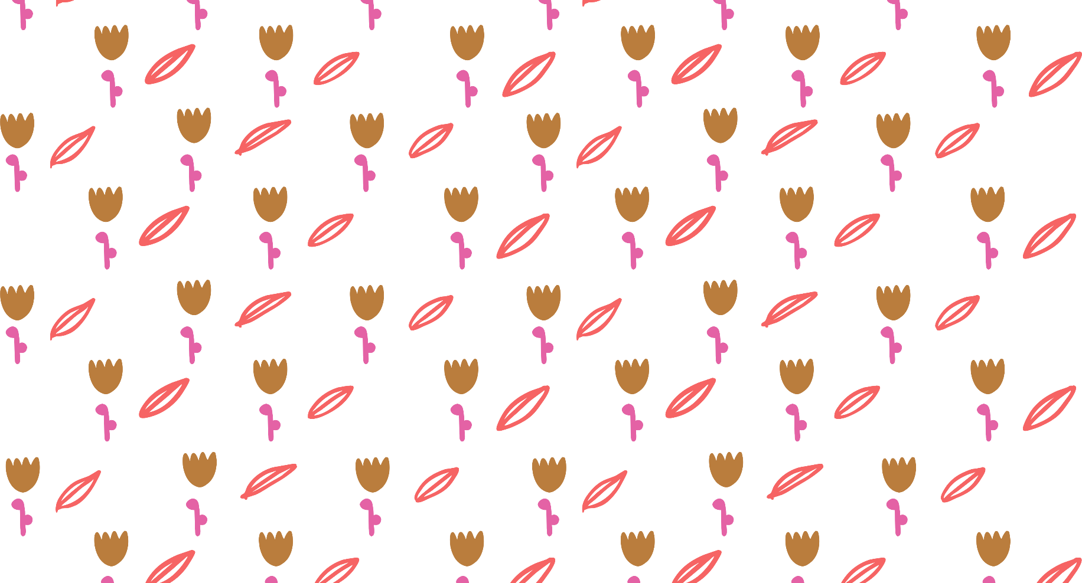
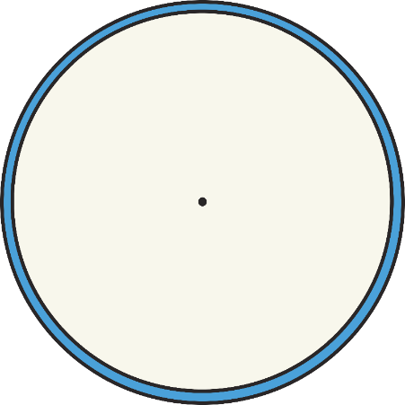
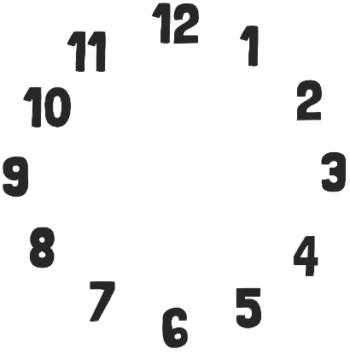


Which Clock?
Which clock says half past 4? Click the correct face.

Slide 16
Which Clock?
Oops!
Try again

Slide 17
Which Clock?
Well done!

Slide 18
Which Clock?
Which clock says 9 o’clock? Click the correct face.

Slide 19
Which Clock?
Oops!
Try again

Slide 20
Which Clock?
Well done!

Slide 21
Which Clock?
Which clock says half past 3? Click the correct face.

Slide 22
Which Clock?
Oops!
Try again

Slide 23
Which Clock?
Well done!

Slide 24
Which Clock?
Which clock says half past 9? Click the correct face.

Slide 25
Which Clock?
Oops!
Try again

Slide 26
Which Clock?
Well done!

Slide 27
Which Clock?
Which clock says 12 o’clock? Click the correct face.

Slide 28
Which Clock?
Oops!
Try again

Slide 29
Which Clock?
Well done!

Slide 30
Which Clock?
Which clock says half past 1? Click the correct face.

Slide 31
Which Clock?
Oops!
Try again

Slide 32
Which Clock?
Well done!

Slide 33
Which Clock?
Which clock says half past 5? Click the correct face.

Slide 34
Which Clock?
Oops!
Try again

Slide 35
Which Clock?
Well done!

Slide 36
Which Clock?
Which clock says half past 8? Click the correct face.

Slide 37
Which Clock?
Oops!
Try again

Slide 38
Which Clock?
Well done!

Slide 39

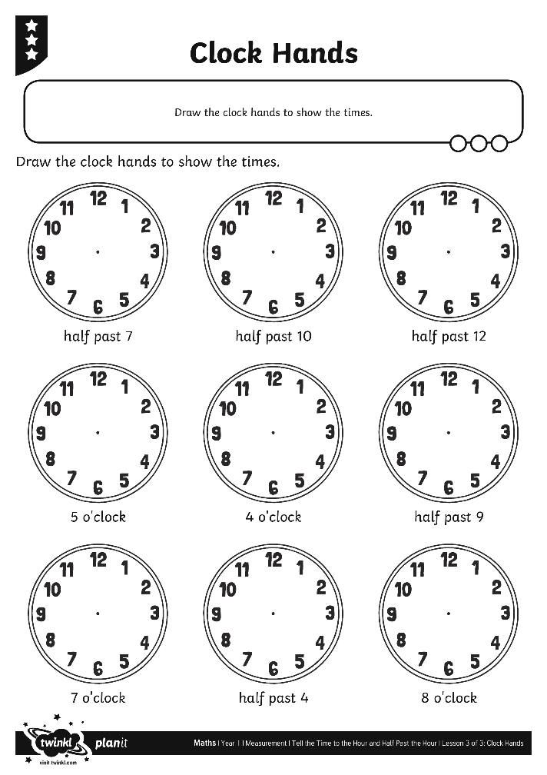
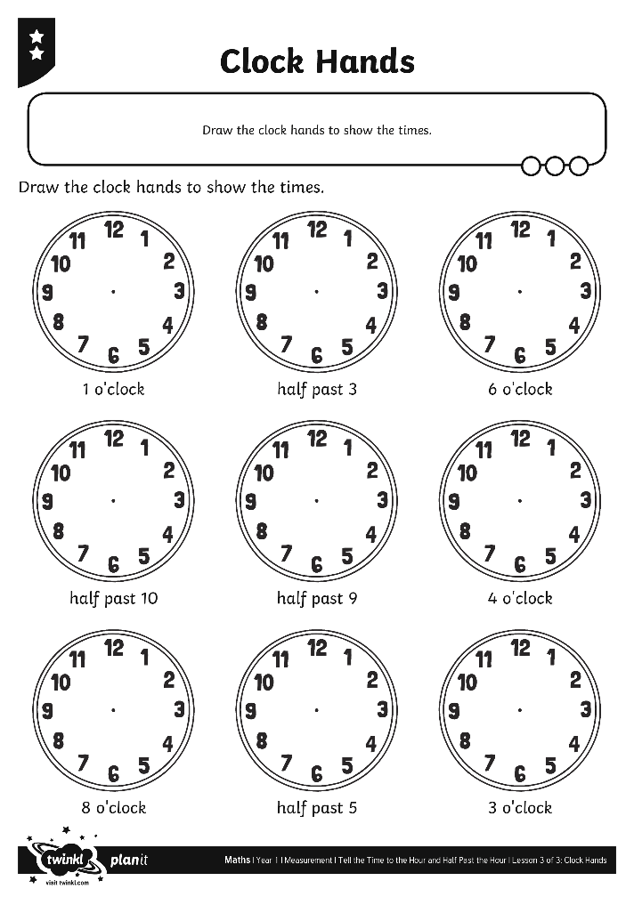
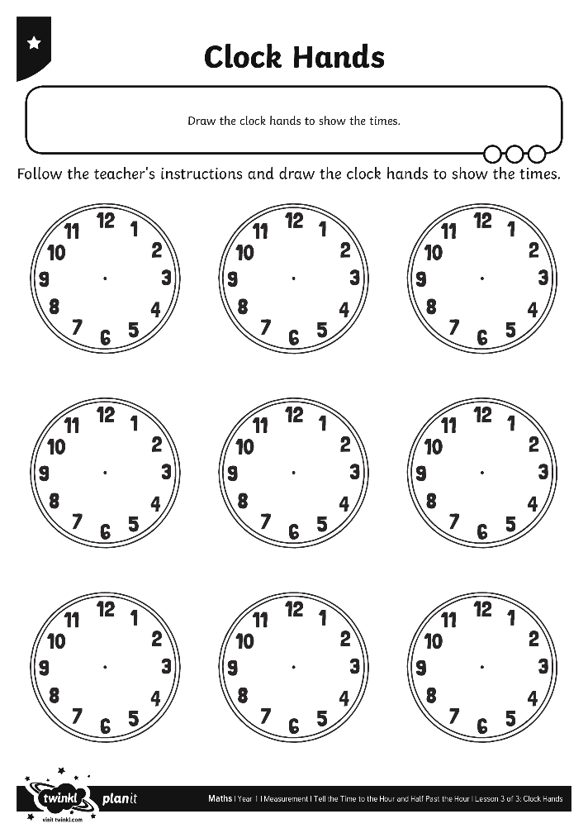
Clock Hands

Slide 40
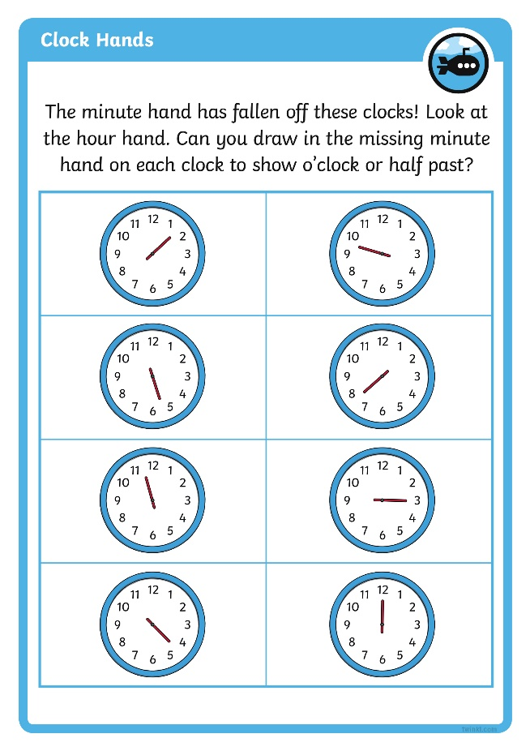
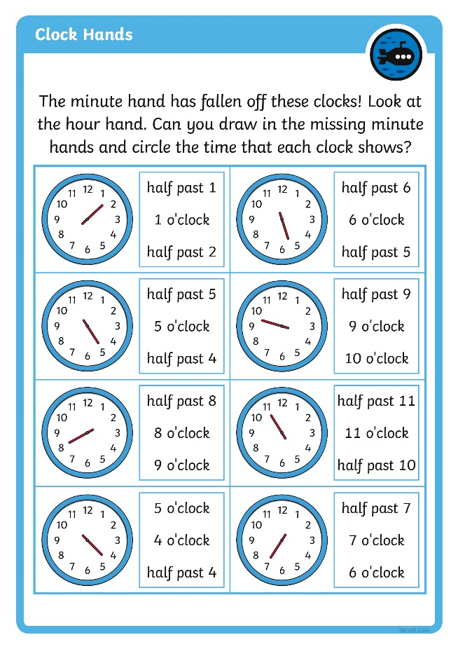
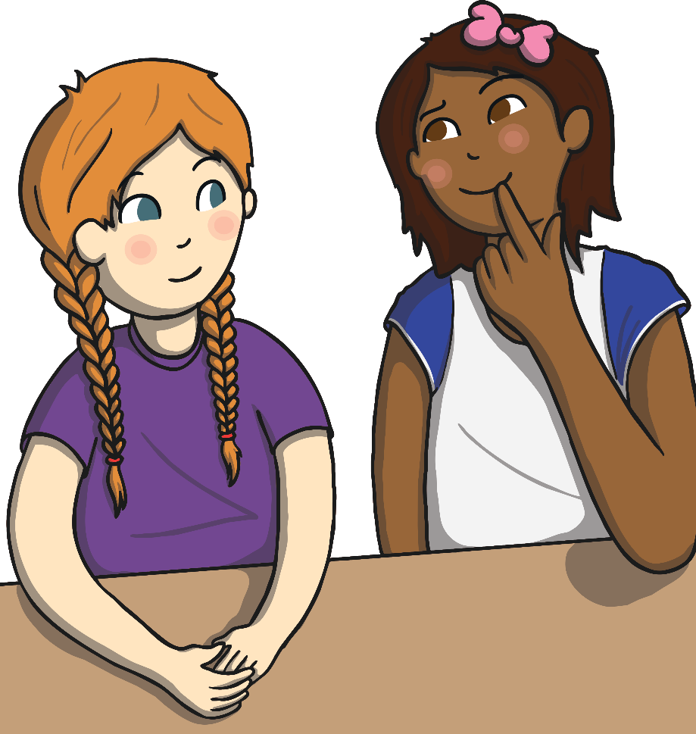
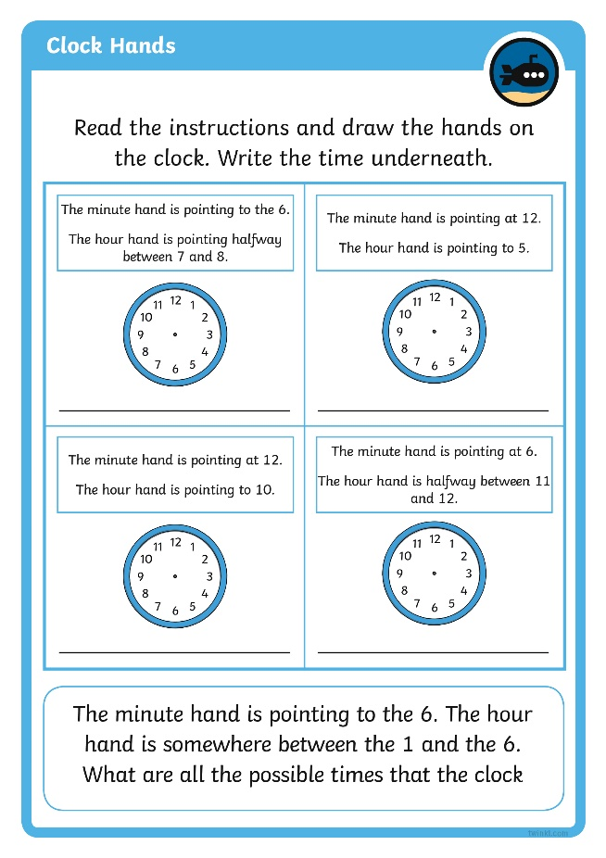
Diving into Mastery
Dive in by completing your own activity!

Slide 41

Question Time
The minute hand has fallen off my clock! Look carefully at the hour hand. Can you tell what time it is?
The hour hand is pointing straight at the 9 so it must be 9 o’clock.

Slide 42
Question Time
The minute hand has fallen off my clock! Look carefully at the hour hand. Can you tell what time it is?
The hour hand is pointing halfway between the 6 and the 7 so it must be half past 6.

Slide 43
Aim
I can draw hands on a clock to show o’clock times and half past times.
Success Criteria
I can tell o’clock times and half past times.
I can draw hands on a clock to show times.

Slide 44


