Slide 1

This is the Key Stage 2 Mathematics Paper 1: Arithmetic. You will need a pen and something to record your answers on. Write your name and school name on the front of your paper. I will read the instructions to you.
This challenge is to be completed as part of your daily walk/exercise.
There are 15 questions in total.
You must not use a calculator to answer any questions in this test but you can work as a family team.
You have as much time as you need to complete this test. If you cannot do a question, don’t worry, go on to the next one. You can come back to it later if you have time.
If you finish before the end, go back and check your work.
In this test, long division and long multiplication questions are worth 2 marks each. You will be awarded 2 marks for a correct answer. You may get 1 mark for showing a formal method. All other questions are worth 1 mark each.
Remember to check your work carefully.
.
Remember, other people can help you to answer any of the test questions.
You can talk to each other.
You may now start the test.
Made by Miss Rodaway__
Notes:
Notes for teacher: instructions can be posted on your home learning portal or recorded by teacher as a video message and then posted.

Slide 2
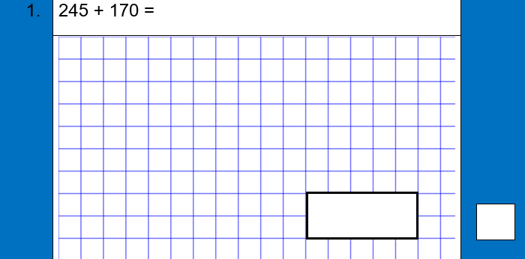
This question is part of a learning challenge set by teachers at (insert school name) Primary School.
Please leave as they are to allow all children to access the challenge.
Teachers will remove when the learning challenge is complete.
Thank you! #staysafe
Notes:
Note for teachers: feel free to remove the note at the top if you feel it isn’t needed in your community. Each page is to be printed and laminated and then scattered around the local area for children to find on their daily walk. Alternatively, you can post each question online using your home learning portal.

Slide 3
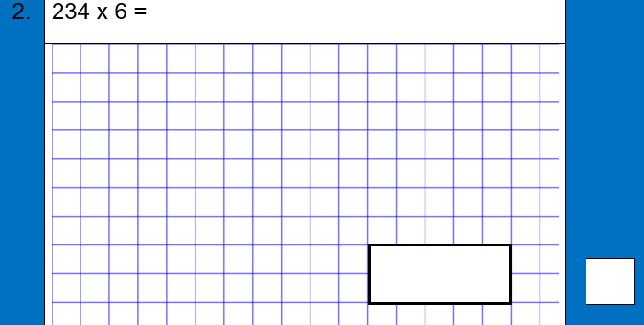
This question is part of a learning challenge set by teachers at (insert school name) Primary School.
Please leave as they are to allow all children to access the challenge.
Teachers will remove when the learning challenge is complete.
Thank you! #staysafe
Notes:
Note for teachers: feel free to remove the note at the top if you feel it isn’t needed in your community. Each page is to be printed and laminated and then scattered around the local area for children to find on their daily walk. Alternatively, you can post each question online using your home learning portal.

Slide 4
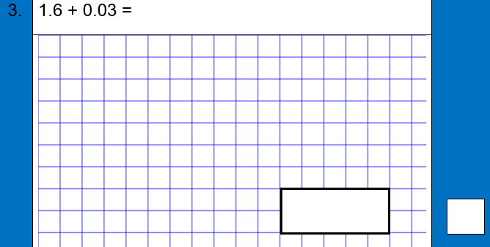
This question is part of a learning challenge set by teachers at (insert school name) Primary School.
Please leave as they are to allow all children to access the challenge.
Teachers will remove when the learning challenge is complete.
Thank you! #staysafe
Notes:
Note for teachers: feel free to remove the note at the top if you feel it isn’t needed in your community. Each page is to be printed and laminated and then scattered around the local area for children to find on their daily walk. Alternatively, you can post each question online using your home learning portal.

Slide 5
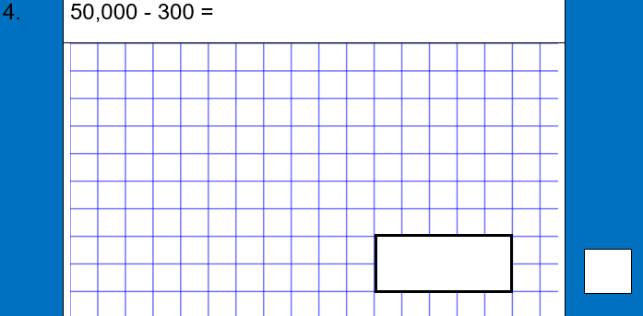
This question is part of a learning challenge set by teachers at (insert school name) Primary School.
Please leave as they are to allow all children to access the challenge.
Teachers will remove when the learning challenge is complete.
Thank you! #staysafe
Notes:
Note for teachers: feel free to remove the note at the top if you feel it isn’t needed in your community. Each page is to be printed and laminated and then scattered around the local area for children to find on their daily walk. Alternatively, you can post each question online using your home learning portal.

Slide 6
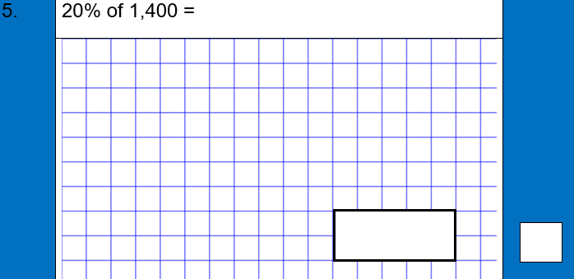
This question is part of a learning challenge set by teachers at (insert school name) Primary School.
Please leave as they are to allow all children to access the challenge.
Teachers will remove when the learning challenge is complete.
Thank you! #staysafe
Notes:
Note for teachers: feel free to remove the note at the top if you feel it isn’t needed in your community. Each page is to be printed and laminated and then scattered around the local area for children to find on their daily walk. Alternatively, you can post each question online using your home learning portal.

Slide 7
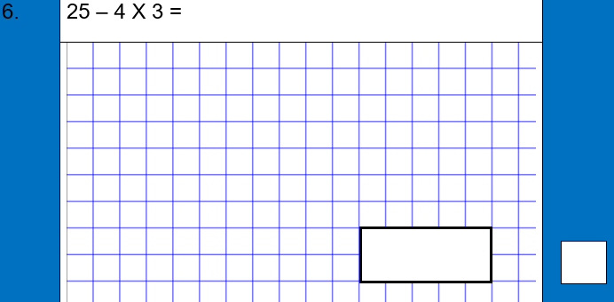
This question is part of a learning challenge set by teachers at (insert school name) Primary School.
Please leave as they are to allow all children to access the challenge.
Teachers will remove when the learning challenge is complete.
Thank you! #staysafe
Notes:
Note for teachers: feel free to remove the note at the top if you feel it isn’t needed in your community. Each page is to be printed and laminated and then scattered around the local area for children to find on their daily walk. Alternatively, you can post each question online using your home learning portal.

Slide 8
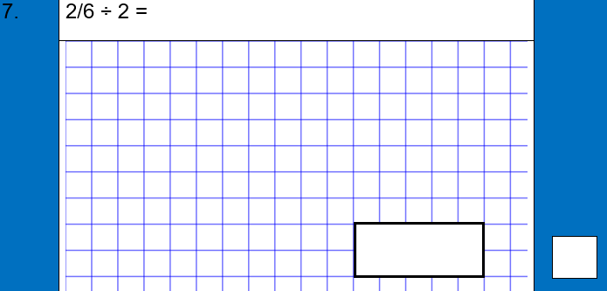
This question is part of a learning challenge set by teachers at (insert school name) Primary School.
Please leave as they are to allow all children to access the challenge.
Teachers will remove when the learning challenge is complete.
Thank you! #staysafe
Notes:
Note for teachers: feel free to remove the note at the top if you feel it isn’t needed in your community. Each page is to be printed and laminated and then scattered around the local area for children to find on their daily walk. Alternatively, you can post each question online using your home learning portal.

Slide 9

This question is part of a learning challenge set by teachers at (insert school name) Primary School.
Please leave as they are to allow all children to access the challenge.
Teachers will remove when the learning challenge is complete.
Thank you! #staysafe
Notes:
Note for teachers: feel free to remove the note at the top if you feel it isn’t needed in your community. Each page is to be printed and laminated and then scattered around the local area for children to find on their daily walk. Alternatively, you can post each question online using your home learning portal.

Slide 10
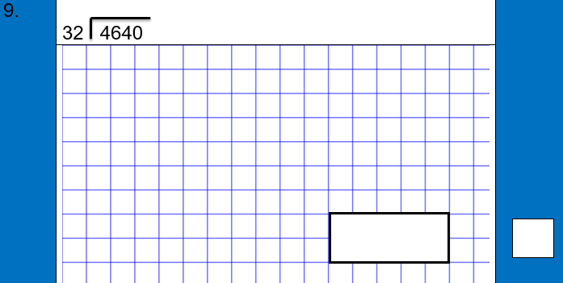
This question is part of a learning challenge set by teachers at (insert school name) Primary School.
Please leave as they are to allow all children to access the challenge.
Teachers will remove when the learning challenge is complete.
Thank you! #staysafe
Notes:
Note for teachers: feel free to remove the note at the top if you feel it isn’t needed in your community. Each page is to be printed and laminated and then scattered around the local area for children to find on their daily walk. Alternatively, you can post each question online using your home learning portal.

Slide 11
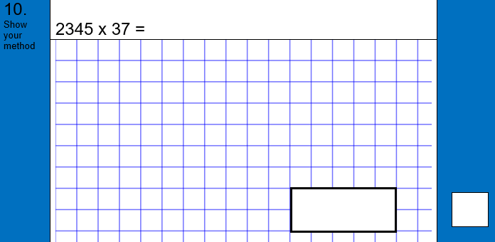
This question is part of a learning challenge set by teachers at (insert school name) Primary School.
Please leave as they are to allow all children to access the challenge.
Teachers will remove when the learning challenge is complete.
Thank you! #staysafe
Notes:
Note for teachers: feel free to remove the note at the top if you feel it isn’t needed in your community. Each page is to be printed and laminated and then scattered around the local area for children to find on their daily walk. Alternatively, you can post each question online using your home learning portal.

Slide 12

This question is part of a learning challenge set by teachers at (insert school name) Primary School.
Please leave as they are to allow all children to access the challenge.
Teachers will remove when the learning challenge is complete.
Thank you! #staysafe
Notes:
Note for teachers: feel free to remove the note at the top if you feel it isn’t needed in your community. Each page is to be printed and laminated and then scattered around the local area for children to find on their daily walk. Alternatively, you can post each question online using your home learning portal.

Slide 13
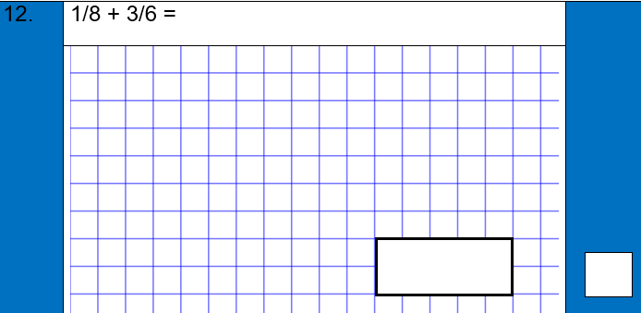
This question is part of a learning challenge set by teachers at (insert school name) Primary School.
Please leave as they are to allow all children to access the challenge.
Teachers will remove when the learning challenge is complete.
Thank you! #staysafe
Notes:
Note for teachers: feel free to remove the note at the top if you feel it isn’t needed in your community. Each page is to be printed and laminated and then scattered around the local area for children to find on their daily walk. Alternatively, you can post each question online using your home learning portal.

Slide 14
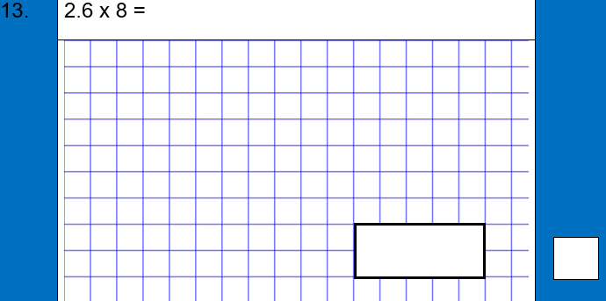
This question is part of a learning challenge set by teachers at (insert school name) Primary School.
Please leave as they are to allow all children to access the challenge.
Teachers will remove when the learning challenge is complete.
Thank you! #staysafe
Notes:
Note for teachers: feel free to remove the note at the top if you feel it isn’t needed in your community. Each page is to be printed and laminated and then scattered around the local area for children to find on their daily walk. Alternatively, you can post each question online using your home learning portal.

Slide 15

This question is part of a learning challenge set by teachers at (insert school name) Primary School.
Please leave as they are to allow all children to access the challenge.
Teachers will remove when the learning challenge is complete.
Thank you! #staysafe
Notes:
Note for teachers: feel free to remove the note at the top if you feel it isn’t needed in your community. Each page is to be printed and laminated and then scattered around the local area for children to find on their daily walk. Alternatively, you can post each question online using your home learning portal.

Slide 16

This question is part of a learning challenge set by teachers at (insert school name) Primary School.
Please leave as they are to allow all children to access the challenge.
Teachers will remove when the learning challenge is complete.
Thank you! #staysafe
Notes:
Note for teachers: feel free to remove the note at the top if you feel it isn’t needed in your community. Each page is to be printed and laminated and then scattered around the local area for children to find on their daily walk. Alternatively, you can post each question online using your home learning portal.

