Slide 1

Fantastic
4 K

Slide 2
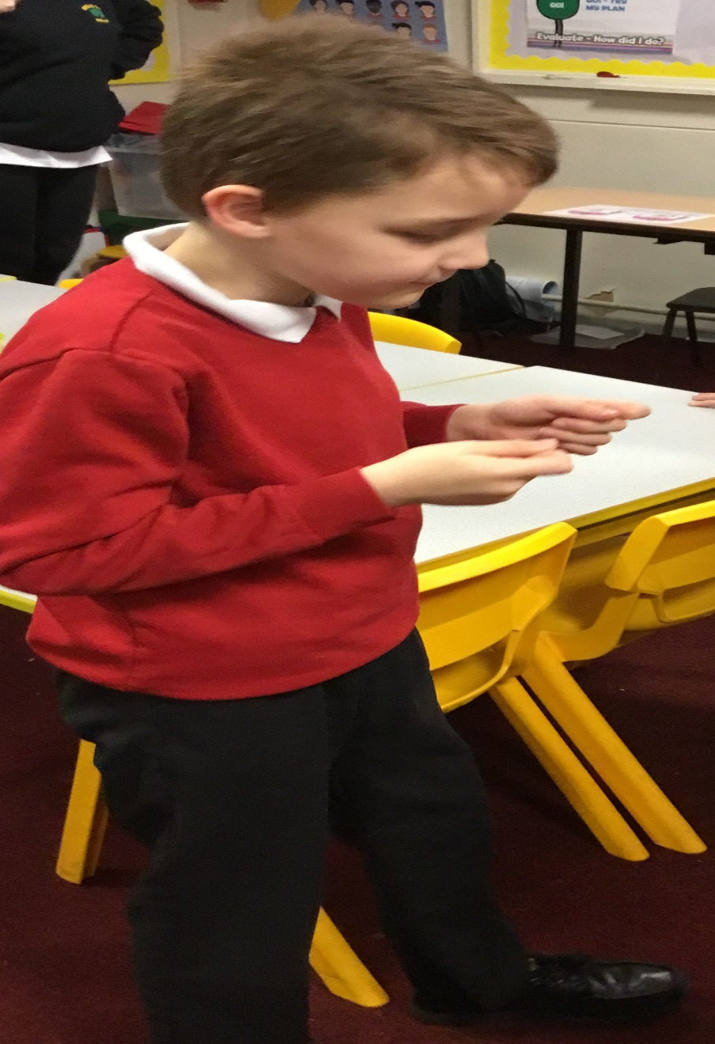
Mr Athletic

Slide 3
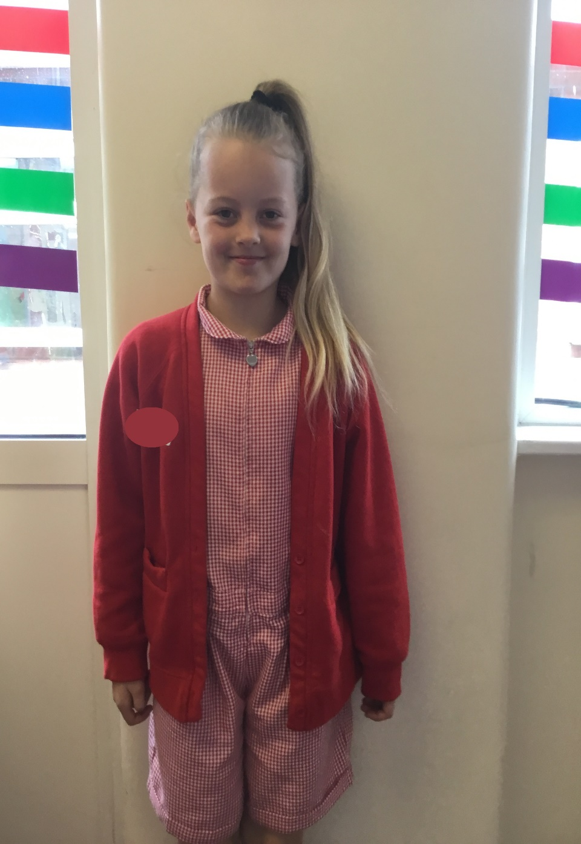
Miss Fashonista

Slide 4
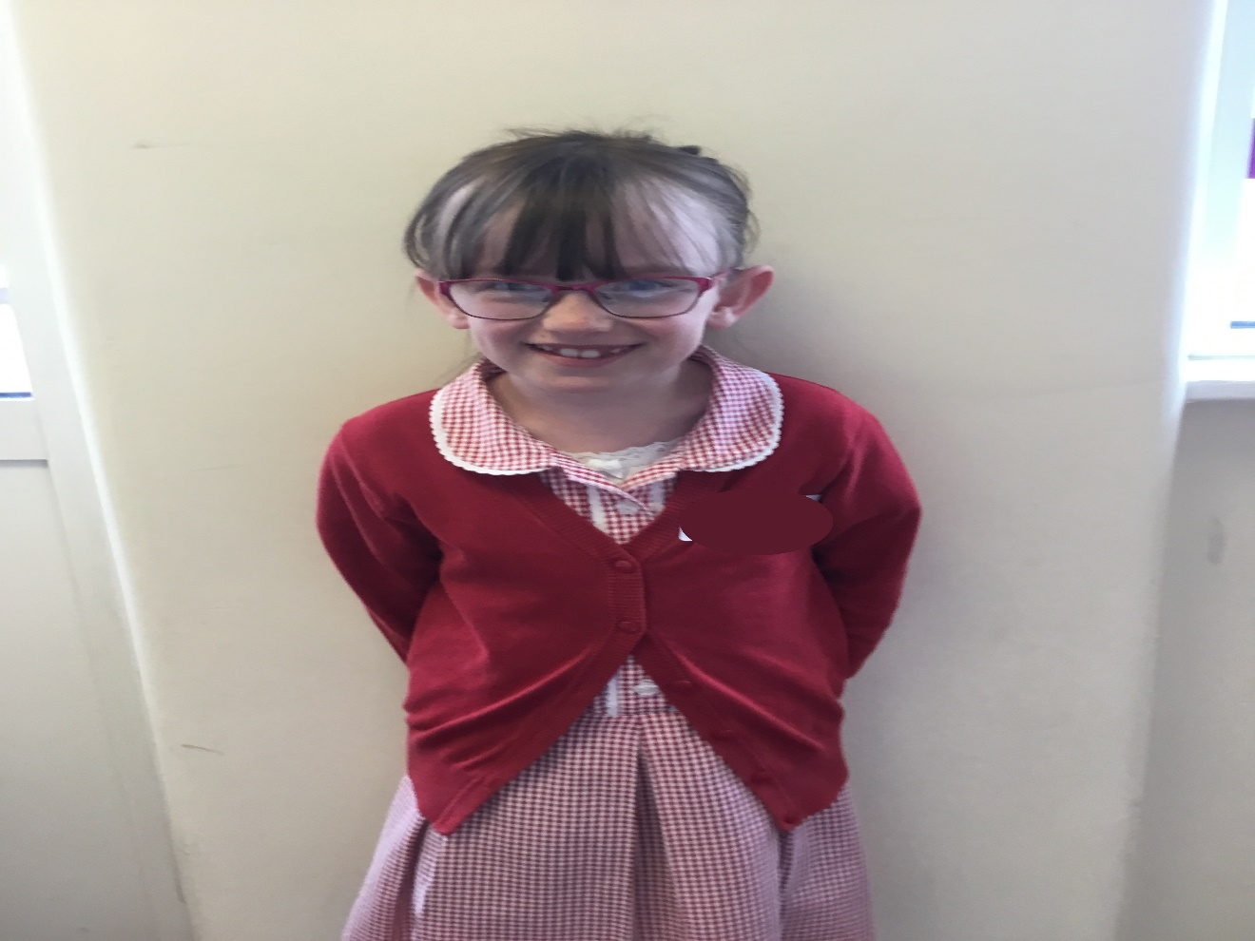
Little Miss Giggles

Slide 5
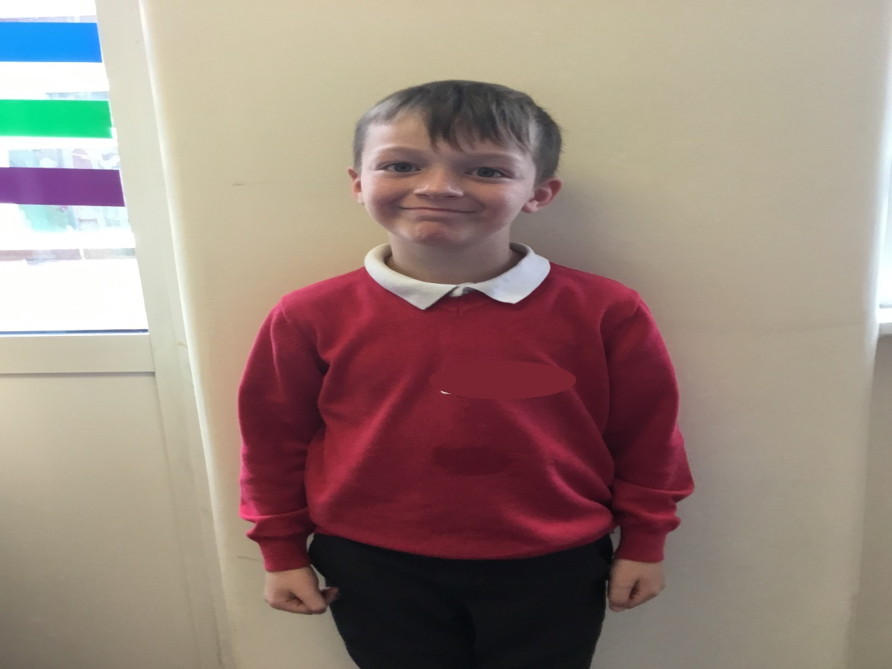
Family Man

Slide 6
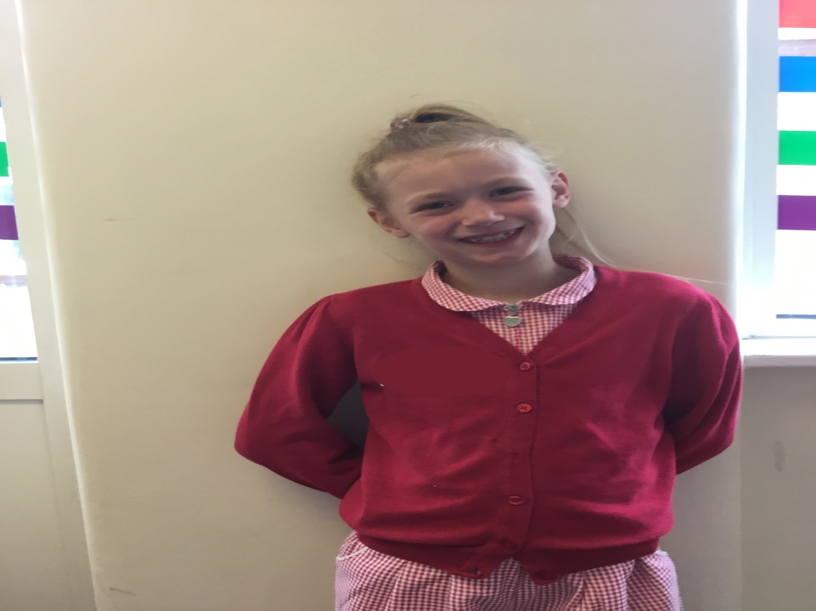
Tender Hearted Princess

Slide 7
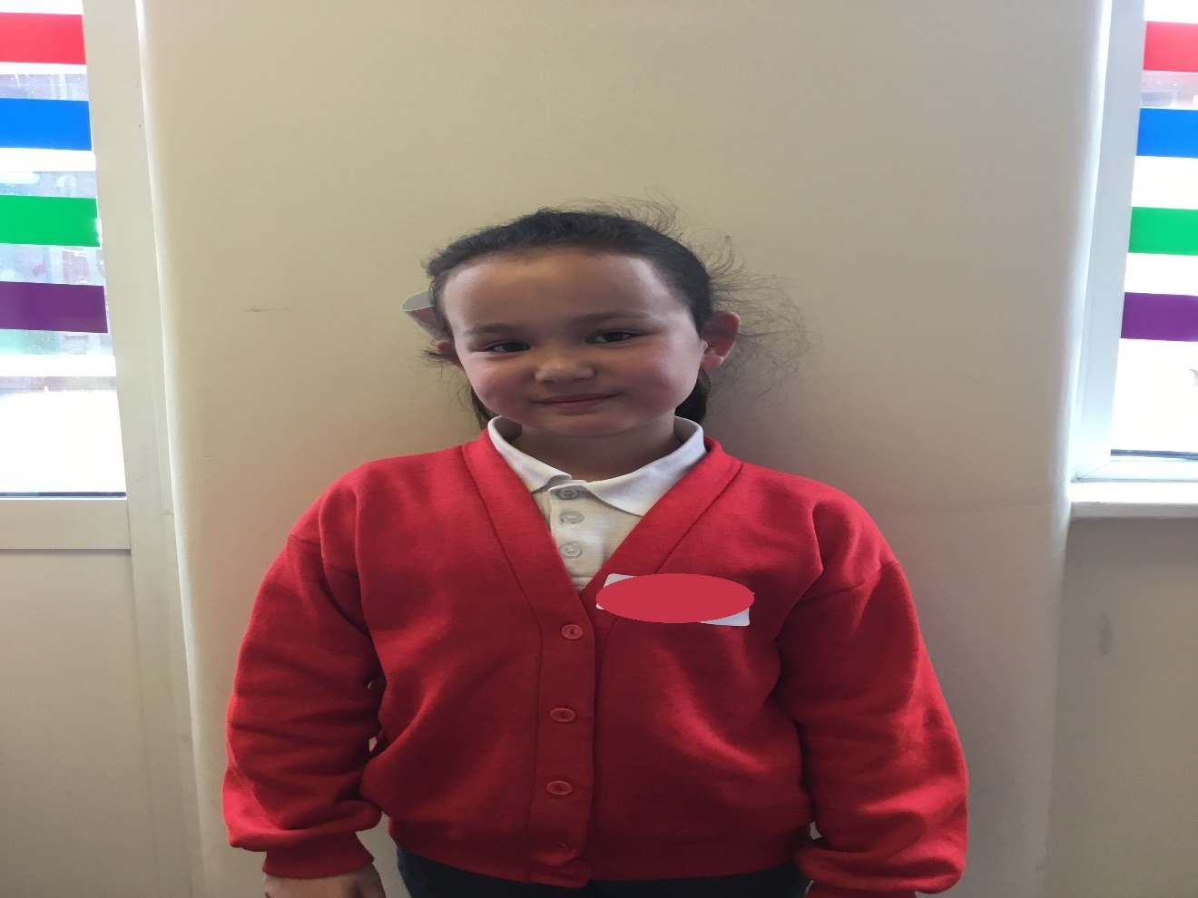
Stationery
Queen

Slide 8
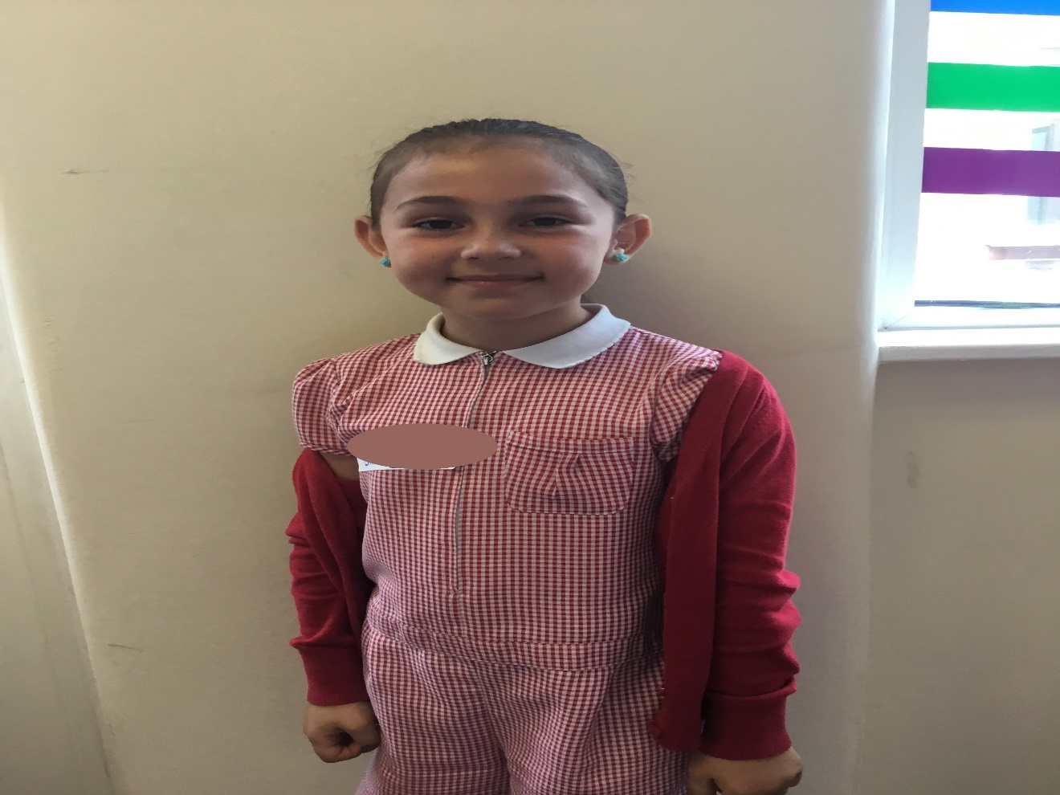
Queen
of Chic

Slide 9
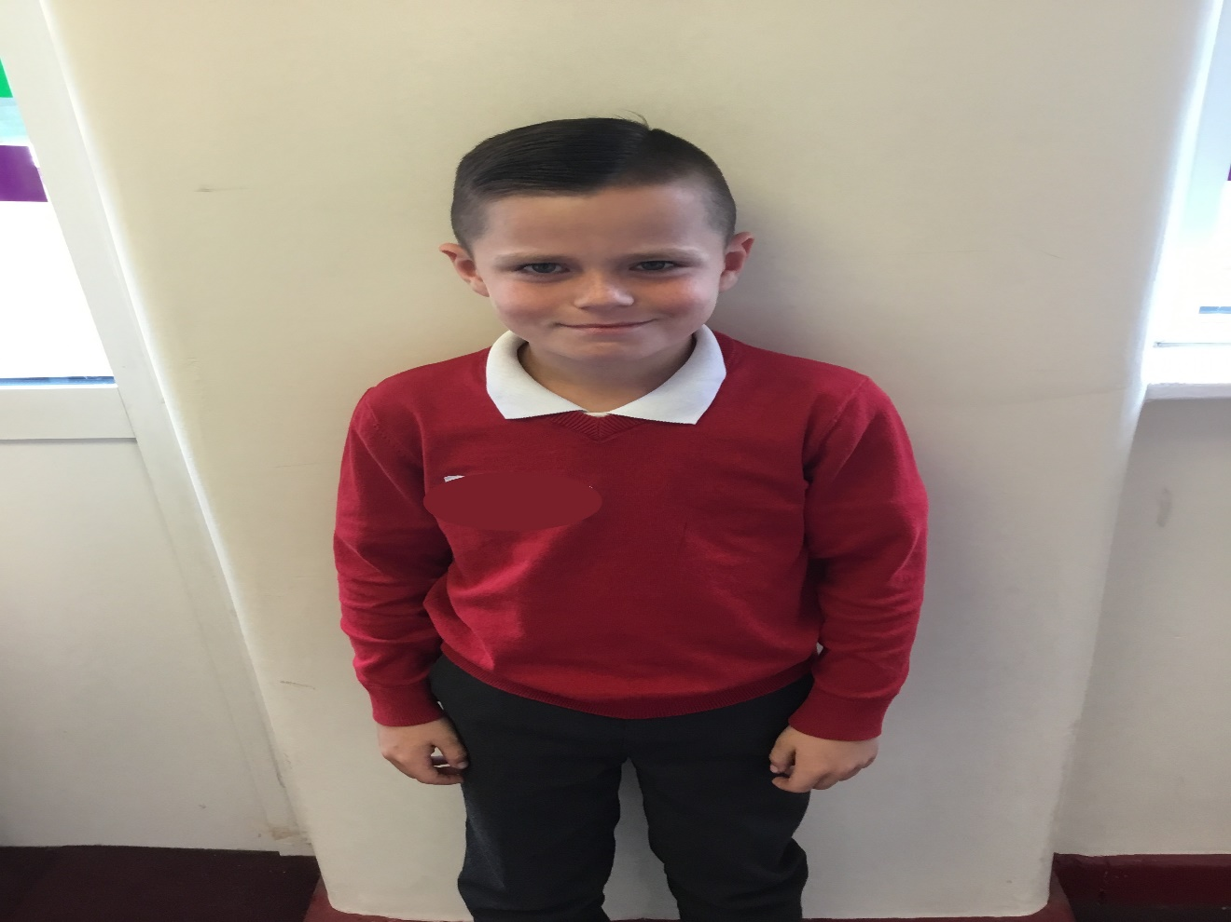
Trendsetter

Slide 10
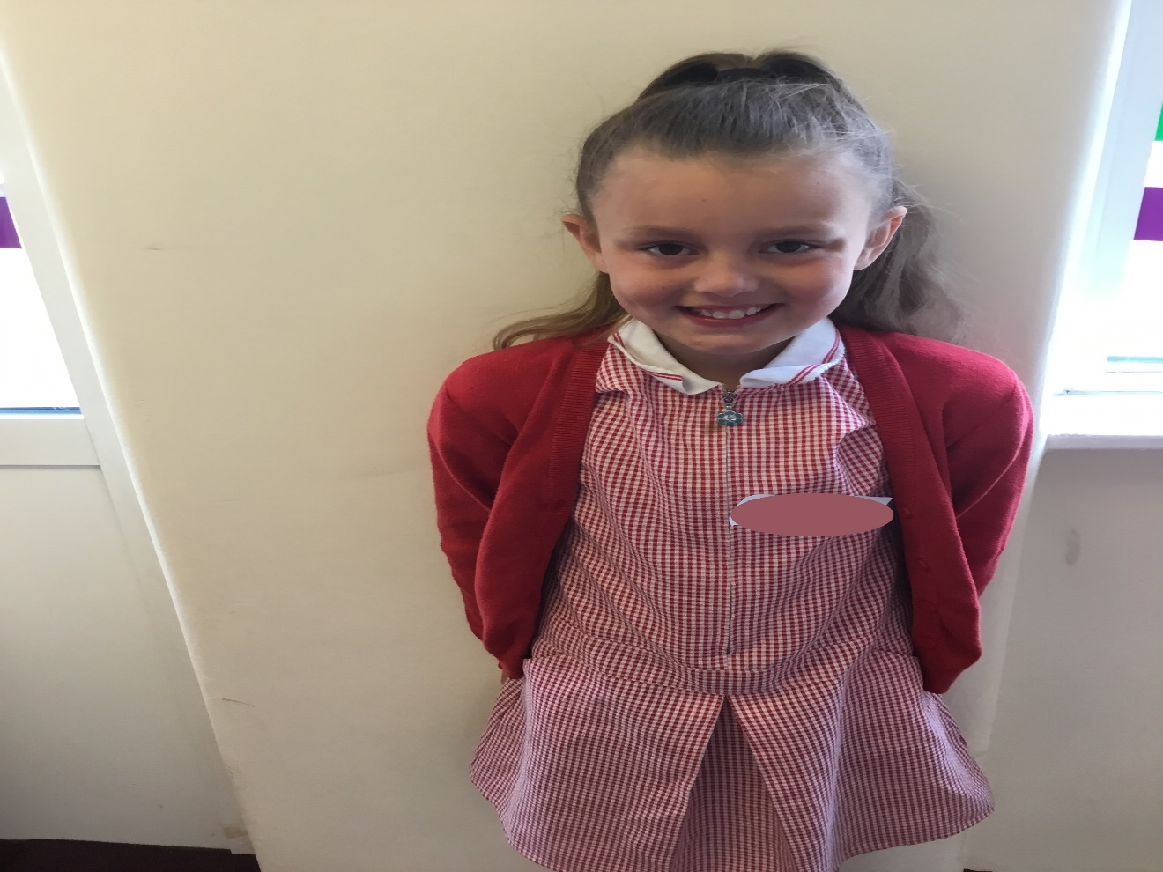
Hair
Accessories
Princess

Slide 11
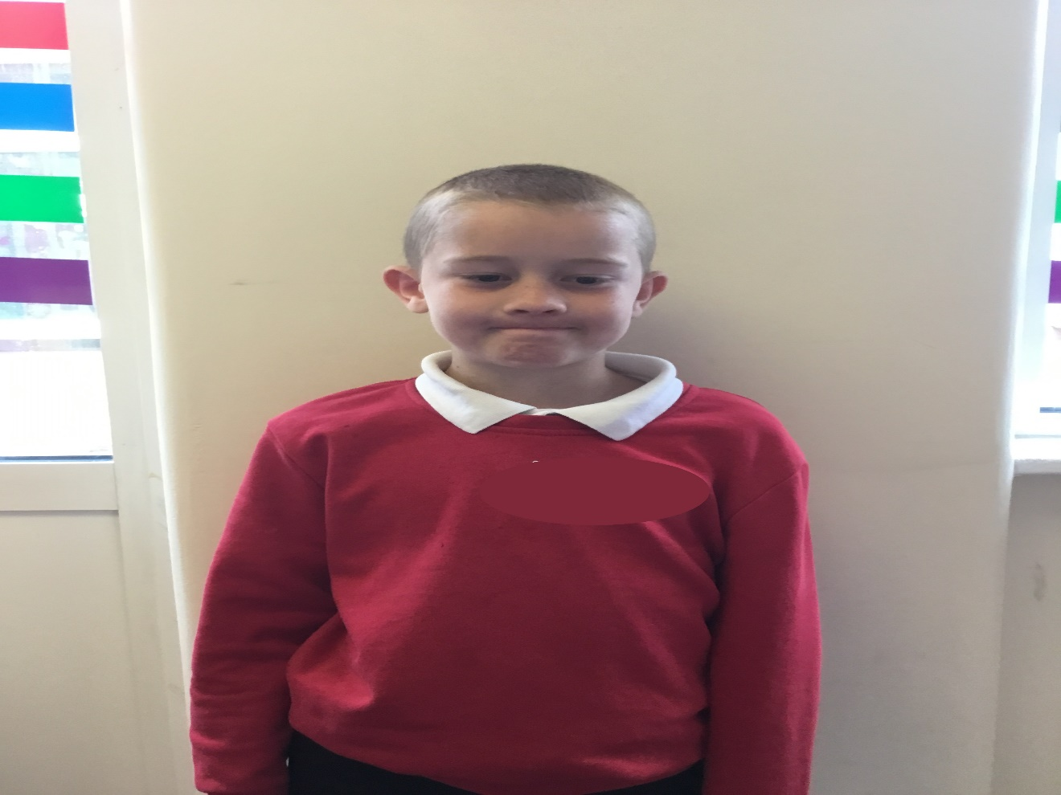
Football
Star

Slide 12
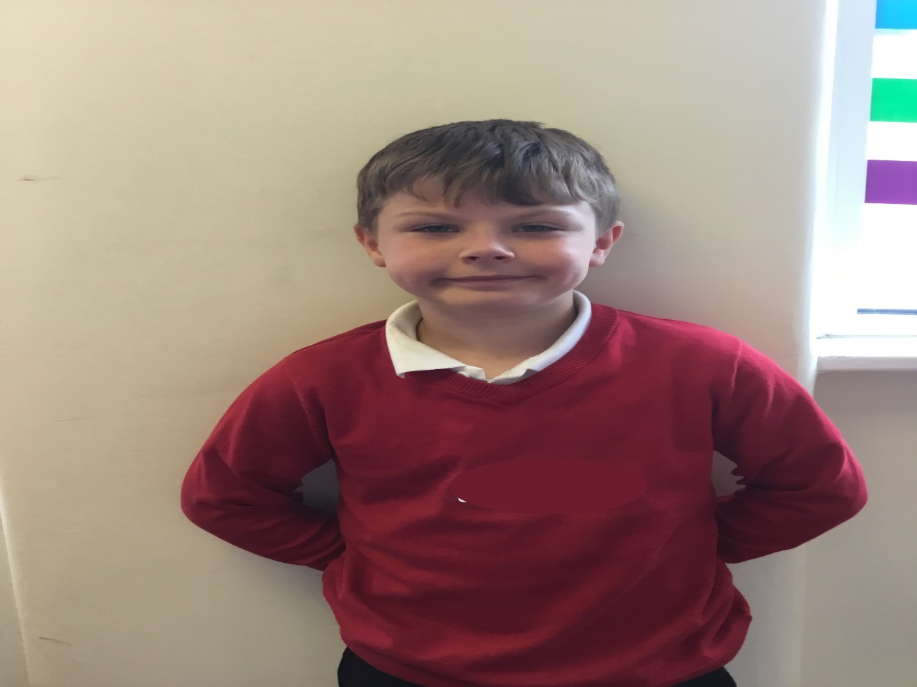
Superhero

Slide 13
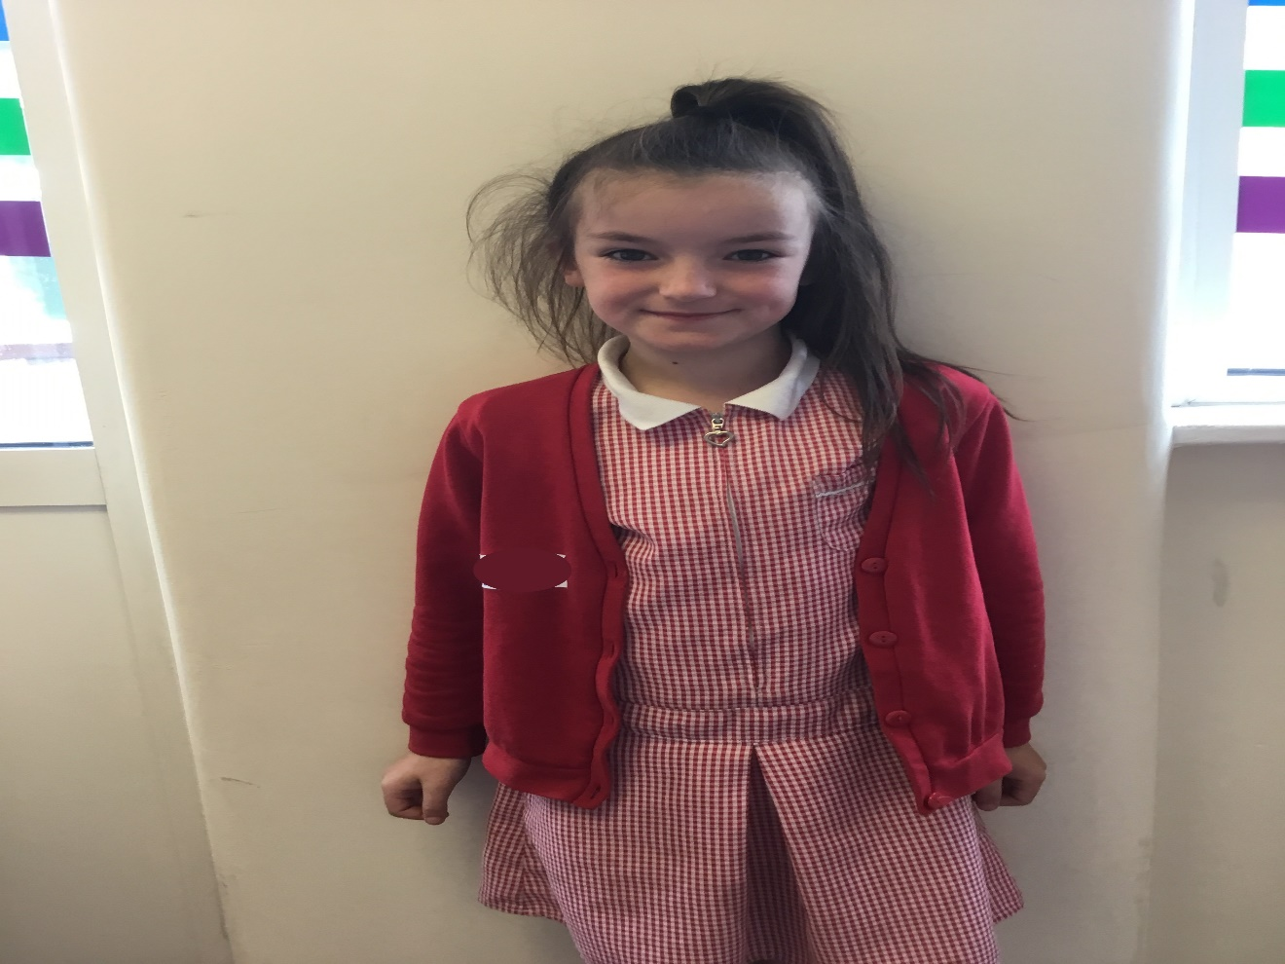
Lipstick
Queen

Slide 14
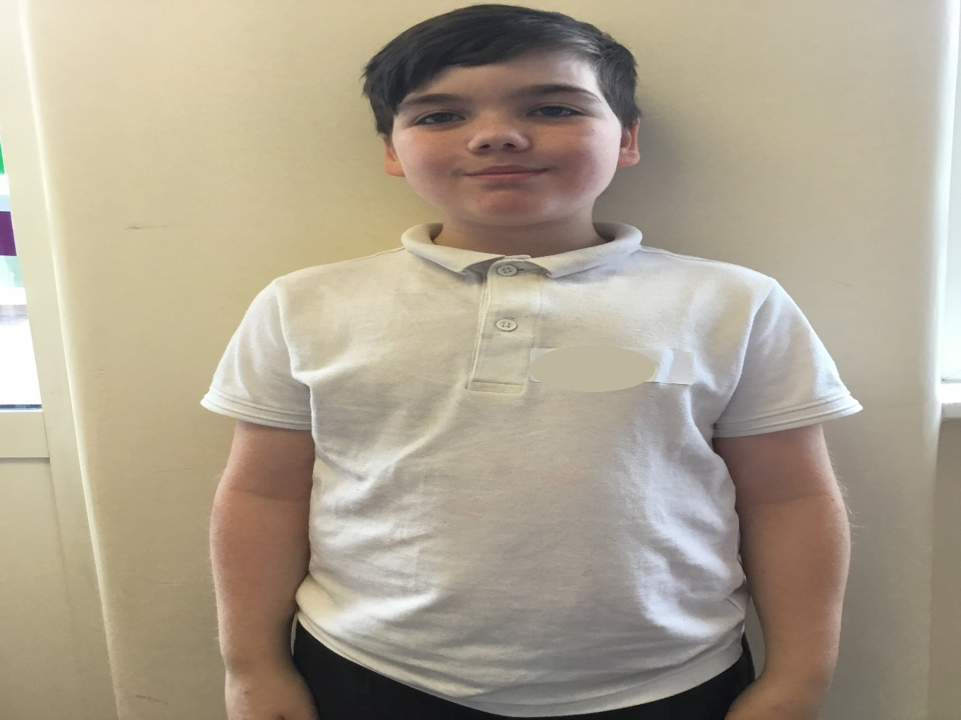
Thespian

Slide 15
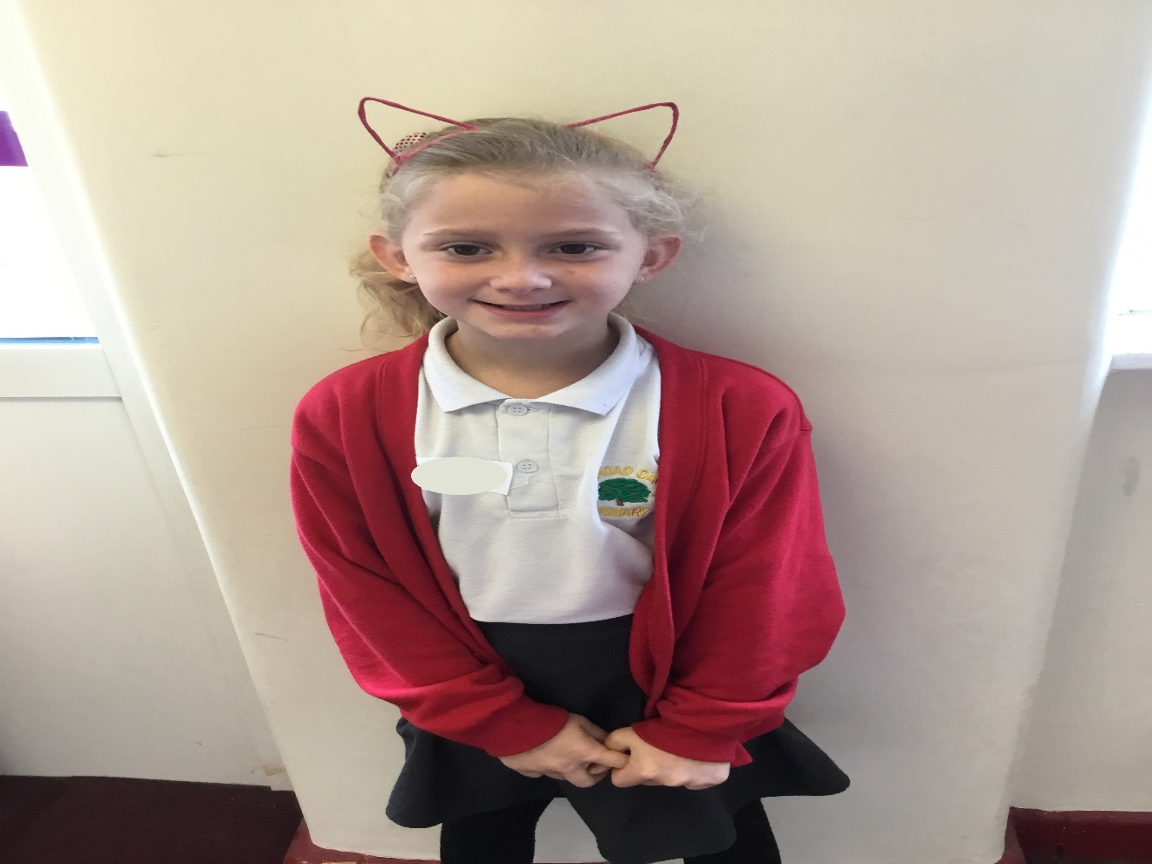
Little Miss
Cuddles

Slide 16
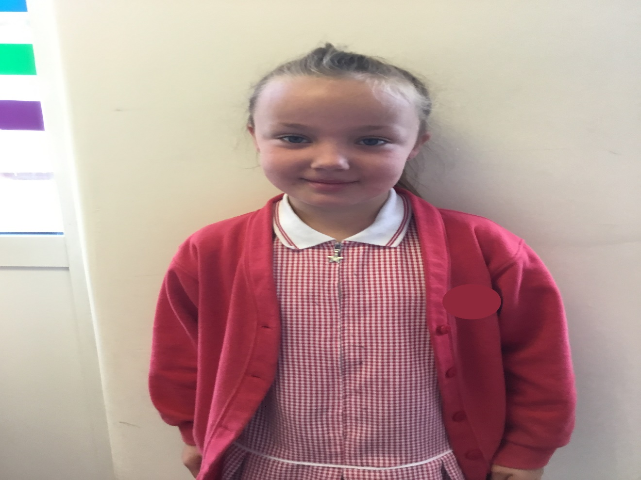
Little Miss
Chatterbox

Slide 17
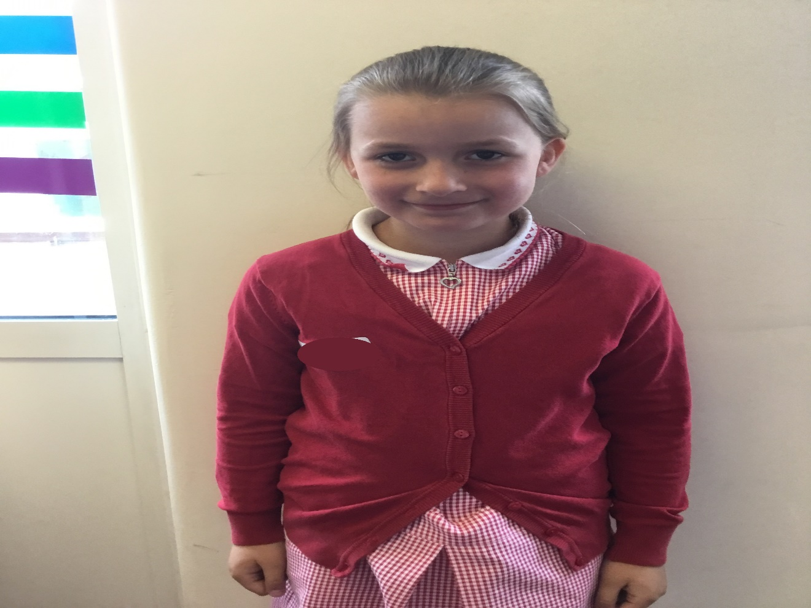
Queen
of Craft

Slide 18
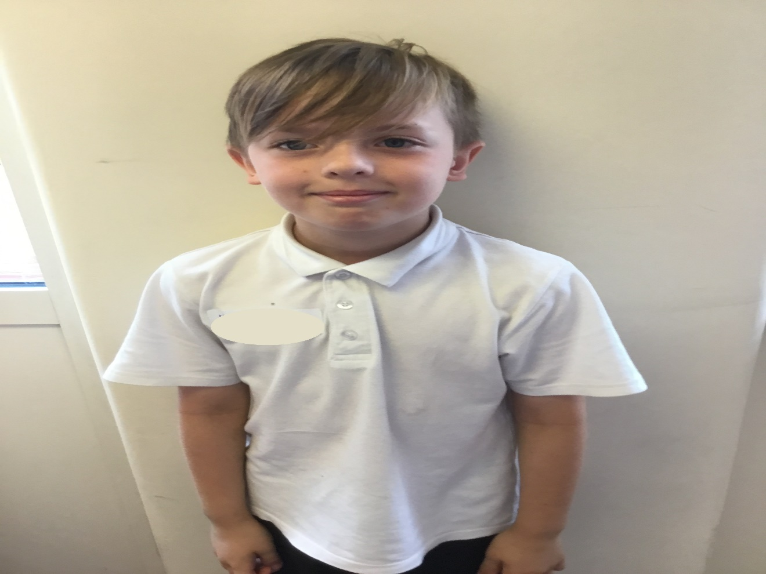
Gentleman
Jackson

Slide 19
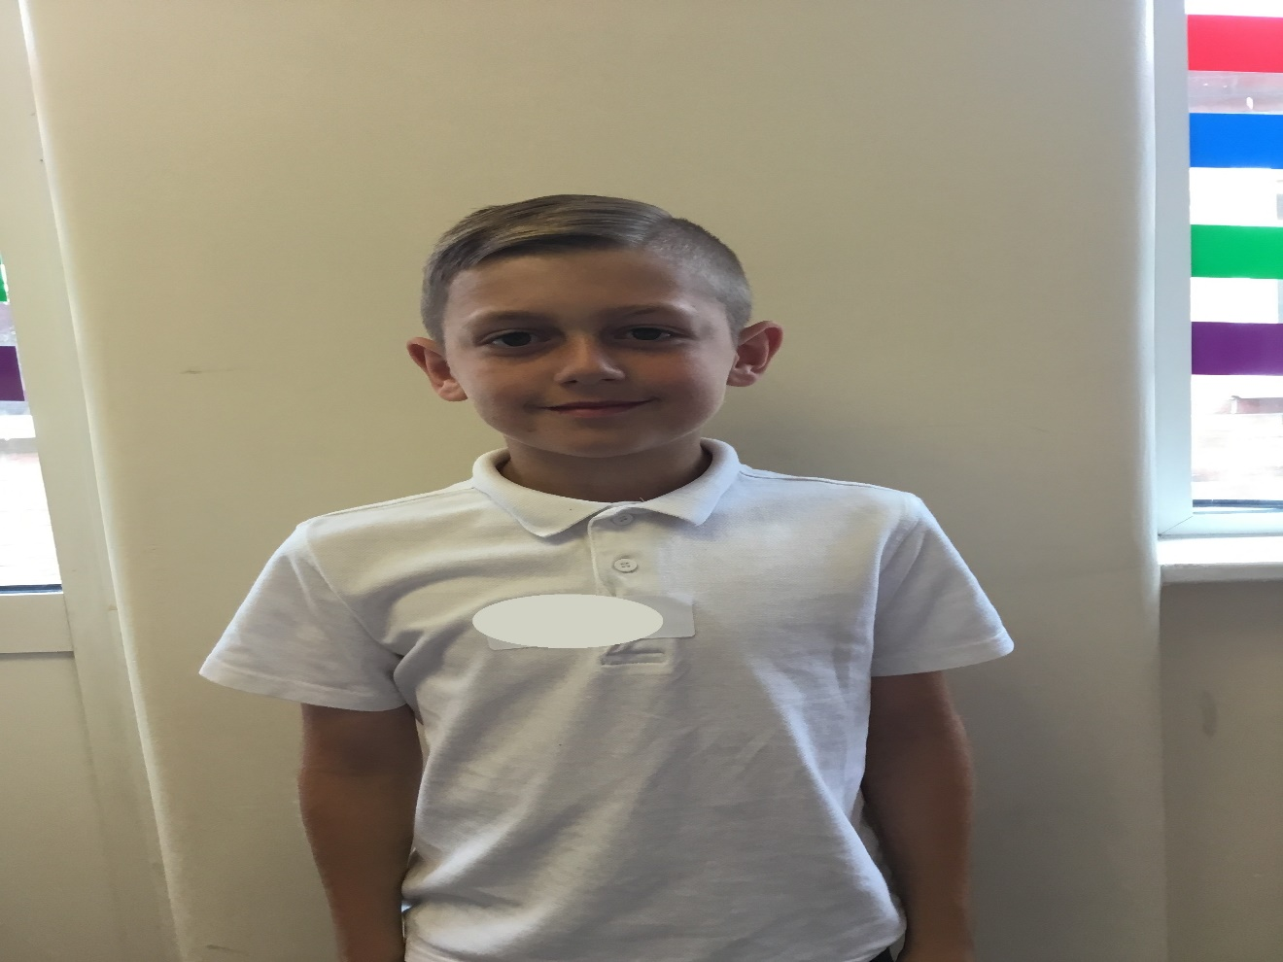
Mr Sporty

Slide 20
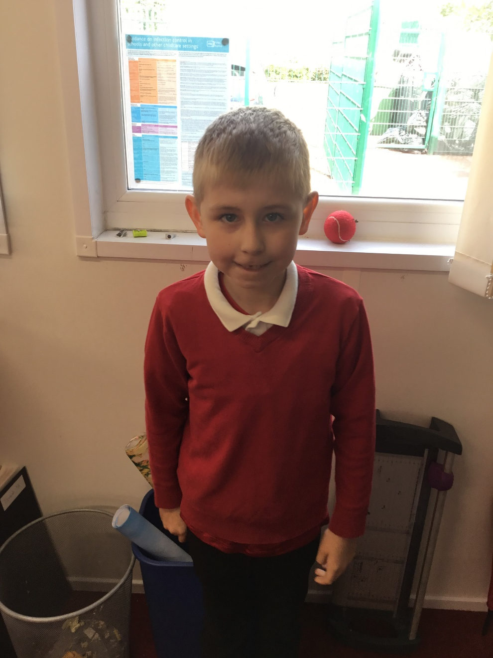
Mr Fix It

Slide 21
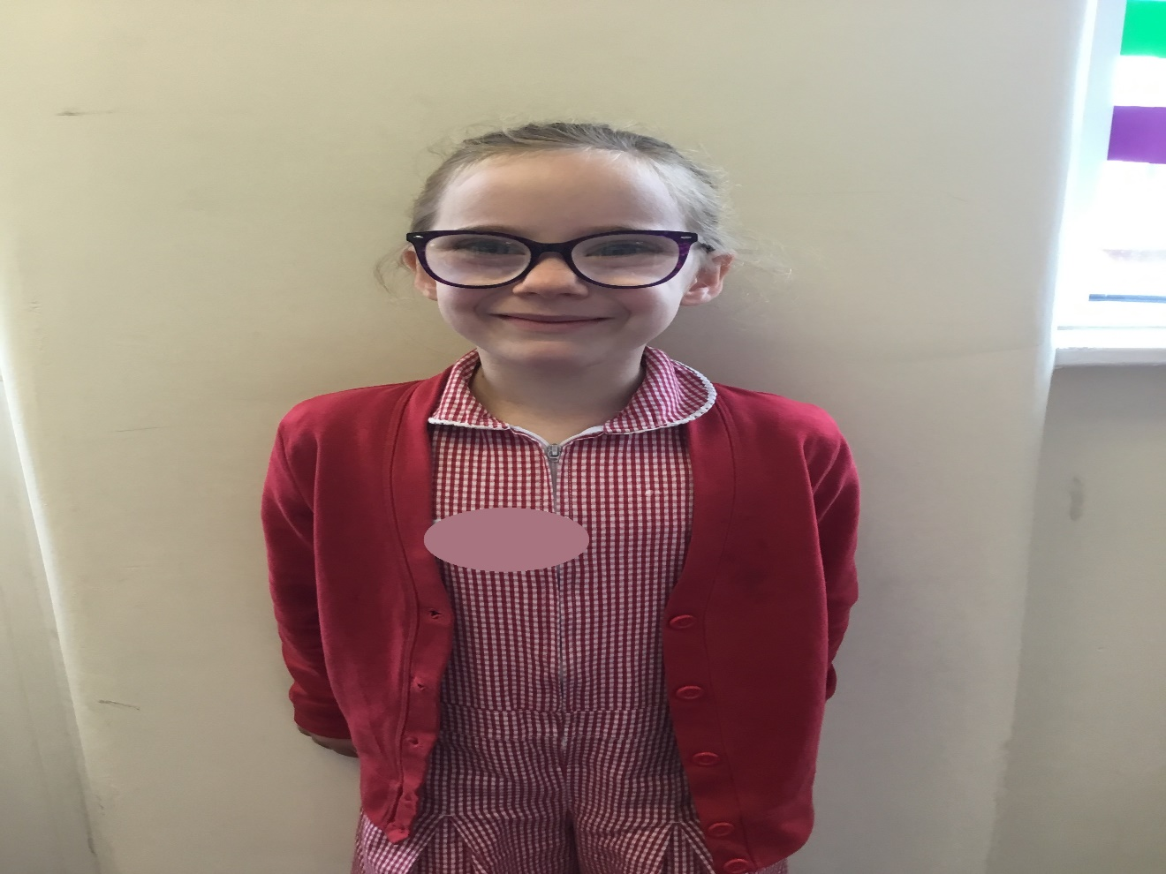
Leading
Lady

Slide 22
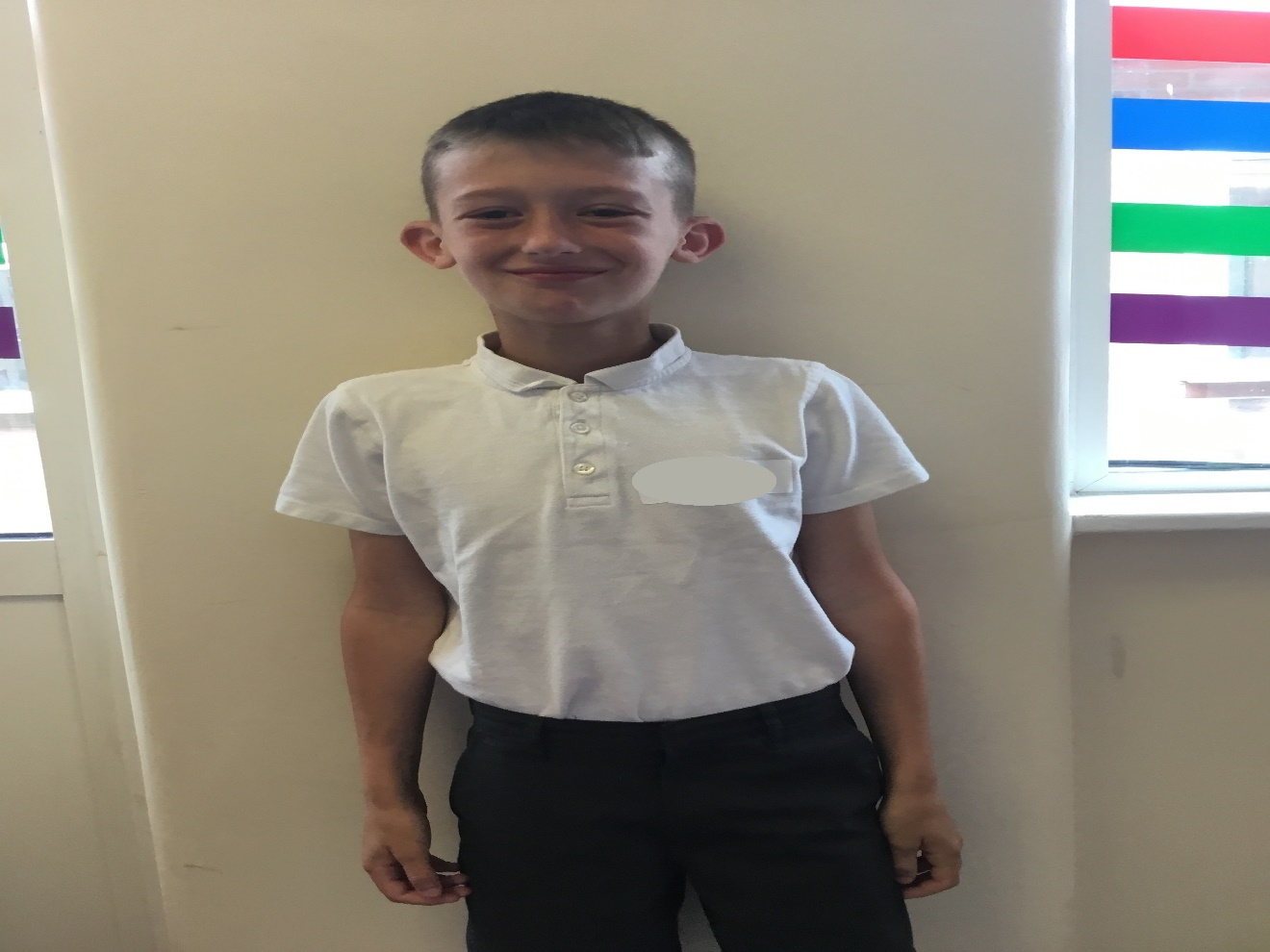
Football
Fanatic

Slide 23
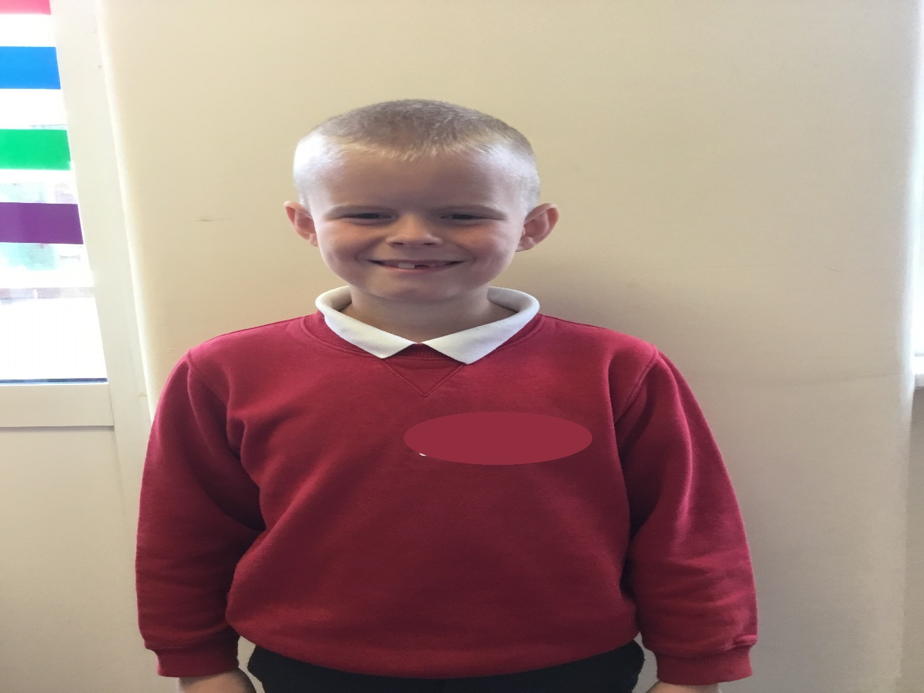
Football
Pundit

Slide 24
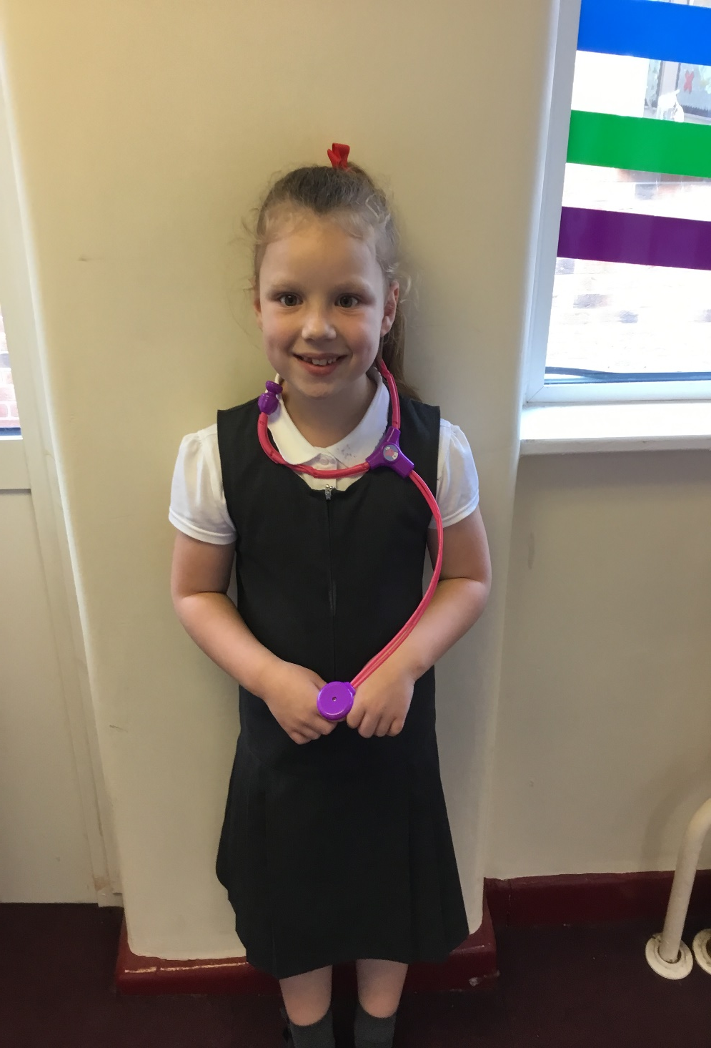
Miss
Gymnast

Slide 25
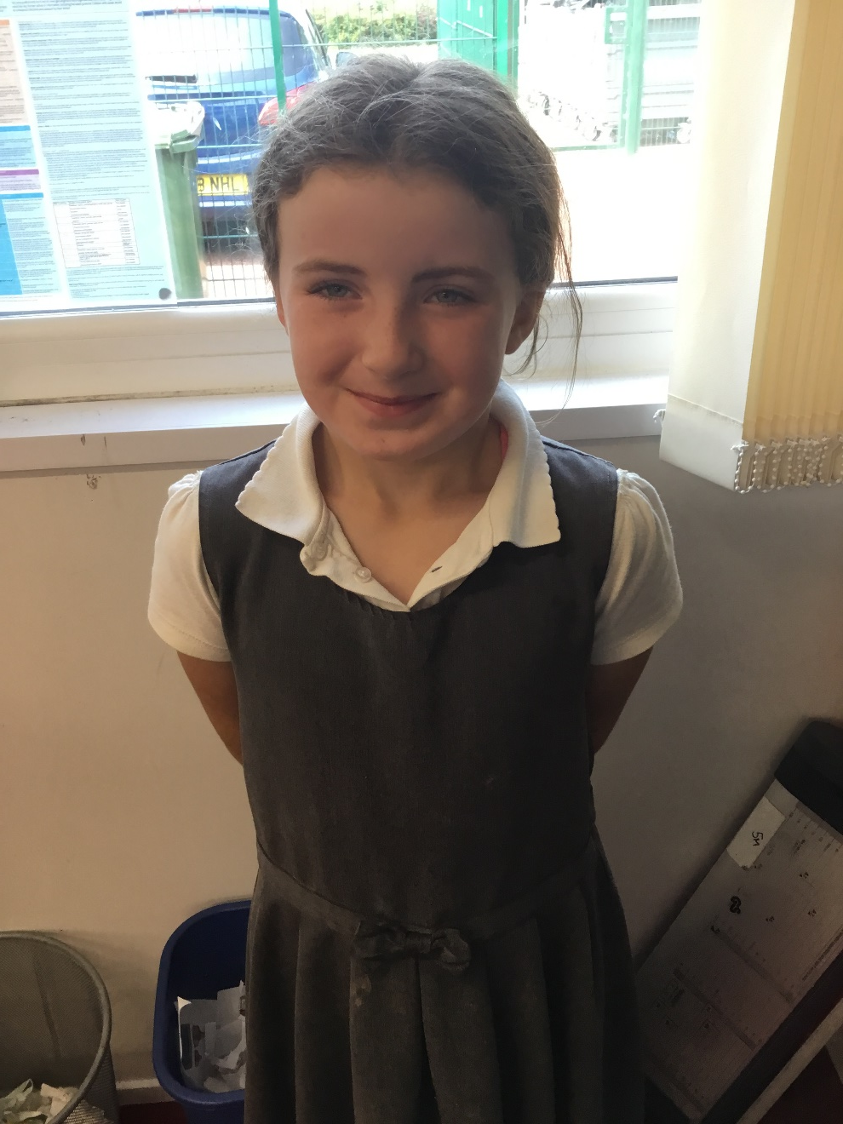
Hero Card
Collecting
Queen

Slide 26
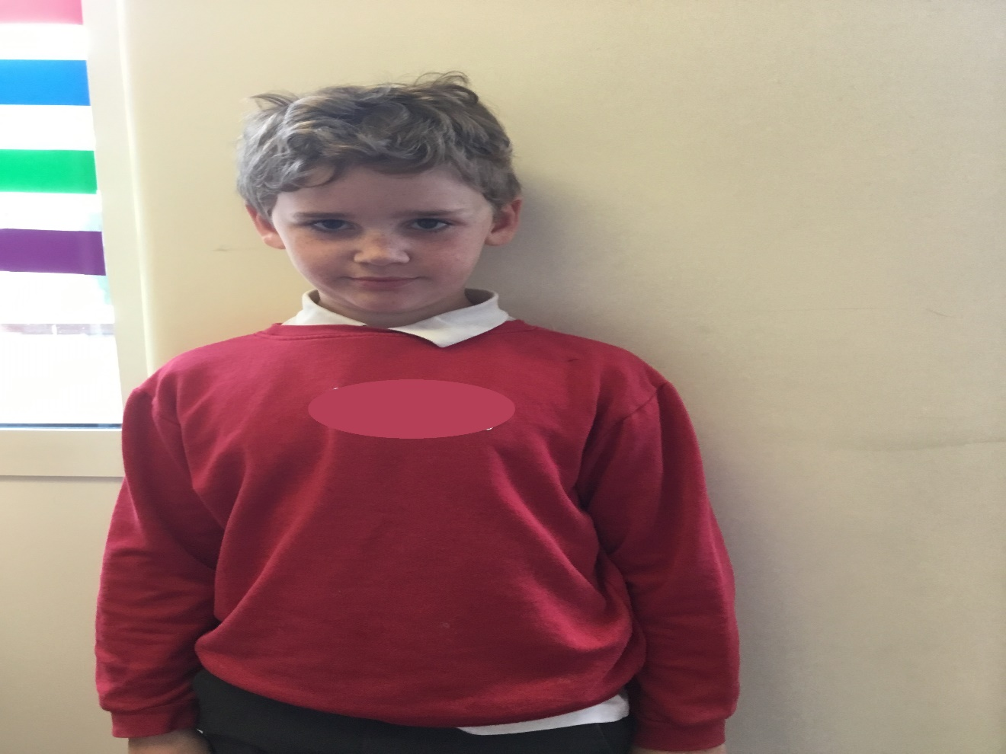
Prankster
Extraordinaire

Slide 27
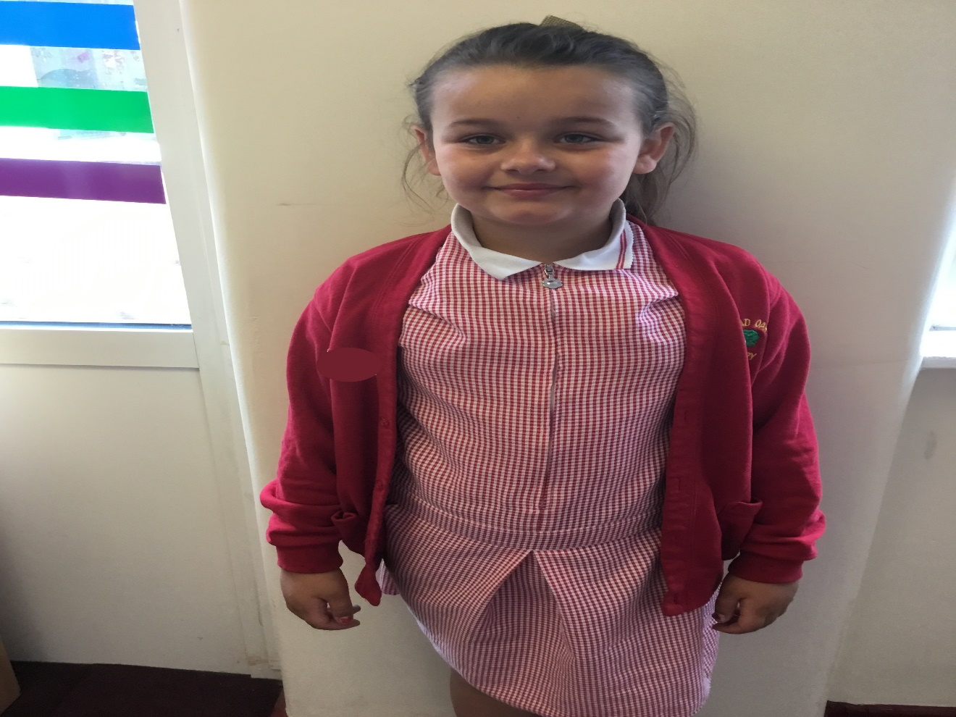
Queen
Of Coats

Slide 28
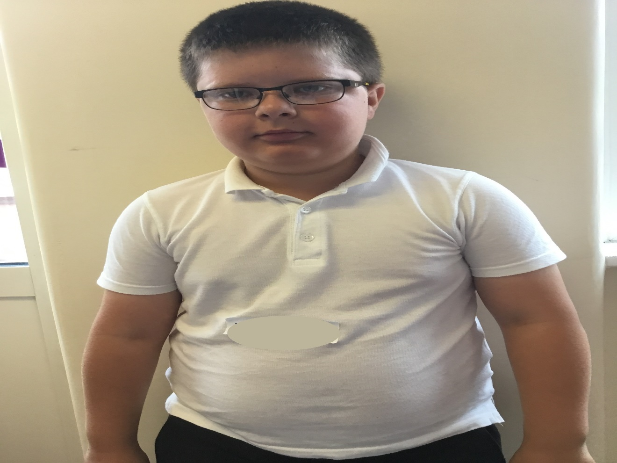
Master
Puppet
Maker

Slide 29
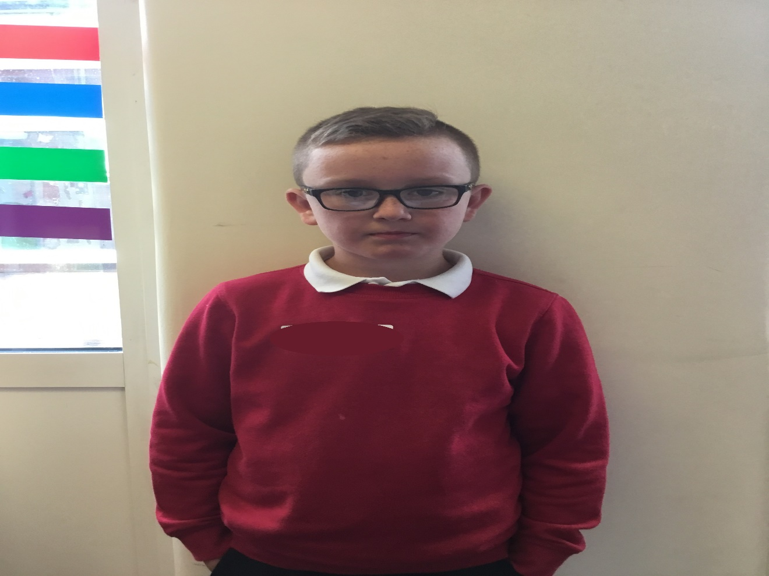
Maths Guru

Slide 30
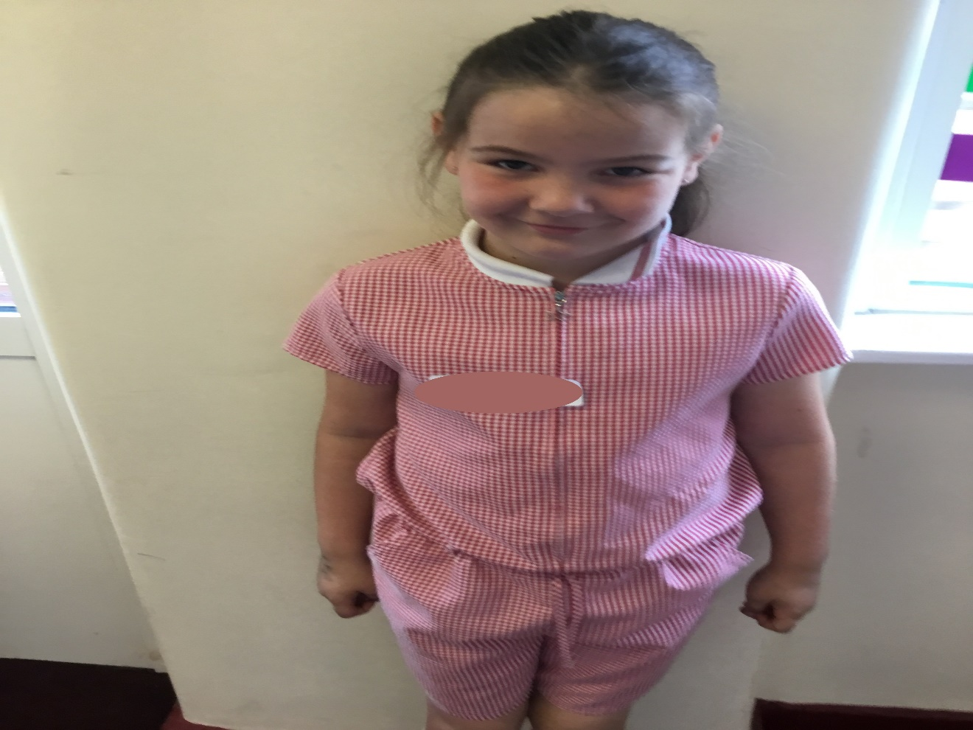
Rock Star

Slide 31
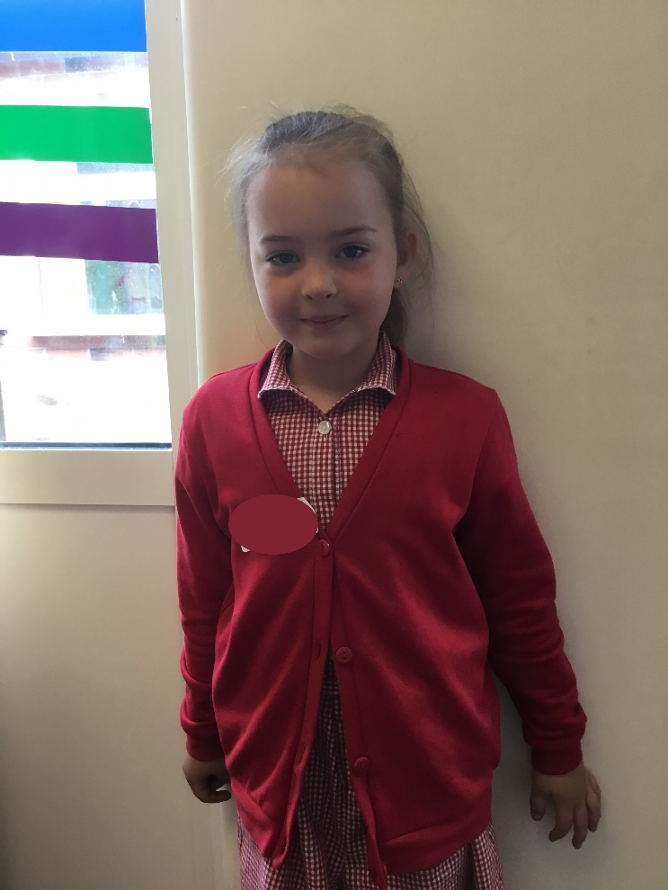
Style Queen

Slide 32
We are missing
you all and hope
to see you soon

Slide 33
Mrs Keyte
Mrs Lindsay
And
Mrs Hull

