Slide 1
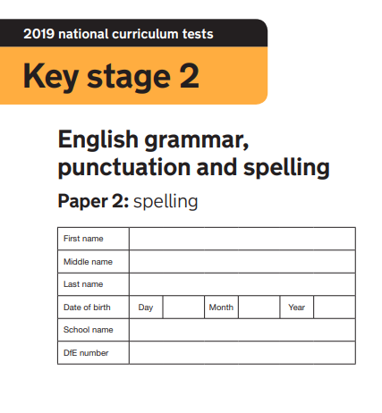
2020
Made by @mrbrownteach

Slide 2

NAME and NAME bought a __________ for their mum
NAME wanted to be a __________
For lunch, NAME and NAME ate a __________
NAME’s party was a really good __________!
The shop accepted NAME’s __________ as payment
NAME went fishing and caught a __________
NAME and NAME loved to play __________
NAME and NAME chased the car with a __________ in hand
NAME’s gloves were made with natural __________
NAME shouted __________ NAME stole his shorts

Slide 3
NAME __________ her homework
To be a real __________, NAME had to work hard
NAME ate her __________ with NAME and NAME at break
NAME had __________ brothers and one sister
NAME bought a new dog for NAME; it was a __________
NAME hit NAME and NAME __________ they all cried
NAME told NAME to __________
NAME had not seen her __________ for 3 years
NAME’s clock would not __________
NAME’s class are __________

