Slide 1
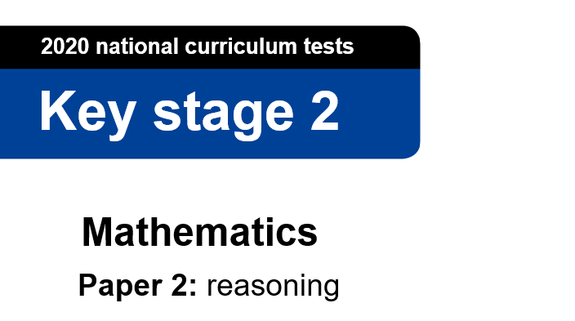
This is the Key Stage 2 Mathematics Paper 2: Reasoning. You will need a pen and something to record your answers on.
You must not use a calculator to answer any questions in this test.
You have as much time as you need to answer these questions.
Follow the instructions for each question.
Work as carefully as you can. If you need to do working out, you can use the space around the question.
Some questions have a method box. For these questions, you may get a mark for showing your method.
If you cannot do a question, go on to the next one. You can come back to it later.
If you finish before the end, go back and check your work.
The number in the bottom right corner of each page tells you the number of marks available for each question.
If you have any questions during the test, feel free to send a message to [teacher name]
You can talk to each other.
You may now start the test.
Made by @MissKhan__

Slide 2
Q1
Put the numbers in the correct positions in the Carroll diagram:
472 76 8,476 0.2
 | The number of pencils in [name of your classroom] | The number of hairs on your head
The length of a piece of string, in cm
Your neighbour’s lucky number
[½ mark]

Slide 3
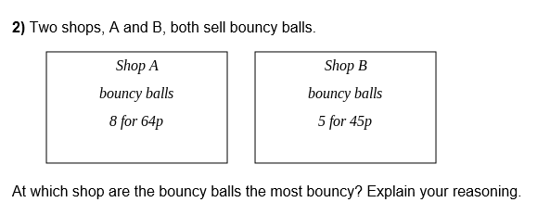
Q2
[12.5 marks]

Slide 4

Q3
[2 marks]

Slide 5

Q4
[Teacher name] says the missing number is 100. Is s/he correct?
[4 x 100 marks]

Slide 6
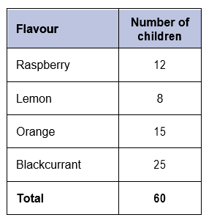
Q5
[Teacher name] asked 60 children to choose their favourite flavour of jelly. These were his/her results.
a) What is your favourite flavour of jelly?
b) What is your family’s favourite flavour of jelly?
c) Does this change the results?
[0.111 marks]

Slide 7
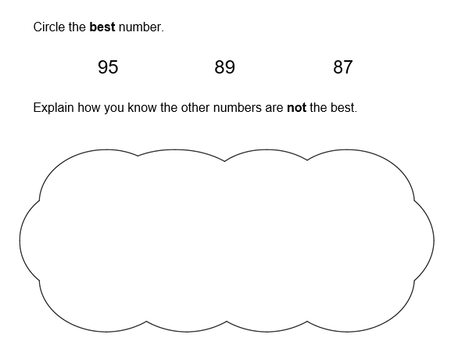
Q6
[958,987 marks]

Slide 8
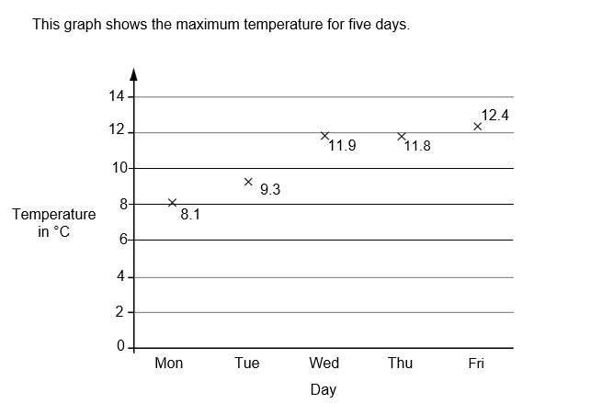
Q7
Has it been warmer or colder today?
[-11 marks]

Slide 9
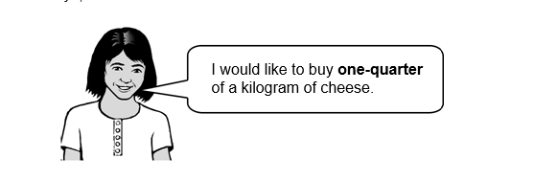
Q8
Amina is shopping. She says,
Why does Amina need so much cheese?
[0.25 marks]

Slide 10
Q9
a) What fraction of her daily allowance of chocolate has [Teacher name] eaten?
b) How much has s/he got left to eat?
c) What is this as a percentage?
[2.5 marks]

Slide 11
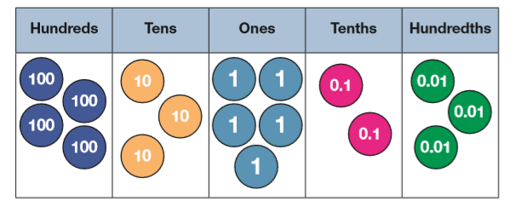
Q10
[Your class name] have been saving money to buy [Teacher name] the best present ever.
How much money have they saved?
[27 marks]

