Slide 1
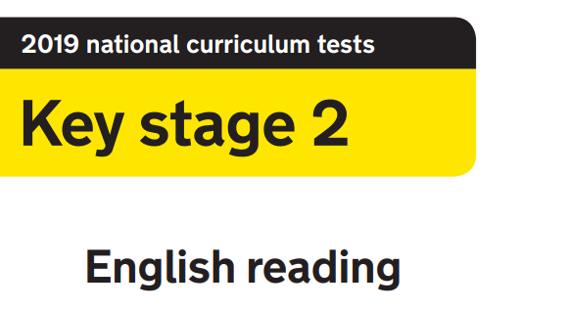
2020
Read the extract on slides 2-3 and then answer the questions on slides 4-5. Ask an adult to mark them for you using the answers on slide 6!
Made by @_MissieBee

Slide 2
Children's manners and etiquette in the 1950s
The behaviour of your children was a symbol of the parents 'status’
Many people, especially those under the age of around 45 will often hear 'us oldens' say "If I'd have spoken to my parents like that, I'd have got a clip round the ear".
But in most cases it's true what we say, you would never answer back, you would do as you were told because that's how it worked. Possibly part of the reason was that for the last 100 years, the vast majority of us were children of those who fought in the Services during the two Wars and this brought about a discipline. There again, discipline goes back centuries before that even.
It is best to write how things were back in the 1950's by just giving examples and the 'rules' which existed, most of which are long forgotten I'm afraid.
1. When any adult, excepting your Parents, entered the Room, you would stand up. If you didn't you'd get ticked off for sure.
2. You would always vacate a Bus or Train seat for a Woman or someone in senior years. You would also offer them your place in a Queue when alighting a Bus
3. You would never leave the Table without seeking permission first. In fact, you would usually not even bother asking, in the 50's most would eat as a family and leave the Table together.
Copied and pasted from http://www.downthelane.net/growing-up-50s-60s/manners-etiquette-1950s.php

Slide 3
4. "Please" and "Thank you" were compulsory and unlike nowadays, if you didn't say it, it wasn't a case of the Adult saying what an impolite young child you were after you'd left, they would tell you face to face.
5. At School, every Teacher was referred to as 'Sir' or 'Madam' and upon entry into the Classroom, everyone would stand and unanimously say "Good morning Sir"
6. If you wore a Hat, you would never wear it indoors, Home or Shop. You would take it off if you met or you were talking to a Lady.
7. "I want" were two 'no no' words, it was always "I would like" or "may I have" (followed by the mandatory Please and Thank you of course.
8. You would always open a door for someone, a woman or adult and allow them entry or exit before you.
9. 'Speak when you're spoken to', another expression us oldens often say. You would not normally make the first comment other than to ask how a person was, you would sit politely when you had Guests and wait for the question - and that was usually based around your Schooling!
10. Going back to Buses and Trains and even walking down the Street, if you saw a Lady struggling with her Shopping, you would offer to help, even if that meant going out of your way to take them to her home.
Taken from http://www.downthelane.net/growing-up-50s-60s/manners-etiquette-1950s.php

Slide 4
If the line beginning with ‘Many people…’ counts as line 1, what is the 17th letter on the line 7? [1 mark]
Add together the numbers used on lines 1, 4 and 7. [3 marks]
How many times is the letter e used in line 9? [17 marks]
This text seems to use a lot of random capital letters that shouldn’t be there. How many misplaced capitals do you think there are? [0.8 marks]
“You would always vacate a Bus or Train seat for a Woman or someone in senior years.” How old do you think someone has to be to qualify them as being in their ‘senior years’? [4/7ths of a mark]
“You would never leave the Table without seeking permission first.” Think of a song with the word ‘table’ in the lyrics. [56 x 87 marks]
“If you wore a Hat, you would never wear it indoors, Home or Shop.” Go and find a hat in your house and wear it whilst you answer the rest of the questions. [3y + 2 = 11, y = marks]

Slide 5
8. “At School, every Teacher was referred to as 'Sir' or 'Madam’”. For the rest of the day, only call the adult in your house ‘Sir’ or ‘Madam’. [0 marks]
9. Apart from number 8, how many rules are there? [-16 marks]
10. “Going back to Buses and Trains…” Find the nearest person in your house. If they’re not busy, say ‘Choo choo! Choo choo!’ to them. If they say, “Why are you making train noises?”, then you get the mark. [1 mark]
11. “"I want" were two 'no no' words…” What are two ‘no no’ words or phrases that the adults in your house don’t like you saying? (No rude words please!) [0.47628 marks]
12. Can you write 5 rules for what you think parents’ manners and etiquette should be like in 2020? [Your adult at home can give you 1 mark for each one they agree with]
Ask an adult to mark them for you, and you could even try to work out your score with a calculator ;)

Slide 6
ANSWERS
It is best to write how things = o
45 + 100 + 1950 = 2095
When any adult, excepting your Parents, entered the Room, you would stand up. If you didn't you'd get ticked off for = 10
I got 25 but I’ll accept anything from 22 – 28… the author of this seemed to like using capitals for random nouns!
Adults at home… I’ll let you answer this one!
Multiple answers!
Marks awarded for the satisfactory wearing of a hat through questions 8 onwards.
Marks awarded for maintaining the titles ‘Sir’ or ‘Madam’ throughout the day.
Nine
Marks awarded for another family member successfully identifying the train noises
Adults at home… down to you to award these marks again!
As above!

