Slide 1

This is the Key Stage 2 Mathematics Paper 1: Arithmetic. You will need a pen and something to record your answers on. Write your name and school name on the front of your paper. I will read the instructions to you.
This challenge is to be completed as part of your daily walk/exercise.
You will find a series of questions scattered around the local area starting from school.
If you cannot find all the locations, send a message to the school twitter or email and (teachers name) can send you a clue!
There are (insert number you want to set) questions in total.
You must not use a calculator to answer any questions in this test but you can work as a family team.
You have as much time as you need to complete this test. If you cannot do a question, don’t worry, go on to the next one. You can come back to it later if you have time.
If you finish before the end, go back and check your work.
In this test, long division and long multiplication questions are worth 2 marks each. You will be awarded 2 marks for a correct answer. You may get 1 mark for showing a formal method. All other questions are worth 1 mark each.
Remember to check your work carefully.
If you have any questions during the test, feel free to send a message via the school twitter or school email.
Remember, I (and others) can help you to answer any of the test questions.
You can talk to each other.
Please send your completed challenge to the school twitter so (teachers name) can see what you’ve been up to! We would love to see pictures of you finding the questions too.
You may now start the test.
Made by @MissKhan__
Notes:
Notes for teacher: instructions can be posted on your home learning portal or recorded by teacher as a video message and then posted.

Slide 2
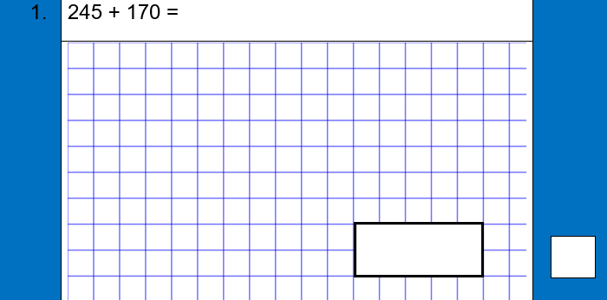
This question is part of a learning challenge set by teachers at (insert school name) Primary School.
Please leave as they are to allow all children to access the challenge.
Teachers will remove when the learning challenge is complete.
Thank you! #staysafe
Notes:
Note for teachers: feel free to remove the note at the top if you feel it isn’t needed in your community. Each page is to be printed and laminated and then scattered around the local area for children to find on their daily walk. Alternatively, you can post each question online using your home learning portal.

Slide 3
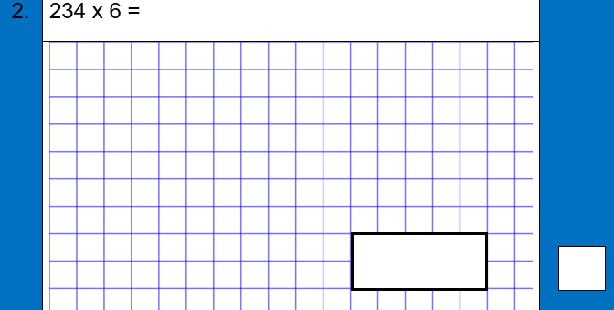
This question is part of a learning challenge set by teachers at (insert school name) Primary School.
Please leave as they are to allow all children to access the challenge.
Teachers will remove when the learning challenge is complete.
Thank you! #staysafe
Notes:
Note for teachers: feel free to remove the note at the top if you feel it isn’t needed in your community. Each page is to be printed and laminated and then scattered around the local area for children to find on their daily walk. Alternatively, you can post each question online using your home learning portal.

Slide 4
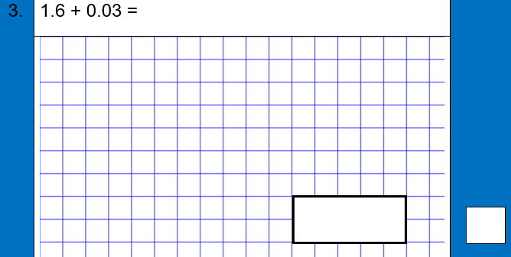
This question is part of a learning challenge set by teachers at (insert school name) Primary School.
Please leave as they are to allow all children to access the challenge.
Teachers will remove when the learning challenge is complete.
Thank you! #staysafe
Notes:
Note for teachers: feel free to remove the note at the top if you feel it isn’t needed in your community. Each page is to be printed and laminated and then scattered around the local area for children to find on their daily walk. Alternatively, you can post each question online using your home learning portal.

Slide 5
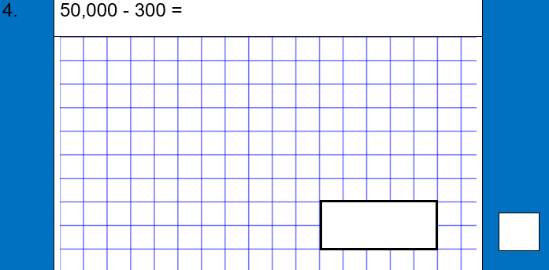
This question is part of a learning challenge set by teachers at (insert school name) Primary School.
Please leave as they are to allow all children to access the challenge.
Teachers will remove when the learning challenge is complete.
Thank you! #staysafe
Notes:
Note for teachers: feel free to remove the note at the top if you feel it isn’t needed in your community. Each page is to be printed and laminated and then scattered around the local area for children to find on their daily walk. Alternatively, you can post each question online using your home learning portal.

Slide 6
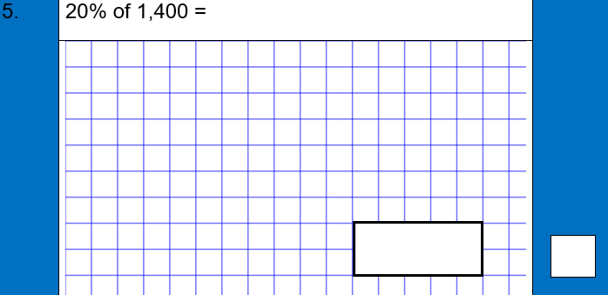
This question is part of a learning challenge set by teachers at (insert school name) Primary School.
Please leave as they are to allow all children to access the challenge.
Teachers will remove when the learning challenge is complete.
Thank you! #staysafe
Notes:
Note for teachers: feel free to remove the note at the top if you feel it isn’t needed in your community. Each page is to be printed and laminated and then scattered around the local area for children to find on their daily walk. Alternatively, you can post each question online using your home learning portal.

Slide 7
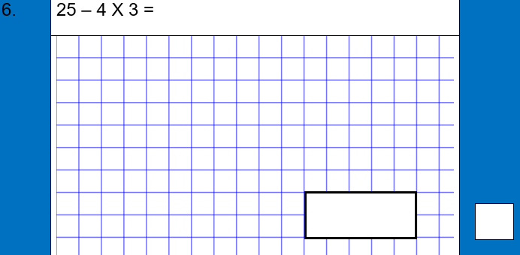
This question is part of a learning challenge set by teachers at (insert school name) Primary School.
Please leave as they are to allow all children to access the challenge.
Teachers will remove when the learning challenge is complete.
Thank you! #staysafe
Notes:
Note for teachers: feel free to remove the note at the top if you feel it isn’t needed in your community. Each page is to be printed and laminated and then scattered around the local area for children to find on their daily walk. Alternatively, you can post each question online using your home learning portal.

Slide 8
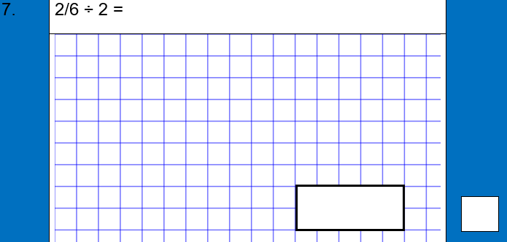
This question is part of a learning challenge set by teachers at (insert school name) Primary School.
Please leave as they are to allow all children to access the challenge.
Teachers will remove when the learning challenge is complete.
Thank you! #staysafe
Notes:
Note for teachers: feel free to remove the note at the top if you feel it isn’t needed in your community. Each page is to be printed and laminated and then scattered around the local area for children to find on their daily walk. Alternatively, you can post each question online using your home learning portal.

Slide 9

This question is part of a learning challenge set by teachers at (insert school name) Primary School.
Please leave as they are to allow all children to access the challenge.
Teachers will remove when the learning challenge is complete.
Thank you! #staysafe
Notes:
Note for teachers: feel free to remove the note at the top if you feel it isn’t needed in your community. Each page is to be printed and laminated and then scattered around the local area for children to find on their daily walk. Alternatively, you can post each question online using your home learning portal.

Slide 10
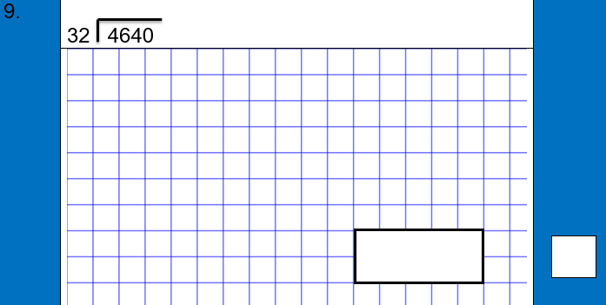
This question is part of a learning challenge set by teachers at (insert school name) Primary School.
Please leave as they are to allow all children to access the challenge.
Teachers will remove when the learning challenge is complete.
Thank you! #staysafe
Notes:
Note for teachers: feel free to remove the note at the top if you feel it isn’t needed in your community. Each page is to be printed and laminated and then scattered around the local area for children to find on their daily walk. Alternatively, you can post each question online using your home learning portal.

Slide 11
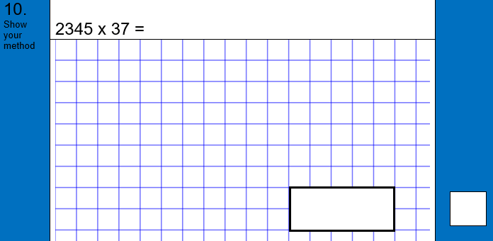
This question is part of a learning challenge set by teachers at (insert school name) Primary School.
Please leave as they are to allow all children to access the challenge.
Teachers will remove when the learning challenge is complete.
Thank you! #staysafe
Notes:
Note for teachers: feel free to remove the note at the top if you feel it isn’t needed in your community. Each page is to be printed and laminated and then scattered around the local area for children to find on their daily walk. Alternatively, you can post each question online using your home learning portal.

Slide 12

This question is part of a learning challenge set by teachers at (insert school name) Primary School.
Please leave as they are to allow all children to access the challenge.
Teachers will remove when the learning challenge is complete.
Thank you! #staysafe
Notes:
Note for teachers: feel free to remove the note at the top if you feel it isn’t needed in your community. Each page is to be printed and laminated and then scattered around the local area for children to find on their daily walk. Alternatively, you can post each question online using your home learning portal.

Slide 13
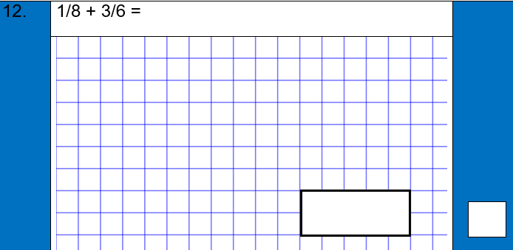
This question is part of a learning challenge set by teachers at (insert school name) Primary School.
Please leave as they are to allow all children to access the challenge.
Teachers will remove when the learning challenge is complete.
Thank you! #staysafe
Notes:
Note for teachers: feel free to remove the note at the top if you feel it isn’t needed in your community. Each page is to be printed and laminated and then scattered around the local area for children to find on their daily walk. Alternatively, you can post each question online using your home learning portal.

Slide 14
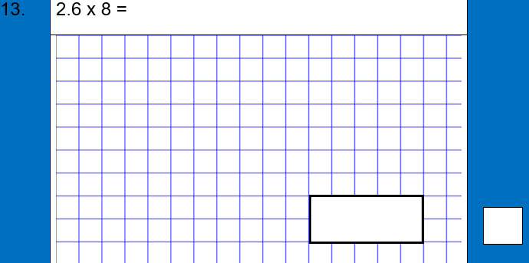
This question is part of a learning challenge set by teachers at (insert school name) Primary School.
Please leave as they are to allow all children to access the challenge.
Teachers will remove when the learning challenge is complete.
Thank you! #staysafe
Notes:
Note for teachers: feel free to remove the note at the top if you feel it isn’t needed in your community. Each page is to be printed and laminated and then scattered around the local area for children to find on their daily walk. Alternatively, you can post each question online using your home learning portal.

Slide 15

This question is part of a learning challenge set by teachers at (insert school name) Primary School.
Please leave as they are to allow all children to access the challenge.
Teachers will remove when the learning challenge is complete.
Thank you! #staysafe
Notes:
Note for teachers: feel free to remove the note at the top if you feel it isn’t needed in your community. Each page is to be printed and laminated and then scattered around the local area for children to find on their daily walk. Alternatively, you can post each question online using your home learning portal.

Slide 16

This question is part of a learning challenge set by teachers at (insert school name) Primary School.
Please leave as they are to allow all children to access the challenge.
Teachers will remove when the learning challenge is complete.
Thank you! #staysafe
Notes:
Note for teachers: feel free to remove the note at the top if you feel it isn’t needed in your community. Each page is to be printed and laminated and then scattered around the local area for children to find on their daily walk. Alternatively, you can post each question online using your home learning portal.

Slide 17
Clues for question locations:
Question | Clue | Actual location
1
2
3
4
5
6
7
8
9
10
11
12
13
14
15
Notes:
Notes for teachers: you can provide the clues first or throughout the day as they get stuck on finding certain questions.

