Slide 1




Year 3
Addition and Subtraction
To be able to add 2-digit and 3-digit numbers
(with exchange)
Block 2 – Addition and Subtraction

Slide 2
To be able to add 2-digit and 3-digit numbers
(with exchange)
Success criteria:
I can use mathematics equipment and place value knowledge to add 2-digit and 3-digit numbers (with exchanging)
I can explain my reasoning when using mathematics equipment and place value knowledge to add 2-digit and 3-digit numbers (with exchanging)

Slide 3
To be able to add 2-digit and 3-digit numbers
(with exchange)
Starter:
What’s the same? What’s different?
Explain your answer.
879 - 45 = 834
826 + 8 = 834

Slide 4
To be able to add 2-digit and 3-digit numbers
(with exchange)
Starter:
What’s the same? What’s different?
Both calculations have the same result, 834; however, 879 – 45 means subtracting a 2-digit number from a 3-digit without exchanging, while 826 + 8 requires adding a 1-digit number to a 3-digit number with an exchange.
879 - 45 = 834
826 + 8 = 834

Slide 5
To be able to add 2-digit and 3-digit numbers
(with exchange)
Talking Time:
Use a place value chart and mathematics equipment to calculate 247 + 35.
hundreds | tens | ones

Slide 6
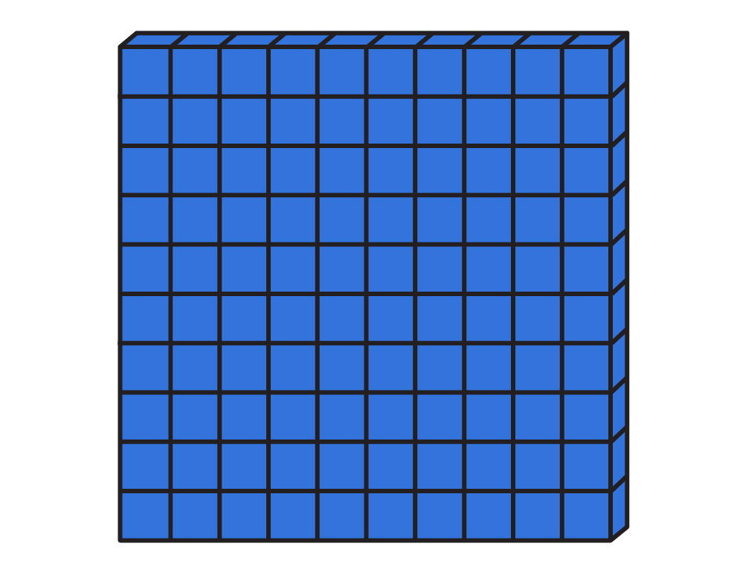

To be able to add 2-digit and 3-digit numbers
(with exchange)
Talking Time:
Use a place value chart and mathematics equipment to calculate 247 + 35.
hundreds | tens | ones

Slide 7
To be able to add 2-digit and 3-digit numbers
(with exchange)
Talking Time:
Use a place value chart and mathematics equipment to calculate 247 + 35.
hundreds | tens | ones

Slide 8
To be able to add 2-digit and 3-digit numbers
(with exchange)
Talking Time:
Use a place value chart and mathematics equipment to calculate 385 + 43.
hundreds | tens | ones

Slide 9
To be able to add 2-digit and 3-digit numbers
(with exchange)
Talking Time:
Use a place value chart and mathematics equipment to calculate 385 + 43.
hundreds | tens | ones

Slide 10
To be able to add 2-digit and 3-digit numbers
(with exchange)
Talking Time:
Use a place value chart and mathematics equipment to calculate 278 + 56.
hundreds | tens | ones

Slide 11
To be able to add 2-digit and 3-digit numbers
(with exchange)
Talking Time:
Use a place value chart and mathematics equipment to calculate 278 + 56.
hundreds | tens | ones

Slide 12
To be able to add 2-digit and 3-digit numbers
(with exchange)
Activity 1:
Use mathematics equipment and/or a place value chart to help you solve:
365 + 83 = 448
H
T
O
5
5
5
78 + 456 = 534
+
9
8
6
5
3
657 + 87 = 744
1
1

Slide 13
To be able to add 2-digit and 3-digit numbers
(with exchange)
Activity 1:
Use mathematics equipment and/or a place value chart to help you solve:
365 + 83 = 448
H
T
O
5
5
5
78 + 456 = 534
+
9
8
6
5
3
657 + 87 = 744
1
1
Notes:
Can children think of a more efficient strategy for the model – e.g. add 100, subtract two!

Slide 14
To be able to add 2-digit and 3-digit numbers
(with exchange)
Talking Time:
Use column addition to complete the calculation shown by the model below.
H
T
O
?
79 | 465
4
6
5
+
7
9

Slide 15
To be able to add 2-digit and 3-digit numbers
(with exchange)
Talking Time:
Use column addition to complete the calculation shown by the model below.
H
T
O
544
79 | 465
4
6
5
+
7
9
5
4
4
1
1
Notes:
Can children think of a more efficient strategy for the model – e.g. add 80, subtract one!

Slide 16
To be able to add 2-digit and 3-digit numbers
(with exchange)
Talking Time:
Use column addition to complete the calculation shown by the model below.
H
T
O
?
6
8
7
687
64
+
6
4

Slide 17
To be able to add 2-digit and 3-digit numbers
(with exchange)
Talking Time:
Use column addition to complete the calculation shown by the model below.
H
T
O
751
6
8
7
687
64
+
6
4
7
5
1
1
1

Slide 18
To be able to add 2-digit and 3-digit numbers
(with exchange)
Talking Time:
Use column addition to complete the calculation shown by the model below.
H
T
O
?
99 | 888
8
8
8
+
9
9

Slide 19
To be able to add 2-digit and 3-digit numbers
(with exchange)
Talking Time:
Use column addition to complete the calculation shown by the model below.
H
T
O
987
99 | 888
8
8
8
+
9
9
9
8
7
1
1
Notes:
Can children think of a more efficient strategy – e.g. add 100, subtract one!

Slide 20
To be able to add 2-digit and 3-digit numbers
(with exchange)
Activity 2:
Use column addition to complete the calculation shown by the model below.
H
T
O
?
7
8
9
789
97
+
9
7

Slide 21
To be able to add 2-digit and 3-digit numbers
(with exchange)
Activity 2:
Use column addition to complete the calculation shown by the model below.
H
T
O
886
7
8
9
789
97
+
9
7
8
8
6
1
1
Notes:
Can children think of a more efficient strategy – e.g. add 100, subtract three!

Slide 22
To be able to add 2-digit and 3-digit numbers
(with exchange)
Activity 3:
Using column addition and no other equipment (if you’re ready), solve:
495 + 78 = 573
H
T
O
7
7
7
738 + 87 = 825
+
8
8
8
6
5
759 + 93 = 852
1
1

Slide 23
To be able to add 2-digit and 3-digit numbers
(with exchange)
Activity 3:
Using column addition and no other equipment (if you’re ready), solve:
495 + 78 = 573
H
T
O
7
7
7
738 + 87 = 825
+
8
8
8
6
5
759 + 93 = 852
1
1

Slide 24
To be able to add 2-digit and 3-digit numbers
(with exchange)
Activity 4:
Three class mates are attempting to solve 478 + 58.
Jamal said, “I used the column method.”
Yasmin said, ”I partitioned 58 into tens and ones and used a number line.”
Chen said, ”I added 60 to 478, then subtracted 2 and did it all mentally.”
Who has the best strategy?
Explain your answer.

Slide 25
To be able to add 2-digit and 3-digit numbers
(with exchange)
Activity 4:
Three class mates are attempting to solve 478 + 58.
Jamal said, “I used the column method.”
Yasmin said, ”I partitioned 58 into tens and ones and used a number line.”
Chen said, ”I added 60 to 478, then subtracted 2 and did it all mentally.”
They have all used effective strategies. If your number bond and partitioning knowledge is strong, like Chen’s, his strategy is perhaps the quickest. Either way, Yasmin and Jamal’s strategies will arrive at the correct result (assuming they don’t make any mistakes!).

Slide 26
To be able to add 2-digit and 3-digit numbers
(with exchange)
Evaluation:
Astrobee has made some mistakes.
What went wrong? Find the correct result.
H
T
O
5
6
8
I have used column addition to calculate 568 + 84
+
8
4
5
4
2

Slide 27
To be able to add 2-digit and 3-digit numbers
(with exchange)
Evaluation:
Astrobee has forgotten to carry forward a ten and a hundred when exchanging after adding 8 and 4 ones to make 12 ones and 6 and 8 (and the extra ten carried forward from the addition of the ones) tens to make 15 tens.
H
T
O
5
6
8
I have used column addition to calculate 568 + 84
+
8
4
6
5
2
1
1

Slide 28
To be able to add 2-digit and 3-digit numbers
(with exchange)
Success criteria:
I can use mathematics equipment and place value knowledge to add 2-digit and 3-digit numbers (with exchanging)
I can explain my reasoning when using mathematics equipment and place value knowledge to add 2-digit and 3-digit numbers (with exchanging)

