Slide 1




Year 3
Addition and Subtraction
To be able to add 2-digit and 3-digit numbers
(with exchange)
Block 2 – Addition and Subtraction

Slide 2
To be able to add 2-digit and 3-digit numbers
(with exchange)
Success criteria:
I can use mathematics equipment and place value knowledge to add 2-digit and 3-digit numbers (with exchanging)
I can explain my reasoning when using mathematics equipment and place value knowledge to add 2-digit and 3-digit numbers (with exchanging)

Slide 3
To be able to add 2-digit and 3-digit numbers
(with exchange)
Starter:
What’s the same? What’s different?
Explain your answer.
879 - 45 = 834
826 + 8 = 834

Slide 4
To be able to add 2-digit and 3-digit numbers
(with exchange)
Starter:
What’s the same? What’s different?
Both calculations have the same result, 834; however, 879 – 45 means subtracting a 2-digit number from a 3-digit without exchanging, while 826 + 8 requires adding a 1-digit number to a 3-digit number with an exchange.
879 - 45 = 834
826 + 8 = 834

Slide 5
To be able to add 2-digit and 3-digit numbers
(with exchange)
Talking Time:
Use a place value chart and mathematics equipment to calculate 247 + 35.
hundreds | tens | ones

Slide 6
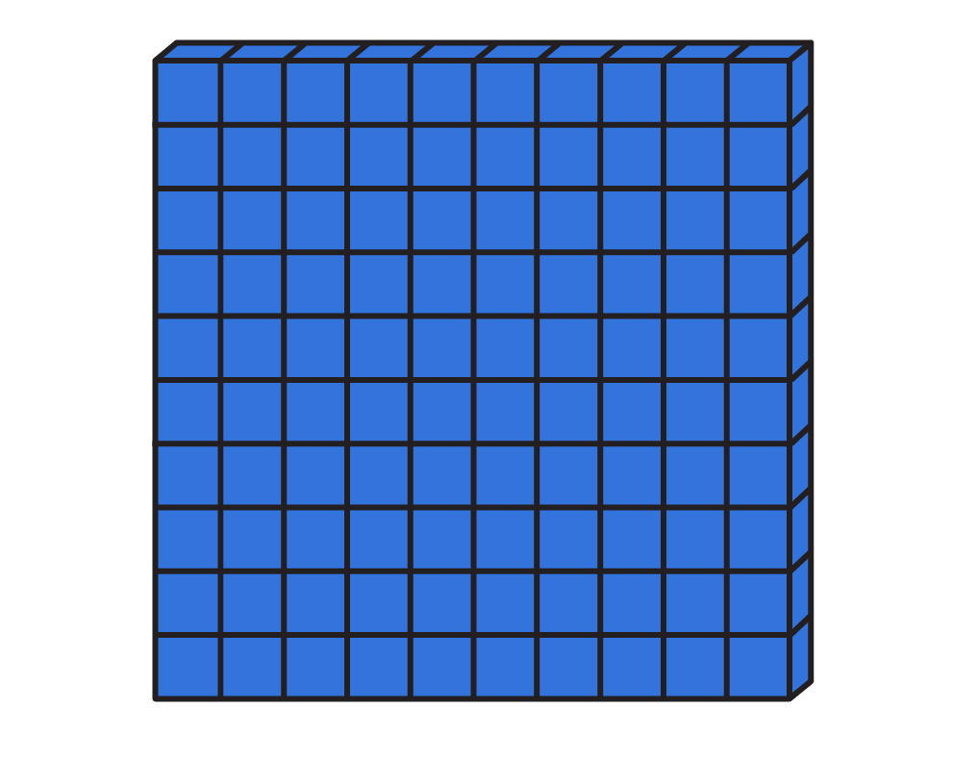

To be able to add 2-digit and 3-digit numbers
(with exchange)
Talking Time:
Use a place value chart and mathematics equipment to calculate 247 + 35.
hundreds | tens | ones

Slide 7
To be able to add 2-digit and 3-digit numbers
(with exchange)
Talking Time:
Use a place value chart and mathematics equipment to calculate 247 + 35.
hundreds | tens | ones

Slide 8
To be able to add 2-digit and 3-digit numbers
(with exchange)
Talking Time:
Use a place value chart and mathematics equipment to calculate 385 + 43.
hundreds | tens | ones

Slide 9
To be able to add 2-digit and 3-digit numbers
(with exchange)
Talking Time:
Use a place value chart and mathematics equipment to calculate 385 + 43.
hundreds | tens | ones

Slide 10
To be able to add 2-digit and 3-digit numbers
(with exchange)
Talking Time:
Use a place value chart and mathematics equipment to calculate 278 + 56.
hundreds | tens | ones

Slide 11
To be able to add 2-digit and 3-digit numbers
(with exchange)
Talking Time:
Use a place value chart and mathematics equipment to calculate 278 + 56.
hundreds | tens | ones

