Slide 1

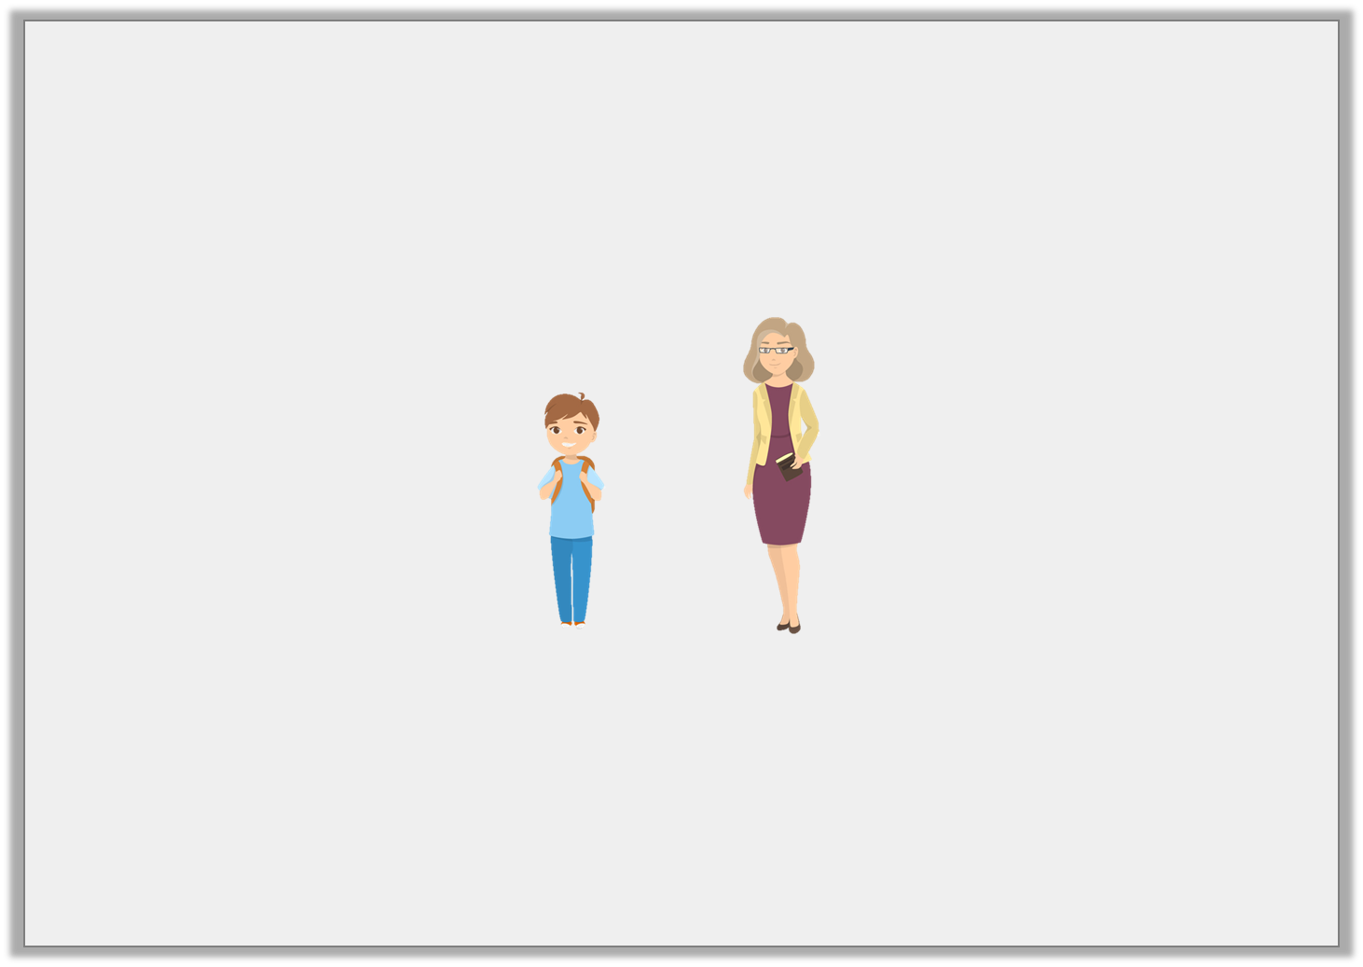

Point to the person that is the shortest.
© Classroom Secrets Limited 2019

Slide 2
Did you get it right?
© Classroom Secrets Limited 2019

Slide 3
Point to the tallest tower.
A.
B.
C.
© Classroom Secrets Limited 2019

Slide 4
Check your answer!
A. | 
B.
C.
© Classroom Secrets Limited 2019

Slide 5
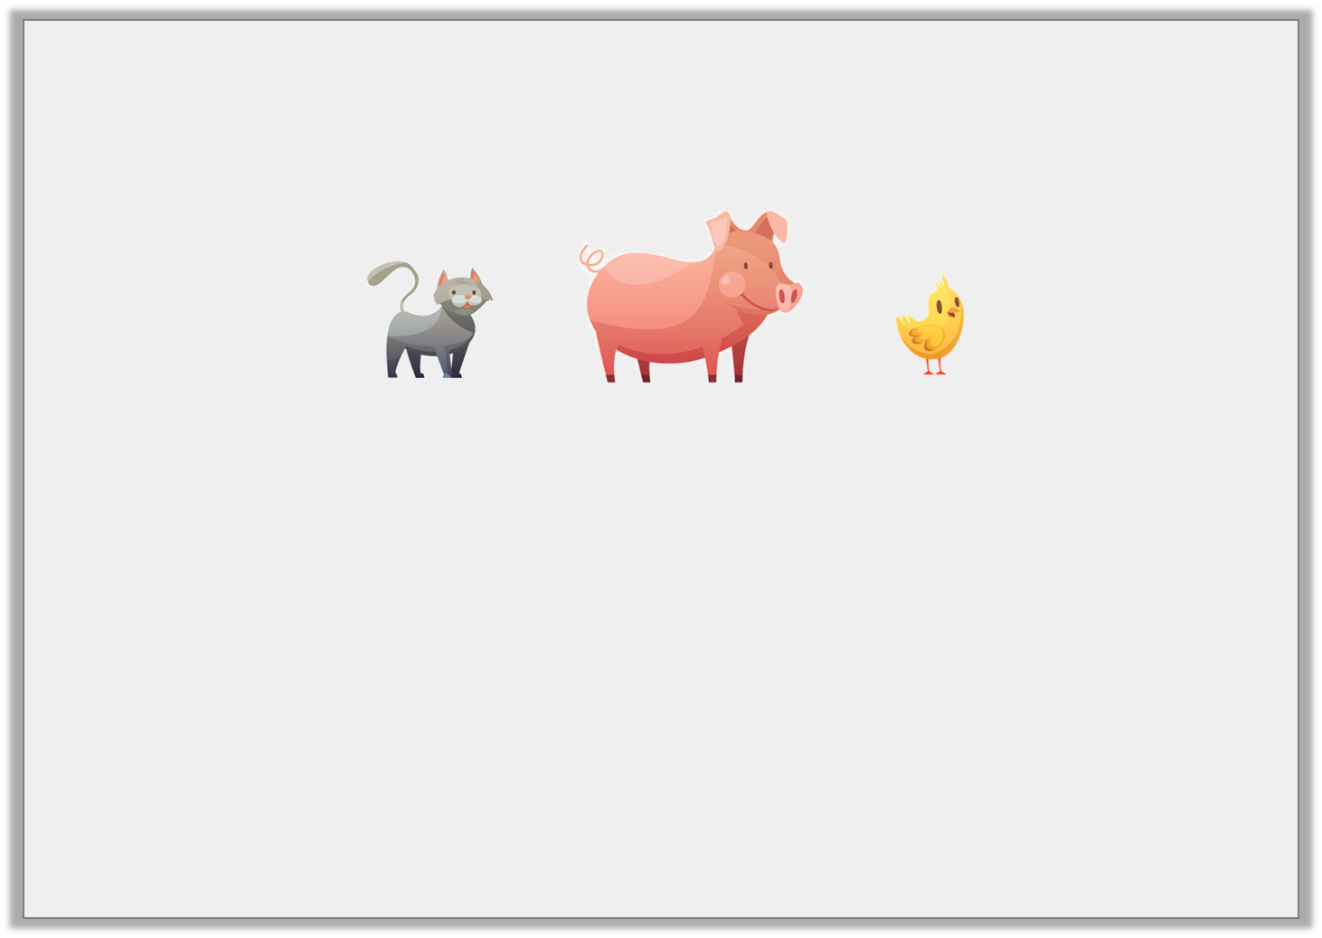
Choose a word to complete the sentences.
The pig is ________________ than the chick.
The cat is ________________ than the pig.
taller | shorter
© Classroom Secrets Limited 2019

Slide 6
Check your answer!
The pig is ________________ than the chick.
The cat is ________________ than the pig.
taller
shorter
© Classroom Secrets Limited 2019

Slide 7
Point to the sentence that is correct.
A.
B.
C.
C is longer than A.
B is shorter than C.
© Classroom Secrets Limited 2019

Slide 8
Check your answer!
A.
B.
C.
C is longer than A. | 
B is shorter than C.
© Classroom Secrets Limited 2019

Slide 9
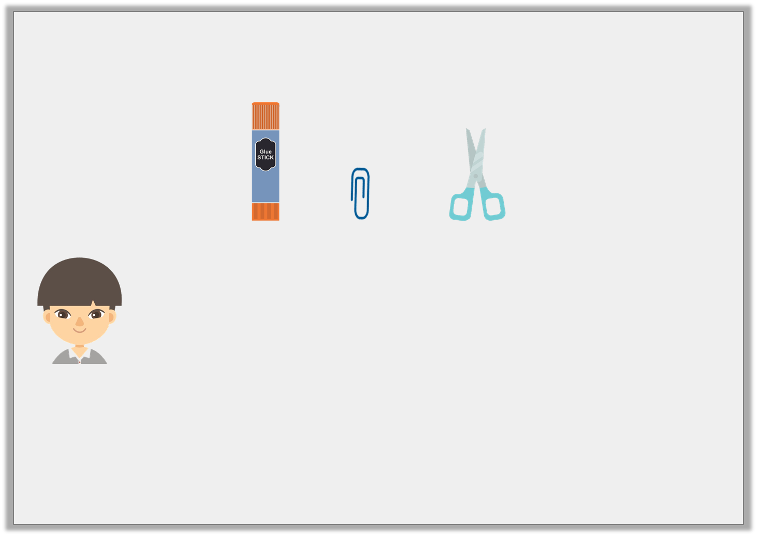
Reece is comparing items at school.
He says,
Do you agree? Explain your answer.
The scissors are the shortest.
The glue stick is the tallest.
© Classroom Secrets Limited 2019

Slide 10
Reece is comparing items at school.
He says,
Do you agree? Explain your answer.
Reece is incorrect because the paperclip is the shortest and the glue stick is the tallest.
The scissors are the shortest.
The glue stick is the tallest.
© Classroom Secrets Limited 2019

Slide 11
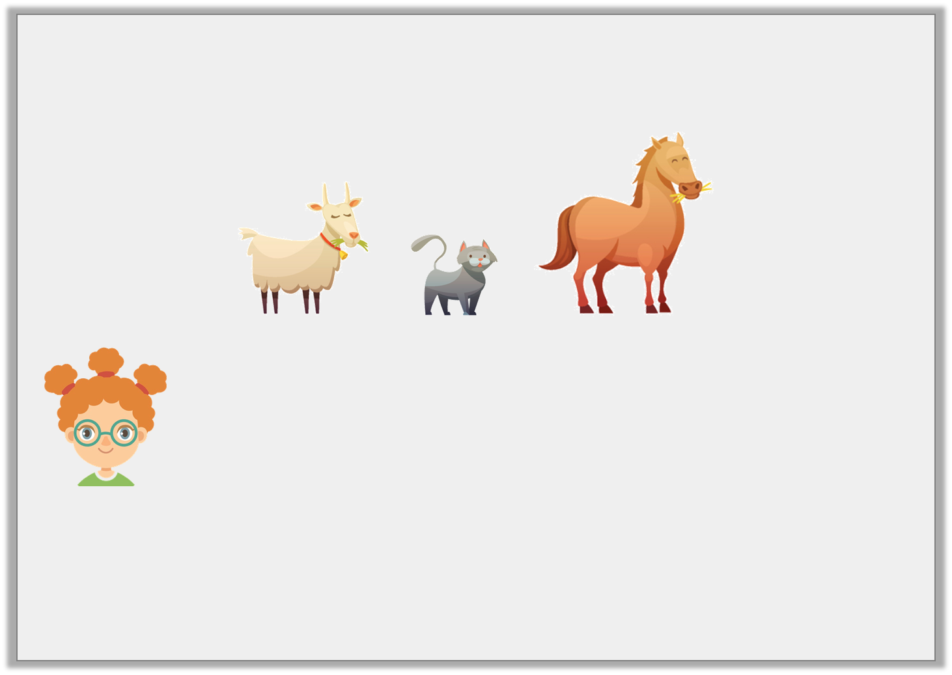
Daisy is thinking of an animal.
She says,
What animal is Daisy thinking of?
My animal is taller than the cat and shorter than the horse.
© Classroom Secrets Limited 2019

Slide 12
Daisy is thinking of an animal.
She says,
What animal is Daisy thinking of?
The goat
My animal is taller than the cat and shorter than the horse.
© Classroom Secrets Limited 2019

