Slide 1
Ready-to-go Lesson Slides
Year 4
Addition and Subtraction Lesson 6
Aut1

Slide 3
STARTER:
Find as many ways as possible to represent the calculation 5,626 – 3104 using words.
You can write the numbers using digits, but need to describe the calculation using words.
A CHALLENGE:
Can you write descriptions using words like “more than”, “is added to” or “total”?
It is possible!

Slide 4
STARTER:
Find as many ways as possible to represent the calculation 5,626 – 3104 using words.
Here are some examples:
What is the difference between 5,626 and 3,104?
How many less than 5,626 is 3,104?
What is 3,104 subtracted from 5,626?
5,626 is 3,104 more than a number. What is the number?
In a part-whole model, 5,626 is the whole. 3,104 is one of the parts.
What is the other part?
3,104 is added to a number. The total is 5,626. What is the number?

Slide 5
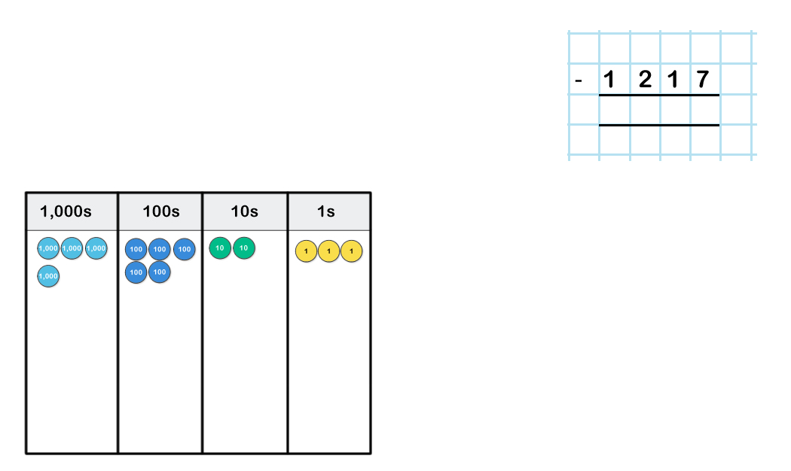
TALKING TIME:
Here is a number. Subtract 1,217.
What is the number we are subtracting from?
Do we have enough in each column to subtract each digit in 1,217?
What can we do to help?

Slide 6
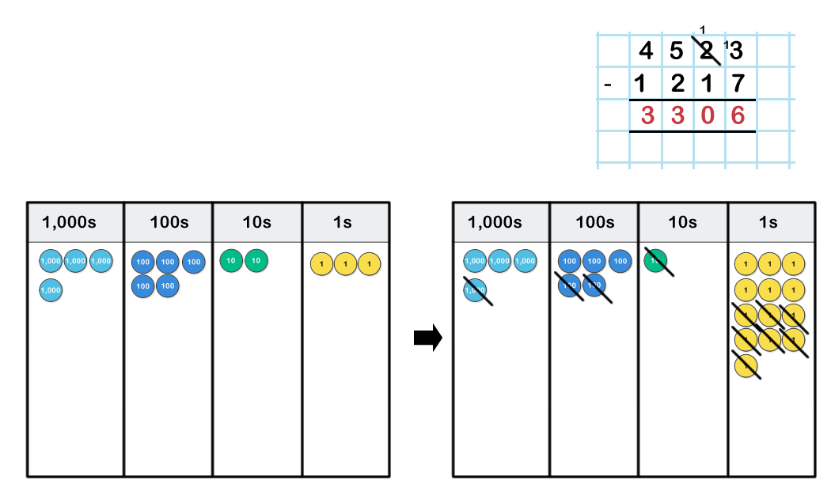
TALKING TIME:
Here is a number. Subtract 1,217.

Slide 7
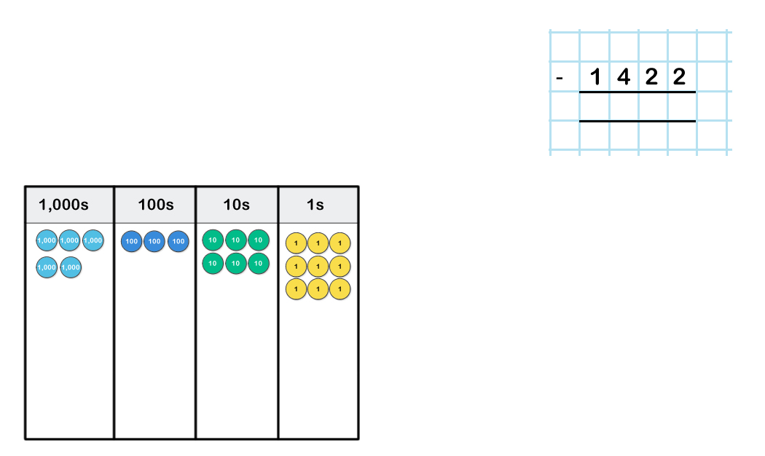
TALKING TIME:
Here is a number. Subtract 1,422.

Slide 8
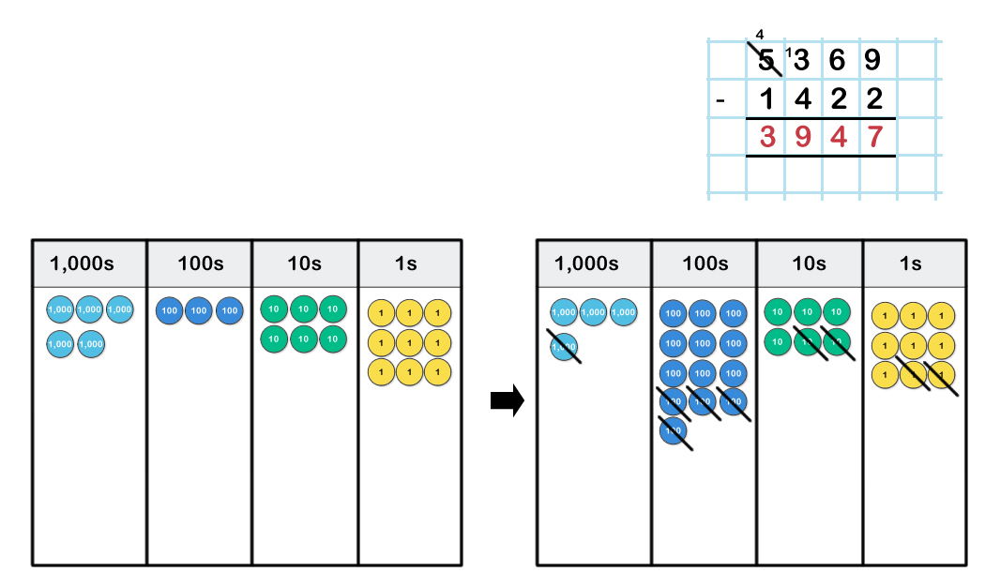
TALKING TIME:
Here is a number. Subtract 1,422.

Slide 9
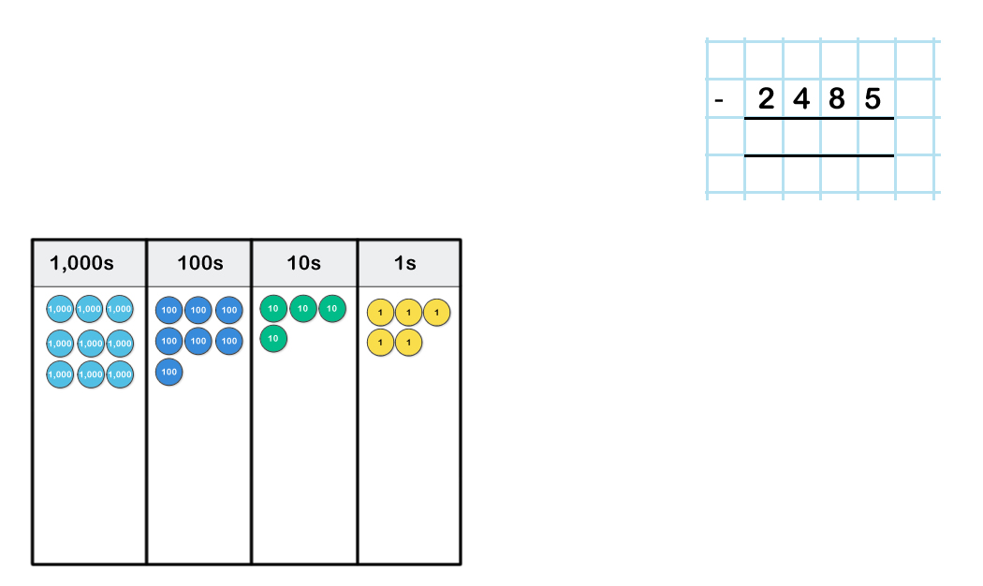
ACTIVITY 1:
What is the difference between this number and 2,485?

Slide 10
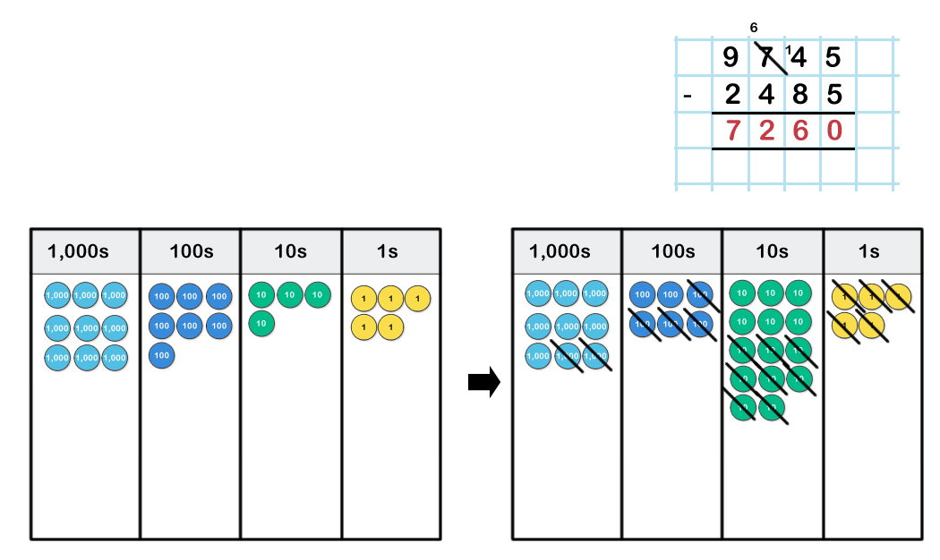
ACTIVITY 1:
What is the difference between this number and 2,485?
Extension:
Alicia subtracts a number from 6,526.
She has to exchange 1 thousand for 10 hundreds to help find the answer.
What could the question be? Think of three possible answers.

Slide 11
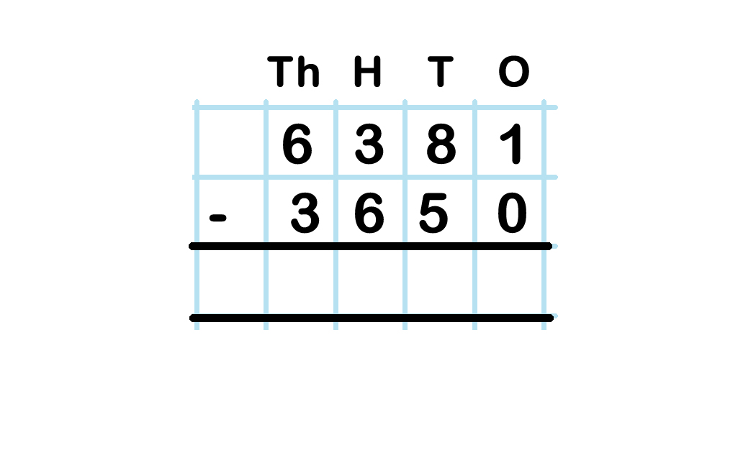
TALKING TIME:
Use column subtraction to find 6381 – 3650.
Do we have enough in each column to subtract each of the digits in 3,650?
What can we do to help?

Slide 12
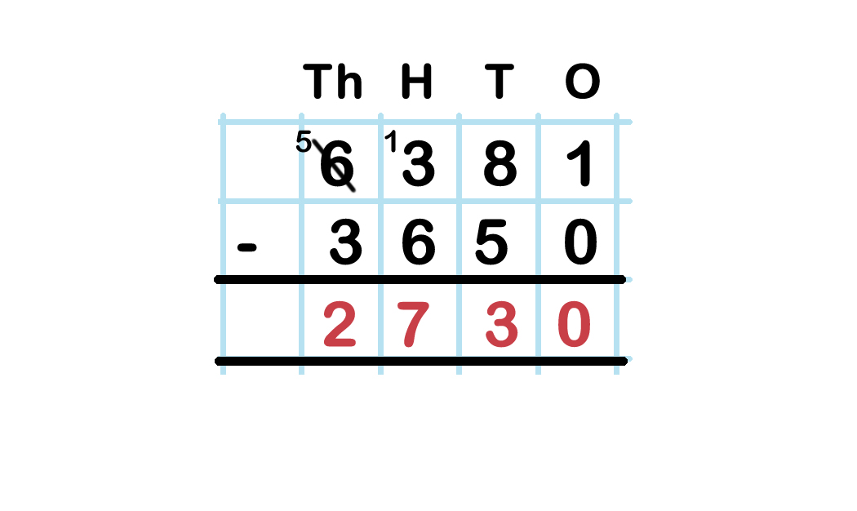
TALKING TIME:
Use column subtraction to find 6381 – 3650.
Explain what has happened in the Thousands column to help solve this calculation.
Can you show this using equipment?

Slide 13
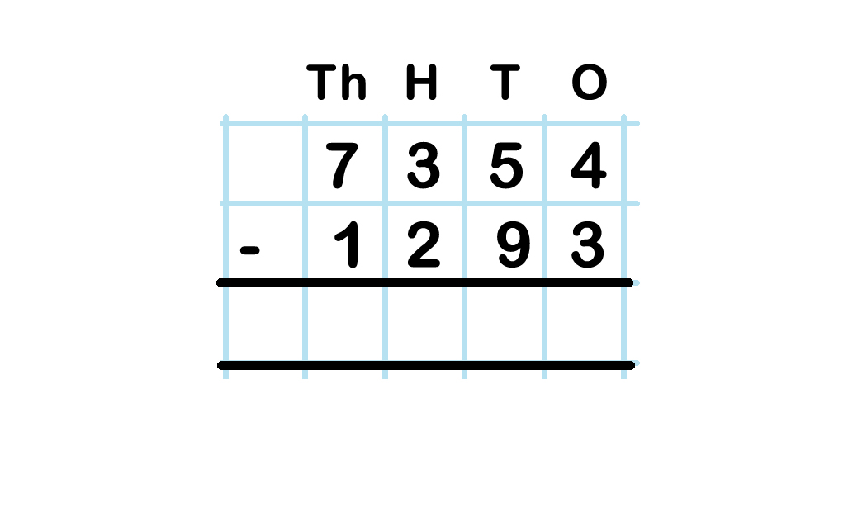
TALKING TIME:
Use column subtraction to find the difference between 7,354
and 1,293.
Will you need to exchange in this subtraction?
Where?
Why?

Slide 14
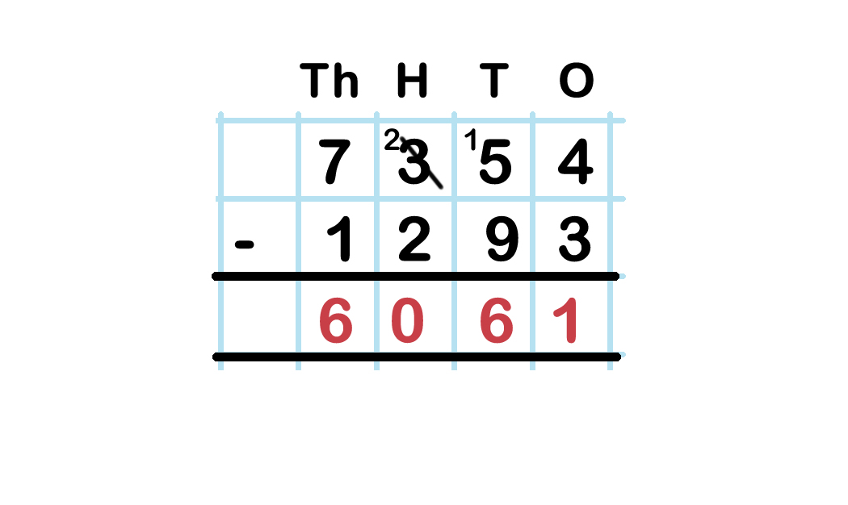
TALKING TIME:
Use column subtraction to find the difference between 7,354
and 1,293.

Slide 15
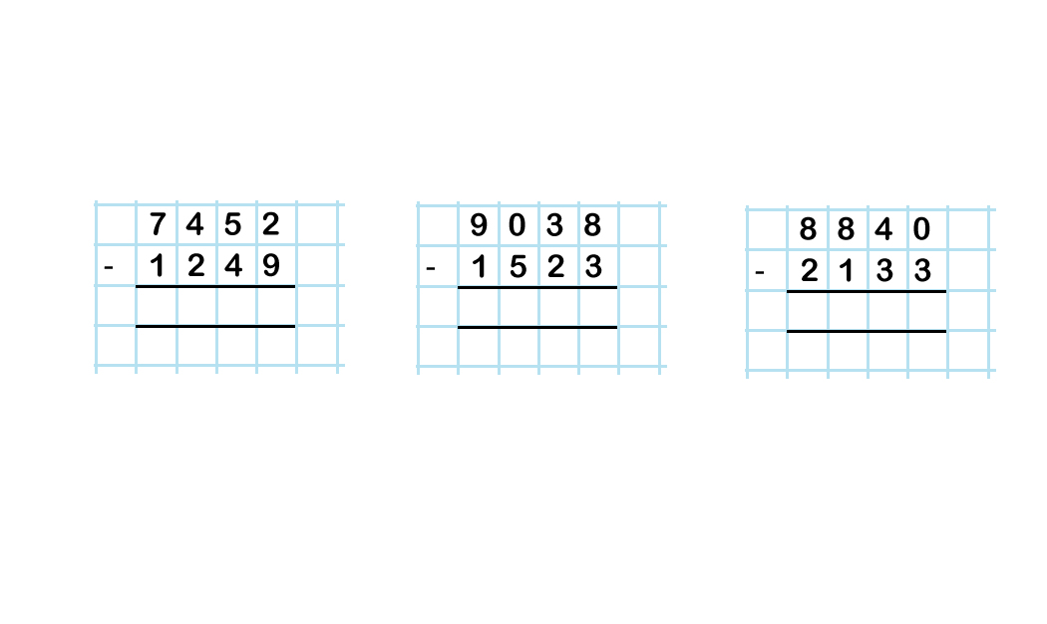
ACTIVITY 2:
Solve each calculation by using the column method.

Slide 16
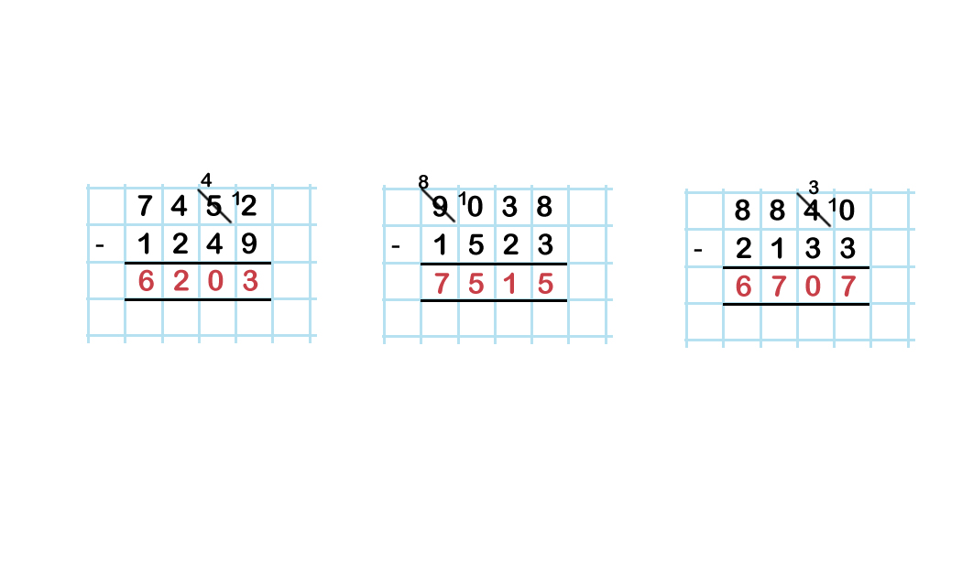
ACTIVITY 2:
Solve each calculation by using the column method.
Extension:
Rearrange the digits in each calculation to make three new questions.
Each calculation should only involve exchanging once.
What are your new subtractions?

Slide 17
ACTIVITY 3:
Only answer the subtraction problem.
There are 5,685 fans watching a football match.
1,962 fans support the Away team.
How many fans support the Home team?
b) A mobile phone shop sells £6,259 of phones in a month.
This is £1,831 less than the previous month.
How many phones did it sell in the previous month?

Slide 18
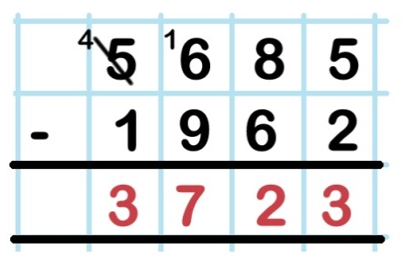
ACTIVITY 3:
Only answer the subtraction problem.
There are 5,685 fans watching a football match.
1,962 fans support the Away team.
How many fans support the Home team?
3,723 fans support the Home team.
b) A mobile phone shop sells £6,259 of phones in a month.
This is £1,831 less than the previous month.
How many phones did it sell in the previous month?

Slide 19
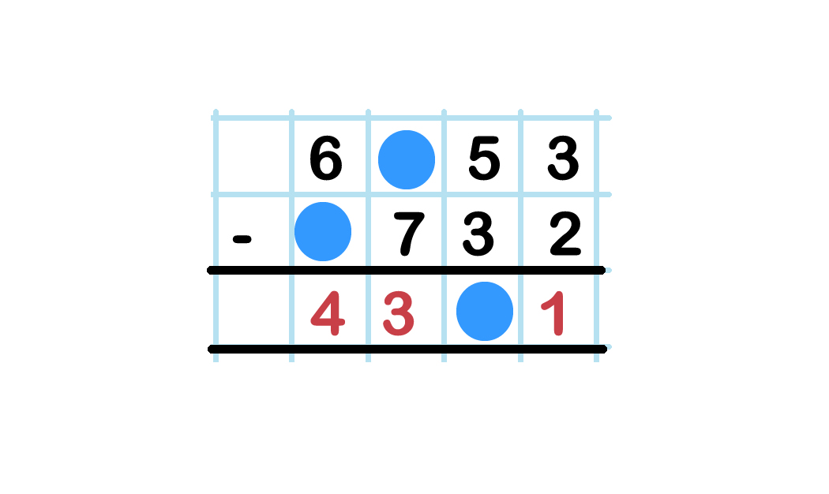
ACTIVITY 4:
Use your knowledge of column subtraction to work out the missing digits.

Slide 20
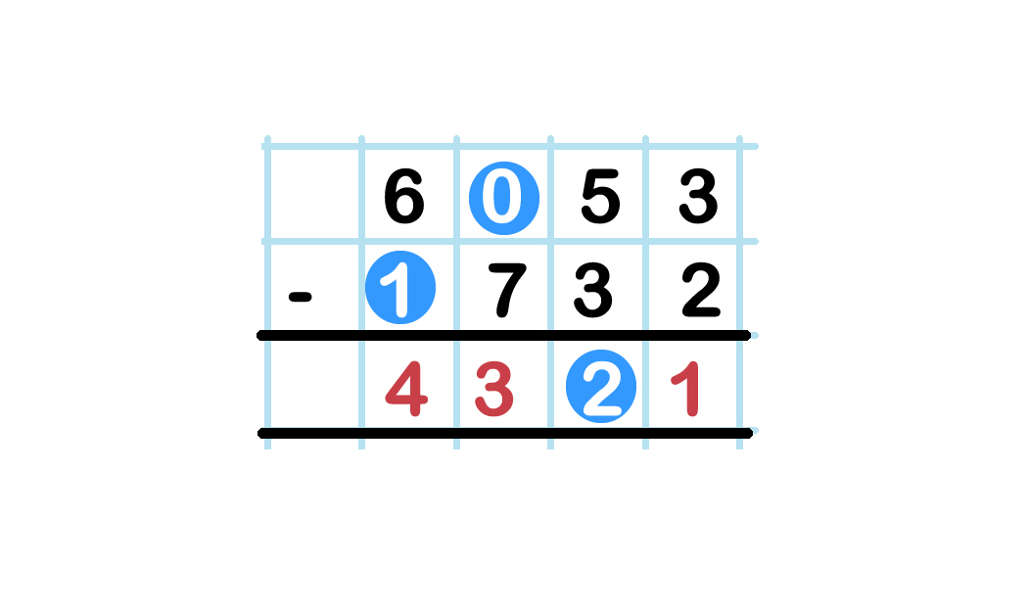
ACTIVITY 4:
Use your knowledge of column subtraction to work out the missing digits.

Slide 21
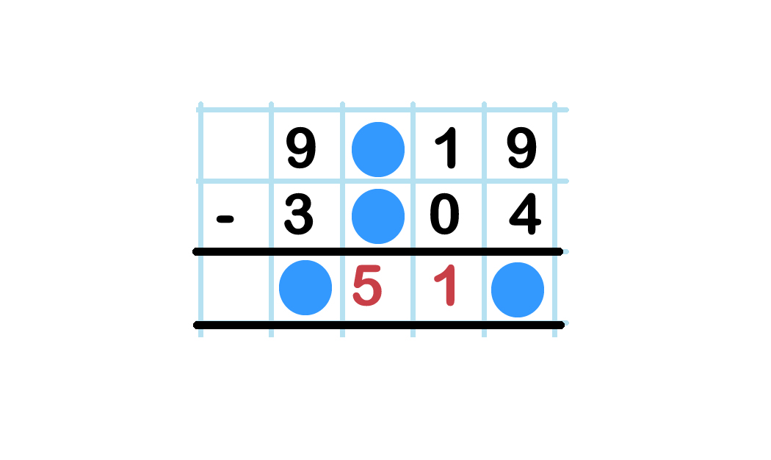
ACTIVITY 5:
What could this subtraction be?

Slide 22
ACTIVITY 5:
What could this subtraction be?
The ones digit in the answer is 5. The thousands digit in the answer could be 6 (if there is no need to exchange in the hundreds column) or possibly 5 (if there is an exchange in the hundreds column. So the answer could be 6,515 or 5,515.
For example:
9,919 – 3,404 = 6,515 9,419 – 3,904 = 5,515
9,819 – 3,304 = 6,515 9,319 – 3,804 = 5,515
9,719 – 3,204 = 6,515 9,219 – 3,704 = 5,515

Slide 23
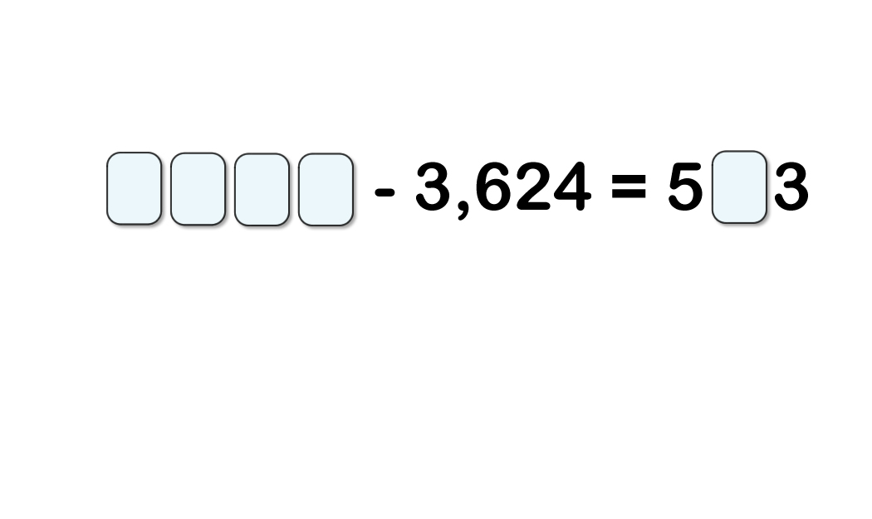
ACTIVITY :
What could the missing digits be?
There is more than one possible answer!

Slide 24
ACTIVITY :
What could the missing digits be?
There is more than one possible answer!
The possible digits in the answer must be 0, 1, 2, 3, 4, 5,
6, 7, 8 or 9. Working backwards, we can add 503, 513, 523 and so on to 3,624 to find the missing digits in the starting number.
The calculations are:
4,127 – 3,624 = 503 4,157 – 3,624 = 533 4,187 – 3,624 = 563
4,137 – 3,624 = 513 4,167 – 3,624 = 543 4,197 – 3,624 = 573
4,147 – 3,624 = 523 4,177 – 3,624 = 553 4,207 – 3,624 = 583
4,217 – 3,624 = 593
Extension:
Invent a similar open-ended problem for your friend to try.
Before you give it to them, make sure that you have worked out all the possible answers!

Slide 25
EVALUATION:
True or False?
a) You will need to exchange when finding the difference
between 7,251 and 5,140.
You will need to exchange when calculating 4,528 – 2,433.
When we exchange, the number being subtracted from does not change. It is exactly the same number, but is simply rearranged to help subtract more easily.
10 hundreds can be exchanged for 10 thousands.

Slide 26
EVALUATION:
True or False?
a) You will need to exchange when finding the difference
between 7,251 and 5,140. FALSE
You will need to exchange when calculating 4,528 – 2,433.
TRUE
When we exchange, the number being subtracted from does not change. It is exactly the same number, but is simply rearranged to help subtract more easily. TRUE
10 hundreds can be exchanged for 10 thousands. FALSE

Slide 27


