Slide 2
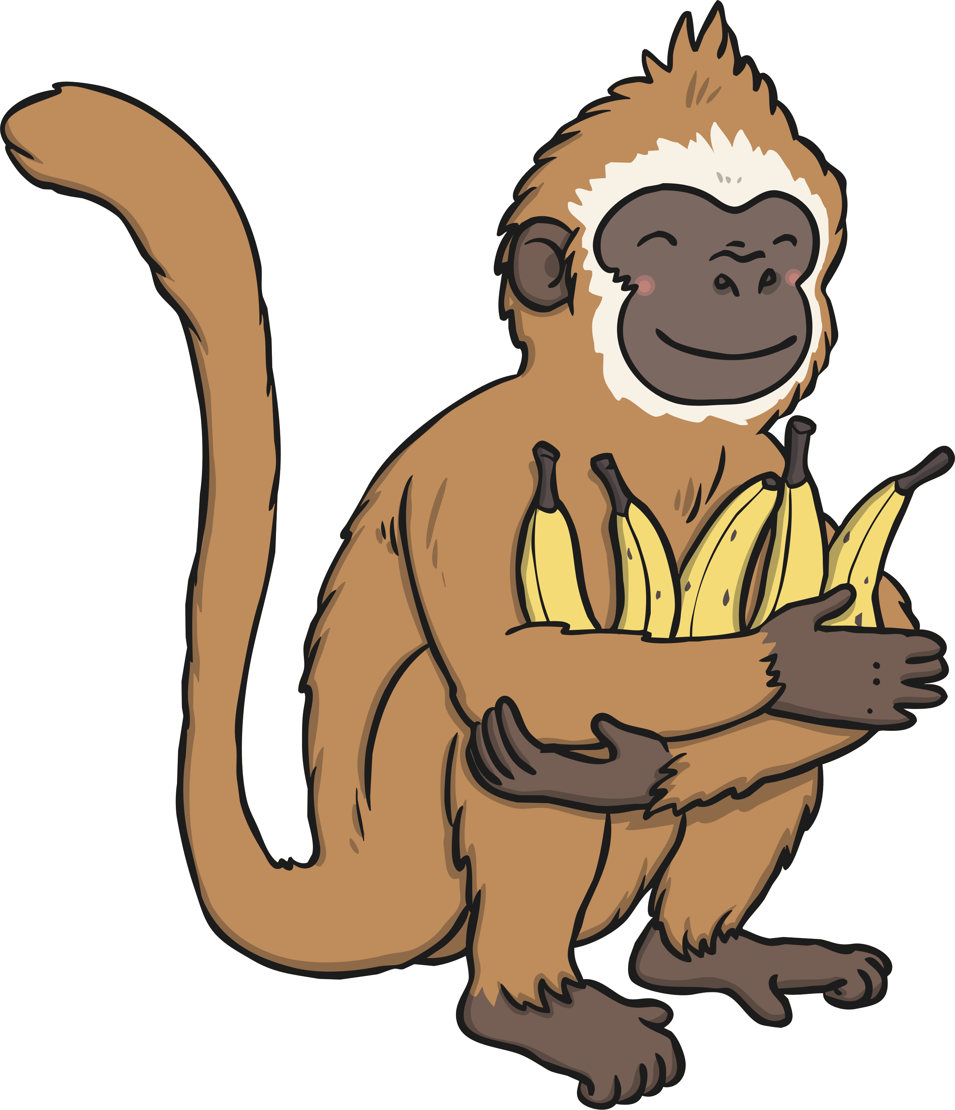
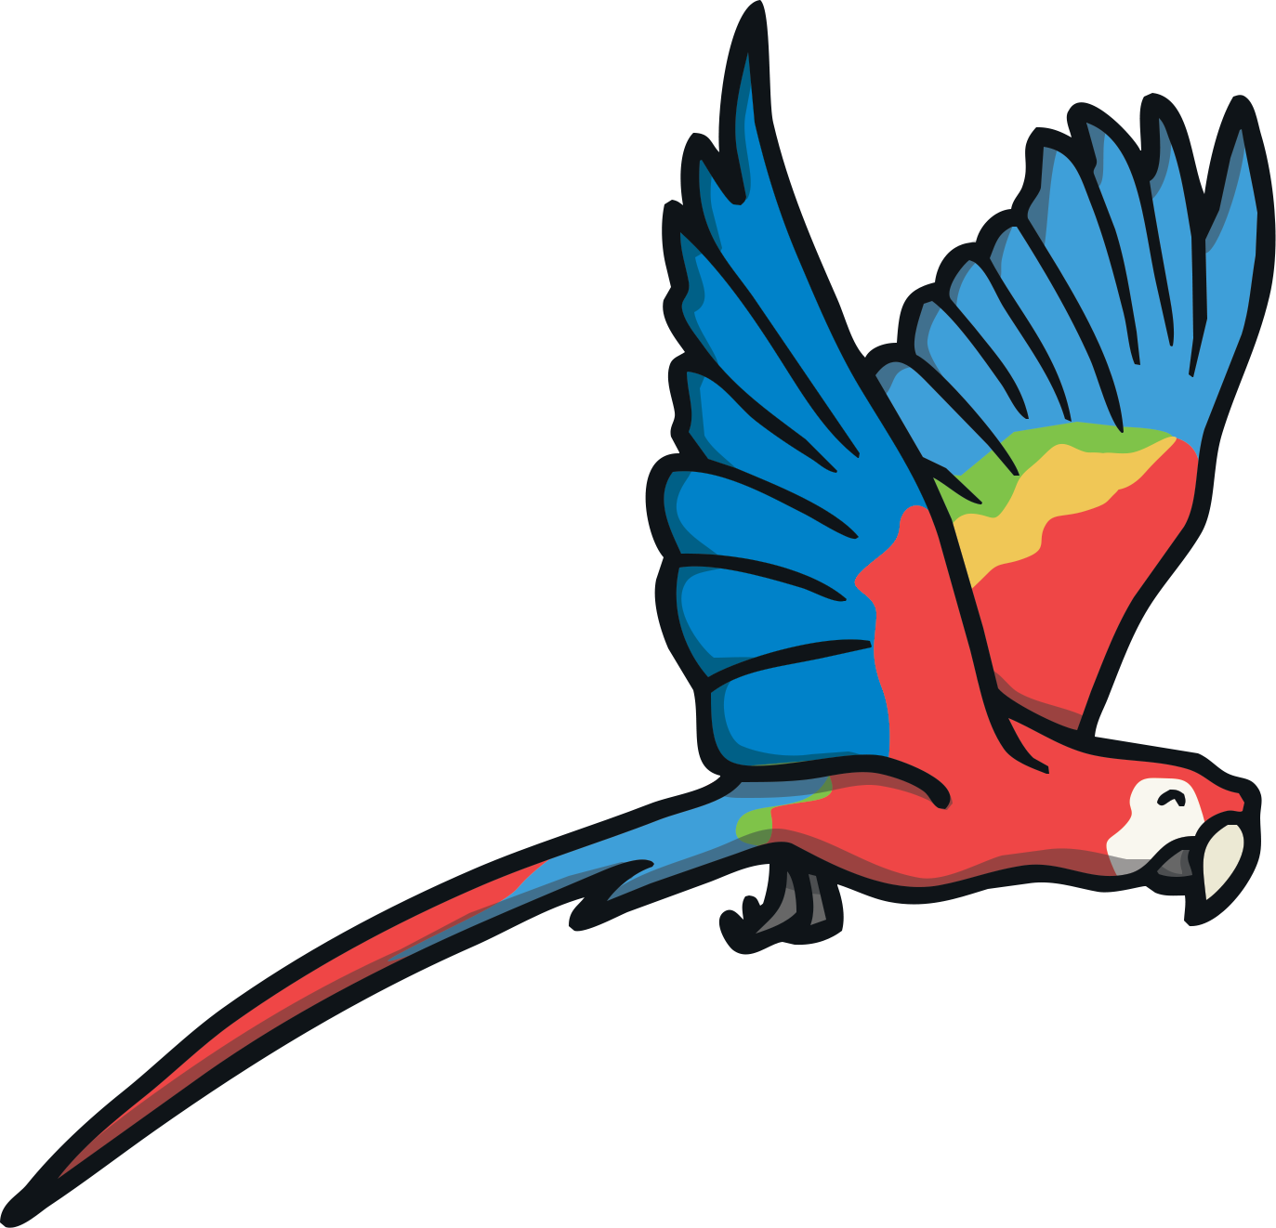
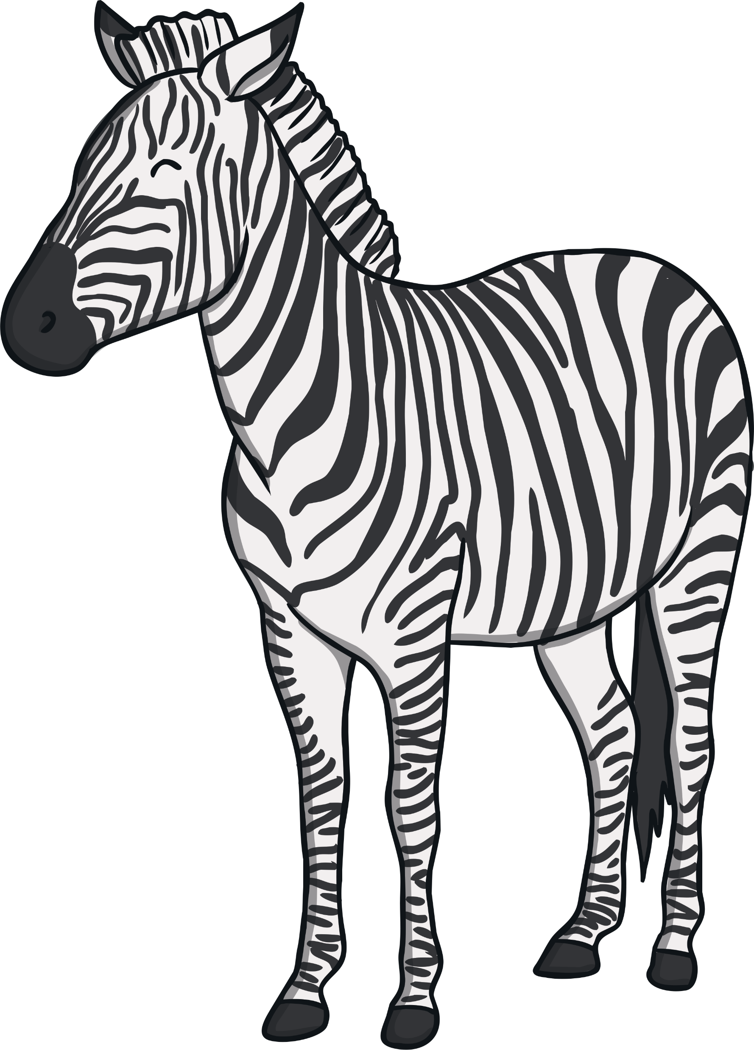
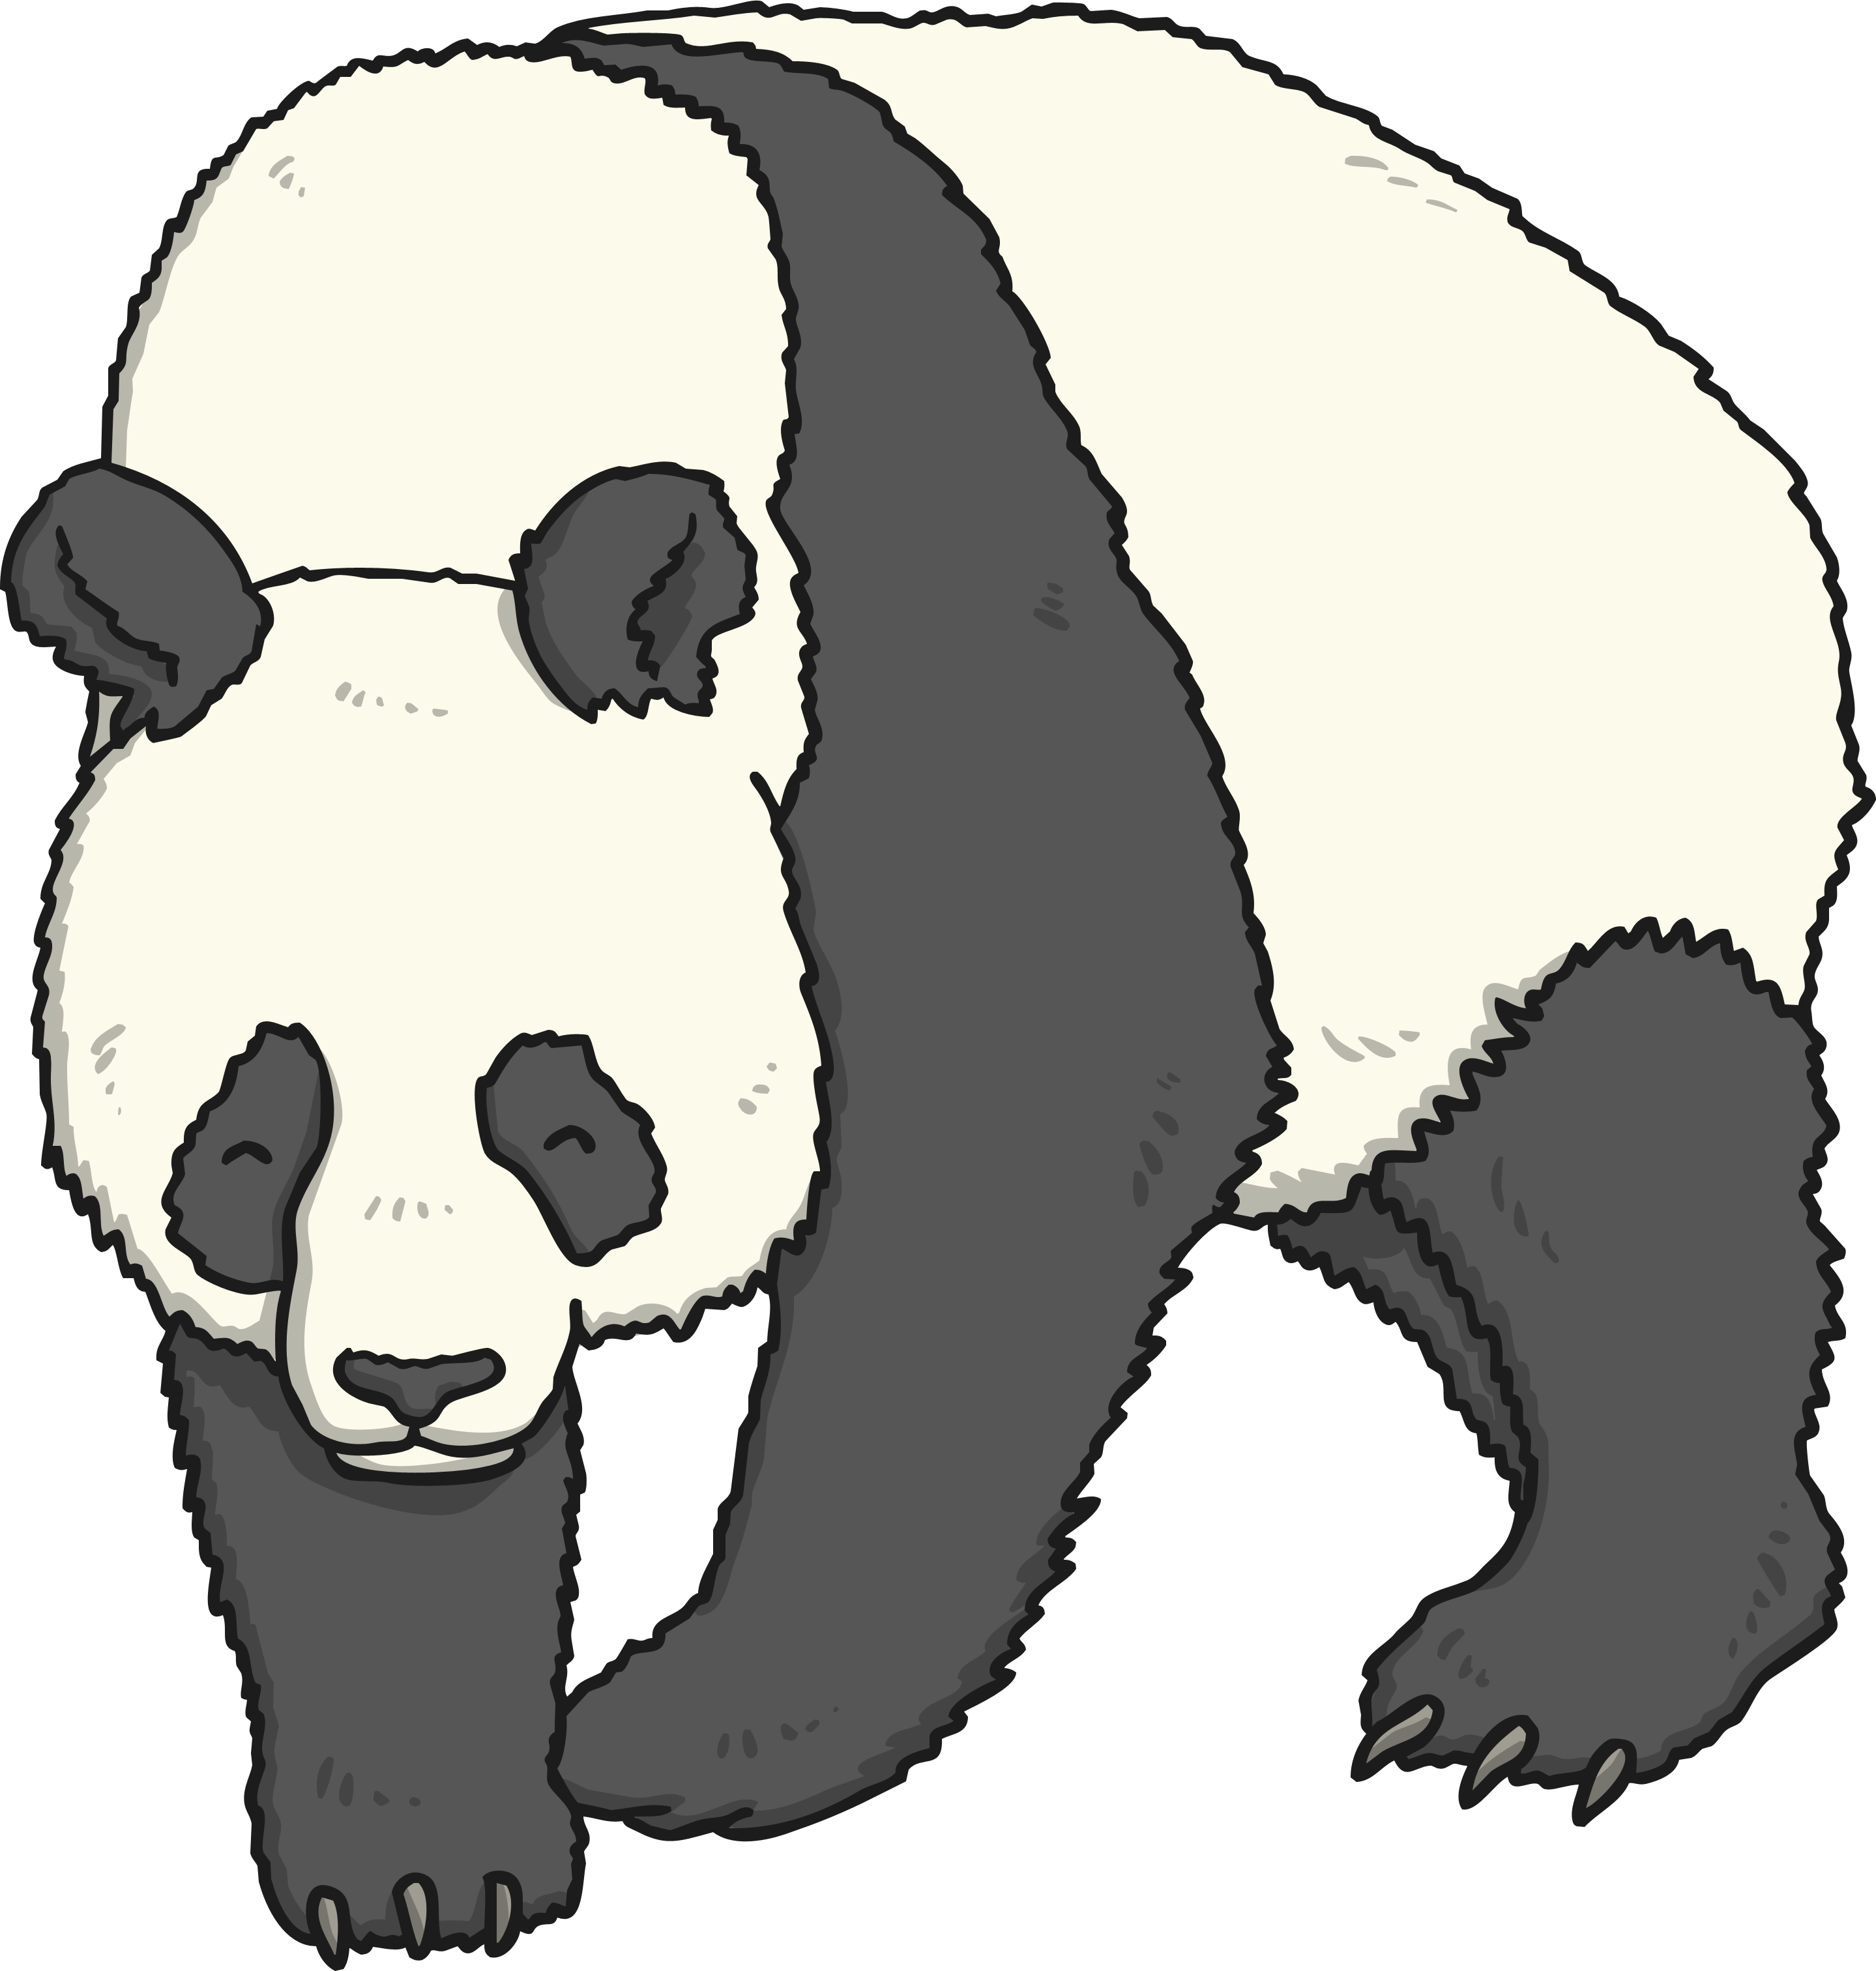
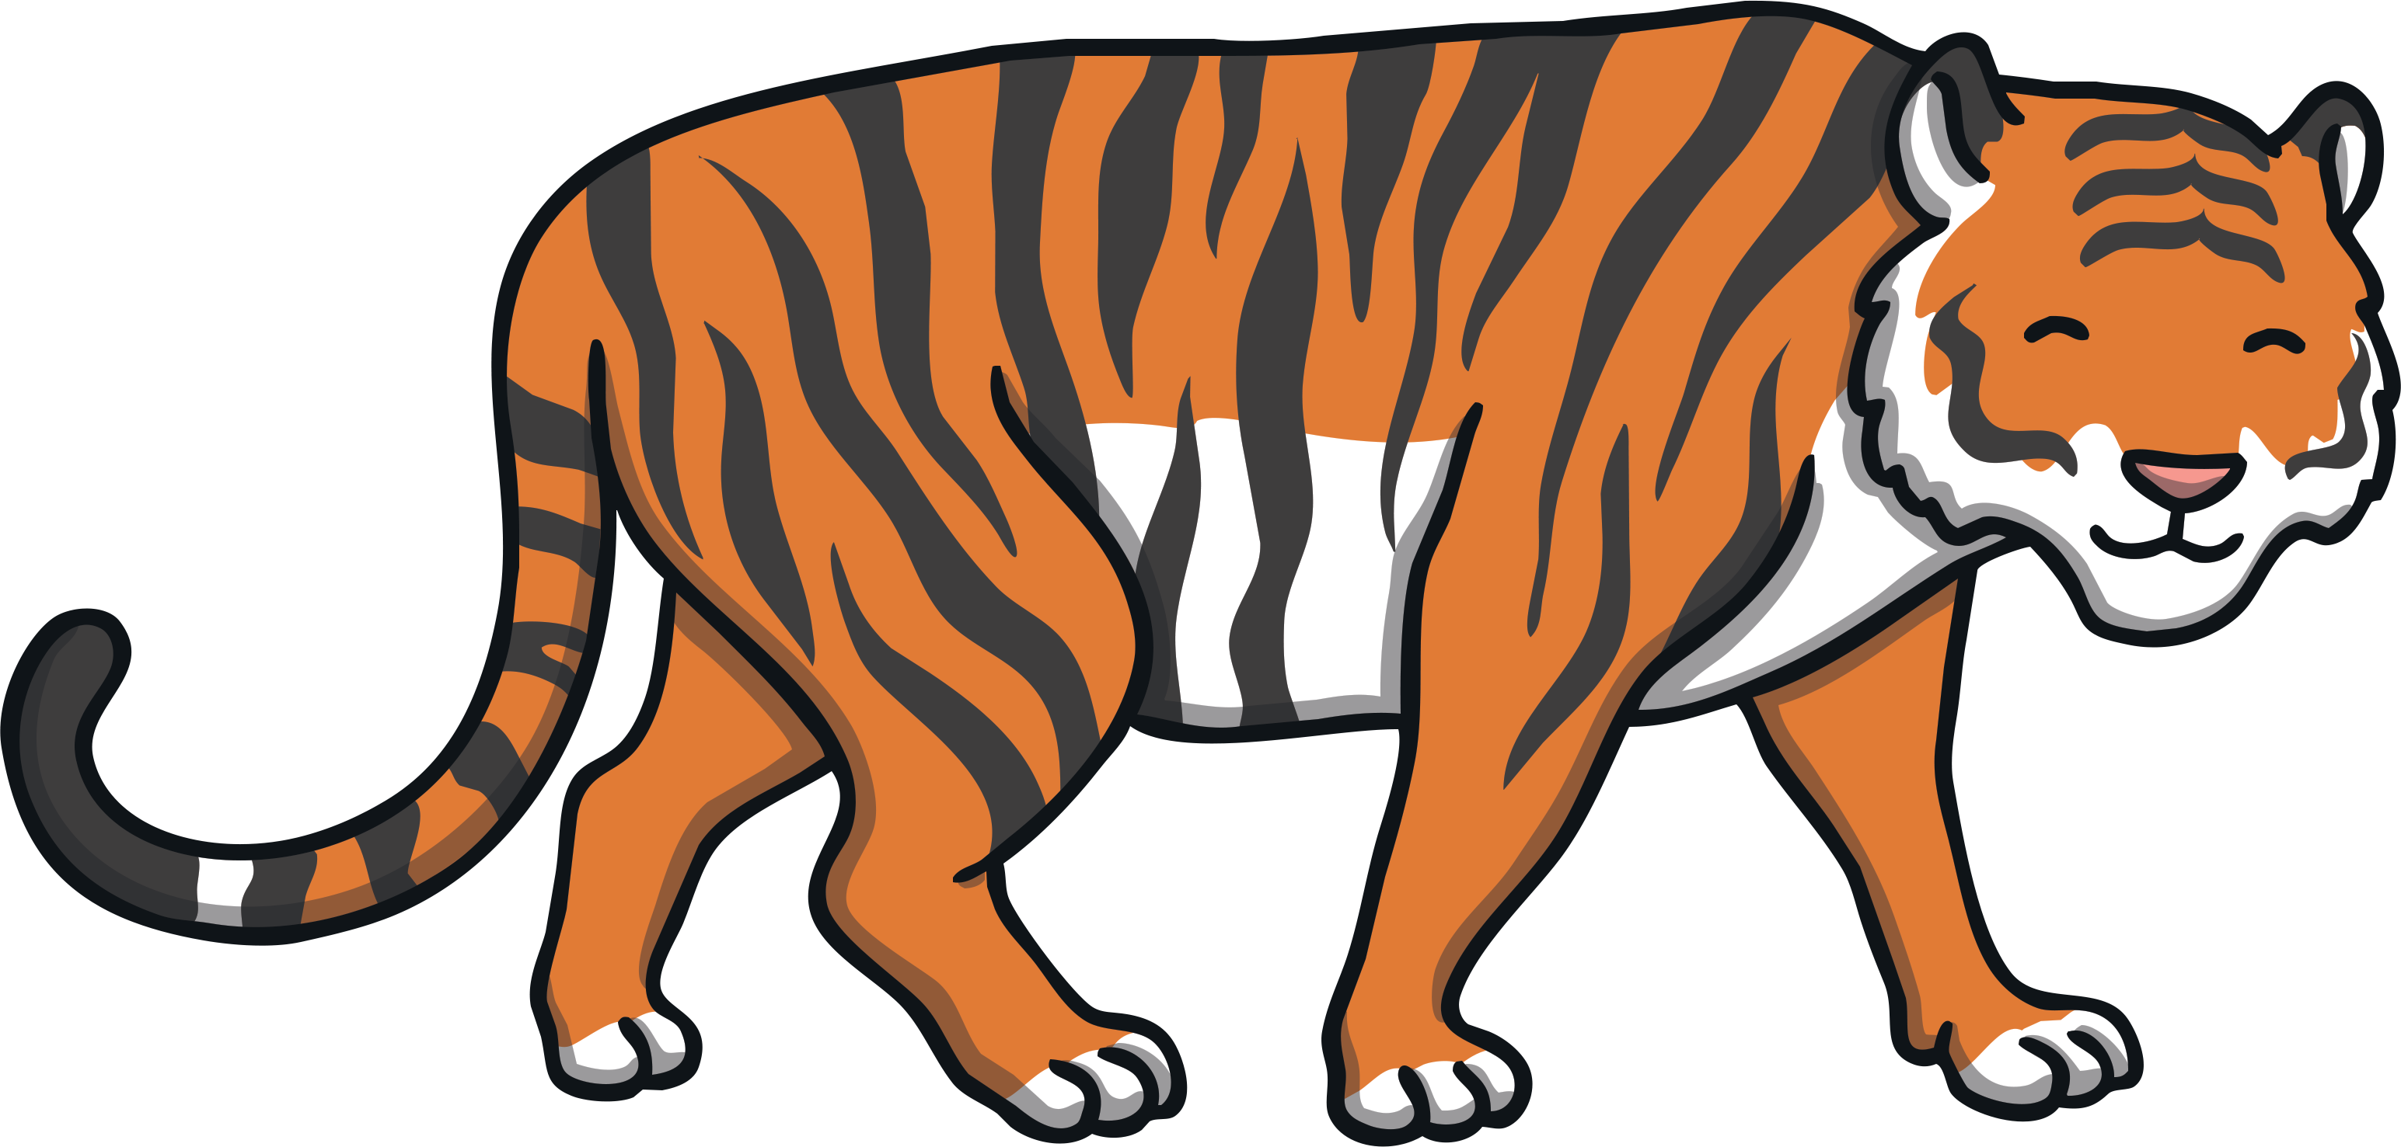
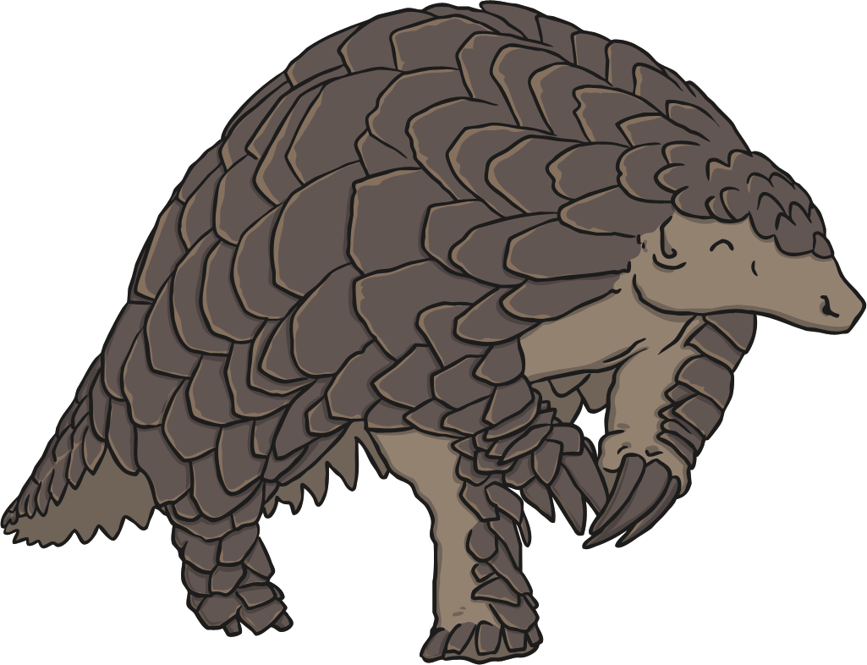
Our Planet
Our planet is amazing and beautiful. It is filled with lots of amazing plants and animals.
What is your favourite animal? Why is it your favourite?

Slide 3
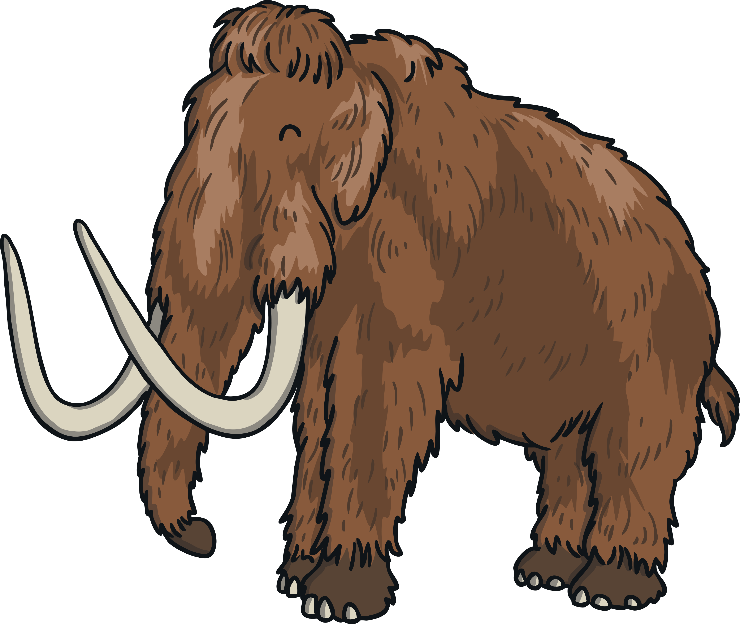
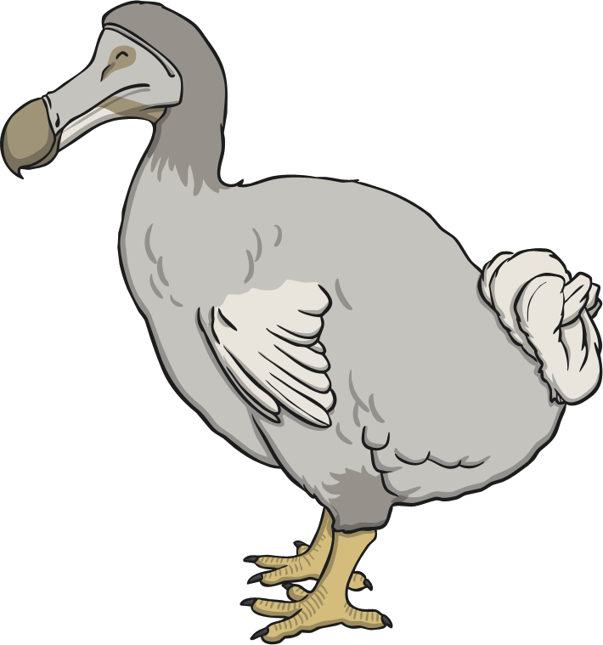
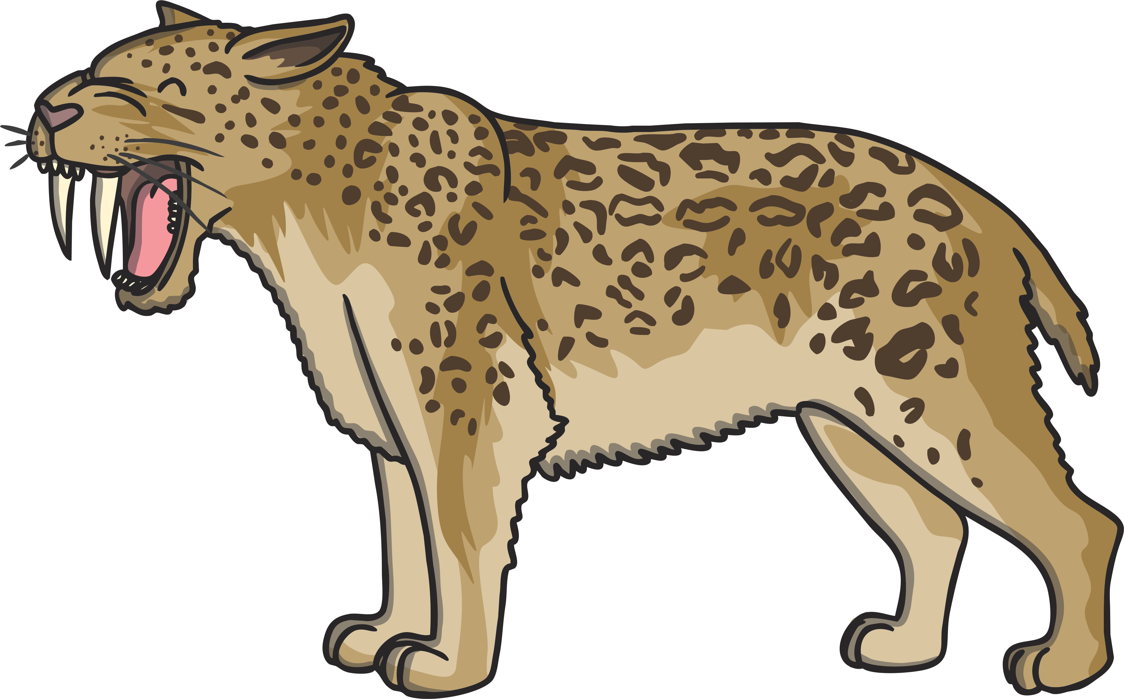
Plants and Animals
There are lots of different plants and animals on our planet.
Sadly, some plants and animals have become extinct. That means that there aren’t any of them on our planet anymore.
Have you heard of these extinct animals?
Dodo
Woolly Mammoth
Sabre-toothed Cat

Slide 4
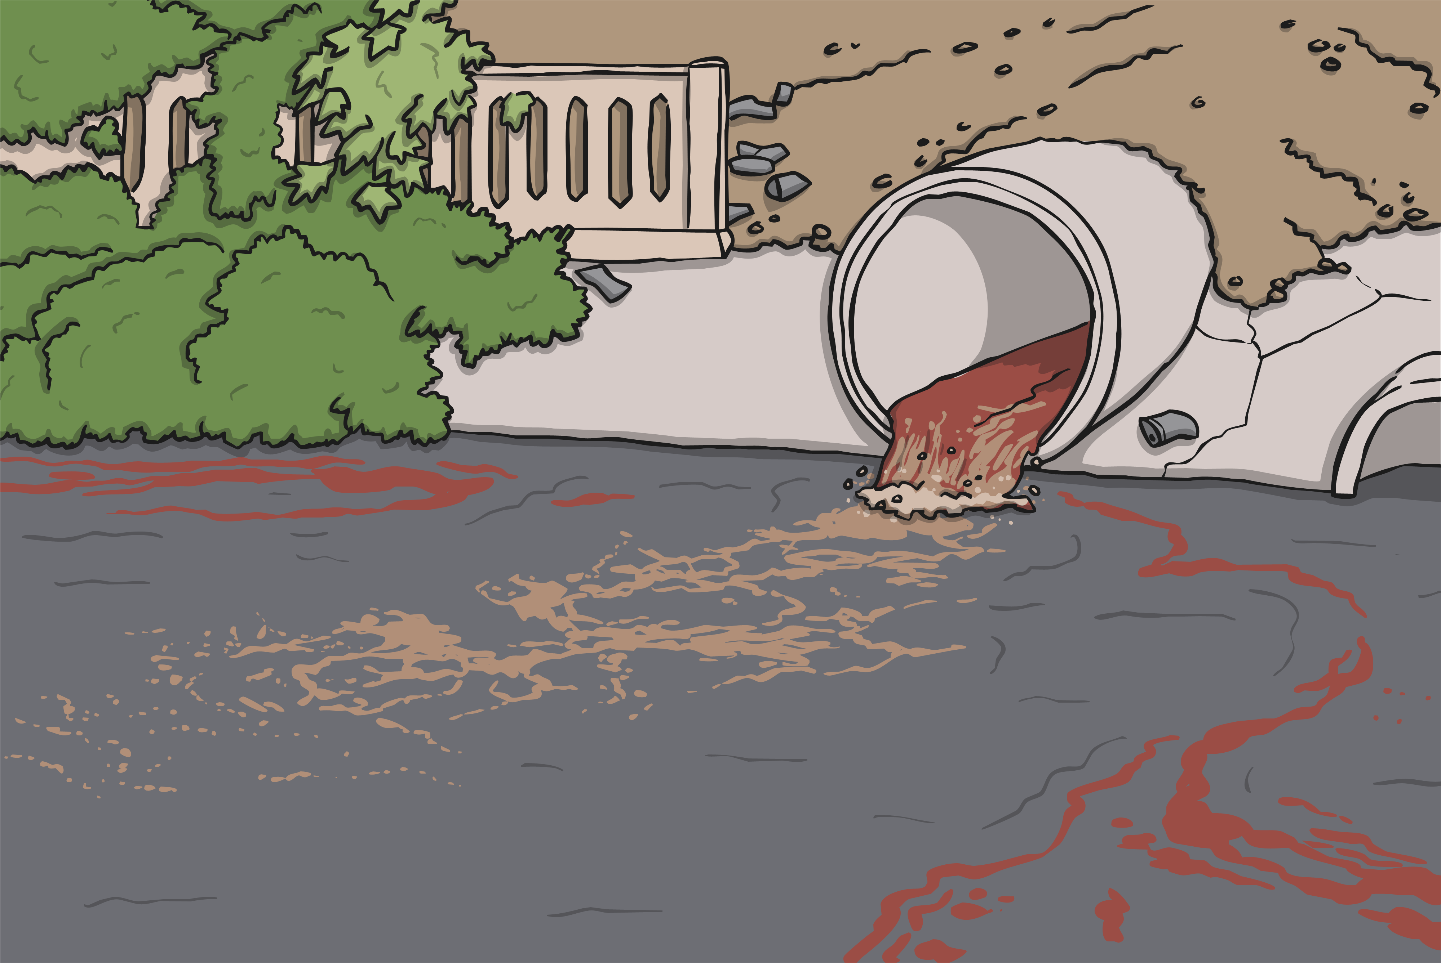
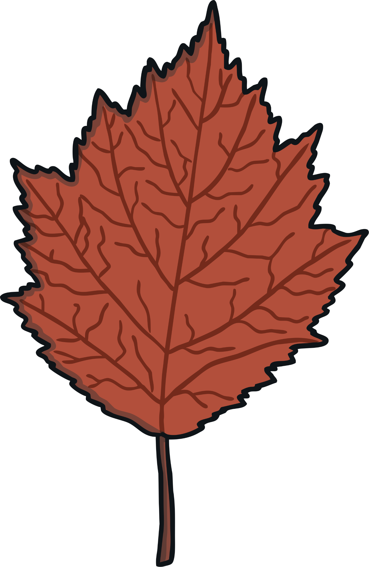

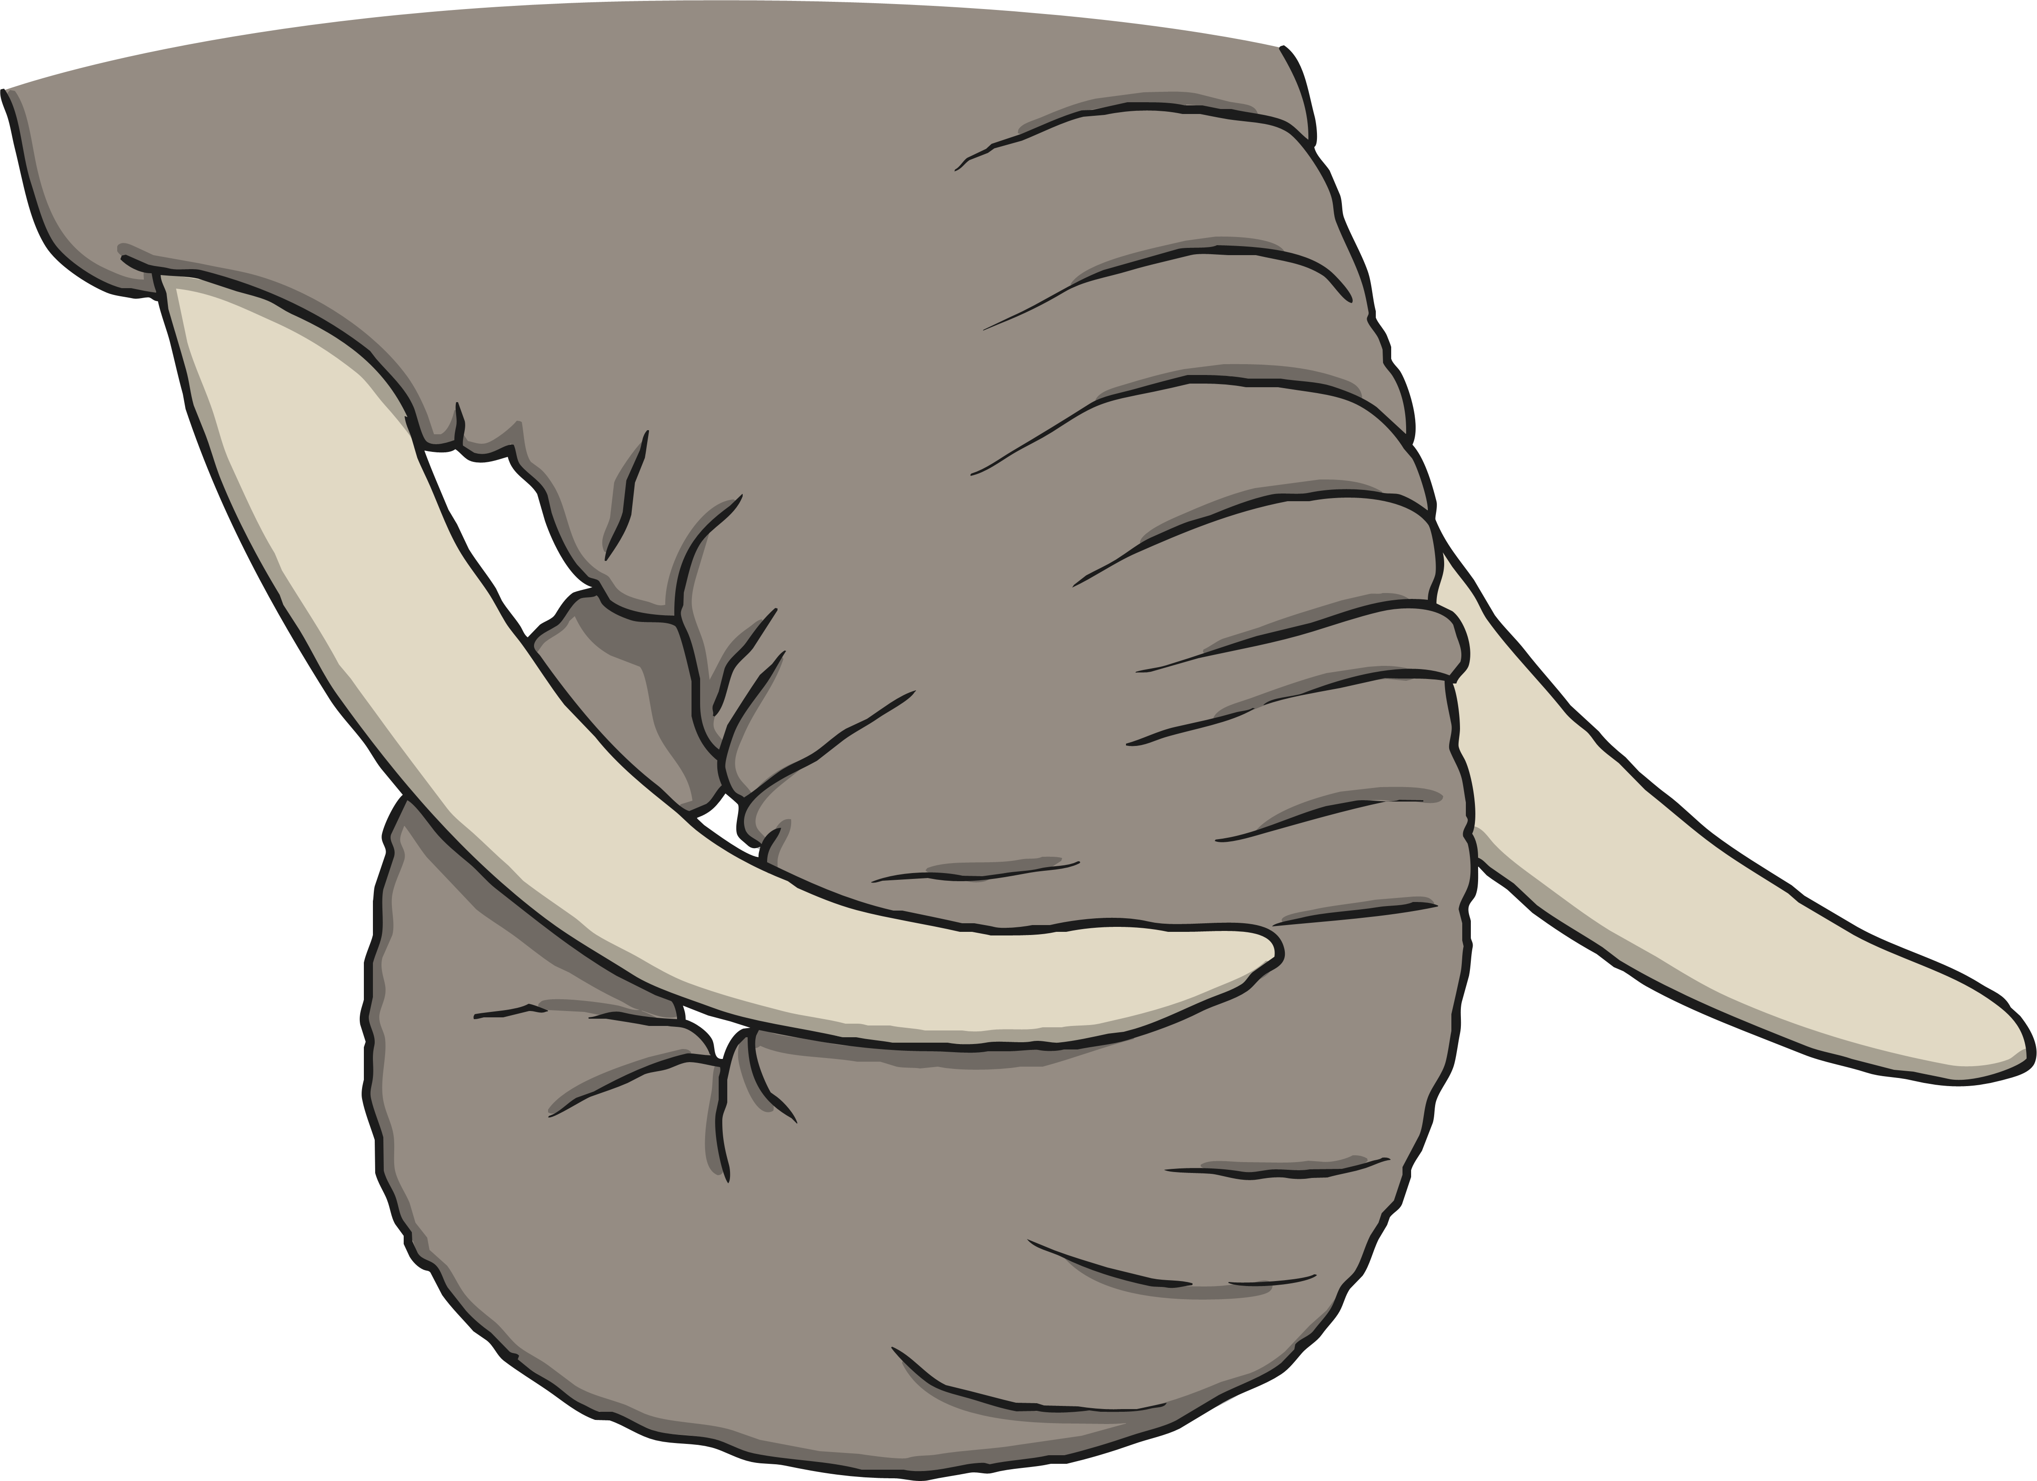
What Hurts Plants and Animals?
Pollution, such as smoke in the air, litter and oil, can hurt animals and plants.
Animals’ homes are being damaged, for example forests might be cut down so an animal has nowhere to live and no food.
Some people kill animals, such as elephants. This is against the law and called poaching.

Slide 5
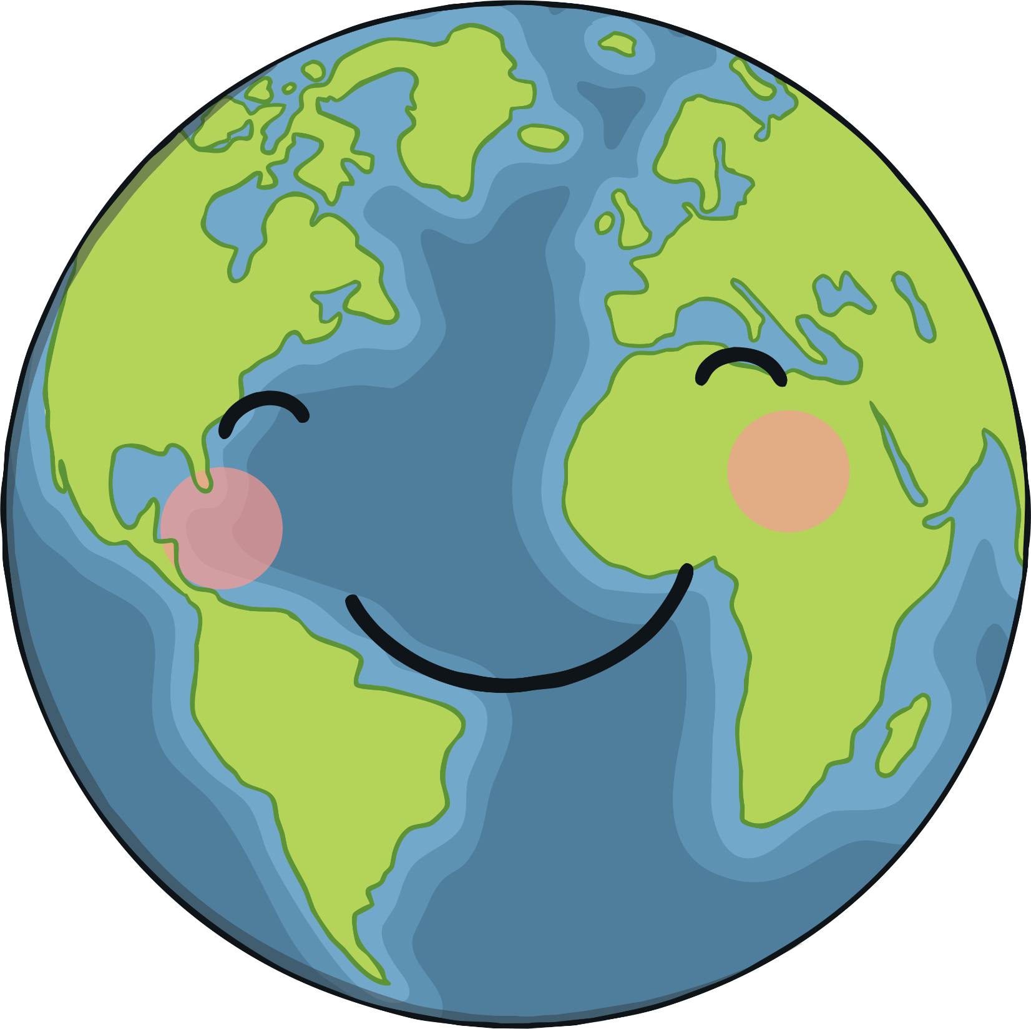

Earth Day
Earth Day is a special time when people think about how to look after our planet. It is on 22nd April.
This year, Earth Day is trying help stop animals and plants from becoming extinct.

Slide 6
What Can We Do to Help?
There are lots of things we can do to help, not only on Earth Day, but all year round.
Reuse and Recycle
Food
Habitats
Think about
where your food is coming from and how it is made. Did you know, 1,414 species of fish are at risk
of extinction?
Try to reuse any plastics if possible and recycle as much as you can.
Why not have a go at making your own habitats – you could make a bug hotel or wormery!

Slide 7
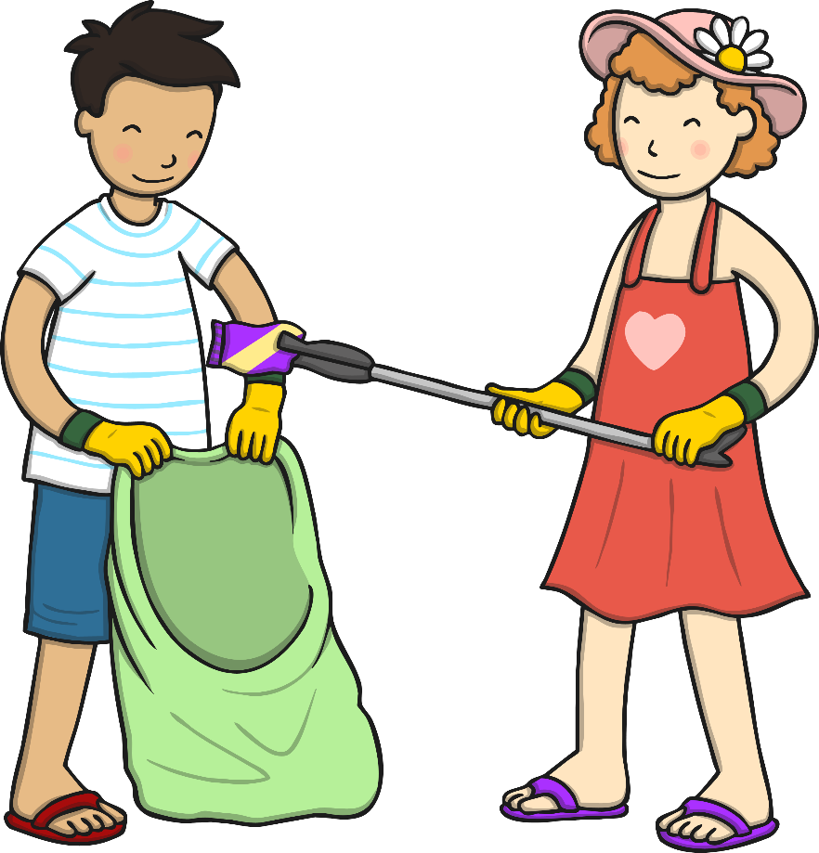
What Can We Do to Help?
Another way you could help is to pick up litter. Make sure you have a grown up with you when you are doing this and wash your hands after.
Also, try to walk, use a bike, bus or train as much as you can to help make less pollution.

