Slide 2



Diving into Mastery Guidance for Educators
Each activity sheet is split into three sections, diving, deeper and deepest, which are represented by the following icons:
These carefully designed activities take your children through a learning journey, initially ensuring they are fluent with the key concept being taught; then applying this to a range of reasoning and problem-solving activities.
These sheets might not necessarily be used in a linear way. Some children might begin at the ‘Deeper’ section and in fact, others may ‘dive straight in’ to the ‘Deepest’ section if they have already mastered the skill and are applying this to show their depth of understanding.
Diving
Deeper
Deepest

Slide 3
Aim
Recognise that shapes with the same areas can have different perimeters and vice versa.

Slide 4

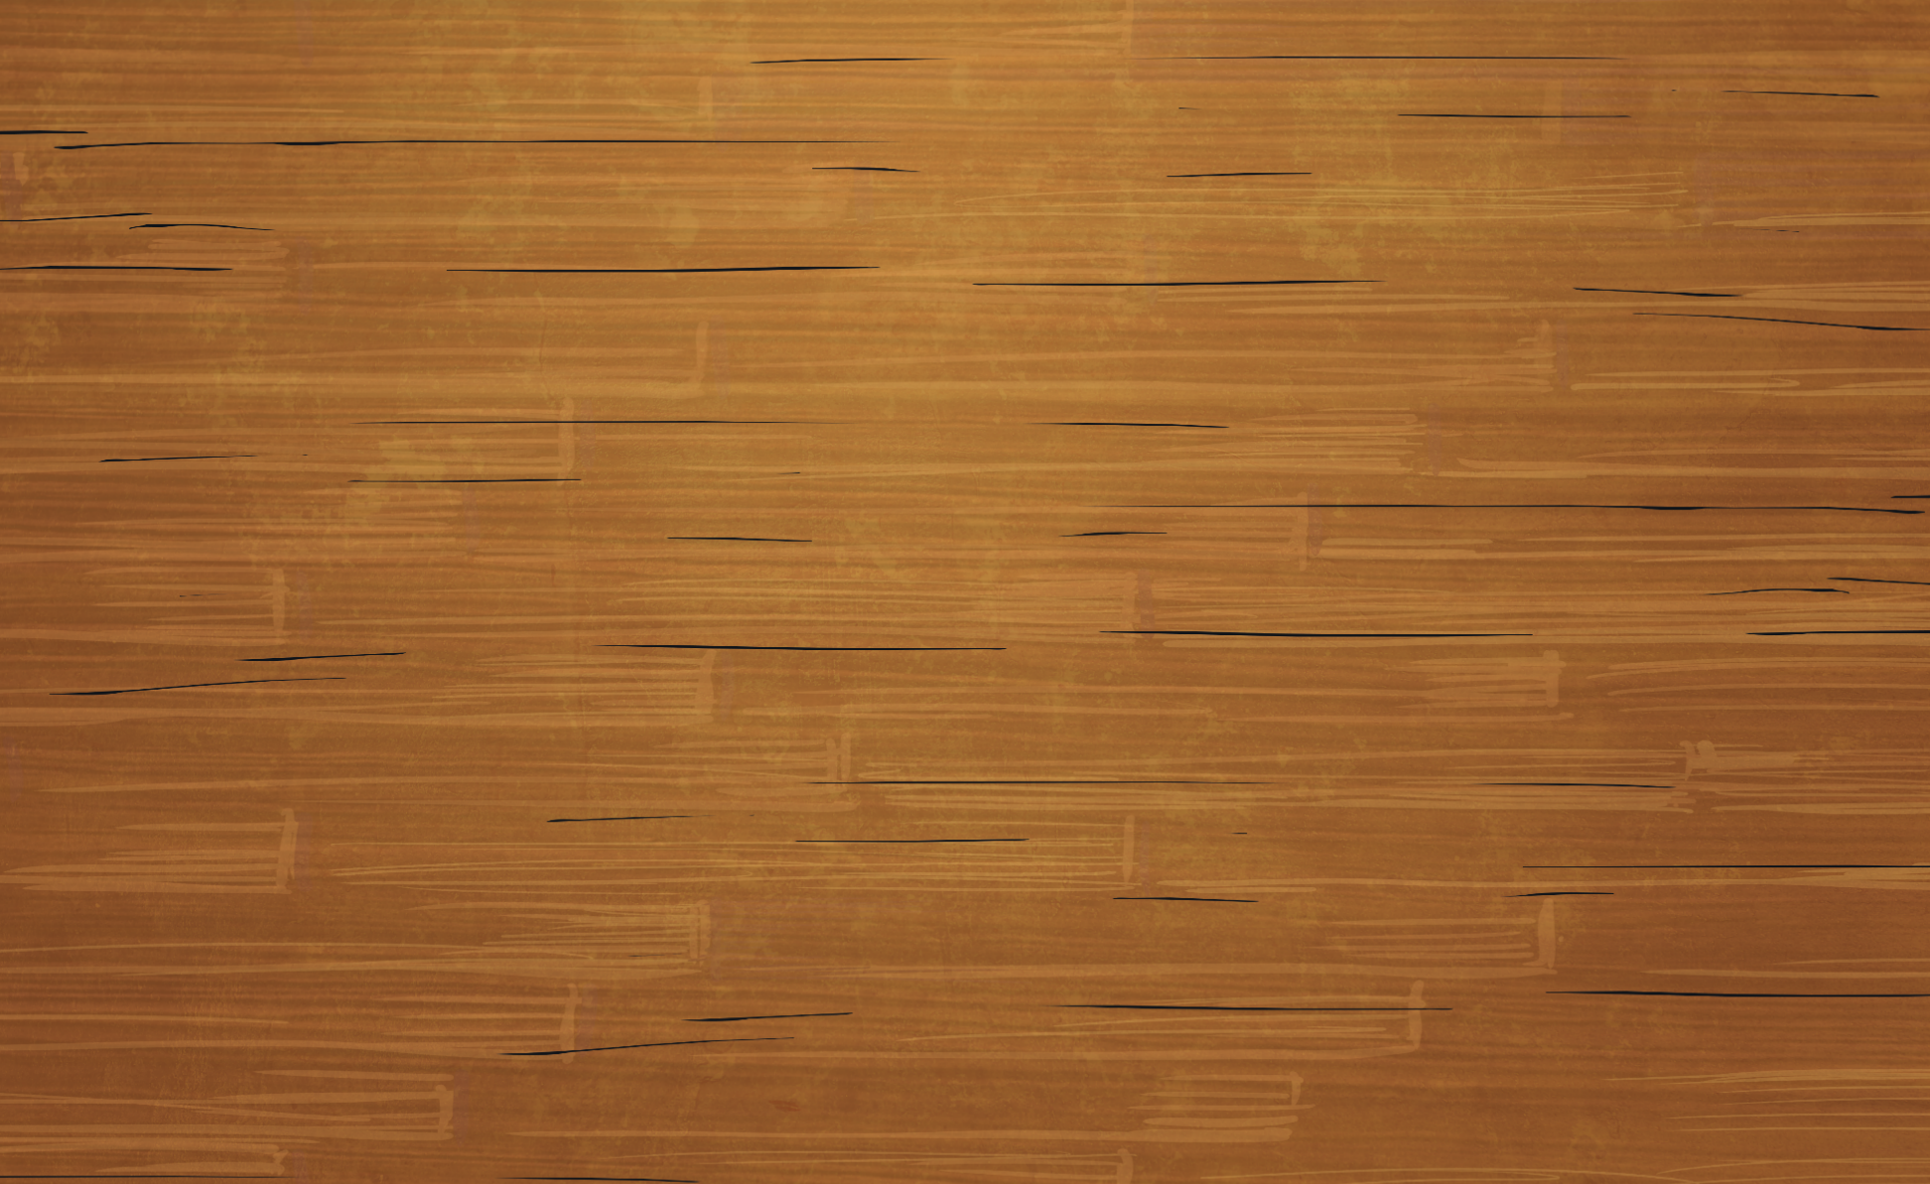





Area and Perimeter
Diving
Perimeter =
Area =
44cm
Perimeter =
Area =
23cm
Give the missing values for the blue shapes (not to scale).
96cm²
28cm²
6cm
3.5cm
18cm
This shape
can be split into two rectangles. We can work out the area of each rectangle separately
then add the two area measurements together
to find the total area
of the shape.
8cm
8cm × 18cm = 144cm²
16cm
16cm
13.4cm
8cm × 4.6cm
= 36.8cm²
8cm
8cm
Perimeter =
Area =
68cm
4.6cm
180.8cm²

Slide 5
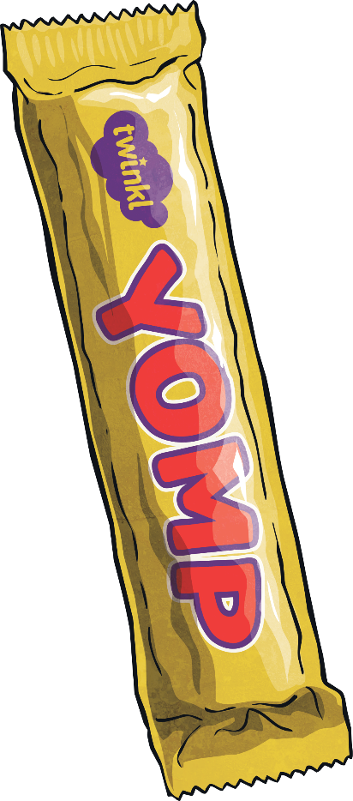
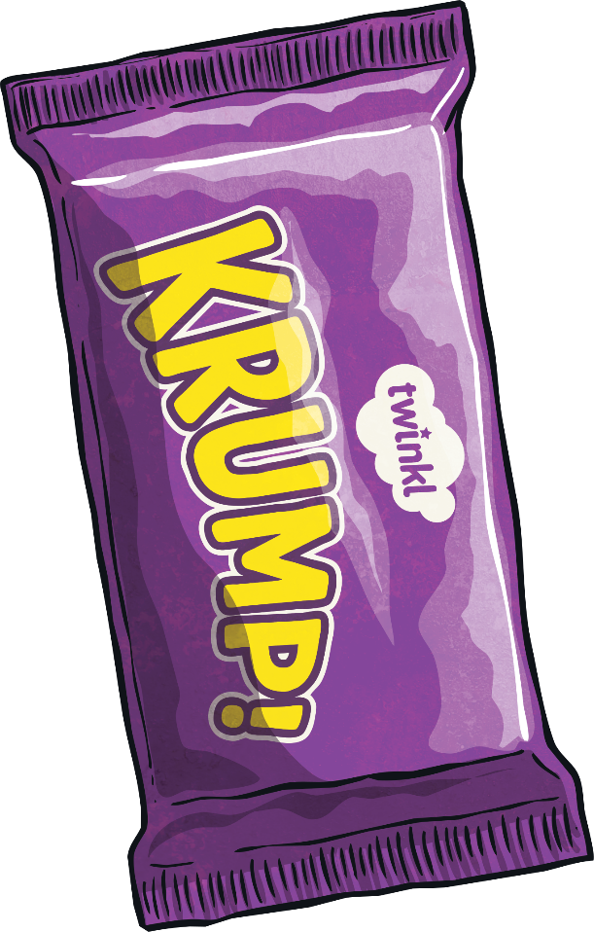
Area and Perimeter
Diving
12cm
Give the missing values for the shapes (not to scale).
20
mm
60cm
Perimeter =
Area =
28cm
24cm²
4
cm
Perimeter =
Area =
20cm
24cm²

Slide 6

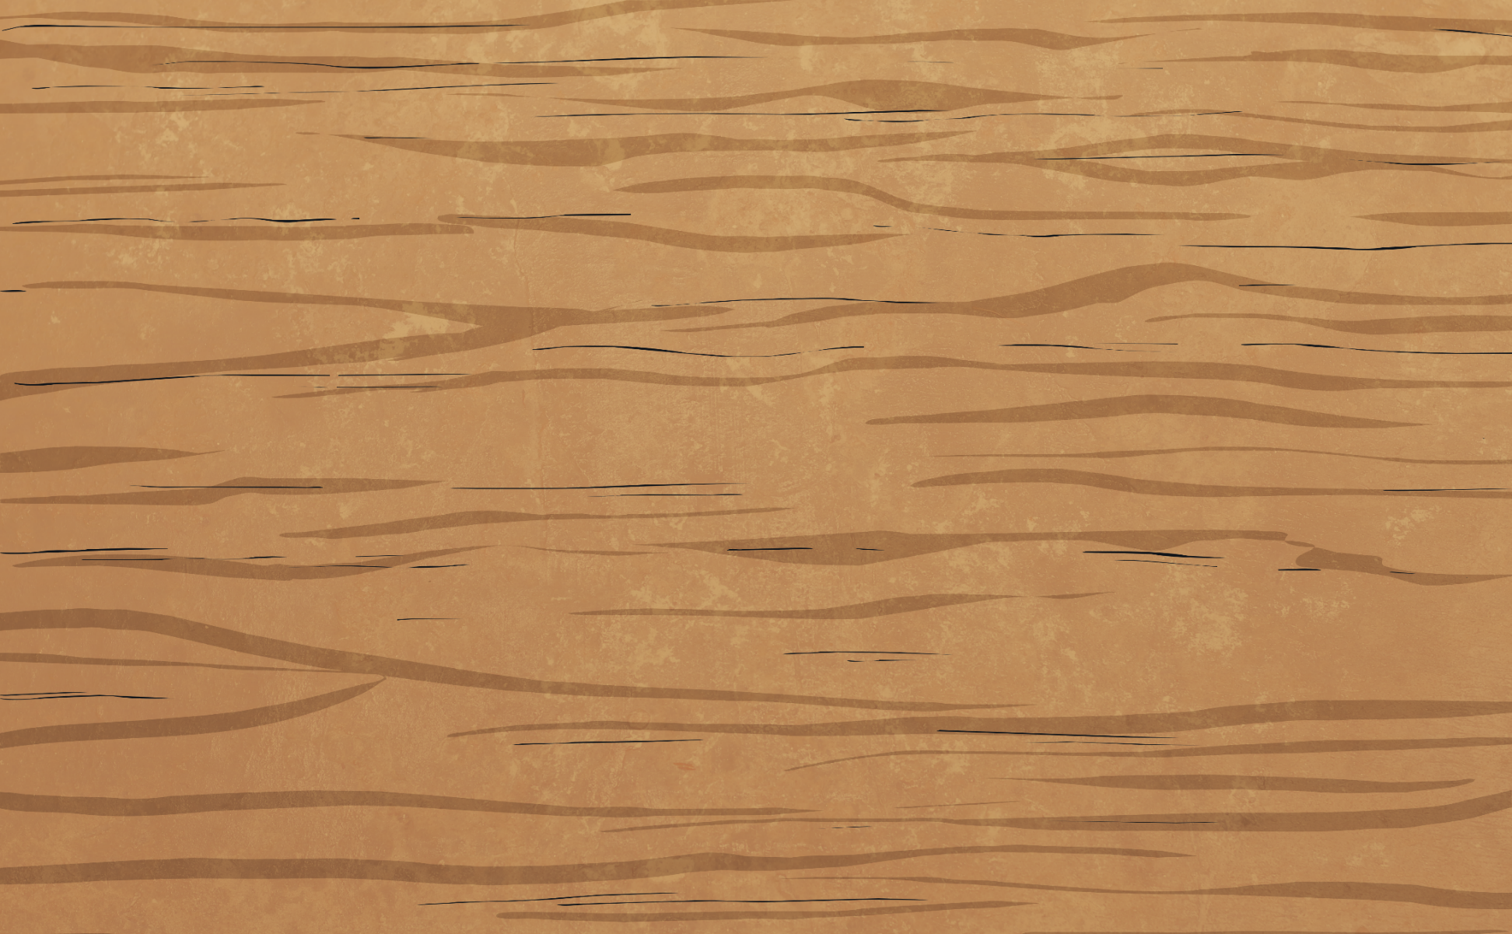
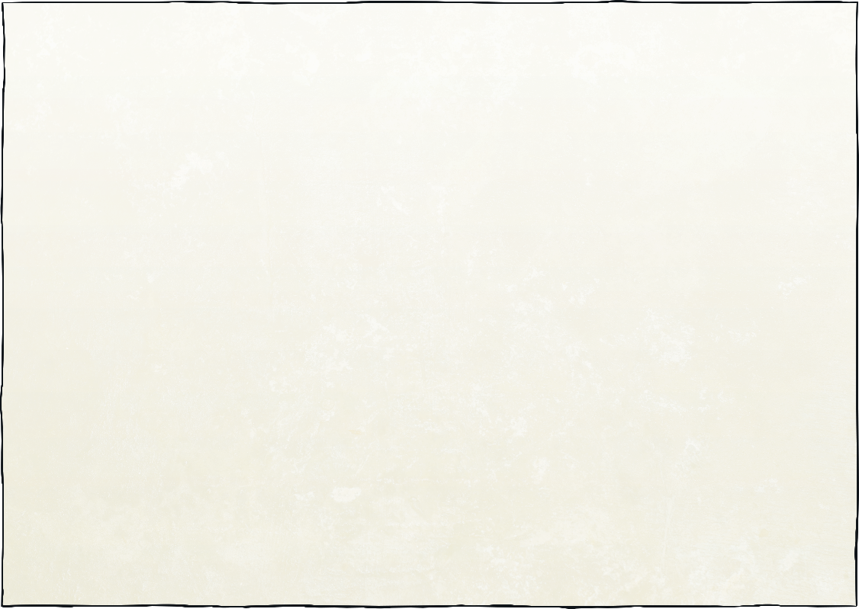
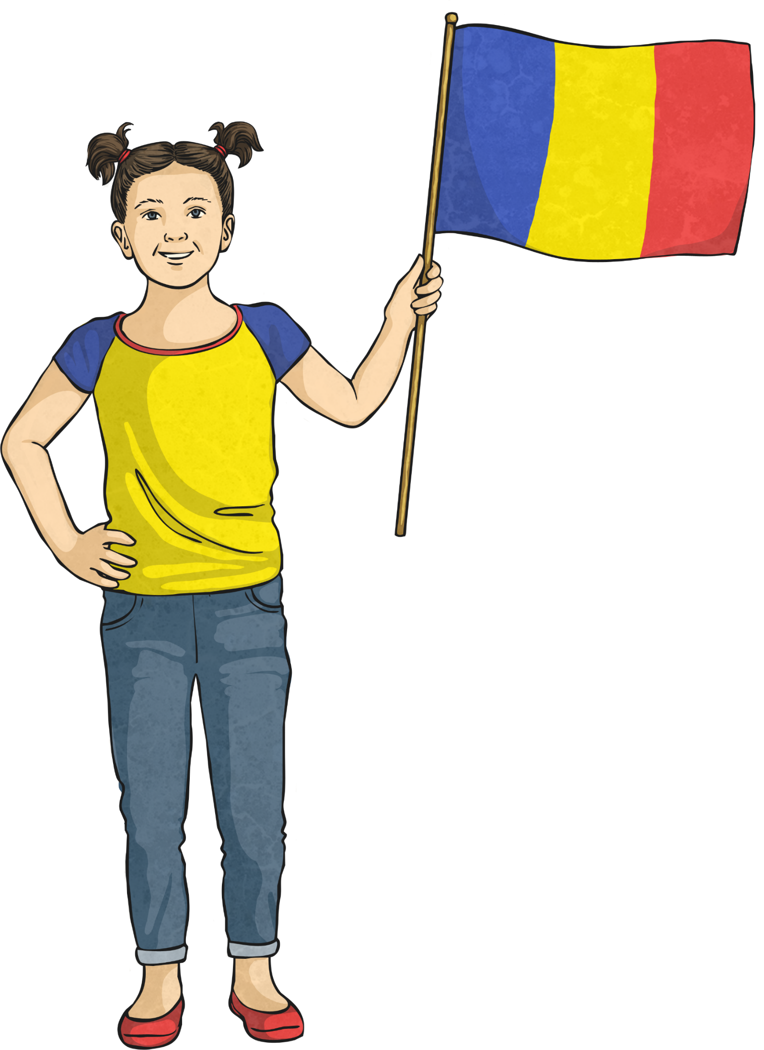
Area and Perimeter
Deeper
True. An 8cm × 8cm square will have an area that is twice its perimeter. See example:
Is Ava’s statement true or false? Prove it by drawing an example shape!
Perimeter =
32cm
Area =
64cm²
Ava
I can draw a shape that has an area that is twice its perimeter.

Slide 7


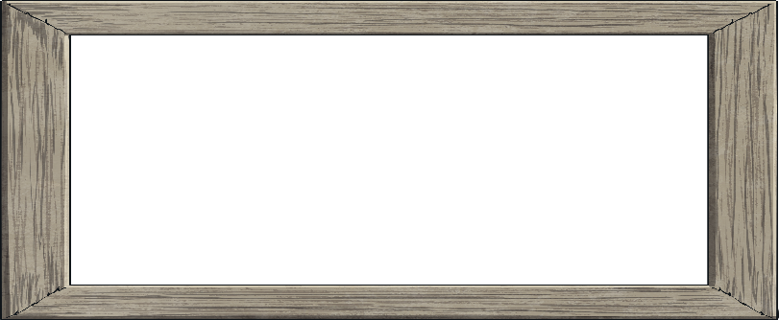
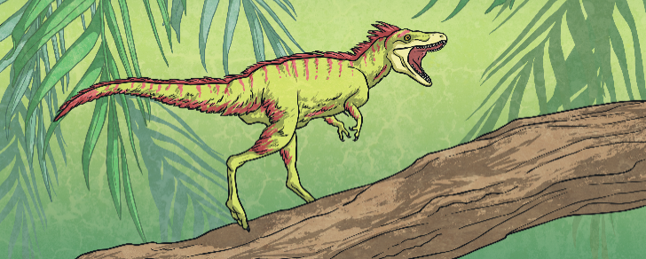

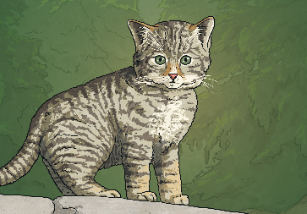


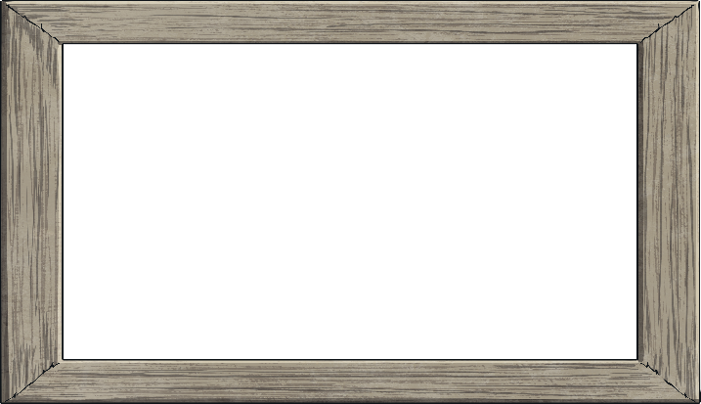
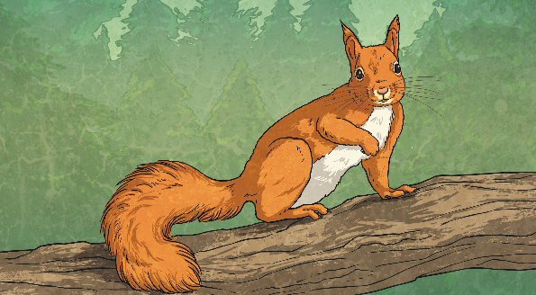
Area and Perimeter
Deepest
The price for each painting is based on the area of the canvas and the length of the wooden frame. Use the prices given to investigate how much the shop charges per square centimetre of canvas and per centimetre for the
wooden frame.
Each 1cm² of a painting =
£3 per cm²
A shop sells amazing miniature paintings with stylish wooden frames.
Each cm of the frame that will go along the outside edge of the painting =
£2 per cm
12cm
6cm
£128
2cm
£112
4cm
8cm
8cm
£172
5cm
£228
7cm

Slide 8
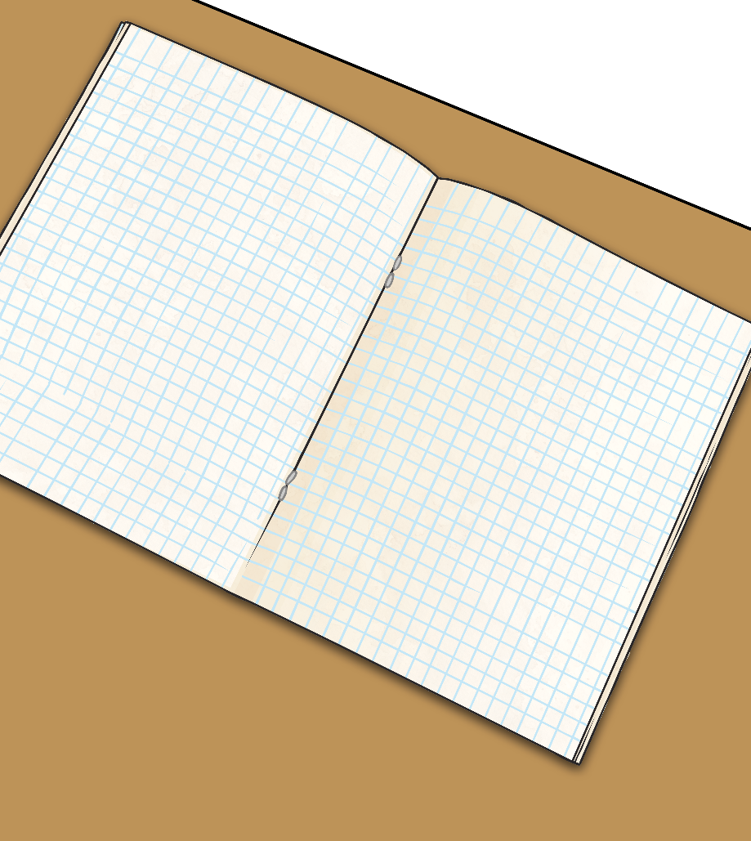
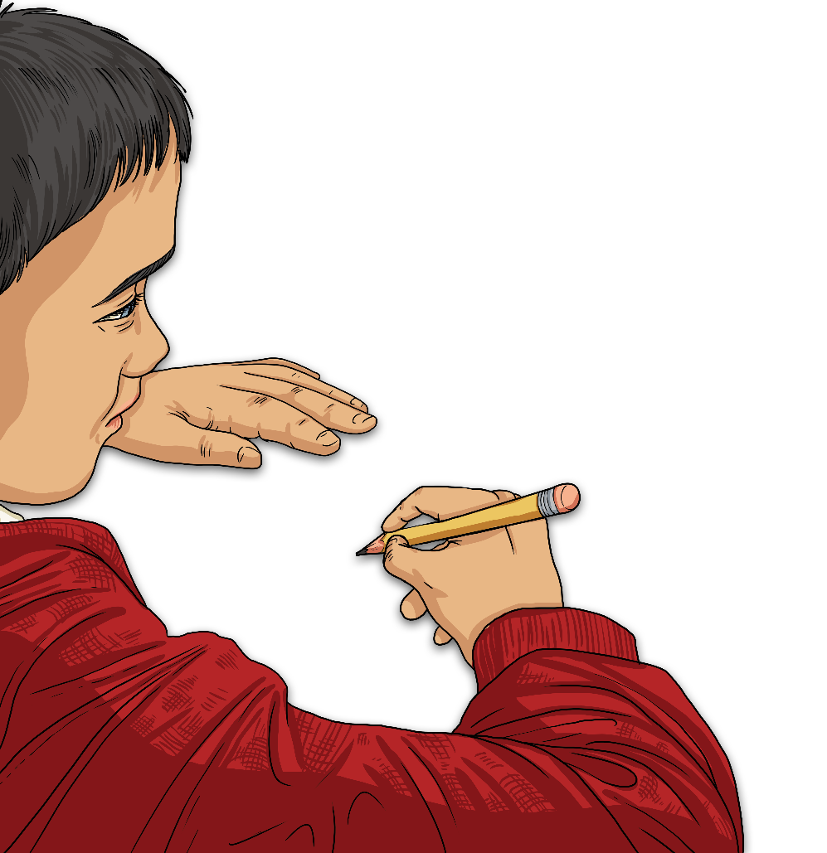
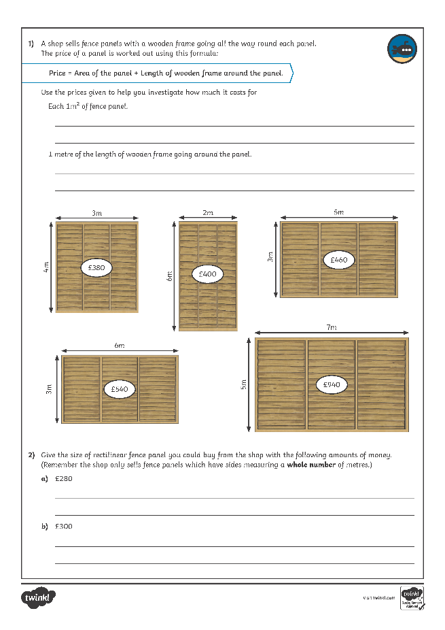
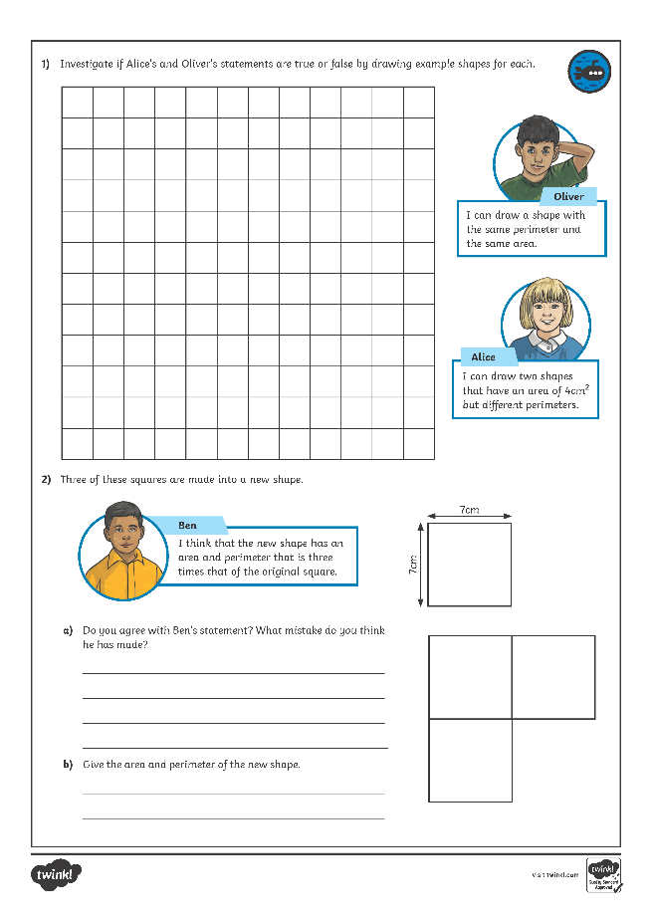
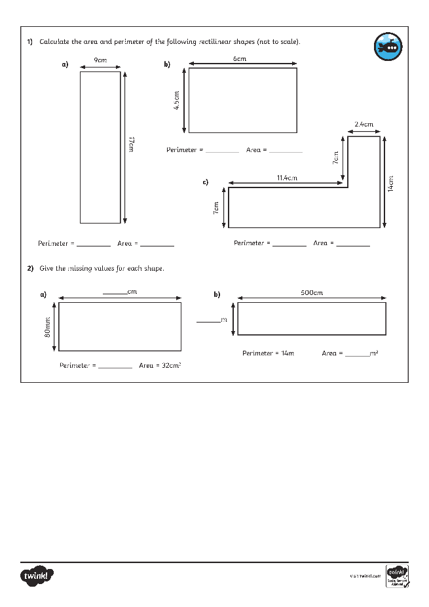
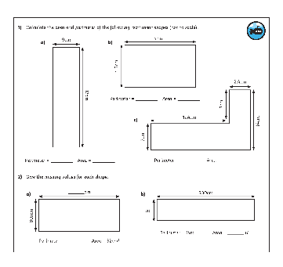
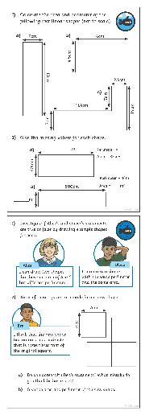
Area and Perimeter
Dive in by completing your own activity!

