Slide 1

Supporting children
Our weekly 1-to-1 online lessons are a fun, confidence-building experience for your pupils, and are aligned with the national curriculum for England and Wales.
Supporting schools
We offer flexibility and great value to fit schools’ busy timetables, and the assurance of world-class, maths specialist tutors in a safe environment.
In schools across the UK
We are the largest provider of online maths interventions in the UK. Every week we provide specialist 1-to-1 lessons to thousands of children in KS2 and KS3.

Slide 2
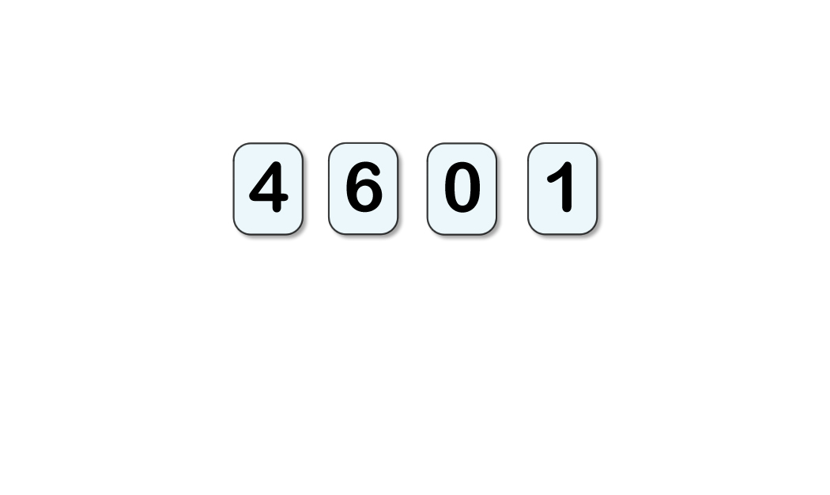
STARTER:
How many different 4-digit numbers can you make out of these
digits?
What is the largest number? What is the smallest number?
Can you think of a way to work methodically, so that you make sure you think of all possible answers?

Slide 3
STARTER:
How many different 4-digit numbers can you make out of these
digits?
What is the largest number? What is the smallest number?
Extension:
Georgia says, “I would have thought that the smallest number would be the largest number backwards.”
Explain why this is not correct for this set of digits. Could it be correct for a different set of digits? Why?
There are 18 possible answers:
1,046 1,064 1,406 1,460 1,604 1,640
4,016 4,061 4,106 4,160 4,601 4,610
6,014 6,041 6,104 6,140 6,401 6,410
The largest number is 6,410 and the smallest number is 1,046.

Slide 4
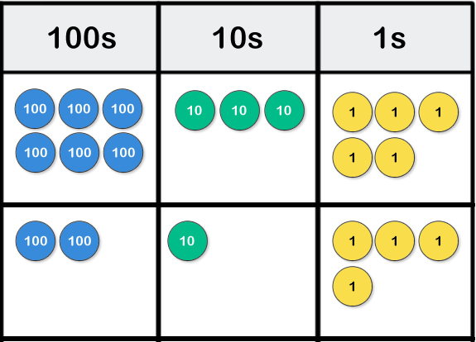
TALKING TIME:
Use your knowledge of adding 3-digit numbers to find the
total of 635 and 214.

Slide 5
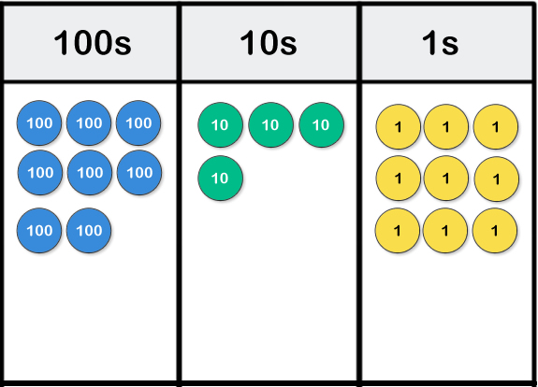
TALKING TIME:
Use your knowledge of adding 3-digit numbers to find the
total of 635 and 214.
635 + 214 = 849

Slide 6
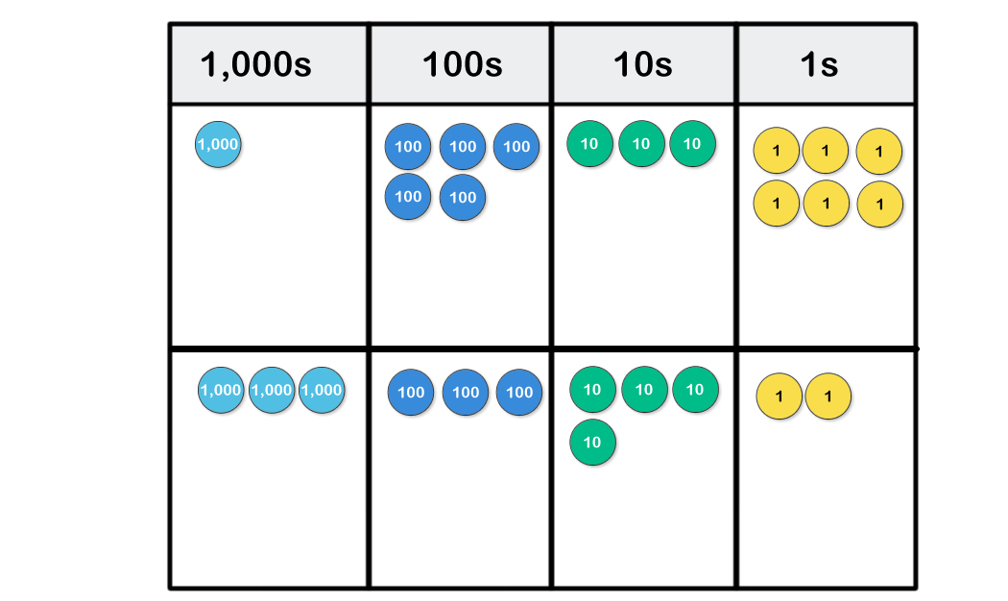
TALKING TIME:
Use place-value counters to combine 1,536 and 3,342.

Slide 7
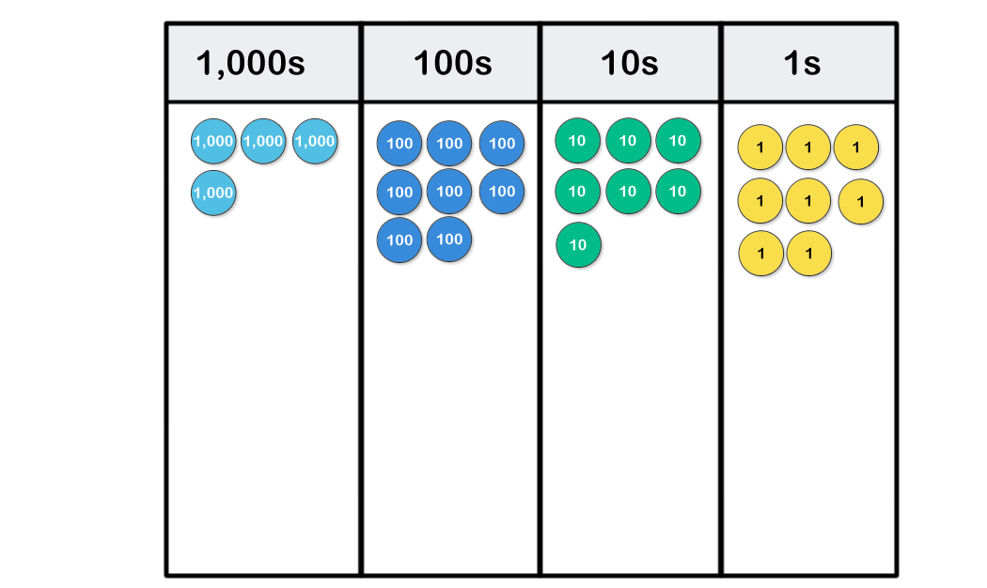
TALKING TIME:
Use place-value counters to combine 1,536 and 3,342.
1,536 + 3,342 = 4,878

Slide 8
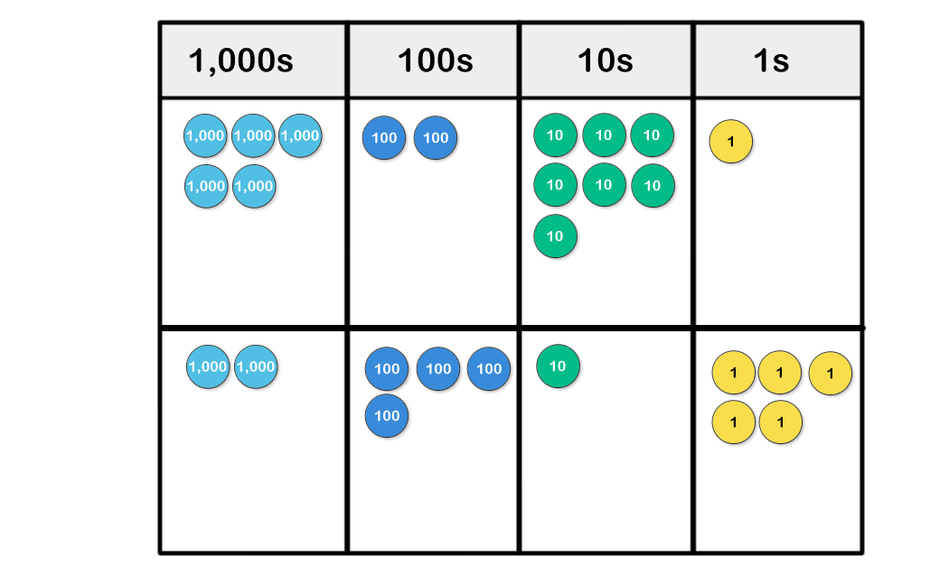
TALKING TIME:
What is five thousand two hundred and seventy-one plus two
thousand four hundred and fifteen?

Slide 9
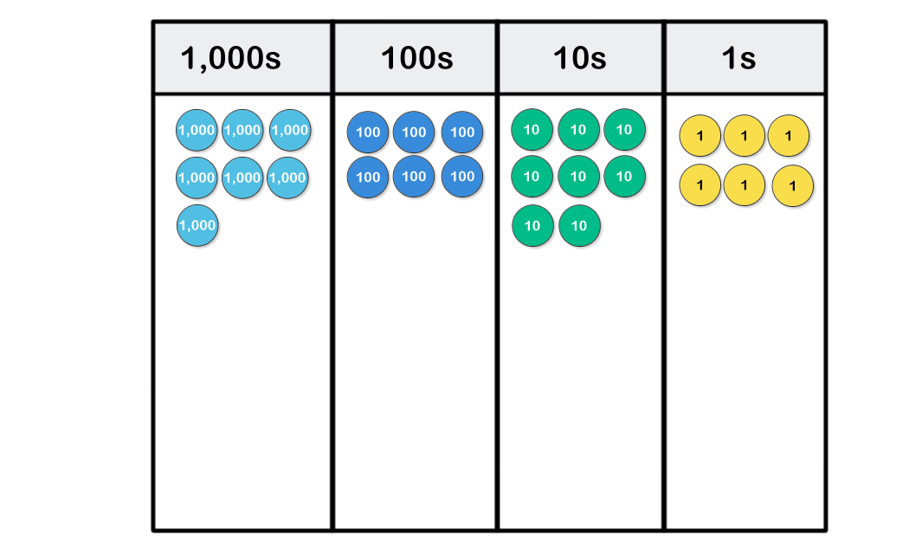
TALKING TIME:
What is five thousand two hundred and seventy-one plus two
thousand four hundred and fifteen?
5,271 + 2,415 = 7,686

Slide 10
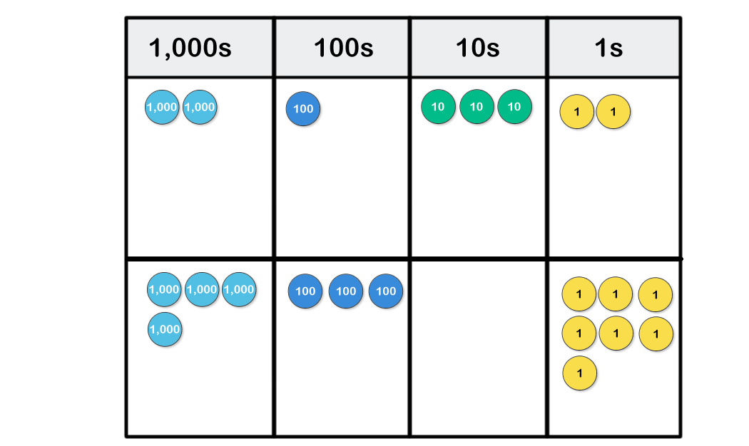
ACTIVITY 1:
What is the sum of 2,132 and 4,307?
Use place-value counters to find the answer.

Slide 11
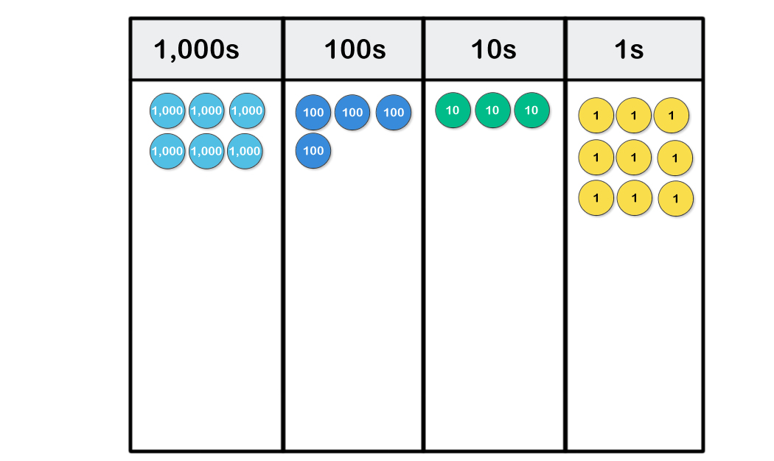
ACTIVITY 1:
What is the sum of 2,132 and 4,307?
Use place-value counters to find the answer.
2,132 + 4,307 = 6,439

Slide 12
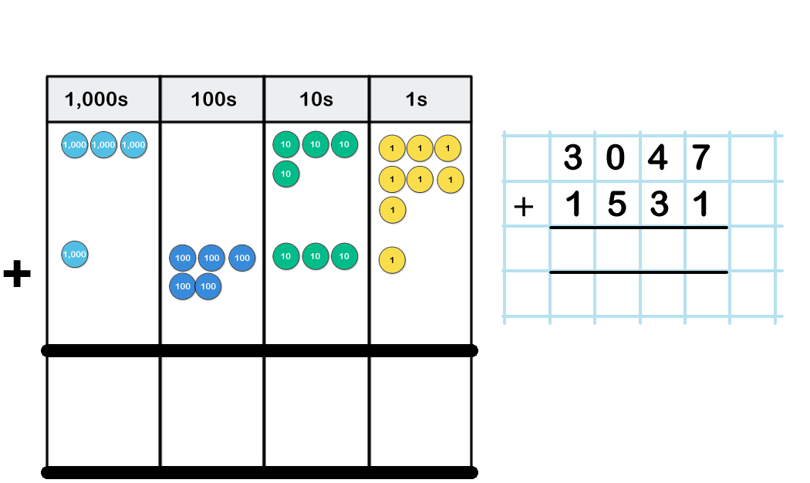
TALKING TIME:
Add 3,047 and 1,531 using the column method.
Use a place-value grid and counters to model each step.

Slide 13
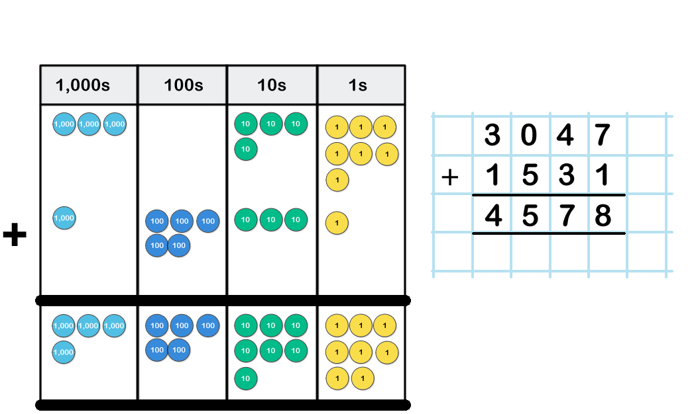
TALKING TIME:
Add 3,047 and 1,531 using the column method.
Use a place-value grid and counters to model each step.

Slide 14
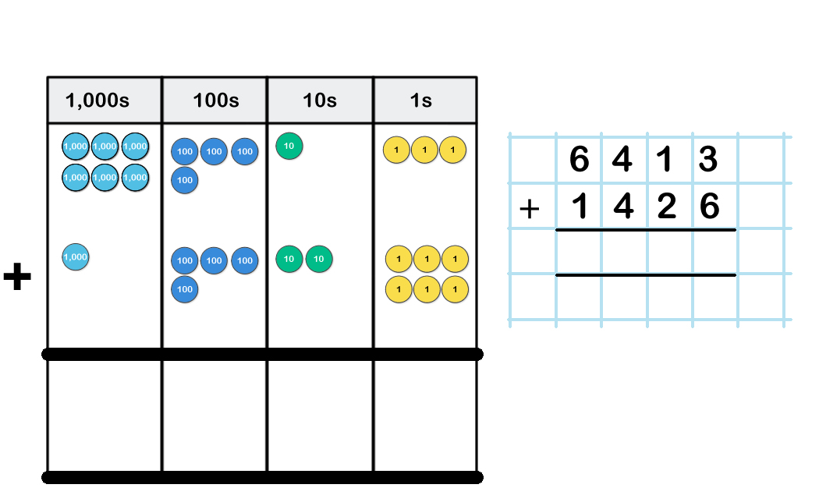
TALKING TIME:
Add 6,413 and 1,426 using the column method.
Use a place-value grid and counters to model each step.

Slide 15
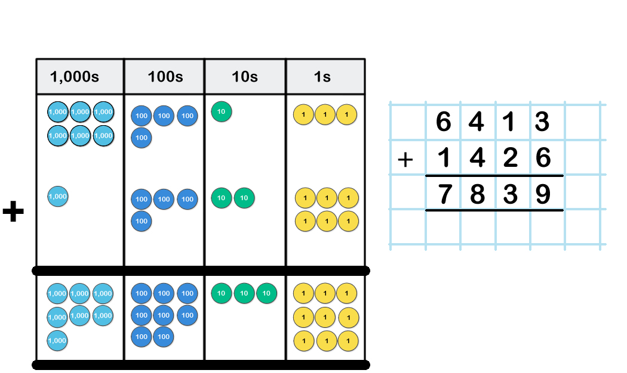
TALKING TIME:
Add 6,413 and 1,426 using the column method.
Use a place-value grid and counters to model each step.

Slide 16
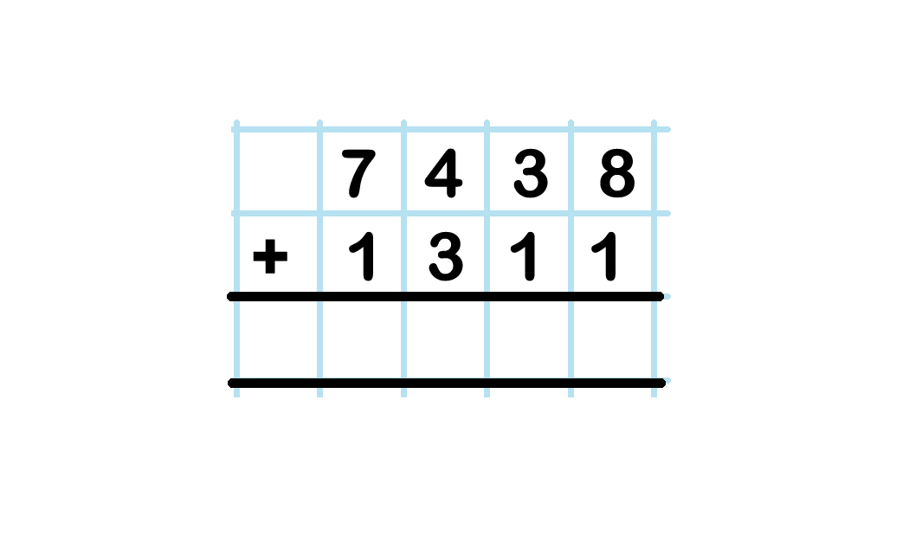
ACTIVITY 2:
Mr Aziz has £7,438 in one bank account and £1,311 in
another. How much money does he have in total?

Slide 17
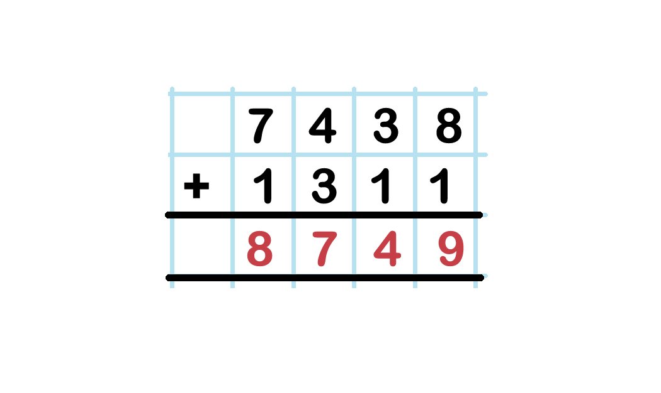
ACTIVITY 2:
Mr Aziz has £7,438 in one bank account and £1,311 in
another. How much money does he have in total?
He has £8,749 in total.

Slide 18
ACTIVITY 3:
Use the numbers 5,416, 2,173 and 1,523 to make as
many different totals as you can.
You must only add two numbers at a time.
How many different totals do you think you will be able to make from these three numbers?

Slide 19
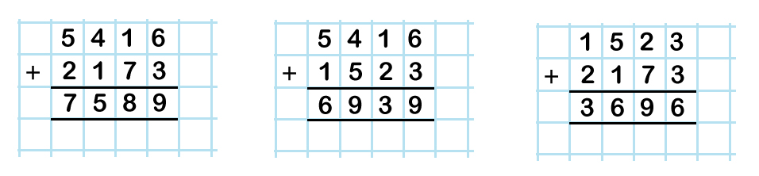
ACTIVITY 3:
Use the numbers 5,416, 2,173 and 1,523 to make as
many different totals as you can.
You must only add two numbers at a time.

Slide 20
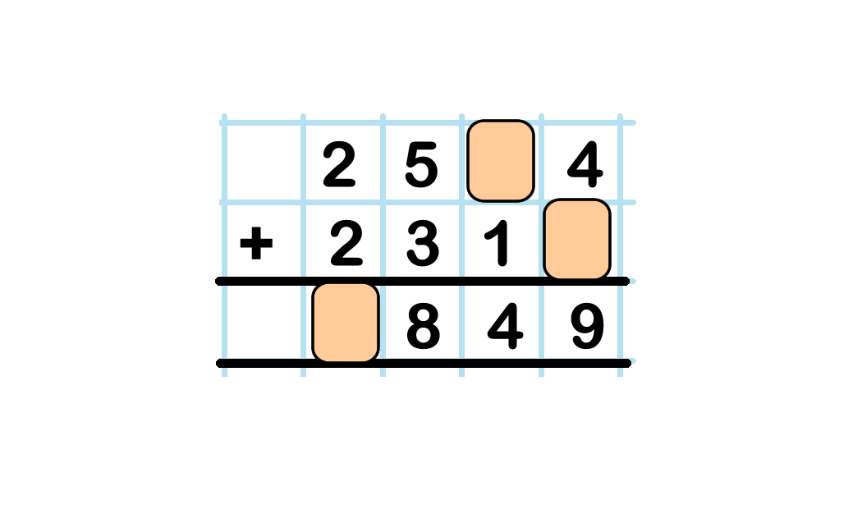
ACTIVITY 4:
Use your knowledge of adding 4-digit numbers to work
out the missing digits.

Slide 21
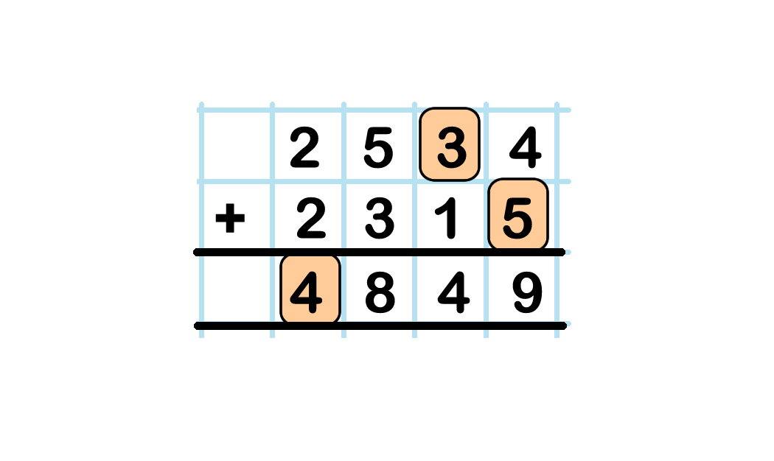
ACTIVITY 4:
Use your knowledge of adding 4-digit numbers to work
out the missing digits.

Slide 22
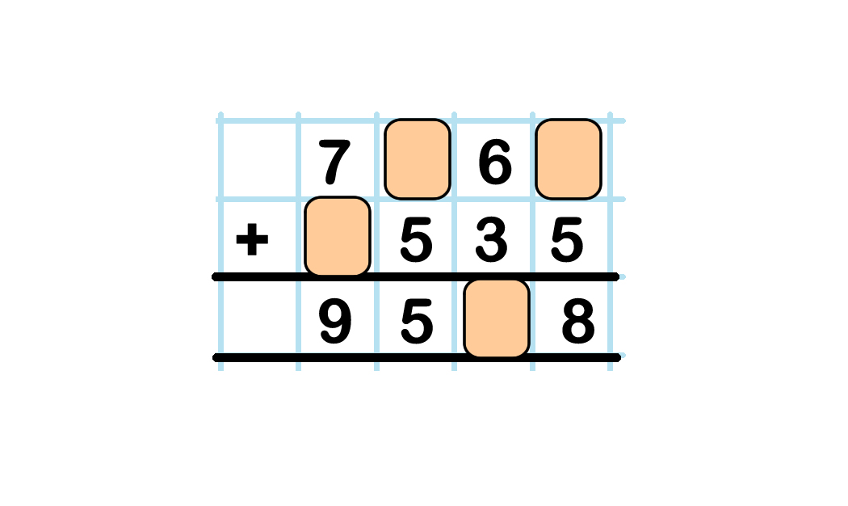
ACTIVITY 5:
Use your knowledge of adding 4-digit numbers to work
out the missing digits.

Slide 23
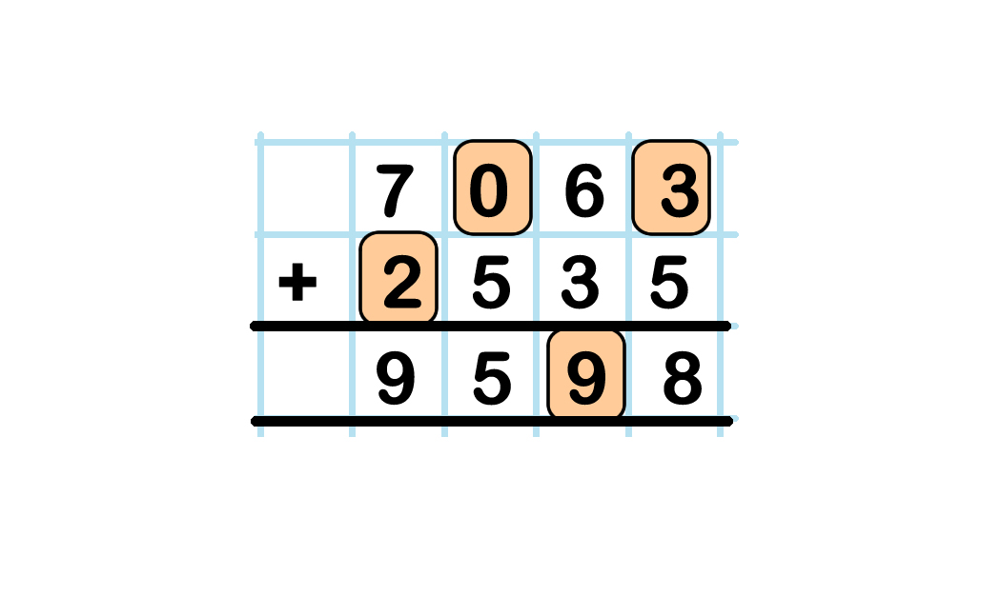
ACTIVITY 5:
Use your knowledge of adding 4-digit numbers to work
out the missing digits.

Slide 24
ACTIVITY 6:
Only solve the addition problem.
a) Number X is 3,214 more than Number Y.
Number Y is 5,175.
What is Number X?
b) The price of a hatchback car is £2,412 less than the
price of an estate car.
The price of the estate car is £7153.
How much does the hatchback cost?

Slide 25
ACTIVITY 6:
Only solve the addition problem.
a) Number X is 3,214 more than Number Y.
Number Y is 5,175.
What is Number X?
3 2 1 4
+ 5 1 7 5
8 3 8 9
Extension:
Invent a similar mystery number problem for a friend to solve.
You should use the phrase “less than” in your problem and it needs to be solved using addition. Think carefully!
b) The price of a hatchback car is £2,412 less than the
price of an estate car.
The price of the estate car is £7153.
How much does the hatchback cost?

Slide 26

ACTIVITY 7:
Clara says,
Two 4-digit numbers
make a total of 4,262.
They both contain
even digits.
What could the two numbers be?
What are the even digits that these numbers could contain?
What can you say for definite about the numbers?

Slide 27
ACTIVITY 7:
Clara says,
Two 4-digit numbers
make a total of 4,262.
They both contain
even digits.
Extension:
What if the two numbers both contain odd digits instead?
Does this make the problem easier, more difficult or the same?
Explain your answer and find six possible answers.
What could the two numbers be?
Some possible answers are:
2,000 + 2,262 2,040 + 2,222
2,002 + 2,260 2,060 + 2,202
2,020 + 2,242
2,200 + 2,062
There are other possible answers.
Can you think of any?

Slide 28
ACTIVITY 8:
Zainab and Ben are calculating the answer to 5,342 + 1,256.
Zainab says, Ben says,
The answer is
6,588!
The answer is
54,676!
Both children have made a mistake!
Work out the correct answer and explain the mistakes they have made.

Slide 29
ACTIVITY 8:
Zainab and Ben are calculating the answer to 5,342 + 1,256.
Zainab says, Ben says,
The answer is
6,588!
The answer is
54,676!
Both children have made a mistake!
Work out the correct answer and explain the mistakes they have made.
Zainab has added the tens column incorrectly. 4 tens plus 5 tens equals 9 tens, not 8 tens.
Ben has not lined up the numbers correctly before adding them, so the place-value of his digits is incorrect.
5 3 4 2
+ 1 2 5 6
6 5 9 8

Slide 30
EVALUATION:
Always, Sometimes or Never?
When adding two 4-digit numbers using the column method, we should ________ start with the thousands digits and ________ start with the ones digits.
A number with 4-digits ________ has an amount of thousands greater than 0.
A number with 4-digits _______ has a hundreds digit less than 9.
Two 4-digit numbers are being added. They both have an odd number of ones. The number of ones in the answer will ________ be odd.

Slide 31
EVALUATION:
Always, Sometimes or Never?
When adding two 4-digit numbers using the column method, we should NEVER start with the thousands digits and ALWAYS start with the ones digits.
A number with 4-digits ALWAYS has an amount of thousands greater than 0.
A number with 4-digits SOMETIMES has a hundreds digit less than 9.
Two 4-digit numbers are being added. They both have an odd number of ones. The number of ones in the answer will NEVER be odd.

Slide 32
Supporting children
Our weekly 1-to-1 online lessons are a fun, confidence-building experience for your pupils, and are aligned with the national curriculum for England and Wales.
Supporting schools
We offer flexibility and great value to fit schools’ busy timetables, and the assurance of world-class, maths specialist tutors in a safe environment.
In schools across the UK
We are the largest provider of online maths interventions in the UK. Every week we provide specialist 1-to-1 lessons to thousands of children in KS2 and KS3.

