Slide 1

Supporting children
Our weekly 1-to-1 online lessons are a fun, confidence-building experience for your pupils, and are aligned with the national curriculum for England and Wales.
Supporting schools
We offer flexibility and great value to fit schools’ busy timetables, and the assurance of world-class, maths specialist tutors in a safe environment.
In schools across the UK
We are the largest provider of online maths interventions in the UK. Every week we provide specialist 1-to-1 lessons to thousands of children in KS2 and KS3.

Slide 2
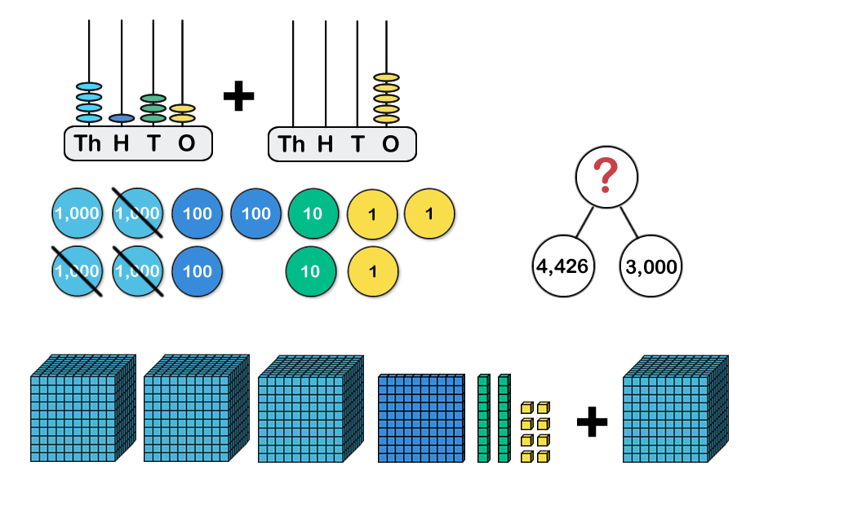
STARTER:
Which one does not belong?

Slide 3
STARTER:
Which one does not belong?
There are several possible answers. For example:
The place-value counters do not belong because they show a subtraction.
The abacus does not belong because it does not add or subtract thousands.

Slide 4
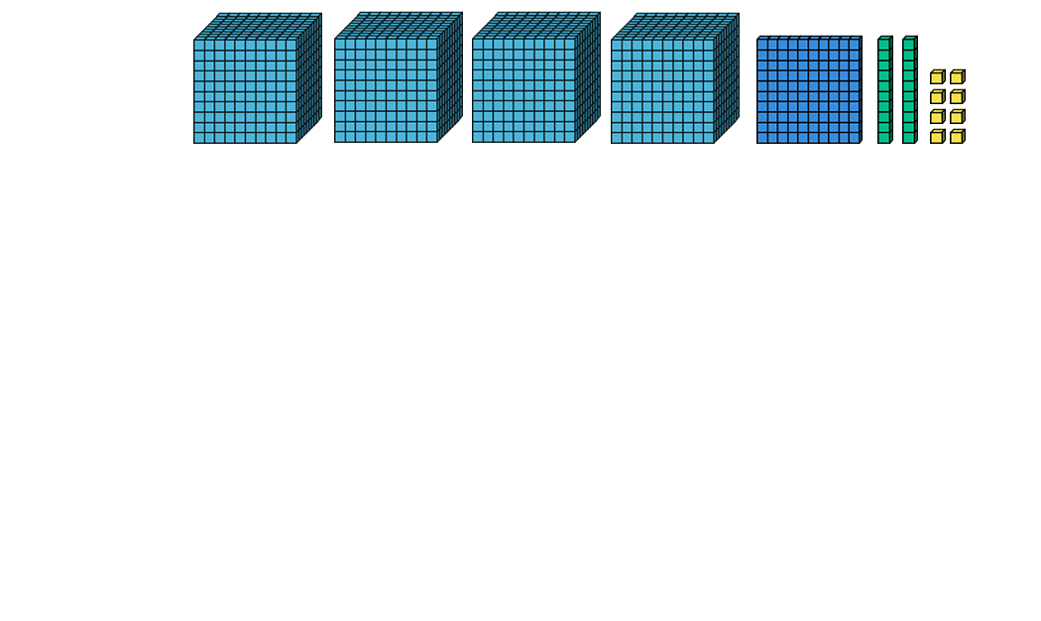
TALKING TIME:
The starting number is .
Subtract 2 thousands
Add 4 tens
Subtract 4 ones
The final number is .

Slide 5
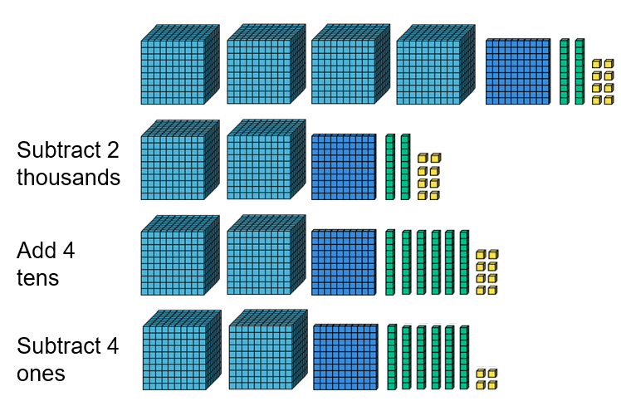
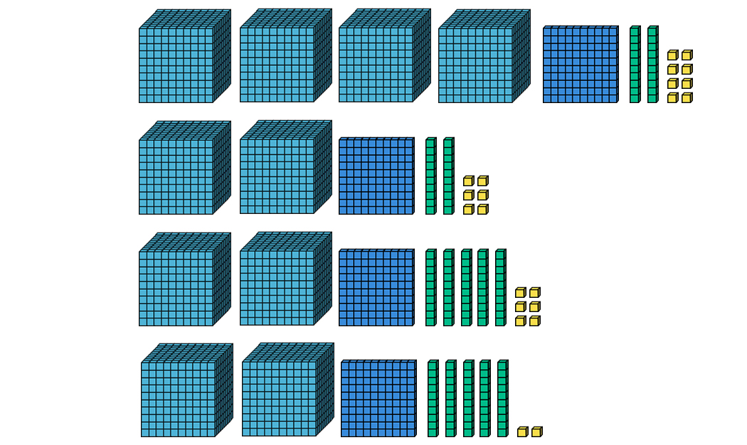

TALKING TIME:
The starting number is 4,128.
Subtract 2 thousands
Add 4 tens
Subtract 4 ones
The final number is 2,164.

Slide 6
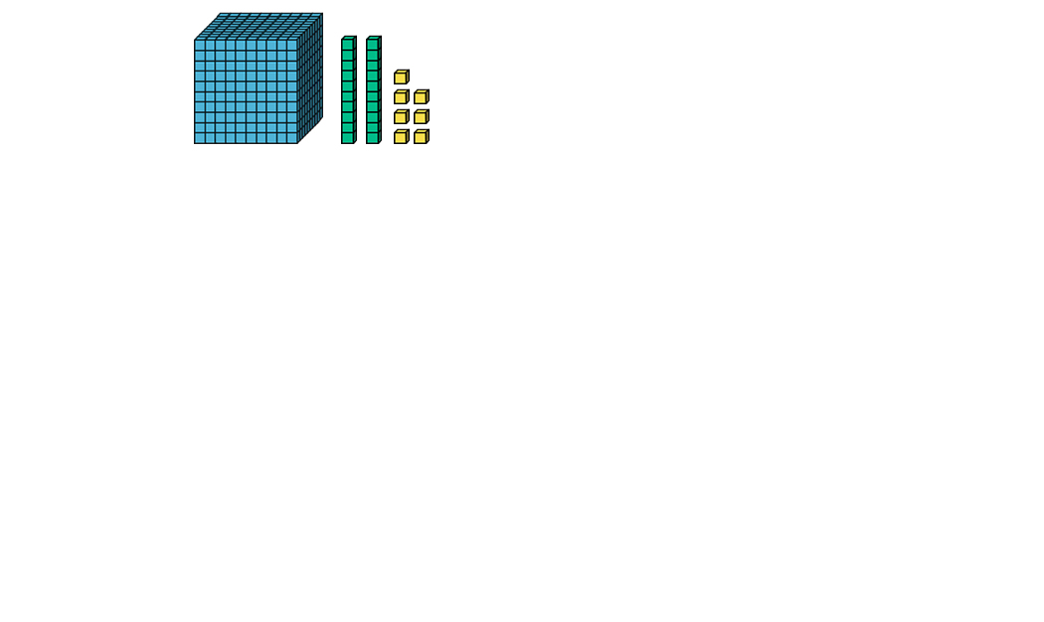
TALKING TIME:
The starting number is .
– 6
+ 4,000
– 1,000
The final number is .

Slide 7
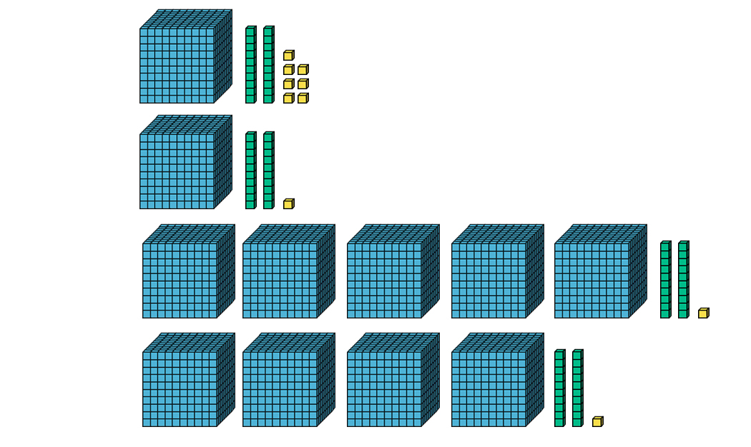
TALKING TIME:
The starting number is 1,027.
– 6
+ 4,000
– 1,000
The final number is 4,021.

Slide 8
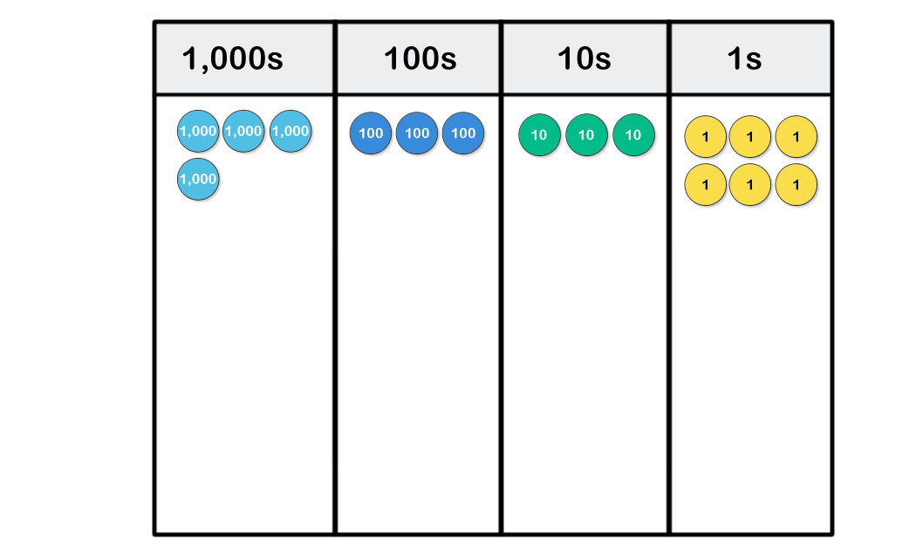
TALKING TIME:
Start with four thousand three hundred and thirty-six.
Subtract five
Subtract two thousand
Add two hundreds
The final number is
.

Slide 9
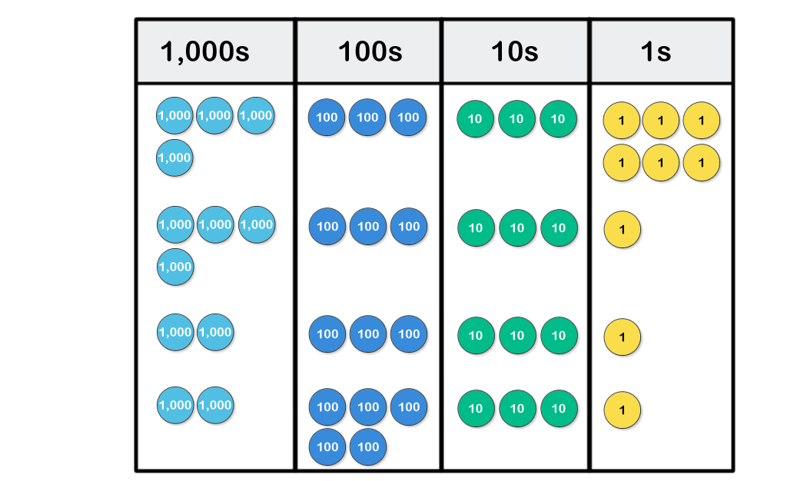
TALKING TIME:
Start with four thousand three hundred and thirty-six.
Subtract five
Subtract two thousand
Add two hundreds
The final number is
2,531.

Slide 10
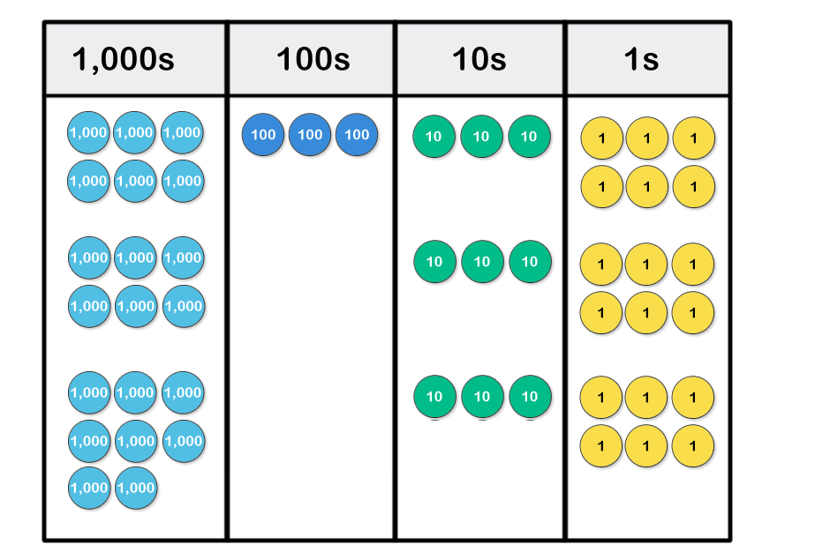
TALKING TIME:
Write the calculations for each step.

Slide 11
TALKING TIME:
Write the calculations for each step.
6,336 – 300 = 6,036
6,036 + 2,000 = 8,036

Slide 12
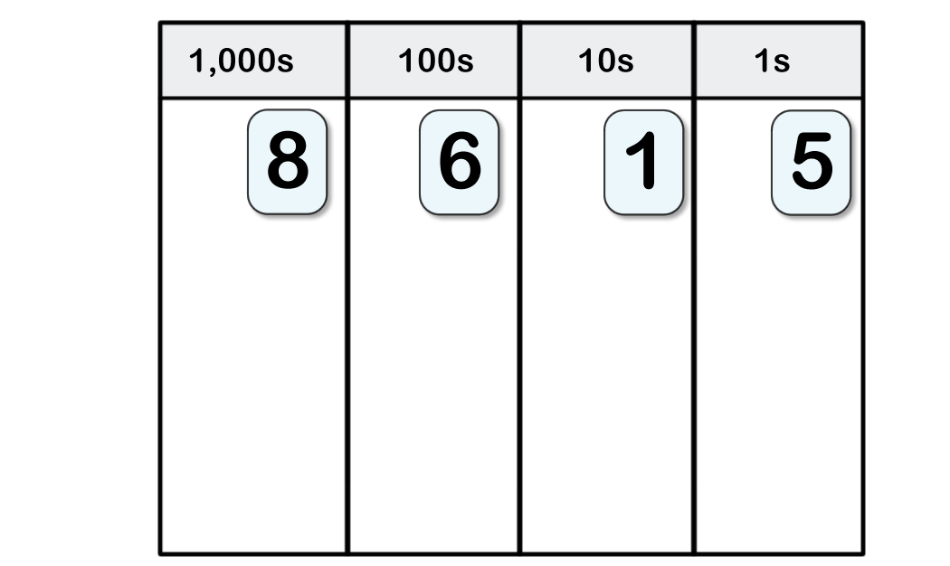
TALKING TIME:
How do the digits change?
– 300
– 6,000

Slide 13
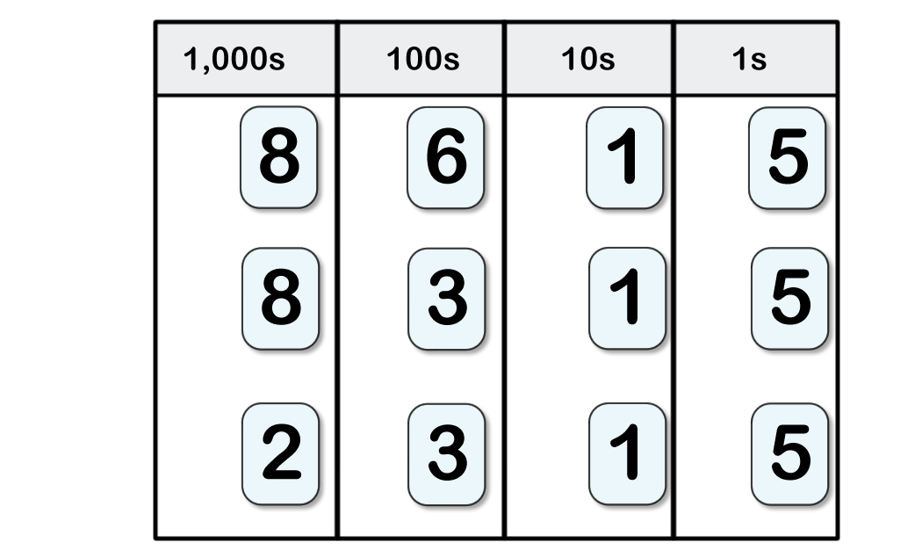
TALKING TIME:
How do the digits change?
– 300
– 6,000

Slide 14
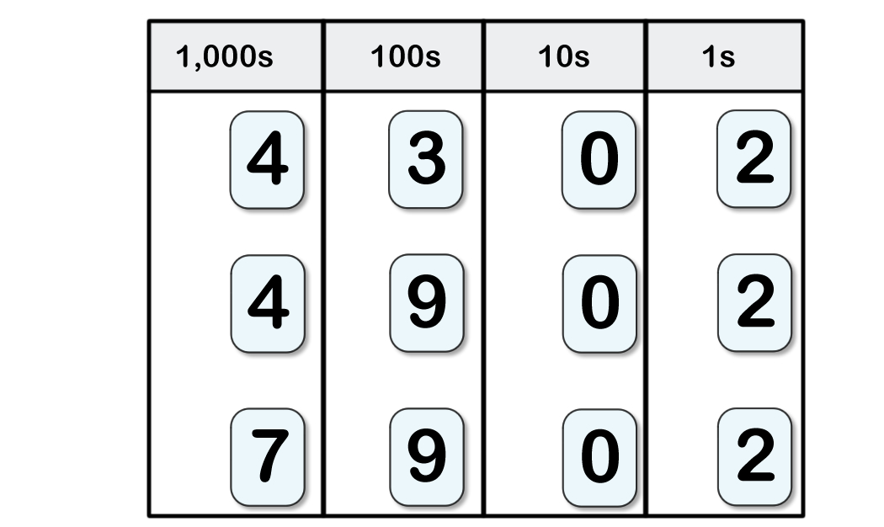
TALKING TIME:
Write a number sentence for both steps.

Slide 15
TALKING TIME:
Write a number sentence for both steps.
4,302 + 600
= 4,902
4,902 + 3,000
= 7,902
Can you explain why the digits 0 and 2 remain the same each time?

Slide 16
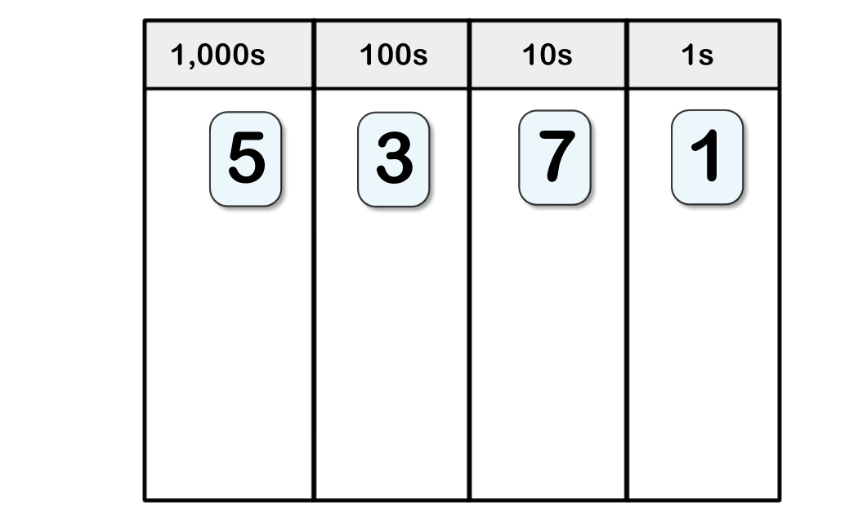
ACTIVITY 1:
Subtract 90
Add 4,000
Subtract 500
What is the answer?

Slide 17
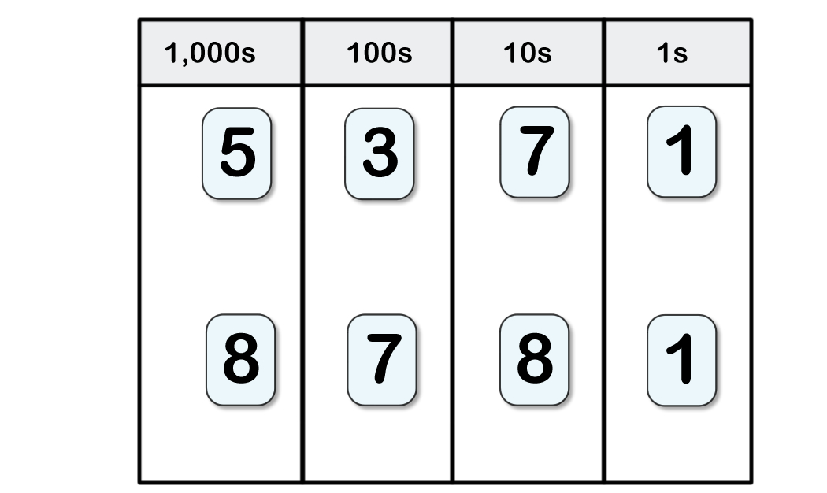
ACTIVITY 1:
Subtract 90
Add 4,000
Subtract 500
What is the answer?
Extension:
The end number is 9,415.
A number of 10s was subtracted, a number of 1,000s was added and a number of 100s was subtracted.
What could the starting number have been? Find five answers.

Slide 18
ACTIVITY 2:
Use place-value counters to find the answer.
9,251 + 60 – 6,000 + 6 – 600

Slide 19
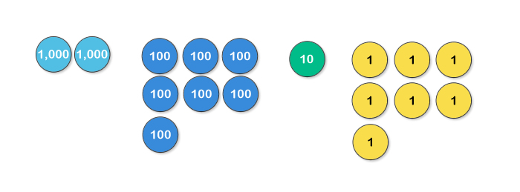
ACTIVITY 2:
Use place-value counters to find the answer.
9,251 + 60 – 6,000 + 6 – 600
9,251 + 60 = 9,311
9,311 – 6,000 = 3,311
3,311 + 6 = 3,317
3,317 – 600 = 2,717
Extension:
Sam makes a number out of 9 counters. He adds 2,000 and subtracts 700. His answer still contains an odd number of counters.
What could his calculation be?
Use counters to show three possible answers.

Slide 20

ACTIVITY 3:
Alice says,
If I subtract a number
of thousands from a
4-digit number,
only one digit will change.
Is Alice correct? Give two examples.

Slide 21
ACTIVITY 3:
Alice says,
If I subtract a number
of thousands from a
4-digit number,
only one digit will change.
Is Alice correct? Give two examples.
Yes. Only the thousands digit will change.
For example: 5,284 – 4,000 = 1,284
9,145 – 6,000 = 3,145

Slide 22
ACTIVITY 4:
Which calculations are easy?
Which are hard?
Discuss your answers with a friend.
7,482 + 7 ones
1,482 + 70
9,482 – 7,000
3,482 – 7 hundreds

Slide 23
ACTIVITY 4:
Which calculations are easy?
Which are hard?
Discuss your answers with a friend.
7,482 + 7 ones
1,482 + 70
9,482 – 7,000
3,482 – 7 hundreds
The slightly harder questions are usually those where the answer crosses over a tens or hundreds boundary.
These calculations are B and D. They need slightly more thought.
What are the answers to these calculations?
Were you correct about B and D needing slightly more thought?

Slide 24
ACTIVITY 5:
Complete the table.
Calculate along each row (so subtract 7,000 from the
first number, then add 500 to the second number
and so on)
Starting number | - 7,000 | + 500 | - 80 | Final number
9,627
8,627
7,627
Sometimes a calculation crosses a hundreds (or tens) boundary. Can you spot which these are?

Slide 25
ACTIVITY 5:
Complete the table.
Calculate along each row (so subtract 7,000 from the
first number, then add 500 to the second number
and so on)
Starting number | - 7,000 | + 500 | - 80 | Final number
9,627 | 2,627 | 3,127 | 3,047 | 3,047
8,627 | 1,627 | 2,127 | 2,047 | 2,047
7,627 | 627 | 1,127 | 1,047 | 1,047

Slide 26
EVALUATION:
True or False?
Adding a number of 1,000s is more difficult than adding a
number of 100s because 1,000 is a larger number.
b) If a number ends in 254 and a number of thousands is
added to it, the answer will end in 254.
If 8 tens are subtracted from a number with less than 8 tens, the hundreds digit in the answer will be one less.
d) It is most efficient to use mental methods to add or subtract a
multiple of 1,000 to or from a 4-digit number.

Slide 27
EVALUATION:
True or False?
Adding a number of 1,000s is more difficult than adding a
number of 100s because 1,000 is a larger number. FALSE
b) If a number ends in 254 and a number of thousands is
added to it, the answer will end in 254. TRUE
If 8 tens are subtracted from a number with less than 8 tens, the hundreds digit in the answer will be one less. TRUE
d) It is most efficient to use mental methods to add or subtract a
multiple of 1,000 to or from a 4-digit number. TRUE

Slide 28
Supporting children
Our weekly 1-to-1 online lessons are a fun, confidence-building experience for your pupils, and are aligned with the national curriculum for England and Wales.
Supporting schools
We offer flexibility and great value to fit schools’ busy timetables, and the assurance of world-class, maths specialist tutors in a safe environment.
In schools across the UK
We are the largest provider of online maths interventions in the UK. Every week we provide specialist 1-to-1 lessons to thousands of children in KS2 and KS3.

