Slide 1

Article 24: “You have the right to the best health care possible, safe water to drink, nutritious food, a clean and safe environment, and information to help you stay well.”

Slide 2



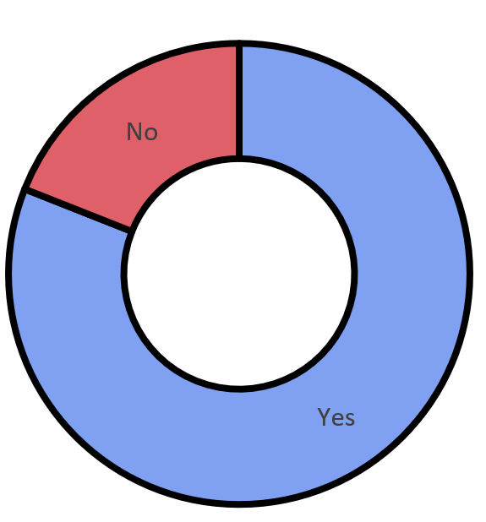




Feedback: “Do young people know what an unhealthy relationship looks like?”
A huge welcome and thanks to first-time commenters at Little Bloxwich Church of England Primary School for these fantastic “Yes” comments this week!
“No because they’re not old enough to know what an unhealthy relationship is”
Fosse Primary School
“I think that honesty and being supportive is easy to see. If anyone feels unsure about sharing their feelings then it is unhealthy to be in that relationship.”
“It was pretty great to learn about this!”
Fosse Primary School
“If they aren’t sharing things or communicating as part of the relationship then that isn’t healthy.”
19%
81%
If you would like to see your school on this slide, ask your teacher to email your comments to amy@votesforschools.com!

Slide 3



Feedback: “Do young people know what an unhealthy relationship looks like?”
“There is a big difference in the number of young people who know what an unhealthy relationship looks like around the country. There is also a big difference in what children in Primary school said and what young people in Secondary school said – we were surprised by this difference which makes what you have told us even more helpful!”
So, what are the Children’s Society going to do with what you told them?
This is Hannah Chetwynd from The Children’s Society, who has some exciting news on your vote! Click to have a look.
1
“We will write a report and include what we have learnt from you – the report will go on our website, on our social media and might be covered in the news!”
2
“We will talk to people in the Government and ask them to help us make the change we want to see.”
3
“If we don’t see the change we want at first we will keep on trying!”
Notes:
Images:
Courtesy of The Children’s Society
https://www.childrenssociety.org.uk/

Slide 4






Starter: My favourite things…
Cameras, tablets, phones, computers… technology!
Over the past 50 years, the world we live in has changed a lot…
Pick your favourite (3-8 mins)
Look at some of the things that have been invented or become easier in the modern world. Which one is your favourite and why?
You can eat food from anywhere in the world now!
It’s easy to travel to different countries.
You can go online to talk, play or find out things.
Did you know?
Pizza was invented in Italy!
Notes:
Images:
1) https://medium.com/@emmanouil/1-how-to-insert-emoji-into-illustrator-df7fc13ddd9a?source=user_profile---------8-------------------

Slide 5

Does the modern world make it harder for diseases to spread?
Worried about Coronavirus?
This week’s assembly contains all the information you need! It explains what it is, whether it is dangerous and how you can stay safe. Click here to download it for your class!
Notes:
Images:
iStock

Slide 6
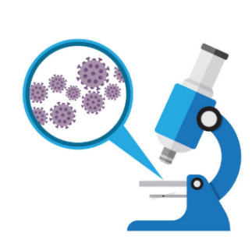



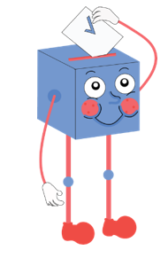


Starter: My favourite things…
Why are we talking about this?
What are diseases?
How do diseases spread?
What’s changed in the modern world?
Vote!
If I was Prime Minister…
Notes:
Images:
iStock

Slide 7



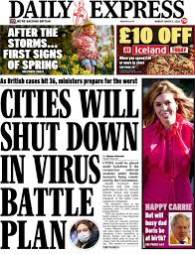

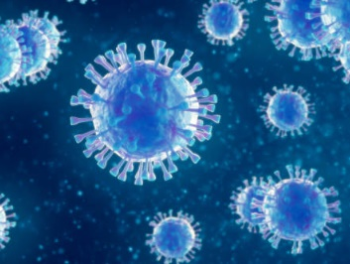
Why are we talking about this?
Everywhere you look right now, it feels like someone is talking about “Coronavirus”, and some people are feeling very worried.
While there are many types of Coronavirus, this one is a new strain that scientists have not seen before. They’ve named in COVID-19.
But COVID-19 isn’t the first ever new disease – there have been lots of them throughout history! In fact, since 1970, scientists have discovered over 40 new diseases.
That’s why, this week, we’re asking whether you think the modern world makes it harder for diseases like Coronavirus to spread.
Modern:
Designed and made using the most recent ideas and methods.
Notes:
Images:
https://www.itv.com/news/2020-02-27/coronavirus-warnings-lead-thursday-s-headlines/
iStock
References:
https://www.bcm.edu/departments/molecular-virology-and-microbiology/emerging-infections-and-biodefense/emerging-infectious-diseases
https://dictionary.cambridge.org/dictionary/english/modern

Slide 8
Starter: My favourite things…
Why are we talking about this?
What are diseases?
How do diseases spread?
What’s changed in the modern world?
Vote!
If I was Prime Minister…
Notes:
Images:
iStock

Slide 9
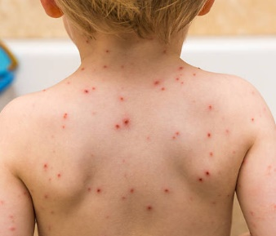
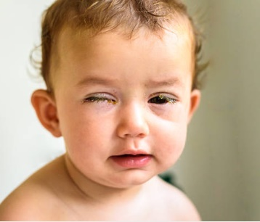
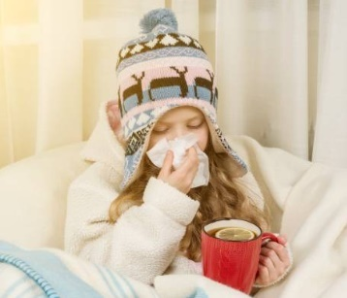
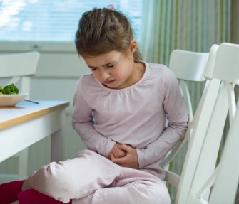
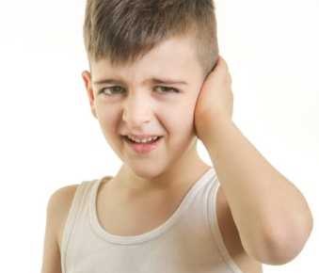
What are diseases?
When we hear the word “disease”, we might think of being extremely ill, but that’s not completely true. Did you know that having a cold is a type of disease too?
Disease:
An illness caused by an infection or a failure of health, not by having an accident.
How many have you had?
(1-2 mins)
Take a look at these different diseases. How many have you had before?
Chicken pox
Conjunctivitis
Challenge:
How did you treat these diseases when you had them?
A cold
Stomach bug
Ear infection
Notes:
Images:
iStock
https://www.dammann.com.au/blog/some-great-tips-for-translating-gaming-instructions/
https://www.pinterest.co.uk/pin/368802656968401571/
https://www.ashtonmedicalgroup.co.uk/pages/Flu

Slide 10
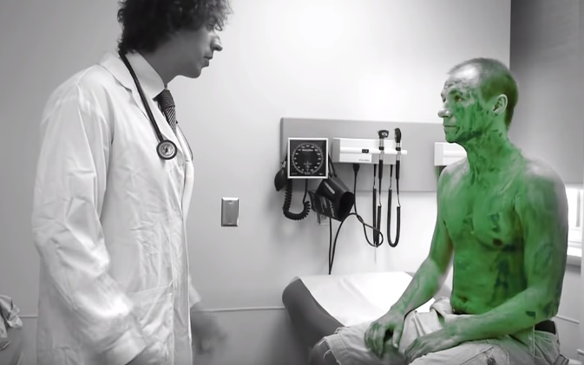
What are diseases?
Diseases are caused by germs. There are four different types of germs:
Viruses
Germs are so small that they can only be seen under a microscope. This means they can spread easily, because we don’t know that we are spreading them!
Bacteria
Fungi
When germs get into our bodies, they can give us a disease. Our body normally tries to fight back, but it may need help from a doctor to get rid of the germs.
Protozoa
0:00-1:35
Watch (2 mins)
Watch the video to see how germs spread. What should the doctor have done to stop them from spreading?
https://safeshare.tv/x/ss5e5e5c4e1b193
Notes:
Alternative video link: https://www.youtube.com/watch?v=M8AKTACyiB0
Images:
1) iStock

Slide 11

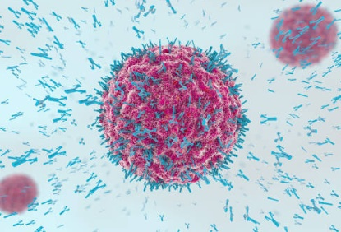
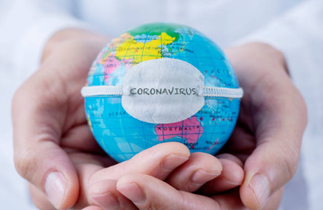
What are diseases?
Discuss (2-5 mins)
With your partner, discuss the question. Can you think of an answer?
“If germs are spreading all of the time, why aren’t we ill all of the time?”
The reason you are usually healthy is because your body has something called an immune system. Your immune system recognises germs it has seen before and sends cells to destroy them, stopping you from becoming ill.
But germs, like all living things, are always changing and growing. If your body doesn’t recognise a new germ, it might not know how to fight it and you will become ill while your immune system is learning how to help you. This is what is happening across the world right now with COVID-19.
Notes:
Alternative video link: https://www.youtube.com/watch?v=M8AKTACyiB0
Images:
1) iStock

Slide 12
Starter: My favourite things…
Why are we talking about this?
What are diseases?
How do diseases spread?
What’s changed in the modern world?
Vote!
If I was Prime Minister…
Notes:
Images:
iStock

Slide 13





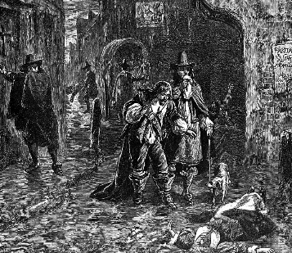
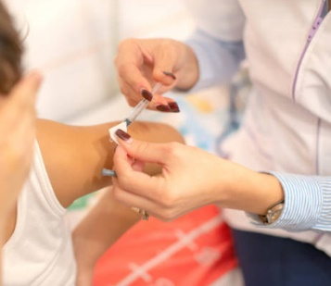

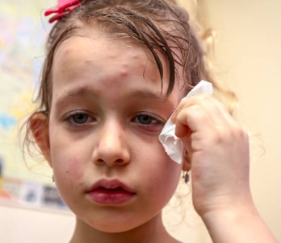
How do diseases spread?
In the past, scientists and doctors didn’t know as much as we do today. This meant that diseases spread very quickly between people and doctors didn’t know how to cure them.
How did it spread? (10-15 mins)
On the next few slides you are going to learn about three of the worst illnesses in history. For each one, can you work out how they were spread and how they have been stopped from spreading in the modern world?

Slide 14
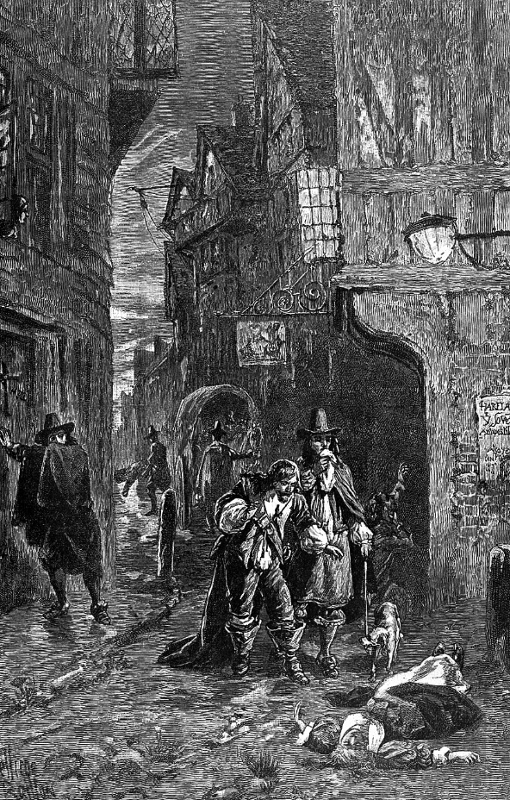
Disease Fact File:
How do diseases spread?
The Bubonic Plague
Year(s):
1347-1351
Deaths:
240 million
The Bubonic Plague (also called “The Black Death”) spread through Europe in the 1300s and killed millions of people. But life was very different back then…
Treatment:
Antibiotics
Symptoms:
Painful, swollen lumps around the throat and face.
There weren’t any bins or toilets, so rubbish and even toilet waste would be emptied out onto the streets.
In 1909, the first antibiotic was invented. This can cure the Bubonic Plague very easily.
The waste would rot in the streets or be blown into rivers and seas.
How did this illness spread and why isn’t it a problem today?
Nobody washed their hands, and soap didn’t exist either.
Notes:
Images:
1) iStock

Slide 15
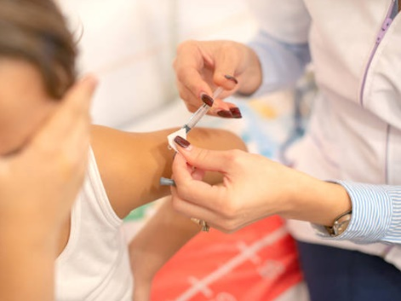
Disease Fact File:
How do diseases spread?
Smallpox
Year(s):
3,000BC-1798
Deaths:
300 million
Smallpox was a virus that existed from Egyptian times up until 1798. 7 out of 10 people who caught the illness would recover, but 3 in 10 would not.
Treatment:
Vaccine
Symptoms:
Rash, headache, backache, sickness, pain
Viruses are contagious, meaning they spread from person to person by face-to-face touching or from sharing clothes, bedding or towels.
How did this illness spread and why isn’t it a problem today?
In 1798, the first vaccine was created. People with the vaccination cannot get the illnesses, and the illness doesn’t exist anymore.
Challenge:
Have you ever had a vaccination?

Slide 16


Disease Fact File:
How do diseases spread?
Spanish Influenza
Year(s):
1918-1919
Deaths:
50-100 million
Spanish Influenza didn’t actually start in Spain, but lots of people there became ill. In just over a year, between 50-100 million people died from it.
Treatment:
Vaccine/
medication
Symptoms:
Fever, feeling sick, aches, upset tummy, turning blue
Every year, lots of people get seasonal flu. This is flu that we have seen before and know how to treat. Sometimes, the flu virus can change into a new flu, called pandemic flu. This flu is more dangerous as doctors and scientists have to work quickly to stop it from spreading.
As well as vaccines to prevent the virus, people that are infected today can take antiviral medication to stop them from passing it on to others.
WWI was just ending when the flu broke out, so most men were soldiers, living in large groups together, allowing the virus to spread very quickly¹.
How did this illness spread and why isn’t it a problem today?
Notes:
References:
1) https://www.historyextra.com/period/20th-century/nhs-history-pay-healthcare-free/

Slide 17
Starter: My favourite things…
Why are we talking about this?
What are diseases?
How do diseases spread?
What’s changed in the modern world?
Vote!
If I was Prime Minister…
Notes:
Images:
iStock

Slide 18

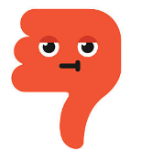
What’s changed in the modern world?
Today we know more about our bodies and about germs than ever before, helping us to stop diseases from spreading and making us ill, but are all the changes as positive?
Vote with your thumbs (6-10 mins)
On the next few slides, look at some of the ways the modern world is different to before. For each one, vote with your thumbs to show whether this makes it harder or easier for diseases to spread. Be ready to explain your answer!
This makes it harder for diseases to spread!
This makes it easier for diseases to spread!
Challenge:
For each example, can you think of an argument for both sides?
Notes:
Images:
1) iStock

Slide 19

What’s changed in the modern world?
Technology
In the modern world, technology such as phones and computers mean that we can work or communicate from home, so we avoid busy areas, as well as finding out information about what is happening around the world.
This makes it harder for diseases to spread!
Vote with your thumbs
Does this make it easier or harder for diseases to spread?
This makes it easier for diseases to spread!
Challenge:
Can you think of a way that this makes it both harder and easier for diseases to spread?

Slide 20

What’s changed in the modern world?
Working conditions
A long time ago, more people worked outdoors and in small groups, whereas lots of people work in busy offices or are on the move in the modern world.
This makes it harder for diseases to spread!
Vote with your thumbs
Does this make it easier or harder for diseases to spread?
This makes it easier for diseases to spread!
Challenge:
Can you think of a way that this makes it both harder and easier for diseases to spread?

Slide 21

What’s changed in the modern world?
Travel
Before fast trains, buses and aeroplanes, people would walk or sail to other places or countries. This would take them a long time. Today we can fly to anywhere in the world quickly and easily.
This makes it harder for diseases to spread!
Vote with your thumbs
Does this make it easier or harder for diseases to spread?
This makes it easier for diseases to spread!
Challenge:
Can you think of a way that this makes it both harder and easier for diseases to spread?

Slide 22
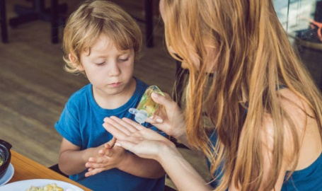
What’s changed in the modern world?
Medicine & hygiene
Today, we can quickly see a doctor or go to a hospital if we feel unwell. We can also buy things like painkillers, anti-bacterial soap and hand sanitiser.
This makes it harder for diseases to spread!
Vote with your thumbs
Does this make it easier or harder for diseases to spread?
This makes it easier for diseases to spread!
Challenge:
Can you think of a way that this makes it both harder and easier for diseases to spread?

Slide 23

What’s changed in the modern world?
Population growth
Our population is constantly growing, and many cities are having problems with overcrowding both inside of houses and in public spaces.
This makes it harder for diseases to spread!
Vote with your thumbs
Does this make it easier or harder for diseases to spread?
This makes it easier for diseases to spread!
Challenge:
Can you think of a way that this makes it both harder and easier for diseases to spread?

Slide 24
Starter: My favourite things…
Why are we talking about this?
What are diseases?
How do diseases spread?
What’s changed in the modern world?
Vote!
If I was Prime Minister…
Notes:
Images:
iStock

Slide 25
Does the modern world make it harder for illnesses to spread?
We know how important it is to be clean and hygienic now, which helps to stop germs from spreading.
Medical equipment, such as thermometers, can help us find out if someone is ill sooner than before, so they can be treated quickly.
Doctors and scientists know more about humans and diseases, so they can find cures faster than before.
Inventions like phones and the internet mean we know what is happening around the world and we can take steps to keep ourselves safe.
The modern world allows people to travel further than before, which can make spreading illnesses easier.
We rely on services such as transport, shops and schools more now than we used to. In these places, there are lot of people in a small space, so illness can spread faster.
The number of people in the world means we might run out of medicine and equipment quicker.
Phones and the internet might mean we know more about what’s happening, but this doesn’t stop it from spreading!

Slide 26
Starter: My favourite things…
Why are we talking about this?
What are diseases?
How do diseases spread?
What’s changed in the modern world?
Vote!
If I was Prime Minister…
Notes:
Images:
iStock

Slide 27

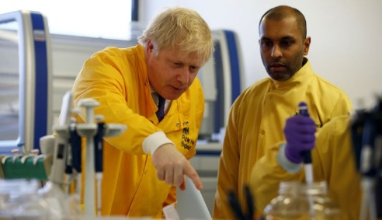





If I was Prime Minister…
World leaders in many countries are taking steps to try and prevent Coronavirus from spreading.
Last week, the UK Government published a 28-page document sharing their plan of action.
They said they would be working closely with the NHS, and possibly even ask soldiers to help out!
It’s possible that if the outbreak gets worse, schools and offices may have to close.
But what do you think should be their priority?
Notes:
References:
https://www.gov.uk/government/publications/coronavirus-action-plan

Slide 28




If I was Prime Minister…
Small group activity (5-15 mins)
Your group is going to form a “mini-Parliament”! It is your job to decide what the Government’s top priority should be when it comes to making sure diseases don’t spread. Click for some ideas.
We should cancel all big events like sports matches and concerts.
We should stop flights to countries that have the virus.
We should only let people use public transport in emergencies.
We should close schools and offices until there are no new cases.
We should save up all our medical equipment and medicines in case it gets worse here.
We should send soldiers to help doctors, nurses and hospitals.
Challenge:
When you’re finished, share your ideas with the rest of the class. How similar were your plans?
Notes:
References:
https://assets.publishing.service.gov.uk/government/uploads/system/uploads/attachment_data/file/869827/Coronavirus_action_plan_-_a_guide_to_what_you_can_expect_across_the_UK.pdf

Slide 29

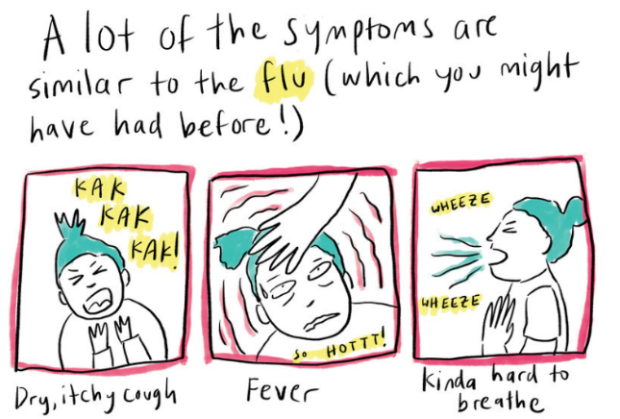
Call to Action
Quick idea
0:00-2:02
What’s really going on?
Click the image to hear from Jenny about what life is like in Hong Kong right now.
Promote cleanliness!
Based on what you have learned today, can you design a cartoon strip that helps show people how to protect themselves and others from illness? Display these somewhere in your school! Click the image to see some examples.
Big idea
https://safeshare.tv/x/BBqqaVptVOk
Notes:
Alternative video link: https://www.youtube.com/watch?v=BBqqaVptVOk&feature=youtu.be
Images:
iStock
https://www.npr.org/sections/goatsandsoda/2020/02/28/809580453/just-for-kids-a-comic-exploring-the-new-coronavirus?t=1583159087769&t=1583164897215

Slide 30
Not sure how?
Click the owl to see a video on how to log your votes. If you have any issues, feedback or comments, email amy@votesforschools.com!
https://safeshare.tv/x/FoQ45XPO_WQ
Notes:
Alternative video link: https://youtu.be/FoQ45XPO_WQ

Slide 31









Coronavirus: advice for students & staff
What should I look out for?
A cough
A high temperature
Finding it hard to breathe
Remember: These things don’t mean you have the virus! These symptoms (signs) are similar to common illnesses like cold & flu.
Key information:
If you are worried about yourself, the best thing to do is call 111 (the NHS non-emergency number)
You can Google “NHS coronavirus questions” for more info
What you should do:
Make sure you cover your mouth & nose with a tissue or sleeve (not your hands) if you cough or sneeze
Put used tissues in the bin straight after using them
Wash your hands with soap & water often (or use hand sanitizer if you have it)
Try to avoid close contact with unwell people
What you shouldn’t do:
Panic! Though there’s lots we still don’t know about the virus, the risk is still quite low compared to other countries
Touch your eyes, nose or mouth if your hands are not clean
Go to busy public places if you think you have been close to someone who definitely has the virus
Notes:
References:
https://www.nhs.uk/conditions/coronavirus-covid-19/
https://www.nhs.uk/conditions/coronavirus-covid-19/common-questions/
Images:
https://commons.wikimedia.org/wiki/File:NHS-Logo.svg

