Slide 1

Assembly Plan
This assembly will cover:
Feedback from previous topic
Recent headlines
Thought of the Week: What is Coronavirus?
Why are we talking about this?
What is Coronavirus?
What are the symptoms of COVID-19?
What can you do to stay safe?
Call to Action!
Introduce the VoteTopic
Please Note:
The statistics referenced in this assembly were correct at the time of publication, but we would recommend checking up-to-date news sources!
Videos:
Connor Reed (Slide 10)
Life in Hong Kong (Slide 14)
Notes:
Safeshare links:
Slide 10: https://safeshare.tv/x/QAPKveL6x2E
Slide 14: https://safeshare.tv/x/BBqqaVptVOk
Alternative video links:
Slide 10: https://www.youtube.com/watch?v=QAPKveL6x2E (0:33-1:49) Please note, after this point the interview makes reference to an alcoholic drink.
Slide 14: https://www.youtube.com/watch?v=BBqqaVptVOk&feature=youtu.be

Slide 2



Primary Assembly

Slide 3



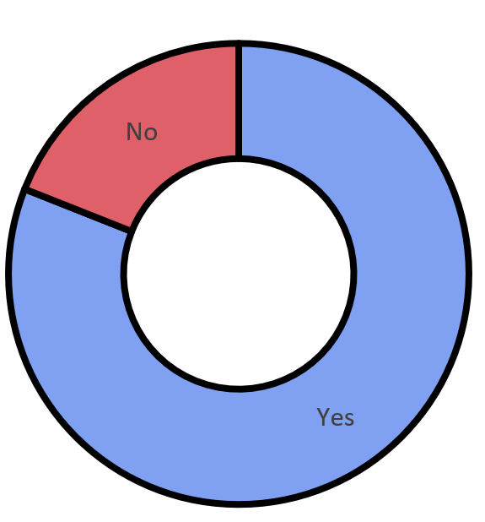




Feedback: “Do young people know what an unhealthy relationship looks like?”
A huge welcome and thanks to first-time commenters at Little Bloxwich Church of England Primary School for these fantastic “Yes” comments this week!
“No because they’re not old enough to know what an unhealthy relationship is”
Fosse Primary School
“I think that honesty and being supportive is easy to see. If anyone feels unsure about sharing their feelings then it is unhealthy to be in that relationship.”
“It was pretty great to learn about this!”
Fosse Primary School
“If they aren’t sharing things or communicating as part of the relationship then that isn’t healthy.”
19%
81%
If you would like to see your school on this slide, ask your teacher to email your comments to amy@votesforschools.com!

Slide 4
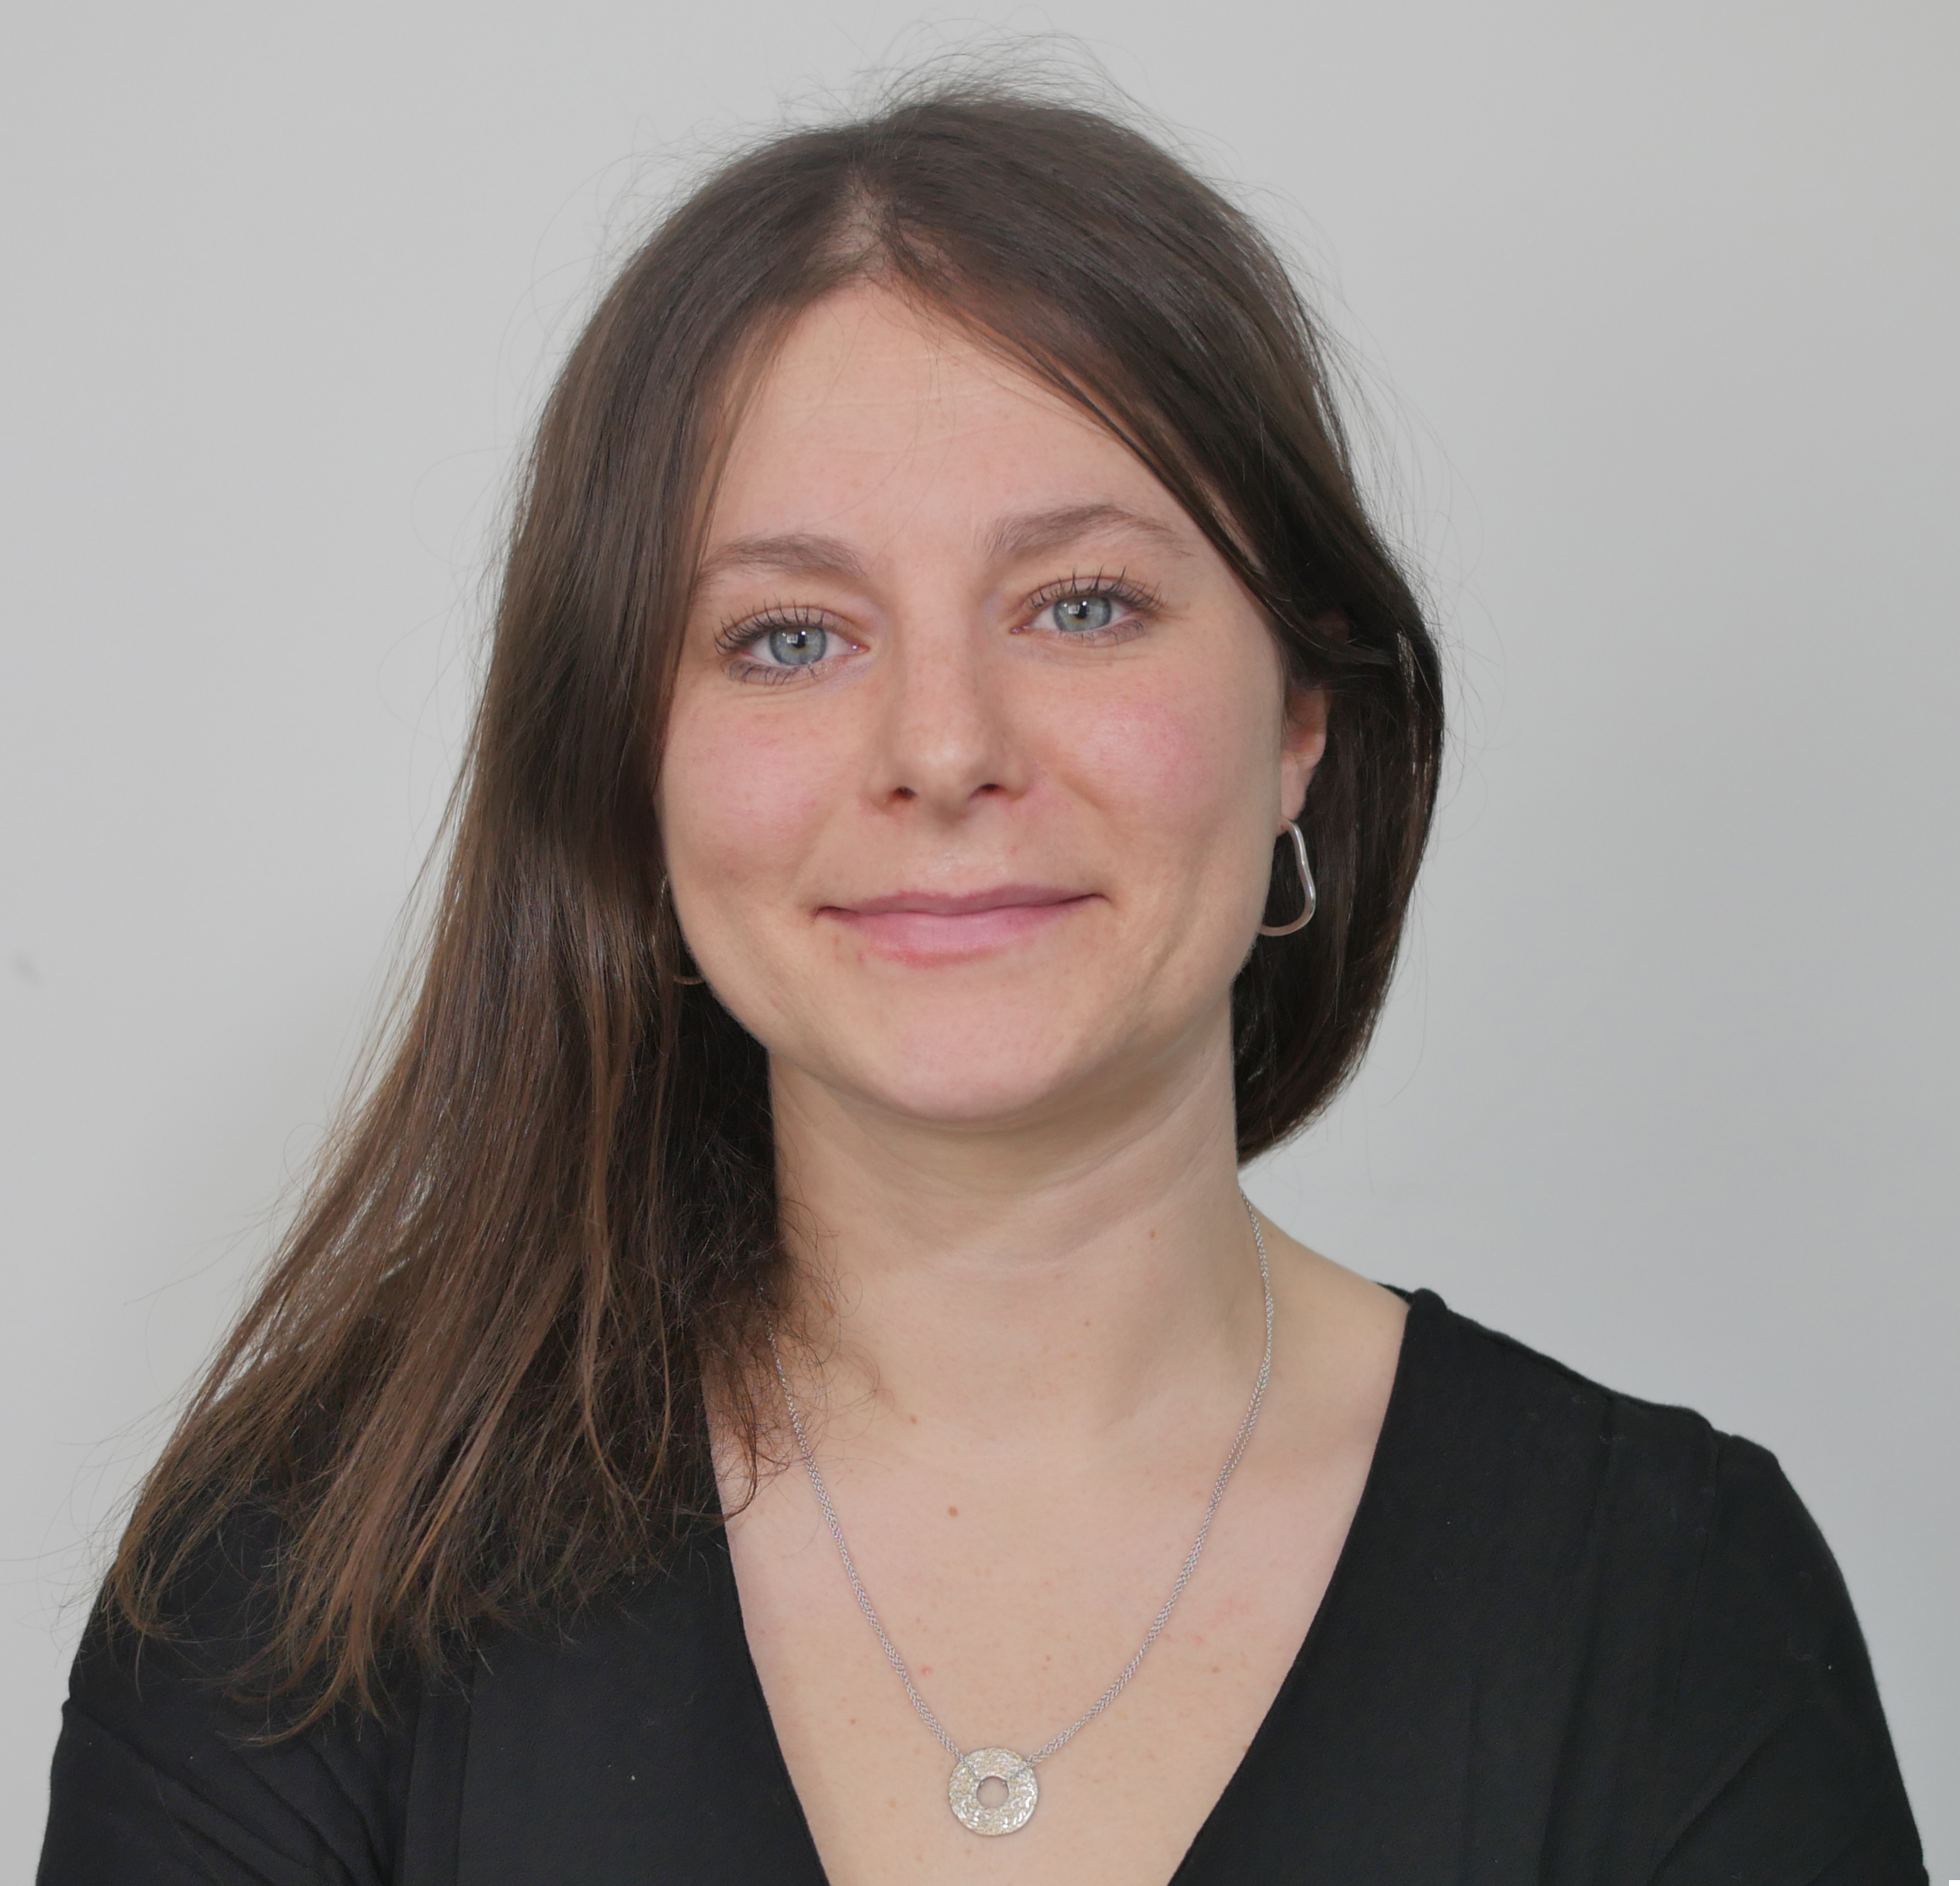


Feedback: “Do young people know what an unhealthy relationship looks like?”
“There is a big difference in the number of young people who know what an unhealthy relationship looks like around the country. There is also a big difference in what children in Primary school said and what young people in Secondary school said – we were surprised by this difference which makes what you have told us even more helpful!”
So, what are the Children’s Society going to do with what you told them?
This is Hannah Chetwynd from The Children’s Society, who has some exciting news on your vote! Click to have a look.
1
“We will write a report and include what we have learnt from you – the report will go on our website, on our social media and might be covered in the news!”
2
“We will talk to people in the Government and ask them to help us make the change we want to see.”
3
“If we don’t see the change we want at first we will keep on trying!”
Notes:
Images:
Courtesy of The Children’s Society
https://www.childrenssociety.org.uk/

Slide 5


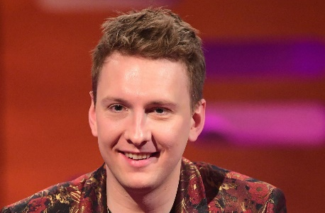





Be informed!
Here’s what’s been in the news this week...
Superhero Meghan Markle!
A new Hugo Boss?
There are reports that Meghan Markle is looking to start acting again, with one source saying that she would like to play a superhero!
Comedian Joe Lycett officially changed his name to “Hugo Boss” as a protest after the company told smaller companies to stop using the word “Boss”!
Scientists in Sweden have discovered that dogs’ noses are cold as they act like a thermometer, helping them to detect small animals nearby.
Flybe, a UK flight company, shut down on Friday after they ran out of money. They said that the Coronavirus had been part of the problem.
Why are dogs’ noses always cold?
The end of Flybe…
Notes:
Images/stories:
https://www.pedestrian.tv/film-tv/meghan-markle-agent-ensemble-superhero-role/
https://news.sky.com/story/comedian-joe-lycett-changes-his-name-to-hugo-boss-in-support-of-small-businesses-targeted-by-fashion-designer-11947629
https://www.bbc.co.uk/news/business-51746564
https://www.dailymail.co.uk/sciencetech/article-8064029/Scientists-sniff-dogs-noses-cold.html

Slide 6


Does the modern world make it harder for diseases to spread?
Notes:
Images:
iStock

Slide 7




Be curious!
In my opinion…
I think that…
Thought of the Week:
What is Coronavirus?
Notes:
Images:
iStock

Slide 8







Why are we talking about this?
Over the last few months, there has been a lot of talk about a new virus that is spreading around the world. There are a lot of questions that people want to know the answer to, such as:
This assembly will tell you all about Coronavirus, what is happening around the world, and what you should be doing to stay safe!
Notes:
Images:
https://www.itv.com/news/2020-02-27/coronavirus-warnings-lead-thursday-s-headlines/
iStock
https://thenounproject.com/search/?q=medical%20mask
References:
https://www.bcm.edu/departments/molecular-virology-and-microbiology/emerging-infections-and-biodefense/emerging-infectious-diseases
https://dictionary.cambridge.org/dictionary/english/modern

Slide 9
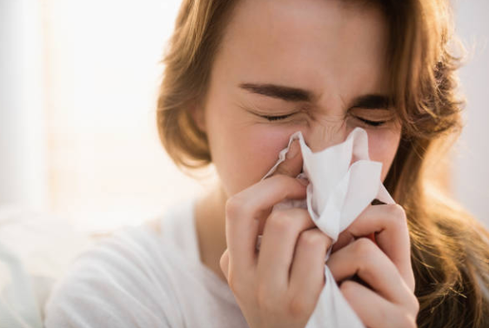
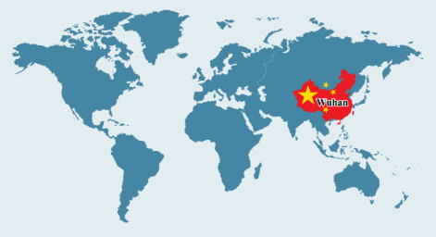
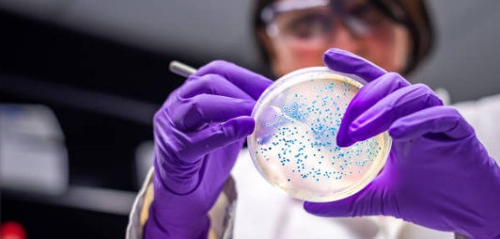
What is Coronavirus?
There are actually many different Coronaviruses, including one that causes you to get a cold! But scientists haven’t seen this type before and have called it COVID-19.
It began in China, but has now spread to lots of other countries. Governments around the world have been working together to slow the spread of the disease and help to develop a vaccine.
Although the number of people affected is relatively small, the new virus hasn't been seen in humans before so scientists are keen to stop its spread.

Slide 10
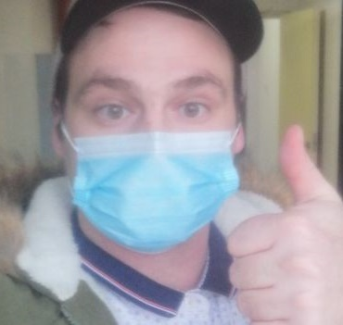
What are the symptoms of COVID-19?
Even though the virus is new, here are some of the things we know already:
0:00-1:16
90%
of people will develop a high temperature.
80%
of people will develop a dry cough.
30%
of people will have a shortness of breath and feel tired.
4%
of people will have a runny nose.
Most people with COVID-19 will feel unwell with the symptoms for 1-2 weeks before they recover. However, very old or very young people, or people who are already ill can develop pneumonia.
Watch this video to hear from Connor Reed who had COVID-19 in November 2019 talk about his symptoms and recovery.
https://safeshare.tv/x/QAPKveL6x2E
Notes:
Alternative video link: https://www.youtube.com/watch?v=QAPKveL6x2E (0:33-1:49) Please note, after this point the interview makes reference to an alcoholic drink.
References:
https://www.nhs.uk/conditions/coronavirus-covid-19/
https://www.washingtonpost.com/health/how-bad-will-the-coronavirus-outbreak-get-in-the-us/2020/03/03/55c5d088-5c9d-11ea-9055-5fa12981bbbf_story.html
https://www.thesun.co.uk/news/10876645/coronavirus-uk-brit-virus-china-wuhan/
https://www.nytimes.com/2020/03/04/world/coronavirus-news.html
https://www.bbc.co.uk/news/uk-wales-51369217

Slide 11
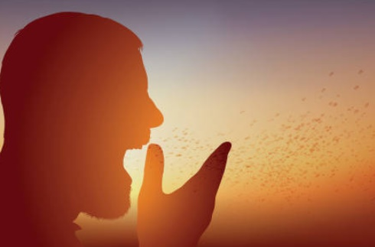
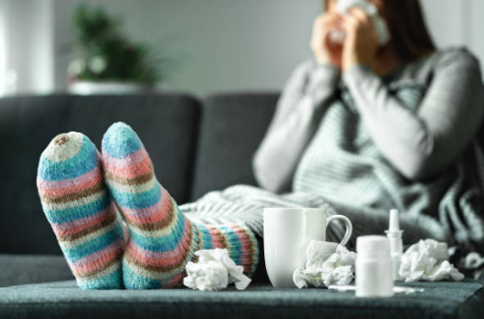
What are the symptoms of COVID-19?
Like the normal cold and flu bugs we sometimes get, the virus spreads to other people by coughing and sneezing, or by touching surfaces that have the virus on them.
To help stop the virus from spreading, the NHS are encouraging people who have the virus to stay at home until they have recovered from the illness.
Did you know?
You can’t get COVID-19 from letters or packages, foods or from your pets.

Slide 12

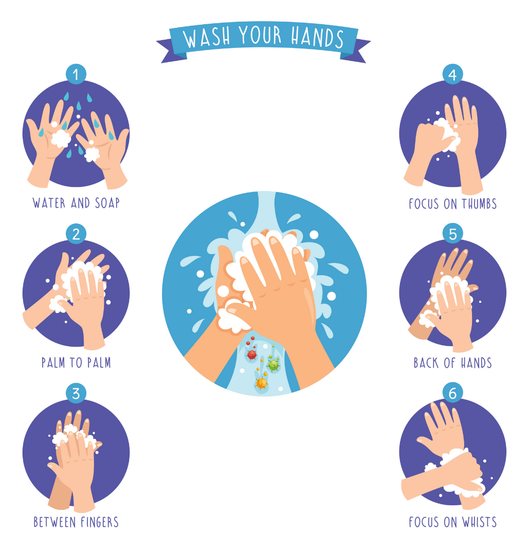
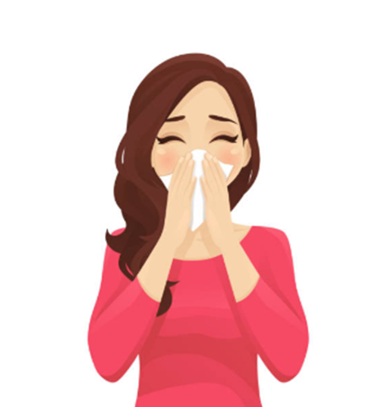
What can you do to stay safe?
The best thing you can do to stay safe is to wash your hands properly (for around 20 seconds) and do this often. Using soap or hand sanitiser kills most of the germs on your hands, preventing them from spreading.
It sounds silly, but to make sure your hands are clean, sing “Happy Birthday” to yourself twice while washing!
The NHS have also advised that you cover your mouth and nose with a tissue or a sleeve (not your hand) when you cough of sneeze, and that you put tissues in the bin straight after.
Notes:
Images:
1) iStock

Slide 13


What can you do to stay safe?
If have recently travelled to one of these countries, call 111 and stay indoors. Avoid contact with other people, just like you would if you had the flu.
Cambodia
Macau
Hong Kong
Taiwan
Vietnam
Iran
Myanmar
China
Singapore
Laos
Thailand
Japan
South Korea
North Italy
Malaysia
Costa Adeje Palace, Tenerife
Also, if you develop symptoms of COVID-19, you should stay indoors and call 111. Someone who has been trained to give advice will tell you what to do next.
Notes:
Alternative video link: https://www.youtube.com/watch?v=l0qg3oS088w

Slide 14

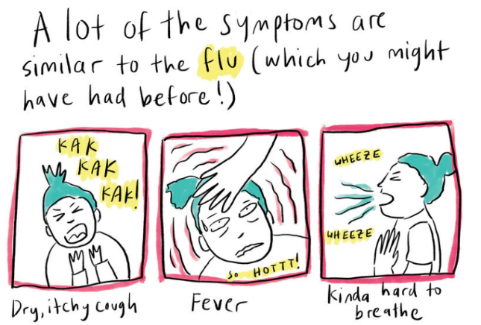
Call to Action
Quick idea
0:00-2:01
What’s really going on?
Click the image to hear from Jenny about what life is like in Hong Kong right now.
Promote cleanliness!
Based on what you have learned today, can you design a cartoon strip that helps show people how to protect themselves and others from illness? Display these somewhere in your school! Click the image to see some examples.
Big idea
https://safeshare.tv/x/BBqqaVptVOk
Notes:
Alternative video link: https://www.youtube.com/watch?v=BBqqaVptVOk&feature=youtu.be
Images:
iStock
https://www.npr.org/sections/goatsandsoda/2020/02/28/809580453/just-for-kids-a-comic-exploring-the-new-coronavirus?t=1583159087769&t=1583164897215

Slide 15

Be heard!
Make your voice heard!
In your classes, you will be discussing these questions:
Everyone around the world is working together to prevent COVID-19 from spreading.
Despite the efforts, COVID-19 is still spreading, so it isn’t hard enough.
Does the modern world make it harder for diseases to spread?
The number of cases in China, Iran or Italy is much higher than in the UK.
Travelling has made it easier for COVID-19 to spread to different countries.
At the end of the lesson, vote to share your opinion with the rest of the VotesforSchools community.

