Slide 1


Year 1
Parent’s meeting
September 2025

Slide 2

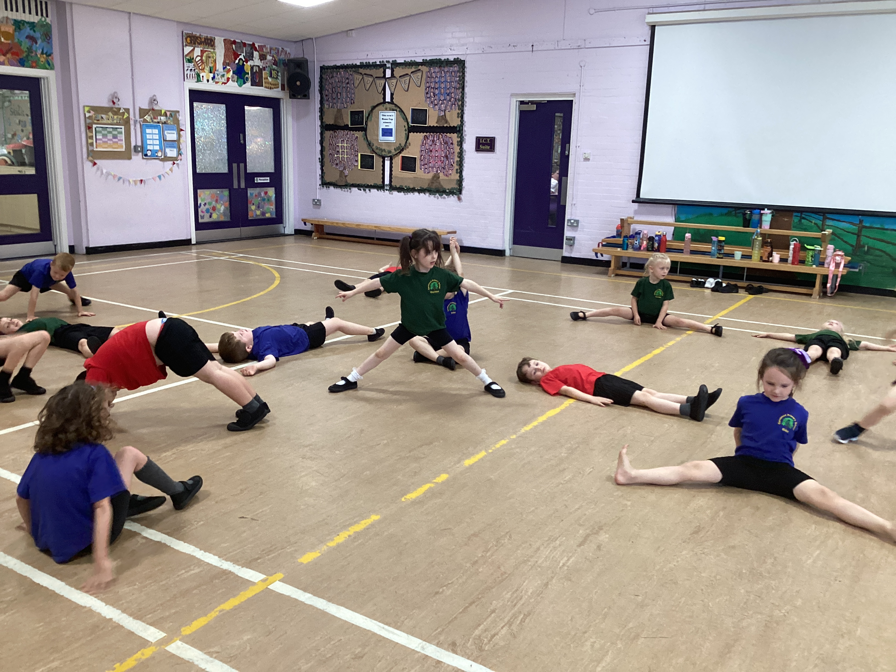
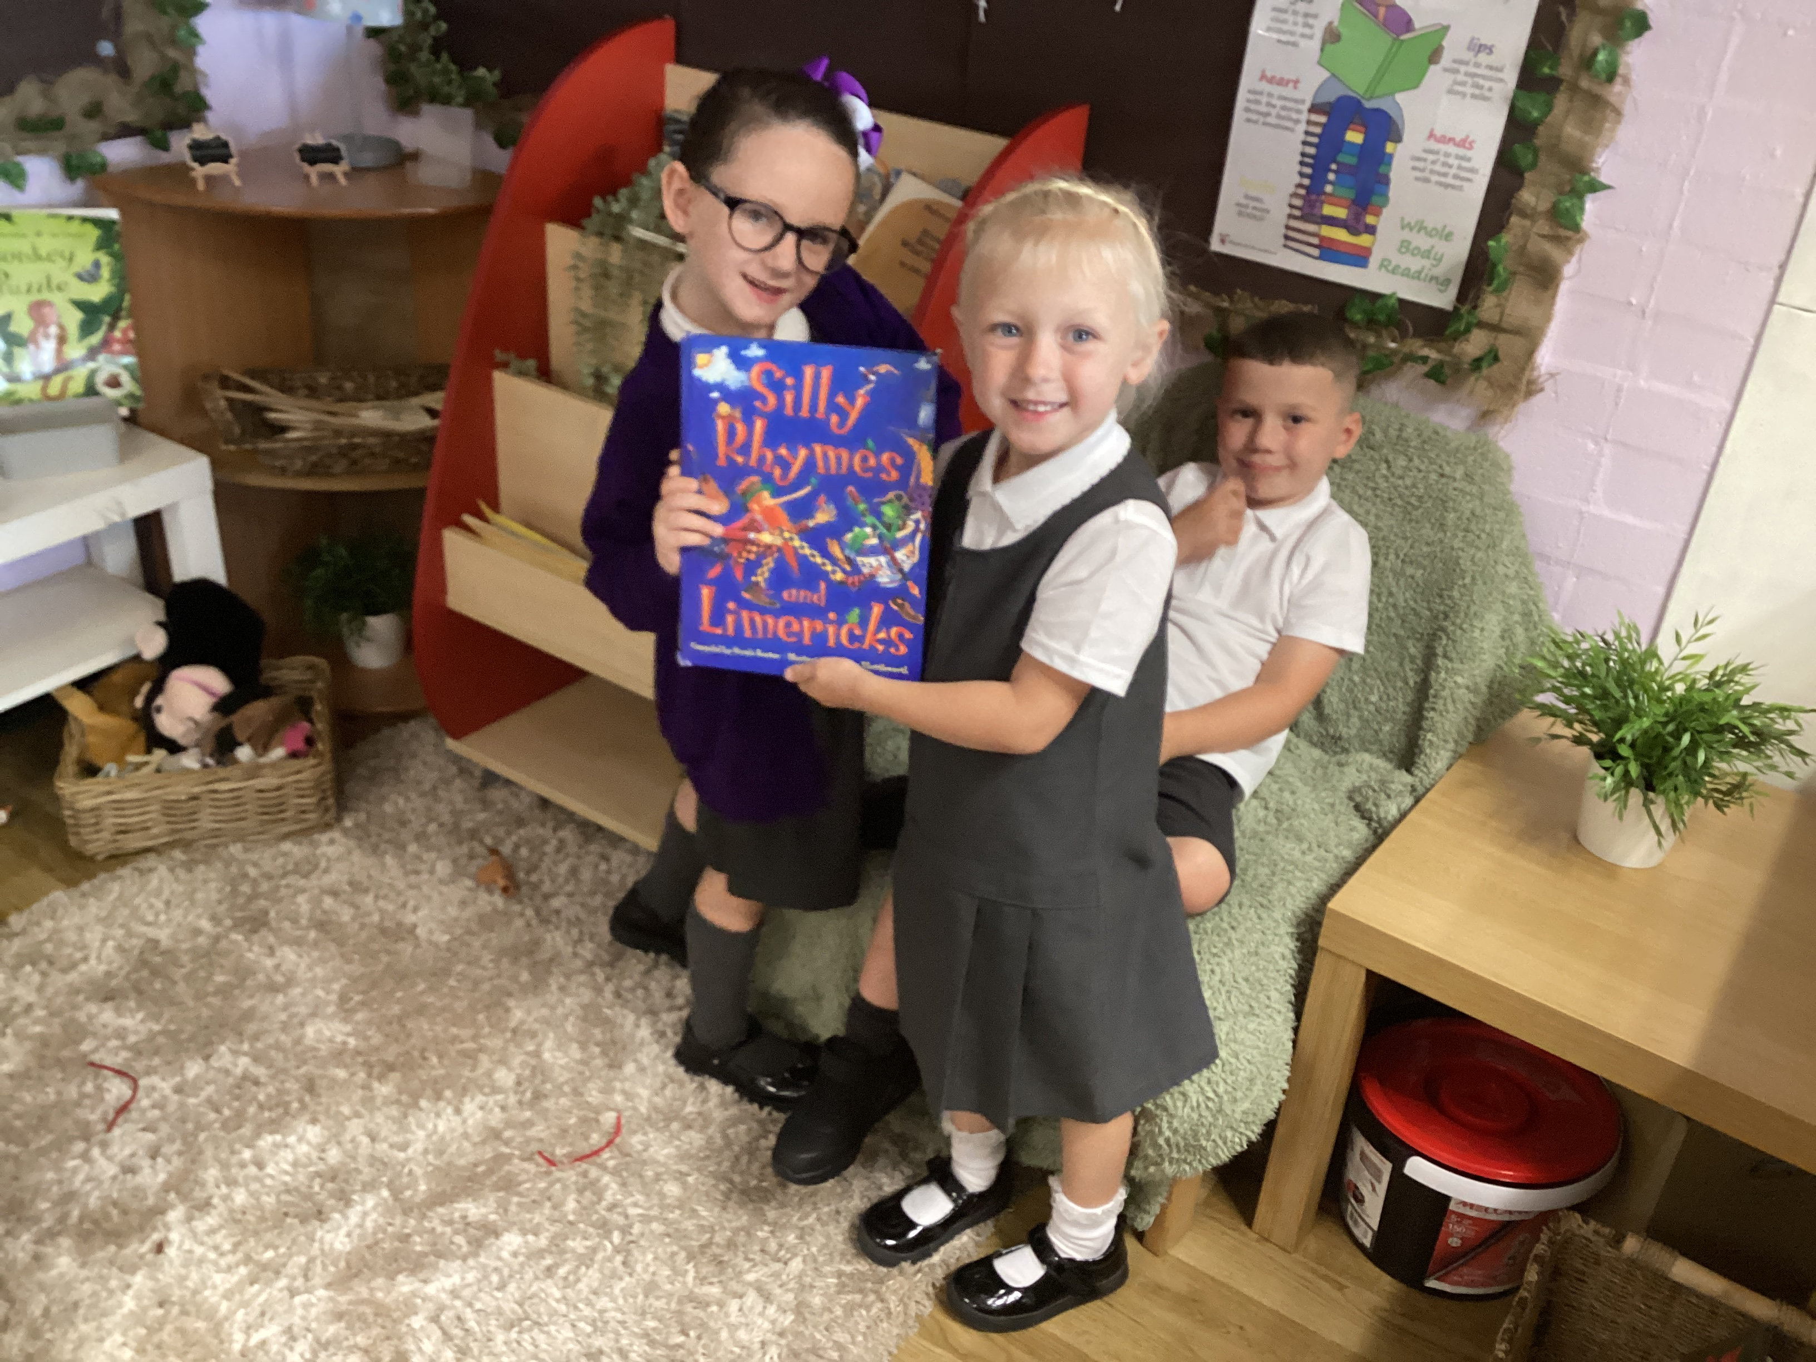
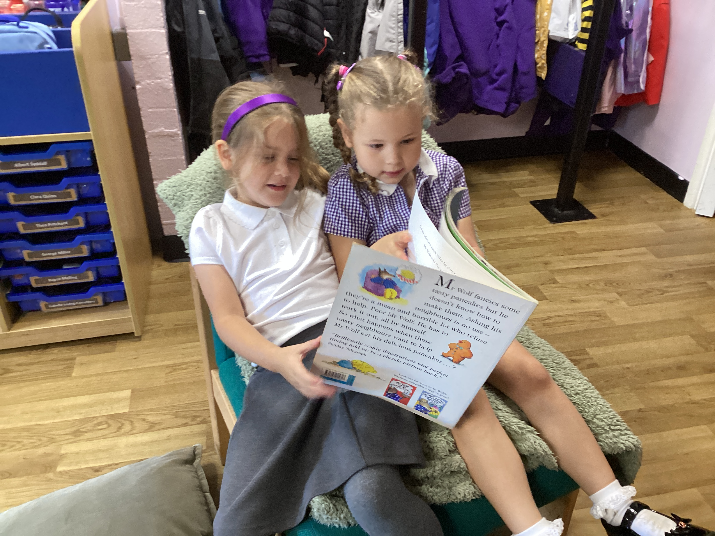
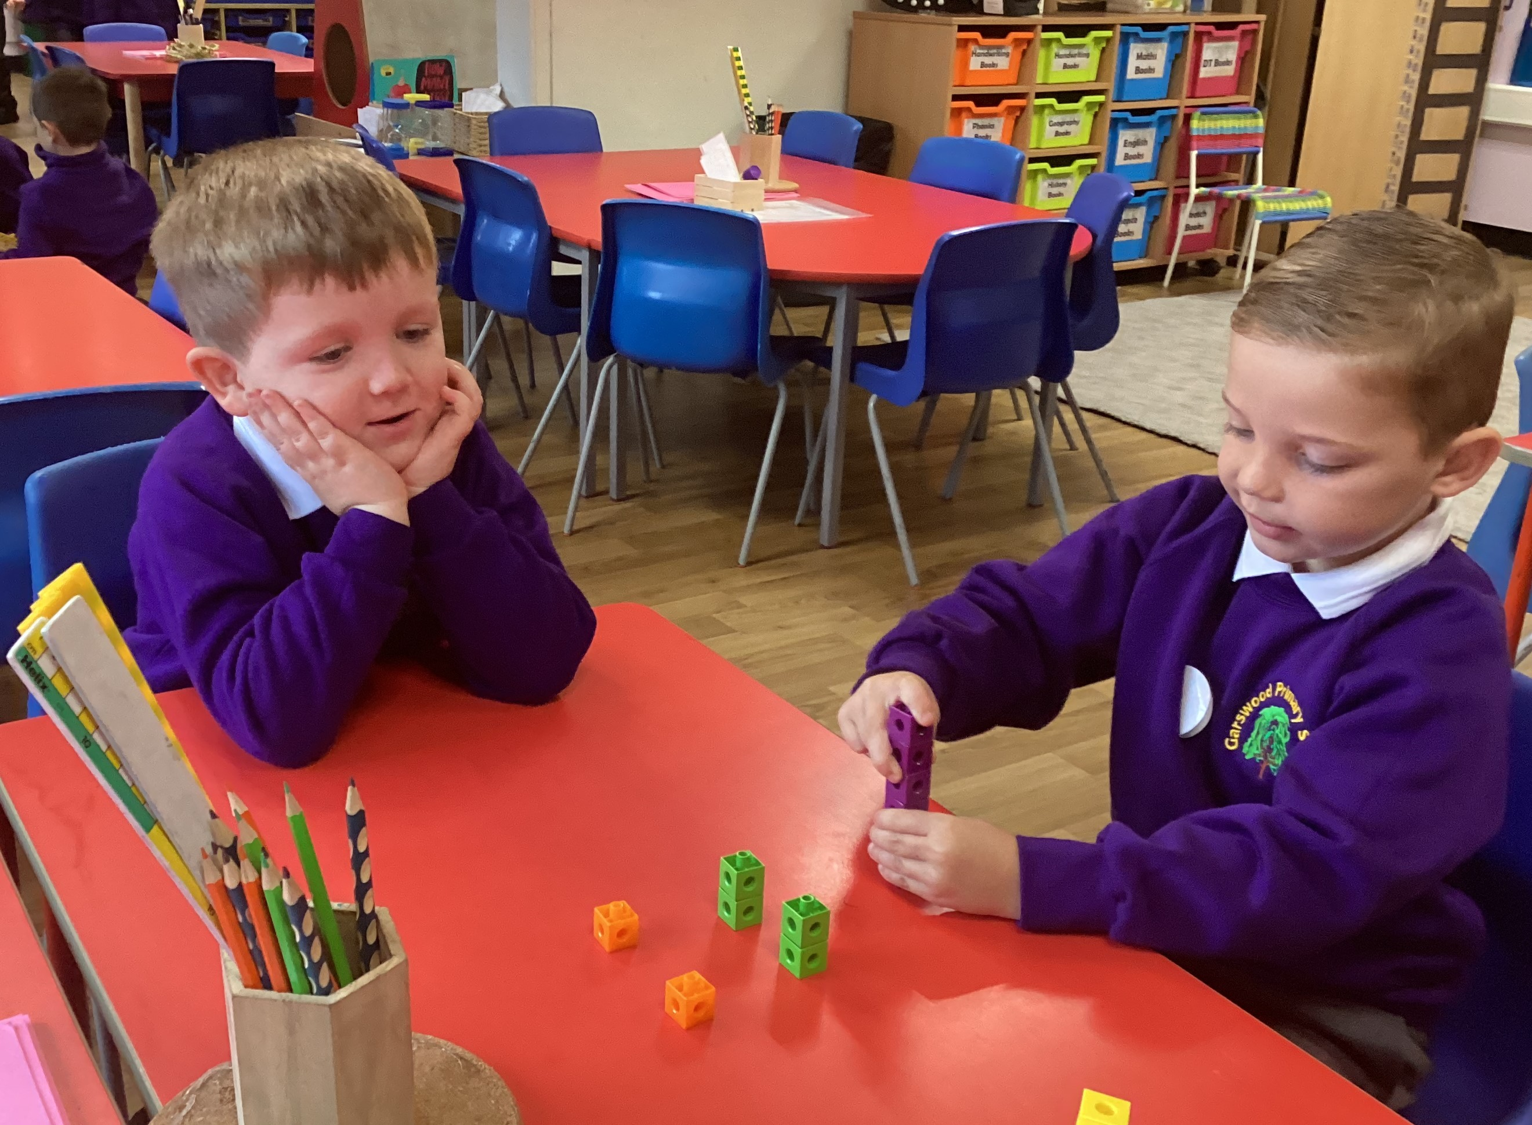
Year 1

Slide 3
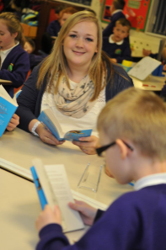





Meet the staff in Y1
Mrs Meehan
Mrs Rollason
Mrs Finegan
Mrs Dodd
Mrs Forshaw
Mrs Evans
A team of support staff

Slide 4
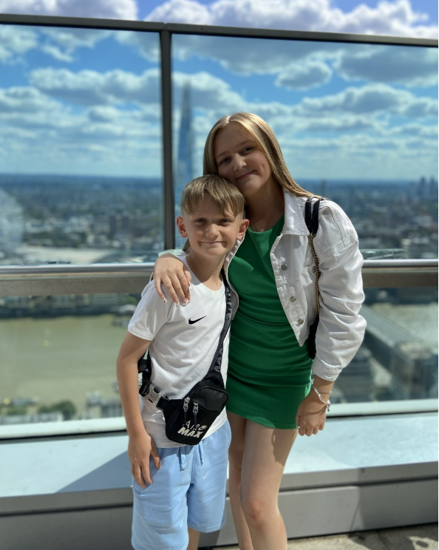
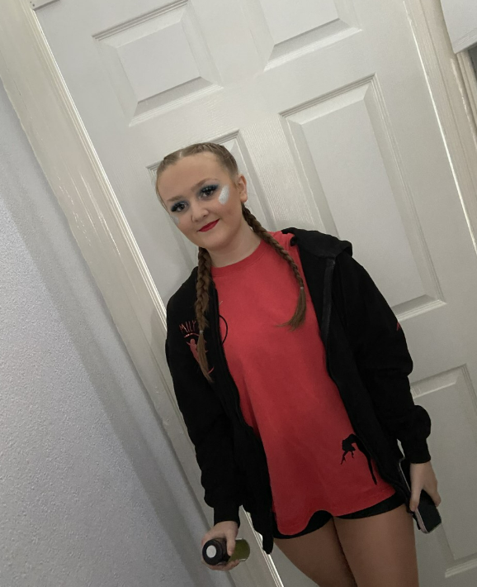
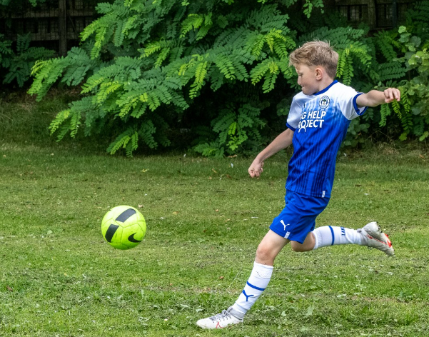
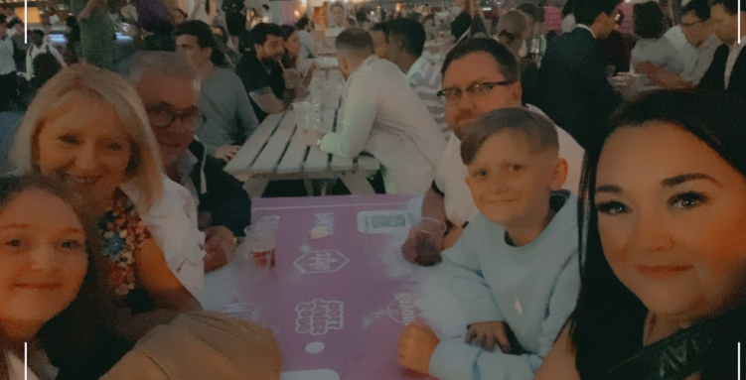
Meet the teacher
I am Mrs Meehan
I have 2 children- Emily is 18 and Elliot is 13.
I support Wigan Athletic.
I like city breaks
History and Geography lead.
Maths lead.
Forest School leader.

Slide 5
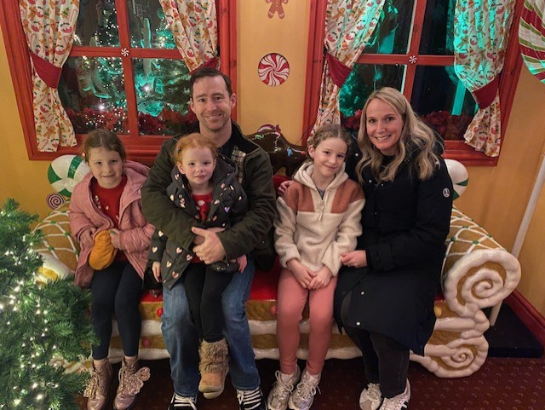
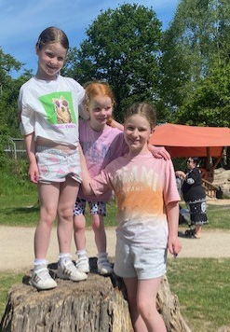
Meet the teacher
I am Mrs Rollason
I have 3 children- Eleanor is 9, Florence is 6 and Scarlett is 4.
I enjoy running and yoga.
I am currently renovating my house.
RE lead.

Slide 6
General information
Snacks will be provided for children in school
Labels – all clothing ie. jumpers, fleeces and PE kits.
Jewellery – only sensible watches.
Earrings should not be worn in school.
Please send in a labelled water bottle. No juice!
1 small keyring on the book bag.
Homework is given on a Friday and to be returned on Wednesday
PE kits (indoor and outdoor) to be brought in and left in school until the end of term.
Forest School kits to be labelled and brought in a bag and a spare carrier bag only on FS day.

Slide 7
Timings of the day
Classroom doors open at 8.40
Registration closes at 8.55
Break time is 10.45
Lunchtime is 11.45-12.45
School day finishes at 3.15

Slide 8
Attendance – 5 day Challenge
Aim for 97% attendance – this is a 5 day challenge. Your child should have no more than 5 days absence as a maximum.
All parents want the best for their children and for them to get on well in life. Having a good education is important to ensure that they have the best opportunities in their adult life. They only get one chance at school, and your child’s future may be affected by not attending school regularly.
By law children must attend school
90% attendance would mean your child has missed 4 weeks of schooling across the year. This is a huge amount of missed learning
Below 90% is considered a persistent absentee and you must work with the EWS to create a parenting agreement
Changes to the law- 5 full days or 10 sessions unauthorised absences could result in a fine from the local authority. This includes being late.
Children do get ill but if attendance drops below 92% then school will contact you and you maybe asked to provide medical evidence.

Slide 9
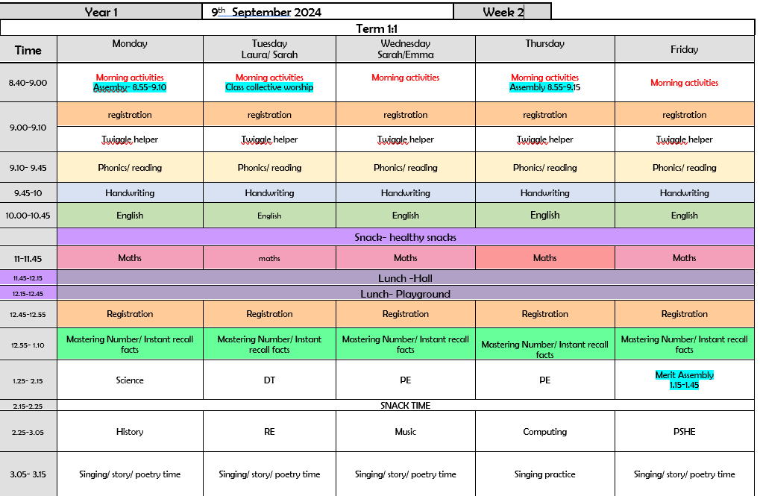
Weekly Timetable

Slide 10
A typical day in Y1
8.40- 9am- Morning activities
9-9.15- Assembly
9.20-9.50- phonics
9.50-10.45- English/ handwriting
10.44- 11- Break time
11-11.45- Maths
11.45-12.45- Lunchtime
12.45- 1- Mastering number
1-2- lesson
2-3 lesson
3- 3.15- story time

Slide 11
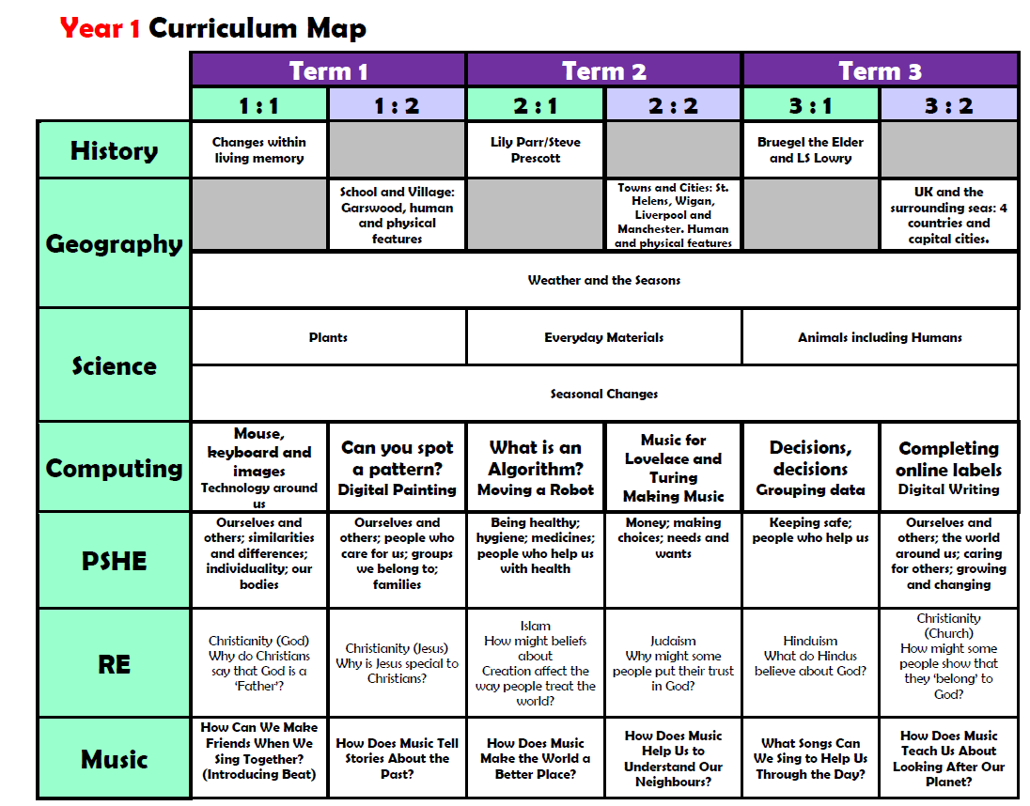
Curriculum

Slide 12
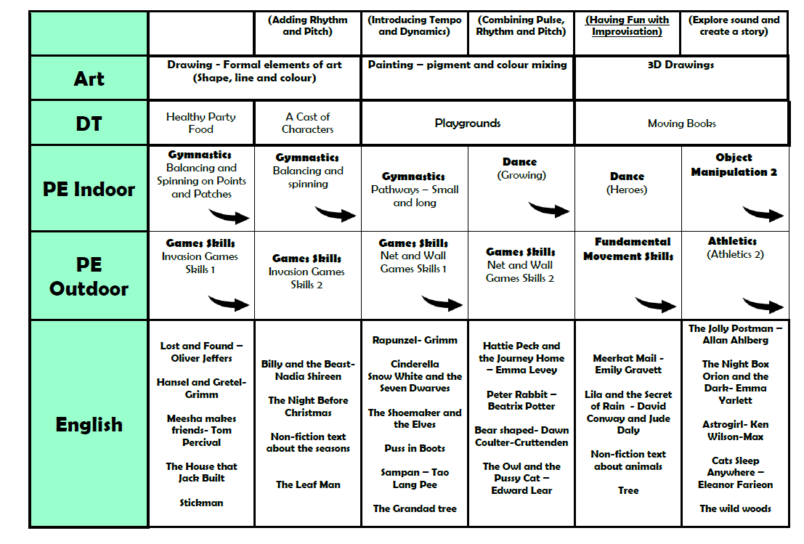
Curriculum

Slide 13

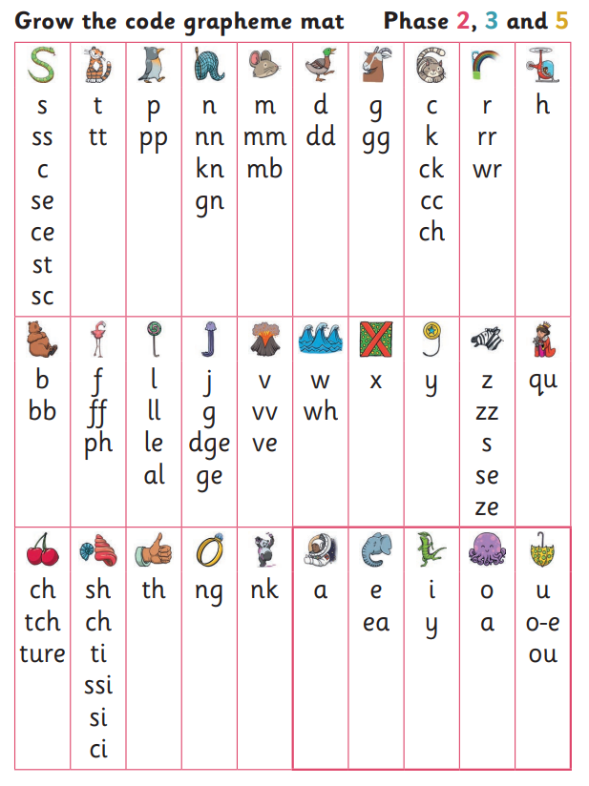
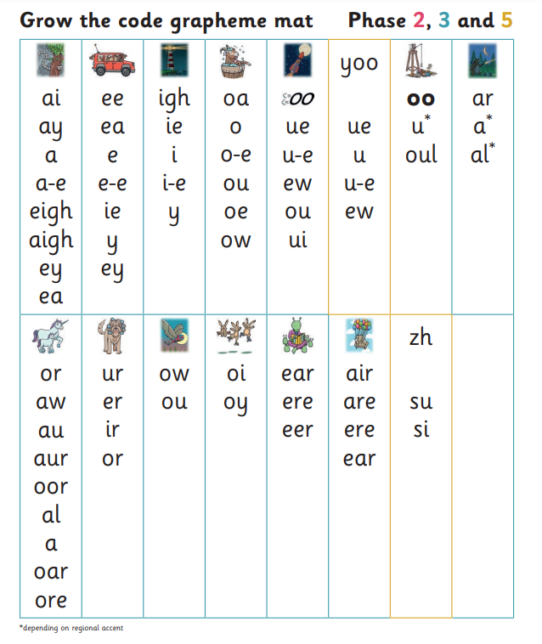
What is phonics?
Children begin to learn phonics (sounds) in early years, both nursery and reception. Once children begin learning sounds, these sounds are used orally to identify and make words. They will then begin to learn the letters which make each of the sounds and these are used to read and spell words.
Once children begin learning sounds, these sounds are used orally to identify and make words. They will then begin to learn the letters which make each of the sounds and these are used to read and spell words.
Phonics enables children to read and write which opens the door to the rest of the curriculum.

Slide 14
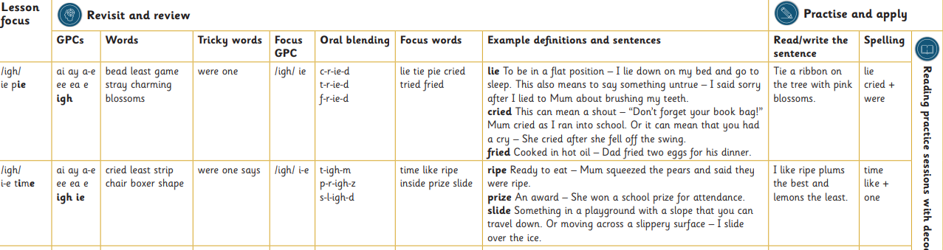
Phonics in school
Your children are completing at least 1 phonics session every day.
This includes:
Every session is the same format meaning the children are very familiar with it and benefit from the repetition.
All children read at least 3 times a week in a group.
Some children read one to one with an adult as well.
Some children receive ‘keep-up intervention’ sessions as well.

Slide 15

Phonics Screening Check?
Children in Year 1 throughout the country will all be taking part in a phonics screening check during the same week in June.
Children in Year 2 will also take the check if they did not achieve the required result when in Year 1 or they have not taken the test before.
What the screening doesn’t check is children’s understanding and fluency.

Slide 16


What will the children
be expected to do?
The check is very similar to tasks the children already complete during phonics lessons.
Children will be asked to ‘sound out’ a word and blend the sounds together.eg d-o-g - dog
The focus of the check is to see which sounds the children know and therefore the children will be asked to read made up ‘nonsense’ words.
THIS IS NOT A READING TEST

Slide 17
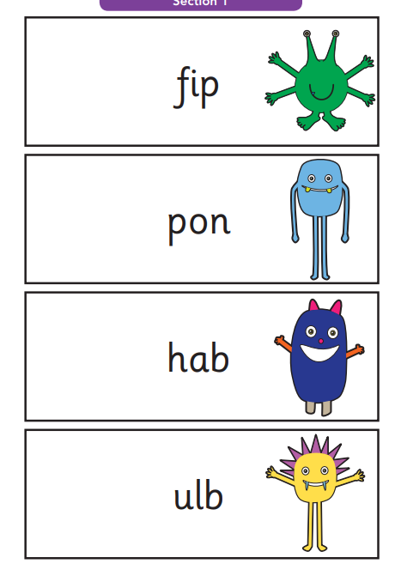
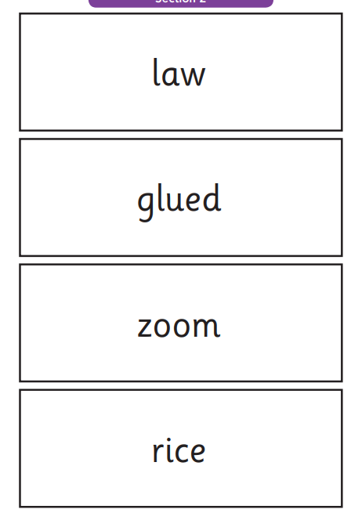
Examples of words:

Slide 18

Reading
Aim to inspire a love of reading for enjoyment.
Reading opens up the whole curriculum for children.
A large emphasis is placed on reading in Y1.
Children read at least 3 times a week in school- 1 for decoding, 2- prosody, 3- comprehension.
It is vital for you to read at home with your child and support them with their reading.
Reading links across the curriculum
There are books for children to access for each topic.
English is taught through a main text giving purpose and meaning to learning.

Slide 19


Reading
Every week your child will get a book to rea to you at home.It is a book they have been reading in school. It is vital you listen to your child read this book.
Every week your child will choose a story book for you to hare together.

Slide 20
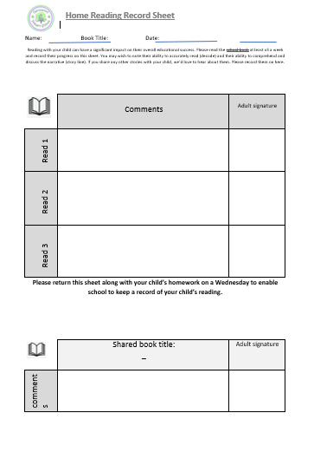
This id for you to record each time you listen to your child read. Celebrate their successes.
The book for sharing is just as important. Make it a special time together.
Write a list of anything you read at home.

Slide 21
Homework will be sent on a Friday and is to be returned on a Wednesday.
Homework will include:
Reading – reading book and shared book. You will be expected to record this on the sheet that will be provided.
Phonics- A weekly phonics sheet will be provided. This will show the sounds, words and sentences your child has learnt and are to be practiced at home. This is vital.
Maths- a maths sheet will be sent home to be completed. This will be focussed on the work your child has completed the previous week. This is to keep maths skills sharp.
Spellings- Each week your child will bring home a set of spellings and tricky words from this weeks phonics work.
These will be tested on a Friday.
House points will be given for homework completed.
Home Learning

Slide 22
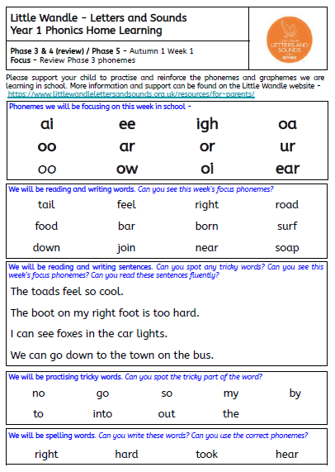

Slide 23
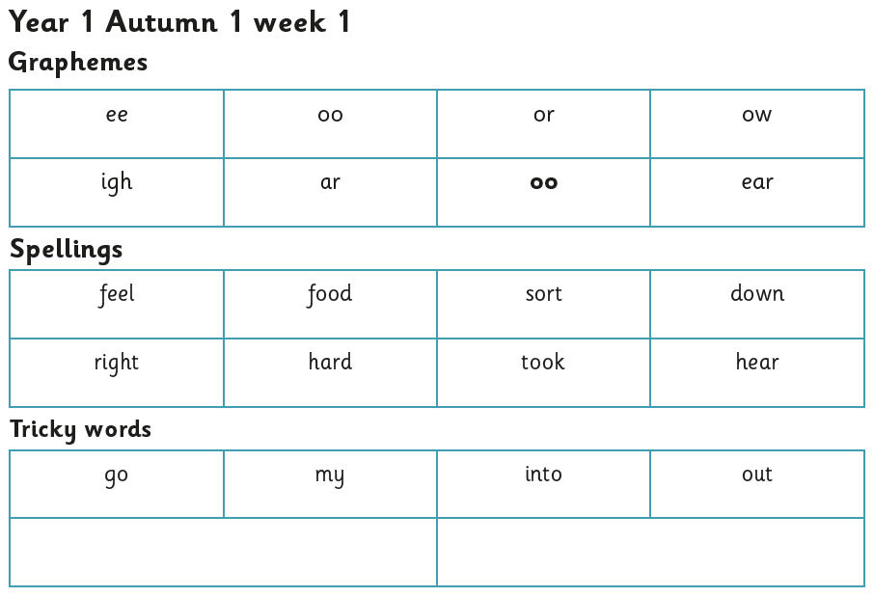
Spellings

Slide 24
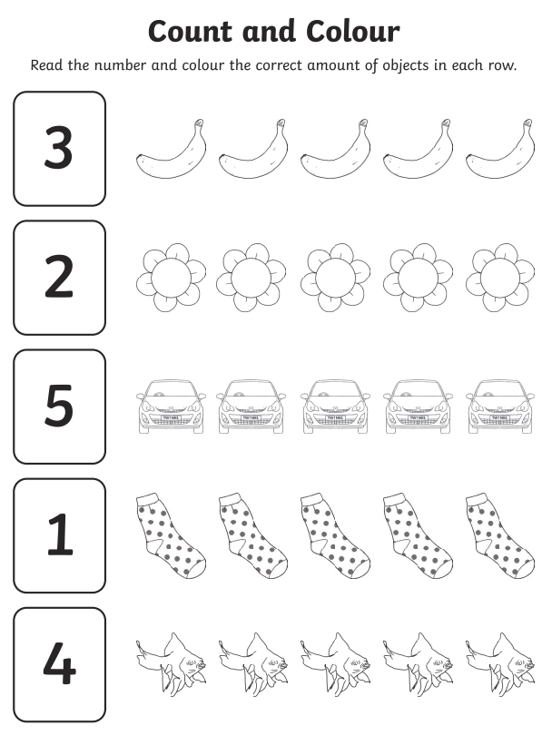

Slide 25
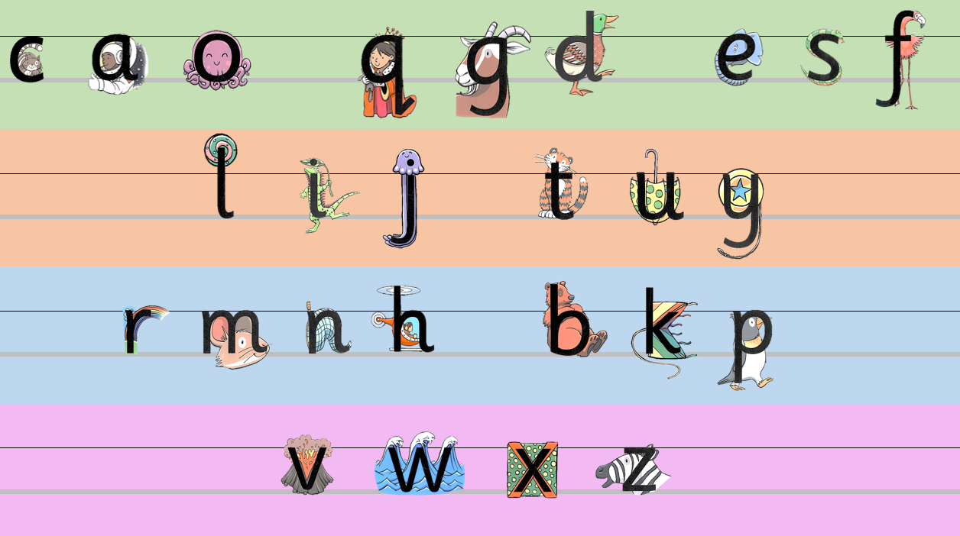
Handwriting
Children’s letters should be….
Sitting neatly on the line
Relative size is clearly identifiable
Correct letter formation
All these will help your child move into joined up writing if they are ready when they move to Year 2.
We follow the Little Wandle Handwriting rhymes to help with formation.

Slide 26
Trips and Visitors
Autumn 1 | Autumn 2 | Spring 1 | Spring 2 | Summer 1 | Summer 2
Haigh Hall | Walk around Garswood | Wigan Athletic Linzi Prescott | Financial advisor or bank worker | Lowry Art Gallery and Football museum | Chester Zoo Church
Science- Plants Wild flowers and deciduous and evergreen trees | Geography- looking for physical and human features of a village | PE/ History Football and Lily Parr Steve Prescott Foundation | PSHE- Money matters | History/ Geography Lowry and Lily Parr Features of a city | Science- Animals including humans RE- baptism
Approx. cost £12 | Approx. cost £0 | Approx. cost £0 | Approx. cost £0 | Approx. cost £35 | Approx. cost £33

Slide 27
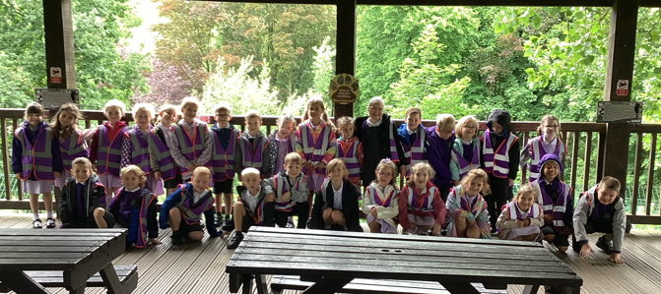
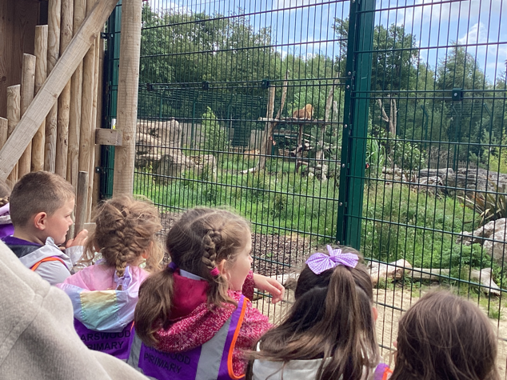
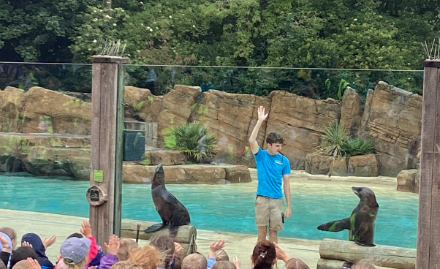
Blackpool Zoo

Slide 28
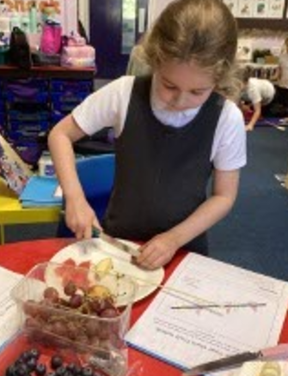
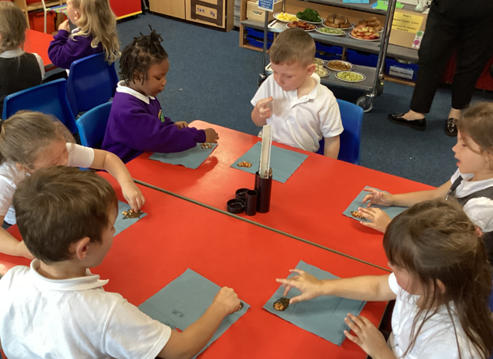
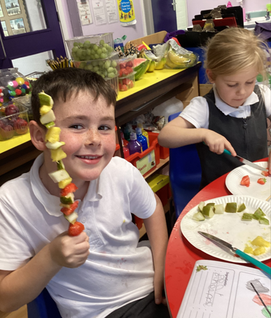
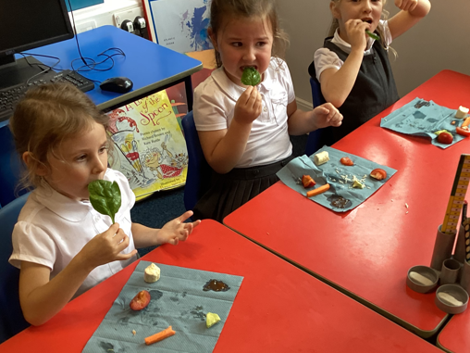
DT Making a healthy snack

Slide 29
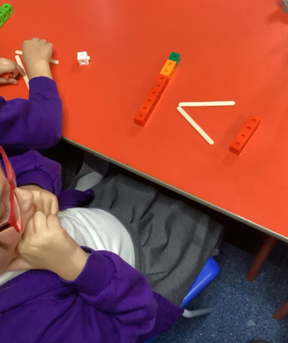
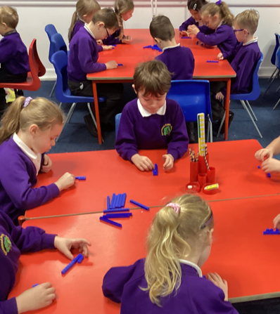
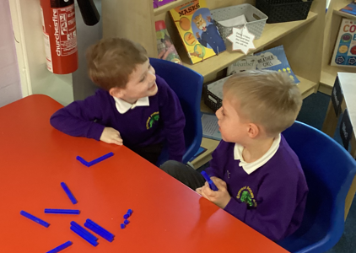
Lots of Fun Maths activites

Slide 30
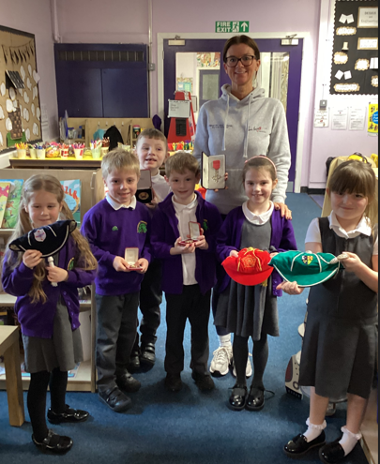
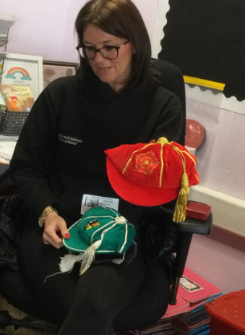
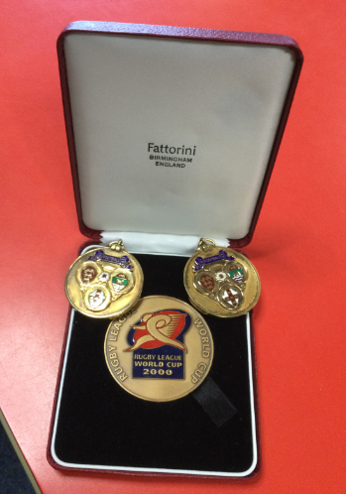
History lessons
Linzi Prescott came to talk to us.

Slide 31
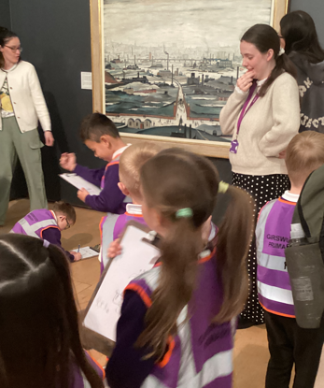
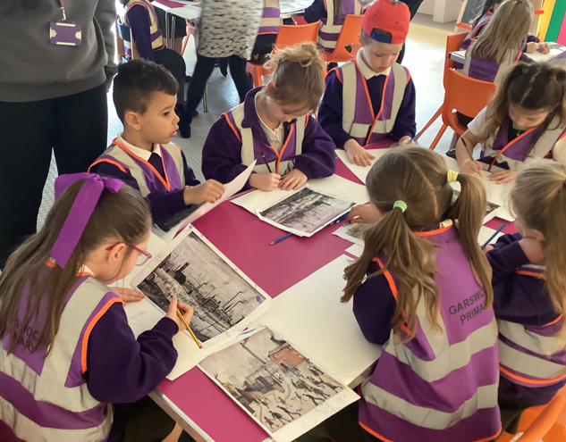
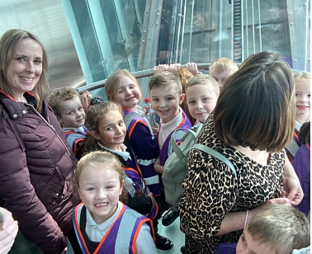
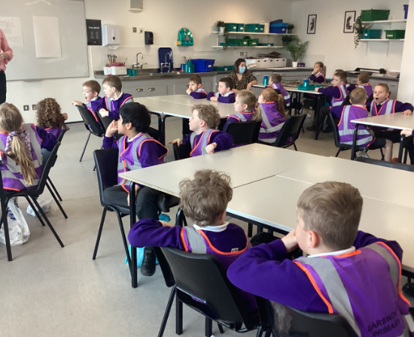
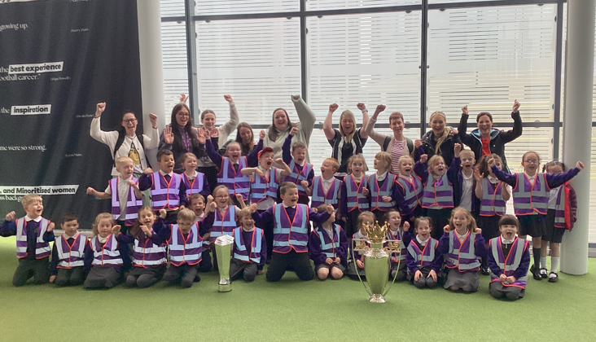
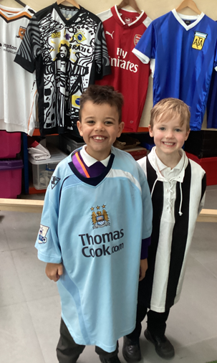
History lessons
Lowry art gallery and the Football museum

Slide 32
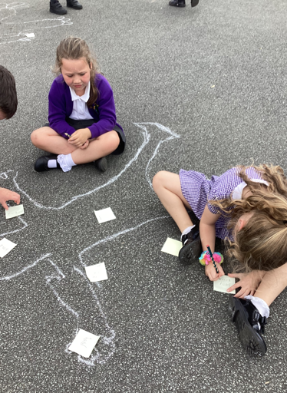
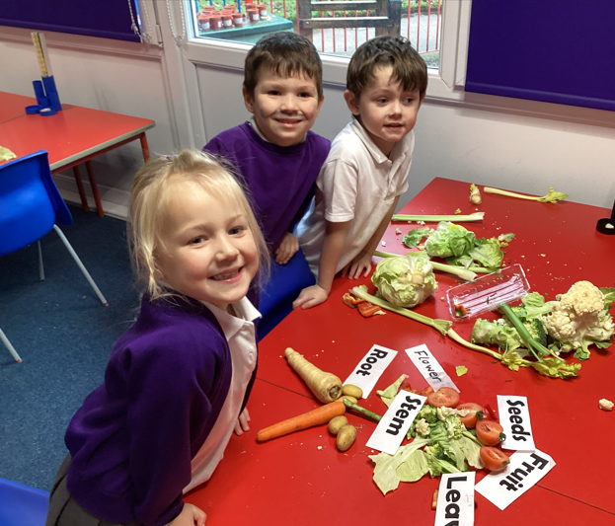
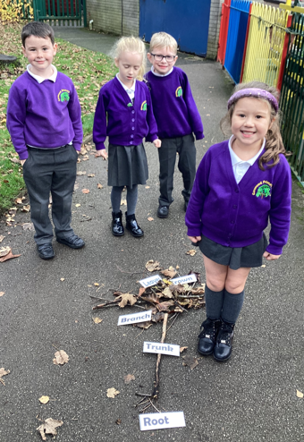
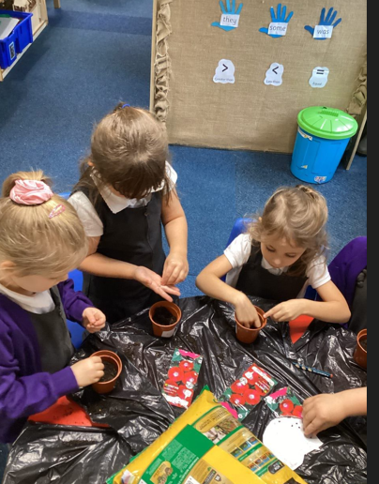
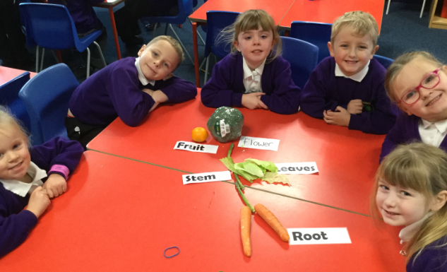
Science

Slide 33
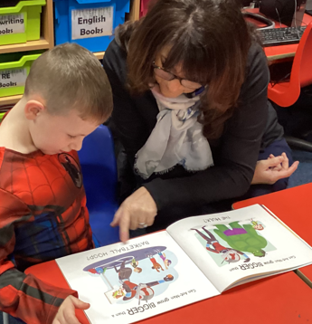
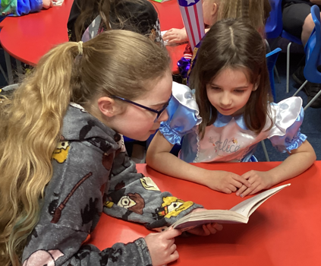




World Book Day!

Slide 34




Geography

Slide 35




During one term the children will take part in a range of activities to help to increase confidence, resilience and self esteem. Activities include: shelters knots digging craft tree climbing cooking on a fire the freedom to play and take risks

Slide 36




Year 1 is so much fun!

Slide 37





@garswoodprimaryschool
http://www.garswoodprimary.co.uk/
- for info, dates and galleries
Useful
links
See saw
https://whiterosemaths.com/resources/1-minute-maths
https://www.topmarks.co.uk/english-games/7-11-years/spelling-and-grammar
- to access fun spelling, punctuation and grammar games

Slide 38
Parental Engagement
Our door is always open!
Arrange an appointment through the office to speak to us or send a message via Seesaw. Please be patient when awaiting a response. We will endeavour to respond as quickly as possible.
Mrs Evans is our family support worker.
We are a team and it is vital that we work together to support your children so they achieve their potential in school.
Please don’t hesitate to ask questions or ask for help when supporting your child.

Slide 39

Safeguarding &
Child Protection at Garswood
Safeguarding risks that can affect children include…..
Online grooming
Domestic abuse
Drug/alcohol misuse
Sexual exploitation
Gang involvement
Child abuse
At Garswood we want above all to ensure that our children feel safe and happy.
At Garswood we want above all children to feel safe and happy and want to work with you to ensure they are.
A whole range of circumstances can make some children vulnerable including cultural and social influences. For example, time spent online and influences from the online world has increased the risks open to our children.
Our children’s education is designed to ensure children feel safe and have the knowledge to tackle any potential issues.
All staff at Garswood are aware that any disclosures from children or any safeguarding concern will be reported to a member of staff who, in turn will report to our Safeguarding Lead Mrs Potter or deputy Mr Yearsley and Mrs Evans.
We have a duty of care to report concerns of a child protection nature to Social Care.
If you as a parent ever have any concerns or questions please consult our family support worker, Mrs Helen Evans. Any safeguarding or child protection concerns should be reported to Mr Yearsley or Mrs Potter.

Slide 40
Q & A

